Slide 1
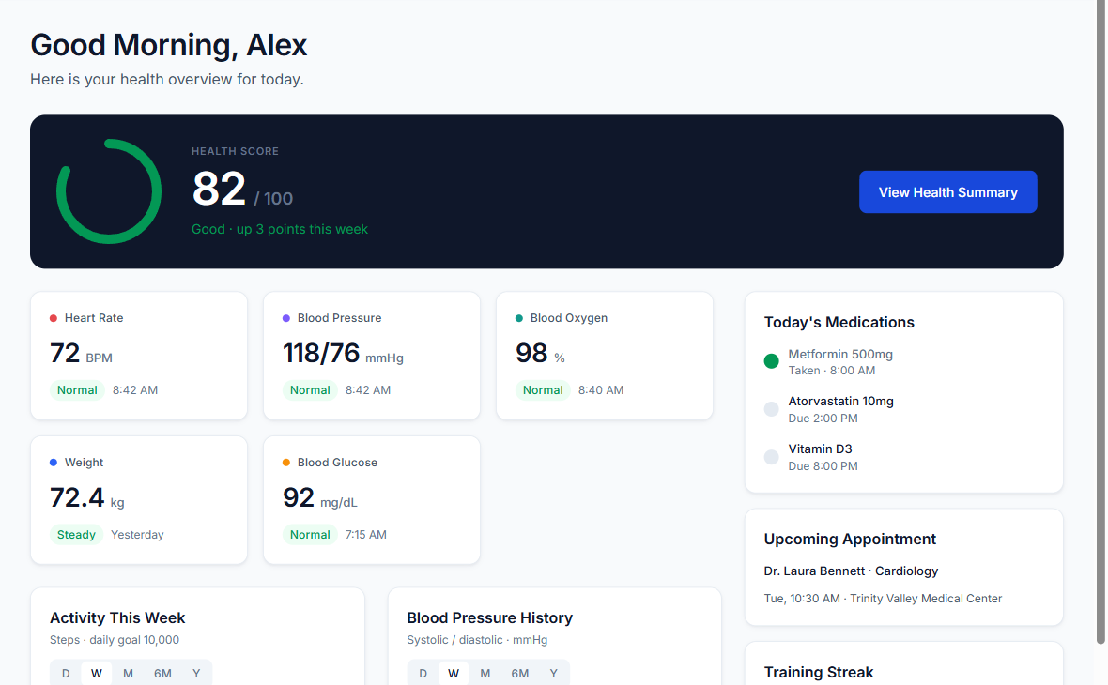
VitalLink
A consumer health and fitness web portal
Final Project Presentation
The University of Texas at Arlington, Group 2
Amrit Gautam
Dinesh Chaudhary
Shreenibash Shrestha
Sudip Ghorasaini
Notes:
Speaker A. Good morning. We are Group 2. Introduce each person by name. VitalLink is a free web portal that keeps a person's health and fitness data in one place, and lets them decide who else can see it.

Slide 2
Agenda
What we will cover today
01
Problem domain
The problem, and the principles we set
02
The application
What each feature does and how it works
03
Tools and technologies
Architecture, stack and testing
04
Use of generative AI
How much we used it, and what we learned
05
Live demonstration
The working system, end to end
06
Limitations and questions
What comes next
Notes:
Speaker A (30 seconds). Five parts. The app first, because that is what we built. Then how it is built and tested, how we used generative AI, a live demo, and your questions.

Slide 3
Problem Domain
Personal health data is scattered across devices, apps and paper
Devices
Separate apps
Email and paper
Steps and heart rate stay in a phone or watch.
Workouts and meals are tracked in different places.
Lab results and documents are hard to find when needed.
Memory
Sharing
Visibility
Medications and appointments are easy to miss.
Showing a doctor or relative is usually all or nothing.
People rarely see who looked at their data, or when.
Notes:
Speaker A (1 minute). Ask the room where their own health data is right now. These are our own observations, not survey results, so say it that way. The point: nothing shows the whole picture, and sharing it is usually all or nothing.

Slide 4
Project Scope
Three principles guided every decision
01
02
03
Consumers only
Free to operate
Not a medical device
No hospital or provider system. A doctor who receives shared data uses an ordinary account.
Hosting, database, email and automation all run on free plans.
It presents a person's data and never diagnoses. The FTC Health Breach Notification Rule applies, not HIPAA.
Notes:
Speaker A (1 minute). Consumers only: a doctor who gets shared data signs up with an ordinary account, so there is no clinic system to build. Free: we used free plans for everything. Not medical advice: it shows your data and does not diagnose. It is not covered by HIPAA. The FTC Health Breach Notification Rule applies instead.

Slide 5
Dashboard
A single daily view of health, medications and activity
What it does
Shows the health score, today's vitals, medications, the next appointment and activity charts.
How it works
Readings are stored as 5-minute blocks, then totalled by day in the user's time zone.
The score compares last night's sleep, resting heart rate and HRV with the user's goal and 30-day baseline.
Notes:
Speaker A (1 minute). This is what you see first. Charts switch between day, week, month, six months and year. Explain 5-minute blocks: that is how every reading is stored. The score needs at least two of those three measures. Without them it shows nothing, not a guess.

Slide 6
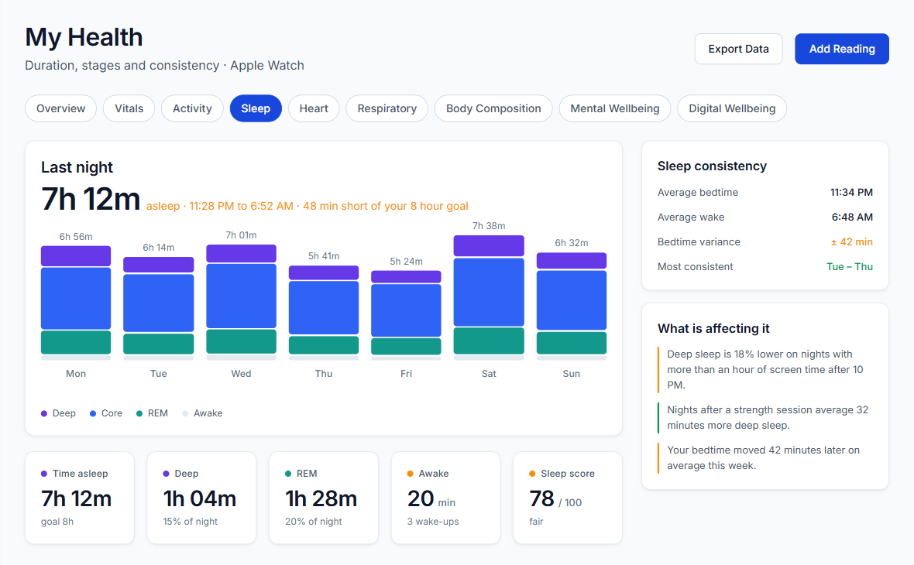
My Health
Nine detailed views of a person's health data
What it does
Overview, vitals, activity, sleep, heart, respiratory, body composition, mental wellbeing and digital wellbeing.
How it works
Each view is calculated when it is opened, so it is never out of date.
Anything that is not measured is left out, not estimated.
Insights compare a person with their own history.
Notes:
Speaker A (1 minute). Use sleep as the example: stages, bedtime consistency and what is affecting it. The important design choice: no fake numbers. If a person has no sleep data, the app says so.

Slide 7
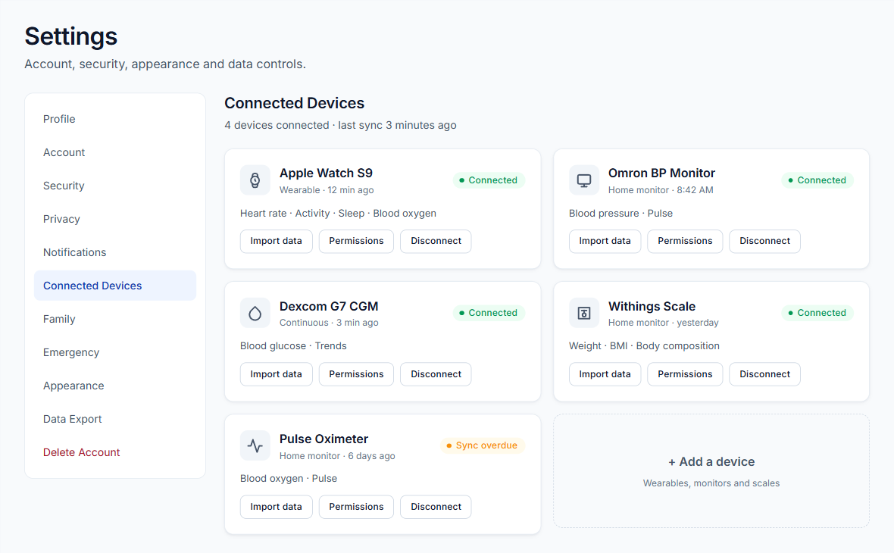
Data Import
Three ways to bring health data into VitalLink
What it does
Import an Apple Health export, pair a Bluetooth device, or enter a reading by hand.
How it works
Apple's export can be very large, so it is read as a stream, not all at once.
iPhone and Watch count the same steps, so each block uses one source.
Importing again updates readings and does not duplicate them.
Notes:
Speaker A (1 minute). Apple gives websites no live access to Health data, so a person exports a file from the Health app and uploads it. Bluetooth works in Chrome and Edge using standard device profiles. We tested a generated file with 2.5 million records. Hand over to Speaker B.

Slide 8
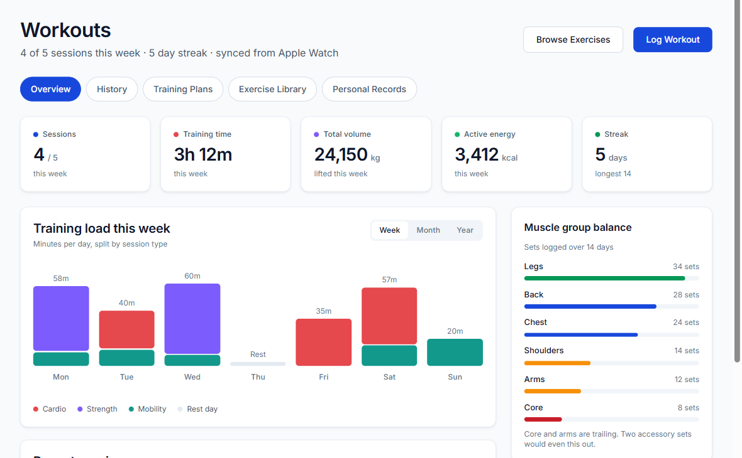
Workouts
Training logs, plans and progress in one place
What it does
Log workouts and sets, follow a training plan, browse exercises and track personal records.
How it works
Weekly load, muscle balance and streaks are calculated from logged sessions.
One plan is active at a time. Starting a new plan archives the previous one.
Notes:
Speaker B (1 minute). Show the training load chart and the muscle balance on the right. Nothing is entered twice: it all comes from logged sessions. Start Session opens the log already filled in from the next planned workout.

Slide 9
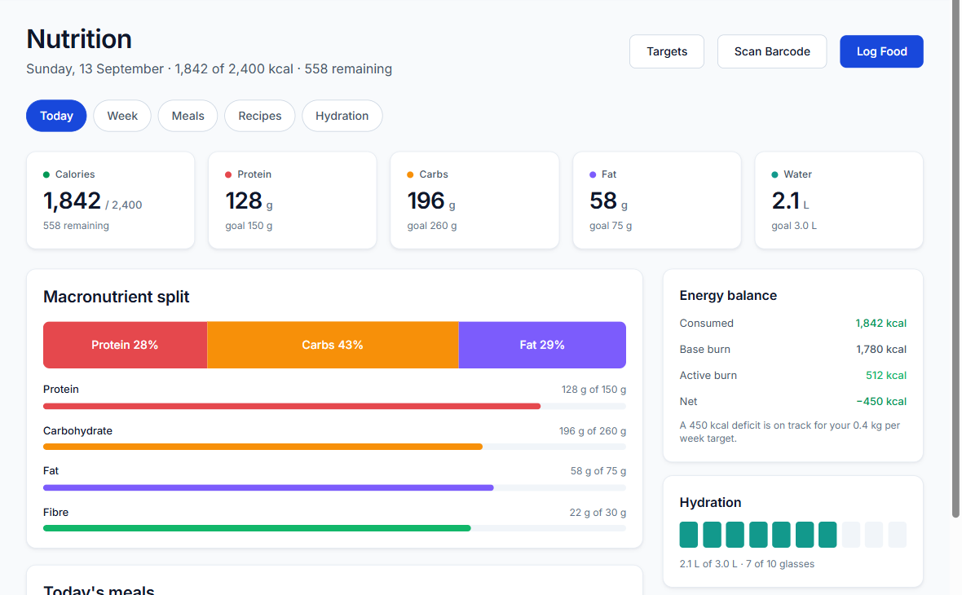
Nutrition
Meals, recipes, barcodes and hydration
What it does
Log meals, scan a barcode, save recipes, track water and set personal targets.
How it works
Barcodes are looked up in Open Food Facts. Only the barcode is sent.
Logging copies the nutrition values, so editing a recipe never changes past meals.
Notes:
Speaker B (1 minute). The recipe detail is a good example of thinking about data over time. A meal eaten last month should not change because the recipe was edited today, so we copy the values at logging time.

Slide 10
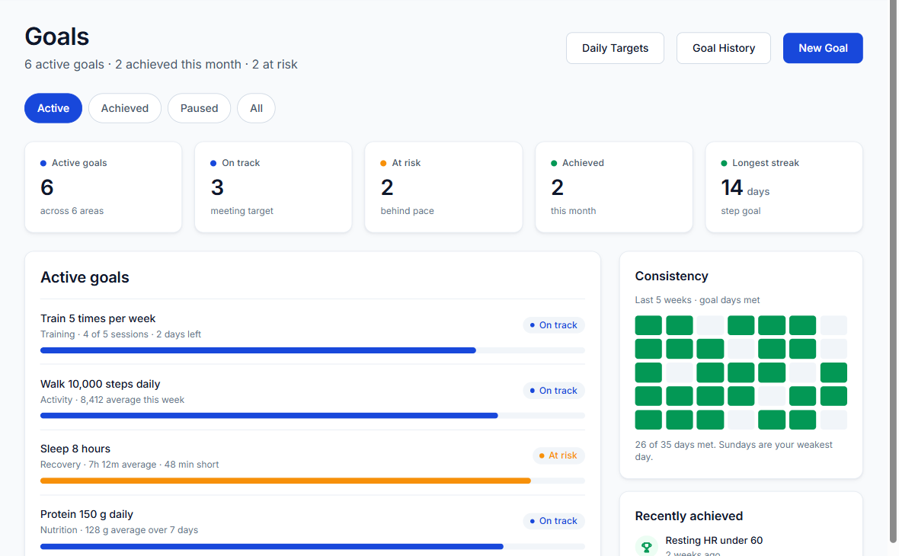
Goals
Clear progress against daily, weekly and target goals
What it does
Set goals, then follow progress, streaks and consistency over time.
How it works
Daily goals use the average of the last 7 days with data. 85% of target counts as on track.
Weekly goals check pace against the days gone.
Status is calculated on each read, so it cannot go stale.
Notes:
Speaker B (1 minute). Why 85 percent: one bad day should not mark a goal as failing. With no data the goal shows at risk, not on track.

Slide 11
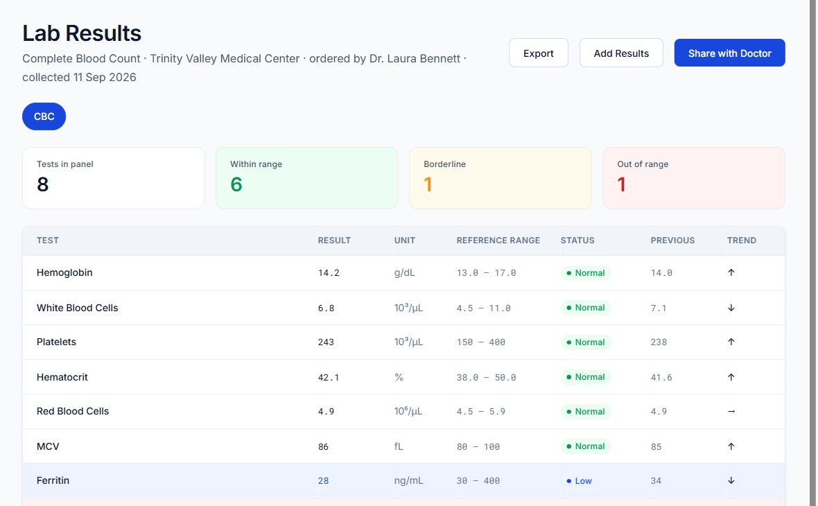
Medical Records and Lab Results
Documents and results that stay under the user's control
What it does
Upload documents, enter lab results, spot values out of range and export to CSV.
How it works
Files stay in private storage and open only through short-lived signed links.
The server checks a file's real type after upload.
Each result is compared with its reference range and previous value.
Notes:
Speaker B (1 minute). Point at the highlighted rows: low and high values stand out. There is never a public link to a file. Lab results are entered by the person. We do not connect to lab systems, because we are consumers only.

Slide 12
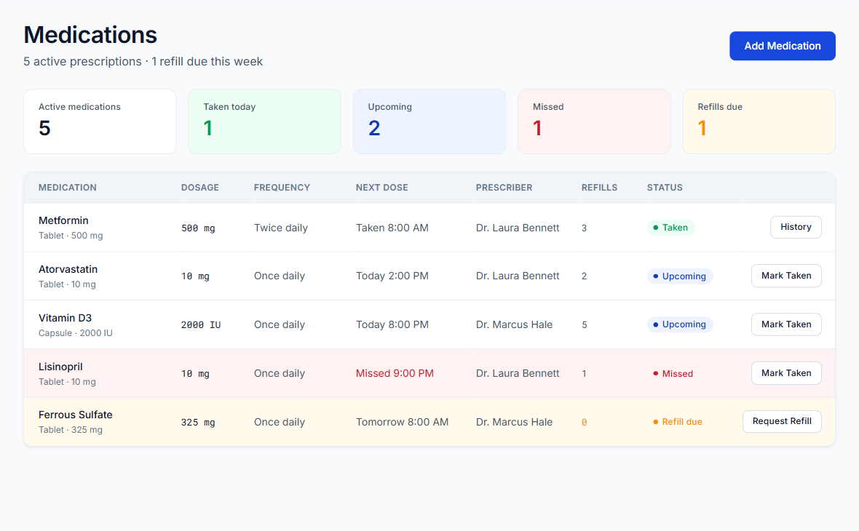
Medications
Doses, history and refills
What it does
See what is due, mark a dose as taken, undo it, review history and record refills.
How it works
A dose stays due for 2 hours, then counts as missed.
Marking the same dose twice records it once.
A nightly job creates notifications for missed doses, refills and the next day's visits.
Notes:
Speaker B (1 minute). The nightly job runs from GitHub Actions. It is safe to run twice, because it will not notify about the same thing again. Hand over to Speaker C.

Slide 13
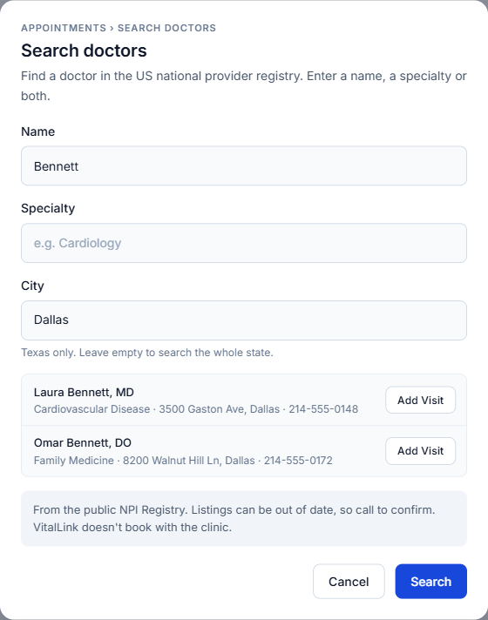
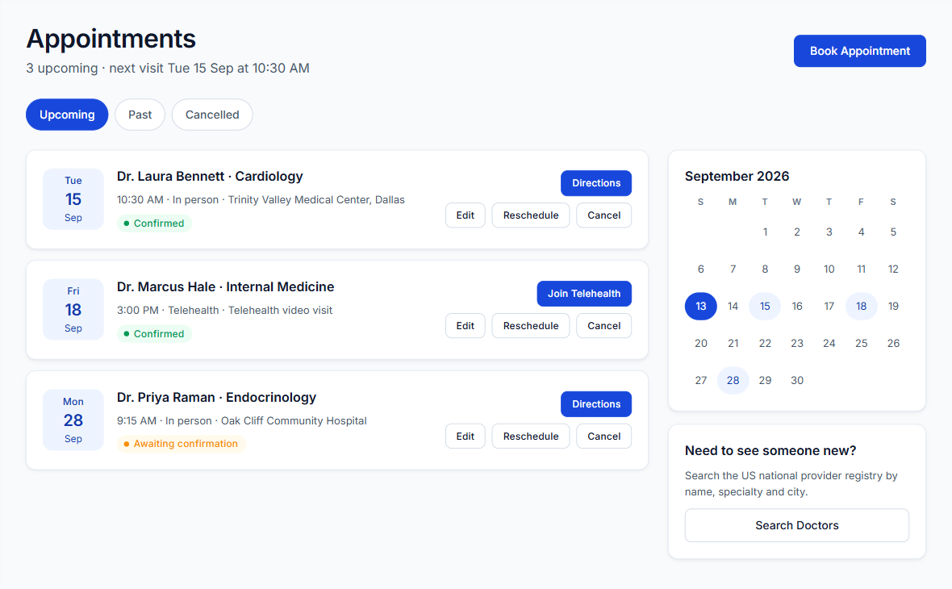
Appointments and Doctor Search
Track visits and find doctors from a public registry
What it does
Track visits and get directions. Search Texas doctors by name, specialty and city.
How it works
Search uses the government's public NPI Registry. Only the search words are sent.
Add Visit fills in the booking form.
VitalLink does not book with the clinic. It keeps the calendar and reminders.
Notes:
Speaker C (1 minute). The search uses the US government's public list of licensed providers. It is free and needs no key. Only the search words leave our API. Everyday words are mapped, so cardiology finds cardiovascular disease. Add Visit opens the booking form filled in. We do not book with the clinic: VitalLink keeps the calendar and reminders.

Slide 14
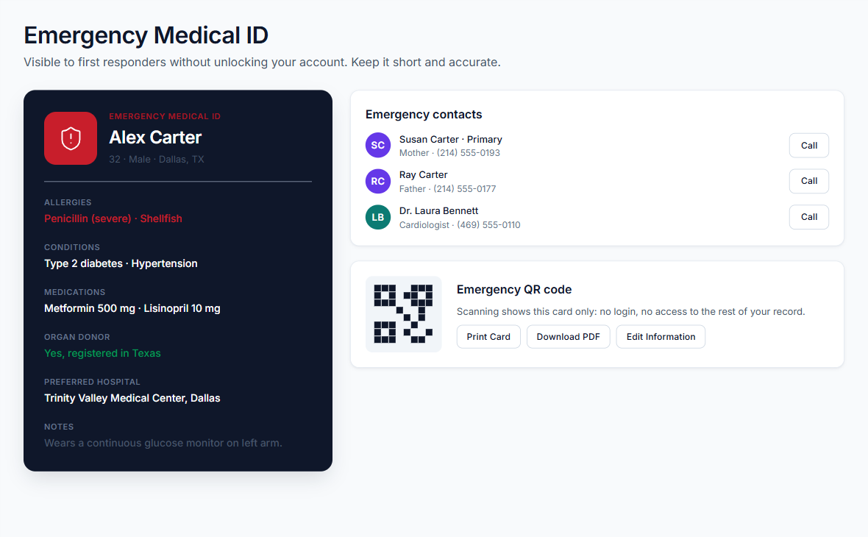
Emergency Medical ID
Critical details on one card
What it does
One card with allergies, conditions, medications and emergency contacts, ready to print.
How it works
The card is built from data already entered, so nothing is typed twice.
Up to five contacts, with one marked primary.
It can be printed or saved as a PDF from the browser.
Notes:
Speaker C (1 minute). The card has its own red shortcut at the bottom of the sidebar, so it is always one click away.

Slide 15
Data Sharing and Consent
Users choose who sees which data and for how long, and can stop at any time
Every read of another person's data passes four checks
1
2
3
4
Read allowed
Email confirmed?
Shared with this person?
Covers this kind of data?
Share still live?
Any answer of no: read refused
Limited by kind and time
Fully logged
No account probing
Vitals, activity, sleep, nutrition or records, with an end date.
Allowed and refused reads go into a log the owner can read.
Strangers cannot tell whether an account exists.
Notes:
Speaker C (2 minutes). This is the most important slide technically. Sharing is limited to chosen kinds of data: vitals, activity, sleep, nutrition or records. Walk the chain left to right: every read of another person's data goes through these checks, in this order. Fail any one and the read is refused. Every decision is logged, including refusals, and the owner can read that log. A stranger gets the same not found answer as a user who does not exist, so nobody can probe for accounts.

Slide 16
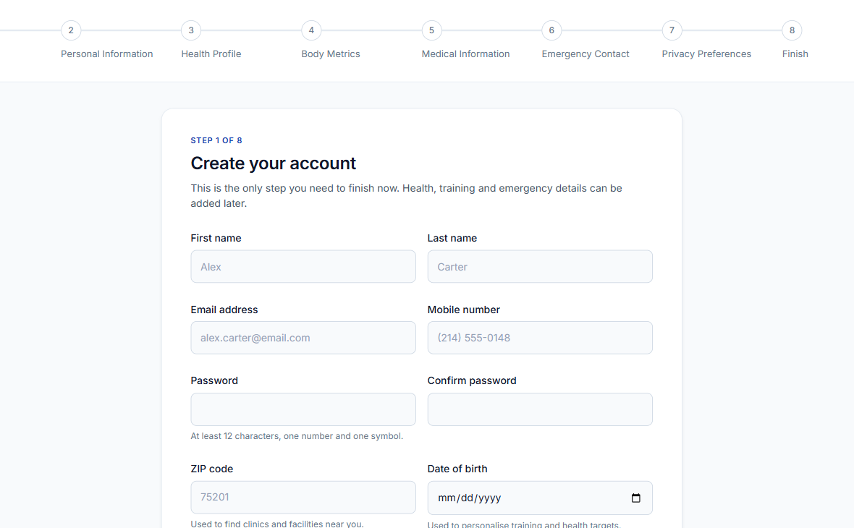
Accounts and Security
Sign-up, setup and control over personal data
What it does
Email or Google sign-up, an eight step setup, two step verification, data export and account deletion.
How it works
The account records whether setup is finished, so Google sign-ups answer the same questions.
With two step on, the API refuses a session that only passed the password.
Deleting an account removes its data and ends its shares.
Notes:
Speaker C (1 minute). Every setup step can be skipped. Sign-in itself is handled by Supabase, and our API checks the token on every request. Export downloads everything we hold about a person as one file. Hand over to Speaker D.

Slide 17
System Architecture
All rules live in one API, in front of the database and files
Database
Supabase Postgres
VitalLink API
Web portal
File storage
Java and Spring Boot, hosted on Render
React, hosted on Vercel
Private, signed links
Sign-in
Supabase Auth
External lookups
NPI Registry, Open Food Facts
Notes:
Speaker D (2 minutes). Follow one request. The browser loads the site from Vercel. Supabase signs the person in and gives them a token. The browser sends that token to our API on Render, which checks it on every call. Only the API touches the database and the files, so every rule lives in one place. Outside services get only search words or barcodes, never anything about the user.

Slide 18
Technology Stack
The tools used for each part of the system
Part | Tools
Web portal | React 19, TypeScript, Vite 5, React Router 6, CSS Modules
API | Java 25, Spring Boot 4.1, Maven, OpenAPI with Swagger UI
Database | PostgreSQL on Supabase, plain SQL, Flyway (38 tables, 20 migrations)
Sign-in and files | Supabase Auth and Storage, Nimbus JOSE for verifying tokens
Hosting | Vercel for the site, Render with Docker for the API, Brevo for email
Automation | GitHub Actions for tests, builds and the nightly job
Design | Figma, with colors, spacing and type generated from its variables
Notes:
Speaker D (2 minutes). Do not read the table. Pick two choices and say why. One service, not microservices: a small team on a free plan does not need that. Plain SQL, not an ORM: we can see and test every query. Row level security is on for every table, and a test fails the build if a new table misses it.

Slide 19
Testing
Hands-on testing of the live site, supported by automated checks
Manual testing
Automated checks
Issues found and fixed
Sign-up with email and Google
Setup and logging activity
Apple Health import
Document upload and sharing
Revoking a share and reading the access log
286
API freeze under load
Many saves at once blocked for 10 seconds. Concurrent requests are now limited.
API tests on a real database
102
frontend tests
Apple Health imports
Large files failed. The size limit and parser were fixed, then tested with 2.5 million records.
47
step check of the running system
Notes:
Speaker D (2 minutes). Start with what the team did by hand on the live site. IMPORTANT: only keep items that your team has actually done, and do all of them before the talk. Then give the automated numbers, which run against a real database. Finish with the two problems testing found.

Slide 20
Use of Generative AI
We used Claude Code, an AI coding tool, under the team's direction
Mostly produced by the AI tool
The team's responsibility
Frontend and backend code
Automated tests
Documentation
First drafts of new screens in Figma
Requirements and project rules
Product and design decisions
Reviewing the work and testing it by hand
Accounts, configuration and deployment
What we learned
AI output needs verification. One import test passed only because its sample file was small, and testing at a realistic size exposed the problem.
Notes:
Speaker D (2 minutes). The assignment asks for this, so say it plainly. Claude Code wrote most of the code, automated tests and documentation. We directed it: we decided what to build, made the product and design decisions, reviewed the work, tried it ourselves and deployed it. We did not measure a percentage, so we do not claim one. Team: confirm this matches what really happened, and add any other AI tools you used.

Slide 21
Live Demonstration
The working system, end to end
01
Sign up with Google and complete setup
02
Review the dashboard and My Health
03
Import Apple Health data
Live site
vital-link-flax.vercel.app
04
Log a workout and a meal
05
Add lab results and share them with a doctor
06
Search for a doctor and add a visit
07
Revoke access and review the access log
Notes:
All speakers, 8 minutes. Each person runs a part. BEFORE THE TALK: open the site 5 minutes early so the API is awake, because the free server takes about a minute to wake. Sign in ahead on a second tab, and have the Apple Health file ready. Use made-up health data only. If the live site fails, go back through the feature slides, which show the real screens. Suggested split: A steps 1 and 2. B steps 3 and 4. C steps 5 and 6. D step 7.

Slide 22
Limitations and Next Steps
What the system cannot do yet, and where it could go
Current limitations
Next steps
Apple Health data arrives by file import, not automatic sync
The free server takes about a minute to wake after sitting idle
A 500 MB free database limits how much data can be stored
Automatic daily updates from iPhone
Usability testing with real users
More database capacity and an always-on server if usage grows
Notes:
Speaker D (1 minute). Be upfront. Apple gives websites no live access to Health data, so a person imports a file. The free server sleeps after about 15 minutes, and we measured about 65 seconds to wake. The free database holds 500 MB, and readings fill it quickly.

Slide 23
Thank You
Questions and discussion
Amrit Gautam | Dinesh Chaudhary | Shreenibash Shrestha | Sudip Ghorasaini
The University of Texas at Arlington, Group 2
Notes:
Speaker D. Thank you. Ask for questions. Everyone should be ready to answer about the part they presented.

