Slide 1
Smart Pharma Demand Forecasting
Submitted by: Submitted to:
Prabin Kr. Shah(181728) Dr. Roshan Chitrakar
Bishwajyoti Chaudhary(181709)
Deepak Yadav(181711)
Deekshya Maharjan(181710)

Slide 2
Contents
INTRODUCTION
PROBLEM STATEMENT
OBJECTIVE
SCOPE
LIMITATION
LITERATURE REVIEW
USE CASE DIAGRAM
METHODOLOGY
TOOLS AND TECHNOLOGIES
CONCLUSION

Slide 3
introduction
Web application designed to optimize operations in a pharmacy.
Includes inventory management, prescription management, sales management, and demand forecasting.
Helps pharmacies to predict future demand for specific medications, enabling them to optimize inventory levels, avoid shortages, and reduce waste.
Customers can order their medications by uploading their prescription through the app.
Improve efficiency, reduce costs, and ultimately enhance customer services.
Valuable tool for pharmacies and pharmaceutical companies.

Slide 4
Problem statement
Used to order drugs through phone calls and paper notes, leading to errors and inefficiencies.
Customers had to physically visit the pharmacy to get their prescribed medicines.
Decreased customer satisfaction and lost revenue for the pharmacy.
Companies face challenges in delivering the right quantity of products to their suppliers on time due to rapid changes in demand.

Slide 5
Objective
Enables retail pharmacies to conveniently order medicines online, reducing errors and delays.
Automatically processes orders and sends a list of medicines to the supplier.
End-users can order medicine by uploading their prescription through the app.
Advanced algorithms accurately forecast demand based on historical sales data.
Optimizes inventory levels, reducing overproduction and avoiding product shortages.

Slide 6
Scope
Online ordering, automated order processing, prescription ordering, demand forecasting, inventory optimization, and advanced technologies are included in the system's scope.
The system is adaptable and scalable to meet the needs of various stakeholders in the pharmaceutical supply chain.

Slide 7
LImItation
Relies heavily on the availability of accurate historical data, which may not always be available.
May still be prone to errors caused by human factors, such as input errors.
Fails to detect fraud prescription.
Requires reliable IT infrastructure, including servers, internet connectivity.

Slide 8
Literature review
NepMeds app in Nepal provides various healthcare services including booking diagnostic tests, connecting users with doctors, and ordering medicines.
However, the app lacks demand forecasting feature which is crucial for pharmaceutical companies.
Retail pharmacies are also unable to order medicines in bulk.
There is a need for a Pharmacy Management System with Demand Forecasting in Nepal to address these limitations and improve pharmaceutical operations.

Slide 9
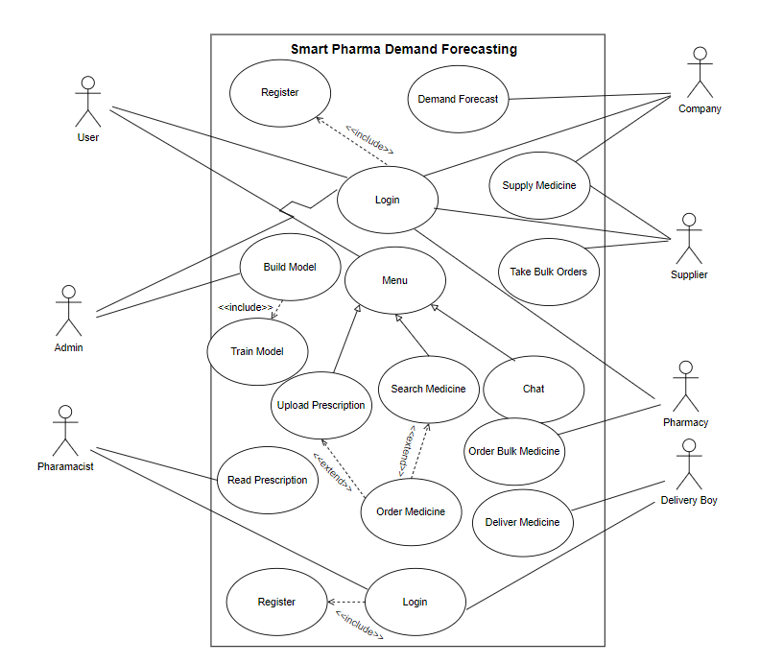
Use Case Diagram

Slide 10
Model Development Methodology

Slide 11
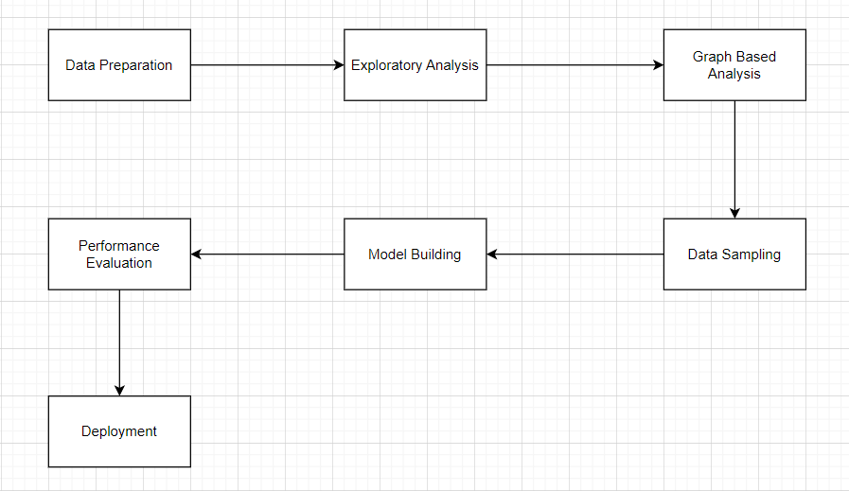
Fig :Model Development Steps

Slide 12
Time Series Analysis
Time series analysis comprises methods for analyzing time series data in order to extract meaningful statistics and other characteristics of the data.
Level: Level is the average of the values of the series.
Trend: Trend shows a pattern in the data
Seasonality: When the data shows a repetitive pattern for over an year, it can be termed as seasonal pattern.
Cyclic Patterns: These are the repetitive patterns shown over a longer period of time(more than one year).
Noise: The variations which do not show any pattern.

Slide 13
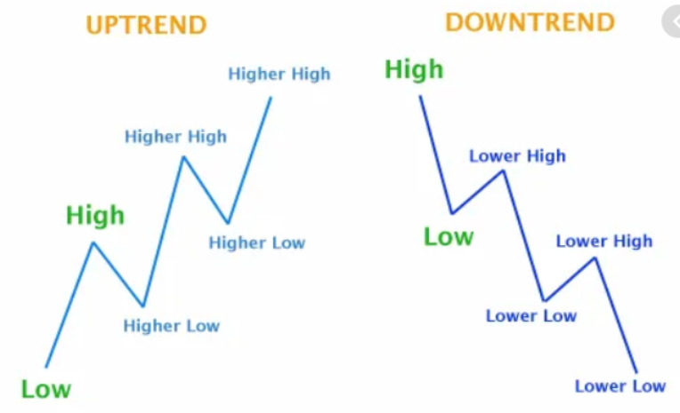

Slide 14
Smoothing Factor:
Simple Moving Average
Cumulative Moving Average
Exponential Weight Moving Average
ARIMA (Autoregressive Integrated Moving Average Model)
AR I MA
Auto Regression --> y = mx +c
Moving Average --> ma = mean + phi *E(t-1)
Integrated --> Differencing

Slide 15
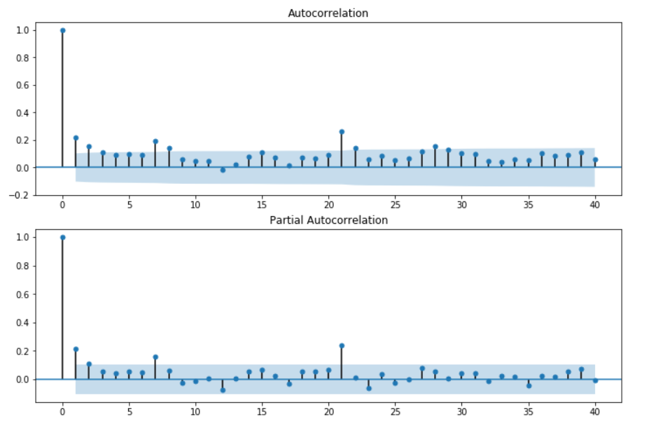

Slide 16
Seasonal Autoregressive Integrated Moving Average Model:
The SARIMA model is an extension of the ARIMA model.
The only difference now is that this model added on a seasonal component.
As we saw, ARIMA is good for making a non-stationary time series stationary by adjusting the trend.
However, the SARIMA model can adjust a non-stationary time series by removing trend and seasonality.
For Checking Stationary Time Series:
Mean and Std should be constant.
Hypothesis Dickey Fuller Testing:
Unit root = 1 --> not stationary else stationary
P value <= CI --> Reject Null Hypothesis

Slide 17
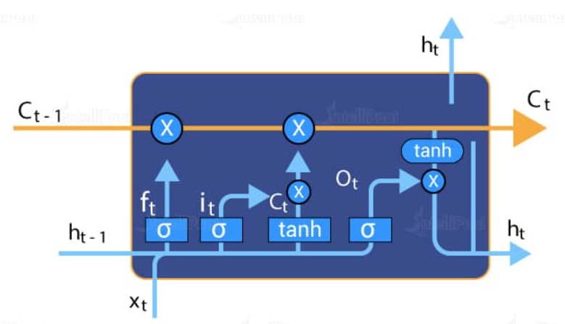
Long short-term memory (LSTM)

Slide 18
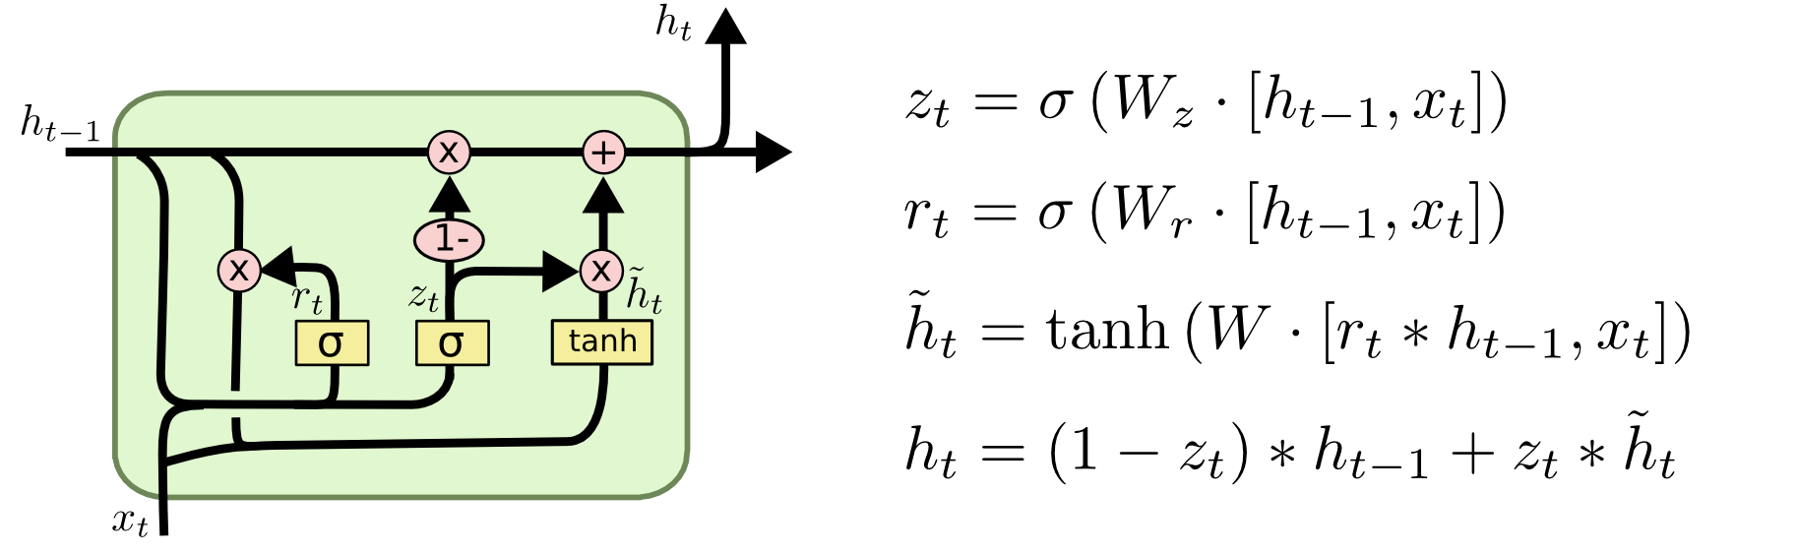
GRU

Slide 19
Calculate Forecast Errors
Mean absolute error:
The mean absolute error (MAE) value is computed as the average absolute error value.
If this value is 0 (zero), the fit (forecast) is perfect.
As compared to the mean squared error value, this measure of fit will “de-emphasize” outliers, that is, unique or rare large error values will affect the MAE less than the MSE value.
Mean Forecast Error (Bias):
The mean forecast error (MFE) is the average error in the observations.
A large positive MFE means that the forecast is undershooting the actual observations, and a large negative MFE means the forecast is overshooting the actual observations.
A value near zero is ideal.

Slide 20
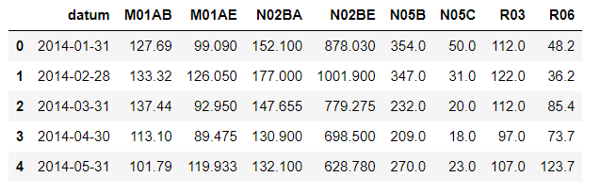
Data

Slide 21
The dataset is built from the initial dataset consisted of 600000 transactional data collected in 6 years (period 2014-2019), indicating date and time of sale, pharmaceutical drug brand name and sold quantity, exported from Point-of-Sale system in the individual pharma.
M01AB - Anti-inflammatory and antirheumatic products, non-steroids, Acetic acid derivatives and related substances
M01AE - Anti-inflammatory and antirheumatic products, non-steroids, Propionic acid derivatives
N02BA - Other analgesics and antipyretics, Salicylic acid and derivatives
N02BE/B - Other analgesics and antipyretics, Pyrazolones and Anilides

Slide 22
N05B - Psycholeptics drugs, Anxiolytic drugs
N05C - Psycholeptics drugs, Hypnotics and sedatives drugs
R03 - Drugs for obstructive airway diseases
R06 - Antihistamines for systemic use

Slide 23
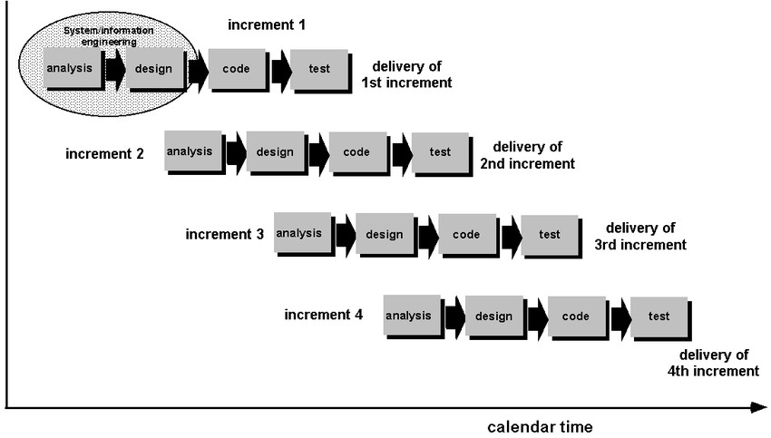
Software Development methodology
Fig: Increment model
[Source: https://www.researchgate.net/figure/ncremental-ModelAdapted-From-Google-Images-211-Fringe-benefit-of-Incremental-Model_fig2_30151330]

Slide 24
Tools And Technologies
Front end
HTML
CSS
JavaScript
Back end
Java
Python
Database
MySql

Slide 25
Framework
Spring Framework
Bootstrap
TensorFlow
Server
Apache Tomcat
IDE
Eclipse
Visual Studio

Slide 26
Conclusion
Pharmacy management system with demand forecasting is a critical tool for pharmacies and pharmaceutical companies.
It automates various tasks, analyzes historical data, and smooth operations, ultimately reducing production costs and improving customer service.
Demand forecasting helps pharmacies predict future demand, allowing them to optimize production, avoid shortages, and reduce waste.

Slide 27
Thank You

