Slide 1


DevOps-CA2 Assignment
MediTwin AI — End-to-End DevOps Implementation
CI/CD • Configuration Management • Containerization • Kubernetes • Observability
Group Number: Group – 19
Adarsh Jha – 23070122261
Jyoti Kumari Sah- 23070122278
Muskan Shah – 23070122279
Prabin Yadav – 23070122280
Under
Arijit Dutta
Department of Computer Science & Engineering | Academic Year 2025–26

Slide 2
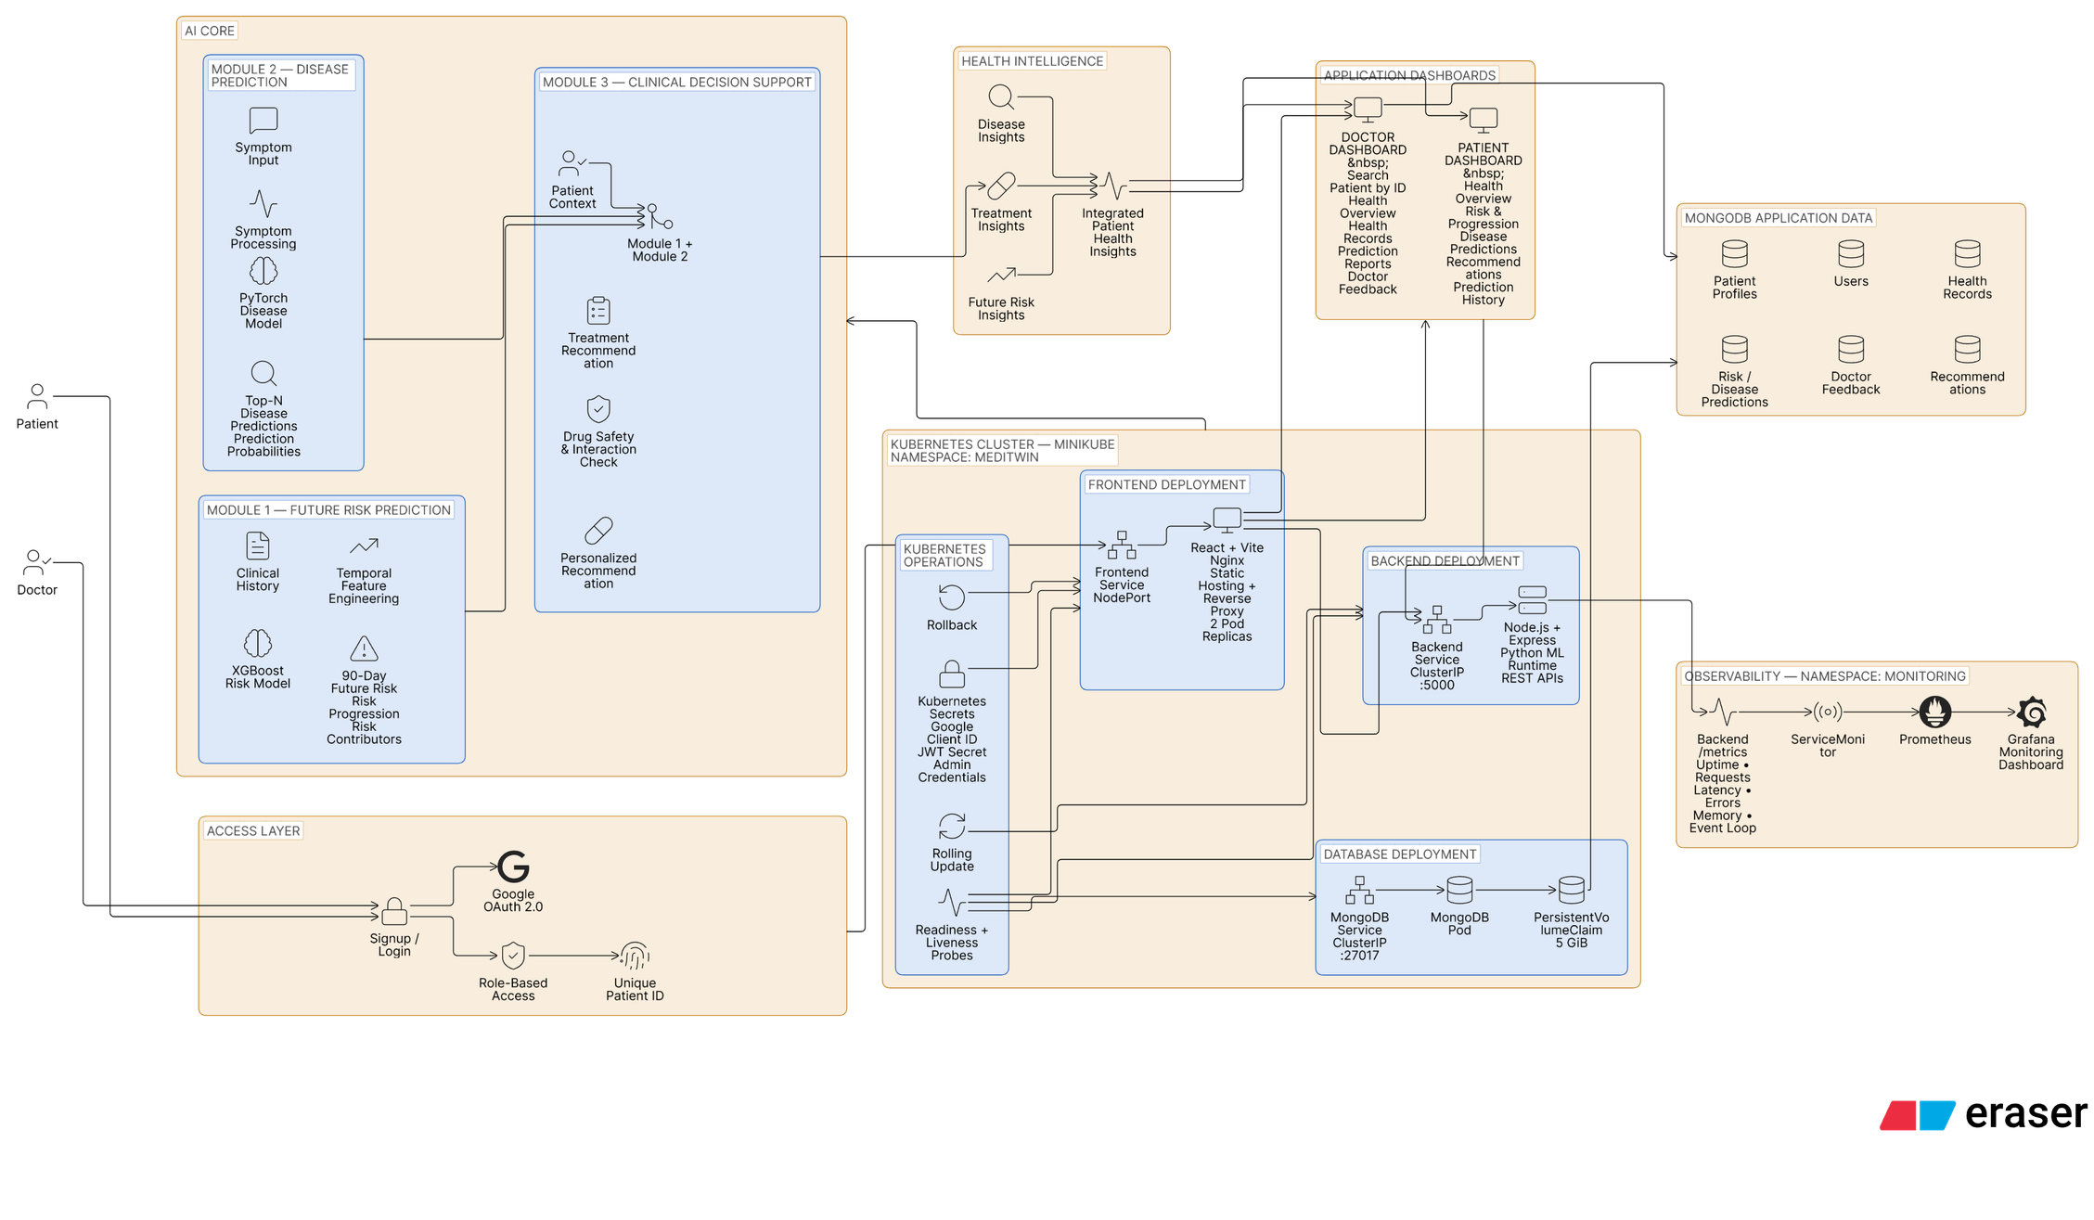
System Architecture

Slide 3
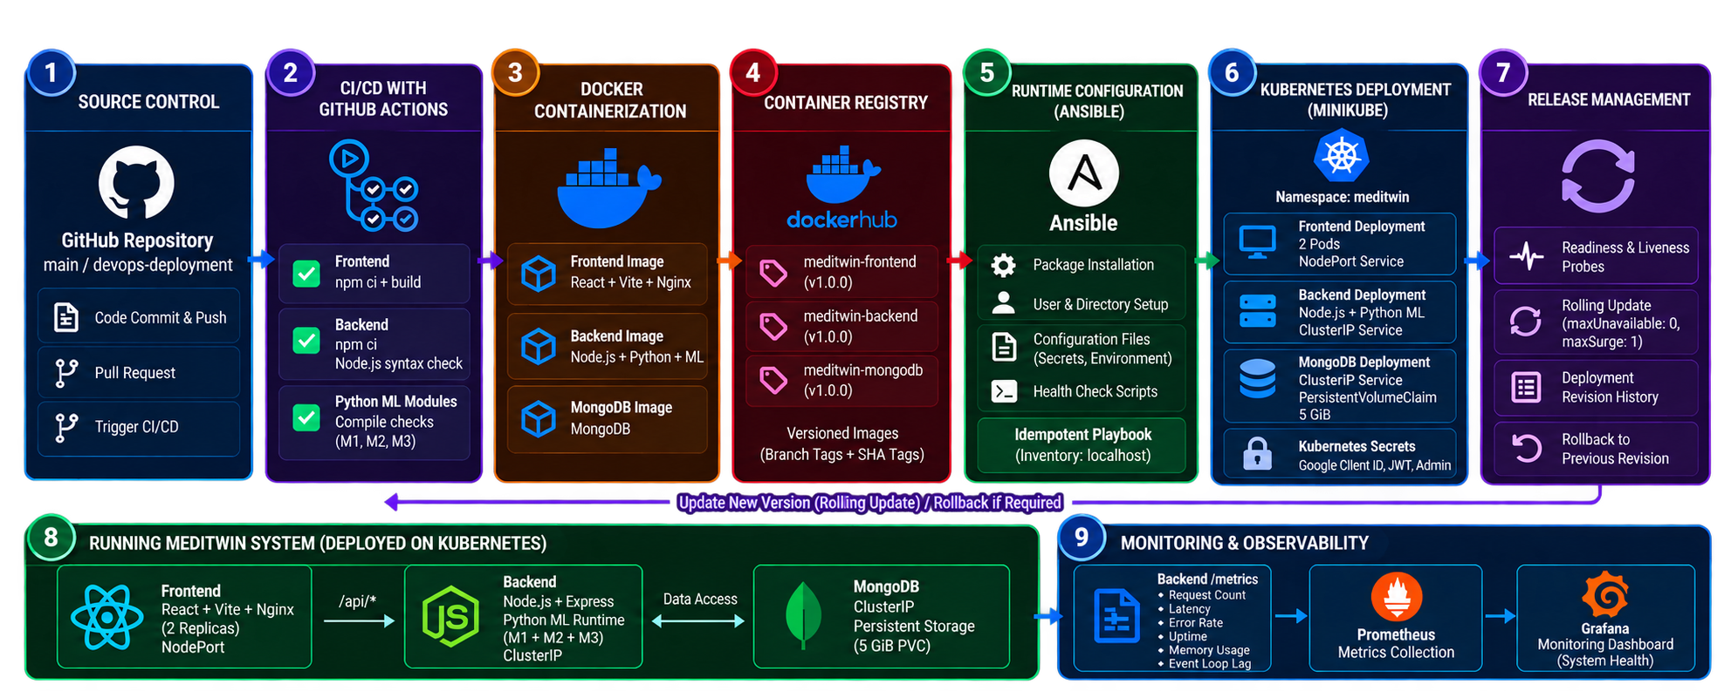
Pipeline Flow
Automated validation → containerization → configuration → deployment → release → monitoring

Slide 4
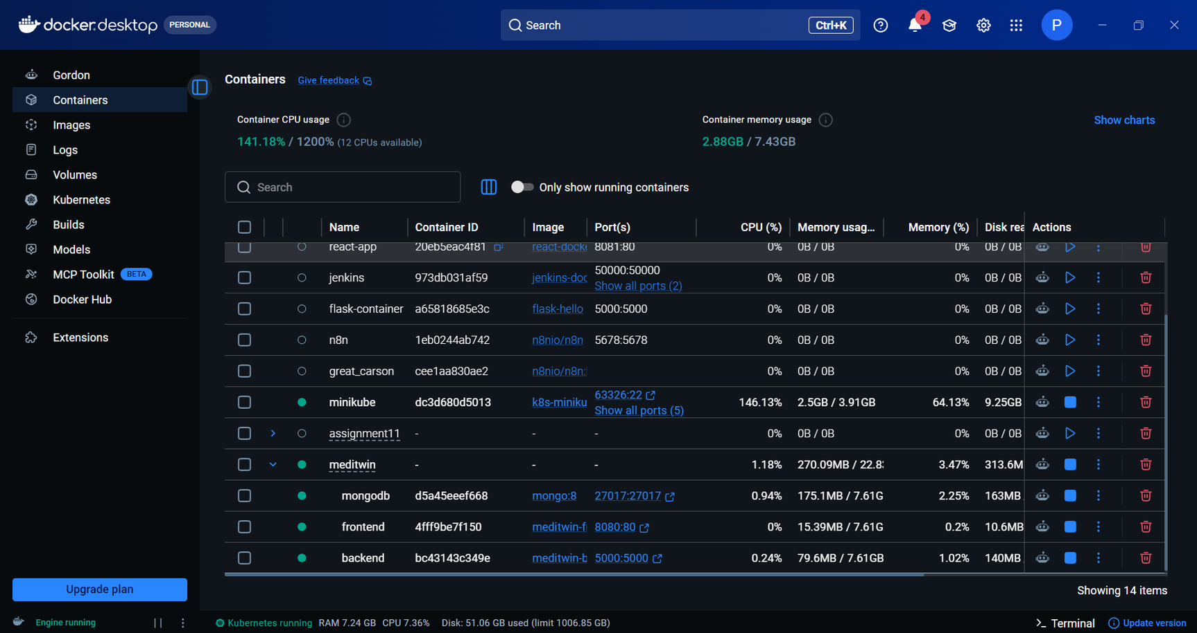
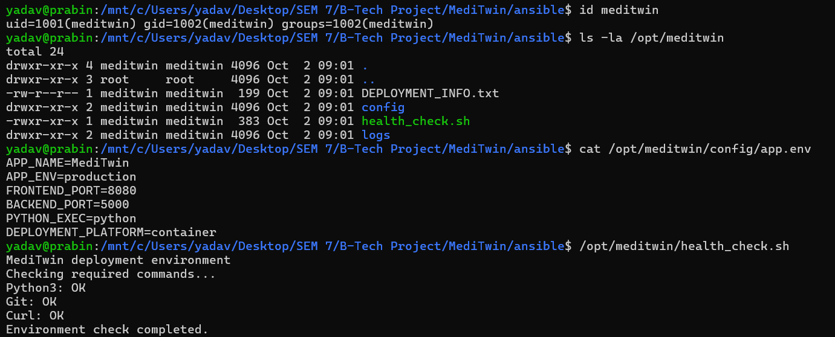
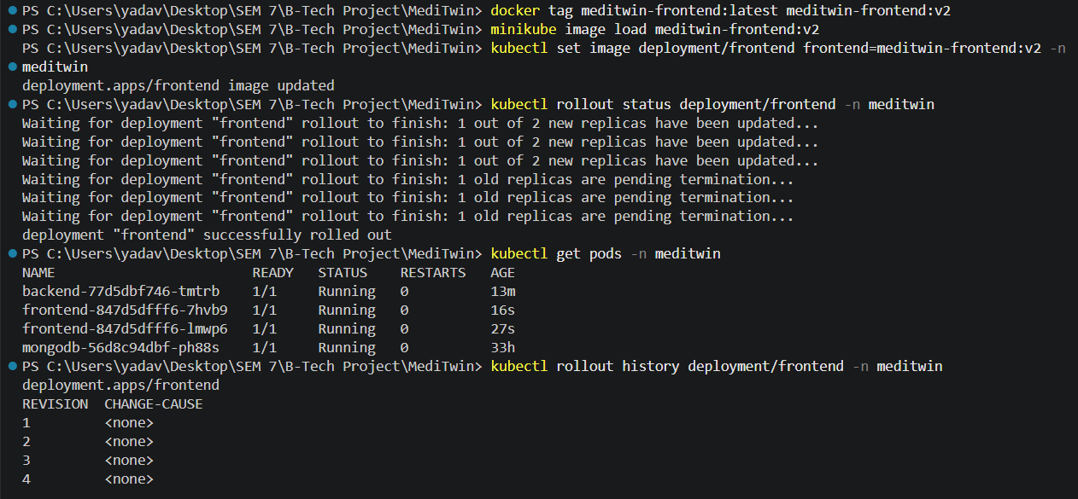
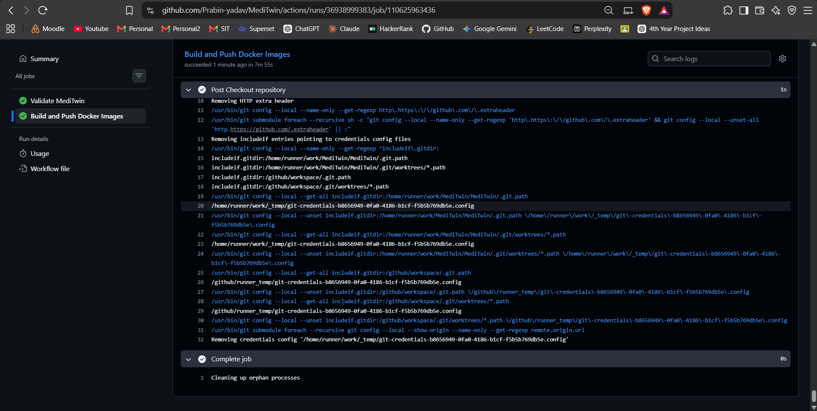
Deployment & Configuration
Figure 1 — Dockerized MediTwin Services
Figure 3 — Ansible Runtime Configuration & Environment Validation
Figure 2 — Kubernetes Deployment, Rolling Update & Rollout Verification
Figure 4 — GitHub Actions CI/CD Execution

Slide 5
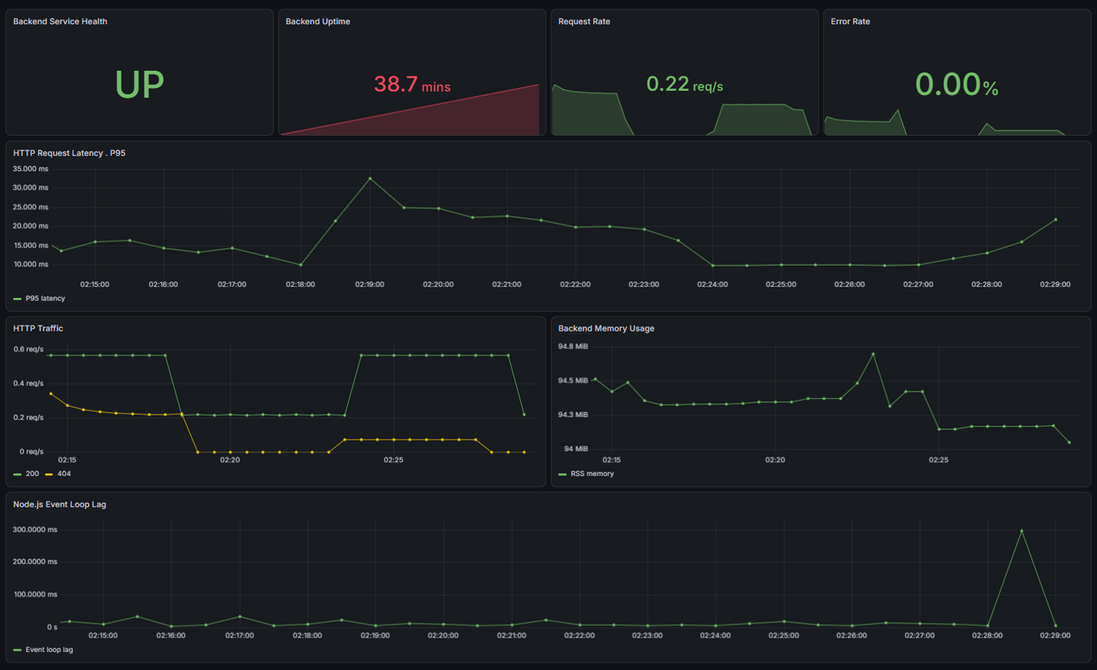


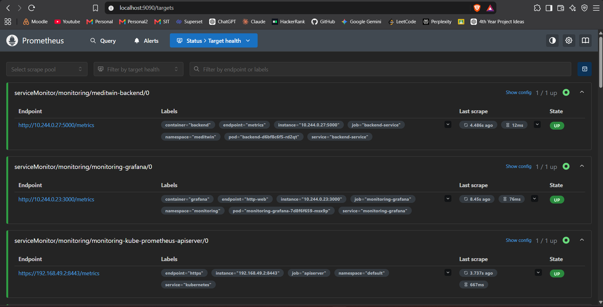
Monitoring & Observability
Why Monitor?
Availability — detect service downtime
Performance — track latency and traffic
Runtime Health — observe memory and event-loop behavior
Reliability — identify HTTP errors
Figure 5 — MediTwin DevOps Monitoring Dashboard in Grafana
Prometheus + Grafana
/metrics → ServiceMonitor → Prometheus → Grafana
Figure 6 — MediTwin backend successfully discovered and scraped by Prometheus

Slide 6



Challenges & Lessons Learned
Large ML Docker Image
PyTorch made the backend image very large.
Reused layers and optimized the build approach.
Kubernetes Runtime Issues
Startup and readiness needed careful configuration.
Configured Services, probes and persistent storage.
Google OAuth origin_mismatch
The deployed origin initially wasn't authorized.
Updated the client ID and authorized origin.
Challenges
Solutions
Dockerized services make deployment consistent across environments.
Lessons Learned
Ansible reduces manual runtime setup and supports idempotent execution.
Kubernetes manages services, replicas, storage, health and deployment state.
Application-level metrics are essential for understanding real system behaviour.

