Slide 1


ONLINE BUS TICKET MANAGEMENT SYSTEM
A
PROPOSAL
DEFENSE: BCA 4th SEM PROJECT I
Prepared by:
Prabita Adhikari

Slide 2
TABLE OF CONTENT
Introduction
Problem Statement
Objectives
Methodology
Gantt Chart
Expected Outcomes
Bibliography

Slide 3
INTRODUCTION
The Online Bus Ticket Management System (OBTMS) is a web-based project.
Aims to automate bus ticket booking and management.
Designed to run on a local server using PHP and MySQL.
Users can search buses, view schedules, select seats, and book tickets digitally.
Admin can manage buses, routes, schedules, and booking records efficiently.

Slide 4
PROBLEM STATEMENT
Manual ticket booking in Nepal leads to long queues and delays, especially during festivals.
I personally waited 2–3 hours for a bus ticket during a festival.
Existing systems are large and include multiple services; this project focuses only on bus ticket booking.
Need for a simple, efficient, and digital solution.

Slide 5
OBJECTIVES
The main objective of the OBTMS are as follows:
To digitize the traditional manual bus ticket booking process.
To reduce passenger waiting time during ticket booking.
To provide easy bus ticket booking and management facilities.
To manage buses, routes, schedules, users, and bookings efficiently using CRUD operations.

Slide 6
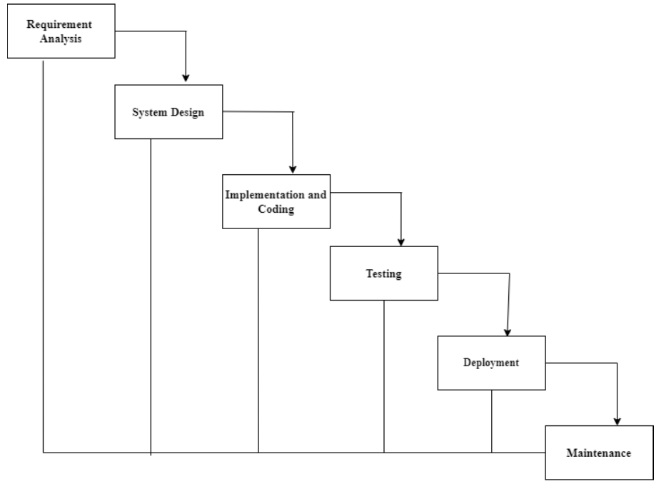
METHODOLOGY
Waterfall Model of OBTMS

Slide 7
CONTINUE…
A. Requirement Identification
i. Study of Existing System
Reviewed online bus ticket platforms like BusSewa[1].
Studied features such as bus search, schedule viewing, seat selection, and online booking.
Identified key functionalities.
ii. Requirement Collection
Based on personal experience and observation of manual ticket booking.
Identified major issues: long queues, booking errors, difficulty in managing tickets.

Slide 8
Continue…
Functional Requirement
The user shall have the ability to register and log into the system.
The user shall have the ability to search available buses and view schedules.
The user shall have the ability to select seats and book bus tickets.
The user shall have the ability to view and cancel bookings.
The admin shall have the ability to log into the admin panel securely.
The admin shall have the ability to add, update, view, and delete bus details.
The admin shall have the ability to manage routes and schedules using CRUD operations.
The admin shall have the ability to manage booking records and customer information.
The system shall have the ability to store and retrieve data from the database.
Non-Functional Requirement
The system must have reliable management and storage of booking records.
The system must have secure authentication, validation, and session management.
The system must have a responsive and user-friendly interface.

Slide 9
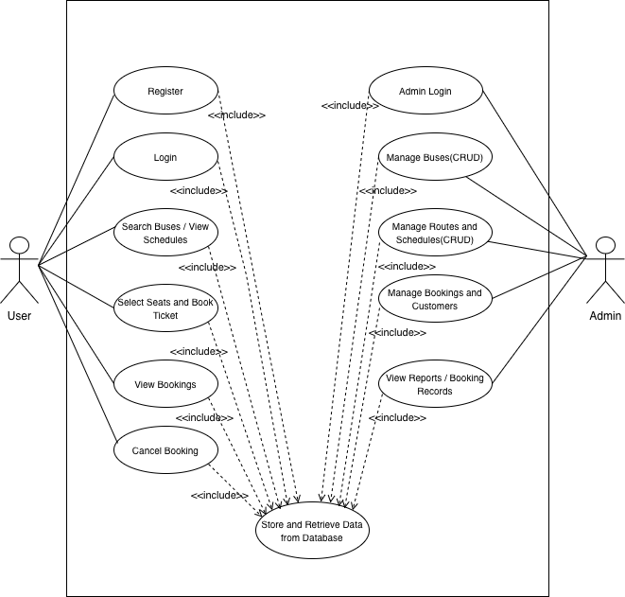
Use Case Diagram
Use Case Diagram of OBTMS

Slide 10
Feasibility Study
i. Technical Feasibility
Technologies: HTML, CSS, JavaScript, PHP, MySQL
Runs on local server (XAMPP)
ii. Operational Feasibility
Simple, user-friendly, easy to operate
iii. Economic Feasibility
Uses free and open-source tools
No additional hardware/software required

Slide 11
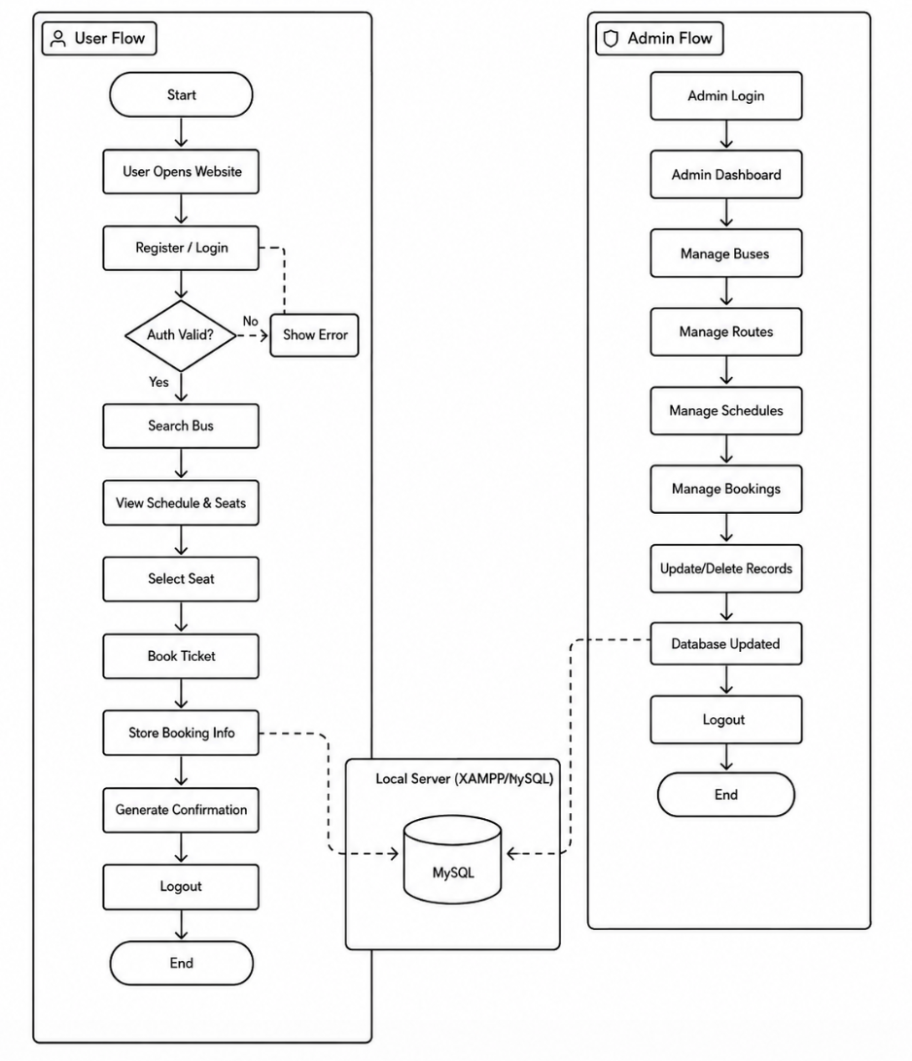
SYSTEM FLOWCHART
System Flowchart of OBTMS

Slide 12
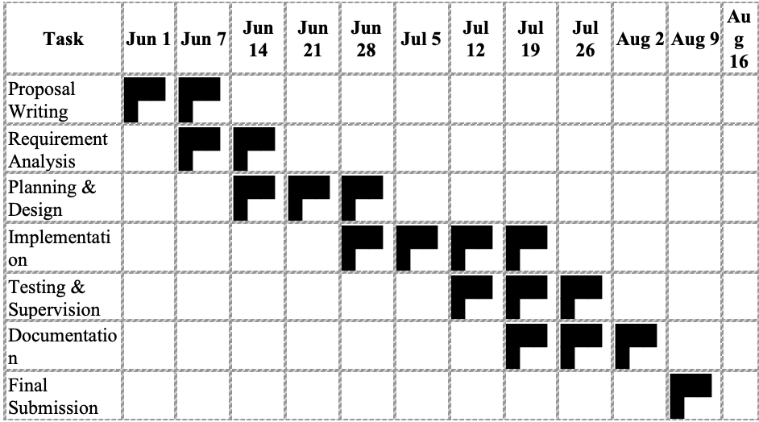
GANTT CHART
Gantt Chart of OBTMS

Slide 13
EXPECTED OUTCOMES

Slide 14
BIBLIOGRAPHY
[1] BusSewa, "BusSewa," [Online]. Available: https://bussewa.com.np.

Slide 15
Any Queries ?

