Slide 1
UIDAI Hackathon
Team Name: *TECHNOCRATS*
Team Reference ID : hYDUeoQlio
Team Member Details
Sl No | Name | E Mail ID
1 | PRABITHA P | 20euai024@skcet.ac.in
2 | SANTHIYA A | 20euai031@skcet.ac.in
3 | SAPARNA K | 20euai033@skcet.ac.in
4 | VEENADEVI C | 20euai053@skcet.ac.in
5 | VISHNUPRIYA V | 20euai057@skcet.ac.in

Slide 2
About the Problem Statement
Theme 1: Address Formatting Issue
PROBLEM STATEMENT 3
Problem Statement:
Our Problem Statement is:
De-Clutter the address.
Identifying the repetitive constituents
Merge and format the address.
To develop the API which will undertake Address Formatting.
Accepts the address in row form
Formats the address and presents as an output.

Slide 3
Approach
Our plan is to develop a Python program which analyses the address and avoids repetitive words and it also shortens the address using Data Analysis.
Cluster analysis is a machine learning technique which groups the unlabeled dataset. We use clustering to group various datasets of people by their Pincodes.

Slide 4
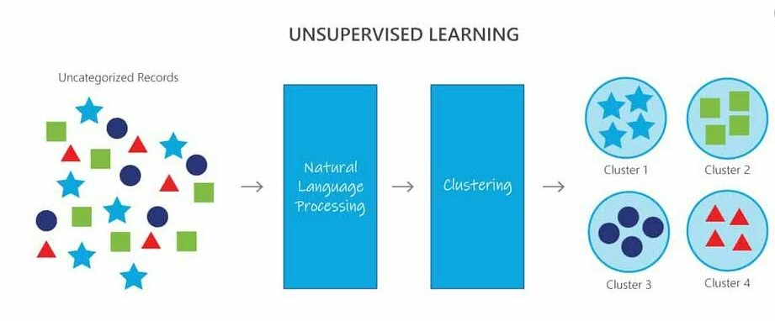
Architectural Diagram

Slide 5
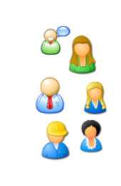
Users accessing
Our API
Node.js,PHP,
C/C++,
Python
Collect PINCODEfrom client
Render and update the address of the client
Real time address of the client

Slide 6
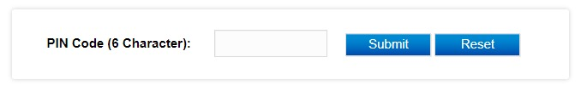
API Usage
Address PIN Code API allows developers to get details of Address by searching with PIN Code.
STEP 1:

Slide 7
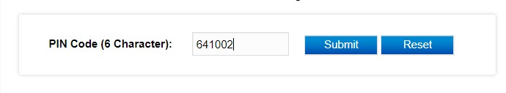
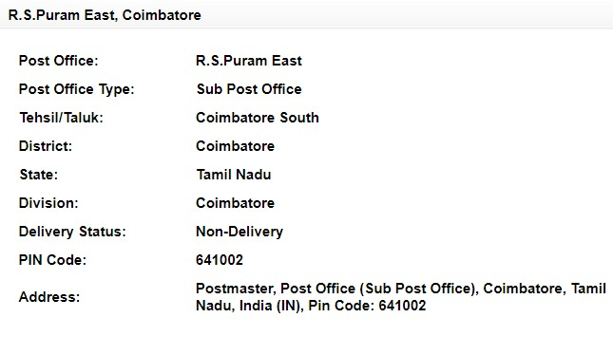
STEP 2:
STEP 3:

Slide 8
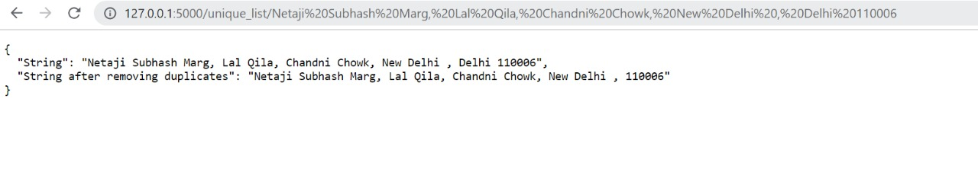
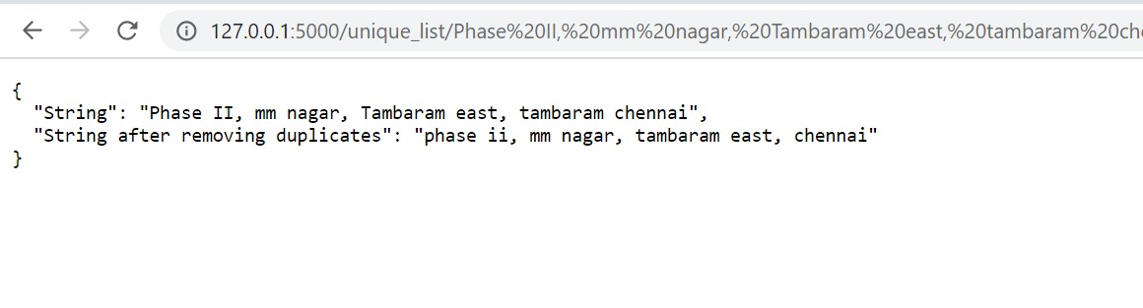
DATA SET – 1:
DATA SET – 2:

Slide 9
PYTHON PROGRAM:
from flask import Flask, jsonify
app = Flask(__name__)
@app.route('/')
def hello_world():
return "<p>Hello, World!</p>"
@app.route('/unique_list/<string:text_str>')
def unique_list(text_str):
text_strl = text_str.lower()
l = text_strl.split()
temp = []
for x in l:
if x not in temp:
temp.append(x)
res = ' '.join(temp)
result = {"String": text_str, "String after removing duplicates": res}
return jsonify(result)
if __name__ == "main":
app.run(debug=True)

Slide 10
Security Considerations
For information security we use One-Time Password(OTP) as first level authentication.
Password as second level authentication.
We also use Biometrics which are the biological measurements used to identify individuals. For example, fingerprint mapping and Facial recognition. Biometrics is used as a third level authentication.

