Slide 1
Control of a magnet, a motor and a PSU using
EPICS
1) Experimental set up
2) EPICS foundations : IOC, PVs and reports
3) Some difficulties
4) System Architecture : Ophyd and Bluesky
5) User interface : Phoebus

Slide 2
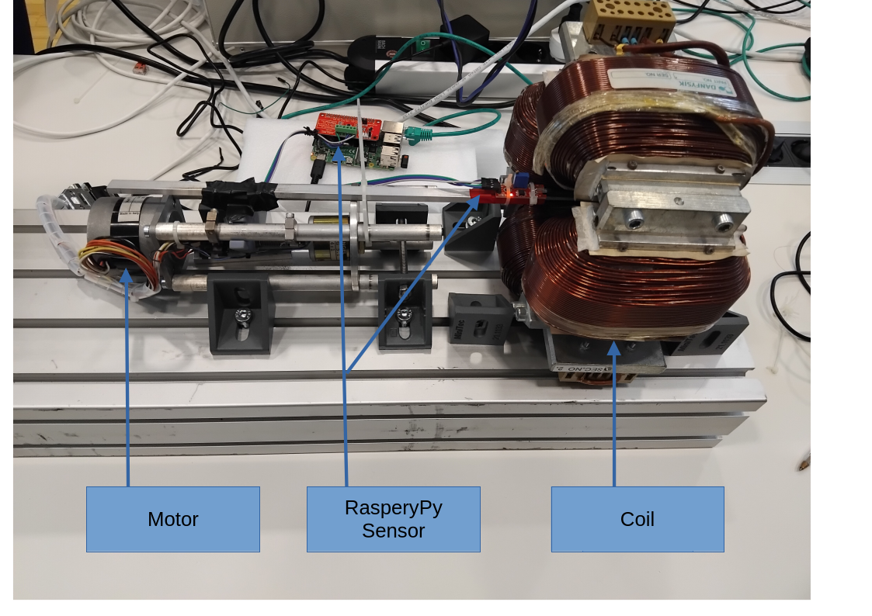
Experimental Setup

Slide 3
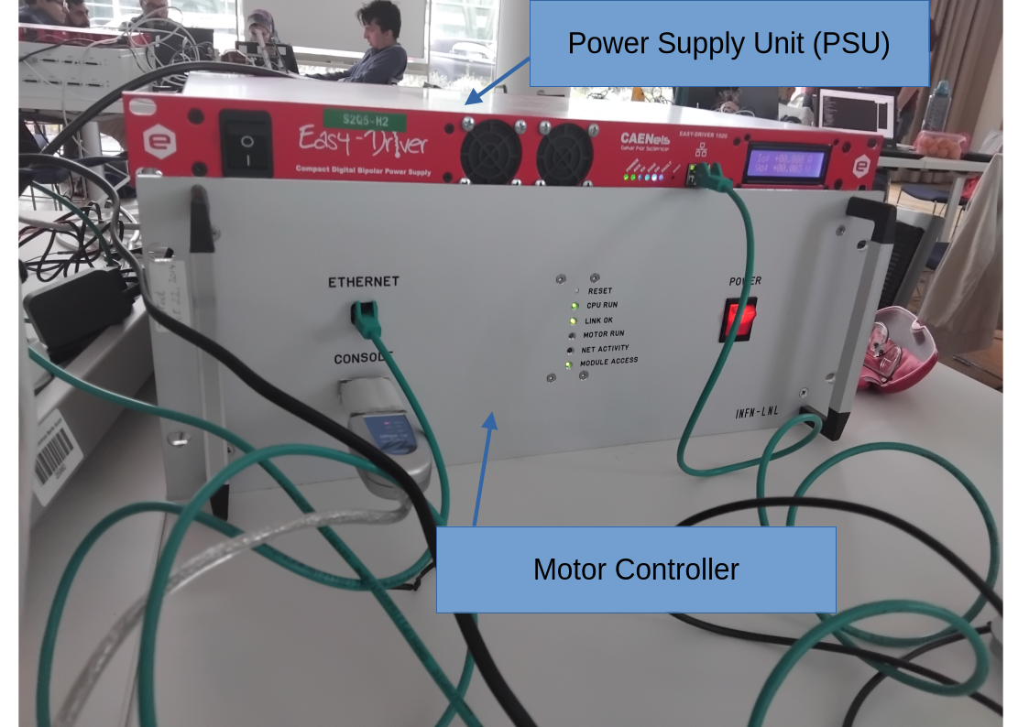
Experimental Setup

Slide 4
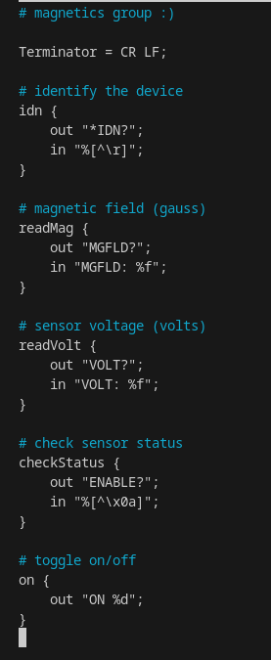
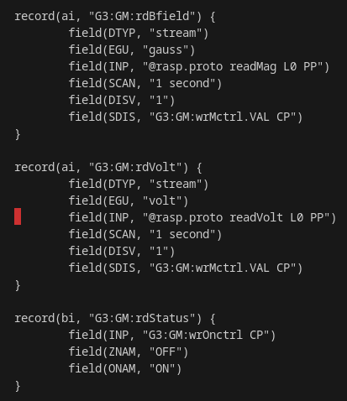
EPICS foundations
Proto file (.proto)
Database (.db)
Database (.db)

Slide 5

Naming conventions
Group number : type of device : designation

Slide 6
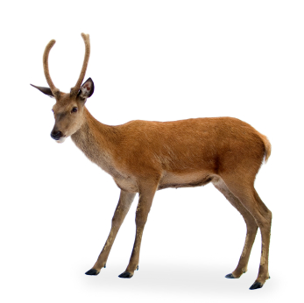
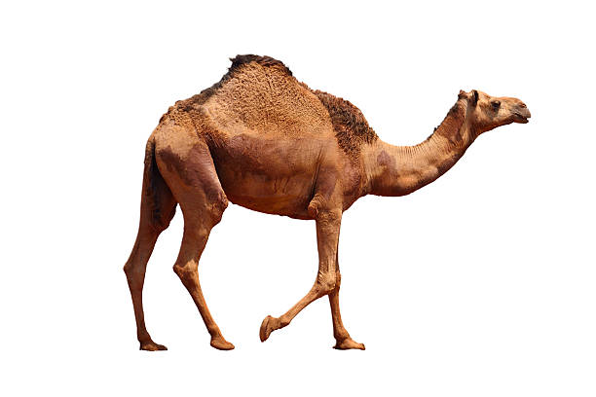
Naming conventions
Is there a difference ?
Gaussmeter | Motor | Powersupply
G3:GM:rdBfield | GR2:Ax1_Mtr.VAL | G3:PS:rdCur

Slide 7
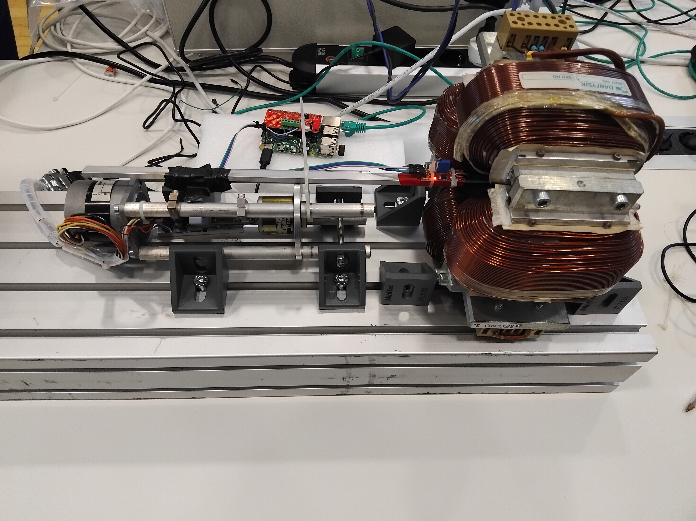
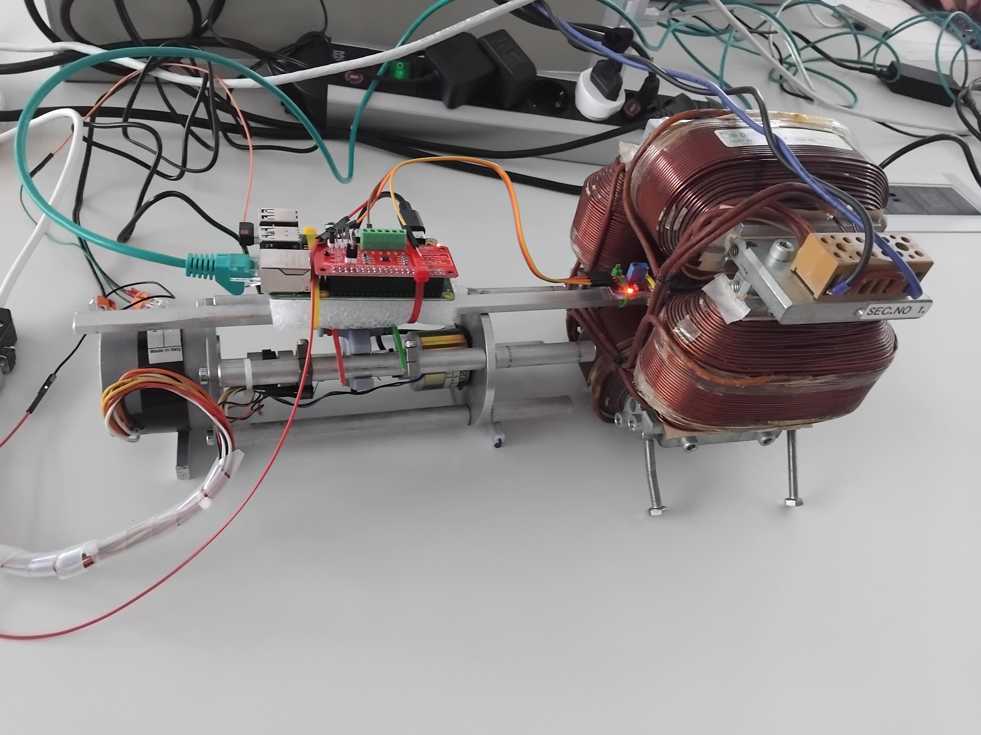
Two technical issues
Interferences with the power supply
Vibrations of the motor

Slide 8
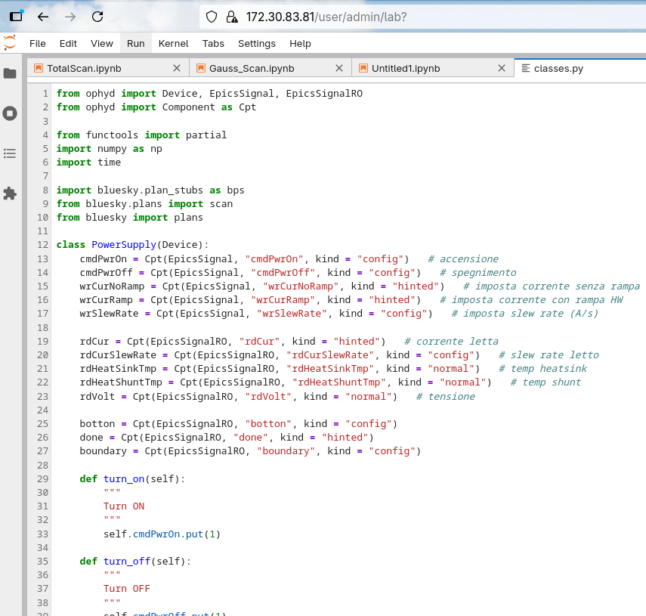
System architecture
Bluesky & Ophyd
Goal/ 2 measurements
B over pos
B over Cur
So need to talk to both and scan with bluesky
Diffucult

Slide 9
System architecture
Bluesky & Ophyd
The two measurements

Slide 10
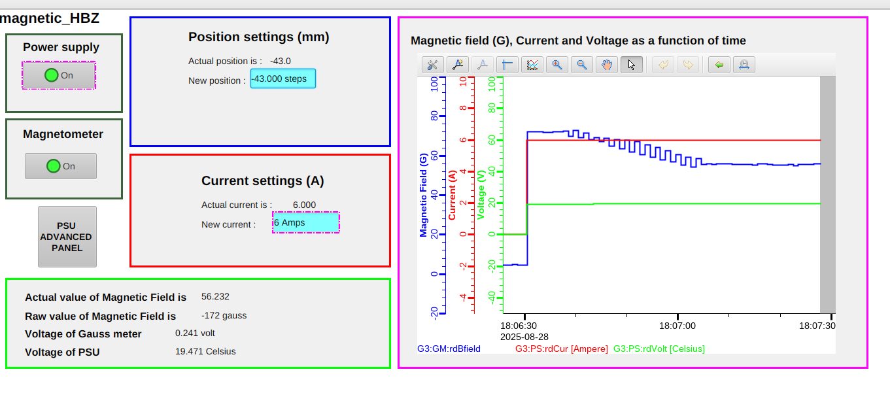
User Interface
gauss
volt

Slide 11
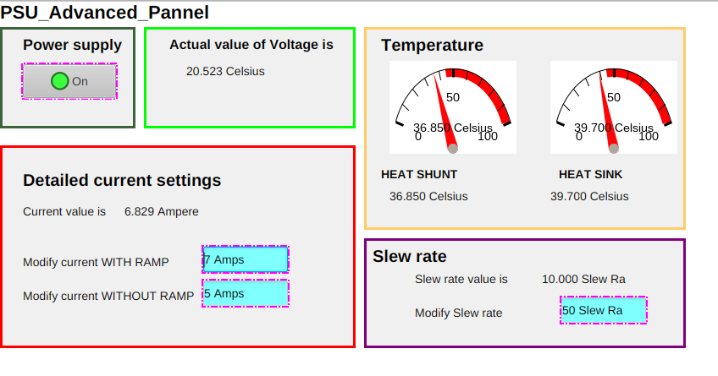
User Interface
volt

Slide 12
User Interface
volt

Slide 13
I <3
EPICS
Thank you for listening !

