Slide 1

Estimating Topic-Based Public Anxiety in Social Media using Fuzzy Tree
Ravi Varshney(191500642)
Sanidhya Varshney (191500714)
Lalit Saini(191500428)
Prabuddha Kumar(191500551)
B.Tech(CSE)
Under the Supervision of:
Dr. Pooja Pathak (Associate Professor)
Dept. of Computer Engineering & Applications

Slide 2
Outline
Abstract
Area of Research
Introduction
Motivation
Issues And Challenges
Objective
Work Break-Down Structure
System Design
Result
References

Slide 3
Abstract
In this present era everyone is using social media in which there are some messages , posts or comments that creates anxiety or depression to users. Although individual anxiety evaluation has been well studied, there is still not much work on evaluating public anxiety of groups, especially in the form of communities on social networks, which can be leveraged to detect mental healthiness of a society.
We cannot simply average individual anxiety scores to evaluate a community’s public anxiety.
Following factors regarding estimating community’s public anxiety :-
(1) impacts from interpersonal relations on each individual group member’s anxiety levels (the Structural component).
(2) topic-based discussions which reflect a community’s anxiety status (the Topical component).

Slide 4
Area of Research
Machine Learning

Slide 5
Introduction
Social network users form different communities by participating in the discussions of different topics.
Emotional State of online communication may have huge impact on society.
Topic-based Social Network analysis task becomes an important social network analysis where community of all users participating in discussion of a certain topic.
Conventional methods are used to evaluate self-rating anxiety scale(SAS) and is used to estimate individual anxiety levels respectively.
According to the Social Influence Theory, social relations provide a basis of an attitude or behavior of one network actor in response to another.

Slide 6
Introduction Cont….
According to the American Psychiatry Association, anxiety disorders, associated with mental and physical tensions, affect nearly 30% of adults at some point in their lives.
“Public Anxiety of a Community” refers to a community’s reaction to stressful situations, reflected by collective attitudes towards the focus of the community , formed by mutual influences among all members.

Slide 7
Motivation
High Anxiety Rate
No Proper Treatment
Predicting the probability of committing suicide
uncovering relationship between online social media fatigue and psychological wellbeing including anxiety

Slide 8
Issues And Challenges
To overcome the Challenges of Public Anxiety in Social Media:-
Estimating the public anxiety using survey is a tedious task to calculate the anxiety score .
A key challenge to our experiment is how to collect enough training examples.
To estimating the accurate value of every topic in fuzzy tree.

Slide 9
Objective
We create a cascading model to dynamically compute the individual anxiety scores using the Structural influence. We design a probabilistic model to measure anxiety score of social network messages using a generalized user, and compose a tree structure to effectively compute the anxiety score.
We make an evaluation framework to project the anxiety level of a TSNC into a score in the [0, 1] range.
If observed and evaluated properly, social support could be provided to communities suffering extreme anxiety, and early-warning systems could be built to assist community moderators to prevent conflicts.
Prevent persons from getting extreme anxiety.

Slide 10
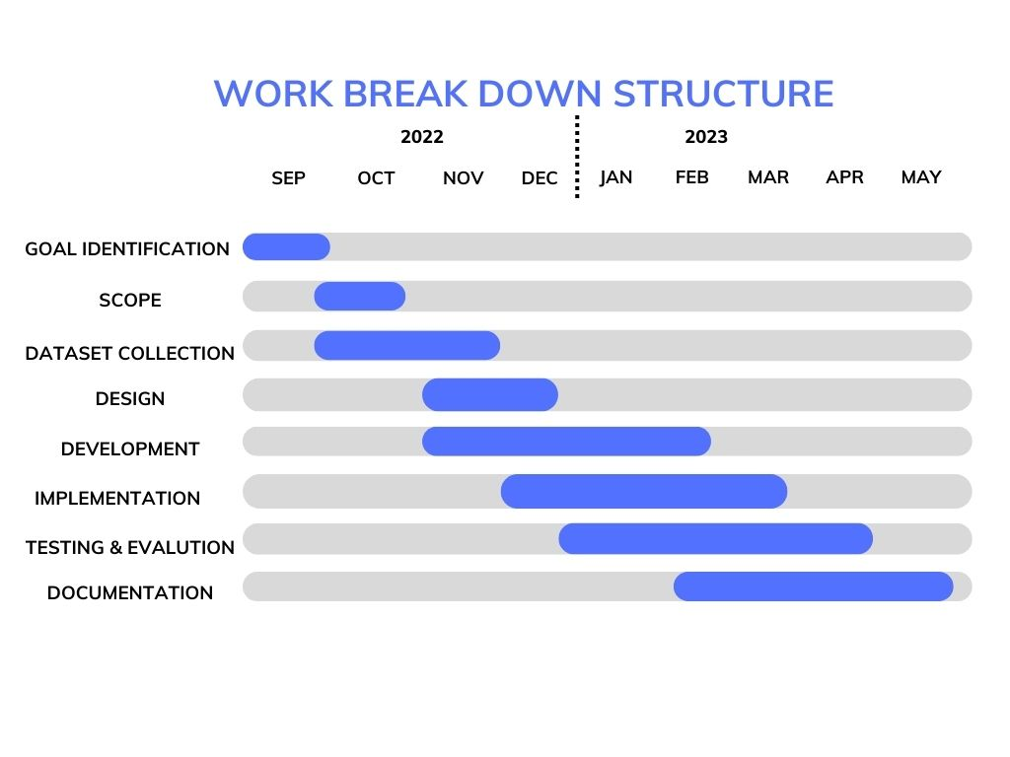
Work Break-Down Structure

Slide 11
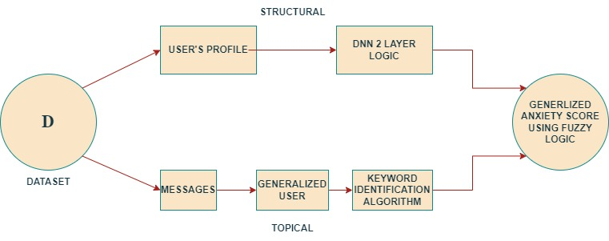
System Design

Slide 12
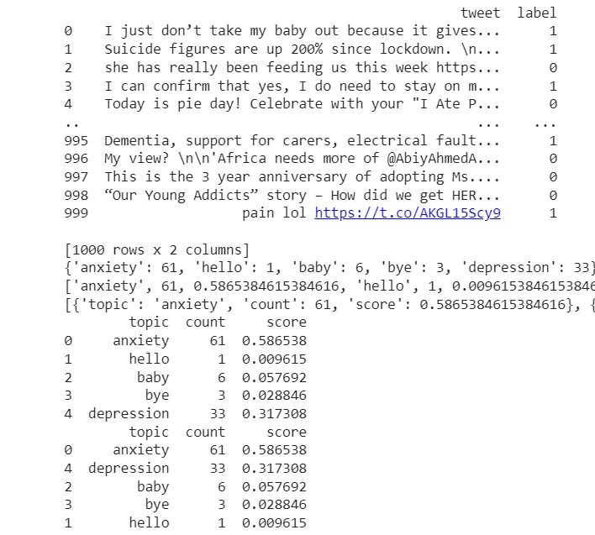
RESULT- DataSet

Slide 13
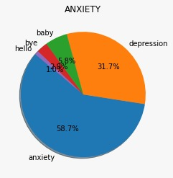
Screenshot – Dataset Outcomes

Slide 14
Outcome
We have tested our model in many test cases and also in topical and structural approach.
From our analysis and testing we calculated the accuracy and precision of our model that is 88% accuracy and 92% precision and Recall is 84% and F1 score is 87%

Slide 15
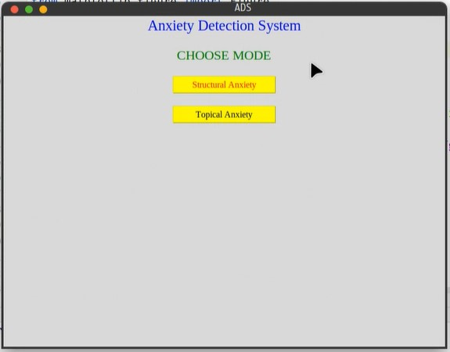
Screenshot – Dataset Outcomes

Slide 16
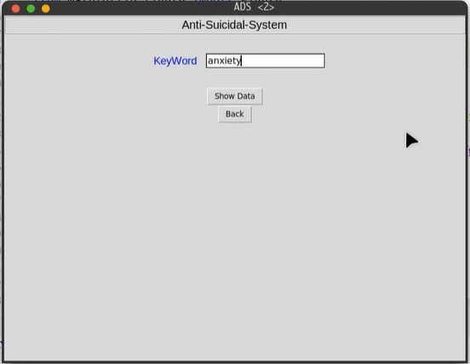
Screenshot – Dataset Outcomes

Slide 17
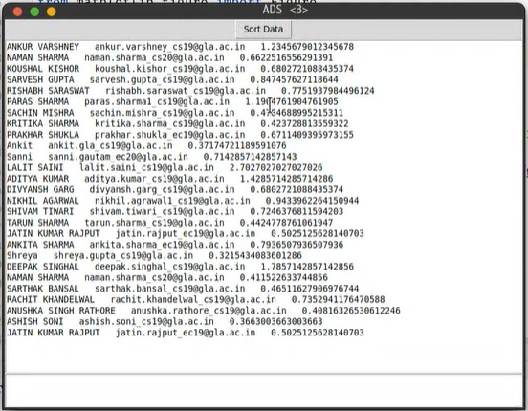
Screenshot – Dataset Outcomes

Slide 18
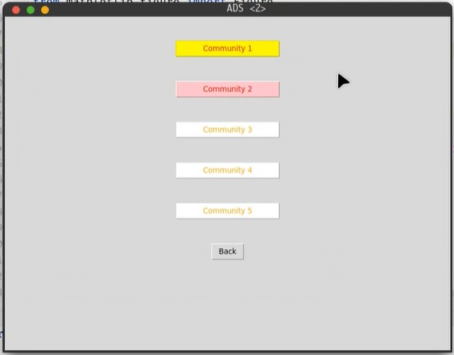
Screenshot – Dataset Outcomes

Slide 19
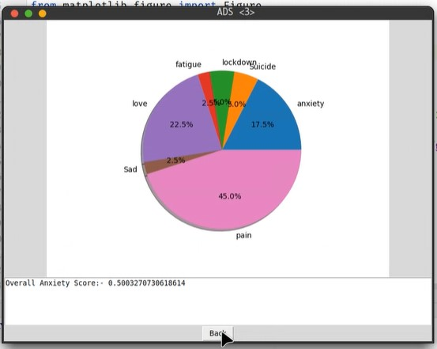
Screenshot – Dataset Outcomes

Slide 20
References
Ta, N., Li, K., Yang, Y., Jiao, F., Tang, Z. and Li, G., 2020. Evaluating public anxiety for topic-based communities in social networks. IEEE Transactions on Knowledge and Data Engineering.
Agarwal, S., Milner, H., Kleiner, A., Talwalkar, A., Jordan, M., Madden, S., ... & Stoica, I. (2014, June). Knowing when you're wrong: building fast and reliable approximate query processing systems. In Proceedings of the 2014 ACM SIGMOD international conference on Management of data (pp. 481-492).
Alkis, Y., Kadirhan, Z., & Sat, M. (2017). Development and validation of social anxiety scale for social media users. Computers in Human Behavior, 72, 296-303.
Walsh, C. G.,Ribeiro, J. D., & Franklin, J. C. (2017). Predicting risk of suicide attempts over time through machine learning. Clinical Psychological Science, 5(3), 457-469.
Park, M., McDonald, D., & Cha, M. (2013). Perception differences between the depressed and non-depressed users in twitter. In Proceedings of the International AAAI Conference on Web and Social Media (Vol. 7, No. 1, pp. 476-485).

Slide 21
Thank You

