Slide 1

STAFF GENIE: Any staff at one snap
Prabuddh Raj Pandey: 12109163
Sristi Maurya : 12113041

Slide 2

INTRODUCTION
"Staff Genie" aims to provide a comprehensive solution for managing all aspects of employee work and performance.
"Staff Genie," highlights how our project aims to help employers and managers to make informed decisions about staffing, track employee performance, manage employee information, and streamline administrative tasks.
It can also emphasize how it will make life easier for managers by fulfilling their HR wishes with minimal effort.
Just like any genie “Staff Genie” brings every detail of your staff at a snap of your finger.

Slide 3
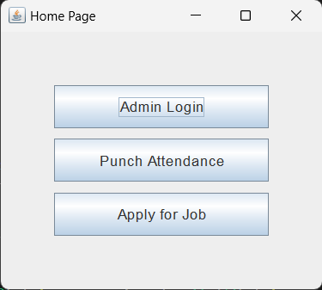
HOME PAGE
The project comprises of 7 frames in which the first frame will have the home page. The home page will be consisting of 3 options as admin page, punch attendance and apply for job.
Home
Admin
Punch Attendance
Apply for Job

Slide 4
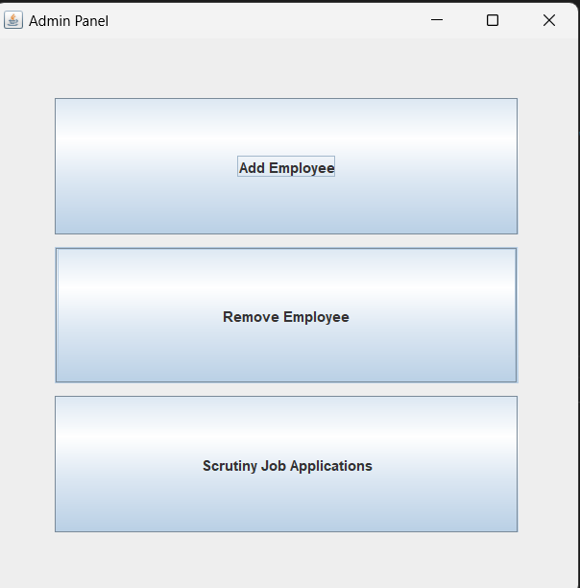
1. ADMIN LOGIN FRAME
While logging in to the admin panel, we will see that the page will be consisting of 3 options - add employee, remove employee and scrutiny for job application.
Admin
Add Employee
Remove Employee
Scrutiny for Job Application

Slide 5
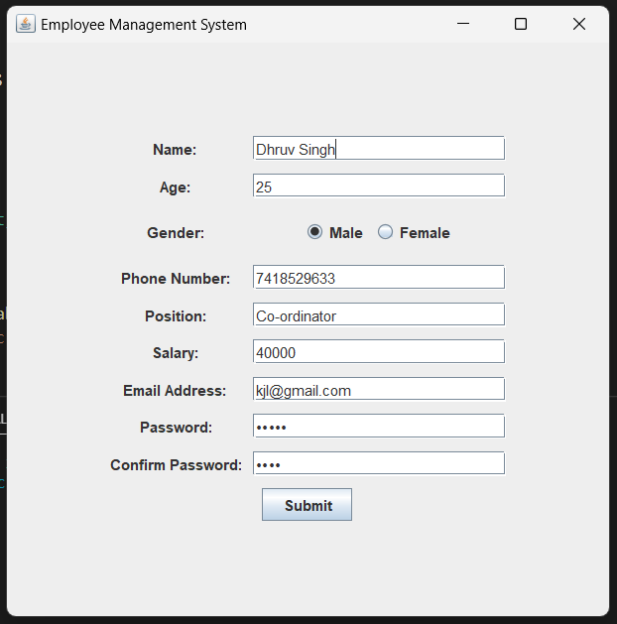
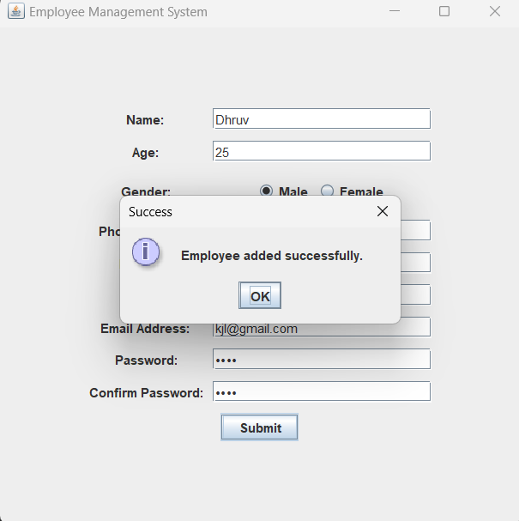
1.1 Add Employee
The admin can add any employee in the company by seeing his/her data which is provided by the employee itself.
For example, we have taken the data of Dhruv Singh to demonstrate this frame. Upon successful submission a dialog box pops up.

Slide 6
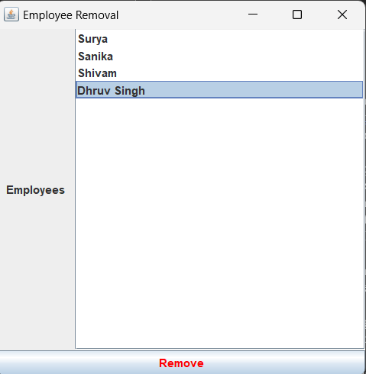
1.2 Remove Employee
This facility of removing the employee by the admin is based on certain criteria which is decided by the admin.

Slide 7
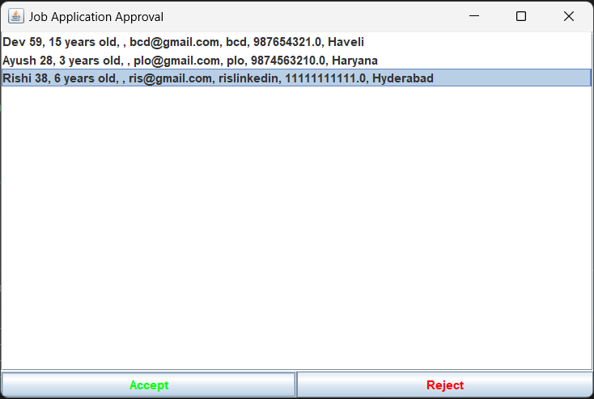
1.3 Scrutiny for Job Application
Scrutiny for the job applications is done by the admin.
This step is related to “Apply for Job” option in the “Home” module where one can fill his/her detail and submit it after completion. Thereafter, in the scrutiny section the admin can either approve or reject the application.
Here we have took the example of Rishi.

Slide 8
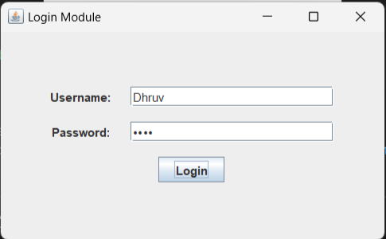
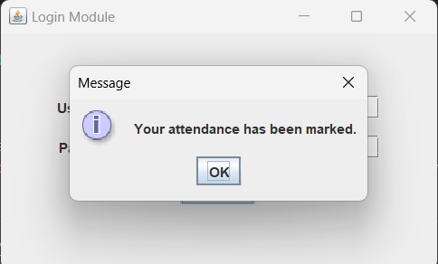
2. PUNCH ATTENDANCE
The next option in the home page is the attendance page. In this page the employee of the company can punch his/her attendance by entering the credentials given to him/her by the admin block.
Dhruv’s example is used to demonstrate this frame.

Slide 9
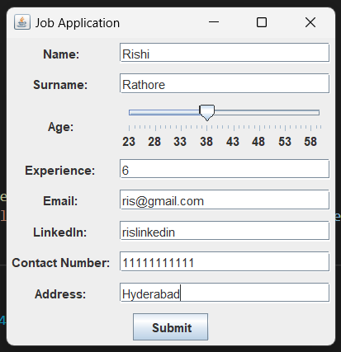
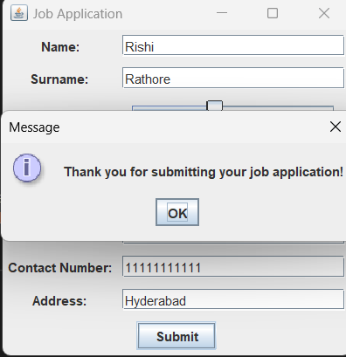
3. APPLY FOR JOB
The user need to enter the credentials that has been demanded by the company.
On entering all the credentials, a popup message will come that your details are submitted successfully.
The details are stored in the database and are forwarded to the admin panel where the admin can access all the job entries.
Here we have taken the example of Rishi Rathore.

Slide 10
SCOPE OF THE PROJECT
An effective employee management system is used to manage the work process and organizational responsibilities of human resources and other departments. It helps managers and employees to work together and accurately monitor, access, manage, and efficiently utilize the working hours for better business growth. Also, it helps in error-free payrolls that can be done on time.
We will be adding more useful modules in future enhancement like
Exit Attendance
Editing Employee details
More defined and organised database
Designing more attractive modules
Leave Application page for employee

Slide 11
CONCLUSION
The project is very efficient when it is divided into modules and sub-modules. As per the requirement in the company, the admin can take action as per his understanding.
The admin panel is very beneficial as the admin can access all the details of the database that which employee is working in his company and whether he have punched the attendance or not or he is doing his job in a good way or not.
The employee can even have his own personal and unique credentials through which he can enter into the database of the company but he cannot access it as the admin has made restrictions on the database of the company.
The project is connected with real time database and it will be shown through the live presentation of the project.

Slide 12
Overall, we can say that the management system is very useful for both the company and the employees of the company. As per the constraints made by the admin, the employee can have access to the data which could be beneficial to them only.
The data would be in a very efficient way as the system is in a organised manner. And whenever the admin want to see any data or want to change any data, he already have the access of the database so he could commit the changes as per the need and requirements of the company. So, we could also say that the command of handling the company is in safe hands.

Slide 13
THANKYOU…

