Slide 1

Intro to SPA framework
Modified from a presentation by
Prabu S

Slide 2
What is Angular JS
Single Page Application Framework for JavaScript
Implements client-­‐side MVC pattern
– Separation of presentation from business logic and presentation state
Support for all major browsers
Supported by Google
Large and fast growing community

Slide 3
Features of AngularJS
Two-way Data Binding
Directives – Extend HTML
MVC Pattern
Dependency Injection
Testing Compatibility
Deep Linking (Map URL to route Definition)

Slide 4
AngularJS – Main Concepts
Templates
Directives
Expressions
Data binding
Scope
Controllers
Modules
Filters
Services
Routing

Slide 5
MVC
MVC pattern
Model (Data)
View (UI)
Notifies
Notifies
Changes
Controller (Logic)

Slide 6
AngularJs Application-Overview
This application is consists of all angular concepts shown on below.
This application interact with user and fetch data as per the user request.
Also as per the MVC pattern data CRUD operation performed and updated.
In this application also i am used UI Components Example Kendo UI.

Slide 7
How to create AngularJs App
View Template
<!DOCTYPE html>
<html>
<head>
1. AngularJs CDN
<script src="https://ajax.googleapis.com/ajax/libs/angularjs/1.6.9/angular.min.js"></script>
Script File
<script src=“myapp.js” type=“”></script>
</head>
<body>
2.ng-app Directive
<div ng-app=“myapp">
3.ng-Controller Directive
<div ng-controller=“myCtrl”>
4. Data binding Expression
Welocome to {{name}}
</div>
</div>
</body>
</html>

Slide 8
Myapp.js
Here Model and Controller written.
Model
var app = angular.module("myApp", []);
Controller
app.controller("myCtrl", function($scope) {
$scope.name = “Prabu";
});
AngularJs App Output
Welcome to Prabu

Slide 9
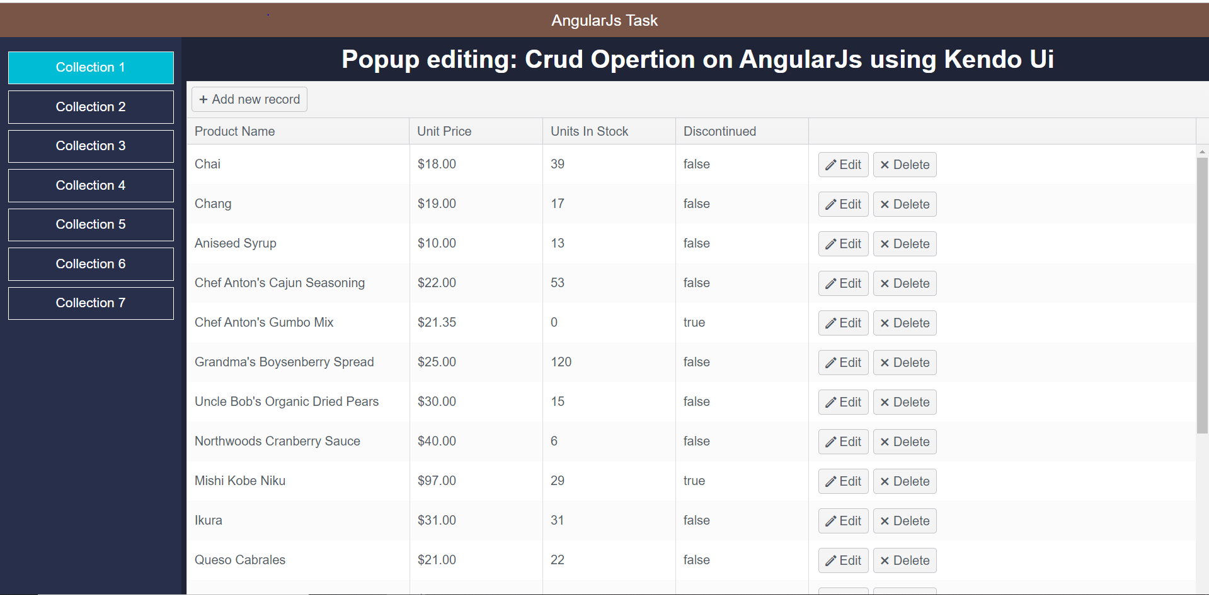
Demo application

Slide 10
Page Layout
The page layout is splitted following ways:
1. Header content
2. Side content
3. Main Content
the main content have all dynamic contents and its change dynamically.

Slide 11
Header Content Creation
The header content data is passed to the controller to view template:
The code of header content data declared by controller in js file.
app.controller('myCtrl', function($scope) {
$scope.header= "AngularJs Task";
});
The Header content output Show on below:

Slide 12
Side Content Creation
Prerequisite
Side content data
Example:
[Collection1, Collection2, Collection3, Collection4, Collection5]
For iterating for array data using angularJs Directive
ng-repeat Directive is one of the angular directive.
Ng-repeat Directive is an used to iterating array.
Also need to apply style for good user interface.

Slide 13
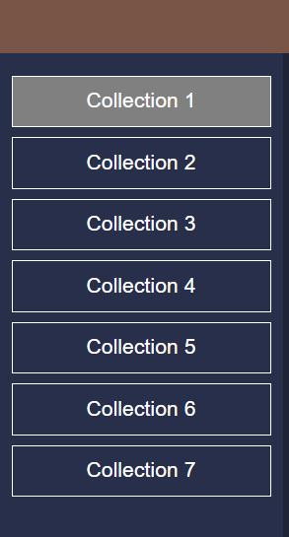
Side Content

Slide 14
Routing Configuration
AngularJs Routing configuration
step:1
first we need to inject ngRoute in app module.
step:2
As per the URL changes we need to load template and data provide to the separate controllers.
step 3
The routing template must be load on Angular provide ng-view Directive. So we need to add angularJs ng-view Directive.

Slide 15
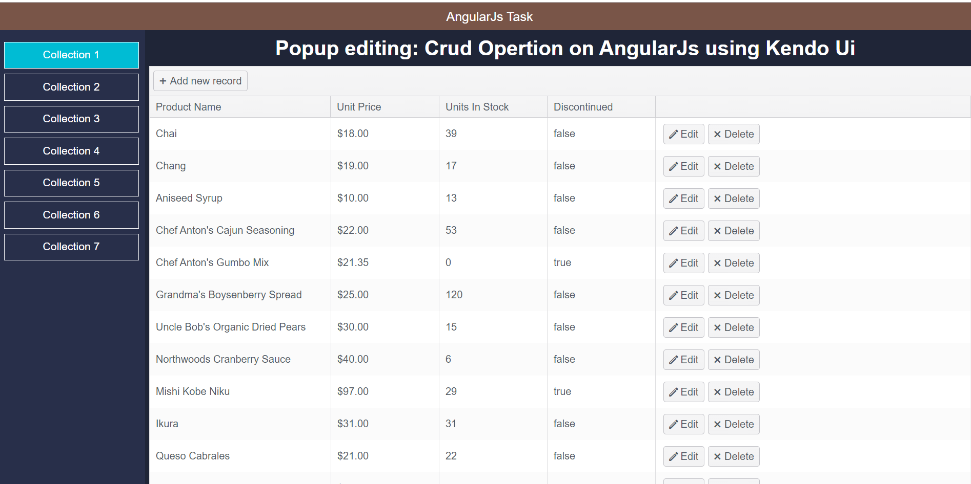
Routing navigation Demo
When you clicking Collection 1 its navigating
to collection1.html and data provided by myCtrl1 controllers.

Slide 16
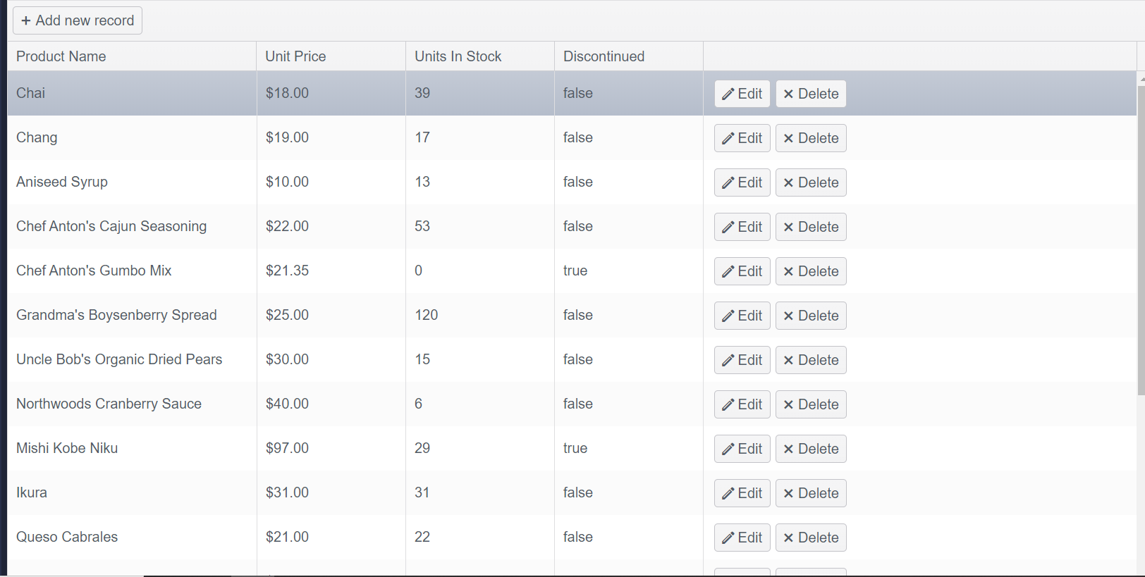
Collection 1 Page creation
Previous slide show you how rendering the page.
Collection 1.html is have kendo Ui and perform CRUD operation.
The kendo UI data is provided by remote data.

Slide 17
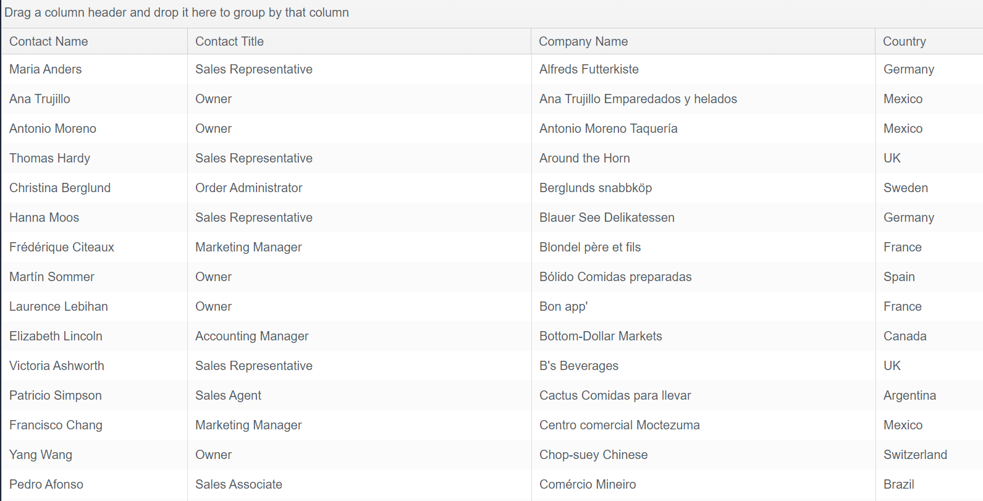
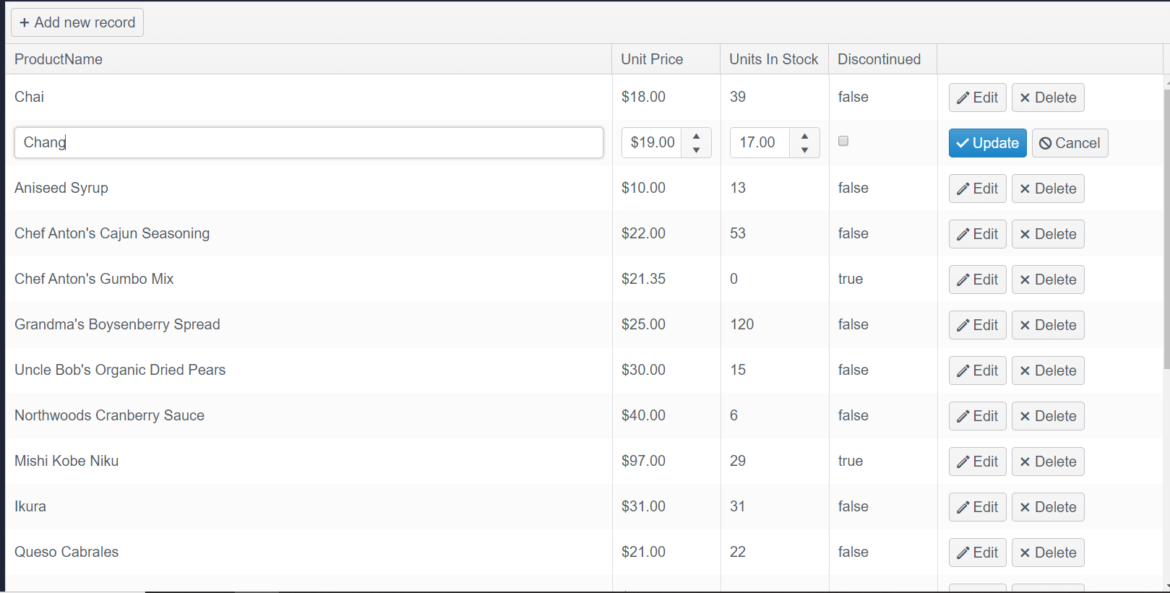
Collection 2 and 3 Page creation
Collection 2.html and collection 3.html is have kendo Ui and perform inline CRUD operation and shown on data table format.
The kendo UI data is provided by remote data.
Collection 2 and Collection 3 output show on below.

Slide 18
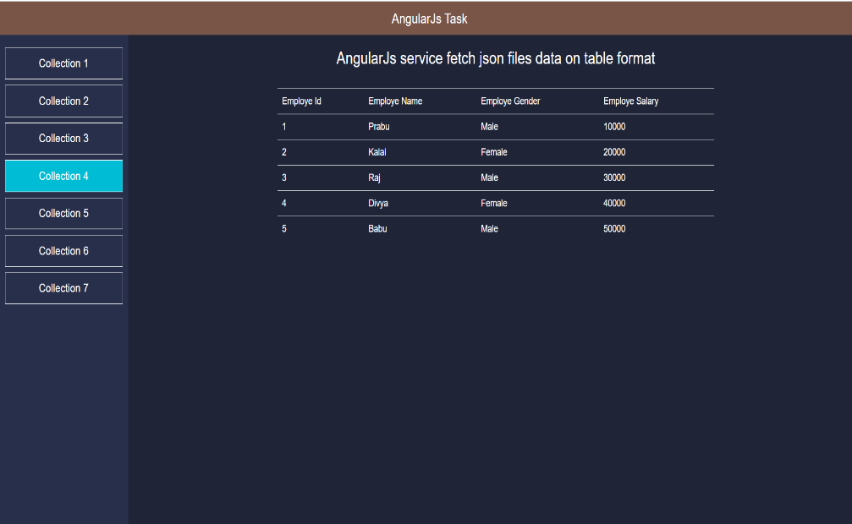
Collection 4 Page creation & Services
This page is contains local data in json format. We retrieve this data
By using angularJs services.
step:1
first we need to inject http in app module.
step:2
As per the user request we need to load json data and iterating the json data.

Slide 19
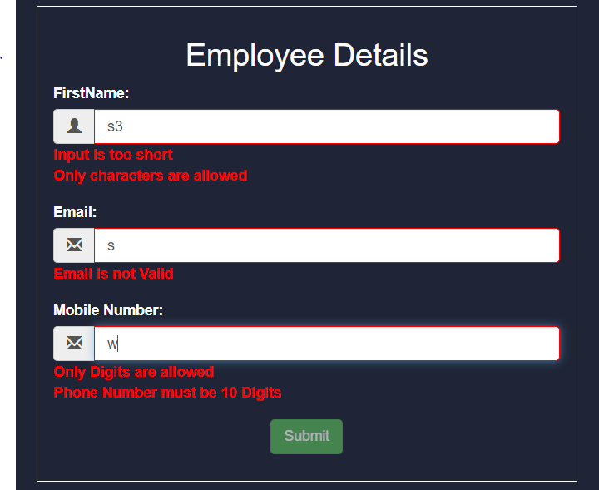
Collection 5 Page creation & Forms
This page contains forms. Forms is used to collect the user valid information. So whenever collect the user information we need to validate client side as well as server side. Here we performing client side validation.
When user enter incorrect data it shows error message and form also not submit until throwing error message.
Shows form validation.

Slide 20
Collection 6 Page creation & Services & CRUD Operation on local data using kendo UI
This page is contains local data in json format. We retrieve this data
By using angularJs services and displaying this data using kendo ui also performing crud operation.
step:1
first we need to inject http in app module.
step:2
As per the user request we need to load json data and iterating the json data.
step:3
As per the user request we need to load json data and iterating the json data and displaying data in kendo UI.
step: 4
CRUD operation performed by behind some logics. Also this kendo UI performing filtering and Sorting, validation.

Slide 21
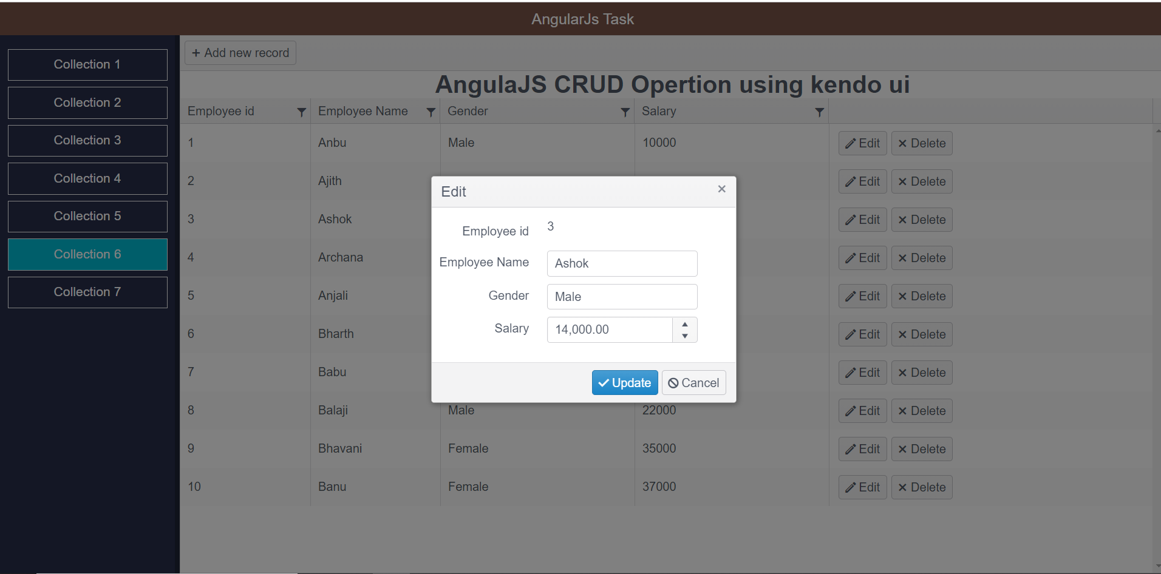
Collection 6 page Output
The Collection 6 page output show on below:

Slide 22
AngularJs Directives
AngularJs Directives is used to extending the Html pages.
Directives adding more extra functionality to html pages.
Some of Directive used on Application:
ng-bind
ng-model
ng-repeat
ng-show
ng-hide
ng-Init

Slide 23
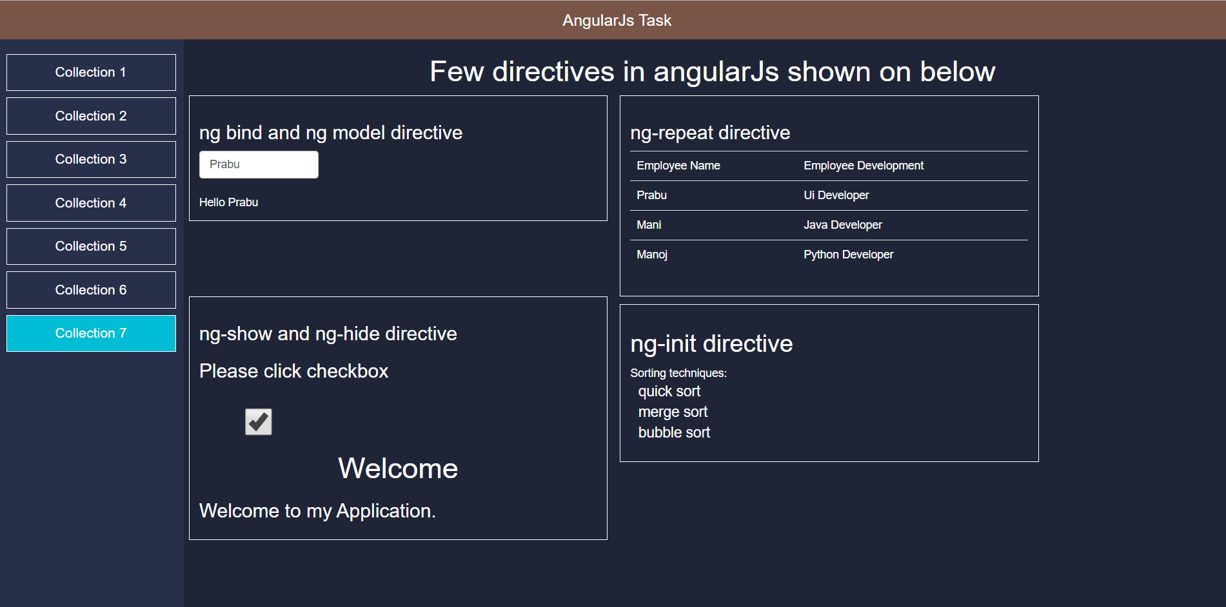
Collection 7 page Directive Output
The Collection 7 page output show on below:

Slide 24
Questions
?

