Slide 1
Lecture # 19

Slide 2
Sorting Algorithms

Slide 3
Selection Sort
The basic idea of Selection Sort is to make a number of passes through the list or part of the list and, on each pass, select one element to be correctly positioned. For example, on each pass through a sub list, the smallest element in the sub list might be found and then moved to its proper location.

Slide 4
As an illustration, suppose that following list has to be sorted into ascending order :
67 33 21 84 49 50 75
We scan the list to locate the smallest element and find it in position 3:
Then we interchange this element with the first element and thus properly position the smallest element at the beginning of the list.
21 33 67 84 49 50 75

Slide 5
We now scan the sub list consisting of the elements from position 2 on to find the smallest element
21 33 67 84 49 50 75
and exchange it with the second element (itself in this case ) and then properly position the next-to-smallest element in position 2
We continue in this fashion, locating the smallest element in the sub list of elements from position 3 and interchanging it with the third element, then properly positioning the smallest element in the sub list of elements from position 4 on, and so on until we eventually do this for the sub list consisting of the last two elements as follows.

Slide 6
21 33 49 84 67 50 75
21 33 49 50 67 84 75
21 33 49 50 67 84 75
21 33 49 50 67 75 84
Positioning the smallest element in this last sub list obviously also positions the last element correctly and thus completes the sort.

Slide 7
Exchange Sort ( Bubble Sort )

Slide 8
Exchange sort systematically interchange pairs of elements that are out of order until eventually no such pairs remain and the list is therefore sorted.
To illustrate bubble sort, consider the following list
67 33 21 84 49 50 75

Slide 9
On the first pass, we compare the first two elements, 67 and 33 and interchange them because they are out of order.
67 33 21 84 49 50 75
33 67 21 84 49 50 75
Now we compare the second and third elements, 67 and 21 and interchange them
33 21 67 84 49 50 75

Slide 10
Next we compare 67 and 84 but do not interchange them because they are already in the correct order.
33 21 67 84 49 50 75
Next 84 and 49 are compared and interchanged.
33 21 67 49 84 50 75
Then 84 and 50 are compared and interchanged.
33 21 67 49 50 84 75
Finally 84 and 75 are compared and interchanged.
33 21 67 49 50 75 84
So the first pass through the list is now complete.

Slide 11
We are guaranteed that on this pass, the largest element in the list will go down to the end of the list, since it will obviously be moved past all smaller elements.
But notice that some of smaller items have “Bubbled Up” toward their proper positions nearer the front of the list.
So we scan the list again but this time we ignore the last item because it is already in its proper location.
33 21 67 49 50 75 84
So in each pass the last element will be placed in its proper location in the sub list.

Slide 12
The worst case of bubble sort occurs when the list elements are in reverse order because in this case only one item ( the largest ) item is placed correctly on each pass through the list.
On the first pass through the list n-1 comparisons and interchanges are made and only the largest element is correctly positioned.
On the next pass, sub list consisting of the first n-1 elements are scanned; there are n-2 comparisons and interchanges; and the next largest element sink to position n-1.

Slide 13
Finally, process continues until the sub list consisting of the first two elements is scanned and on this pass there is one comparison & interchange.
Thus a total of
(n-1) + (n-2) + (n-3) +…….. + 1 = n(n-1)/2
= n²/2 – n/2
Comparisons and interchanges are required.

Slide 14
Merge Sort
The Merge sort algorithm closely follows the divide and conquer paradigm. It works as follows.
Divide : Divide the n - element sequence to be sorted into sub sequences each of size n / 2 elements.
Conquer : Sort the two sub sequences recursively using merge sort.
Combine : Merge the two sorted sub sequences to produce another sorted list.

Slide 15
The key operation of the merge sort algorithm is the merging of two sub sequences in the “combine” step.
To perform merging, we use Merge(A, left, mid, right); function, where A is an array of elements and left, right and mid representing leftmost, rightmost and center indices of an array respectively.
The above function assumes that the sub array A[left…..mid] and A[mid+1 …… right] are in sorted order where n = right - left + 1

Slide 16

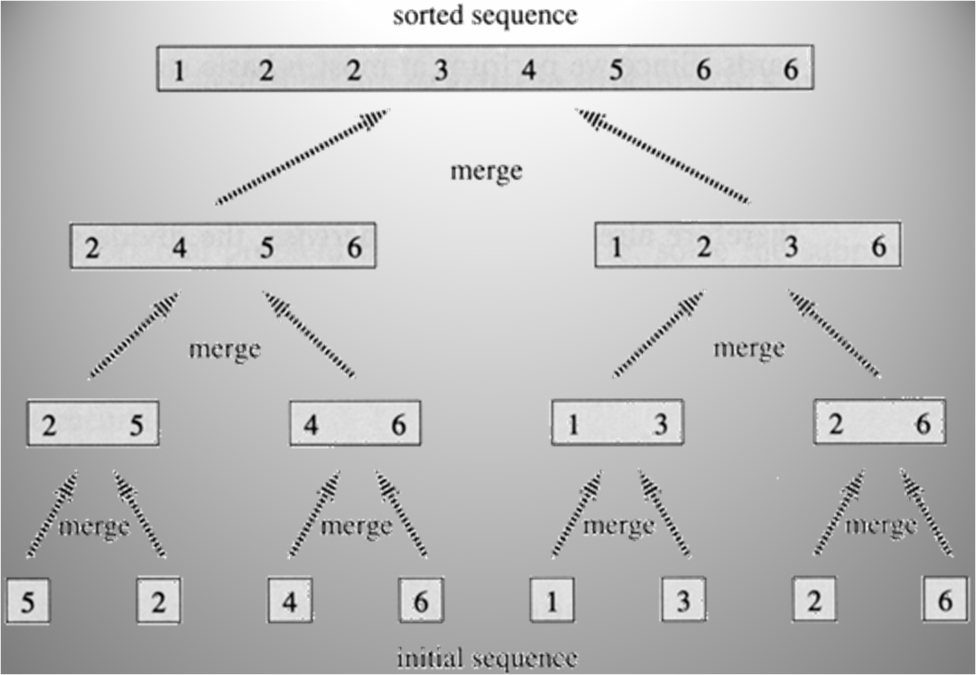

Slide 17
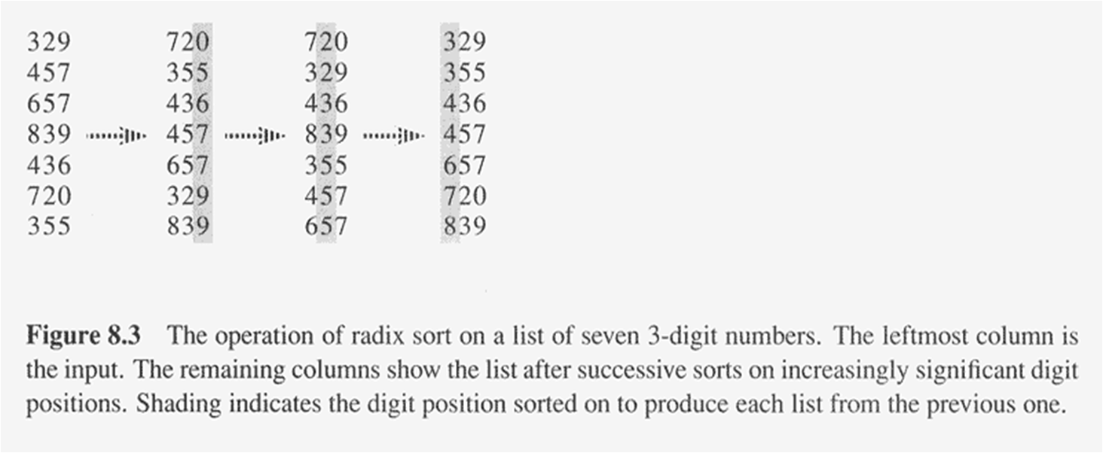
Radix Sort
Key idea: Sort least significant digits first.

Slide 18
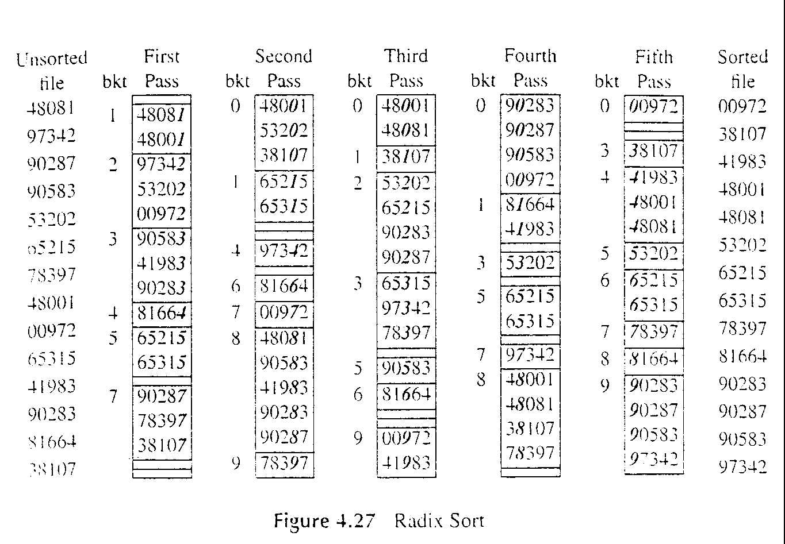
Radix Sort e.g Start from least significant digit

Slide 19
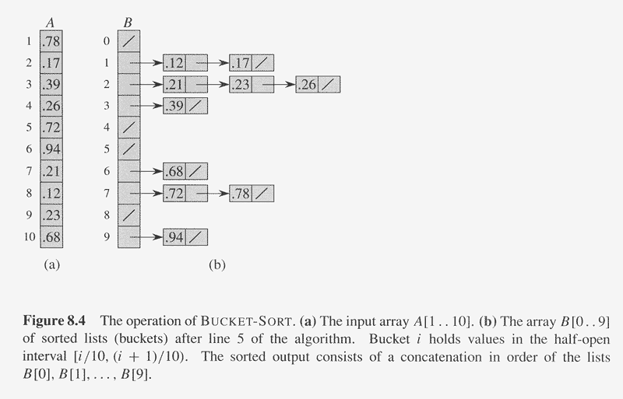
Bucket Sort

Slide 20
Types of Search

Slide 21
Linear / Sequential Search
Most fundamental search algorithm
Input to linear search is a sequence (array) plus a target key we intend to search
UNORDERED array – elements of the array are not in any order that would aid the search (random)

Slide 22
Simple sequential search where we would check each element of the array and compare it with our key
If a match is found then our search is successful
If none of the items match the key value, then the key item is not present in the array.
If the array has n items, then in the worst case, all items in the sequence will have to be checked against the key value for equality

Slide 23
Binary Search
Search algorithm applied to ordered lists
Uses the divide and conquer approach
At each step, compare the key with the middle element of the array
split the array into two halves – upper half and lower half.
If key equals middle element algorithm is done

Slide 24
If key < middle element – discard upper half of array
If key > middle element – discard lower half of array
Repeat this process
If the entire array has been discarded using this method, then the element is not found.

Slide 25
Thank You……

