Slide 1

Logistic Regression
What is Logistic Regression?
Logistic Regression is another statistical analysis method borrowed by Machine Learning. It is used when our dependent variable is dichotomous or binary. It just means a variable that has only 2 outputs, for example,
A person will survive this accident or not, The student will pass this exam or not. The outcome can either be yes or no (2 outputs).
Why do we use Logistic Regression rather than Linear Regression?
Problem with linear regression is that the predicted values may be out of range. We know that probability can be between 0 and 1, but if we use linear regression this probability may exceed 1 or go below 0.
It is used when our dependent variable is binary and in linear regression this dependent variable is continuous.
Logistic Function
You must be wondering how logistic regression squeezes the output of linear regression between 0 and 1.
Let’s start by mentioning the formula of logistic function:
https://www.analyticsvidhya.com/blog/2021/08/conceptual-understanding-of-logistic-regression-for-data-science-beginners/#h2_5

Slide 2

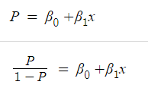

We all know the equation of the best fit line in linear regression is:
Let’s say instead of y we are taking probabilities (P). But there is an issue here, the value of (P) will exceed 1 or go below 0 and we know that range of Probability is (0-1). To overcome this issue, we take “odds” of P:
We know that odds can always be positive which means the range will always be (0,+∞ ). Odds are nothing but the ratio of the probability of success and probability of failure.
The problem here is that the range is restricted, and we don’t want a restricted range. By restricting the range, we are decreasing the number of data points and of course, if we decrease our data points. It is difficult to model a variable that has a restricted range. To control this, we take the log of odds which has a range from (-∞,+∞).
https://www.analyticsvidhya.com/blog/2021/08/conceptual-understanding-of-logistic-regression-for-data-science-beginners/#h2_5

Slide 3
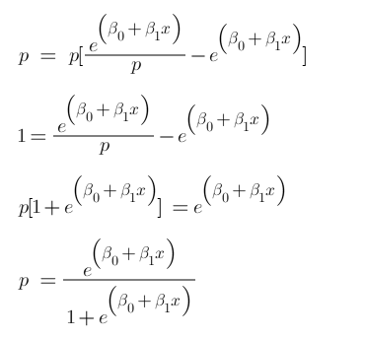
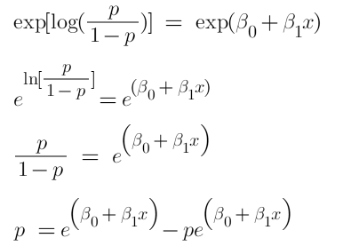
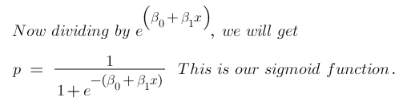
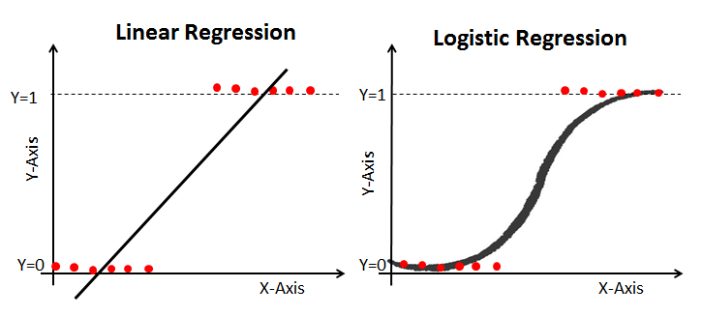
Now we just want a function of P because we want to predict probability, right? not log of odds. To do so we will multiply by exponent on both sides and then solve for P.
Now we have our logistic function, also called a sigmoid function. The graph of a sigmoid function is as shown below. It squeezes a straight line into an S-curve.
https://www.analyticsvidhya.com/blog/2021/08/conceptual-understanding-of-logistic-regression-for-data-science-beginners/#h2_5

Slide 4

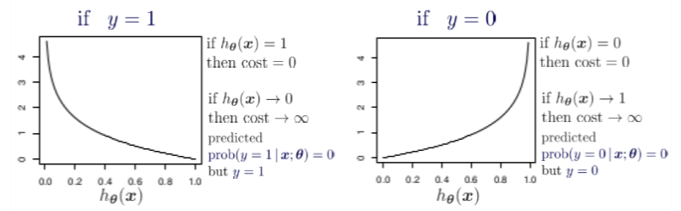
Cost Function of Logistic Regression
This cost function is also called log loss. It also ensures that as the probability of the correct answer is maximized, the probability of the incorrect answer is minimized. Lower the value of this cost function higher will be the accuracy.
https://www.analyticsvidhya.com/blog/2021/08/conceptual-understanding-of-logistic-regression-for-data-science-beginners/#h2_5

Slide 5
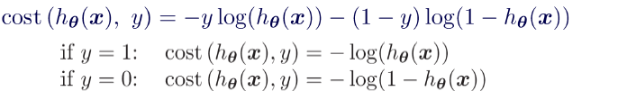
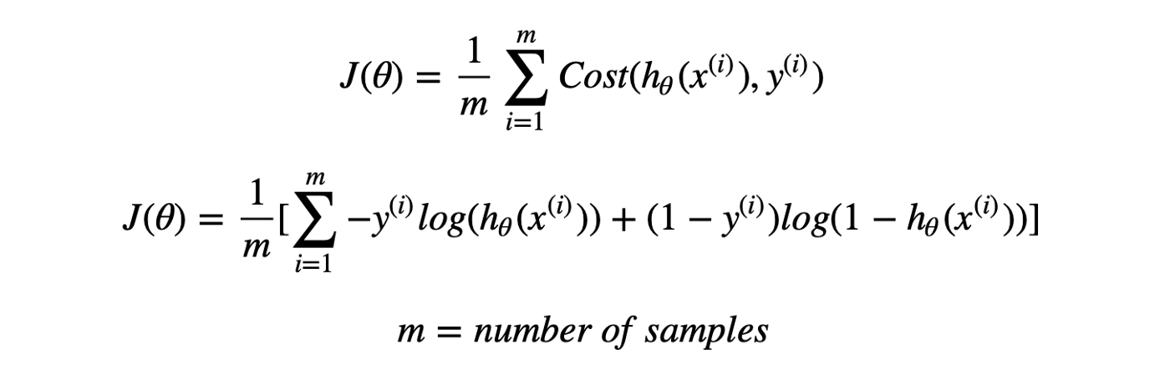
Combining both the equation we get a convex log loss function as shown below-
https://medium.com/analytics-vidhya/derivative-of-log-loss-function-for-logistic-regression-9b832f025c2d
The cost function of the model is the summation from all training data samples:
https://www.analyticsvidhya.com/blog/2021/08/conceptual-understanding-of-logistic-regression-for-data-science-beginners/#h2_5

Slide 6
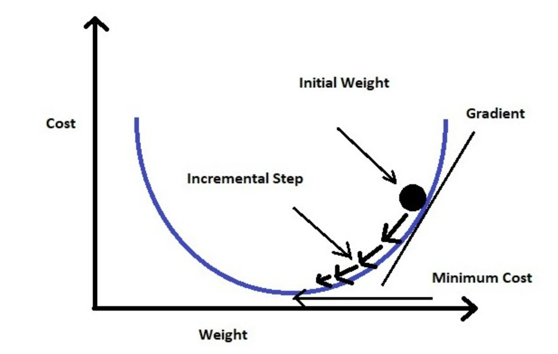
Gradient Descent Optimization
In this section, we will try to understand how we can utilize Gradient Descent to compute the minimum cost.
Gradient descent changes the value of our weights in such a way that it always converges to minimum point, or we can also say that it aims at finding the optimal weights which minimize the loss function of our model. It is an iterative method that finds the minimum of a function by figuring out the slope at a random point and then moving in the opposite direction.
https://www.analyticsvidhya.com/blog/2021/08/conceptual-understanding-of-logistic-regression-for-data-science-beginners/#h2_5

Slide 7
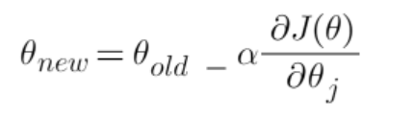
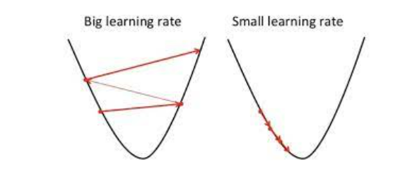
The intuition is that if you are hiking in a canyon and trying to descend most quickly down to the river at the bottom, you might look around yourself 360 degrees, find the direction where the ground is sloping the steepest, and walk downhill in that direction.
At first gradient descent takes a random value of our parameters from our function. Now we need an algorithm that will tell us whether at the next iteration we should move left or right to reach the minimum point. The gradient descent algorithm finds the slope of the loss function at that particular point and then in the next iteration, it moves in the opposite direction to reach the minima. Since we have a convex graph now we don’t need to worry about local minima. A convex curve will always have only 1 minima.
We can summarize the gradient descent algorithm as:
Here alpha is known as the learning rate. It determines the step size at each iteration while moving towards the minimum point. Usually, a lower value of “alpha” is preferred, because if the learning rate is a big number then we may miss the minimum point and keep on oscillating in the convex curve
https://www.analyticsvidhya.com/blog/2021/08/conceptual-understanding-of-logistic-regression-for-data-science-beginners/#h2_5

Slide 8
https://www.datacamp.com/tutorial/understanding-logistic-regression-python
Dropbox - Section-03-Metrics - Simplify your life
https://towardsdatascience.com/logistic-regression-in-real-life-building-a-daily-productivity-classification-model-a0fc2c70584e#:~:text=Logistic%20regression%20is%20used%20across,patient%20developing%20a%20particular%20disease.

