Slide 1

Compiler Design Lab
Dr. Soumen Das

Slide 2
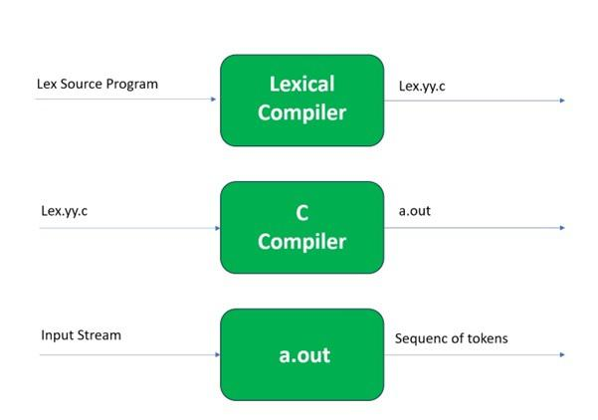

Slide 3
Download the following Software:
Download Flex 2.5.4a: http://gnuwin32.sourceforge.net/packages/flex.htm
Download Bison 2.4.1: http://gnuwin32.sourceforge.net/packages/bison.htm
Download DevC++: https://www.bloodshed.net/

Slide 4
Installing the Software and setting up the environment variable (path):
Install Flex at “C:\GnuWin32”
Install Bison at “C:\GnuWin32”
Install DevC++ at “C:\Dev-Cpp”

Slide 5
Set Environment variable
Next, click on Environment Variable and set the path variable.
Add “C:\GnuWin32\bin; C:\Dev-Cpp\TDM-GCC-64\bin” to path.

Slide 6
Compiling and Running LEX Programs
Use the following commands to compile and run the LEX program in the Windows environment.
flex hello.l
gcc lex.yy.c y.tab.c
a.exe
Note: hello.l is the LEX program

