Slide 1
nebula @ BITS team bob

Slide 2
agenda
Project Overview
The Packet
Structure
Assembly & Disassembly
Router Microarchitecture
Router Overview
Pipeline Stages
VC Allocation FSM
Routing Algorithms
Credit Based Flow Control & Arbitration
Credit-Based Flow Control
Arbitration Mechanism
Q & A

Slide 3
Project Overview

Slide 4
High level explanation
Output: A scalable NOC design for multi-GPU system
Topology: 2D mesh, 2x2 to 8x8 grid (up to 64 GPUs)
Protocols: ARM AMBA AXI4 (non-coherent), CHI (coherent)
Languages Used: SystemVerilog (RTL), Python (Analysis)
Key Features:
Five-Stage Router Pipeline
Adaptive and Deterministic Routing
Credit Based Flow and Arbitration

Slide 5
The Packet

Slide 6
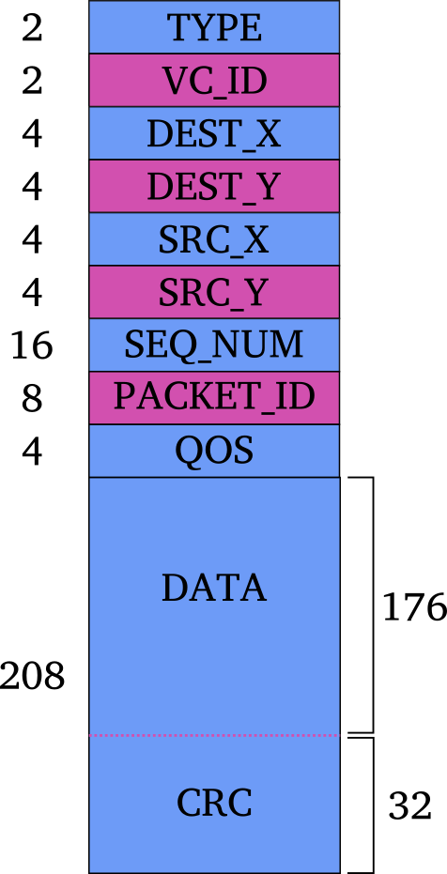
Packet Structure
Packets are decomposed into FLITs
48-bit Header
208-bit body
May be single- or multi-flit based on size
Routers are configured to handle QoS for prioritization

Slide 7
Assembly and disassembly
Converts coordinates and metadata into predefined packets.
Payload segmentation splits large payloads across multiple flits to optimize transmission.
Ensures proper packet conversion for both AXI4 and CHI protocols.

Slide 8
Router microarchitecture

Slide 9
Router overview
Five-stage pipeline to process packets:
Buffer Write
Route Computation
Virtual Channel Allocation
Switch Allocation
Switch Traversal
5 ports per router, 4 VCs per port
Four-stage FSM for VC control

Slide 10
Router pipeline
Buffer Write
Route Computation
Virtual Channel Allocation
Switch Allocation
Switch Traversal

Slide 11
Virtual Channel FSM
Idle
Routing
Waiting VC
Active
Notes:
Each virtual channel maintains independent state, enabling concurrent packet processing across flows.
Transitions are driven by pipeline events: head/single flit arrival, route computation results, VC allocation success, and tail/single flit detection.
Coordination relies on switch arbitration signals for FIFO timing

Slide 12
Navigating Q&A sessions
Maintaining composure during the Q&A session is essential for projecting confidence and authority. Consider the following tips for staying composed:
Stay calm
Actively listen
Pause and reflect
Maintain eye contact
Know your material in advance
Anticipate common questions
Rehearse your responses

Slide 13

Speaking impact
Your ability to communicate effectively will leave a lasting impact on your audience
Effectively communicating involves not only delivering a message but also resonating with the experiences, values, and emotions of those listening

Slide 14
Dynamic delivery
Learn to infuse energy into your delivery to leave a lasting impression
One of the goals of effective communication is to motivate your audience
Metric | Measurement | Target | Actual
Audience attendance | # of attendees | 150 | 120
Engagement duration | Minutes | 60 | 75
Q&A interaction | # of questions | 10 | 15
Positive feedback | Percentage (%) | 90 | 95
Rate of information retention | Percentage (%) | 80 | 85

Slide 15
Final tips & takeaways
Consistent rehearsal
Strengthen your familiarity
Refine delivery style
Pacing, tone, and emphasis
Timing and transitions
Aim for seamless, professional delivery
Practice audience
Enlist colleagues to listen & provide feedback
Seek feedback
Reflect on performance
Explore new techniques
Set personal goals
Iterate and adapt

Slide 16
Speaking engagement metrics
Impact factor | Measurement | Target | Achieved
Audience interaction | Percentage (%) | 85 | 88
Knowledge retention | Percentage (%) | 75 | 80
Post-presentation surveys | Average rating | 4.2 | 4.5
Referral rate | Percentage (%) | 10 | 12
Collaboration opportunities | # of opportunities | 8 | 10

Slide 17
Thank you
Brita Tamm
502-555-0152
brita@firstupconsultants.com
www.firstupconsultants.com

