Slide 1


Social
Buzz

Slide 2


Today's agenda
Project recap
Problem
The Analytics team
Process
Insights
Summary

Slide 3

Social Buzz is a fast growing technology unicorn that need to adapt quickly to its global scale. Accenture has began a 3 month POC focusing on these tasks:
An audit of Social Buzz’s big data practice.
Recommendations for a successful IPO.
Analysis to find Social Buzz’s top 5 most
popular categories of content.
Project Recap

Slide 4


Problem
Over 100000 posts per day
36,500,000 pieces of content per year
But how to capitalize on it when there is so much?
Analysis to find Social Buzz's top 5 most popular categories of content

Slide 5



Andrew Fleming
Chief Technical Architect
The Analytics team
Marcus Rompton
Senior Principle
Jakes Sparrow
Data Analyst

Slide 6
Data Understanding
Process
1
Data Cleaning
2
Data Modelling
3
Data Analysis
4
Uncover Insights
5

Slide 7
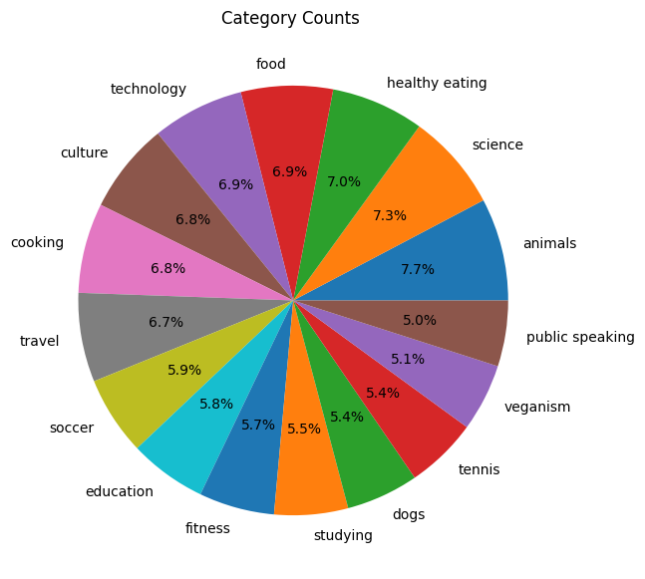
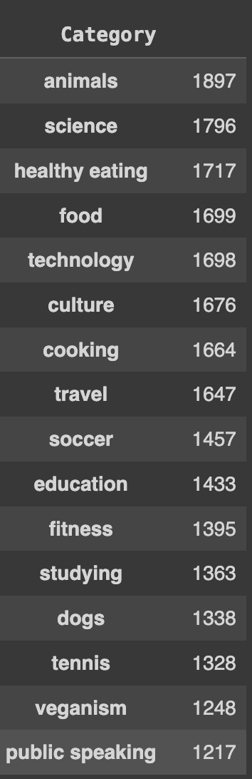
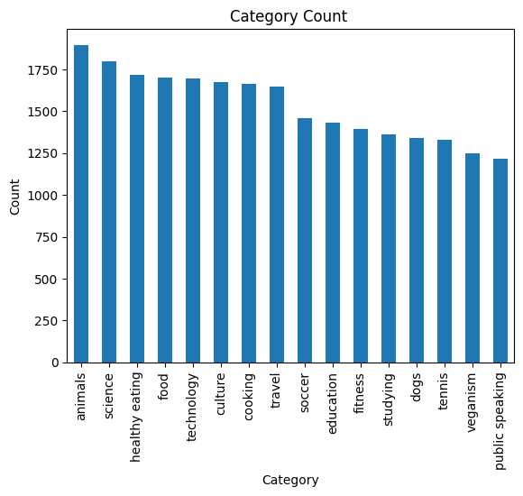
Insights about Category of content:

Slide 8
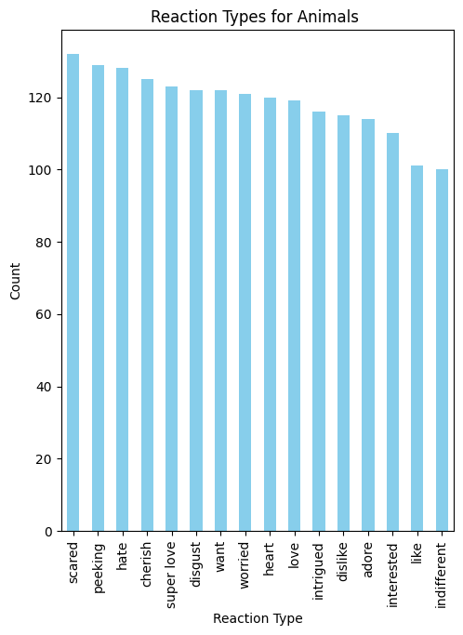
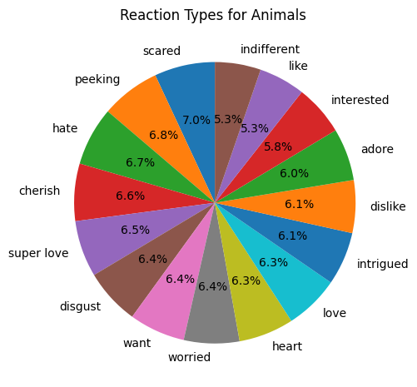
Insights about Most Popular Category:
Most Popular Category : Animal

Slide 9
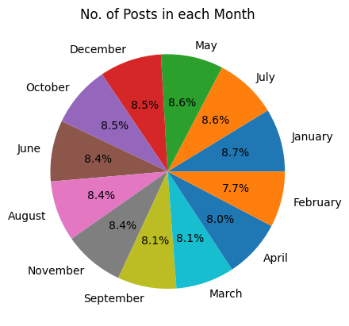
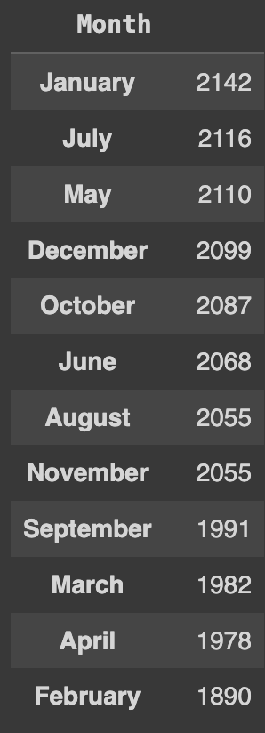
Insights about Months with Post:
Month with most Posts: January

Slide 10
Summary
Based on the data, the top 5 content categories—Animals, Science, Healthy Eating, Food, and Technology—highlight key user interests.
High interest in Healthy Eating and Food indicates users are concerned about health and exploring new food options.
Strong engagement with Technology and Science reflects users' interest in global tech trends and scientific innovations.
Animal Interest: Notable attention towards Animals suggests users enjoy content related to wildlife and nature.
1
For the most popular category, Animals, the reactions suggest two distinct user groups:
Some users express fear or dislike towards animals.
Others show a strong affection and interest in animal-related content.
These contrasting reactions indicate diverse user perspectives, ranging from admiration to apprehension.
2
From the analysis of monthly post counts, January, July, May and December emerge as the peak months.
The highest number of posts occurs in January, July, and December, aligning with holiday seasons.
Users show heightened interest in the social buzz application during these months due to increased free time
The trend suggests a significant portion of users are youngsters, particularly school and college students.
3

Slide 11

Thank you!
ANY QUESTIONS?

