Slide 1
MHD Flow Around a Heated Stationary Cylinder at Moderate to High Reynolds Numbers
Paper ID-251
Author and Presenter: Pracheta Ganguly ¹
Co Authors: Sourabh Khambra^{2,3}, Arundhati Sahoo ¹, Sharanya Bhaumik ¹, Dipankar Chatterjee^{2,3}, Ranjit Ray^{2,3}
Author affiliations: ¹Department of Mechanical Engineering, IIT(ISM) Dhanbad, Dhanbad-826004, Jharkhand, India
²Academy of Scientific and Innovative Research, Ghaziabad-201002, India
³CSIR - Central Mechanical Engineering Research Institute, Durgapur-713209, India.

Slide 2
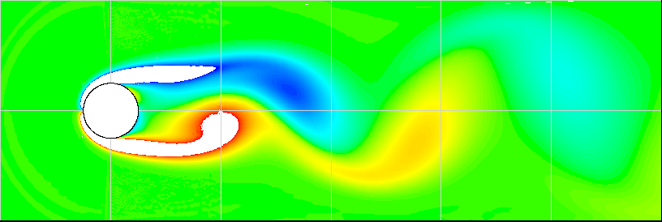
Motivation
How flow around bluff bodies impacts drag, heat transfer & structural integrity
Magnetic fields can suppress instabilities & control flow separation
Relevant in metallurgy, cooling systems & nuclear reactors , aerospace
Key Question: How does a magnetic field reshape flow patterns?
Source:FLUID MECHANICS: Fundamentals and Applications by Yunus A. Cengel and John M. Cimbala

Slide 3
Background & References
Kang (2003): Flow over two circular cylinders placed side-by-side at low Reynolds numbers and how spacing between cylinders influences vortex shedding, wake interaction, and stability.
Yoon et al. (2010): Laminar forced convection heat transfer around two rotating side-by-side cylinders and the role of cylinder rotation on heat transfer and flow stability.
Chatterjee et al. (2012): Control of flow separation around bluff obstacles using a transverse magnetic field.
Geberth et al. (1990): Theoretical analysis of MHD flow around a cylinder under crossed electric and magnetic fields.
→ Inspired this numerical investigation

Slide 4
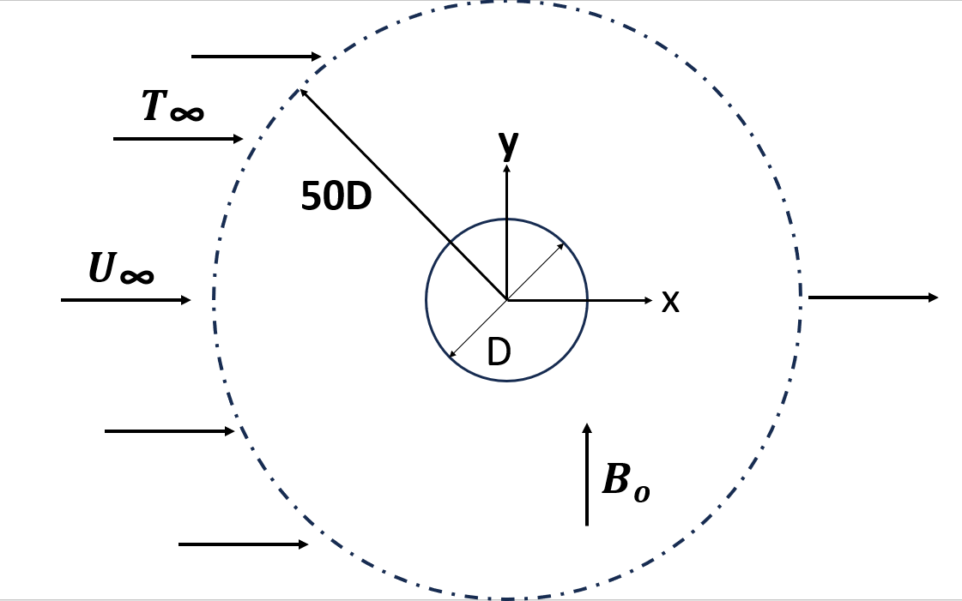
Problem Statement & Objective
2D MHD flow & heat transfer around a stationary cylinder
Re = 1,000, 10,000, 100,000; Ha = 0–200 (extended to 500 for Re 100,000)
Analyse Nu, Cp, Cd, Cl, vortex shedding & wake dynamics
Assess influence of transverse magnetic fields
Computational Domain

Slide 5

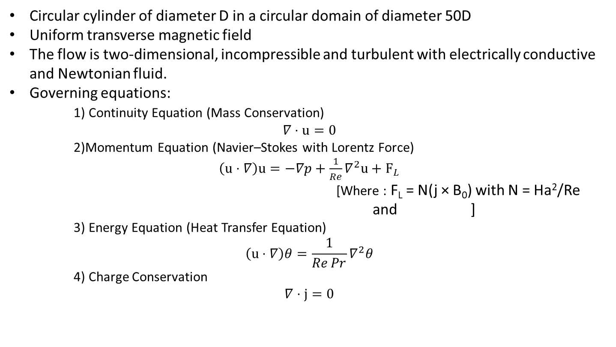
Physical Model & Governing Equations
Circular cylinder of diameter D in a circular domain of diameter 50D
Uniform transverse magnetic field
The flow is two-dimensional, incompressible and turbulent with electrically conductive and Newtonian fluid.
Governing equations:
1) Continuity Equation (Mass Conservation)
$$∇⋅u=0$$
2)Momentum Equation (Navier–Stokes with Lorentz Force)
$\left(u⋅∇\right)u=−∇p+\frac{1}{Re}∇^{2}u+F_{L}$
[Where : F_{L} = N(j × B₀) with N = Ha²/Re
and ]
3) Energy Equation (Heat Transfer Equation)
$$\left(u⋅∇\right)θ=\frac{1}{Re Pr}∇^{2}θ$$
4) Charge Conservation
$$∇⋅j=0$$

Slide 6
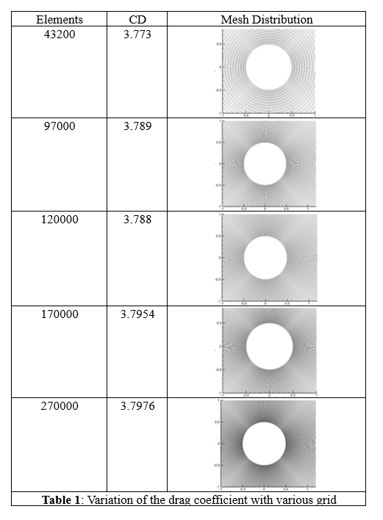
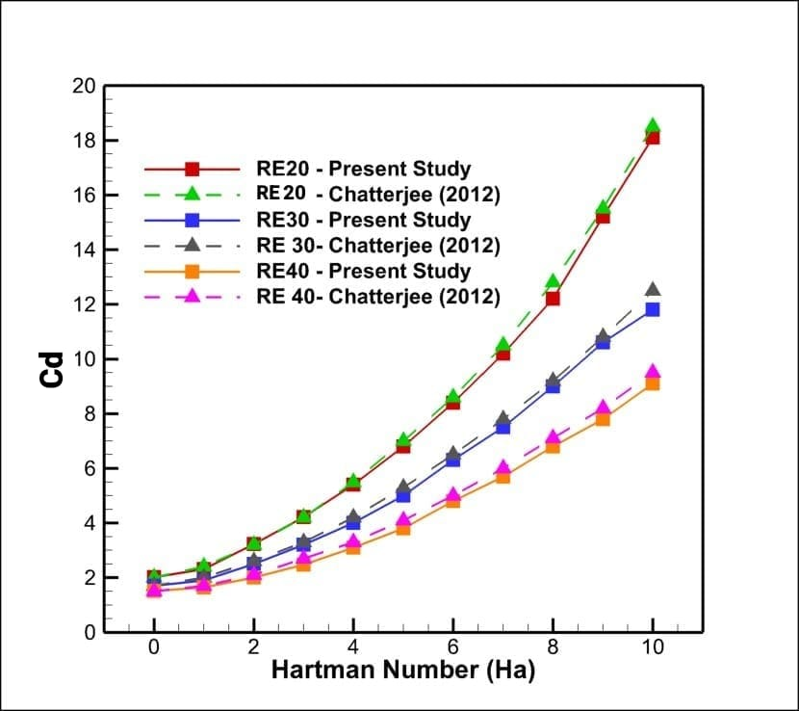
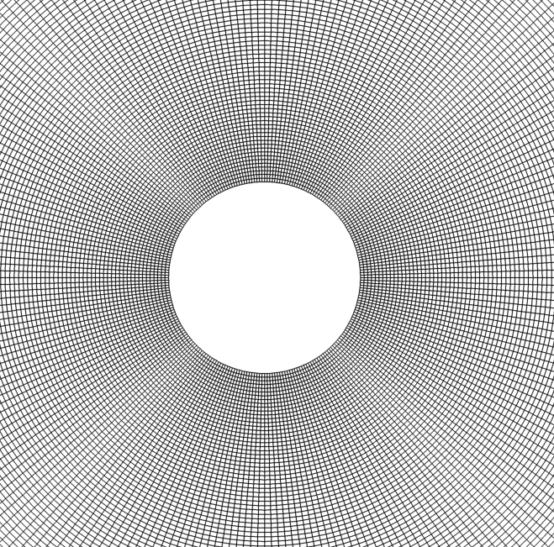
Mesh & Validation
The mesh selected for the present study has 170000 quadrilateral elements based on Grid independence Test.
The validation of computational methodology is performed by comparing the Cd vs Ha plot for Re 20,30,40 with existing literature (Chatterjee et al. 2012). It is observed that present simulation shows close resemblance with existing literature.
Close View of Mesh near Cylinder
Grid Independence Study
Validation of Methodology

Slide 7
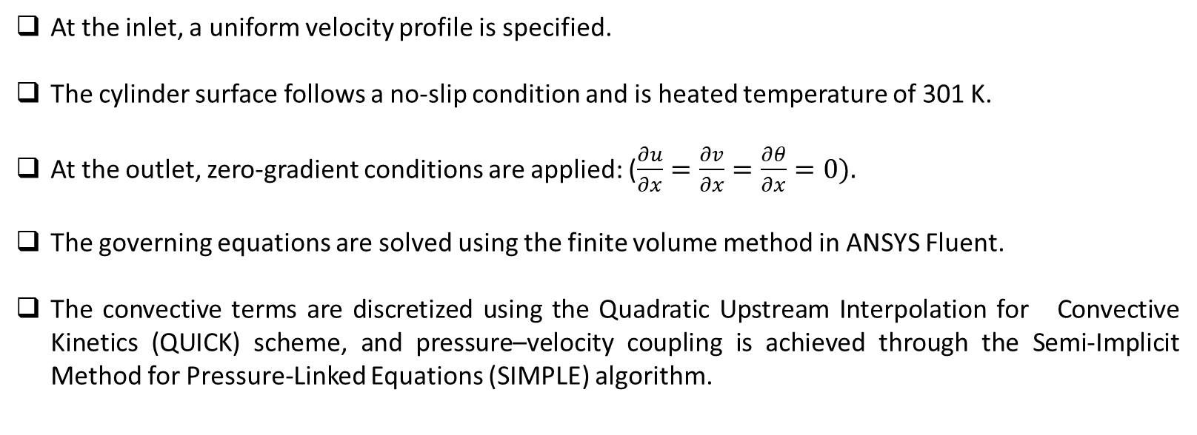
Setup
At the inlet, a uniform velocity profile is specified.
The cylinder surface follows a no-slip condition and is heated temperature of 301 K.
At the outlet, zero-gradient conditions are applied: ($\frac{∂u}{∂x}=\frac{∂v}{∂x}=\frac{∂θ}{∂x}=0).$
The governing equations are solved using the finite volume method in ANSYS Fluent.
The convective terms are discretized using the Quadratic Upstream Interpolation for Convective Kinetics (QUICK) scheme, and pressure–velocity coupling is achieved through the Semi-Implicit Method for Pressure-Linked Equations (SIMPLE) algorithm.

Slide 8
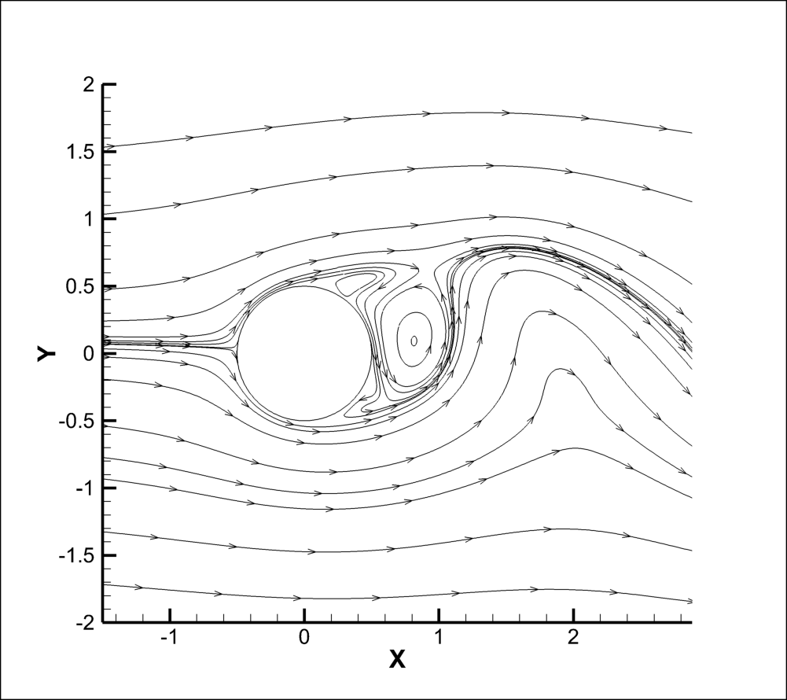
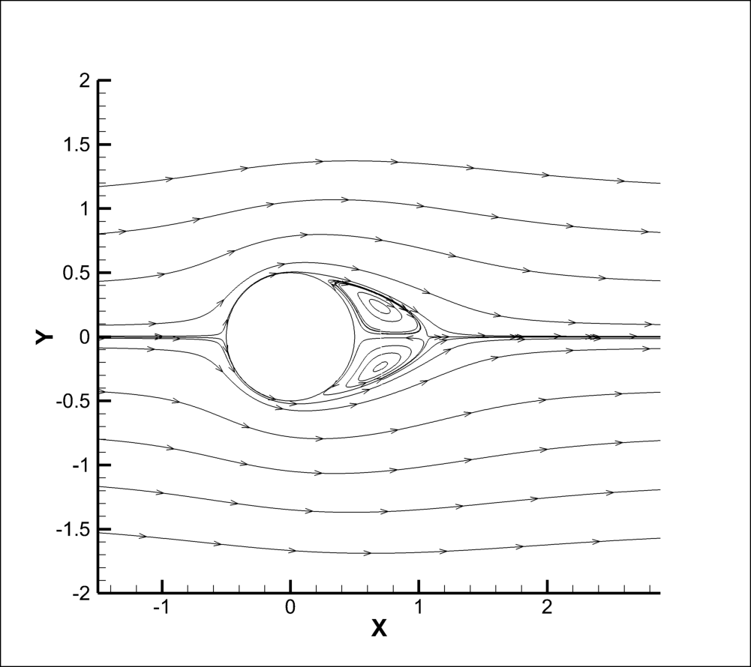
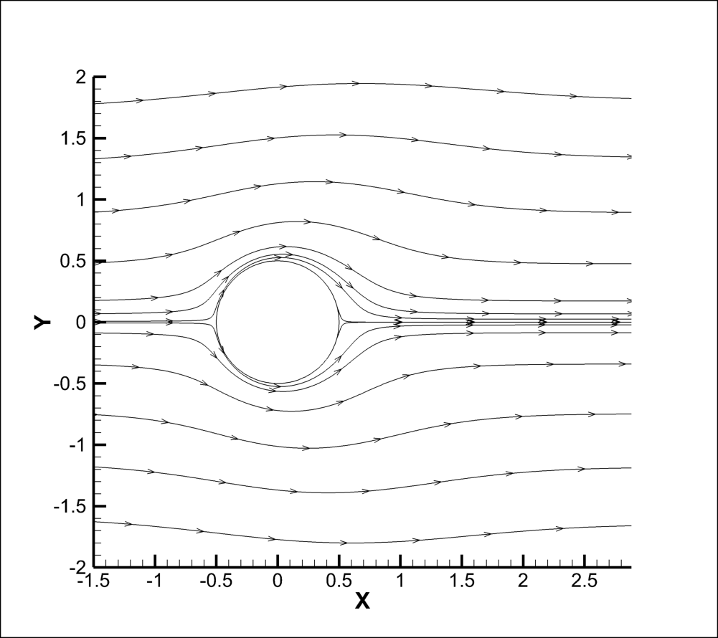
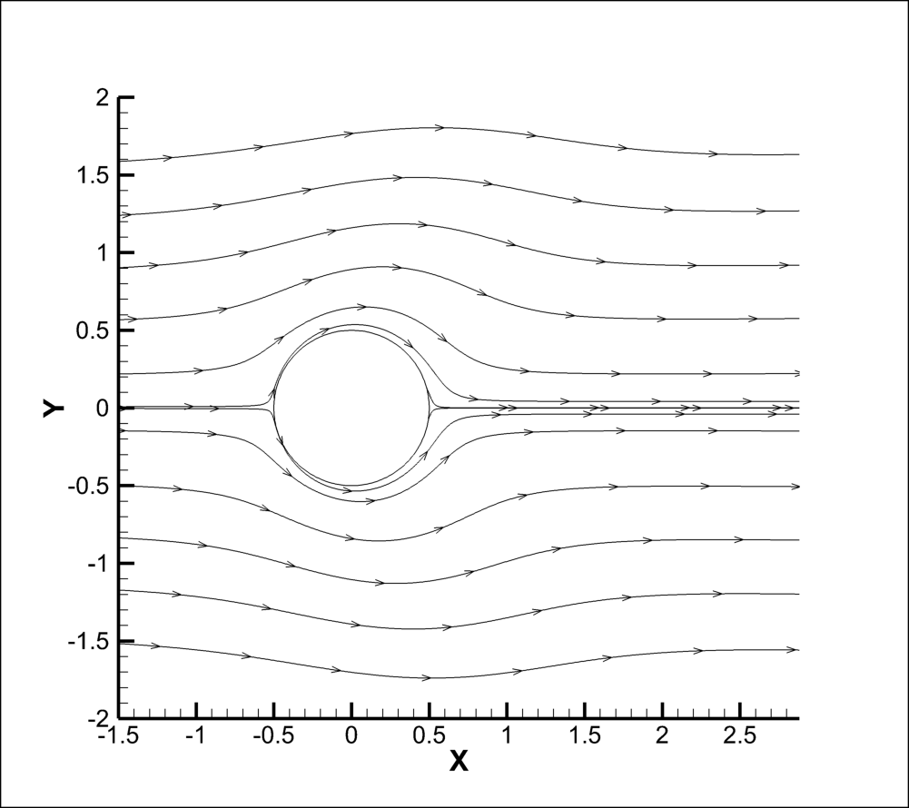
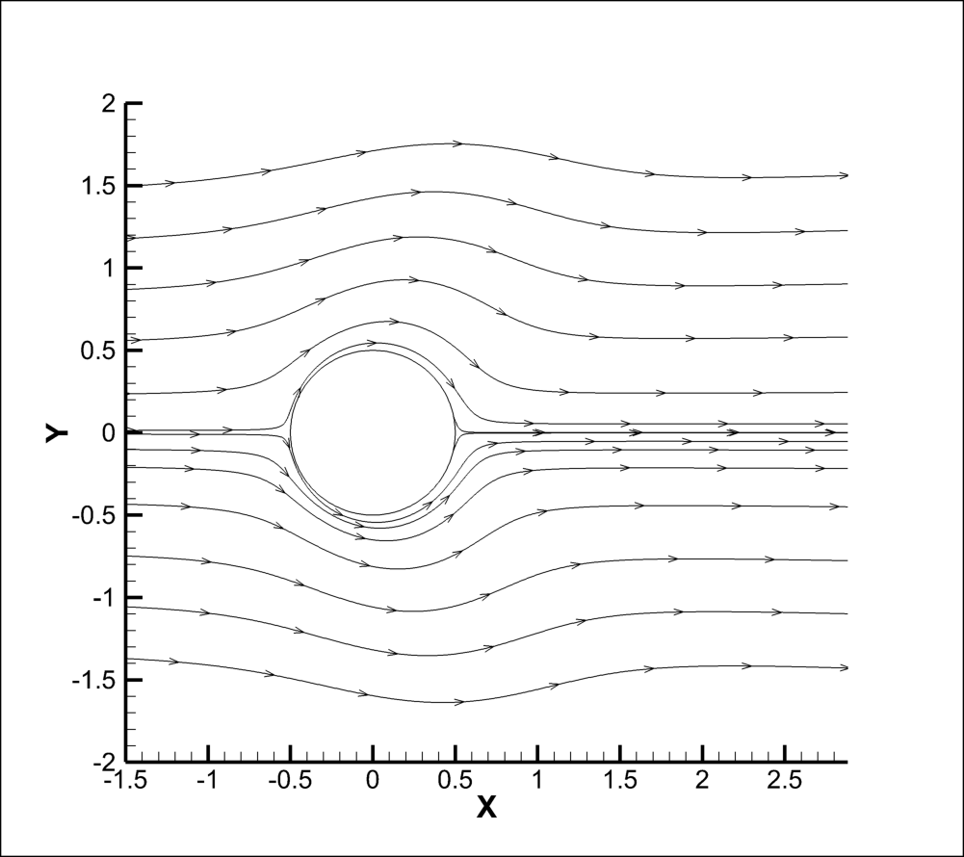
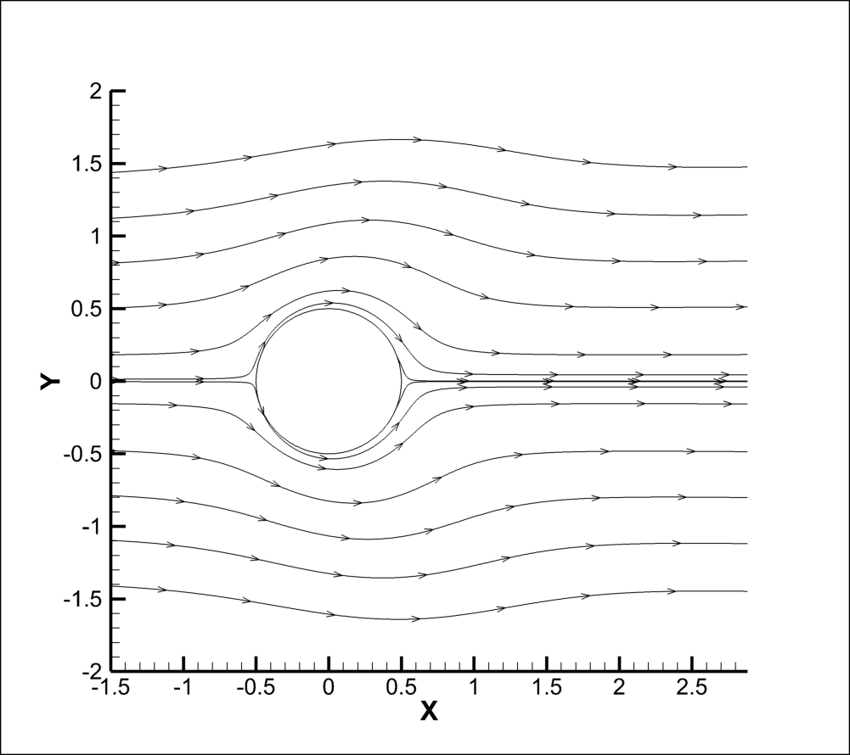
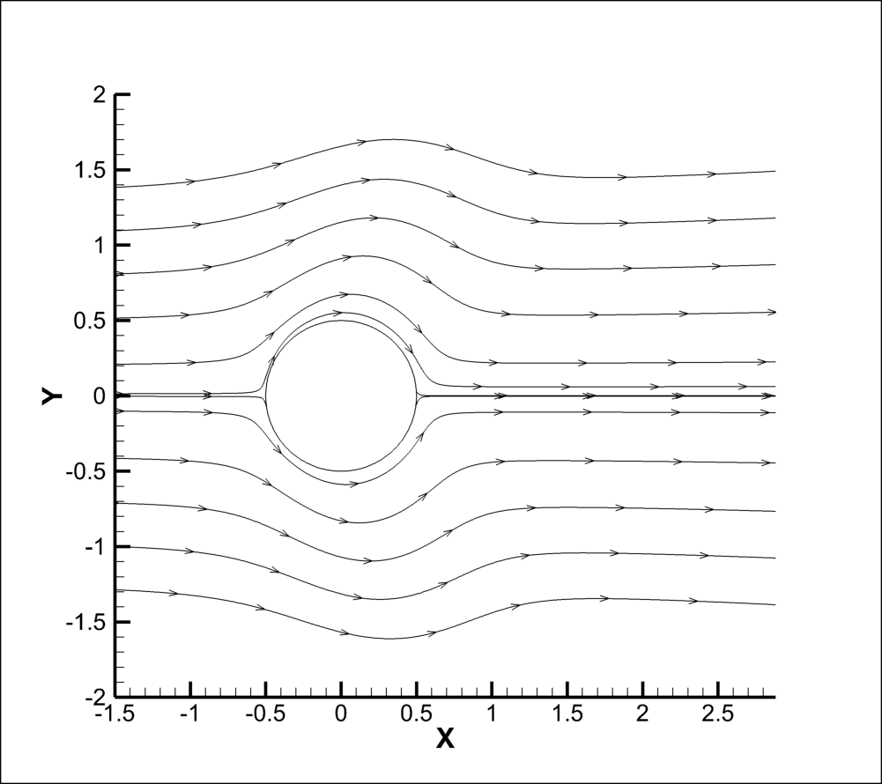
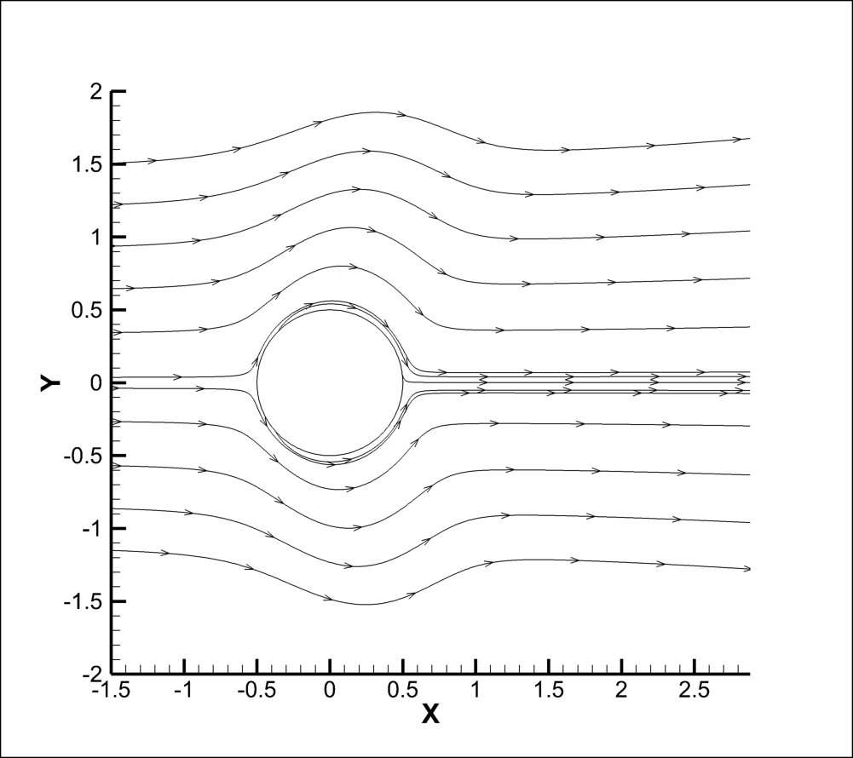
Flow Dynamics- Streamlines, Re 1000
  Re = 1,000: At Ha = 25, the flow stabilizes significantly, forming symmetric recirculation bubbles at the wake of the cylinder.
  When Ha is further increased to Ha = 50, the wake becomes completely steady and symmetric, and no distinct vortex structures are observed.
  Beyond Ha= 50, the flow continues to be fully stabilized.
Ha=0
Ha=25
Ha=50
Ha=75
Ha=100
Ha=125
Ha=150
Ha=200

Slide 9
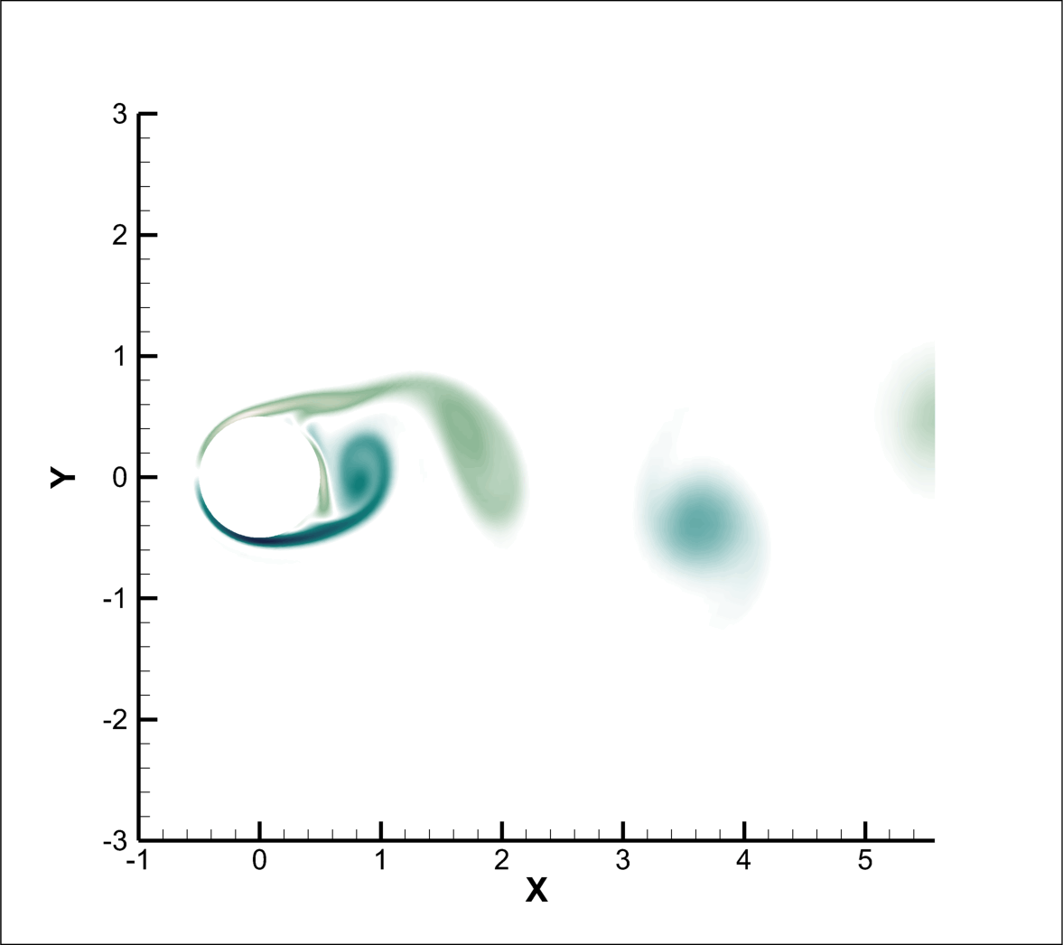
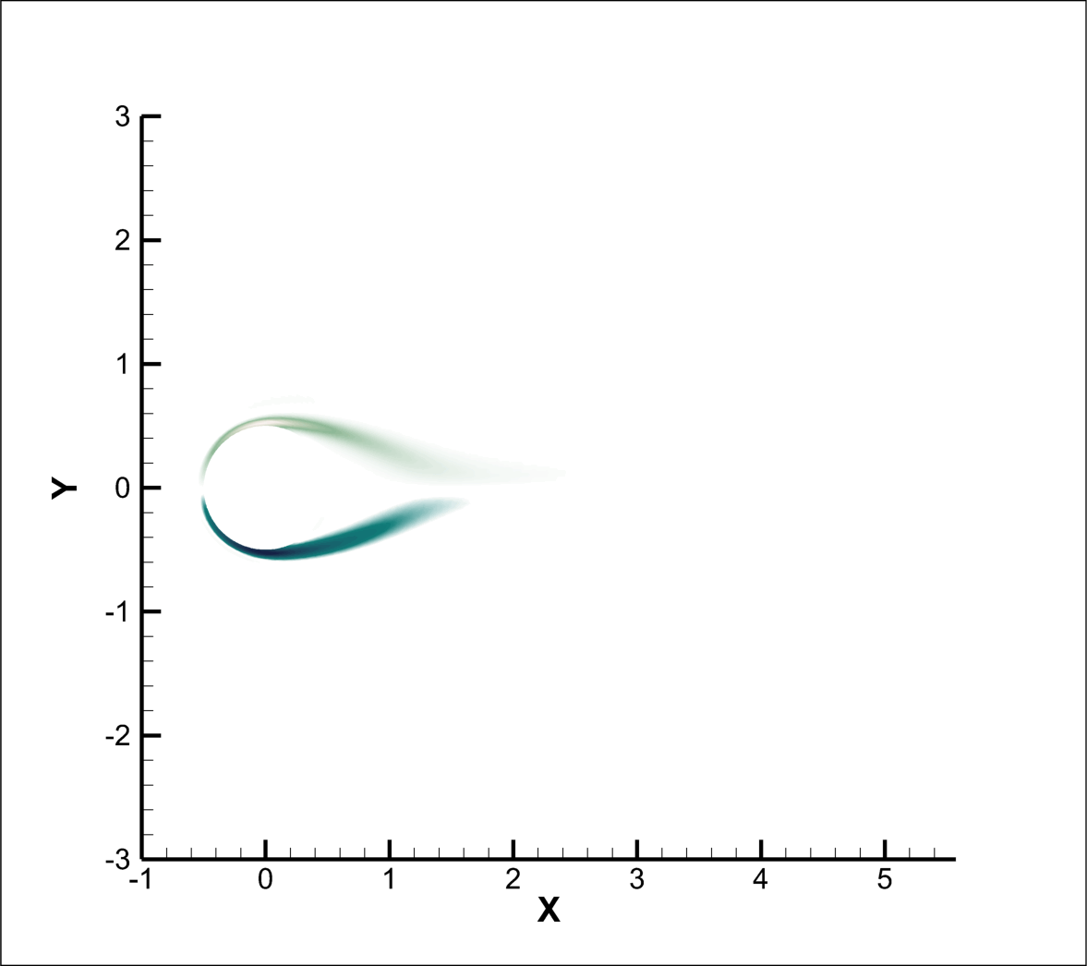
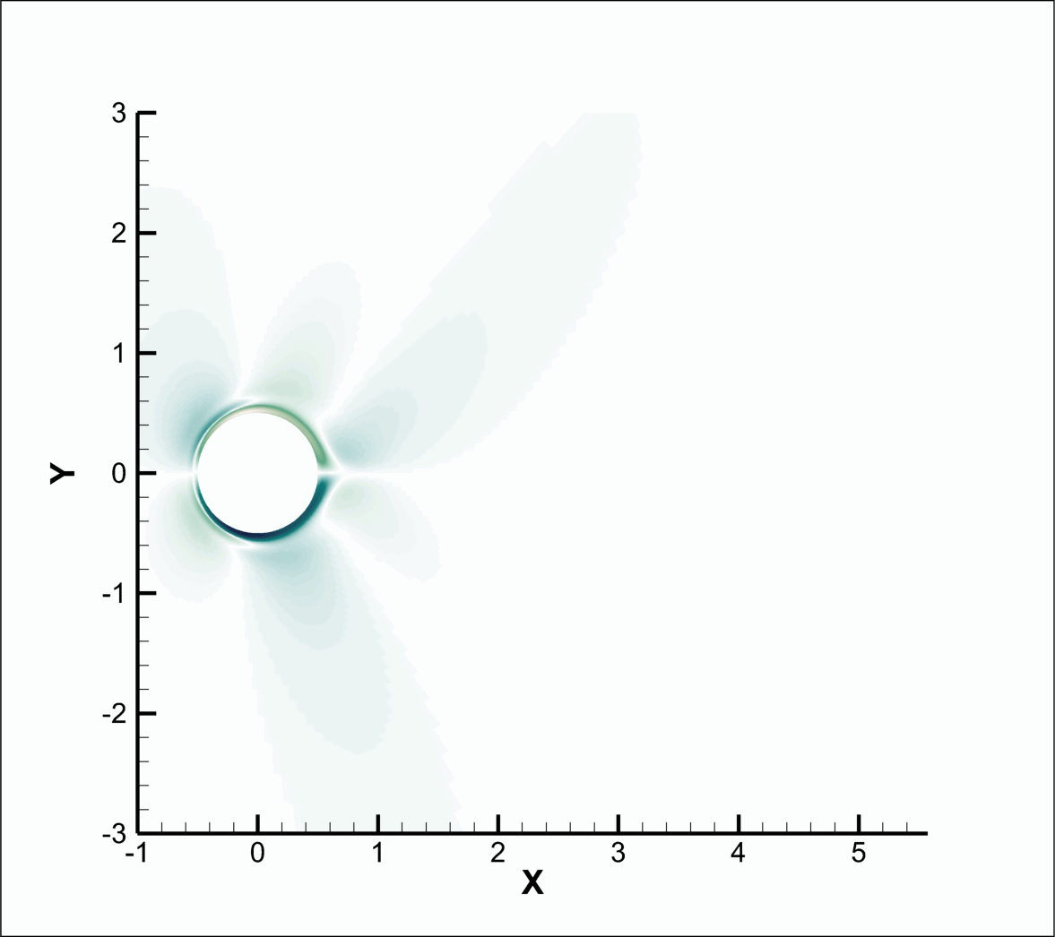
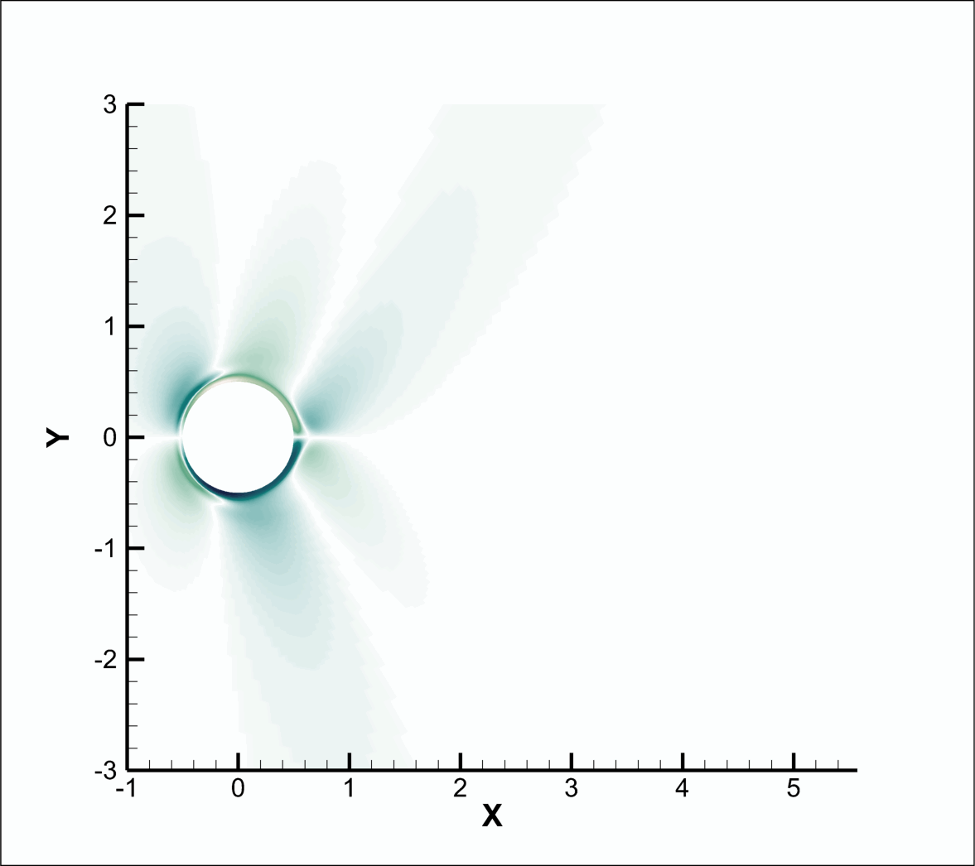
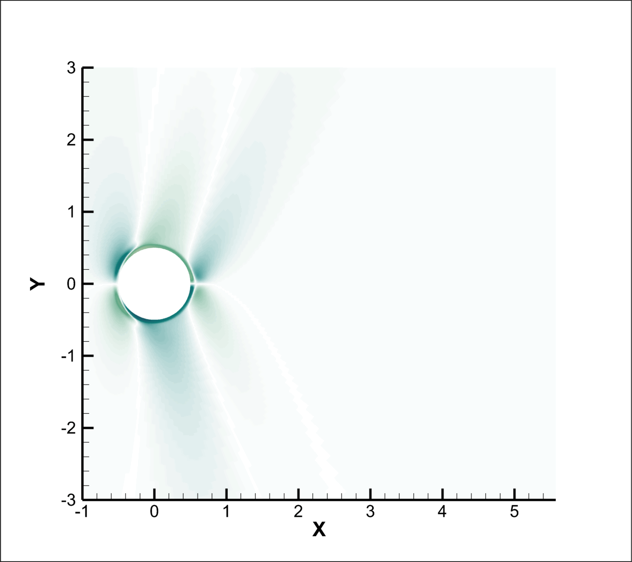
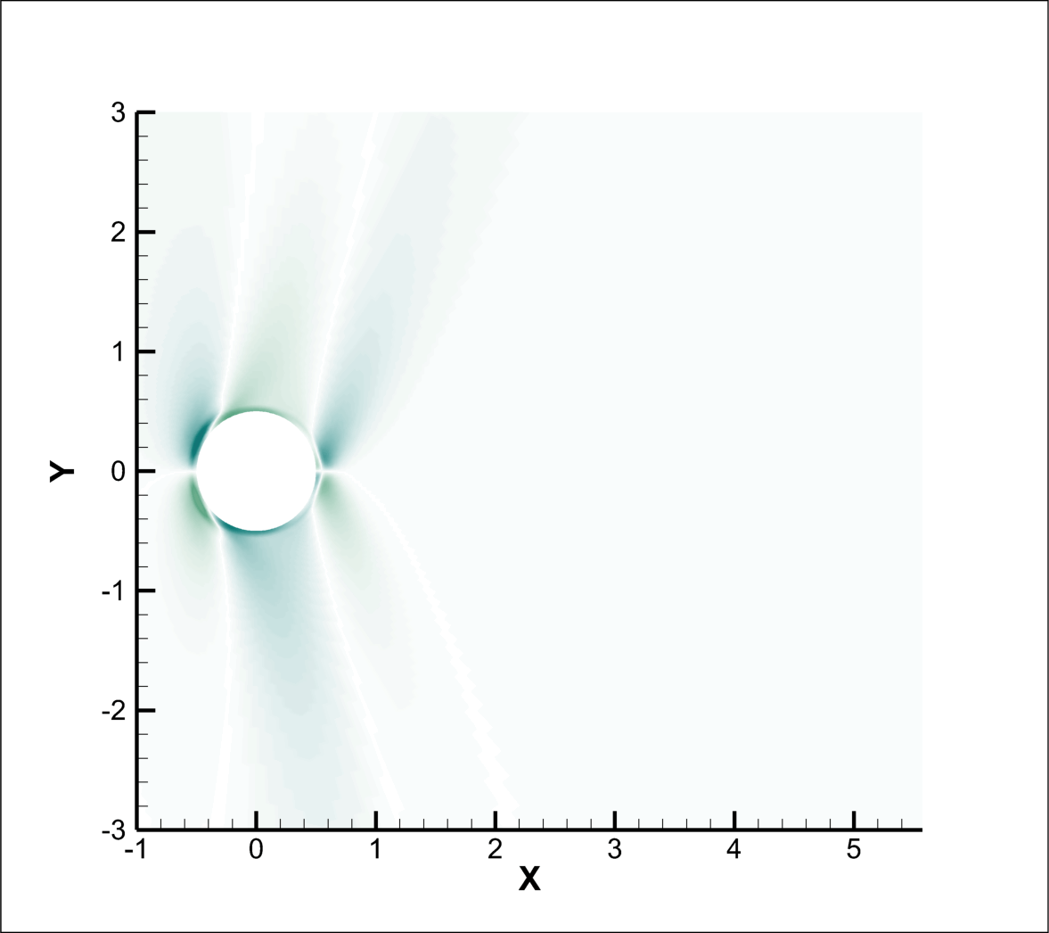
Z- Vorticity : Re 1000
Ha=0
Ha=25
Ha=50
Ha=75
Ha=100
Ha=125
Ha=150
Ha=200

Slide 10
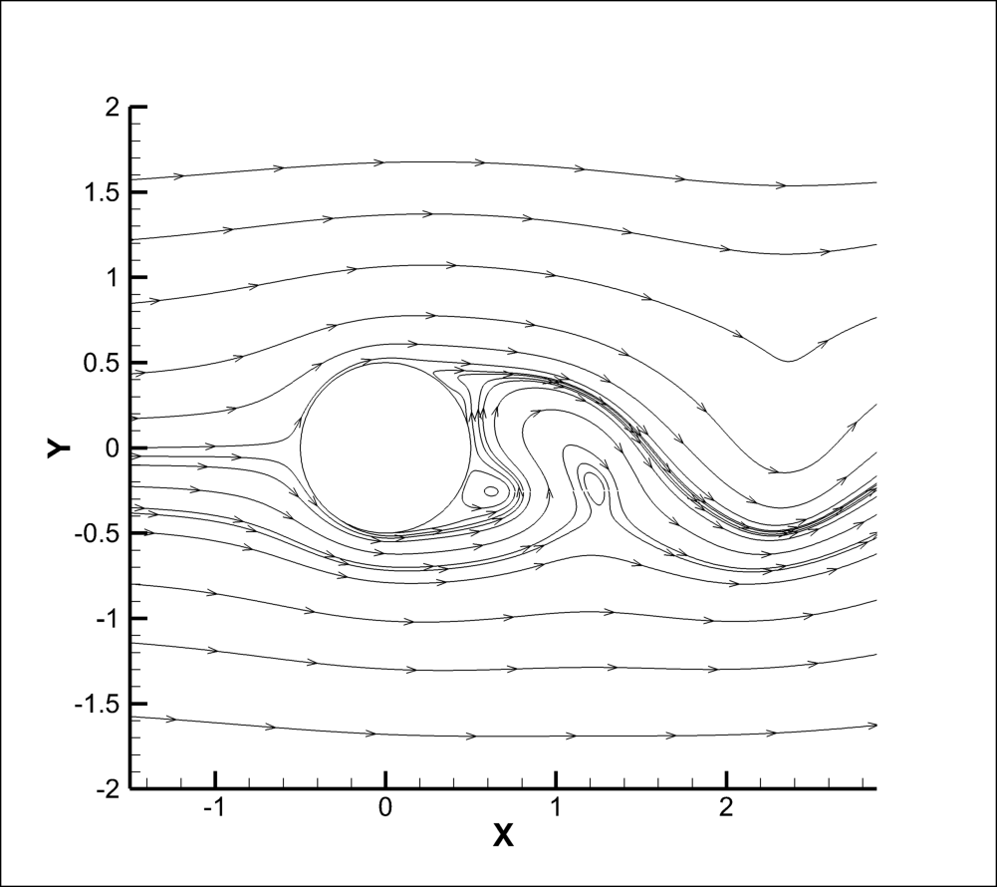
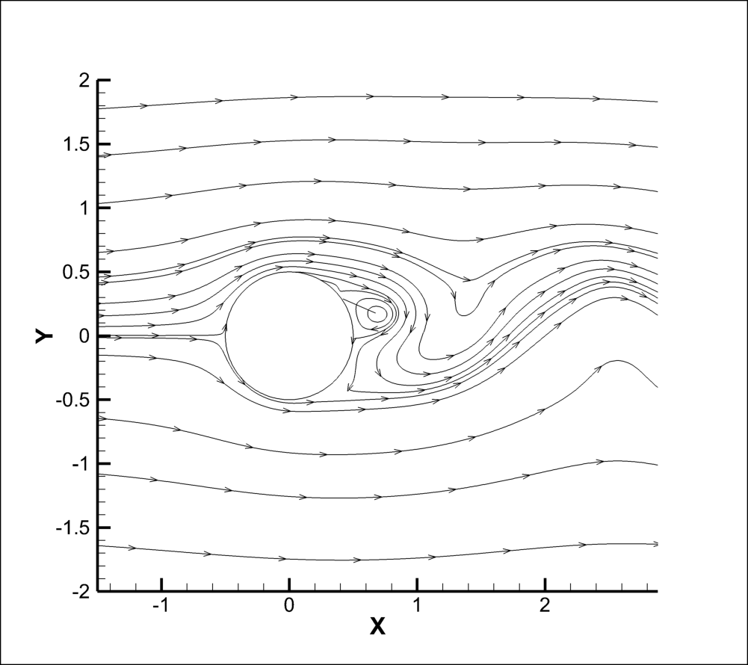
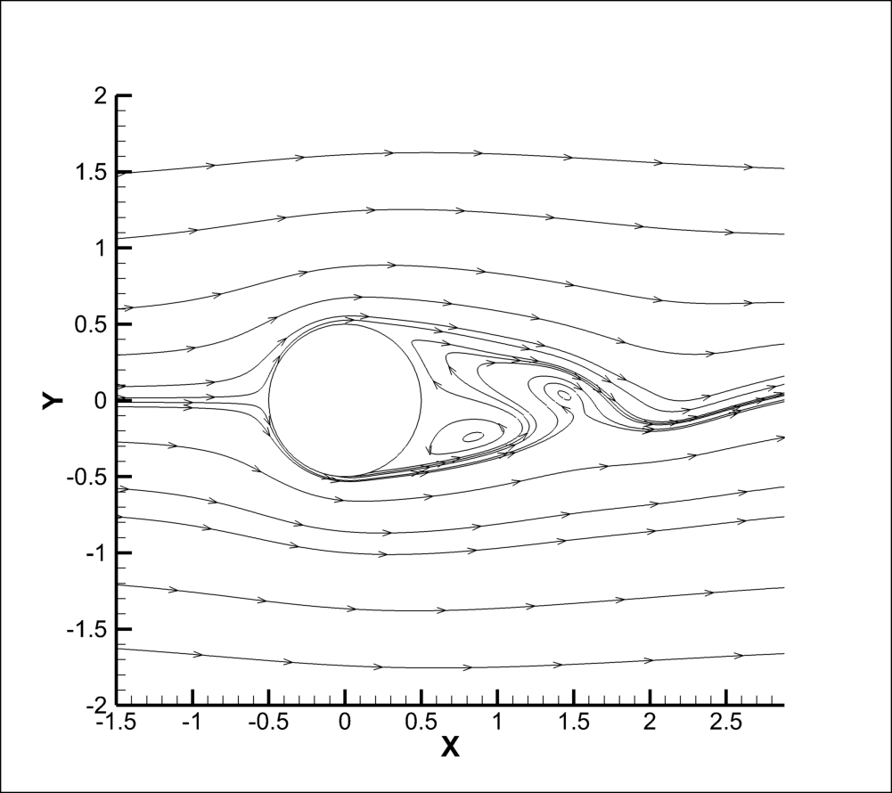
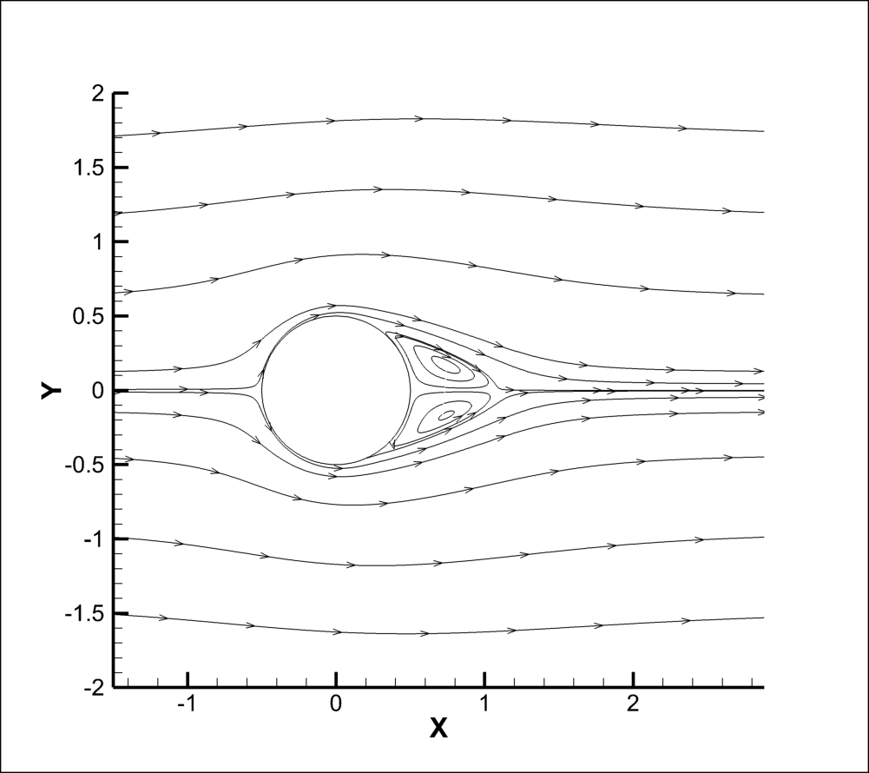
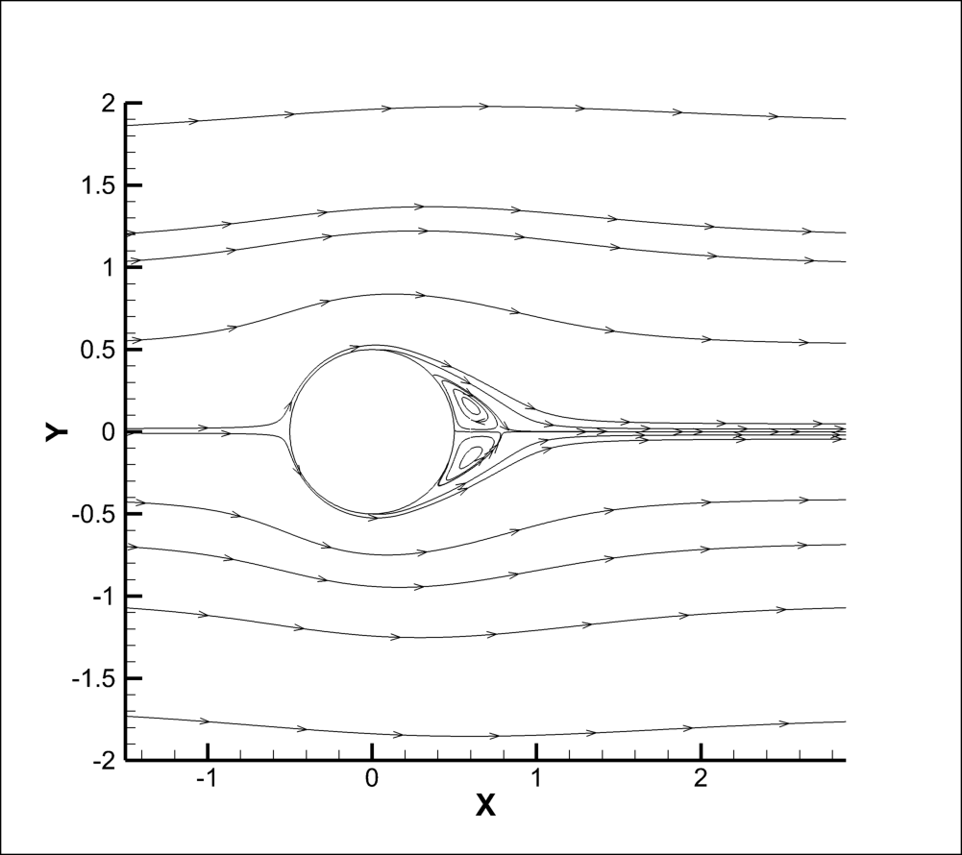
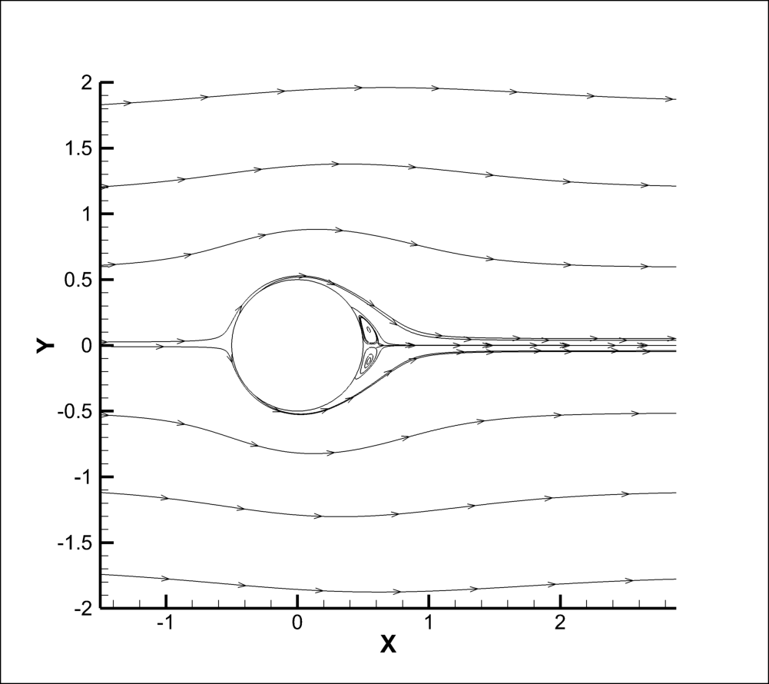
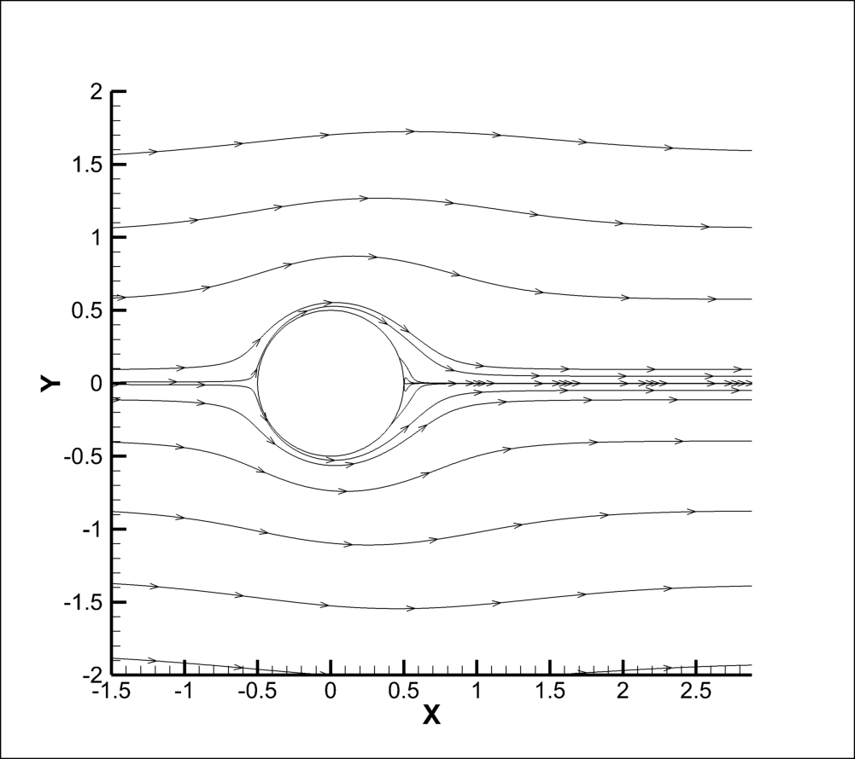
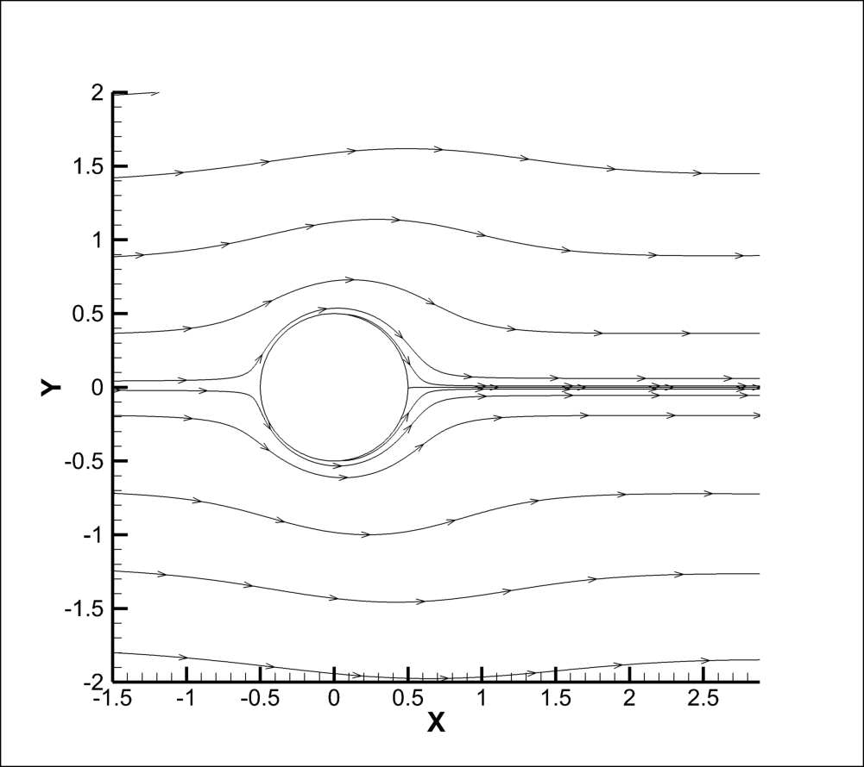
Streamlines, Re 10000
Re = 10,000, a similar suppression trend is observed: pronounced vortex shedding at low Ha transitions to smoother, symmetric vorticity fields by Ha ≈ 75, and it complete disappears for Ha>150.
Ha=0
Ha=25
Ha=50
Ha=75
Ha=100
Ha=125
Ha=150
Ha=200

Slide 11
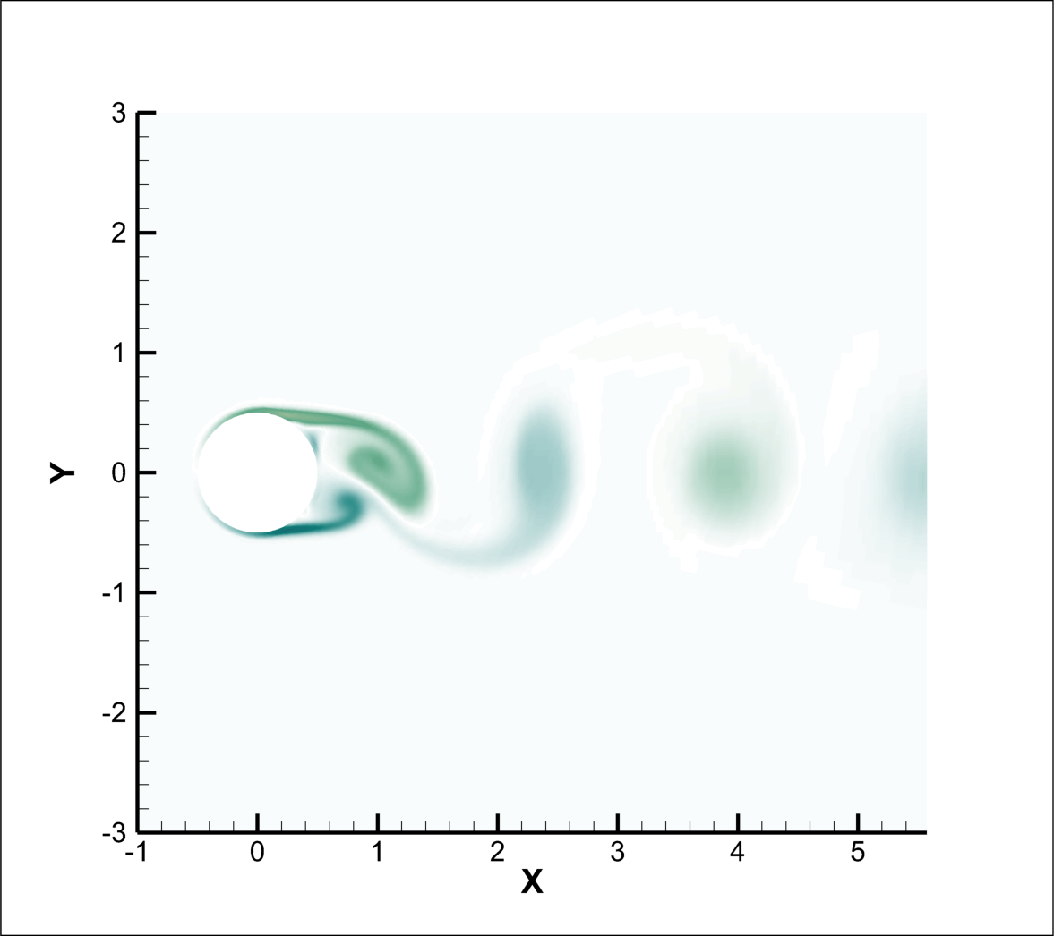
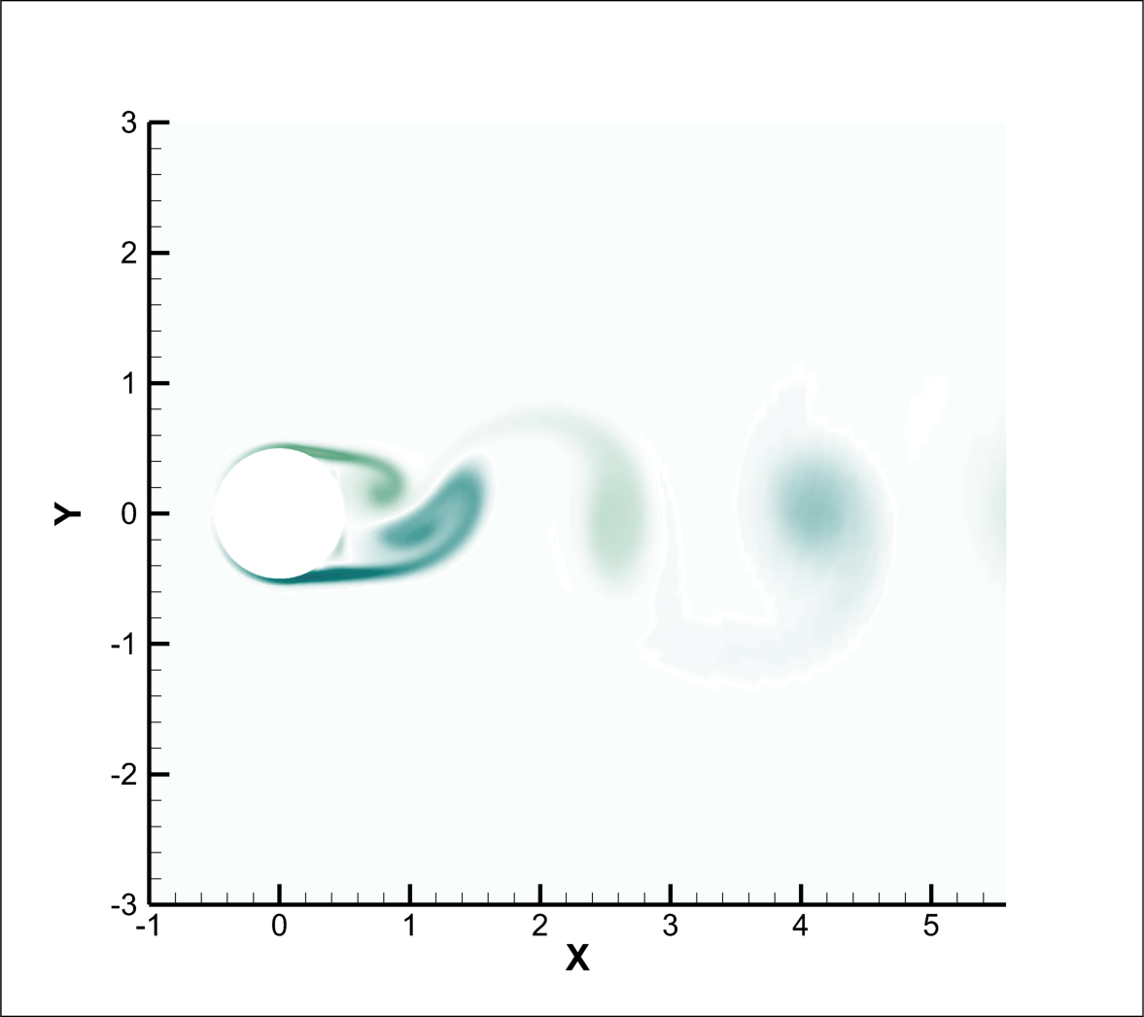
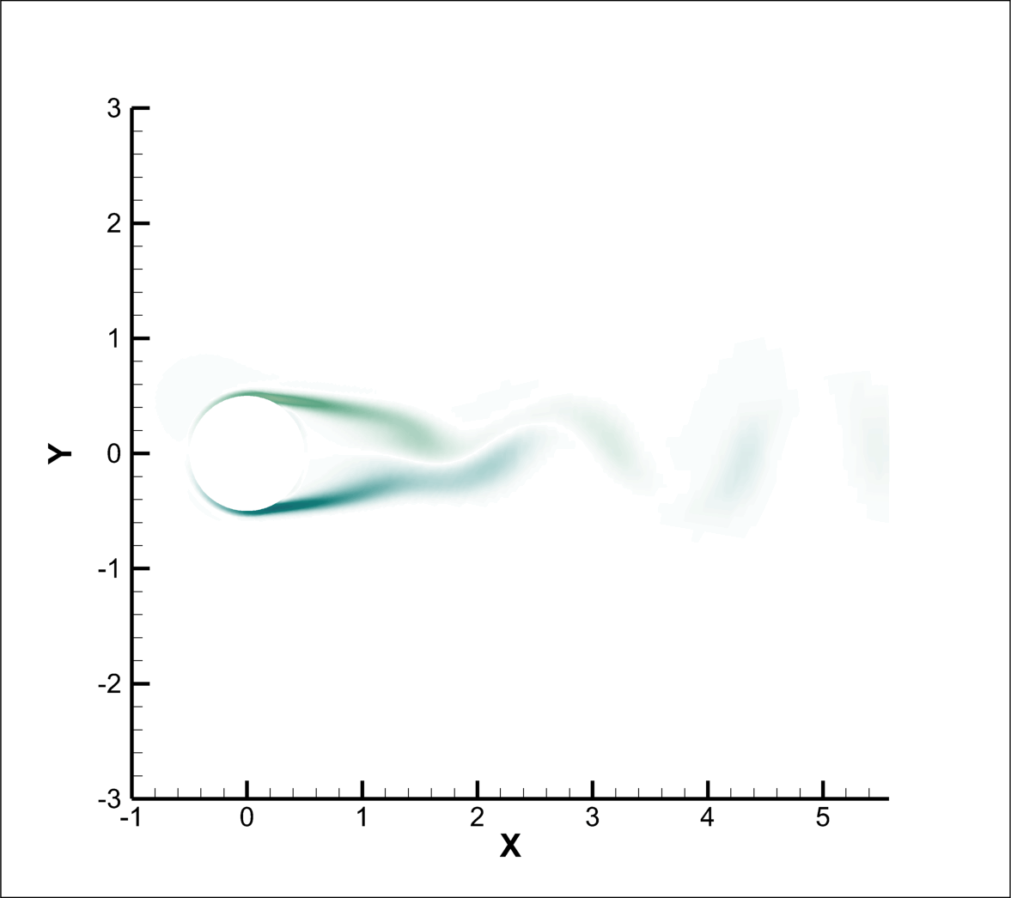
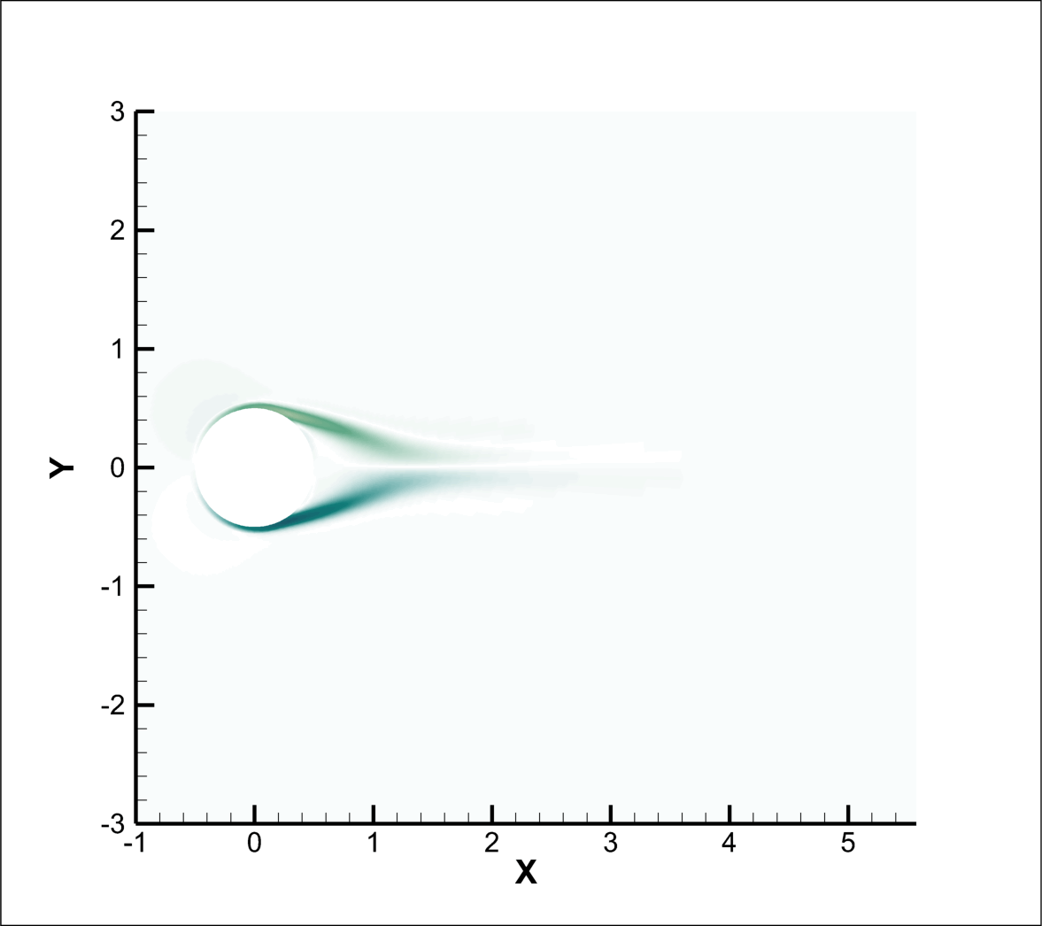
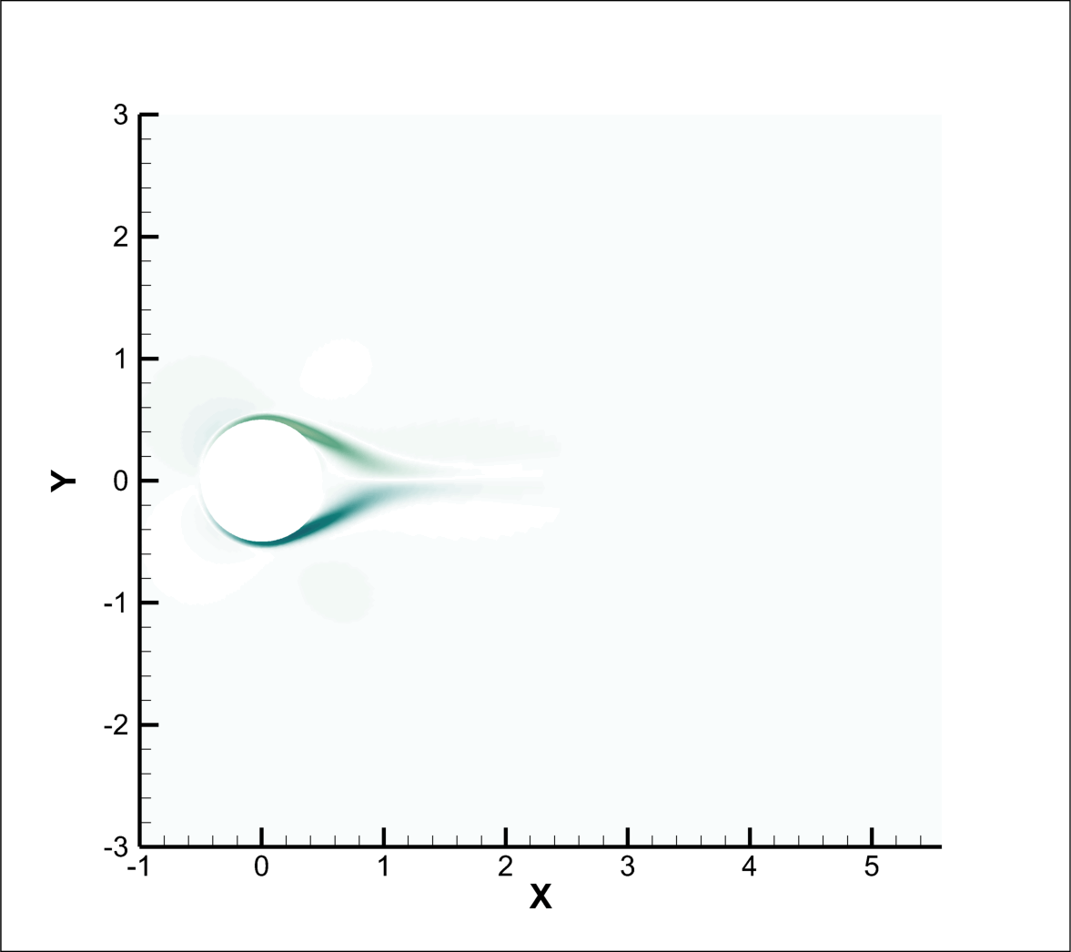
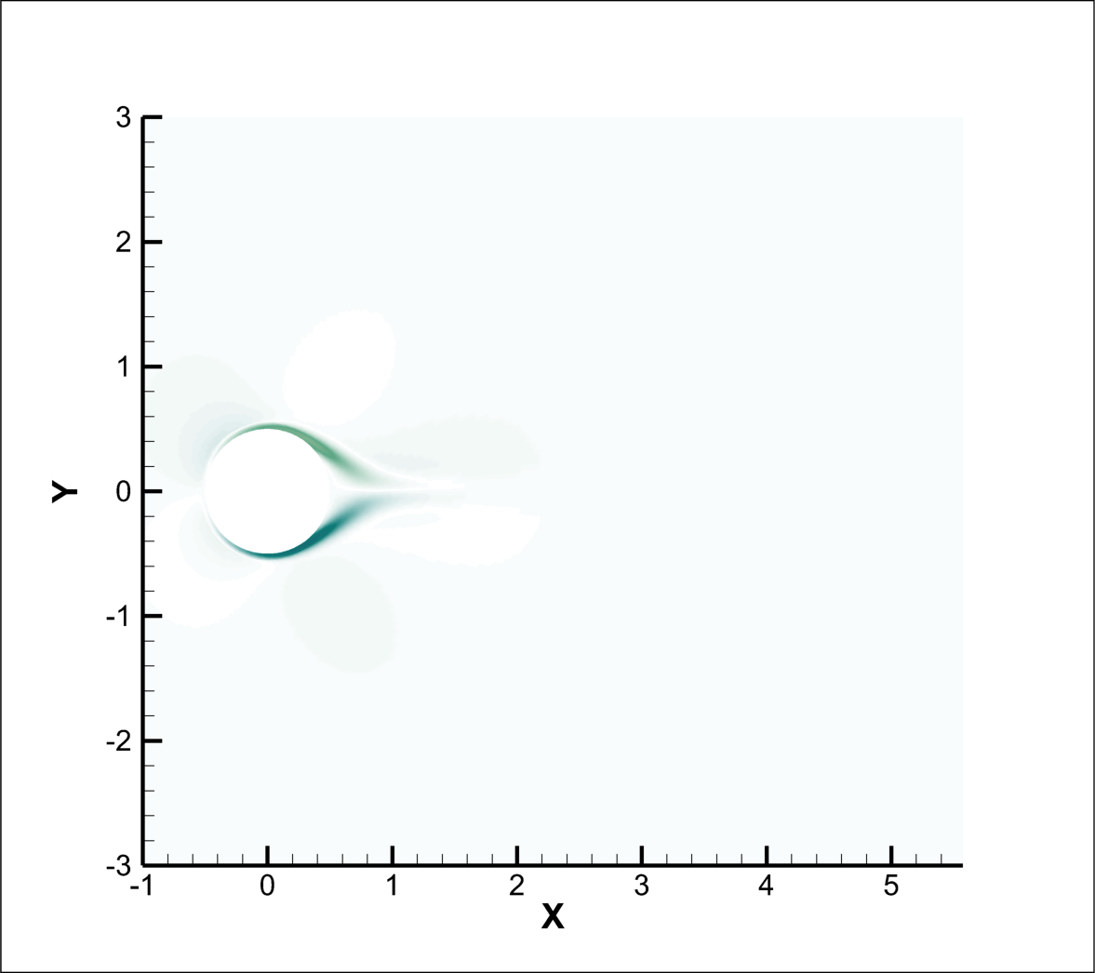
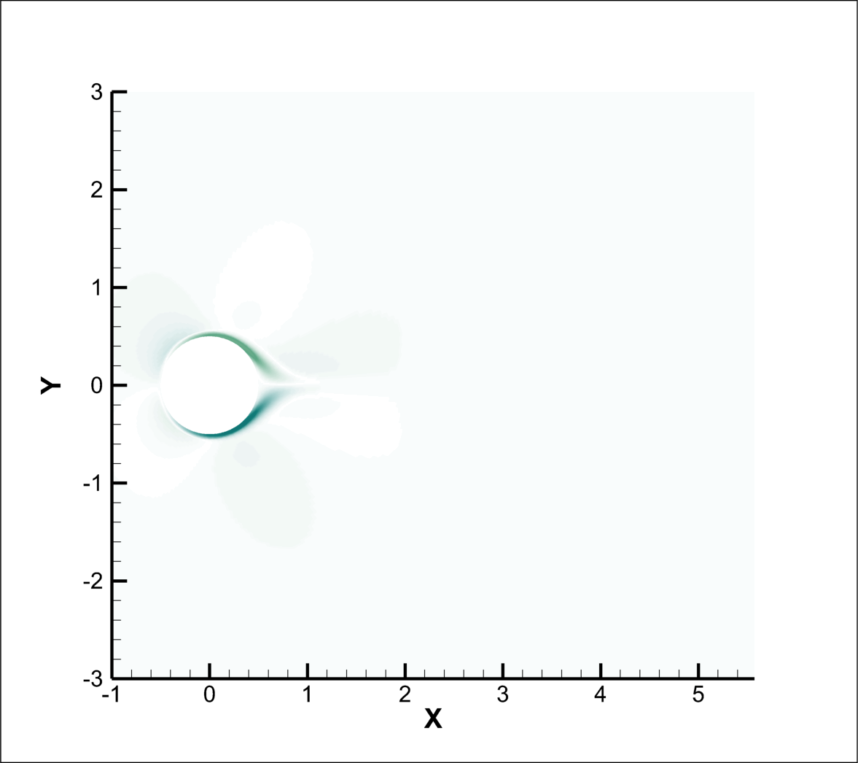
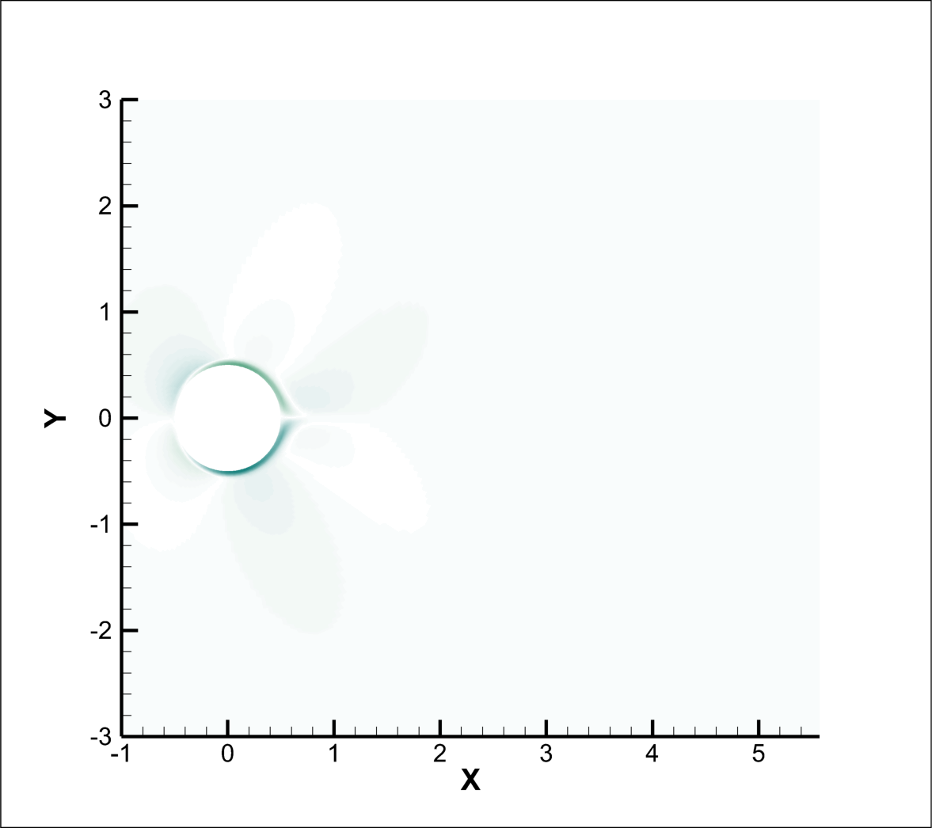
Z- Vorticity : Re 10000
Ha=0
Ha=25
Ha=50
Ha=75
Ha=100
Ha=125
Ha=150
Ha=200

Slide 12
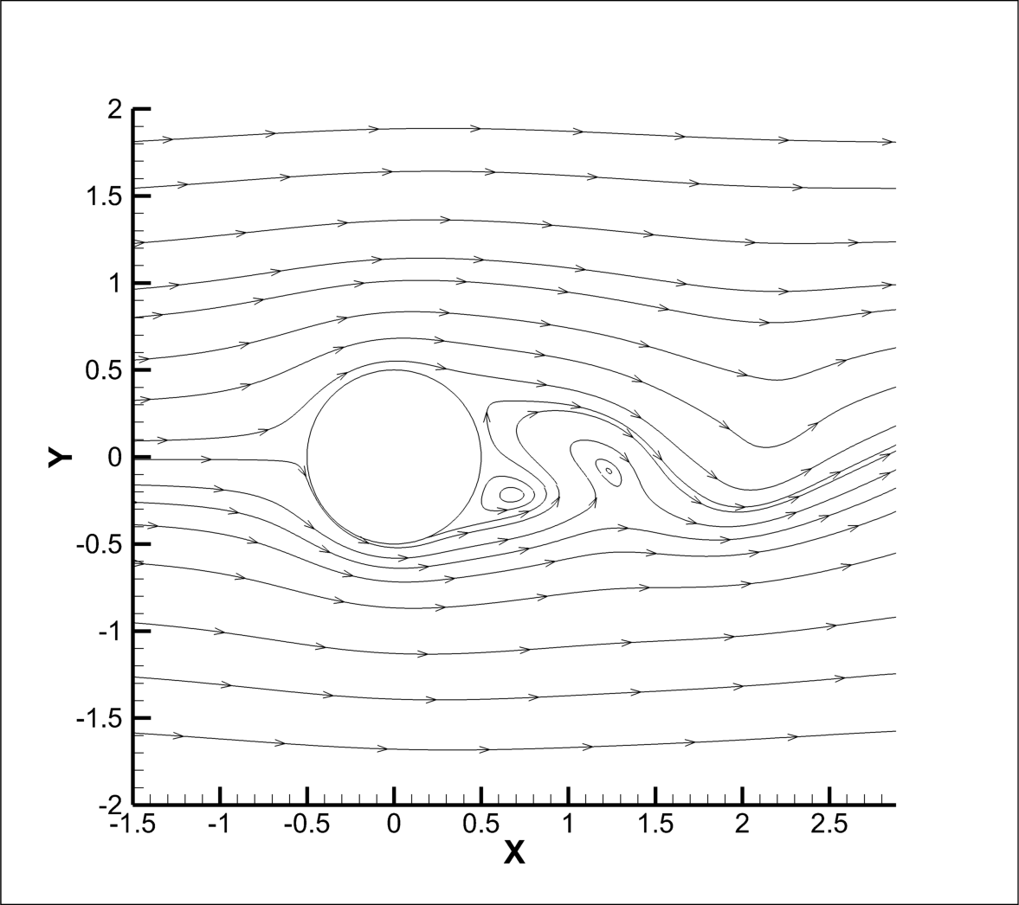
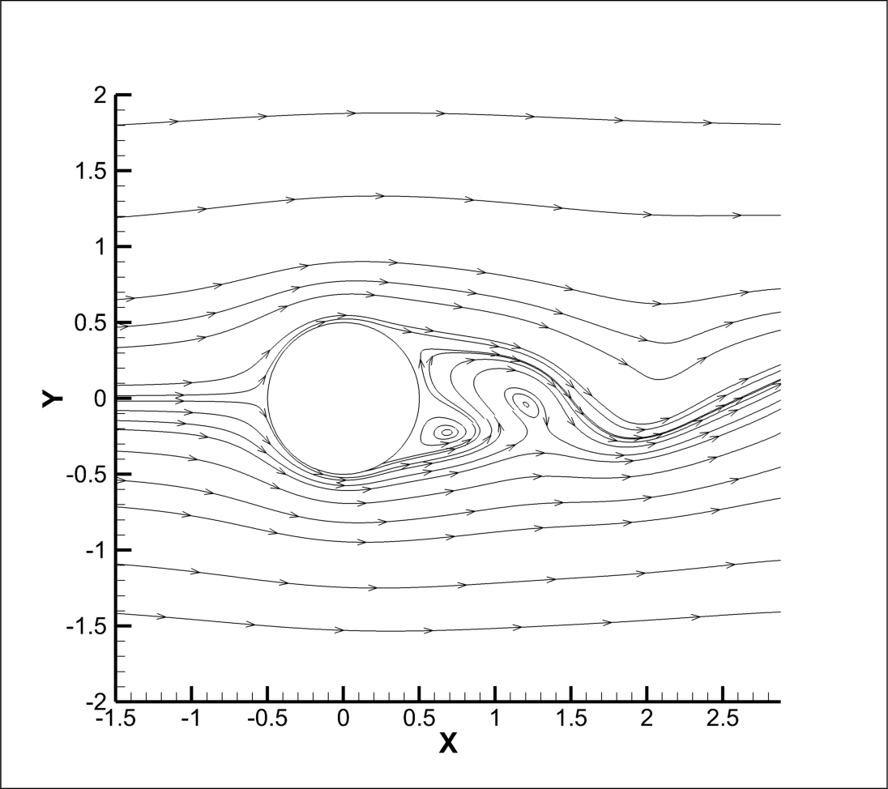
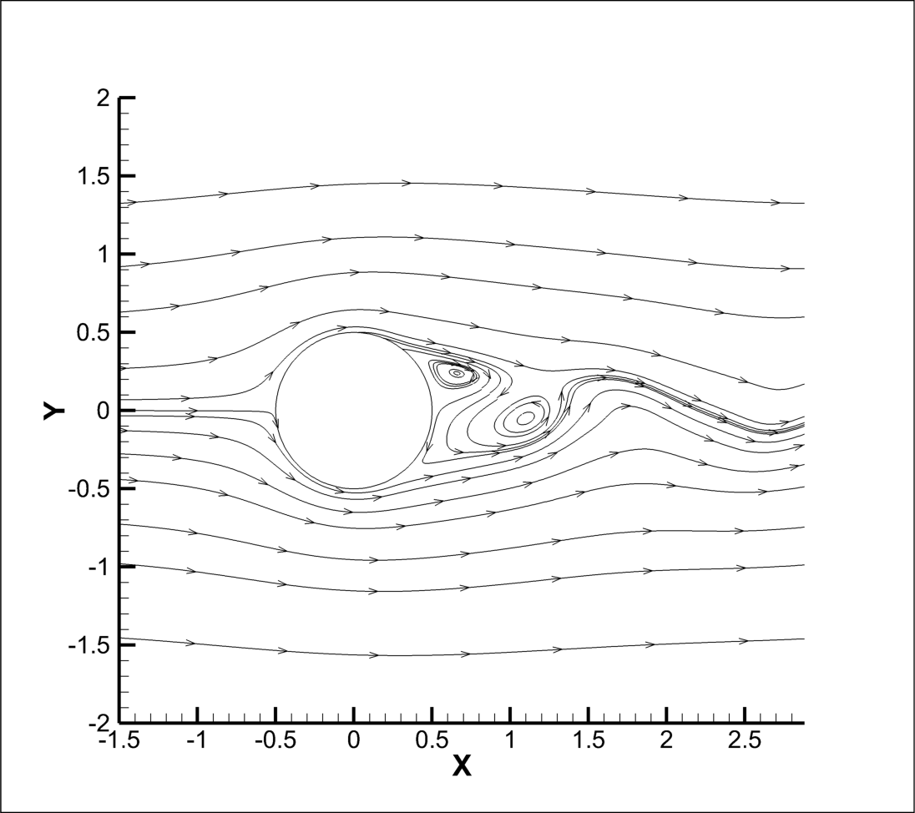
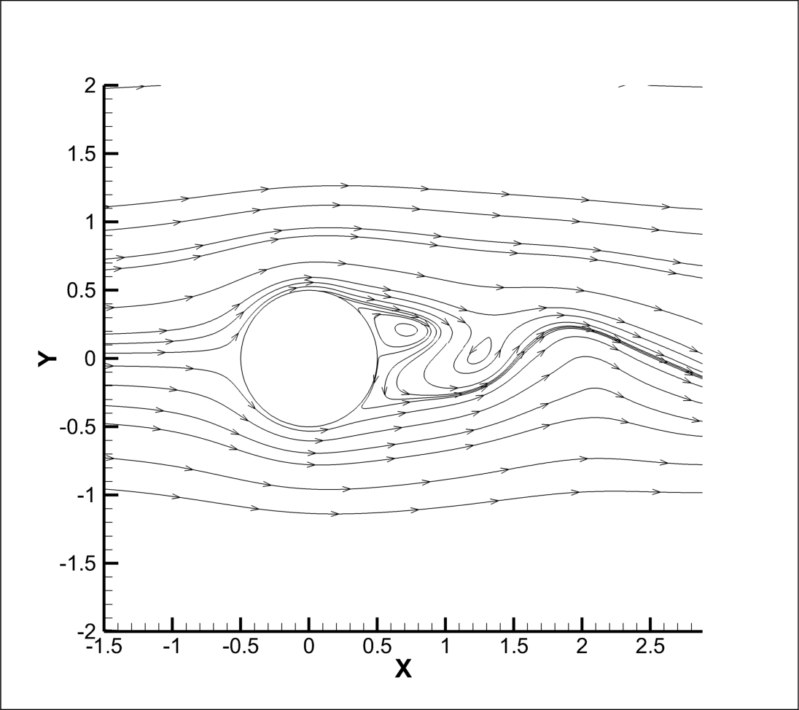
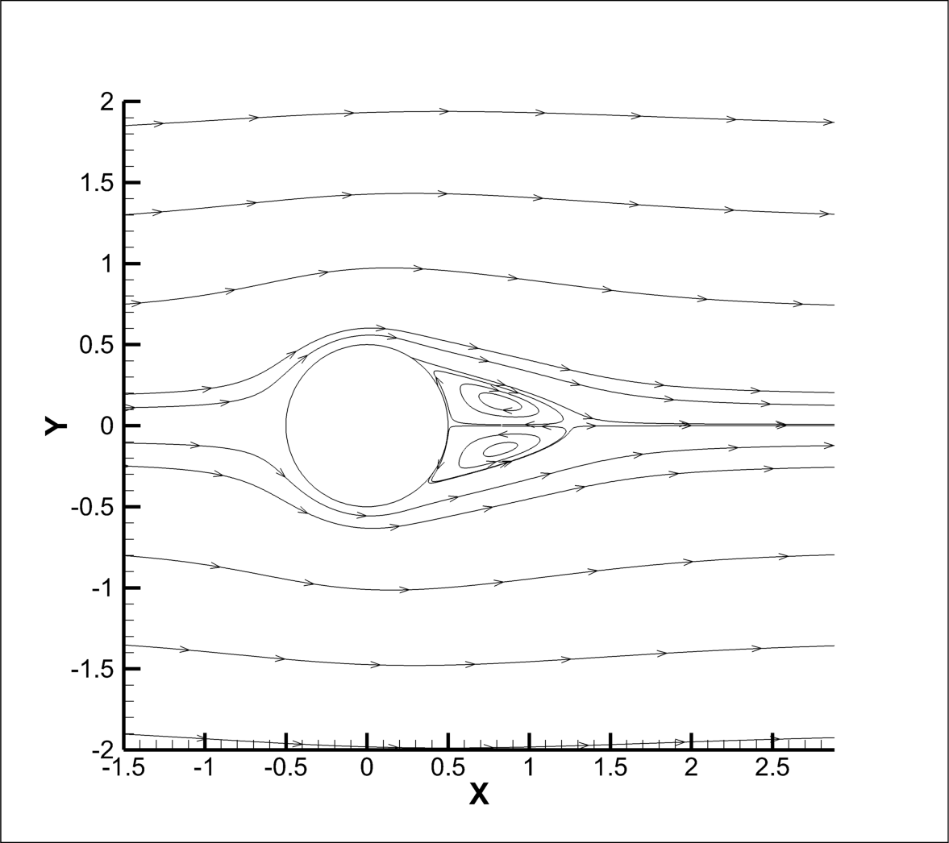
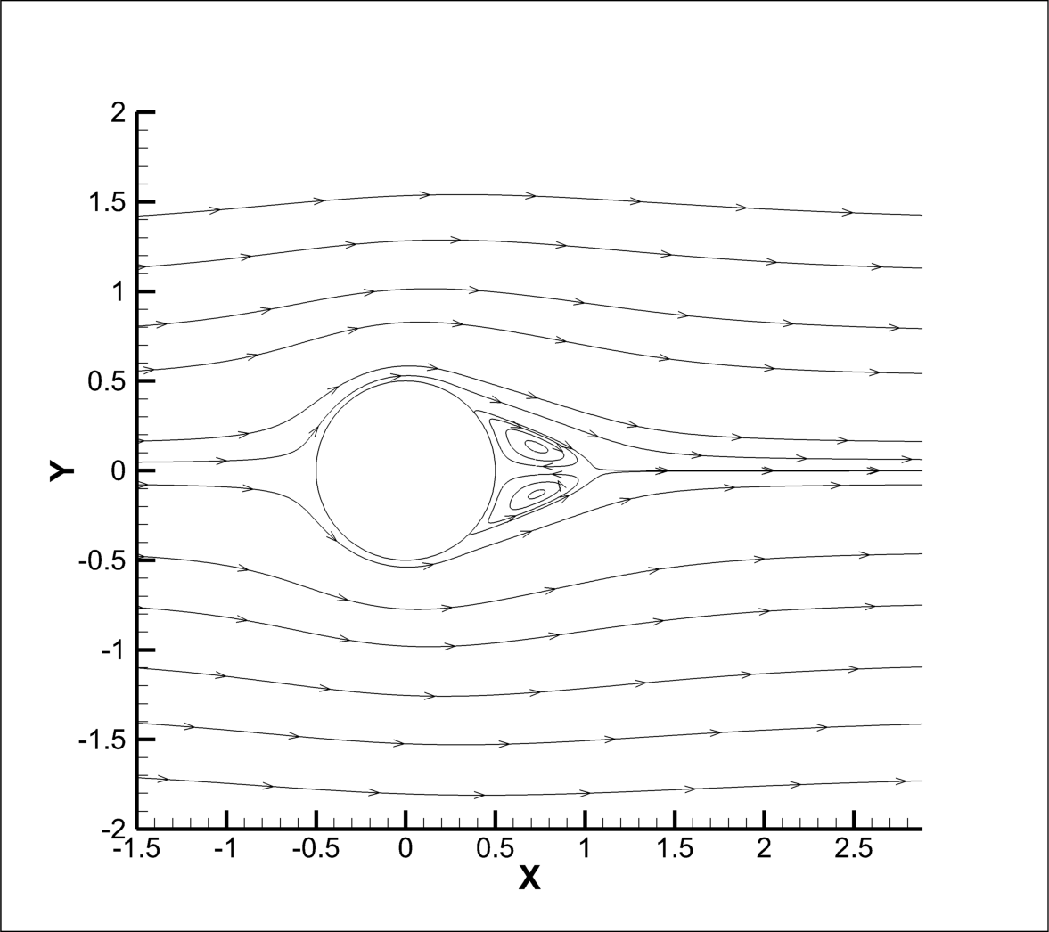
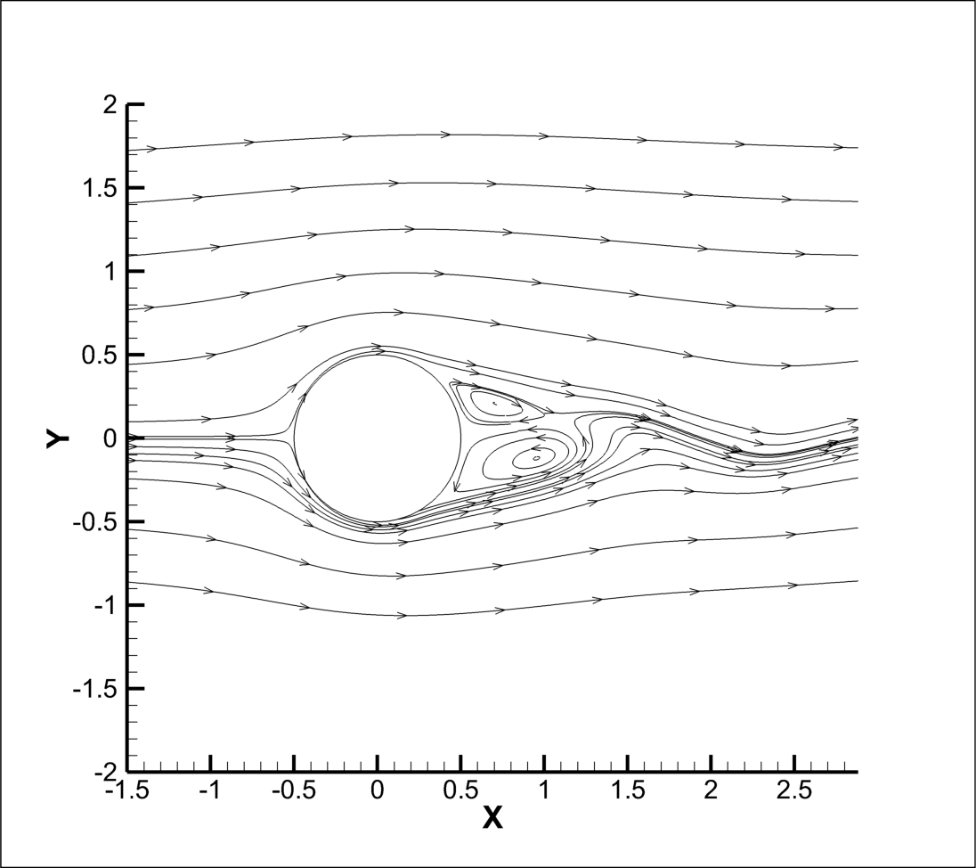
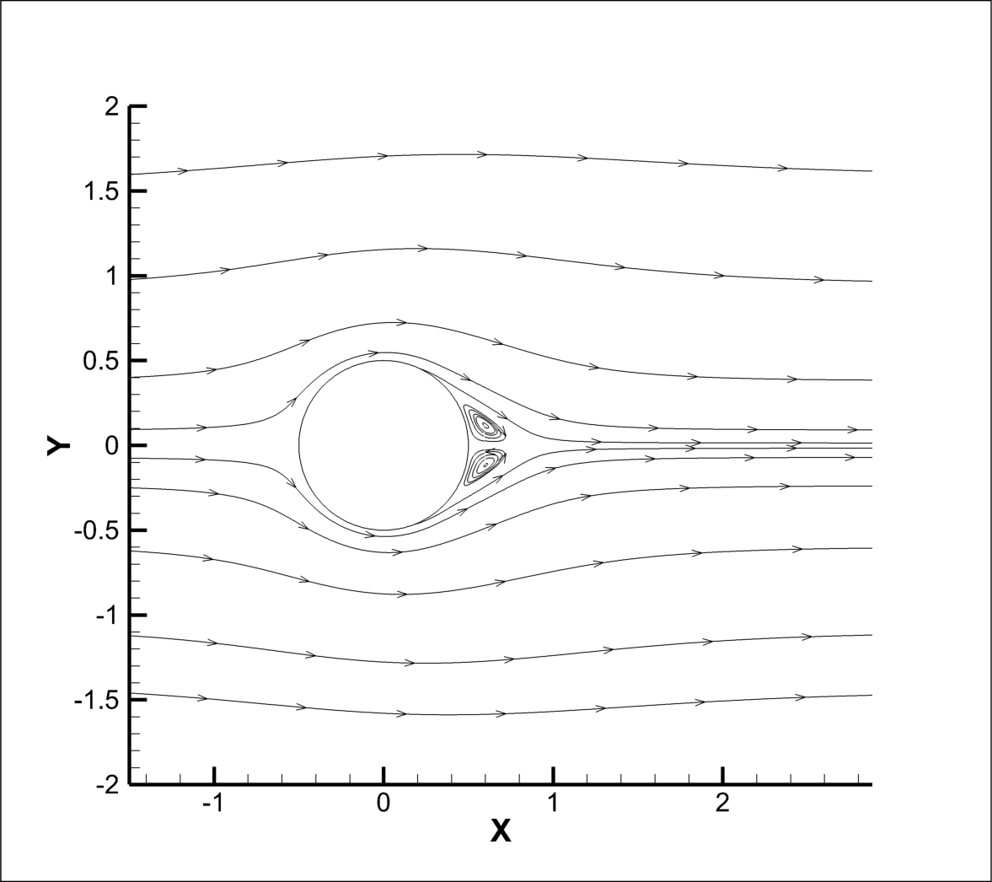
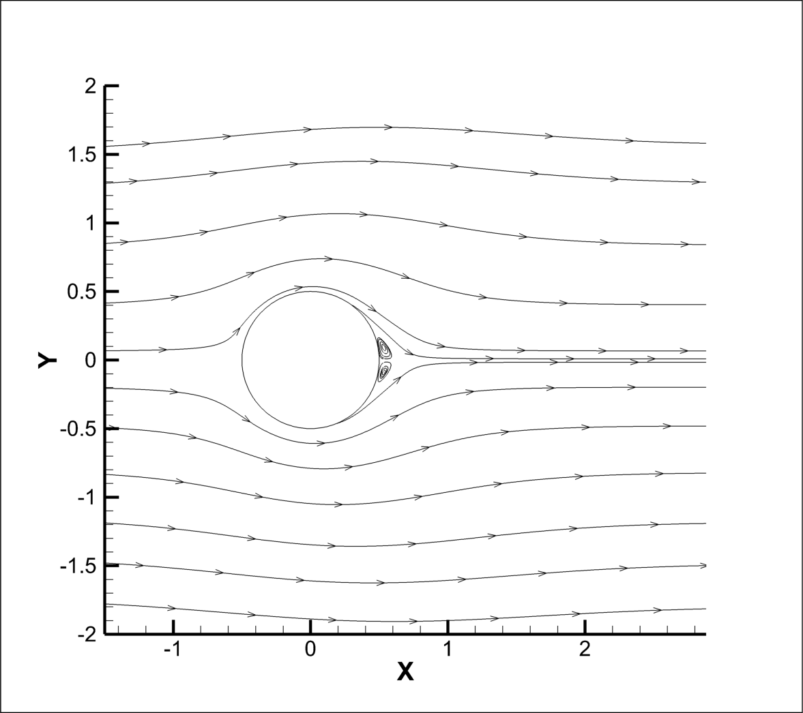
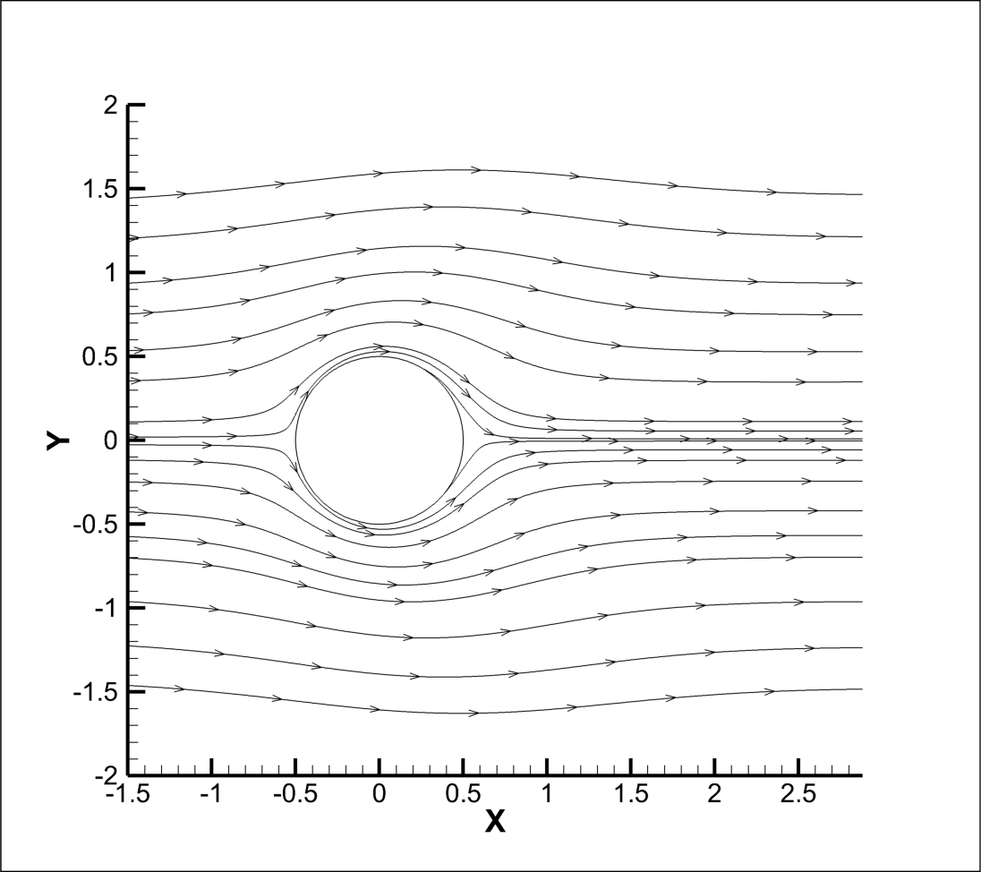
Streamlines, Re 100000
Re = 100,000, strong wake shedding persists up to Ha = 100, but diminishes by Ha = 150–200, where near-wall vorticity dominates and a quasi-steady flow appears.
Interestingly, at Ha = 250, vortex shedding re-emerges with alternating wake vortices suggesting a non-monotonic response, likely due to altered boundary layer behaviour or secondary instabilities induced by excessive Lorentz forces.
At Ha = 300, weak remnants of unsteady vortices remain, but for Ha = 500 the wake becomes fully stabilized
Ha=0
Ha=50
Ha=75
Ha=100
Ha=150
Ha=200
Ha=250
Ha=300
Ha=400
Ha=500

Slide 13
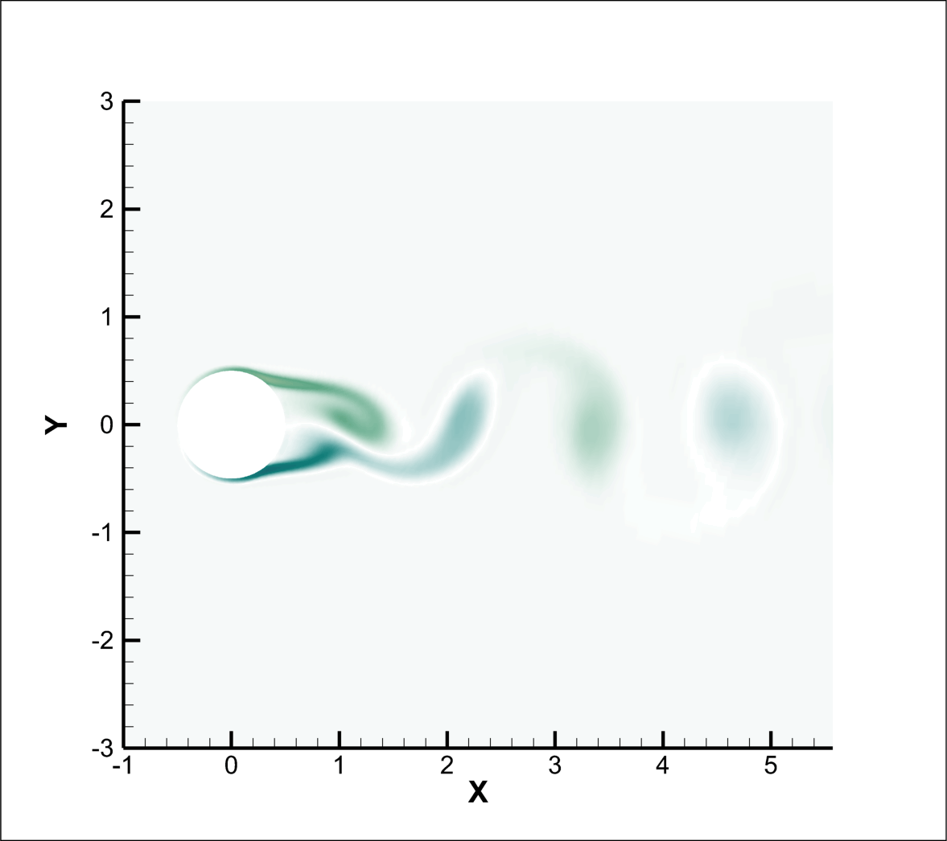
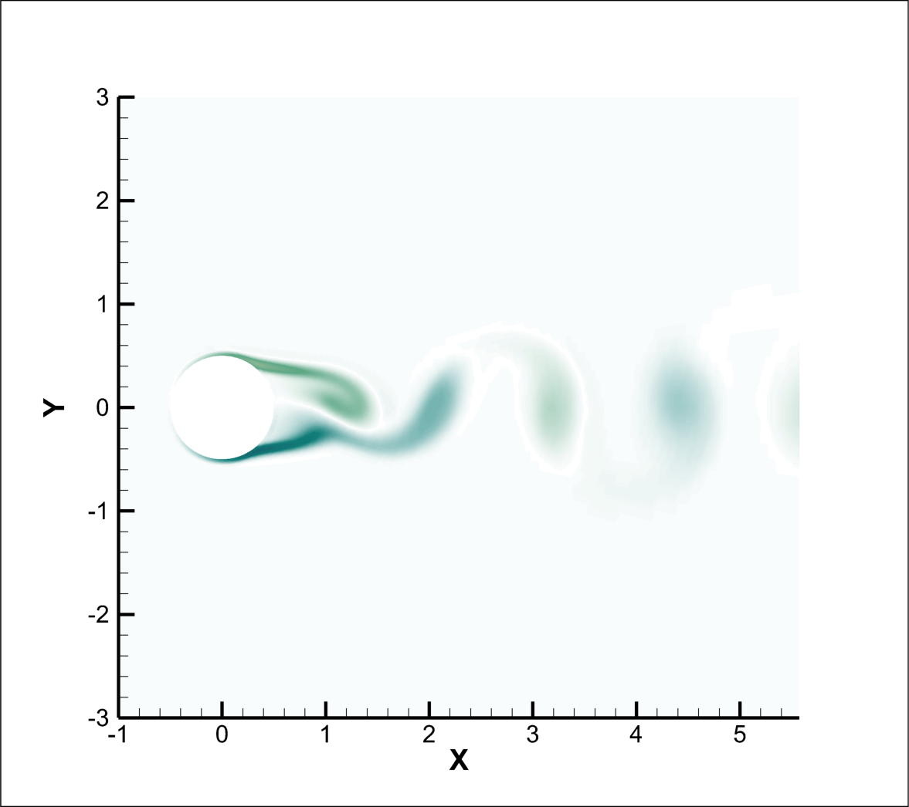
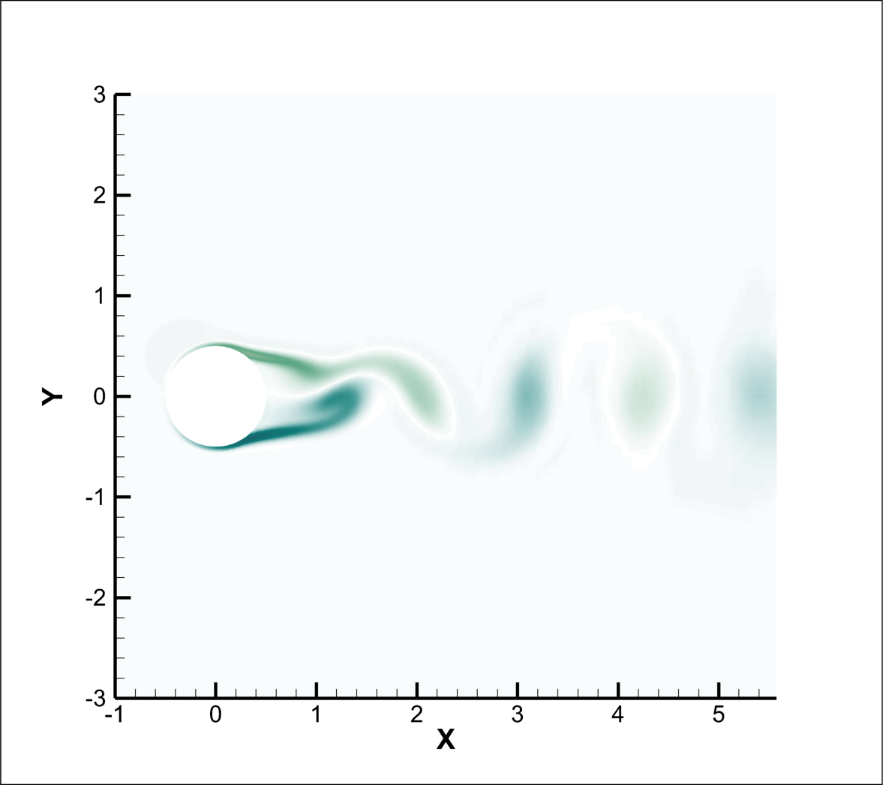







Z- Vorticity : Re 100000
Ha=0
Ha=50
Ha=75
Ha=100
Ha=150
Ha=200
Ha=250
Ha=300
Ha=400
Ha=500

Slide 14




Nusselt Number
🔹 Nusselt Number (Nu)
The Nusselt number increases moderately with Hartmann number across all Reynolds numbers. At higher Re, the enhancement is more pronounced due to stronger convective activity.
The Lorentz force suppresses turbulence, it steepens the near-wall temperature gradients, leading to improved heat transfer.
Nu vs Hartman Number
Nu vs θ (deg) for Re 1000
Nu vs θ (deg) for Re 10,000
Nu vs θ (deg) for Re 1,00,000

Slide 15



Pressure Coefficient
🔹 Pressure Coefficient($C_{p}$)
The pressure coefficient $C_{p}$shows high values at the front stagnation point (θ = 0°), drops sharply along the sides, and rises again at the rear, with the rise becoming smoother and weaker as Ha increases due to Lorentz damping of separation
Cp vs θ (deg) for Re 10,000
Cp vs θ (deg) for Re 1,00,000

Slide 16





Drag & Lift Behaviour
🔹 Lift Coefficient ($C_{l}$)
The lift coefficient fluctuations diminish steadily as Ha increases.
The suppression of unsteady lift forces demonstrates the stabilizing role of the magnetic field on vortex shedding.
At high Ha, the wake becomes symmetric, and Cl approaches nearly steady values.
🔹 Drag Coefficient ($C_{d}$)
Lorentz force resists the motion of the conducting fluid. This adds an electromagnetic drag component to the usual viscous + pressure drag.
The stronger the magnetic field (higher Ha), the stronger this damping → so Cd rises.
$C_{l}$ vs Hartman Number
$C_{d}$vs Hartman Number

Slide 17
Key Takeaways / Conclusion
Magnetic field (Ha) effectively controls flow around bluff bodies.
Lorentz force suppresses vortex shedding → smoother Cl profiles.
Drag coefficient (Cd) increases with Ha due to electromagnetic damping.
With increase in Ha, Nu number increases.
At very high Re, stronger fields are required to stabilize flow.
Transverse Magnetic field can control flow dynamics and heat transfer in electrically conducting fluid. The degree of control scales with both Reynolds and Hartmann Number.

Slide 18
Future Scope
Extended Geometries: Study of MHD flow over more complex bluff bodies (airfoils, arrays of cylinders).
3D Simulations: Extension to fully 3D turbulent wakes for better industrial applicability.
Coupled Physics: Integration with nanofluids or oscillating cylinders for enhanced control.
Applications: Insights can guide drag reduction and thermal management in aerospace, nuclear cooling, and metallurgical processes.

Slide 19
Thank-You

