Slide 1
GAN Based Brain MRI Detection Using Limited Annotations.
Name | Usn
Pracheth M H | 01FE16BCS096
Tanushree Kale | 01FE16BCS216
Rakesh Kuratti | 01FE17BCS419
Sushant Huilgol | 01FE17BCS424
Guide: Dr. Shrinivas D Desai.
Team: 13

Slide 2
Agenda
Problem Statement
Objectives
System model(Black Box)
System Architecture(GAN architecture)
Data Flow Diagram(level 0)
Data Flow Diagram(level 1)

Slide 3
Problem Statement
Generative Adversarial Networks (GAN) based data augmentation for brain metastases detection using limited annotation on MR Images.

Slide 4
Objectives
To develop a model using Generative Adversarial Network(GAN) for the synthesis of brain image dataset.
Evaluate and validate the model from an expert in the medical field.
Compare the results with existing models.

Slide 5
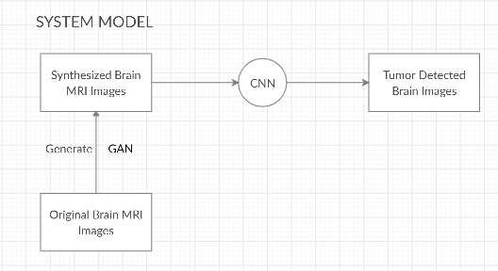
Sytem Model(Black Box)

Slide 6
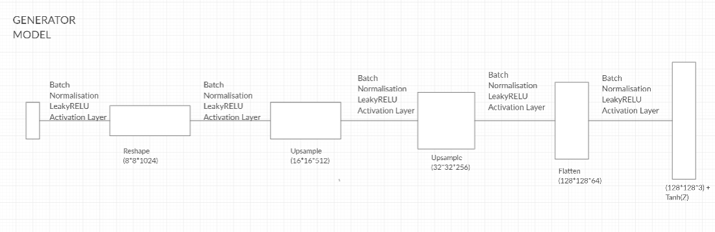
System Architecture

Slide 7
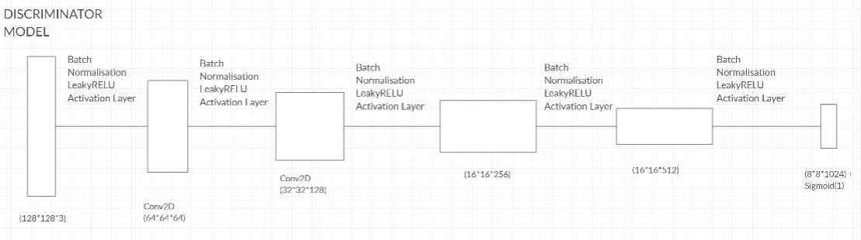
System Architecture

Slide 8
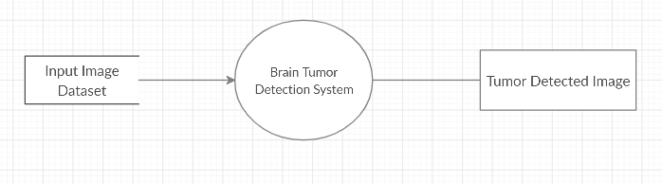
DATA FLOW DIAGRAMS
LEVEL 0

Slide 9
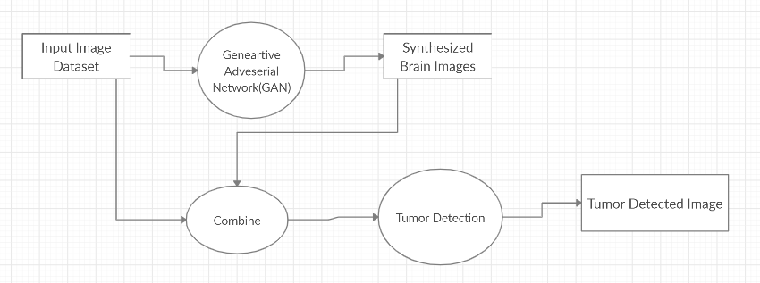
DATA FLOW DIAGRAM
LEVEL 1

Slide 10
Implementation Phase:
Dataset used, contains 253 brain images in which:
98 tumour images
155 non-tumour images
Generator input: resize the image to the previous generator’s output resolution/channel size and concatenate them (noise samples generate the first 4×4 images)
Discriminator input: concatenate the conditioning image with a real or synthetic image.
The model uses a U-net architecture.

Slide 11
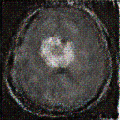
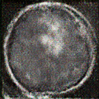
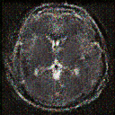
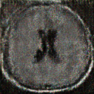
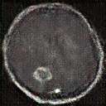
Implementation Results
Above are the synthetic images generated by the GAN model by using the following
parameters:
Epochs = 1000
Generator learning rate = 0.0004
Discriminator learning rate = 0.004

