Slide 1

RMD Sinhgad School of Engineering, Warje,
Pune-58.
NAAC accredited with "A" Grade Department of Computer Engineering
Academic Year: 2020-21
TE [Data Science Project] (SEM-V)

Slide 2
A Vision-based Home Security System using OpenCv
Presented By -
Manjusha Katkhede (A - 58)
Prachi Pachang (B - 06)
Dhanashri Aadhav (A - 03)
Vaishnavi Ugale (B – 67)
Guided by – prof Shrutika Nalawade Ma’am

Slide 3
CONTENTS
Introduction
Objective
System Architecture
Working of system
Technical details
Advantages & Disadvantages
Conclusion
References

Slide 4
INTRODUCTION
Home security system is established to benefit numerous times by providing immediate monitoring of the house. Because of the increasing home theft and burglary incidents that create an awareness among most of the house owners.
There are many Systems which are using a Passive Infrared (PIR) motion sensor for motion detection. Although affordable, such a system still has many limitations.
For example, false alarms triggered due to an abnormal condition such as rapid heating from sunlight exposure. In this work, a vision-based home security system using OpenCV was developed to improve the effectiveness of motion detection in

Slide 5
OBJECTIVE
The project is designed to help immediate monitoring of the house. The main objective of the project is following:
Crime prevention is one of goals of this system. This is because it saves valuable lives, money and time. Home and work place become the victims of crime nowadays. Many people have started using various types of security system to prevent unauthorized trespasses in their property such a system still has many limitations
This system provides immediate monitoring with advance burglar detection technique.

Slide 6
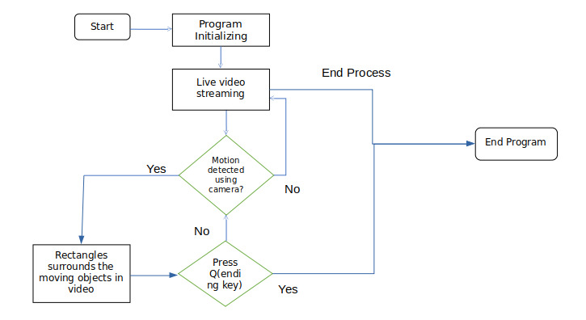
SYSTEM ARCHITECTURE

Slide 7
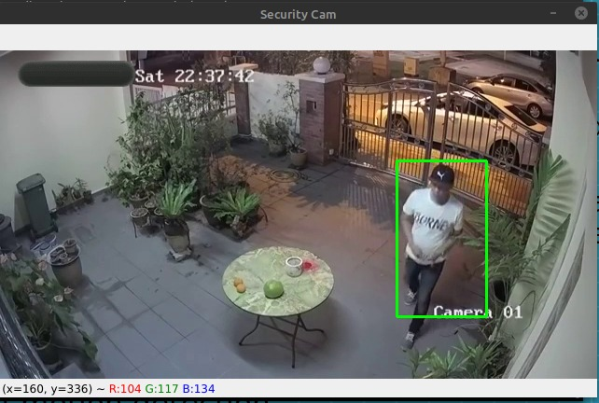
WORKING
Firstly web cam captures video frames & openCv reads the frames when camera is opened(on).
Basically two frames we are generating for comparison.
If the one frame is static & another frame(pixels) is moving or there is difference in two frames then the camera detects the motion
And it shows the rectangular border around that particular area where motion is detected.

Slide 8
TECHNICAL DETAILS
HARDWARE REQUIREMENTS
Processor : Dual Core or higher.
Hard Drive : 500GB or higher.
RAM : 2GB or higher.
Internet Connection : Preferred 1 MBPS or higher.
2.SOFTWARE REQUIREMENTS
Open CV (computer vision) library : Open source computer vision library known as Open CV is written in C and C++ and runs under Linux, Windows and Mac OS X. There is active development on interfaces for Python and other languages.
Operating System : Windows 7/Linux
Python interpreter
Web cam

Slide 9
ADVANTAGES & DISADVANTAGES
Advantages :
Provides Security
Cost Savings
High accuracy
It improve the effectiveness of motion detection
Provide immediate monitoring of house
Disadvantages :
If the subject or object has a similar color to the background, either the movement is not detected or it is poorly detected.

Slide 10
CONCLUSION
The system is designed to reduce home theft ,burglary & criminal activities by providing immediate monitoring with low maintenance.
We conclude that a vision based home security system has been successfully developed according to its objectives and desired specifications.

Slide 11
REFERENCES
R. Sampson, “False burglar alarms,” in Problem-Oriented Guides for Police: Problem-Specific Guides Series No. 5, U. S. D. o. J. Office of Community Oriented Policing Services, Ed., 2 ed, (2007).
R. R. Ragade, “Embedded home surveillance system with pyroelectric infrared sensor using GSM,” in 2017 1st International Conference on Intelligent Systems and Information Management (ICISIM, 2017), 321–324,
https://ieeexplore.ieee.org/document/6850818
https://pypi.org/project/opencv-python/
https://www.google.com/search?q=opencv+python&rlz=1C1CHBD_enIN811IN811&oq=open+cv+&aqs=chrome.1.69i57j0i10i512l9.5286j0j15&sourceid=chrome&ie=UTF-8

Slide 12
THANK YOU !!

