Slide 1



Meal Magic –
Elevate your meals , simplify your budget
Represented By:
Prachi Agrawal (230941220121)
Sakshi Wasankar(230941220152)

Slide 2
In an era defined by hectic schedules, diverse culinary preferences, and a growing emphasis on personalized dining experiences, Meal Magic emerges as a transformative solution poised to revolutionize the way individuals engage with professional culinary services.
01
Project Introduction –
At its essence, Meal Magic is more than just a digital platform; it embodies a culinary renaissance, redefining the traditional boundaries of culinary exploration and engagement. By seamlessly integrating advanced technological features with the artistry of culinary craftsmanship, the system empowers users to embark on a culinary journey unlike any other, where culinary aspirations are realized, and gastronomic boundaries are transcended.
02

Slide 3
Meal Magic is designed to create a platform which will act as a bridge, connecting chefs and consumers, enabling users to hire profession chefs/home cooks to prepare their favorite meals in the comfort of their own homes in their budget. It not only allows chefs to demonstrate their skills to a broader audience but also provides an avenue for home cooks to generate income by offering their cooking services.
Objective (Purpose):

Slide 4
01
User’s and chef’s will have profiles with relevant information. User’s will be able to browse various categories of food and select a chef based on their budget ,location and ratings.
Scope:
The booking can be done on a monthly, per meal, or per day basis. Chefs have the flexibility to accept or reject requests based on their availability.
02
Chefs can showcase their work by uploading pictures of their dishes. Users can see the availability of chefs 24/7 and need to book a chef at least 2 hours prior.
03

Slide 5
01
Front-End:
ReactJS , CSS , HTML5
Technology Used:
Backend:
J2EE
Java Spring Boot API
02
03
Database:
MYSQL

Slide 6
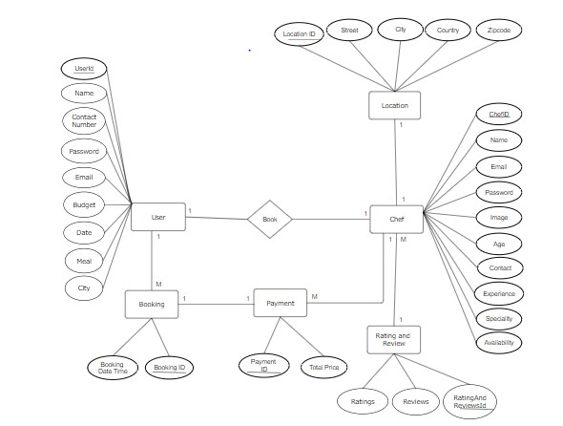
E-R Diagram:

Slide 7
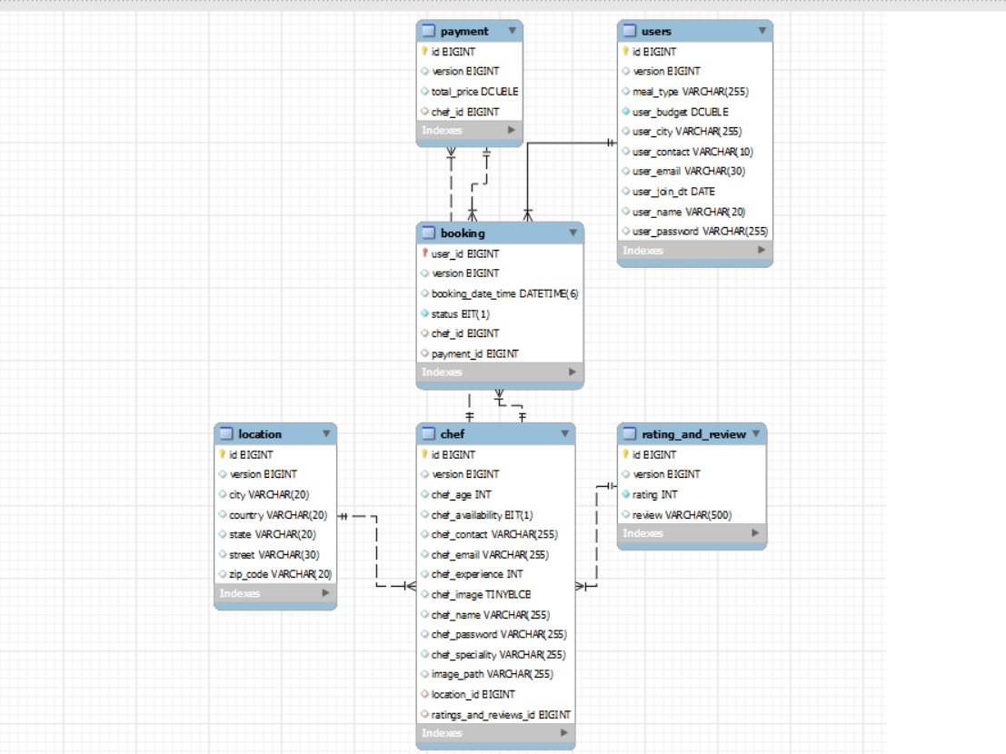
Database Genrated
E-R Diagram:

Slide 8
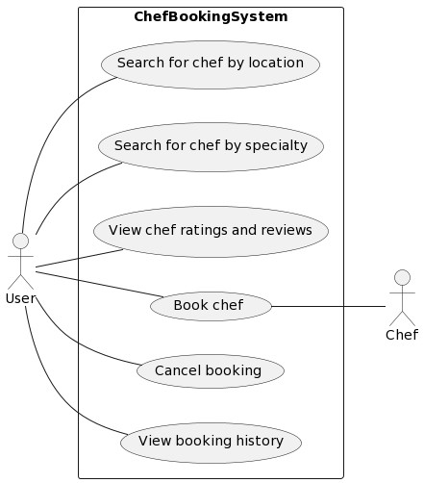
Use Case:

Slide 9
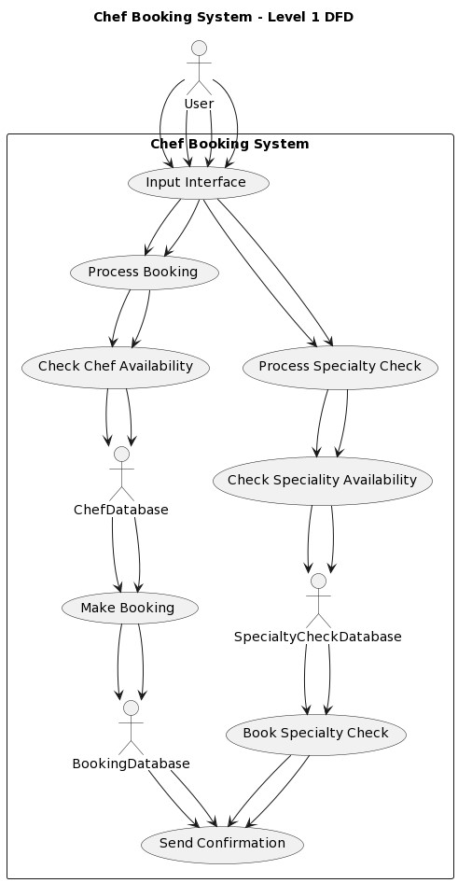
DFD diagrams :

Slide 10
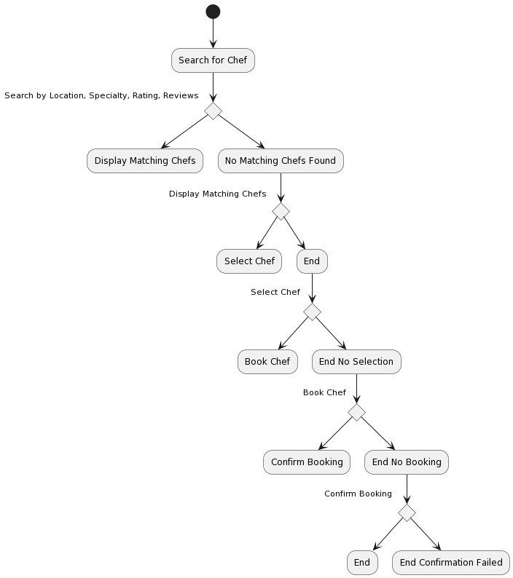
Activity Diagram:

Slide 11
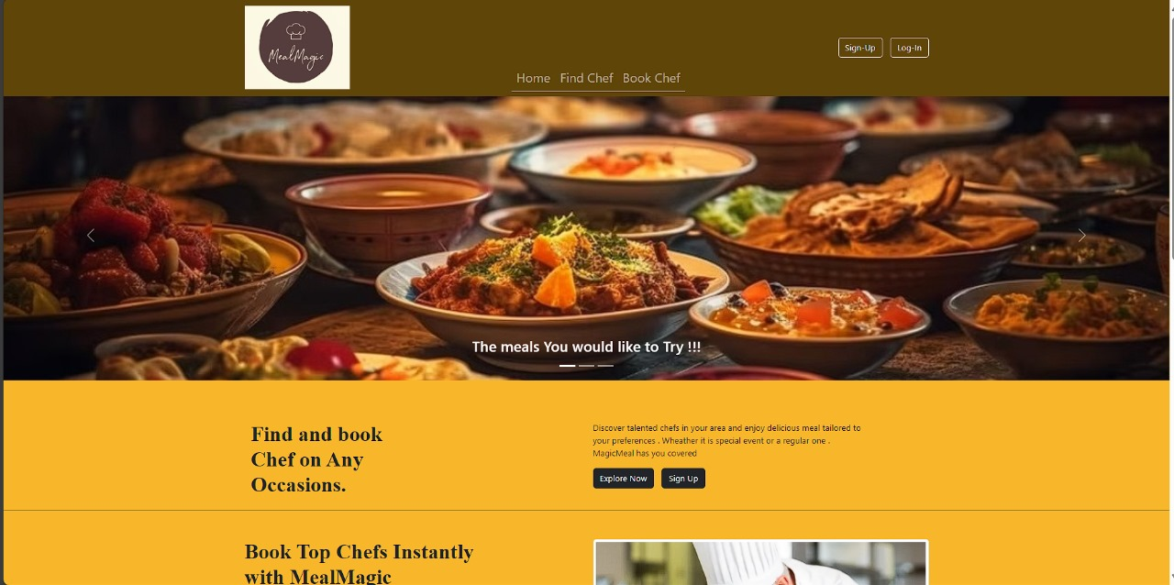
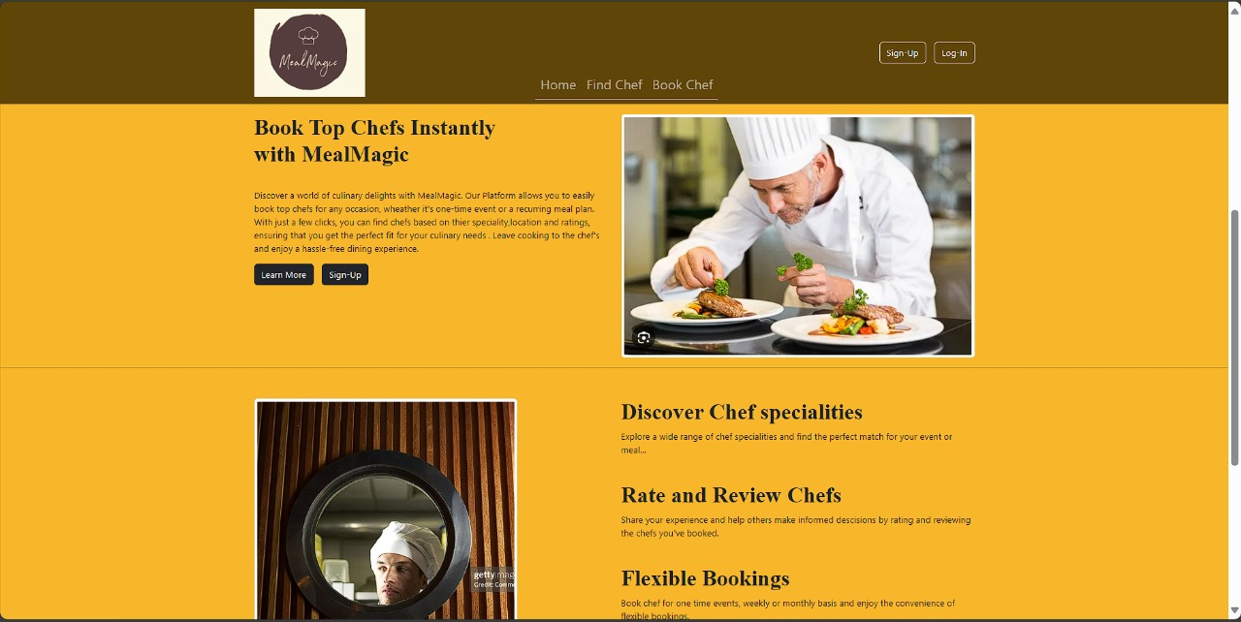
UI Screen Shots :
Home Page

Slide 12
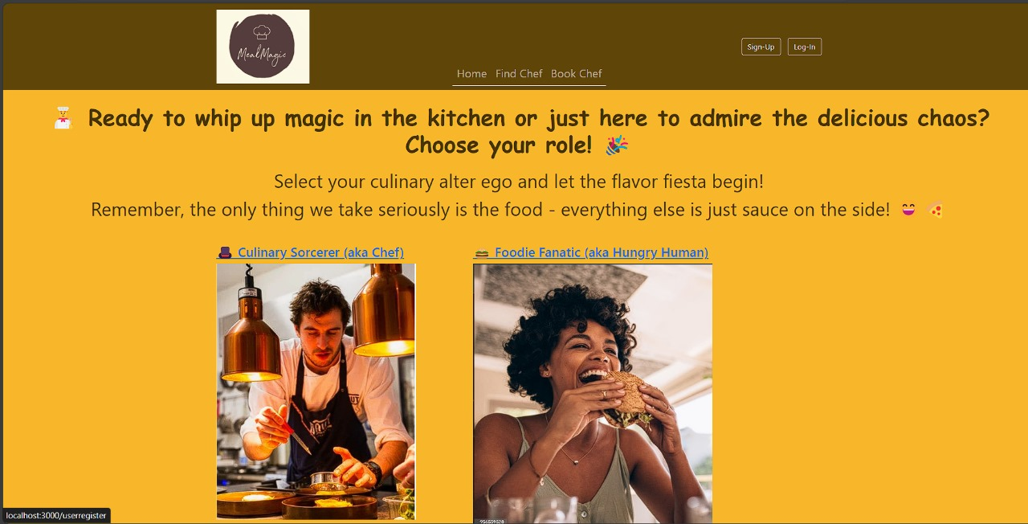
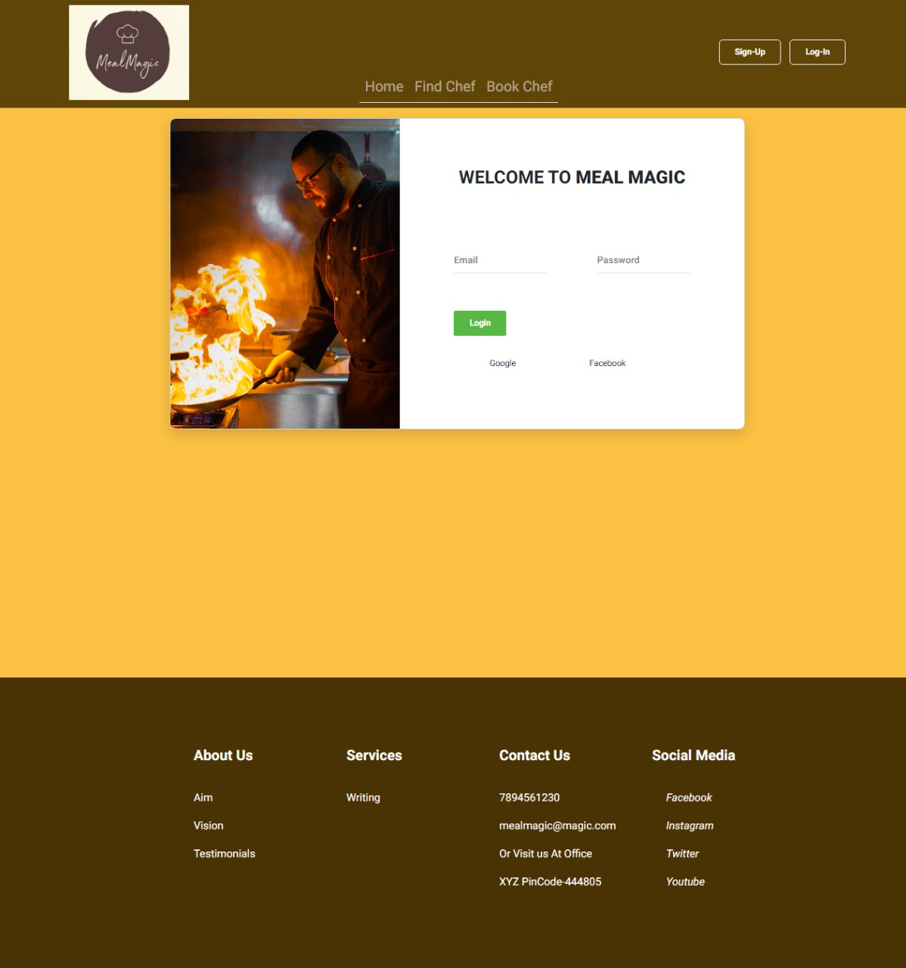
Sign-Up and Login Page

Slide 13
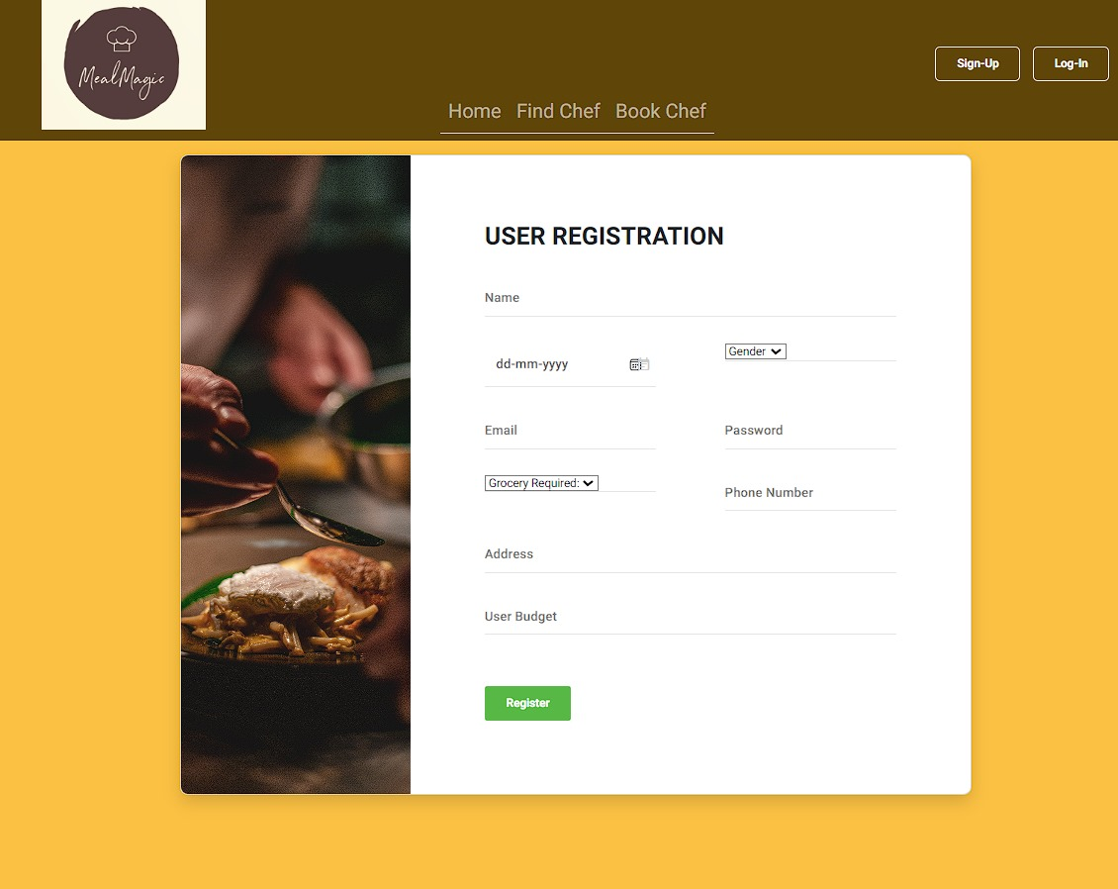
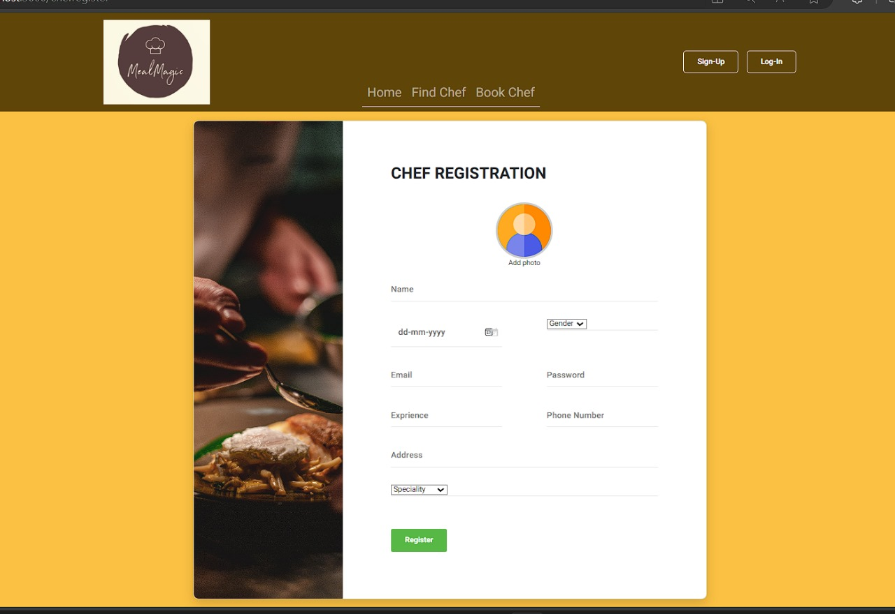
Registration Page

Slide 14
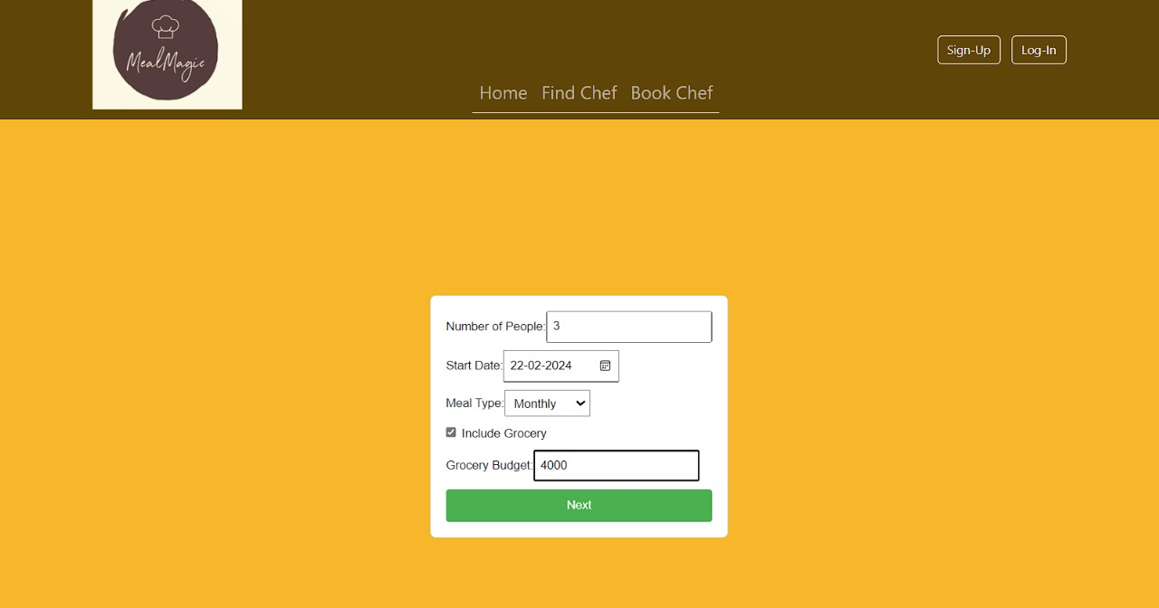
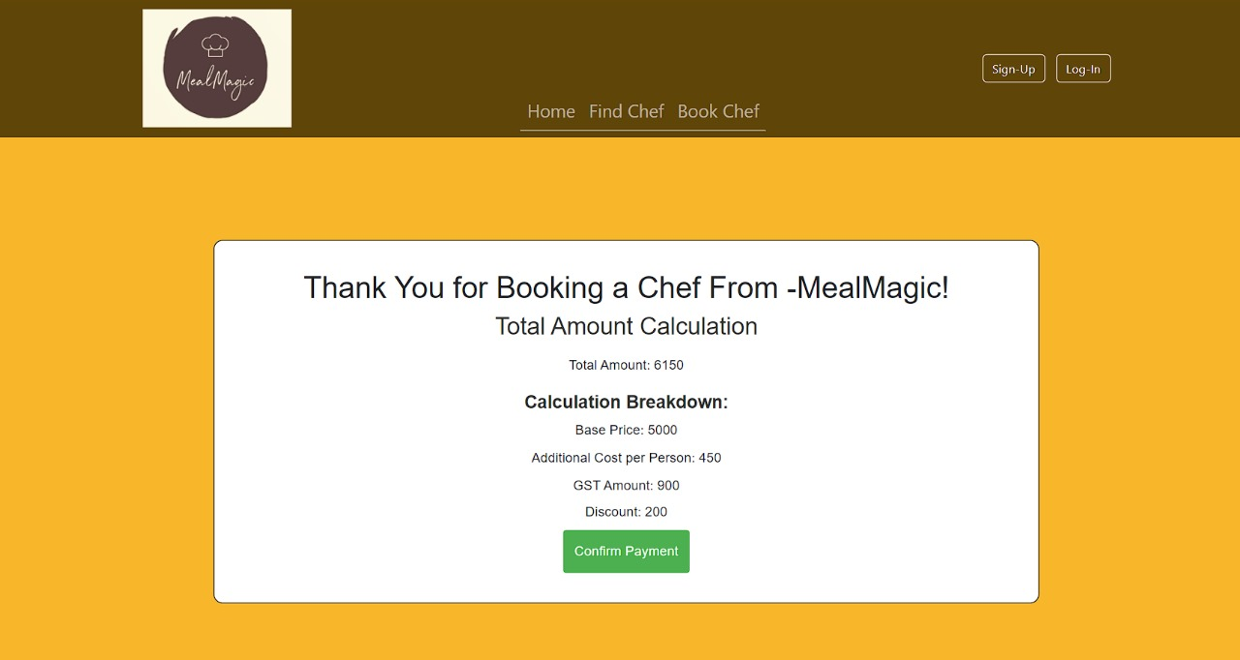
Booking and Payment

Slide 15
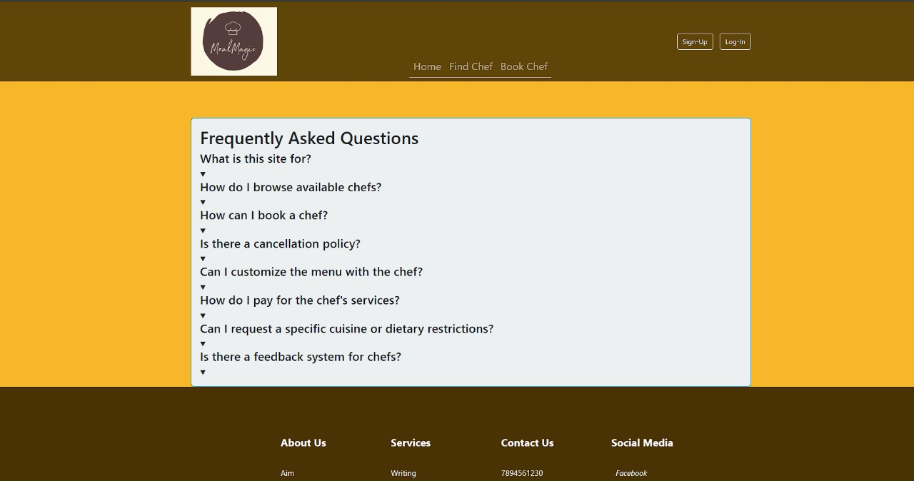
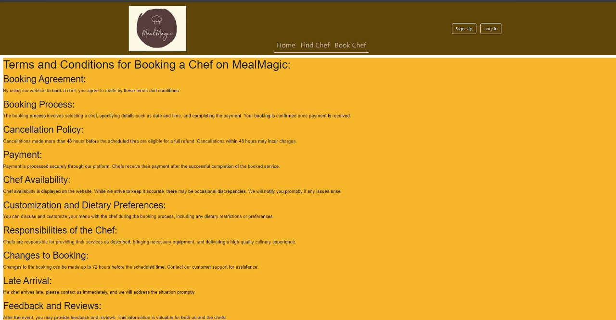
FAQ , Terms and Conditions

Slide 16
Enhanced Personalization:
01
By leveraging advanced data analytics and machine learning algorithms, the system can gain deeper insights into user preferences, dietary restrictions, and culinary trends.
Futures Scope :
Integration of Virtual and Augmented Reality:
Users could virtually explore chef profiles, attend interactive cooking classes, and even visualize their meal preparations in real-time using augmented reality overlays. This integration enhances user engagement and provides a unique way to interact with chefs and their culinary creations.
02
Expanded Culinary Services:
the Chef Booking System can expand beyond traditional chef services to offer a broader range of culinary experiences. This could include curated meal delivery services, pop-up dining events, and virtual food festivals.
03

Slide 17
The Chef Booking System revolutionizes the culinary experience by seamlessly connecting users with professional chefs and personalized culinary experiences. .
01
Conclusion:
Through innovative technology, cultural exchange, and a commitment to sustainability, the system empowers users to explore, create, and savor memorable dining experiences tailored to their preferences.
02
As it continues to evolve and innovate, the Chef Booking System remains at the forefront of culinary excellence, reshaping the way individuals engage with food and culinary culture in the digital age.
03

Slide 18
Thank You !!!!

