Slide 1
Autism Detection in Adults PROJECT WORK
SUBMITTED TO-
Dr. Satya Prakash Sahu
SUBMITTED BY-
Prachi Nagdeve(20118068)
Prathamesh Bhosale(20118070)
Sumona Sarkar(20118102)

Slide 2
Table of contents
1
2
3
4
Problem Statement
Literature Survey
Result Analysis and Conclusions
Methodology

Slide 3
Problem Statement
The problem statement for Autism Spectrum Disorder (ASD) detection revolves around the increasing prevalence of ASD and the need for efficient and accurate diagnostic tools. As the number of individuals diagnosed with ASD rises, there is a growing demand for reliable methods that can aid in early and precise identification of the disorder. Traditional diagnostic approaches may have limitations, and there is a pressing need to explore advanced technologies, such as machine learning algorithms, to enhance the diagnostic process. The challenge is to develop and evaluate these algorithms, considering a comprehensive dataset of behavioral and clinical features, to determine their effectiveness in detecting ASD. The goal is to contribute to the improvement of early diagnosis, leading to timely intervention and support for individuals on the autism spectrum.

Slide 4
Literature Survey
Autism Spectrum Disorder’s economic impact on healthcare is substantial due to rising cases and the time/cost of diagnosis. Early Autism Spectrum Disorder detection is crucial, reducing long-term costs and improving patient outcomes. There's an urgent need for a quick, robust, accessible Autism Spectrum Disorder screening method to predict and inform clinical diagnosis. However, challenges arise, as scarce datasets hinder thorough analysis for enhancing screening efficiency, sensitivity, and accuracy.

Slide 5
Prediction and Analysis of Autism Spectrum Disorder Using Machine Learning Techniques (2023) -Muhammad Shuaib Qureshi, Muhammad Bilal Qureshi, Junaid Asghar, Fatima Alamand Ayman Aljarbouh This study examines autism spectrum disorder (ASD) prediction models, particularly focusing on machine learning techniques. It provides a theoretical overview, enabling new researchers to understand these models. A detailed comparison highlights architectural and implementation differences, distinguishing this analysis. The study exclusively consolidates ASD prediction techniques, offering a comprehensive coverage of state-of-the-art methods. While the current model surpasses existing methods, future investigations could explore enhancing accuracy through fuzzy logic algorithms and experimenting with additional datasets. The achieved accuracy is 89.23%
1

Slide 6
Analysis and Detection of Autism Spectrum Disorder UsingMachine Learning Techniques (2019) -Suman RaJ ,Sarfaraz Masood In this work, detection of Autism Spectrum Disorder was attempted using various machine learning and deep learning techniques. Various performance evaluation metrics were used to analyze the performance of the models implemented for ASD detection on non-clinical dataset from three sets of age groups viz. Child, Adolescents and the Adult. When comparing the result with another recent study on this problem got a better result of the CNN classifier instead of SVM with including all its features attributes after handling missing values. In this work after handling missing value, both the SVM and CNN based models show the same accuracy of prediction of about 98.30 % for ASD Child dataset. These results strongly suggest that a CNN based model can be implemented for detection of Autism Spectrum Disorder instead of the other conventional machine learning classifier suggested in earlier researches.
2

Slide 7
Automated Detection of Autism Spectrum Disorder Using a Convolutional Neural Network (2020) -Soorena Salari, Vahid Salari, Moloud Abdar, U. RaJendra Acharya In this study, they introduced a CNN architecture for identifying and classifying ASD patients and control subjects, achieving a superior accuracy of 70.2% on the preprocessed ABIDE I dataset. Their model outperformed existing methods with fewer parameters (4,398,802) compared to previous large-scale models. Notably, the CNN demonstrated better efficiency and reduced training time. They have also analyzed connectivity matrices, representing brain region correlations.
3

Slide 8
Dataset
We'll be using the "Autistic Spectrum Disorder Screening Data for Adult" public dataset from the UCI repository. The datset was donated by Prof. Fadi Thabtah, after being published in the article "Autism Spectrum Disorder Screening: Machine Learning Adaptation and DSM-5 Fulfillment".
Our data set involves ten behavioral features (AQ-10-Adult) (binary data) and ten individual characteristics such as Gender, Ethnicity and Age (categorical data), and we would like to be able to identify the most influential autistic traits. This algorithm can prove to be invaluable by helping to identify individuals who have high chance to be diagnosed with ASD and provide them with relevant treatment, therapy and counseling in a time sensitive fashion.

Slide 9
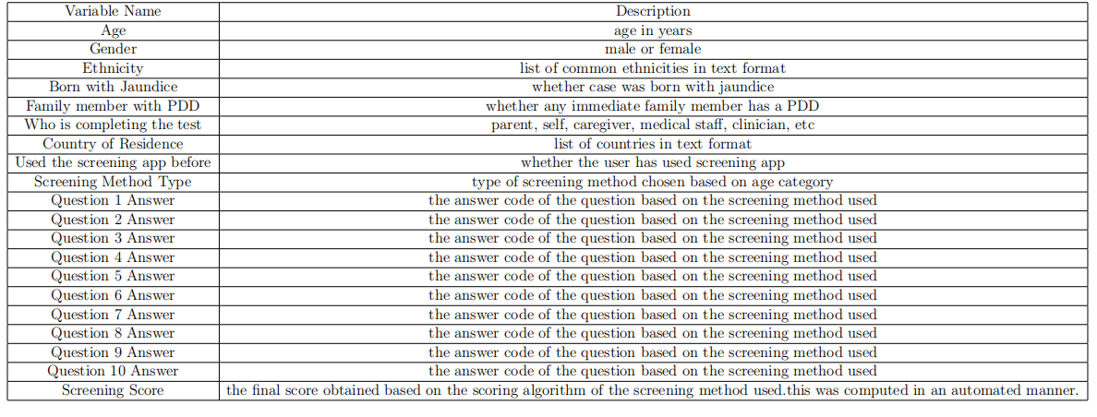

Slide 10
Methodology
With the data on 704 individuals our goal is to make a prediction regarding each patient and classify them into one of two categories: ”patient has ASD” and ”patient does not have ASD ”. In other words, we are working on a binary classification problem using supervised machine learning with the ultimate goal of being able to classify new instances, i.e. when we have a new adult patient we would like to able to predict whether or not that individual has high probability of having ASD. We will use supervised machine learning to refer to creating and using models that are learned from data i.e., there is a set of data labelled with the correct answer for the model to learn from. we will also apply Principle Component

Slide 11
Dataset Info: 1. Original dataset: 200 instances, 13 attributes (including class variable). 2. Attributes: Categorical, continuous, and binary. Preprocessing Steps: 1. Identified Issues: Detected non-contributing and categorical attributes. 2. Data Cleaning: Removed 'Case-No,' 'Who completed the test,' and 'Qchat-1-0- Score.' Handling Categorical Values: 1. Label Encoding: Applied to four features with 2 classes each. 2. Binary Features: Used binary label encoding. 3. Multiclass Feature: Applied One-Hot Encoding to 'Ethnicity' (11 classes). Purpose of Preprocessing: 1. To make the data suitable for machine learning models by cleaning and transforming it. 2. Enhance model training and analysis by addressing noise and irrelevant attributes.
Data Preprocessing

Slide 12
Employ feature engineering
It chooses the most beneficial feature out of all the features
available. Because it reduces data dimensionality and improves speed and efficiency during the time training.
A. RF classification:
1. Success Factors:
i. Dataset Quality: The quality of the dataset impacts model success.
ii. Feature Choice: Selecting relevant features is crucial.
iii. Algorithm Selection: Choosing the right machine learning algorithm is key.
2. Key Requirement:
Understanding characteristics of RF signals for effective feature extraction.

Slide 13
Employ feature engineering
B. xGBoost Classification:
1. Algorithm Type: Ensemble learning, specifically Extreme Gradient Boosting.
2. Versatility: Effective for both classification and regression tasks.
3. Popularity: Widely used in competitions and real-world applications.
4. Strengths: Excellent predictive performance.
C. LightGBM (Light Gradient Boosting Machine):
1. Framework Type: Gradient boosting, developed by Microsoft.
2. Efficiency: Designed for efficient and distributed training.
3. Suitability: Well-suited for large datasets and high-dimensional data.
4. Notable: Known for speed and efficiency in various machine learning applications.

Slide 14
Employ feature engineering
D. Logistic Regression (LR):
1. Model Type: Linear model for binary classification.
2. Advantages: Simplicity and interpretability.
3. Purpose: Finding the best-fitting model for the relationship between variables.
4. Functionality: Uses logistic function to fit an optimal curve to the data.
E. Naive Bayes (NB):
1. Classifier Type: Probabilistic, based on Bayes' theorem.
2. Assumption: Features are conditionally independent.
3. Computational Efficiency: Efficient due to its assumptions.
4. Limitations: Works well with a limited number of features.

Slide 15
Employ feature engineering
F. K-Nearest Neighbors (KNN):
1. Algorithm Basis: Relies on a distance metric and similarity of nearby points.
2. Prediction Process: Finds k nearest training data points to predict a label.
3. Accuracy in Analysis: Lower values of k (1 to 10) yielded higher accuracy.
4. Conceptual Foundation: Points close to each other are considered similar.

Slide 16
Results analysis
As important as it is to find the right model it is equally important to establish which modelsmay not be the best choice. Evaluation metrics such as AUC Score(AUC), F Beta-score with beta=0.5(F-Beta), Cross-validation score(CVS) for each method are used.
After exploring the ASD dataset with different learning algorithms, we have arrived at the conclusion that all of our model work extremely well with the data. we have used three different metrics (accuracy, AUC score and F-score) to measure the performance of the models, and it seems like all of the metrics indicated an almost perfect classification of the ASD cases.

Slide 17
Conclusions
The ASD assessment process is time-consuming due to overlapping symptoms, necessitating an optimized screening tool for early detection. Our automated prediction model, developed with minimal behavior sets, addresses the challenge of lengthy assessments. However, limited large, open-source ASD datasets impact model accuracy. Despite this, our research provides insights for an automated model aiding childhood autism detection. Future plans involve larger datasets, deep learning techniques, and dynamic ASD prediction over time for enhanced screening strategies.

Slide 18

Improvements
In our consideration, to build an accurate and robust model, one needs to have larger
datasets. Here the number of instances after cleaning the data were not sufficient enough
to claim that this model is optimum.
Also, in future we are expecting to add a few more classification algorithms for a better metric comparison such as Logistic Regression, MLP, KNN, etc.

Slide 19
References
Thabtah, Fadi. "Machine learning in autistic spectrum disorder behavioral research: A review and ways forward. (2018) " Informatics for Health and Social Care : 1-20.
Brian Godsey, Think Like a Data Scientist Manning, ISBN: 9781633430273
D. Cielen, A. Meysman, M. Ali, Introducing Data Science, Manning ISBN:9781633430037
G. James, D. Witten, T. Hastie, R. Tibshirani, An Introduction to Statistical Learning with Applications in R, Springer, ISBN 9781461471370
Vaishali, R., and R. Sasikala. "A machine learning based approach to classify Autism with optimum behaviour sets. (2018) " International Journal of Engineering & Technology
Tabtah, F. (2017). Autism Spectrum Disorder Screening: Machine Learning Adaptation
and DSM-5 Fulfillment. Proceedings of the 1st International Conference on Medical and Health Informatics 2017, pp.1-6. Taichung City, Taiwan, ACM.

Slide 20

Thanks…
Please keep this slide for attribution

