Slide 1




PROJECT ENDSEM PRESENTATION
Prachi Sanyal
Roll No: 90
PRN No: 8022005098
Seat No: 645190
TYBCA: Div A

Slide 2

DOMAIN
Full Stack Web Development
( MERN Stack Developer )

Slide 3

Comprehensive Curriculum:
Classes for Students of class 6 to 10 and 11/12 Science.
Boards: GSEB/CBSE/ICSC.
All Subjects under 1 roof.
Experienced & Dedicated Team:
Managed By: Samarth Doshi.
Highly Experienced Professionals.
Guidance by Subjective Experts.
CLIENT
OVERVIEW
Holistic Development:
Personal Attention to Each and Every Student.
Weekly Tests.
Special batches for SOF Olympiad.
Special class for Gujcet/JEE/NEET.
Career Guidance.
Contact & Location:
Contact Num : 9687621805
shreejiclasses.vadodara@gmail.com
.Location: FF 11-14,Dream Aatman2, Opp. Billabong School, Vadsar, Vadodara-390010
Client Name: Samarth Doshi

Slide 4






TOOLS &
TECHNOLOGIES
Code Editor
Cloud Service
Primary Stack
For API Testing
For VersionControl

Slide 5


PROJECT SCOPE
The scope of this project is to digitize coaching class management, improving efficiency and reducing manual work. It offers a secure system for authentication, course enrollment, inquiry management, fee processing, attendance tracking, notifications, timetable management, study materials, and quizzes, with role-based access allowing only authorized users to sign up via admin-generated links. Key processes like inquiries, fee tracking, attendance, and progress monitoring are automated. The system enhances the educational experience by providing students with easy access to learning resources and giving parents regular updates on their child’s progress, strengthening communication and engagement.

Slide 6


WORK MODULES
1
2
3
User Authentication & Management
Course Management
Consultation and Inquiry
Inquiry form submission
Admin actions for responses
Auto-delete resolved inquiries
User registration and login
Profile management
Account recovery (password reset).
CRUD operations for courses .
Course listing

Slide 7
WORK MODULES
4
5
6
Announcement and
Notifications
Fee Management
Uploading Test Marks & Attendance
Admin & teacher manages and publishes announcements.
Notifications displayed on user dashboards.
Notify users about events and activities.
Payment gateway integration.
Fee structure display.
Generate payment receipts.
Attendance tracking
Test marks management.
Monthly progress reports

Slide 8
WORK MODULES
7
8
Timetable Management
Uploading Study Materials
Study material management
Material access (Students download materials)
Quiz creation and management
Admin manages class schedules for students and teachers.
Timetable visibility on respective dashboards..

Slide 9
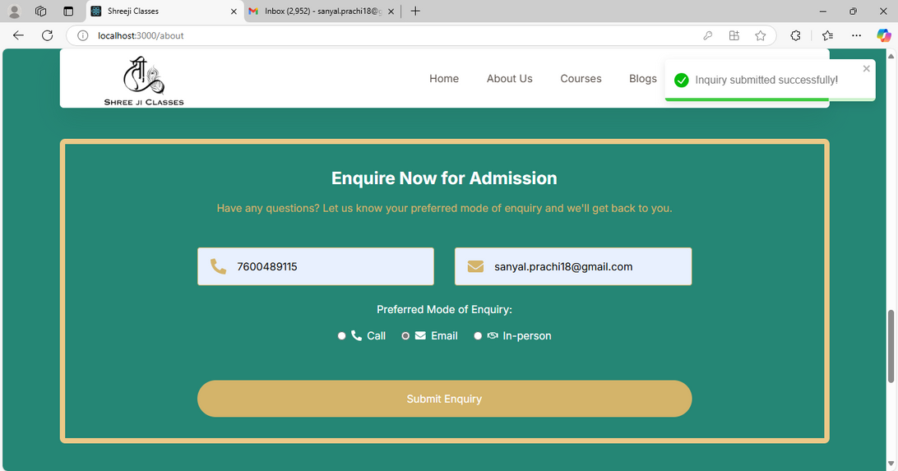
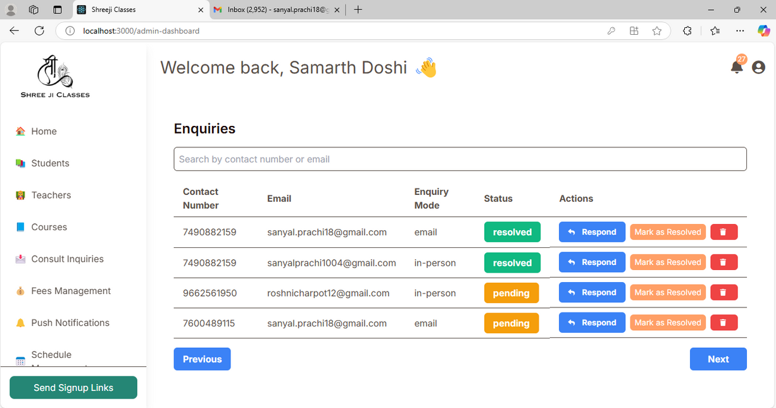
Visitor submits enquiry form
Admin responds to enquiries
9

Slide 10
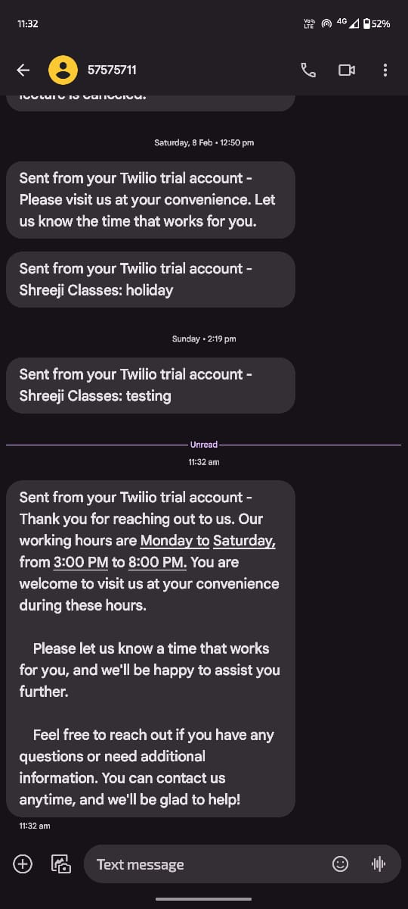
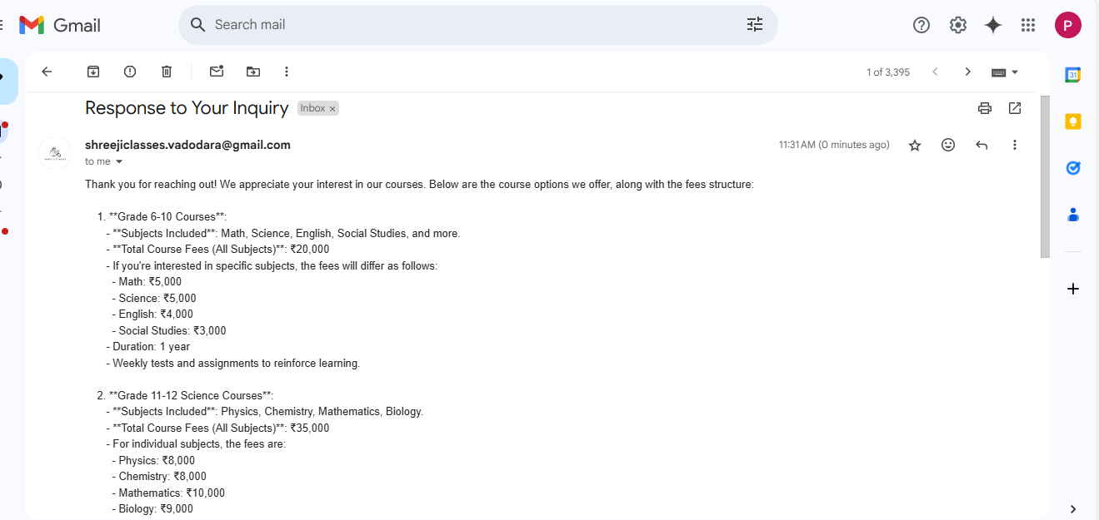
Mode of enquiry : Email
Mode of enquiry : SMS

Slide 11
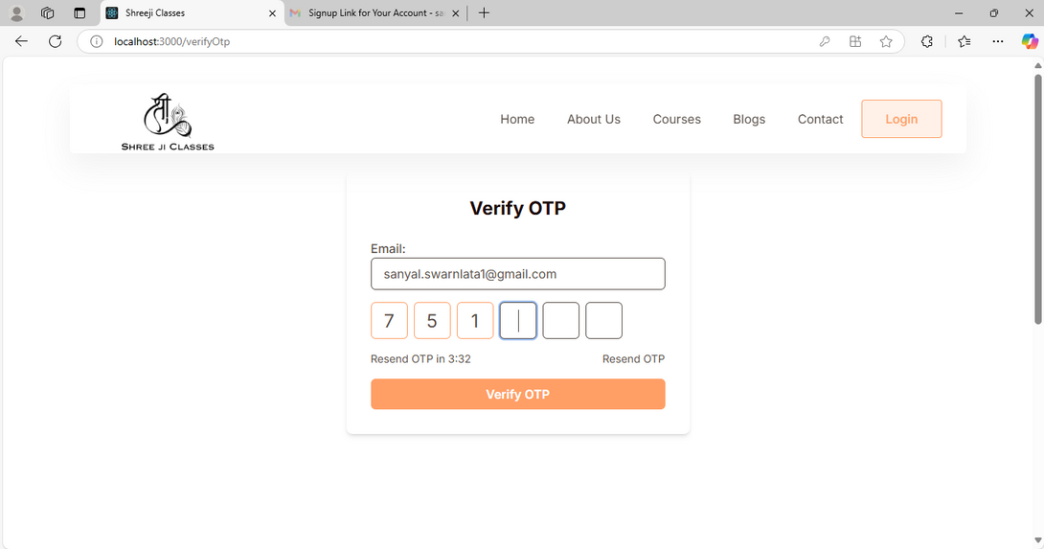
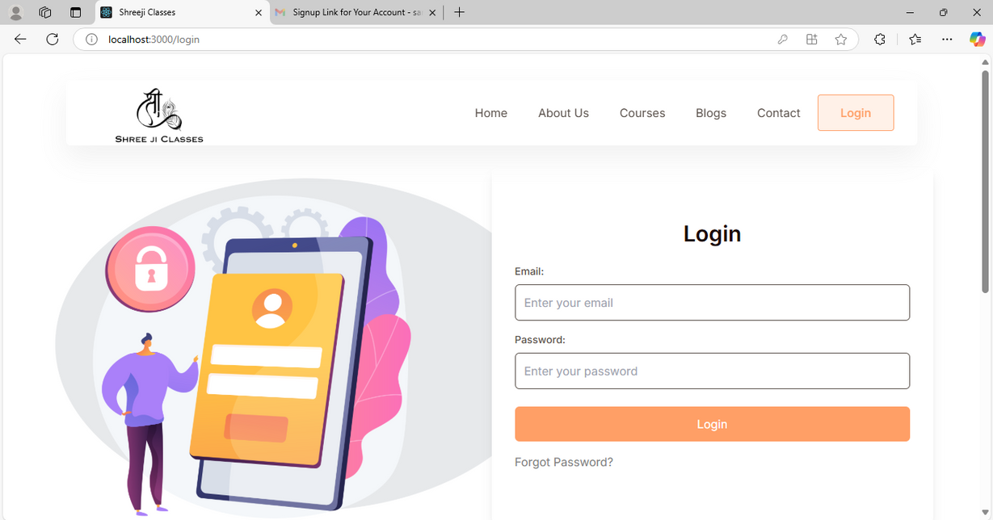
OTP Verification
Login

Slide 12
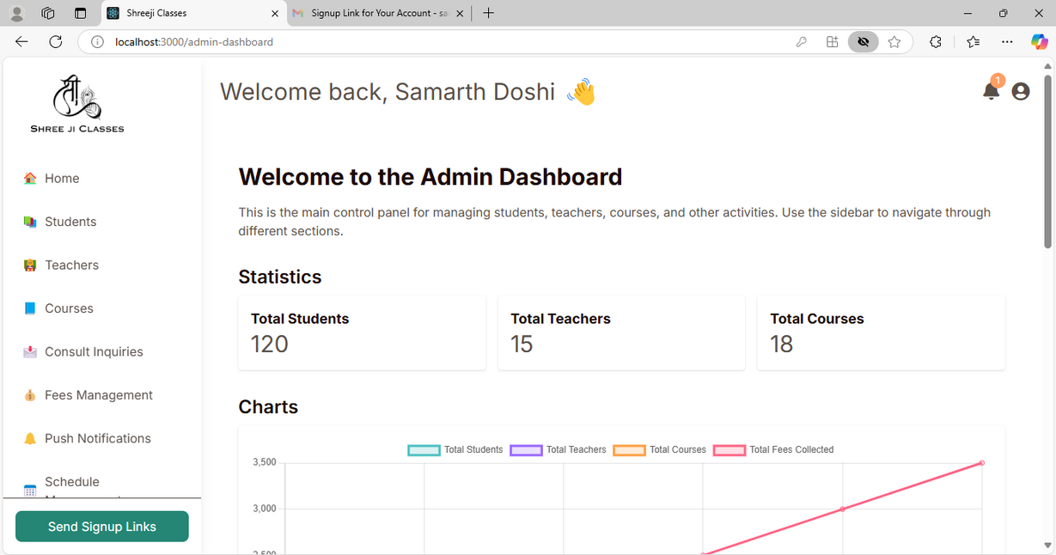
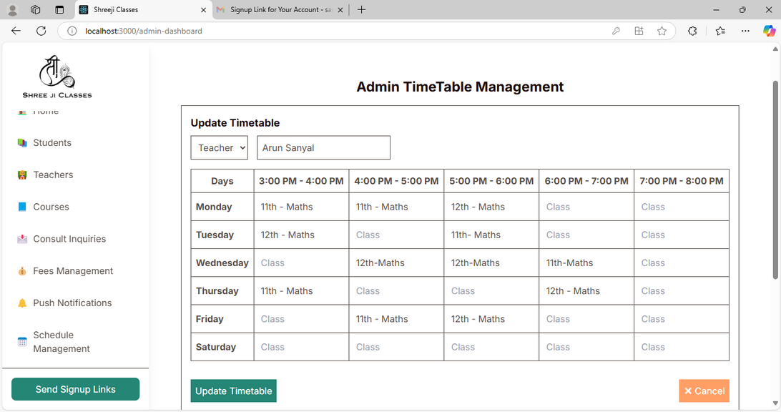
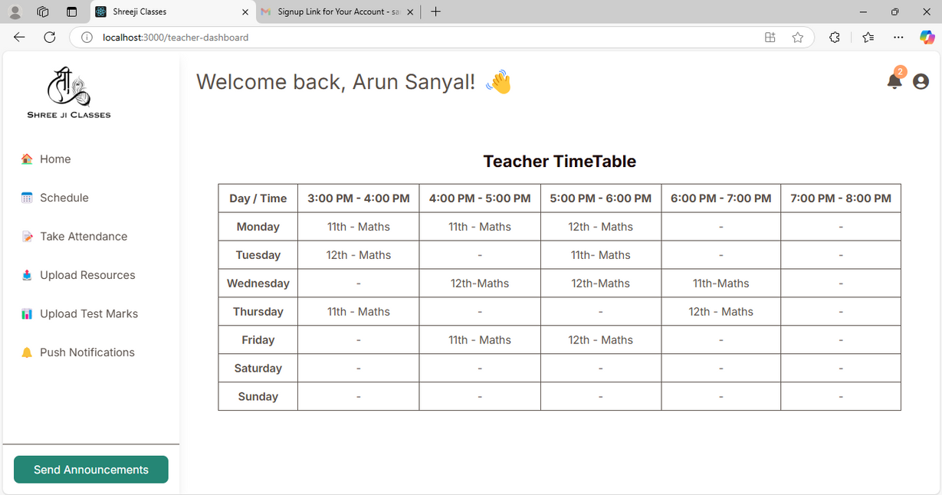
Admin
Dashboard

Slide 13
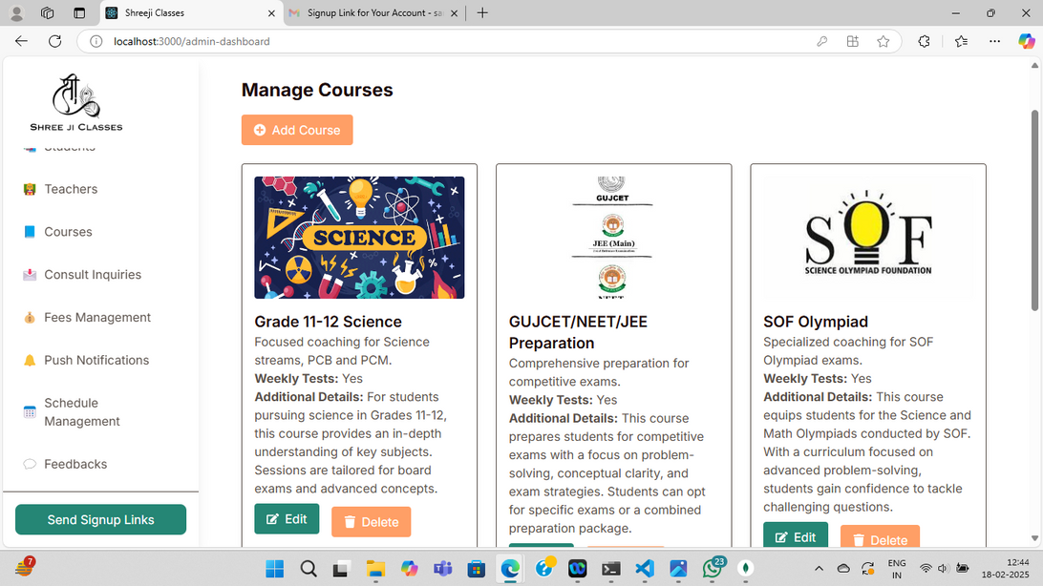
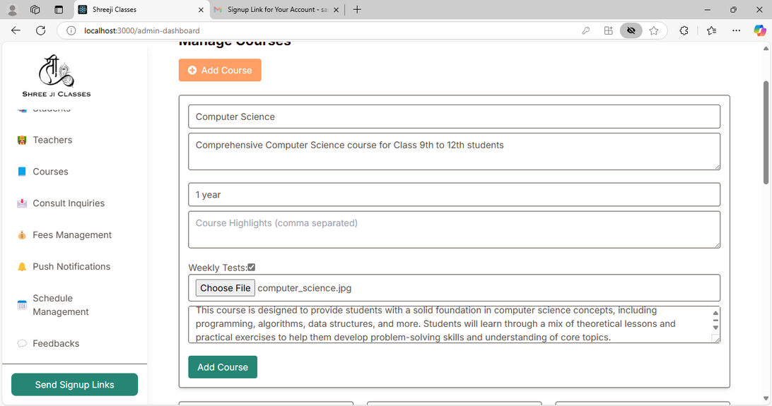
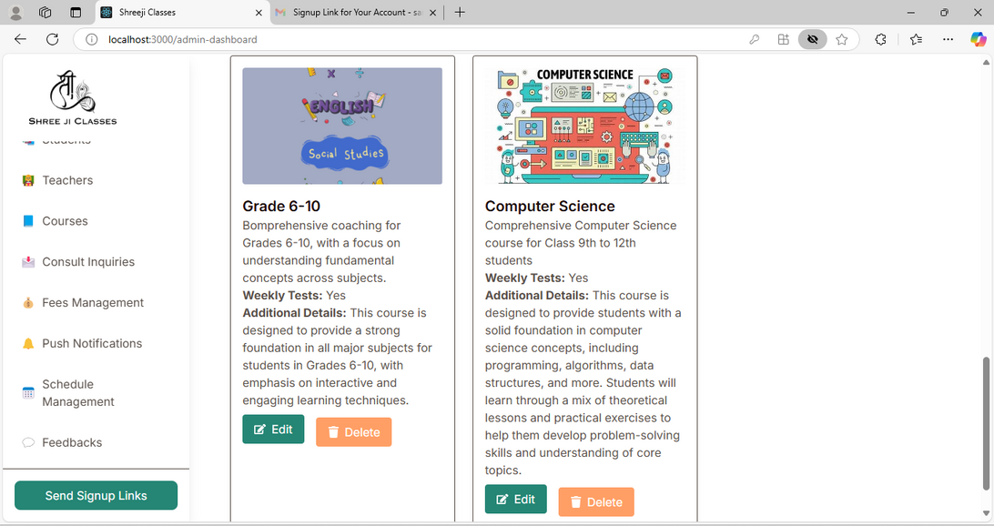
Course
Management

Slide 14
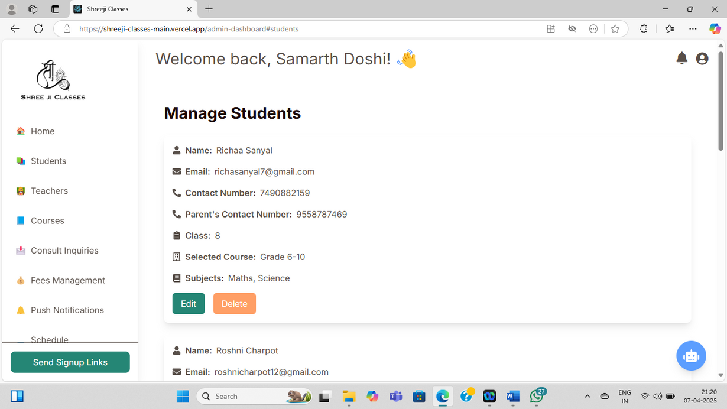
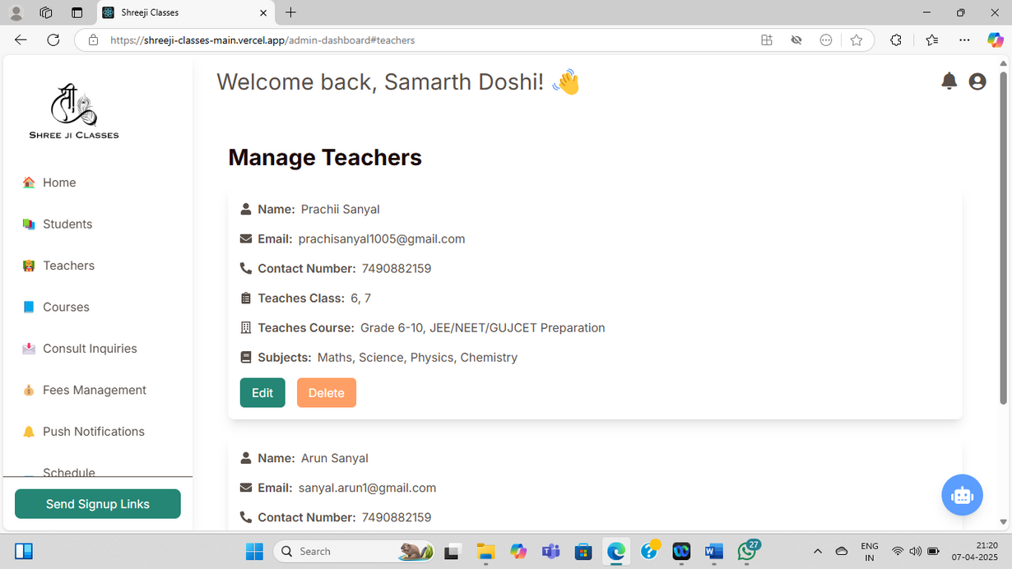
Admin can manage Students &
Teachers

Slide 15
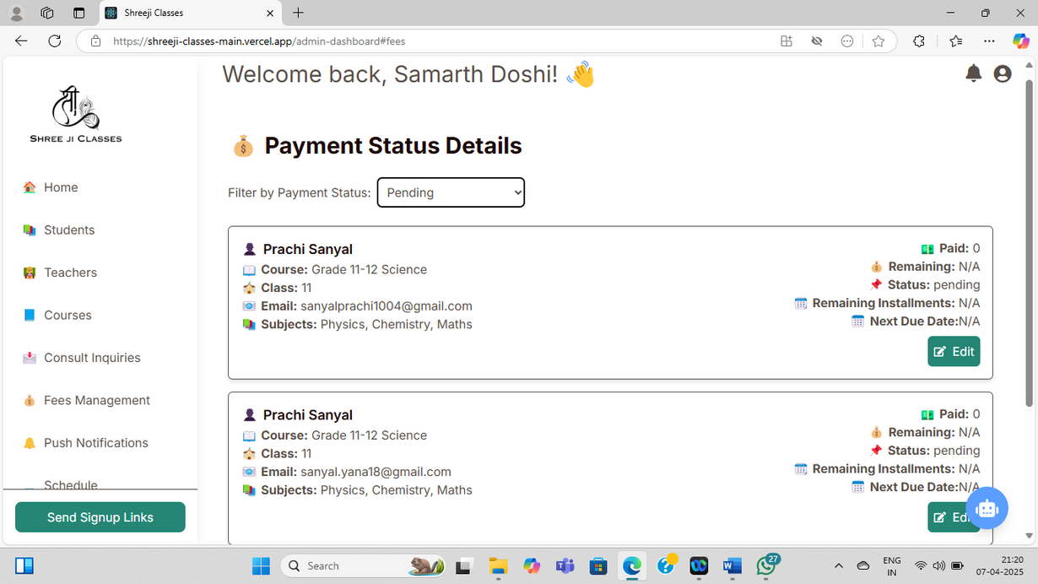
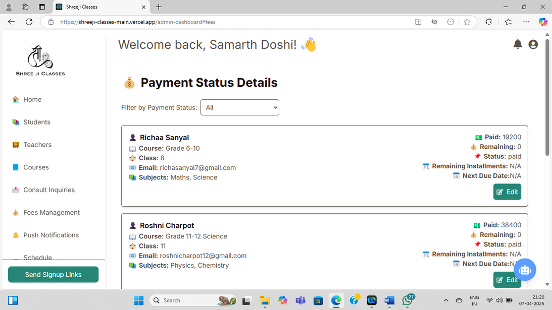
Admin can monitor fee status

Slide 16
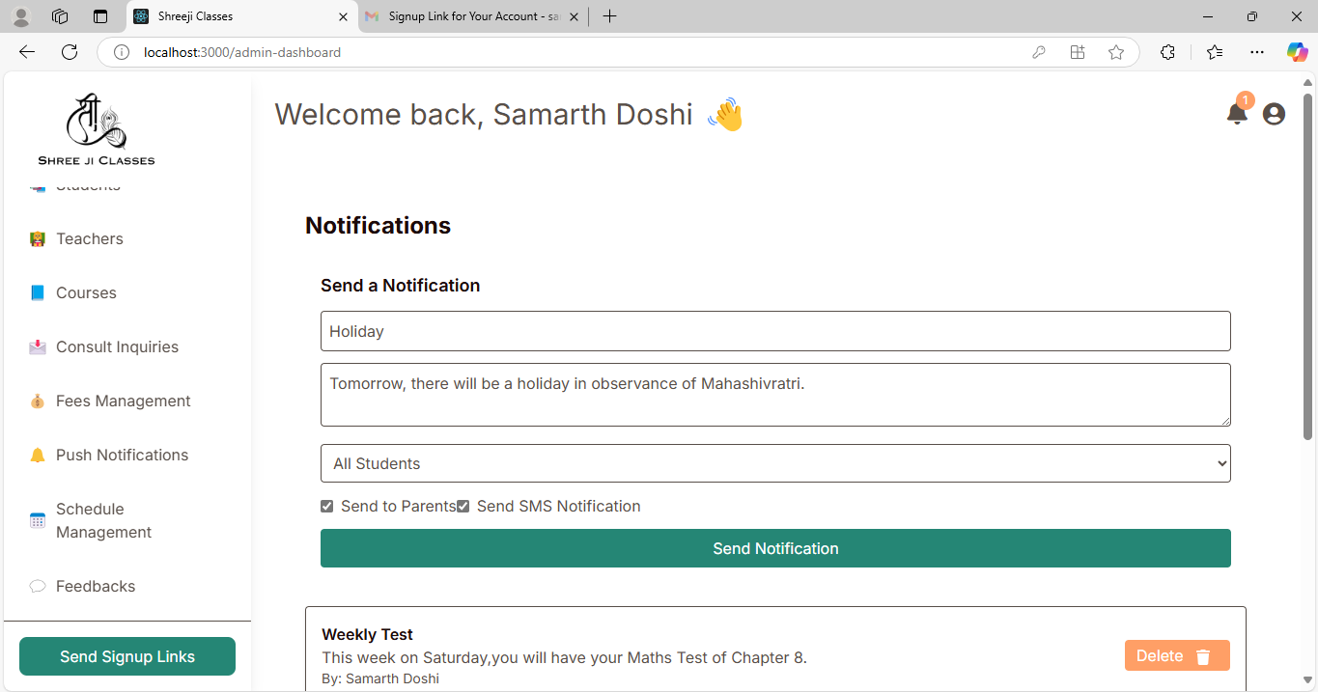
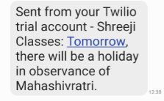

Admin can send notifications to students and teachers.

Slide 17
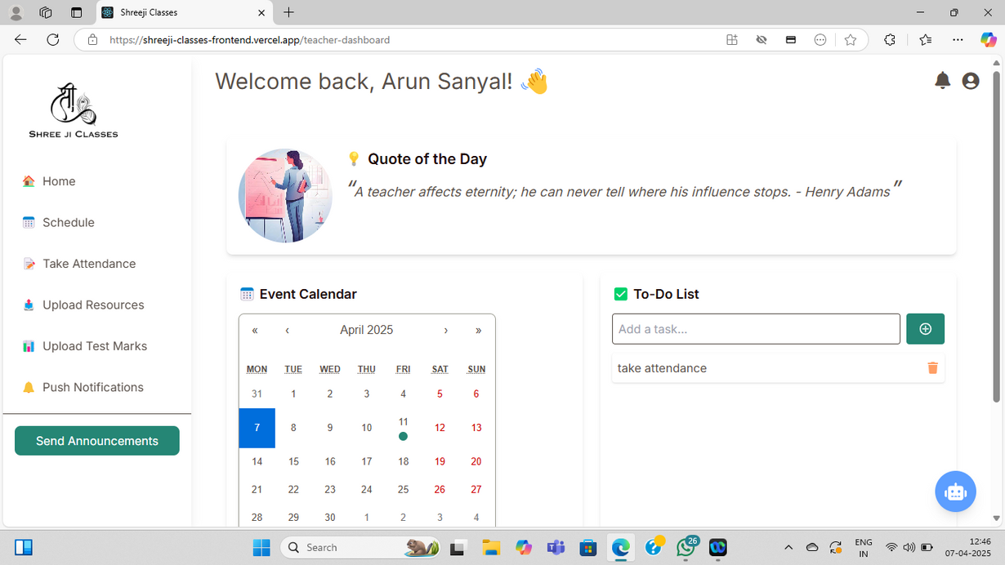
Teacher
Dashboard

Slide 18
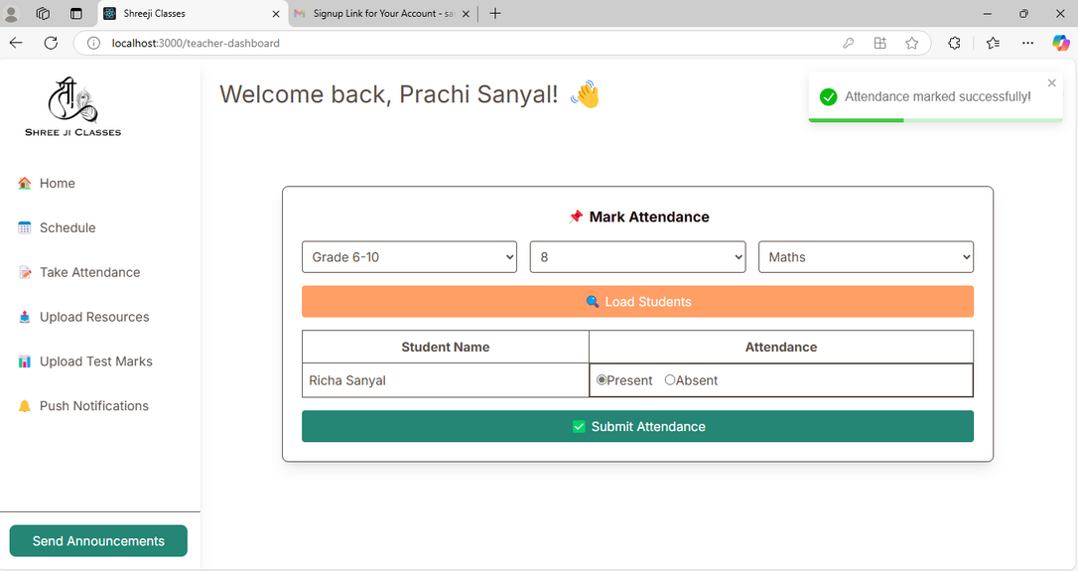
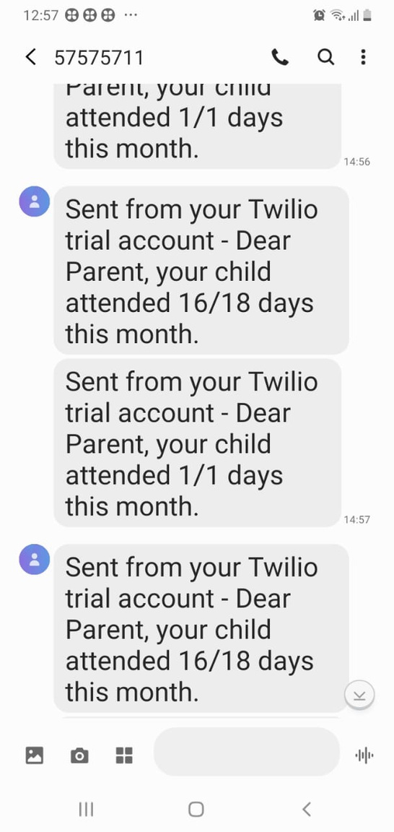
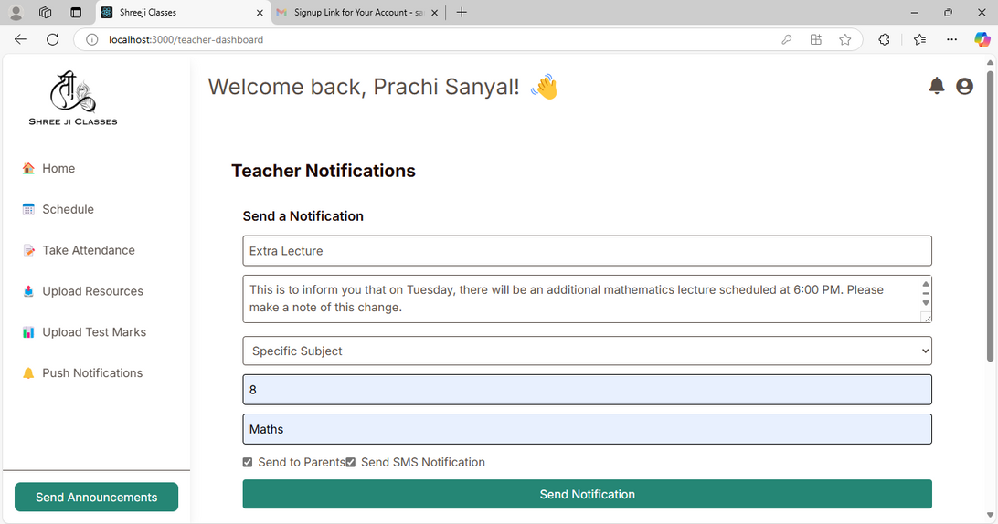
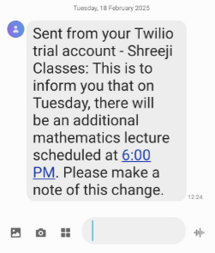
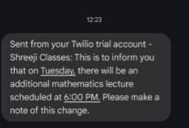

Slide 19
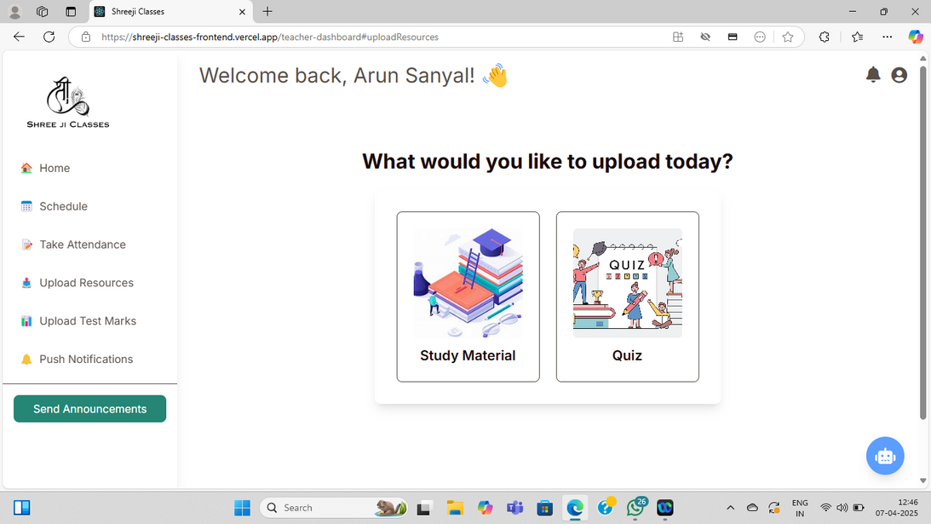
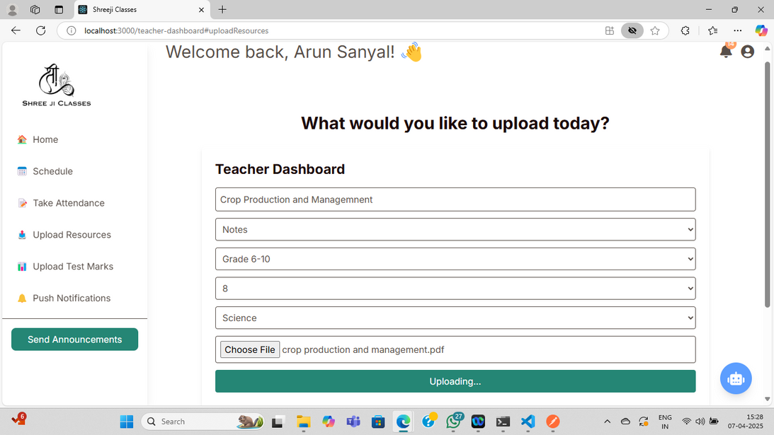
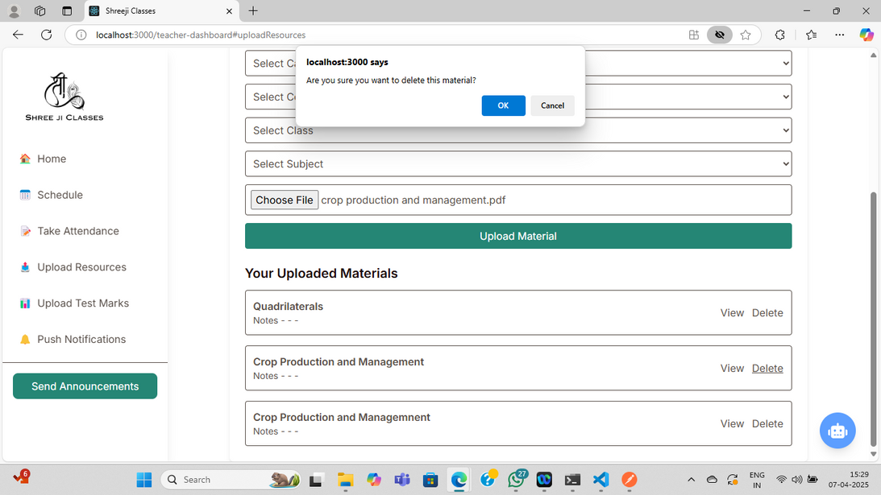
Teacher can upload notes, assignments & quizzes

Slide 20
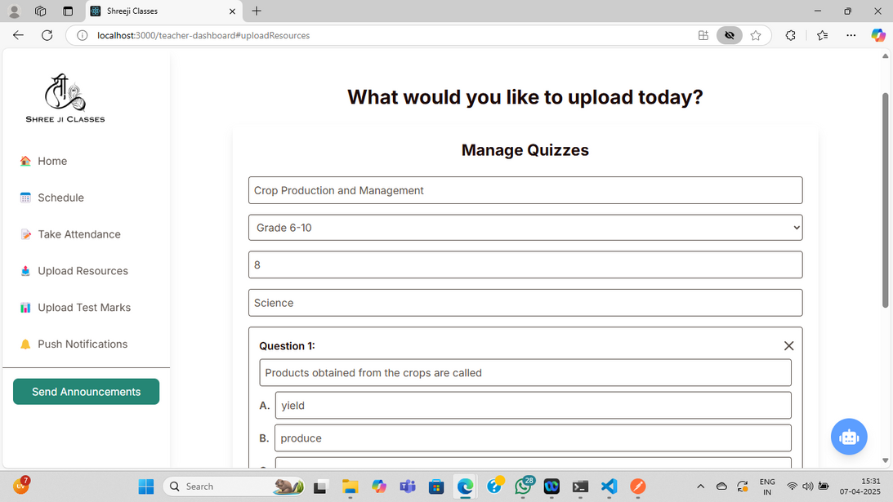
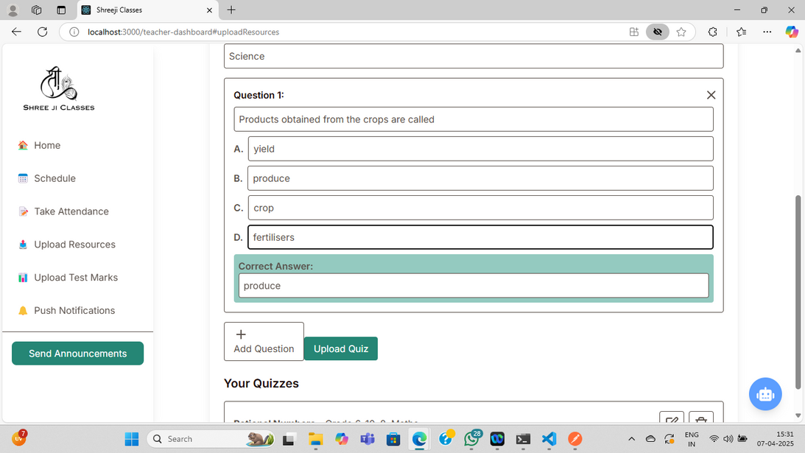
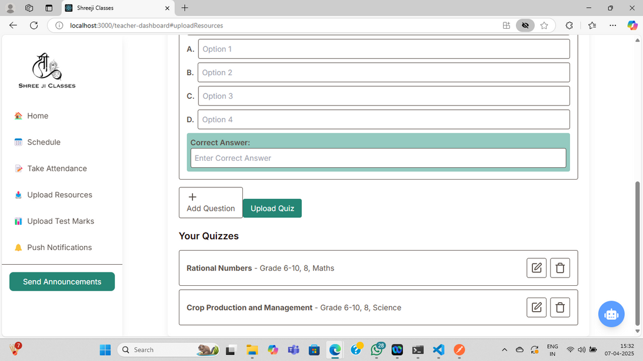
22

Slide 21
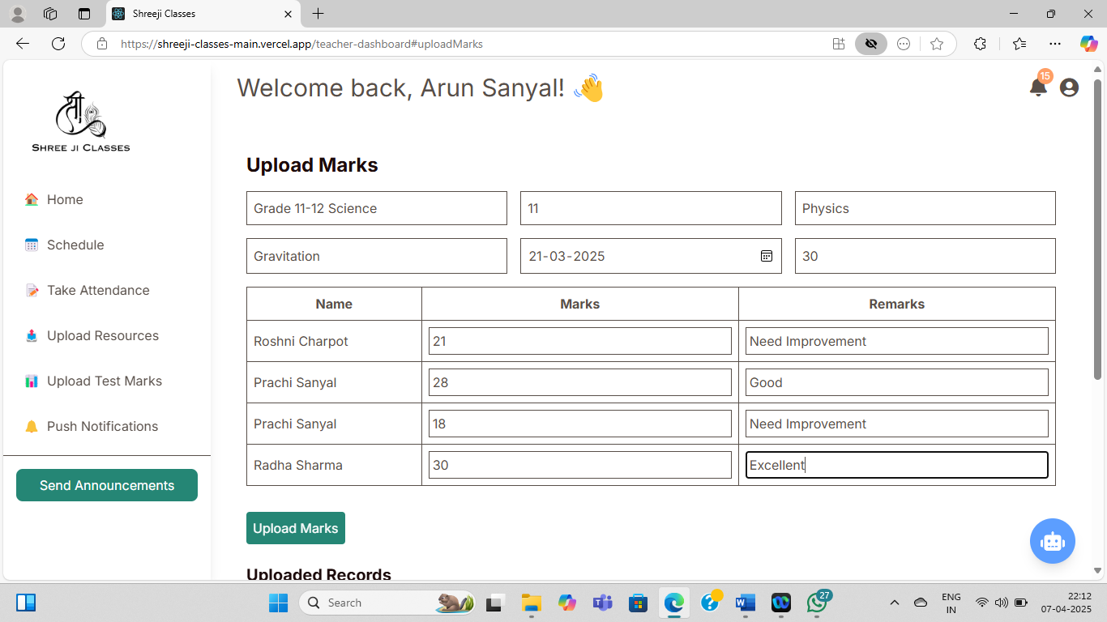
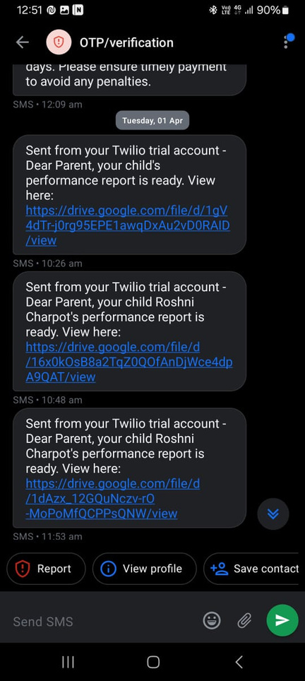
Upload Test Marks & Monthly Report via Drive Link

Slide 22
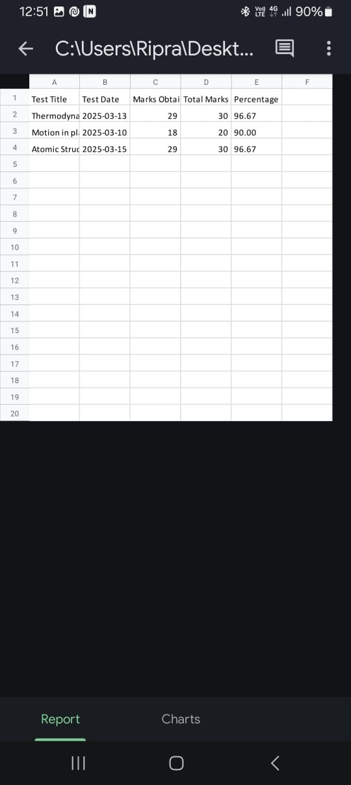
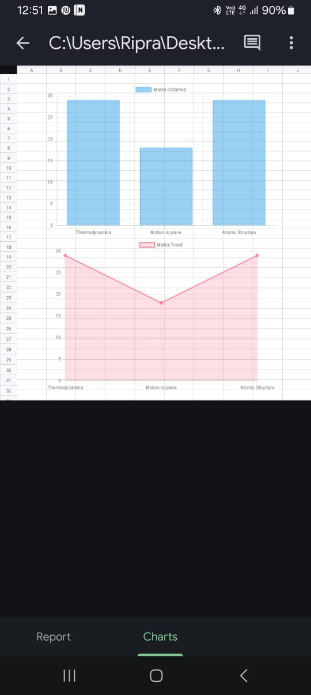

Slide 23
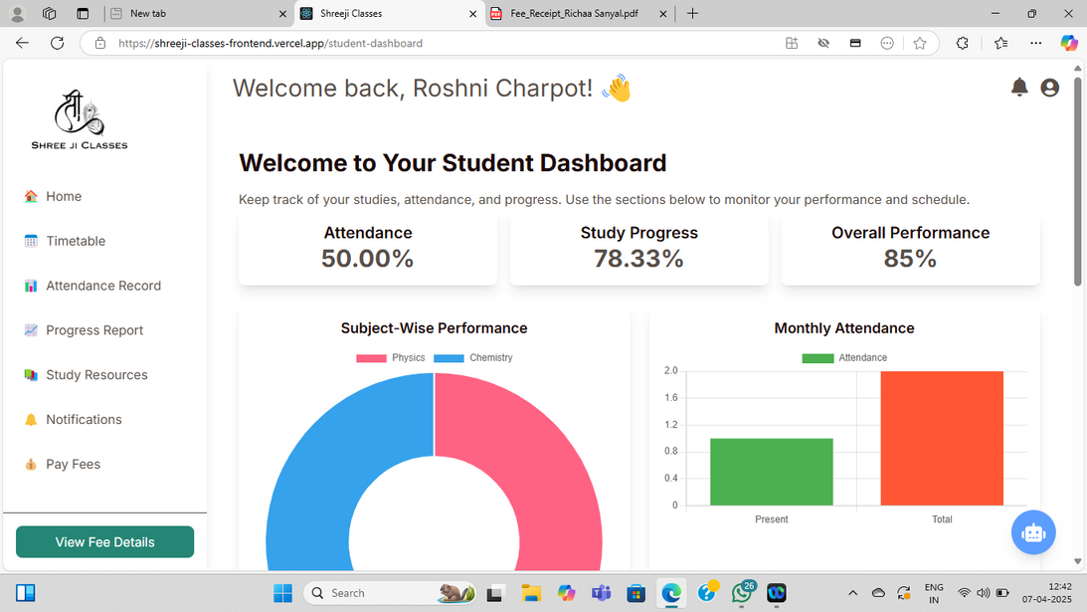
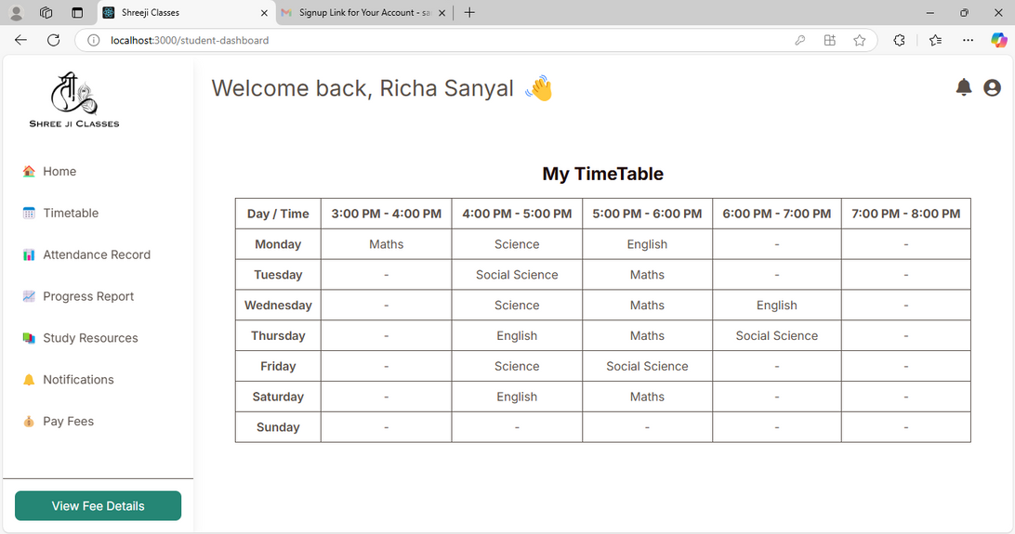
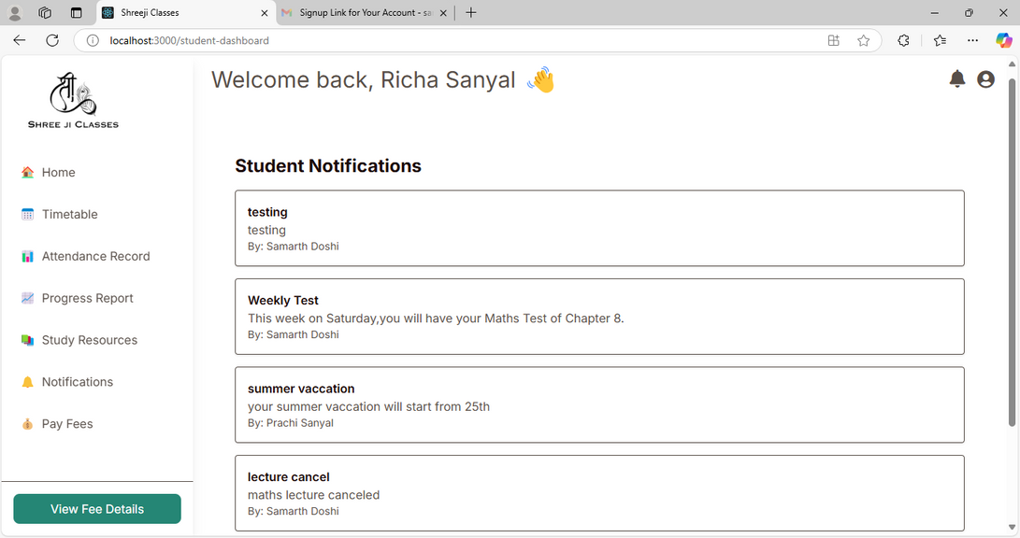
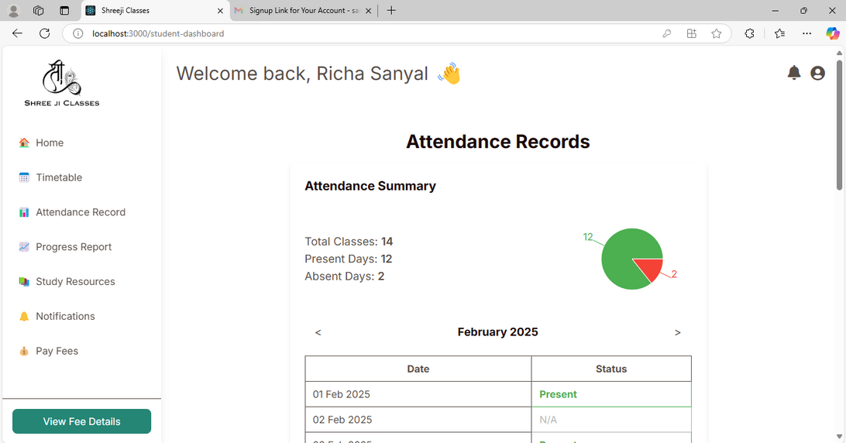

Slide 24
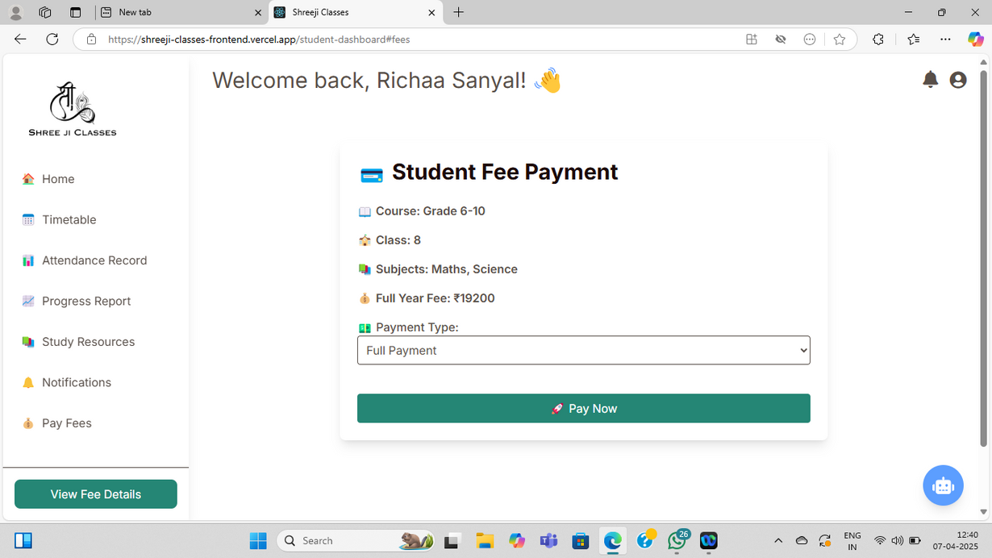
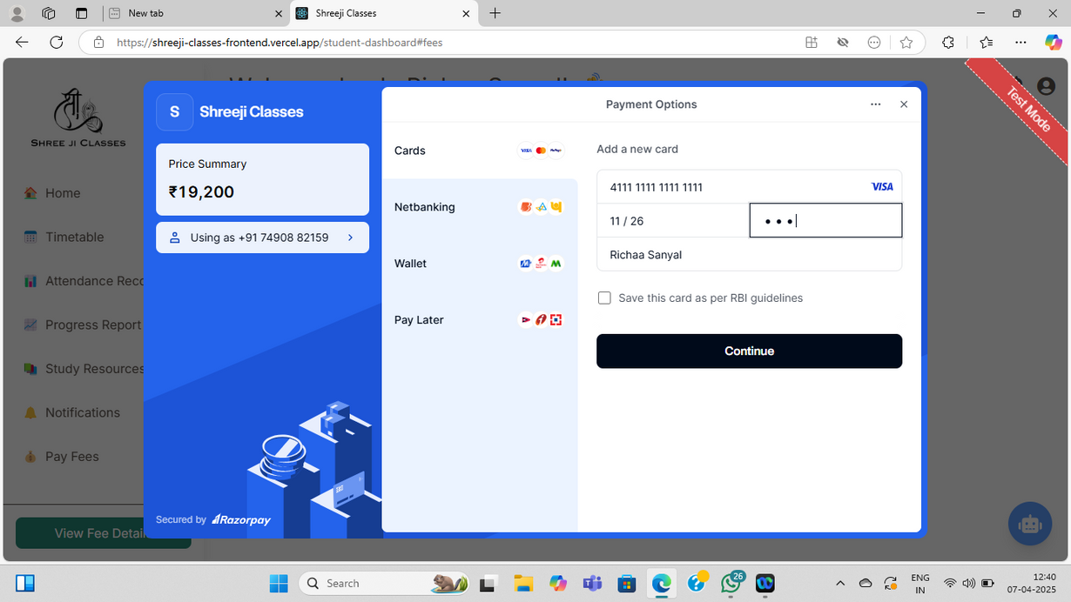
View Fee Structure & Choose Payment Plan

Slide 25
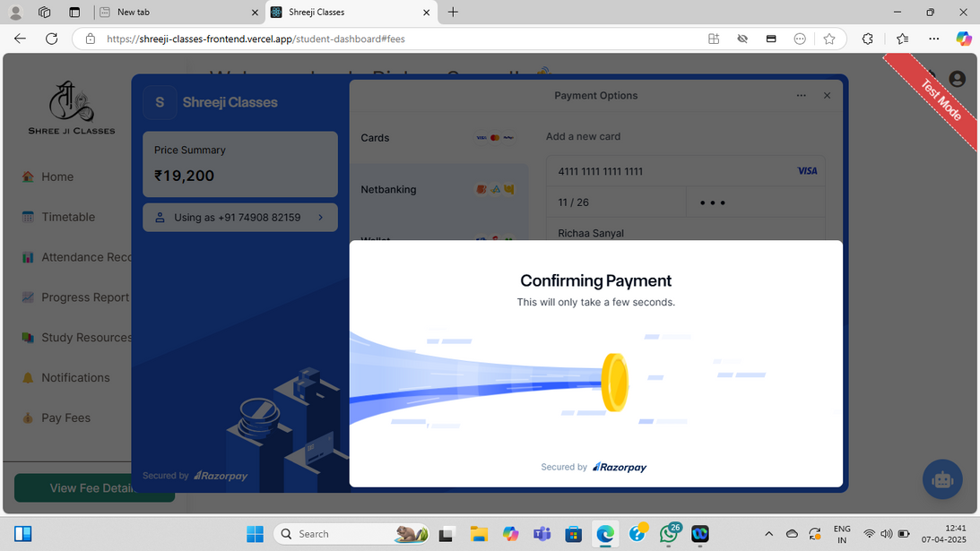
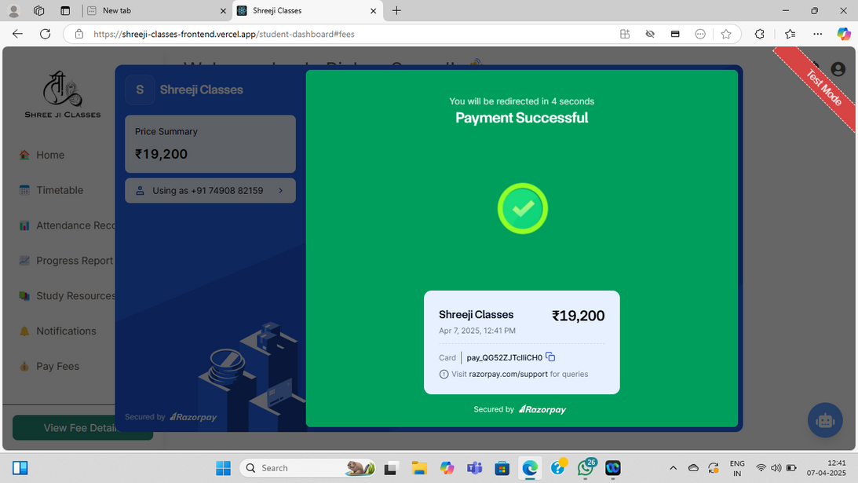

Slide 26
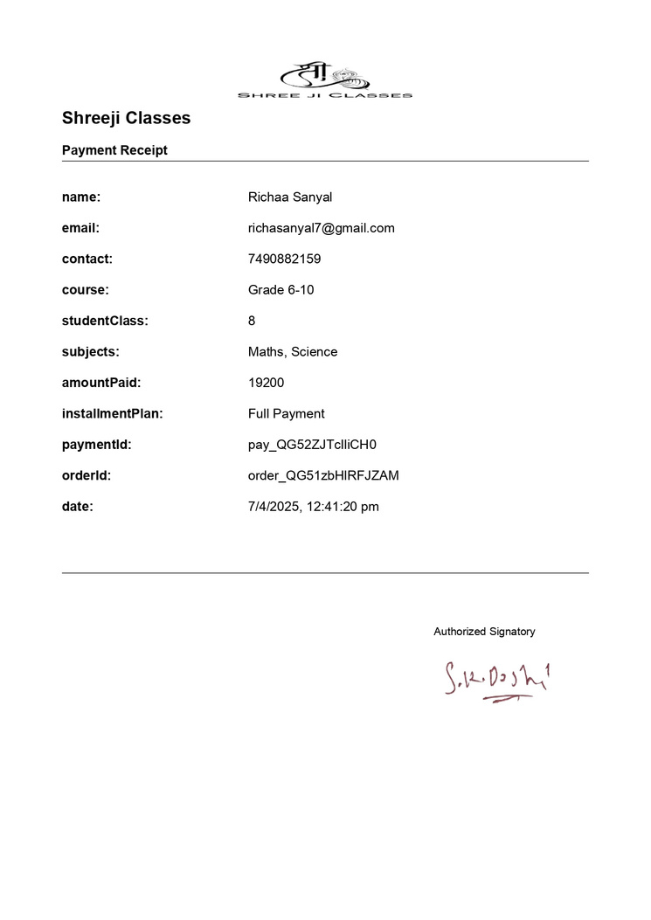
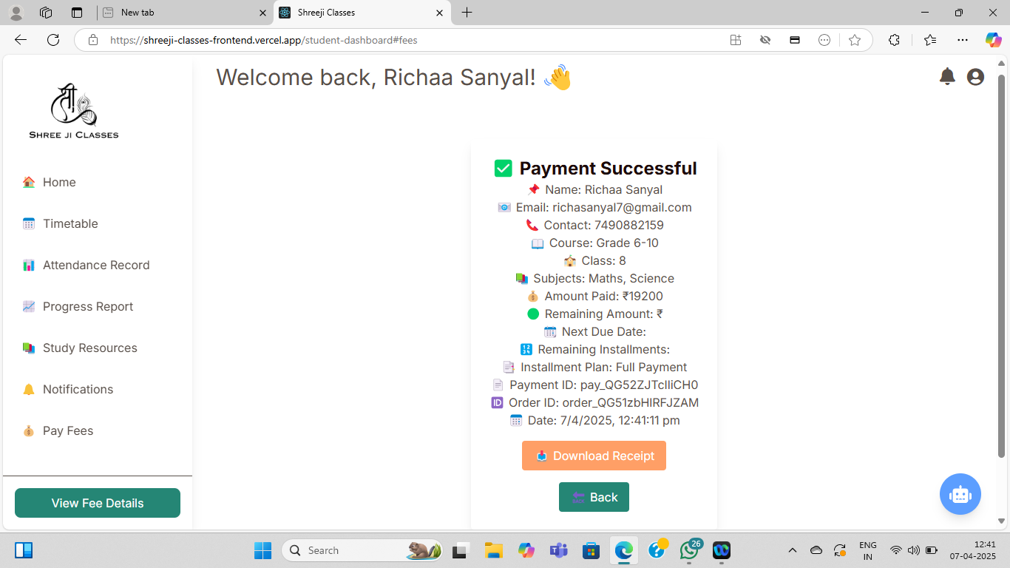
Fee Receipt

Slide 27
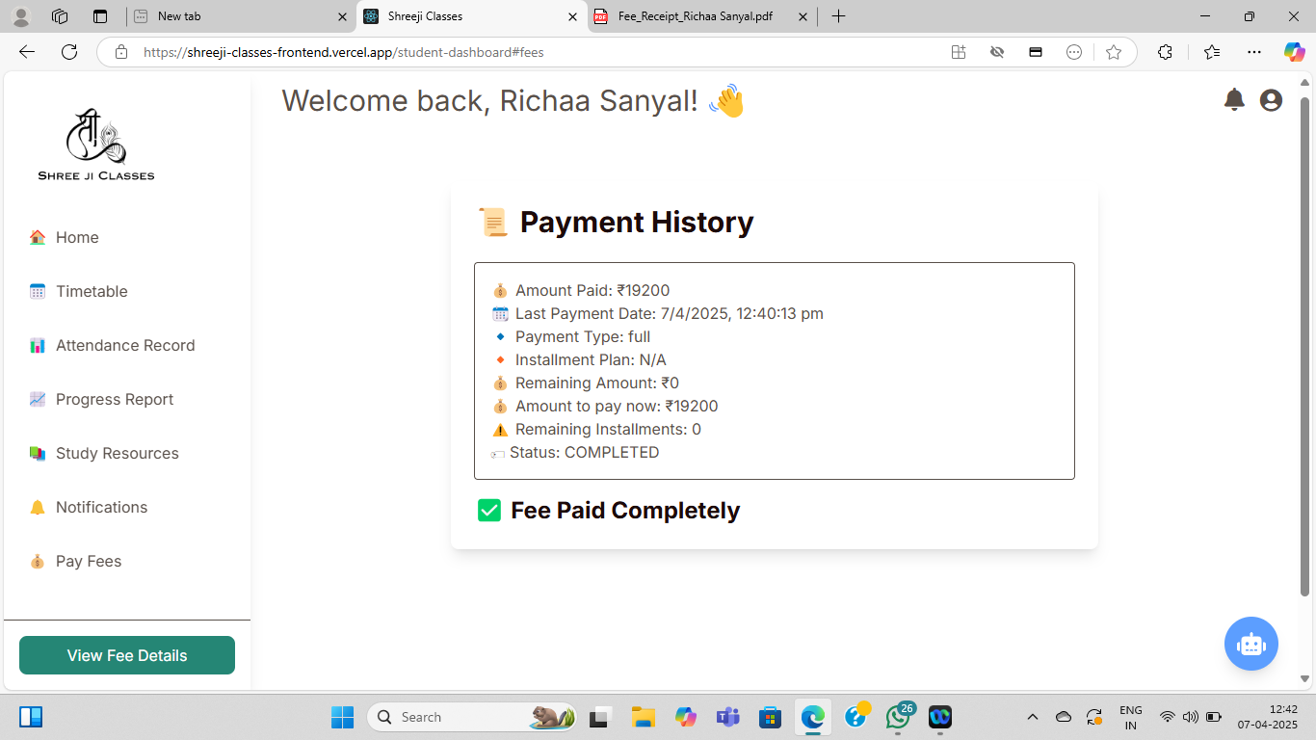
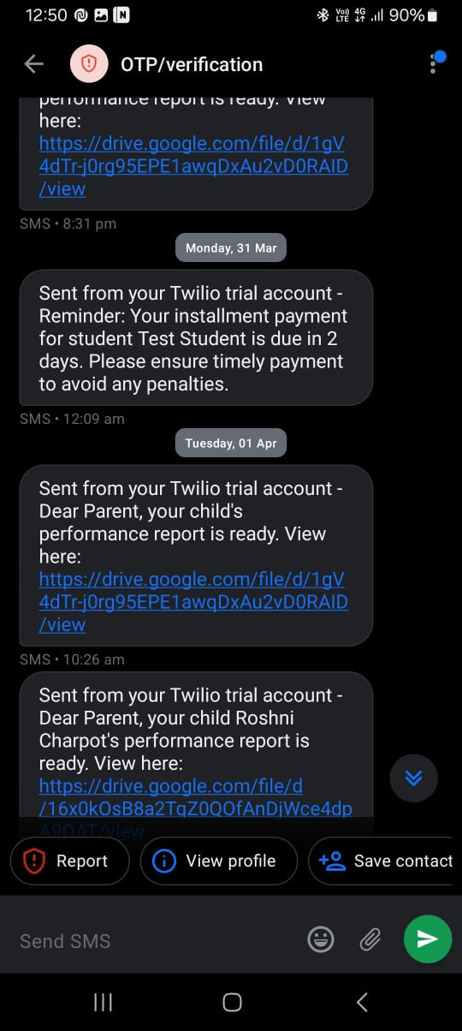
View Payment History on Dashboard
Installment Reminder SMS

Slide 28
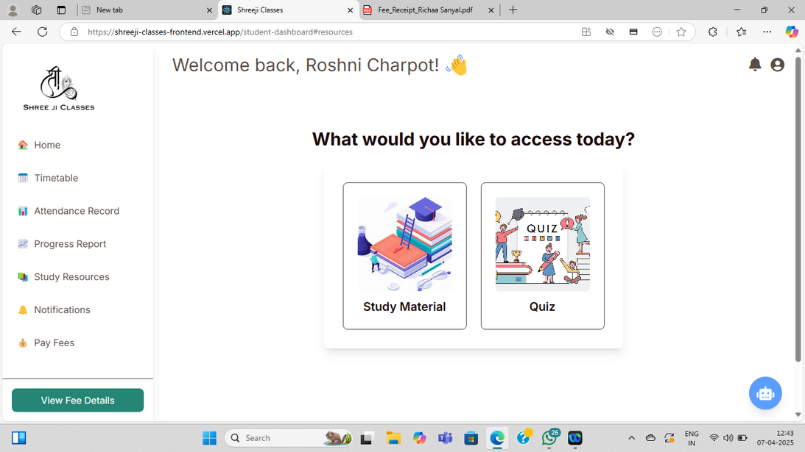
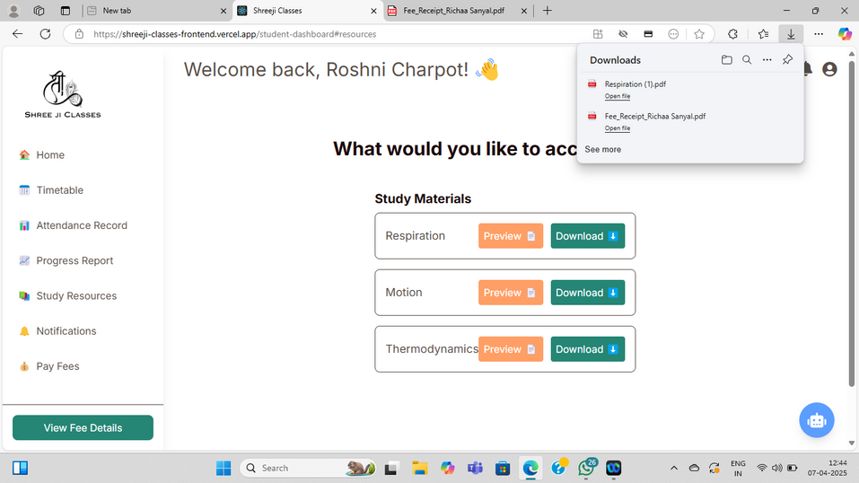
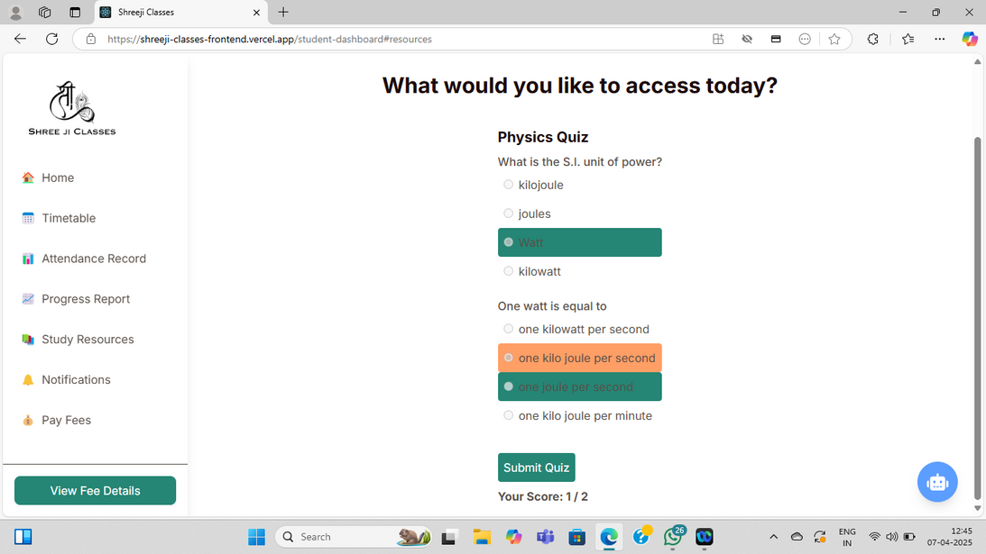
Preview/Download Materials &
Solve Quizzes

Slide 29
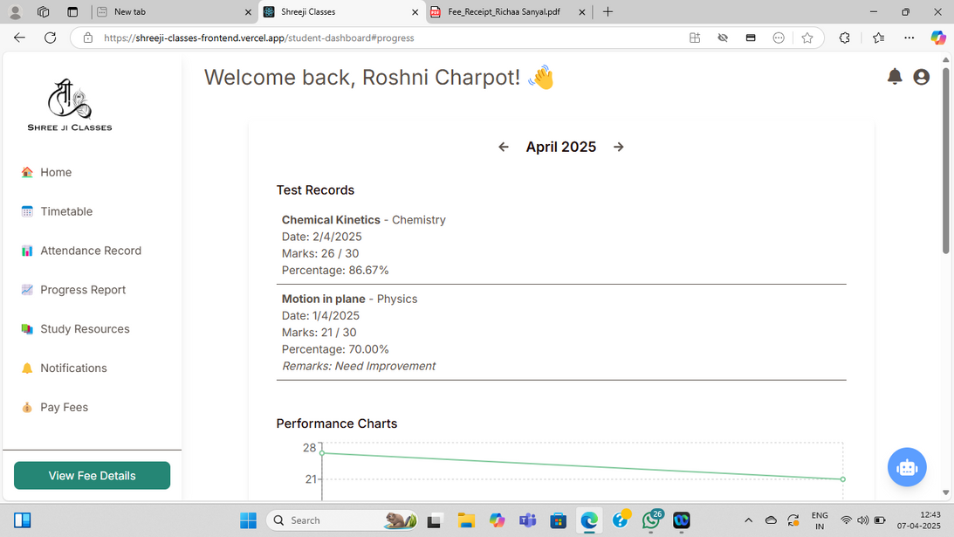




Slide 30
Live Project URL
You can explore the live working version of the Shreeji Classes web application by visiting the following URL:
🌐https://shreeji-classes-main.vercel.app/

Slide 31
BIBLIOGRAPHY
React.js - https://react.dev/
Node.js - https://nodejs.org/
Express.js - https://expressjs.com/
MongoDB - https://www.mongodb.com/docs/
Twilio (SMS & Notifications API) -https://www.twilio.com/docs
Razorpay Payment Gateway - https://razorpay.com/docs/ •
Cloudinary - https://cloudinary.com/documentation
Tailwind CSS - https://tailwindcss.com/docs
Razorpay Integration - https://www.youtube.com/watch?v=ICxmav6ezJM

Slide 32
BIBLIOGRAPHY
Twilio Integration - https://www.youtube.com/watch?v=t3pzsLpC1J0
Cloudinary Files Upload - https://www.youtube.com/watch?v=HndnQOwstq8
Canvas Package - https://www.youtube.com/watch?v=MJwaoidar6s
EmailJs - https://www.youtube.com/watch?v=wWiTouBHibs

Slide 33
THANK YOU
27 Dec, 2024

