Slide 1
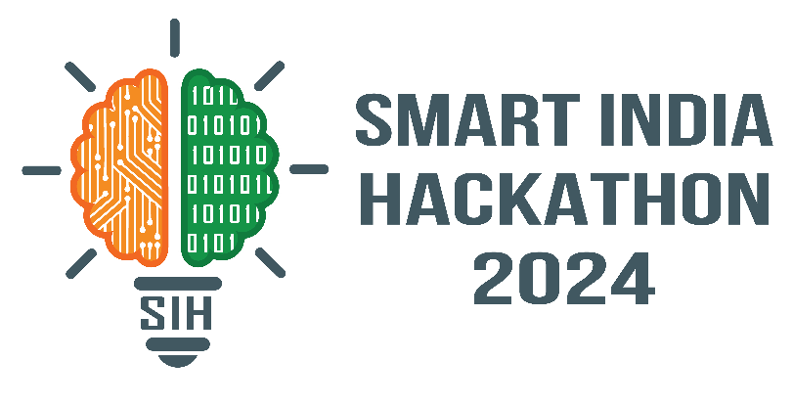
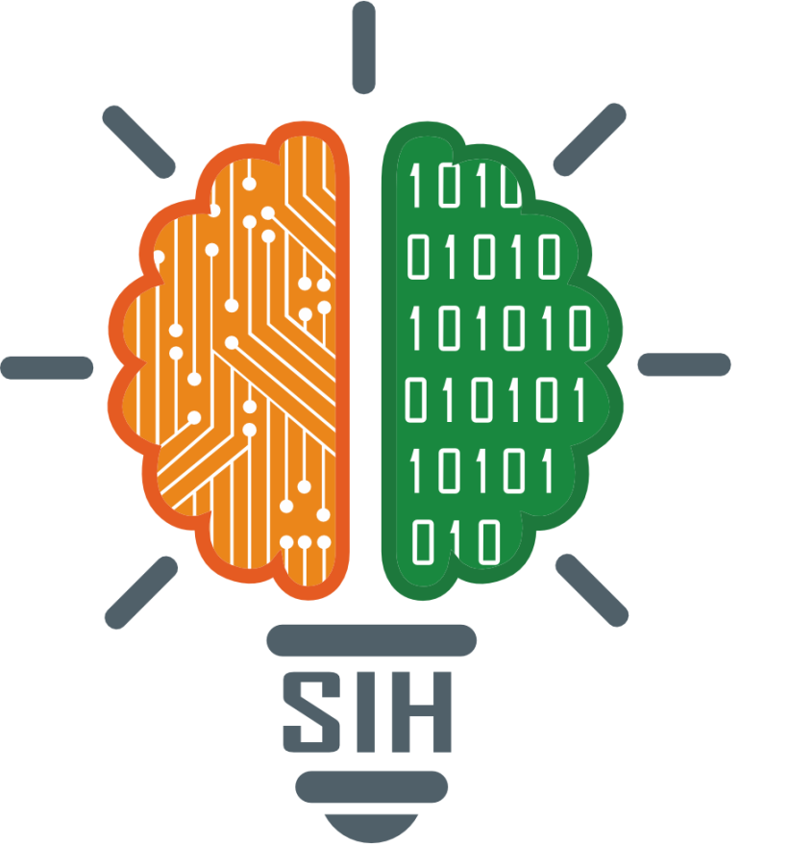
SMART INDIA HACKATHON 2024
TITLE PAGE
Problem Statement ID - 1605
Problem Statement Title - Women Safety Analytics – Protecting Women from safety threats
Theme - Miscellaneous
PS Category- Software
Team ID -
Team Name (Registered on portal) - The Glitch Hunters

Slide 2
Women Safety Analytics – Protecting Women from safety threats
The Glitch Hunters
Proposed Solution
Explanation- It uses real-time monitoring to analyze gender distribution, detect anomalies, and generate alerts to enhance the safety of women.
How it addresses the problem-It addresses the growing safety concerns for women by providing continuous surveillance and early threat detection.
It also minimizes false alerts through human verification.
Innovation and uniqueness of the solution-It include person detection with gender classification.
Identifying lone women at night
Recognizing when a woman is surrounded by men.
Detecting SOS situations.

Slide 3
TECHNICAL APPROACH
The Glitch Hunters
Technologies getting used- Python, React, Flask, SQL etc
Real time Video Feed Input
Person Detection
Gender Classification
Alert Generation
Anomaly Detection
Gender Distribution Analysis
Lone women detection
Data Storage & Analysis
Women surrounded by men
Identifying Hotspots
SOS gesture recognition
Feedback Loop
Continuous Improvement
Alert Generation

Slide 4
FEASIBILITY AND VIABILITY
The Glitch Hunters
Your Team Name
Analysis of the feasibility of the idea-Gender classification, anomaly detection algorithms, and gesture recognition can be integrated into a unified system.
The potential for reducing crime and enhancing public safety.
Potential challenges and risks-Increasing accuracy in person detection, gender classification, anomaly detection in diverse and crowded environments, may be challenging.
Strategies for overcoming these challenges-Regularly updating the models on diverse datasets, using advanced algorithms can improve accuracy.
Feedback loop for continuous learning can reduce false alerts.

Slide 5
IMPACT AND BENEFITS
The Glitch Hunters
Your Team Name
Potential impact on the target audience-It will improve women's sense of security in public spaces by providing real-time monitoring.
Provides women with a sense of independence and reduces the fear of potential threats.
Benefits of the solution- Crime reduction(Social Benefit)
Increase public confidence(Social Benefit)
Optimized resource use(Environmental Benefit)
Smart city integration(Environmental Benefit)
Attracting Investment(Economical Benefit)
Boosting Tourism(Economical Benefit)

Slide 6
RESEARCH AND REFERENCES
The Glitch Hunters
Your Team Name
https://www.kaggle.com
https://chatgpt.com
https://www.youtube.com
https://github.com

