Slide 1
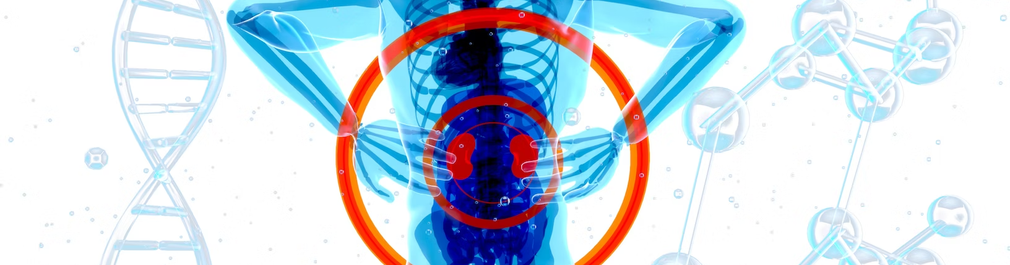
E22BCAU0090 - PRACHI SINGH
E22BCAU0092 - AAKASH SHARMA
STATISTICAL MACHINE LEARNING
KIDNEY STONE PREDICTION
Page 01 of 16

Slide 2
KIDNEY STONE PREDICTION
INTRODUCTION
Leveraging machine learning models, our study delves into urine analysis data to predict kidney stone formation, exploring diverse algorithms to determine their respective accuracies.
Page 02 of 16

Slide 3
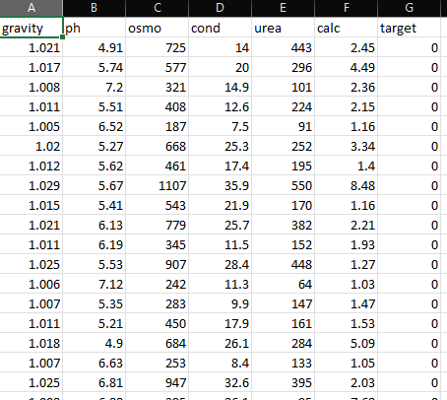
ABOUT THE DATASET
PROBLEM FORMULATION
The aim of this project is to broaden a machine learning model which could predict the presence or absence of kidney stones in urine samples based totally on diverse urine measurements. The model will use a dataset of 79 urine specimens that were analyzed for six physical traits: specific gravity, pH, osmolarity, conductivity, urea concentration, and calcium concentration.
Page 03 of 16

Slide 4

KIDNEY STONE PREDICTION
JULIANA SILVA
PYTHON PACKAGES USED
Page 04 of 16

Slide 5
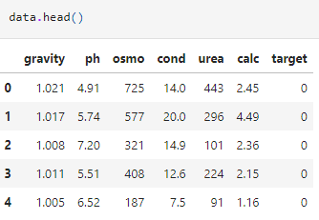
KIDNEY STONE PREDICTION
JULIANA SILVA
HEAD OF THE DATASET
Page 05 of 16

Slide 6
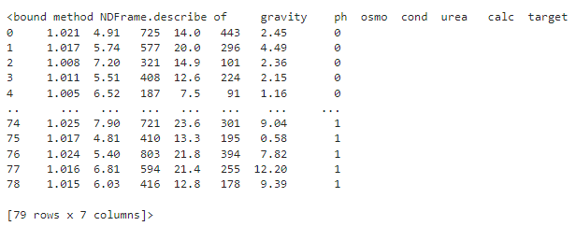
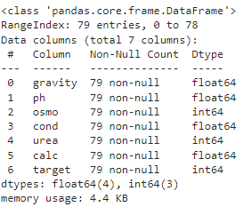
KIDNEY STONE PREDICTION
INFORMATION & DESCRIPTION
Page 06 of 16

Slide 7

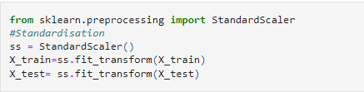
KIDNEY STONE PREDICTION
LIBRARIES & CLASSES
Page 07 of 16

Slide 8
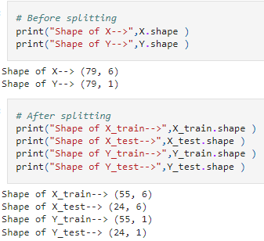
KIDNEY STONE PREDICTION
SHAPE OF DATASET
Page 08 of 16

Slide 9
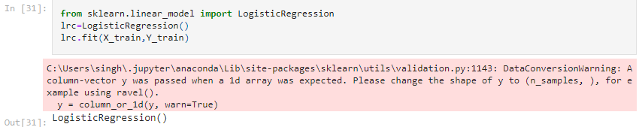
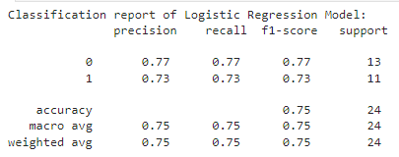
KIDNEY STONE PREDICTION
LOGISTIC REGRESSION
Page 09 of 16

Slide 10
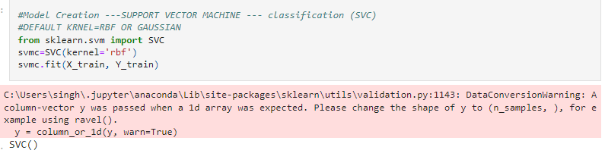
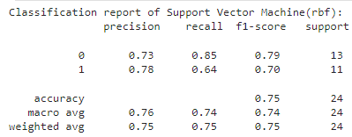
KIDNEY STONE PREDICTION
SVC (RBF)
Page 10 of 16

Slide 11
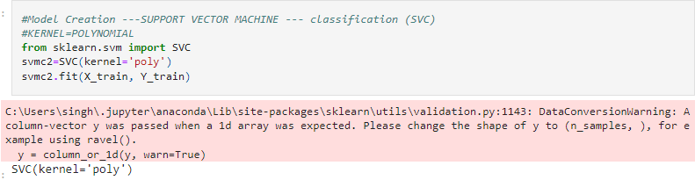
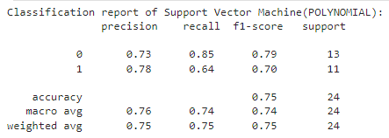
KIDNEY STONE PREDICTION
SVC (POLYNOMIAL)
Page 11 of 16

Slide 12
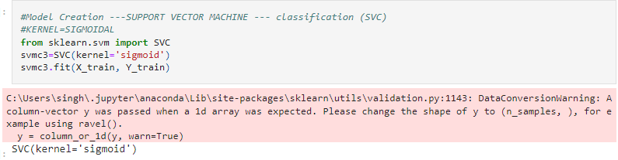
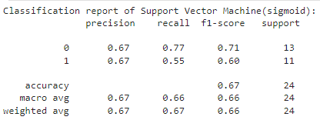
KIDNEY STONE PREDICTION
SVC (SIGMOIDAL)
Page 12 of 16

Slide 13
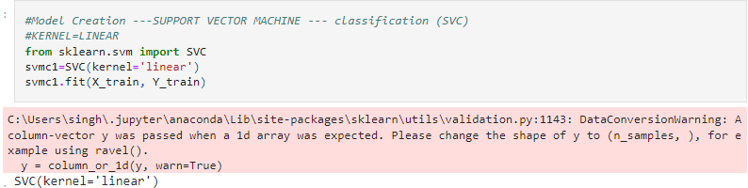
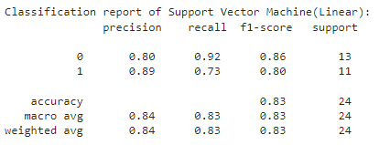
KIDNEY STONE PREDICTION
SVC (LINEAR)
Page 13 of 16

Slide 14
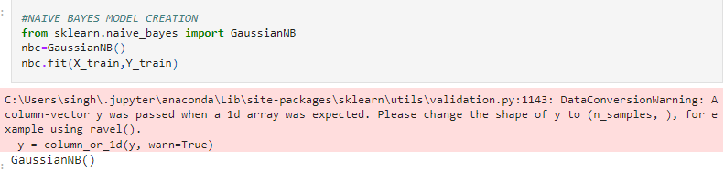
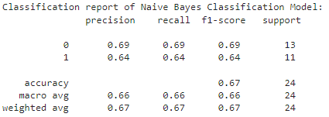
KIDNEY STONE PREDICTION
NAIVE BAYES MODEL
Page 14 of 16

Slide 15
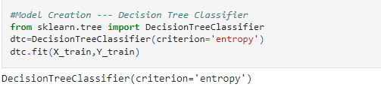
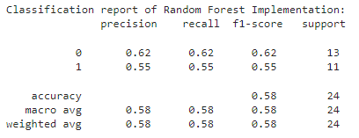
KIDNEY STONE PREDICTION
RANDOM FOREST
Page 15 of 16

Slide 16
KIDNEY STONE PREDICTION
“BEST FIT FOR THE DATASET”
ACCURACY = 89%
- Support Vector Machine (SVM) with a linear kernel achieved an overall accuracy of 83%.
- Precision for class 0 was 0.80, and recall was 0.92.
- Precision for class 1 was 0.89, and recall was 0.73.
- F1-score for class 0 was 0.86, and for class 1, it was 0.80.
- Macro-average F1-score considering both classes was 0.83.
- Weighted average precision, recall, and F1-score were all 0.84.
Page 16 of 16

