Slide 1
Predictive Modeling for Iris Species
By Prachi Chavan

Slide 2
Summary
01
Introduction
04
Model Selection and Training
02
About Dataset
Model Evaluation
05
03
Data Preprocessing
Conclusion
06

Slide 3
Introduction
Objective
To demonstrate a structured approach to building, tuning, and evaluating machine learning models
Loading the dataset from a CSV file containing modified Iris dataset
Explore the dataset to understand its structure and contents

Slide 4
Introduction
01
02
03
Identify data
Data Preprocessing
Choose algorithm
04
05
Train the model
Model Output

Slide 5
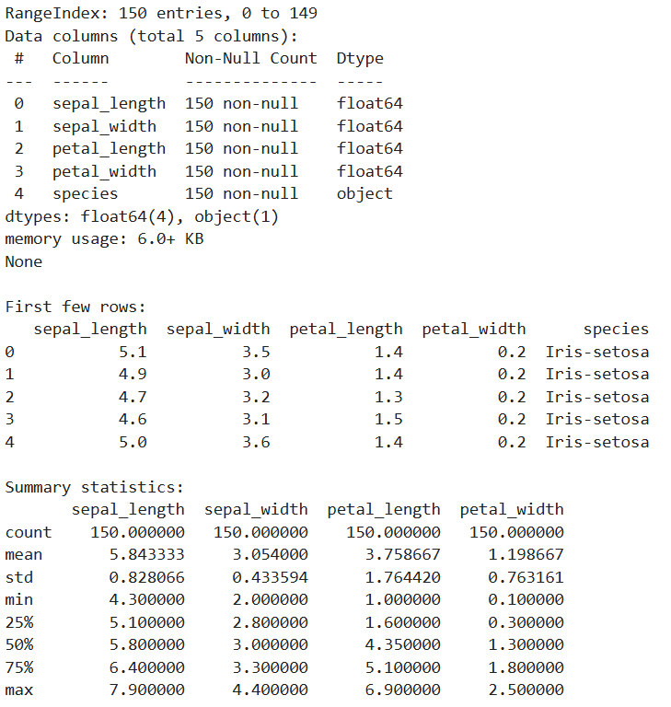
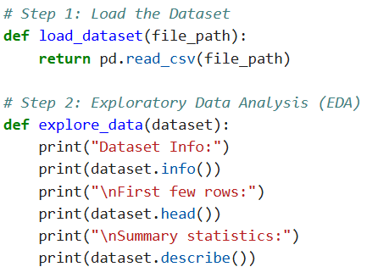
Understanding the data
Output
Input
Input 1
Output 1
Input 2
Output 2
Input 3
Output 3

Slide 6
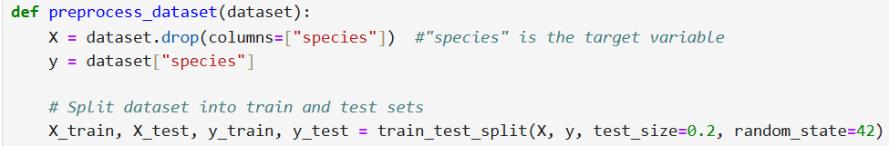
Data Preprocessing
Preprocess the dataset by splitting it into features (X) and target variable (y).
Perform train-test split to create separate sets for training and testing
Handle missing values by imputing using mean imputation
Scale the features using StandardScaler to standardize them.

Slide 7
Data Preprocessing
preprocessing for model performance
01
02
03
04
EDA
Handling missing values
Splitting the dataset into training and testing sets
Scaling numerical features.

Slide 8
Model Selection and Training
Random Forest Classifier
Some machine learning algorithms used
SVM
KNN
Logistic Regression

Slide 9
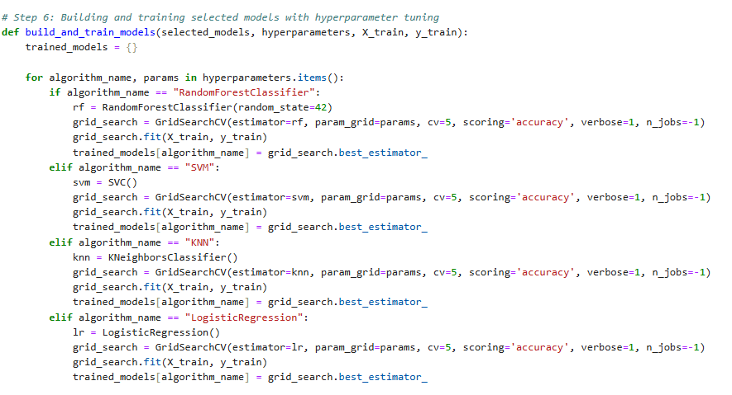
Hyperparameter tuning:
Explanation of hyperparameters for each model.
GridSearchCV for hyperparameter optimization.
Training the models on the preprocessed dataset.

Slide 10
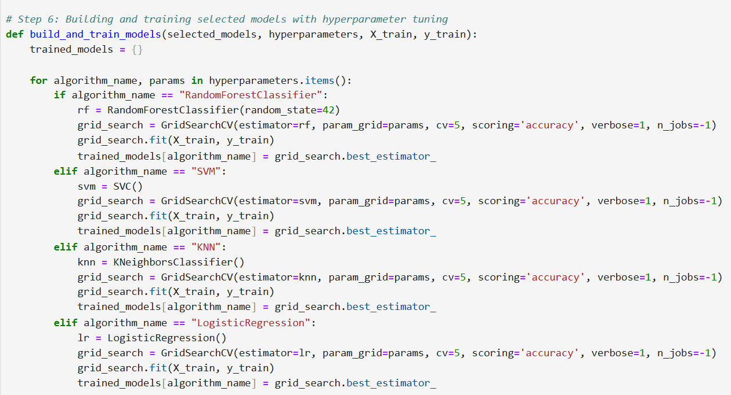
Model Building
Grid Search CV
Build and train machine learning models using hyperparameter tuning
Utilize GridSearchCV for exhaustive hyperparameter tuning and cross-validation
Models include Random Forest Classifier, Support Vector Machine (SVM), K-Nearest Neighbors (KNN), and Logistic Regression
Disadvantages
Data acquisition
Time and space
Time-consuming
High error possibilities
Algorithm selection

Slide 11
Types of algorithms
01
02
Regressor
Classifier

Slide 12
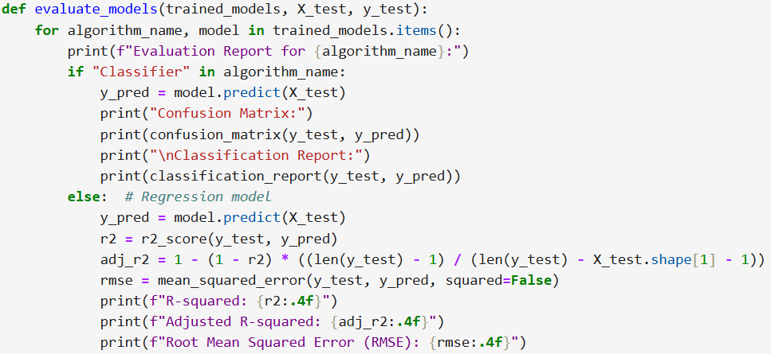
Model Evaluation
Evaluate the trained models using appropriate metrics
For classification models, evaluate using confusion matrix and classification report
Classification report: precision, recall, F1-score.
For regression models, evaluate using R-squared, adjusted R-squared, and root mean squared error (RMSE).

Slide 13
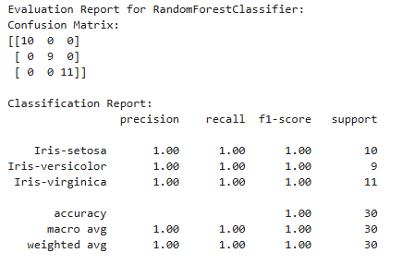
Conclusion
Random Forest Classifier gave the best results on the given dataset.
Based on the data we can tell that Classification was the more suitable approach.
The Random Forest Classifier gave an accuracy of 1.00
The precision, recall and the f1-score was very good.

Slide 14

Random Forest Classifier gave the best results on the given dataset.
Based on the data we can tell that Classification would be a more suitable approach.
The Random Forest Classifier gave an accuracy of 1.00
Predict based on previous patterns
Pre-programmed algorithms

