Slide 1
SCRUTINIZING ACCOMMODATION IN TORONTO WITH VIRTOUS NEIGHBORHOOD
Submitted by:
PRACHI SINGLA

Slide 2
How research is valuable?
First thing that comes in our mind is that, why this research has been done and what is the significance of this analysis?
Here is answer to this question by telling the interests of this research:
Immigrants could find a virtuous place to live.
Citizens could also check out recent data analysis for shifting/relocating purpose within Toronto
Real estate businessmen & Investors could analyse property prices based on venues around.
City Management would be benefited for survey purposes for further improvement of city with same data analysis.
Venues density would be helpful in measuring pollution, noise or crime around different areas.

Slide 3
Data acquisition and cleaning
Data of neighbourhoods of Canada extracted from : https://en.wikipedia.org/wiki/List_of_postal_codes_of_Canada:_M
Geographical coordinates of each postal code: http://cocl.us/Geospatial_data.
All Venues data extracted from foursquare API: https://api.foursquare.com/v2/venues/explore?
In total, 288 rows and 3 features in the raw dataset.
Duplicate, highly similar or highly correlated features, Not assigned features were dropped.
After cleaning data, 211 rows & 3 features left.

Slide 4
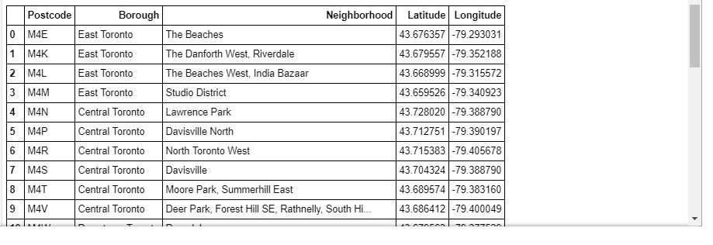
Data featured and redundancy free along with Geospatial Coordinates

Slide 5
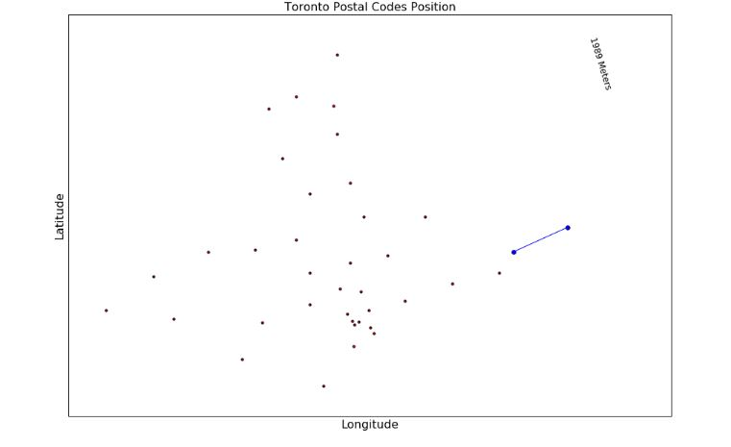
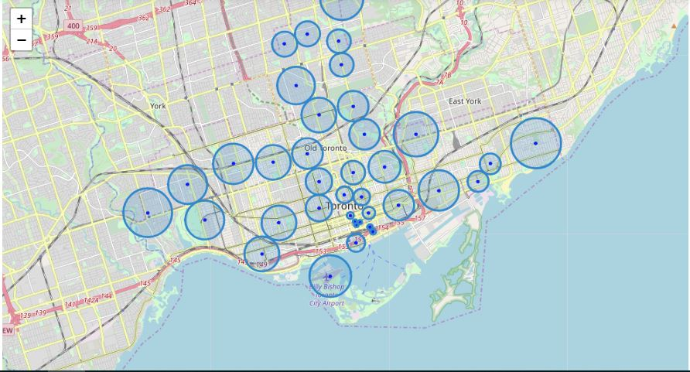
Data Exploratory Analysis
Scatter plot of Toronto Postcode positions
Choropleth map of Toronto Postcode positions

Slide 6
Getting Venues
After plotting a map of Toronto with it’s geospatial coordinates, we will get all venues in neighbourhoods of Toronto.
But we need only five specific type of venues for our case problem.
Further we will extract only those five types of venues from all venues and then analyse them.

Slide 7
Analysing Venues
Now we have extracted different types of venues data frames with their total numbers in all neighbourhoods of Toronto out of total 1610 venues in total.
Restaurants-373
Parks-44
Clubs-4
Shopping malls-1
Gyms-33

Slide 8
Cont……
After getting and analysing venues totality per neighbourhood, we will get their densities per group of neighbourhoods in each postcode.
Then we will get density description statistically and will make histograms to visualize their densities in each venue clearly.
Then we will apply clustering technique for further processing to get useful outcome.

Slide 9
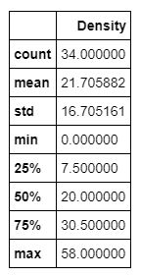
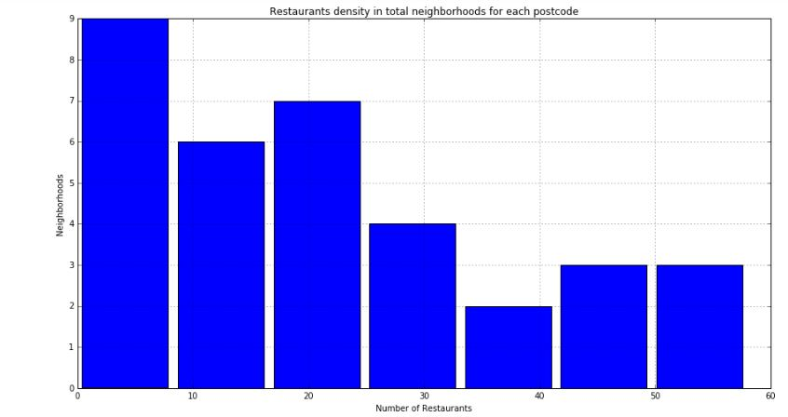
Restaurants Histogram

Slide 10
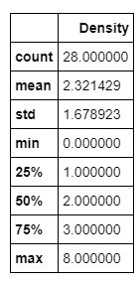
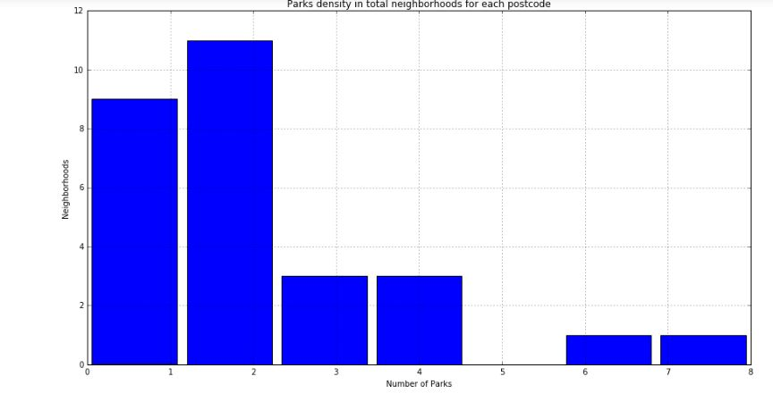
Parks Histogram

Slide 11
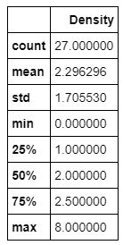
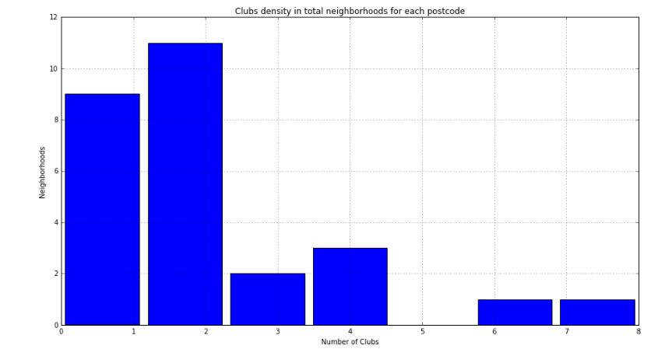
Clubs Histogram

Slide 12
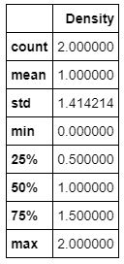
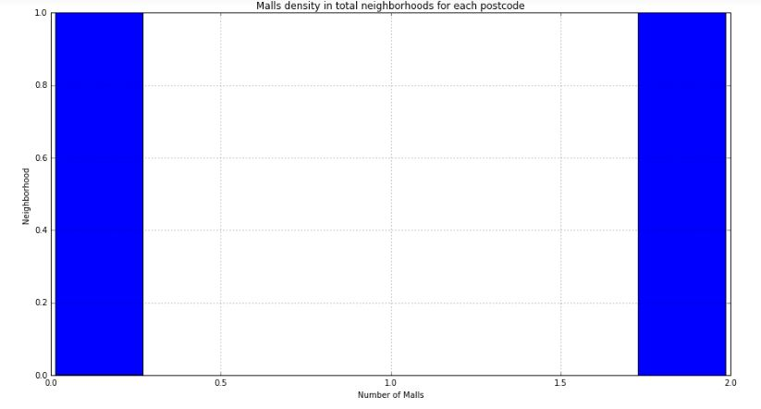
Malls Histogram

Slide 13
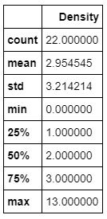
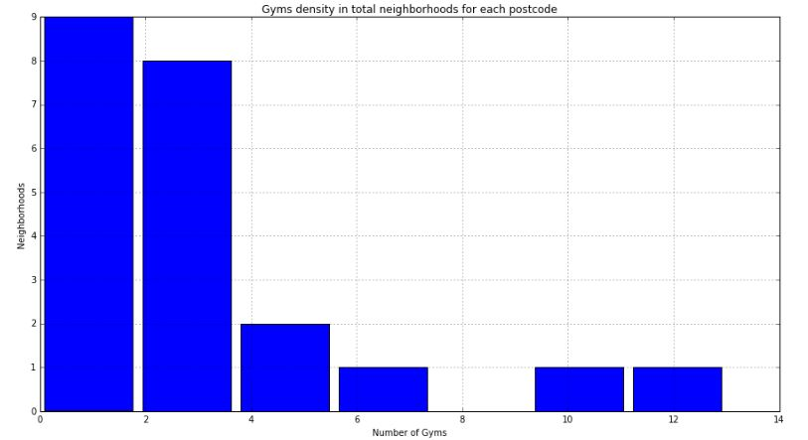
Gyms Histogram

Slide 14
Data Modelling
In modelling part of data science methodology, we will use k-means algorithm for all five venues separately for our case problem.
As we know, k-means algorithm constitutes three main steps to complete so we followed all these steps:
Initialization-K initial “means” (centroids) are generated at random.
Assignment-– K clusters are created by associating each venue data with the nearest centroid.
Update-The centroids of the clusters of different venues becomes the new mean

Slide 15
Cont…..
Assignment and Update are repeated iteratively until convergence. The end result is that the sum of squared errors is minimised between points and their respective centroids & better accuracy will be received.
After this process of k-means clustering, we got clusters & centroids for each type of venue separately with different k-values using elbow method.
Performance of k-means model will be good enough to measure accuracy of model.

Slide 16
Visualizations
We will visualize clusters in bar graphs of restaurants, parks, clubs, malls, gyms, that would display no. of neighbourhoods constitutes per cluster and each cluster shows particular no. of centroids.
After getting no. of clusters, cluster categories are formed with category name for all type of venues based on their cluster and centroid formation. Number of cluster categories are different for all which are as follows:
Restaurants-10
Parks-5
Clubs-3
Malls-2
Gyms--3

Slide 17
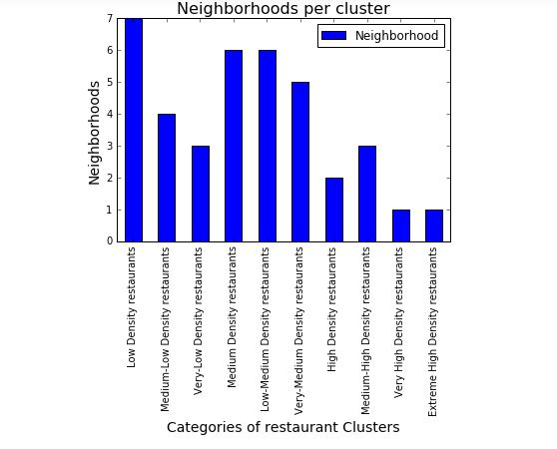
Restaurants visualization
1. "Low Density restaurants: Centroid equals to 7, Cluster=0
2. 'Medium-Low Density restaurants: Centroid equals to 37, Cluster=NAN
3. 'Very-Low Density restaurants: Centroid equals to 52, Cluster=2
4. 'Medium Density restaurants: Centroid equals to 74, Cluster=NAN
5. 'Low-Medium Density restaurants: Centroid equals to 91, Cluster=4
6. 'Very-Medium Density restaurants': Centroid equals to 113, Cluster=1
7. 'High Density restaurants: Centroid equals to 142 , Cluster=NAN
8. 'Medium-High Density restaurants: Centroid equals to 176, Cluster=NAN
9. 'Very High Density restaurants: Centroid equals to 225, Cluster=3
10. 'Extreme High Density restaurants: Centroid equals to 257, Cluster=NAN

Slide 18
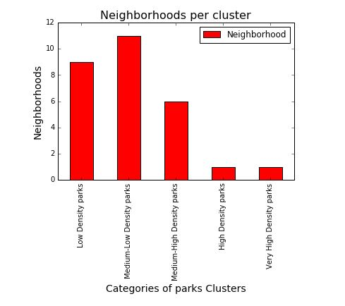
Parks visualization
Based on the centroids of each cluster of parks formed in k- means, the cluster names are as follows:
1. 'Low Density parks': Centroid equals to 1, Cluster=0
2. 'Medium-Low Density parks': Centroid equals to 2, Cluster=3
3. 'Medium-High Density parks': Centroid equals to 4, Cluster=1
4. 'High Density parks': Centroid equals to 6, Cluster=4
5. 'Very High Density parks': Centroid equals to 8, Cluster=2

Slide 19
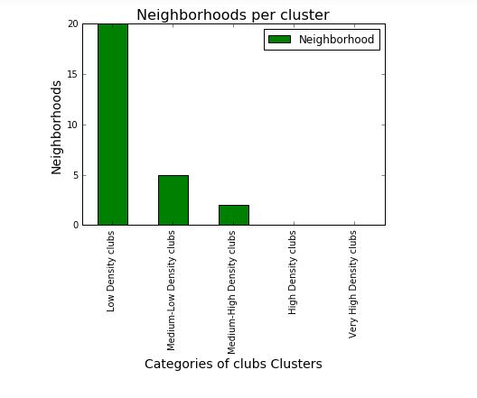
Clubs visualization
Based on the centroids of each cluster of clubs, the cluster names can be defined as
1. 'Low Density clubs': Centroid equals to 2, Cluster=0
2. 'Medium-low Density clubs': Centroid equals to 4 , Cluster=2
3. 'Medium-high Density clubs': Centroid equals to 8, Cluster=1
4. 'High Density clubs': Centroid equals to NAN, Cluster=3
5. 'Very-High Density clubs': Centroid equals to NAN, Cluster=4

Slide 20
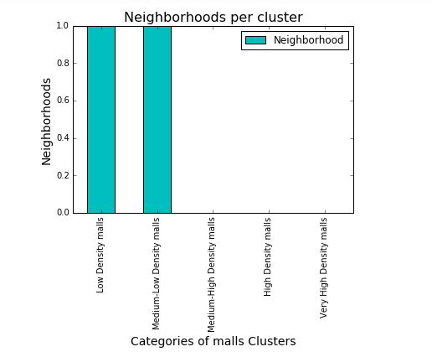
Malls visualization
Based on the centroids of each cluster of malls formed in k-means, the cluster names are as follows:
1. 'Low Density malls': Centroid equals to 0, Cluster=01
2. 'Medium-low Density malls': Centroid equals to 2, Cluster=0
3. 'Medium-high Density malls': Centroid equals to NAN, Cluster=2
4. 'High Density malls': Centroid equals to NAN, Cluster=3
5. 'Very-High Density malls': Centroid equals to NAN, Cluster=4

Slide 21
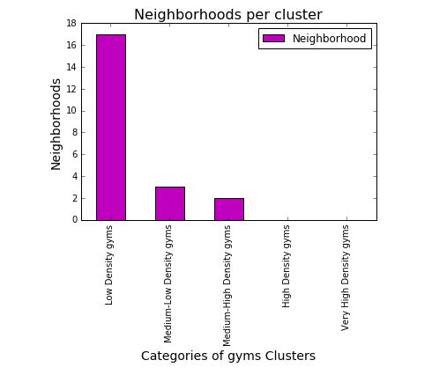
Gyms visualization
Based on the centroids of each cluster of gyms formed in k-means, the cluster names are as follows:
1. 'Low Density gyms': Centroid equals to 1, Cluster=0
2. 'Medium-low Density gyms': Centroid equals to 5, Cluster=2
3. 'Medium-high Density gyms': Centroid equals to 12, Cluster=1
4. 'High Density gyms': Centroid equals to NAN, Cluster=3
5. 'Very-High Density gyms': Centroid equals to NAN, Cluster=4

Slide 22
Conclusion
Conclusion part will include five choropleth maps of Toronto for all five types of venues which we have analysed.
These maps will show respective venue location, density, cluster category(in which they fall which we defined earlier), venue neighbourhood name with different colours for easy identification.
Five maps will be:
Restaurant choropleth map
Park choropleth map
Club choropleth map
Mall choropleth map
Gym choropleth map

Slide 23
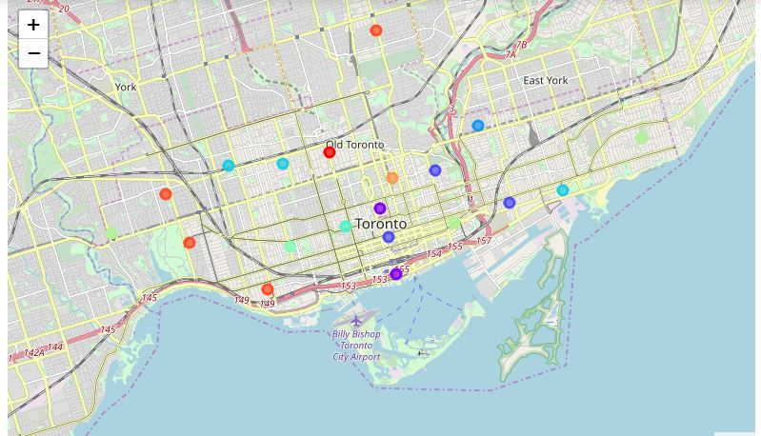
Restaurant Map
Firstly, I have created Choropleth map of Restaurants which contains below information for each highlighted point:
1. Venue name
2. Neighbourhood name
3. Cluster No.
Here map is showing different locations of restaurants along with their densities in Toronto. Here cluster no. has been shown on each point which actually fall into particular cluster category according to every unique venue. For knowing category of cluster(i.e. density of venue in particular location), we have to refer bar plots which we have made earlier(i.e. Neighbourhoods per cluster bar plots for each venue type

Slide 24
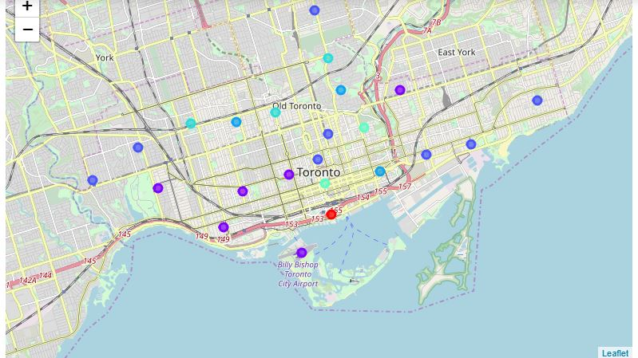
Park Map
Secondly I have created Choropleth map of Parks which contains below information for each highlighted point:
1. Venue name
2. Neighbourhood name
3. Cluster No.
Here map is showing different locations of parks along with their densities in Toronto. Here cluster no. has been shown on each point which actually fall into particular cluster category according to every unique venue. For knowing category of cluster(i.e. density of venue in particular location), we have to refer bar plots which we have made earlier(i.e. Neighbourhoods per cluster bar plots for each venue type

Slide 25
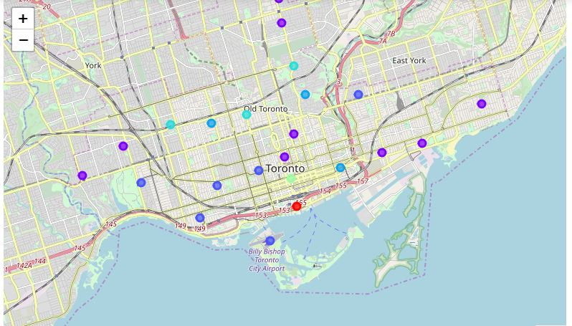
Club Map
Thirdly, I have created Choropleth map of Clubs which contains below information for each highlighted point:
1. Venue name
2. Neighbourhood name
3. Cluster No.
Here map is showing different locations of clubs along with their densities in Toronto. Here cluster no. has been shown on each point which actually fall into particular cluster category according to every unique venue. For knowing category of cluster(i.e. density of venue in particular location), we have to refer bar plots which we have made earlier(i.e. Neighbourhoods per cluster bar plots for each venue type

Slide 26
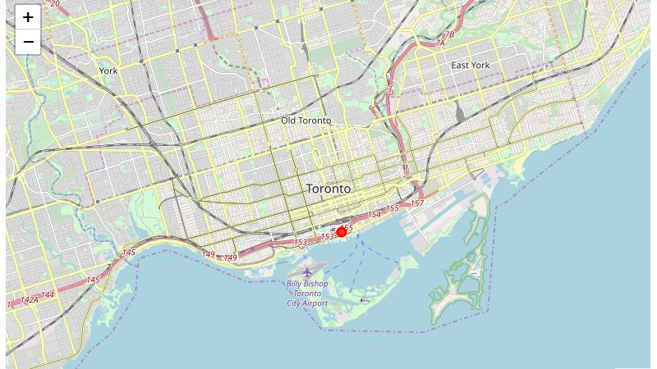
Mall Map
Fourth, I have created Choropleth map of Malls which contains below information for each highlighted point:
1. Venue name
2. Neighborhood name
3. Cluster No.
Here map is showing different locations of malls along with their densities in Toronto. Here cluster no. has been shown on each point which actually fall into particular cluster category according to every unique venue. For knowing category of cluster(i.e. density of venue in particular location), we have to refer bar plots which we have made earlier(i.e. Neighbourhoods per cluster bar plots for each venue type

Slide 27
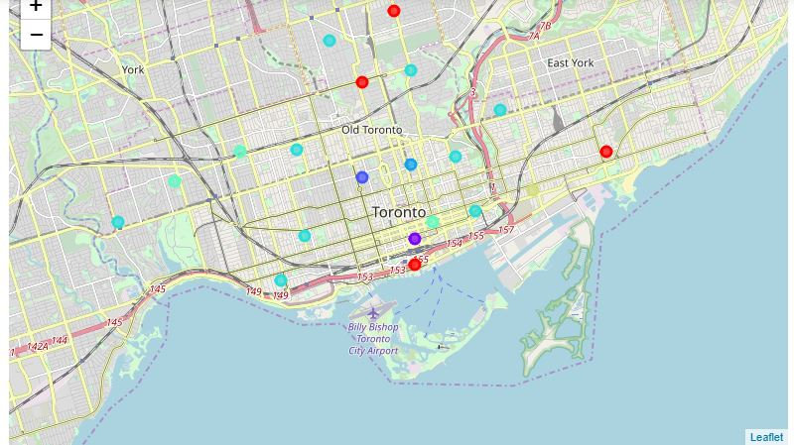
Gym Map
Fifth, I have created Choropleth map of Gyms which contains below information for each highlighted point:
1. Venue name
2. Neighbourhood name
3. Cluster No.
Here map is showing different locations of gyms along with their densities in Toronto. Here cluster no. has been shown on each point which actually fall into particular cluster category according to every unique venue. For knowing category of cluster(i.e. density of venue in particular location), we have to refer bar plots which we have made earlier(i.e. Neighbourhoods per cluster bar plots for each venue type

Slide 28
Discussion
Toronto is a big city with a high and multicultural population density . The total number of venues present in neighbourhoods of Toronto of the 38 postcodes in total can vary. As there is such a complexity, very different approaches can be tried in clustering and classification studies. Moreover, it is obvious that not every classification method can yield the same high quality results.
I used the K-means algorithm as part of this clustering study. When I tested the Elbow method, I set the optimum k value to every venues separately. However, only 38 district coordinates were used. For more detailed and accurate guidance, the data set can be expanded and the details of the neighbourhood or street can also be drilled.
I also performed data analysis through this information by adding the coordinates of districts and venues. In future studies, this data can also be accessed dynamically from specific platforms or packages.
I ended the study by visualizing the data and clustering information on the Toronto map. In future studies, web or telephone applications can be carried out to direct investors or Accommodators.

Slide 29
Future Insights
As we know People are turning to big cities to start a business or for service purpose or for any other work.. For this reason, people can achieve better outcomes through their access to the platforms where such information is provided.
For investors: Real estate investors who want to invest in properties could get better idea of property prices by observing this venues data near by.
For immigrants: People coming from different areas, suburbs, or different countries could find an accommodation in an easy way by using this data analysis according to their priorities.
Management purpose: City managers can manage the city more regularly by using similar data analysis types or platforms.
Citizens prospective: Citizens who already lived there could also check out this data analysis for shifting/relocating purpose within Toronto.
Social prospective: Venues density in particular area could decide measure of pollution, noise or crime also.

Slide 30


