Slide 1
TIDYQUANT ASSIGNMENT
Submitted by: PRACHI SINGLA

Slide 2
1. Perform EDA analysis and find out what key factors are affecting the overall sales?
The factors affecting overall sales are multiple.
Geographically: location code 18 has highest sales
Demographically: females & males are more prominent in purchasing rather than unisex or kids.
Technically: “3H” technology with line up “SPECIALS” is most selling product.
Product features: Watches with dial type “ANALOG”, dial colour “ WHT”, strap type “SS” & strap colour “SLV” or “GLD” are most selling in market.
Item Discount/Offer: Sales activity code “MYSTMAX” contributes to high sale.
Brand C of Indian style BASICS watches are trending.
Under this, watches with technology “3H” and Line up “SPECIALS” are contributing high to sales.
Under this, “ANALOG” “WH” coloured DIALs & “SS” type of “GLD” OR “SLV” coloured strap are most selling watches

Slide 3
2. Plot graph wherever possible and demonstrate top sales by various attributes. During Univariate Analysis, top sales by various attributes as below:
ATTRIBUTE | MAXIMUM SALES | MINIMUM SALES
CATEGORY | BASICS | GWP
COLLECTION | BH2015 | 2000s
LINE UP | SPECIALS | CORPORATE
CATEGORY.1 | INDIA | REBEL
GENDER | MALES | KIDS
CASE MATERIAL | BRASS | PLASTIC
CASE COLOUR | GLD | SILV
CASE SHAPE | ROUND | DIAMOND
CASE SIZE | 39MM | 18.5MM
DIAL TYPE | ANALOG | ANADIGI
DIAL COLOUR | WHT | GRN CAMO
STARP TYPE | SS | ALLOY

Slide 4
ATTRIBUTE | MAXIMUM SALES | MINIMUM SALES
STRAP COLOUR | GLD | SILV
PRICE RANGE | 2K-3K | NA
TECHNOLOGY | 3H | AUTOMATIC
BRAND | C | B
TRANSACTION TYPE | SI-ITEMS | CM-ITEMS
LOCATION CODE | 18 | 3
SALES CODE | MYSTMAX | NA
TRANSACTION DAY | 30th | NA
TRANSACTION WEEK | 50th | 2nd-21st
TRANSACTION MONTH | 11th | 6th
ITEM DISCOUNT | 50% | NA

Slide 5
3. What are the key business insights that can be pulled from this data?
Minimize the no. of sales activity codes which has no great impact on sales. MYSTMX, MYSMD, REGDISC & REGULAR are the codes which are mainly contributing sales.
Identifying Least demanding products from all attributes’ prospective and discontinue and focus on high demand products.
Identifying target customers. This is possible if we get below data in addition:
Socio-demographic factors: Gender, age, education
Engagement factors: Frequency, Monetary
Stationary factors: Season, date, time
Conversion of customer

Slide 6
4. What data solutions/Model you can suggest to the business owner in order to optimize this business?
Classification: In classification techniques, we can use any of machine learning classification model like logistic regression, Decision tree, random forest, SGD, Gradient boosting, Naïve Bayes according to data and performance measures for great rise of business.
Recommendation:The most common task of a recommendation system is to improve customer experience through the most relevant recommendation of items/products based on their previous behavior. There are multiple types of recommendation systems/models. But in E-commerce, mostly content based and collaborative recommendation systems are used.
Sales Forecasting Models: Sales forecasts can be used to identify benchmarks and determine incremental impacts of new initiatives, plan resources in response to expected demand, and project future budgets.

Slide 7
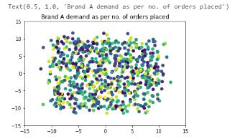
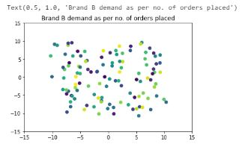
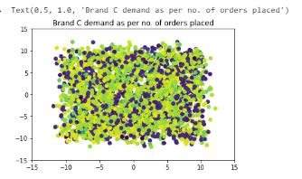
5. Split the data by brands and then find the clusters in each brand (Optional)
BRAND C is most selling with high density of clusters and BRAND B with minimum sales as indicating by low density of clusters.

Slide 8


