Slide 1
A Master’s Project report submitted to
School of Engineering
In Fulfillment for the Degree of
Masters of Science in Computer Science
Submitted By:
Prachi Sethi(19963)
Prepared under the supervision and guidance of
Professor Henry Chang
THE MAZE
School of Engineering
San Francisco Bay University
161,MIssion Falls ln, Fremont, CA 94539

Slide 2
Acknowledgement
I would like to express my deepest gratitude to my Professor, Henry Chang, whose patience, guidance and questioning was critical to the completion of this study. I have not only acquired broad knowledge in my field from taking his courses but have benefited from his unflagging support during my academic pursuit.
I would like to express my sincere appreciation to all individuals who have supported me throughout the completion of this project.
Additionally, I thank my peers and colleagues for their encouragement and support. Finally, I acknowledge the resources and facilities provided by SFBU. This project would not have been possible without their assistance.

Slide 3
Abstract
The project "Maze" investigates traversal algorithms for solving maze navigation problems. It compares Depth-First Traversal and Breadth-First Traversal methods, focusing on finding the shortest path. The project explores scenarios involving a legged robot and a self-driving car, demonstrating manual solutions and Python code implementations. Emphasis is placed on the effectiveness of Breadth-First Traversal in real-world applications like autonomous navigation systems.
Overall, this project contributes to a deeper understanding of traversal algorithms and their implications in solving maze navigation challenges, with practical implications for robotics and autonomous systems development.

Slide 4
Contents
Introduction.................................................................................................................5
Motivation...................................................................................................................6
Objectives of the work................................................................................................6
Relevant theory...........................................................................................7
Review of past/reported work.....................................................................................8
Brief intro of the proposed work/solution................................................................9
Design.....................................................................................................................10-15
Implementation and Source Code.....................................................................................................16
Test Cases......................................................................................................................17
Enhancement Ideas..................................................................................................18
Conclusion................................................................................................................19
Bibliography..............................................................................................................20

Slide 5
Introduction
Navigating through complex mazes poses a significant challenge for autonomous systems, requiring efficient traversal algorithms to find the shortest path. In the project "Maze," I explore the efficacy of Depth-First Traversal and Breadth-First Traversal methods in solving maze navigation problems. The aim is to understand their application in scenarios involving a legged robot and a self-driving car.
In this presentation, I delve into the manual solutions and Python code implementations for both traversal methods. By analyzing their effectiveness in finding the shortest path, I highlight the practical implications of Breadth-First Traversal in real-world applications such as autonomous navigation systems.

Slide 6
Motivation
Through this project, I aim to deepen our understanding of traversal algorithms and their relevance in robotics and autonomous systems development. By showcasing manual processes and code implementations, I demonstrate the significance of Breadth-First Traversal for efficient maze navigation.
Objectives of the Work
The primary objectives of this research are to:
Understand the intricacies of the "Maze" problem and its underlying rules and constraints.
Develop an algorithm or approach to solve the maze and determine the possibility of reaching the destination from the starting point.
Analyze the efficiency and correctness of the proposed solution.

Slide 7
Relevant Theory
Traversal algorithms are fundamental in navigating complex mazes, enabling autonomous systems to find the shortest path from a start point to an end point.
Two primary traversal algorithms used are:
Depth-First Traversal (DFS): Explores as far as possible along each branch before backtracking.
Breadth-First Traversal (BFS): Explores all neighbor nodes at the present depth before moving on to the nodes at the next depth level.
DFS and BFS play a crucial role in maze navigation by systematically exploring the maze structure to determine the optimal route.
Understanding the differences in their exploration strategies and complexities is essential for efficient maze solving and path planning in various applications, including robotics and autonomous systems.

Slide 8
Review of past/reported work
Previous research has extensively explored traversal algorithms in maze navigation and path planning.
Studies have focused on comparing the effectiveness of Depth-First Traversal (DFS) and Breadth-First Traversal (BFS) in various scenarios.
Research findings have highlighted the advantages and limitations of each traversal algorithm in terms of time complexity, space complexity, and ability to find the shortest path.
Existing literature provides insights into the practical applications of traversal algorithms in robotics, autonomous vehicles, and computer graphics.
Some studies have proposed hybrid approaches or optimizations to enhance the performance of traversal algorithms in maze solving.
Reviewing past and reported work is crucial for understanding the current state-of-the-art and identifying potential areas for improvement or innovation in maze navigation algorithms.

Slide 9
Brief intro of the proposed work/solution
The proposed work aims to investigate the efficacy of Depth-First Traversal (DFS) and Breadth-First Traversal (BFS) algorithms in maze navigation.
We will analyze these traversal methods in two scenarios: navigating a maze with a legged robot and navigating with a self-driving car.
Our focus is on determining which traversal algorithm is more effective in finding the shortest path in each scenario.
Through manual solutions and Python code implementations, we will demonstrate the practical implications of DFS and BFS in real-world maze navigation problems.
This research will contribute to a deeper understanding of traversal algorithms and their applications in robotics and autonomous systems development.

Slide 10
Design
The design phase involves outlining the methodology and approach for comparing Depth-First
Traversal (DFS) and Breadth-First Traversal (BFS) in maze navigation.
Methodology:
Define the maze structures and scenarios for both legged robot and self-driving car navigation.
Implement DFS and BFS algorithms for maze solving.
Develop manual solutions for maze navigation using both traversal methods.
Implement Python code to simulate maze navigation with DFS and BFS.
Approach:
Start by defining the maze environment and obstacle configurations.
Apply DFS and BFS algorithms to find the shortest path from the start point to the end point in each scenario.
Compare the performance of DFS and BFS in terms of solution accuracy, time complexity, and space complexity.
Evaluate the practical implications of each traversal algorithm for real-world applications.

Slide 11
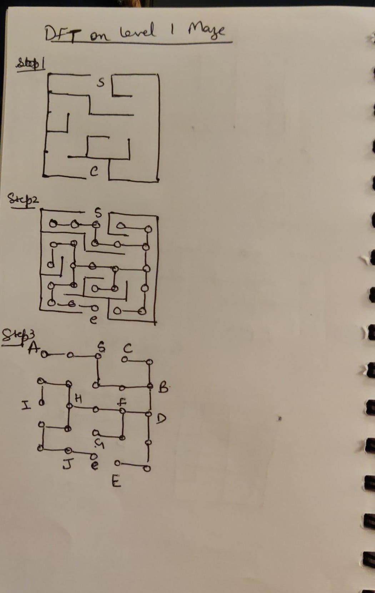
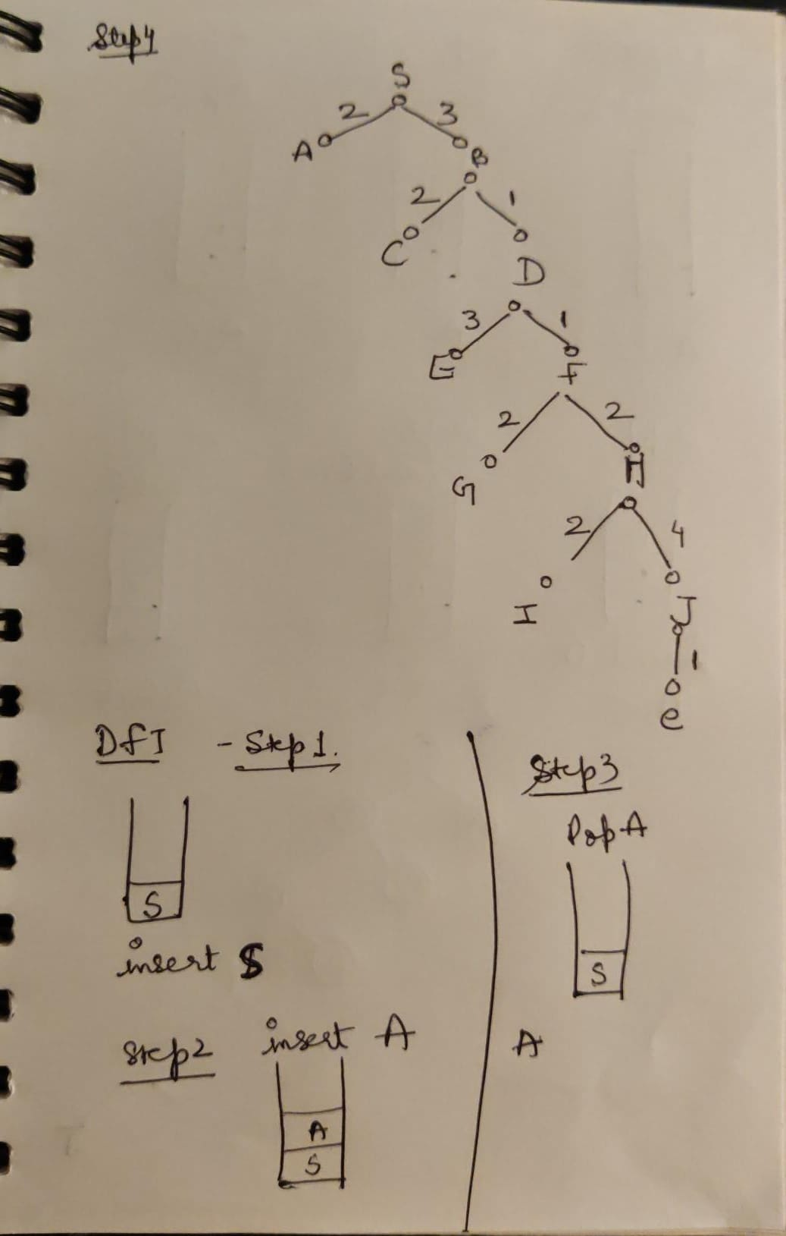
Design
Example 1- The Maze (DFT)

Slide 12
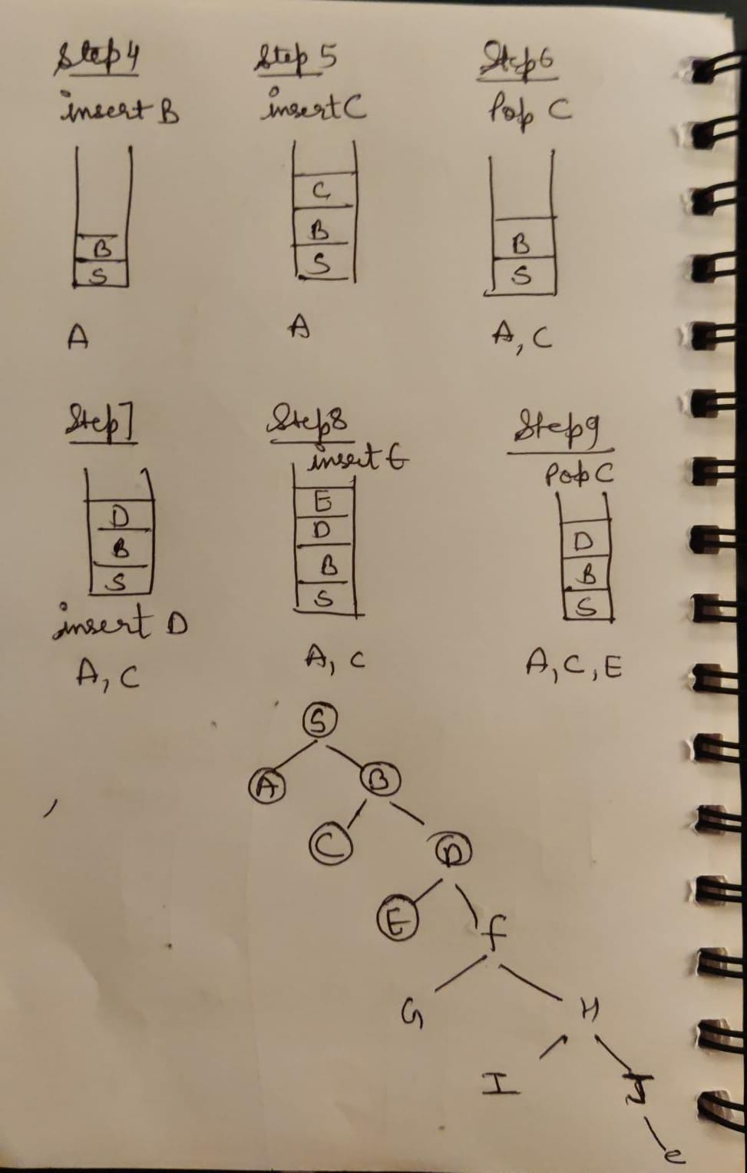
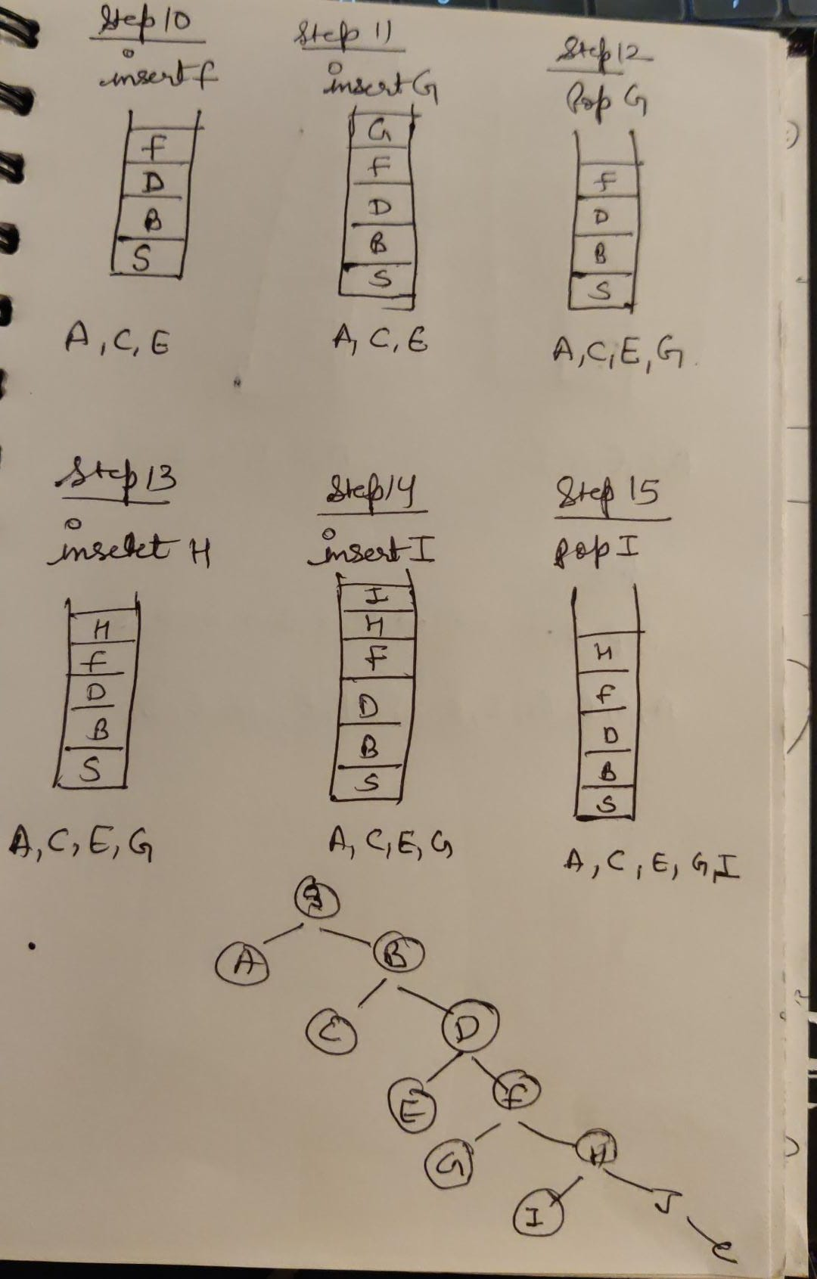
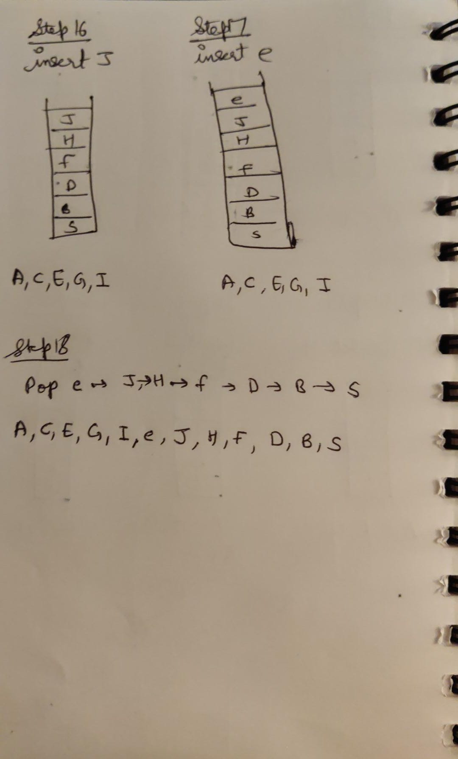

Slide 13
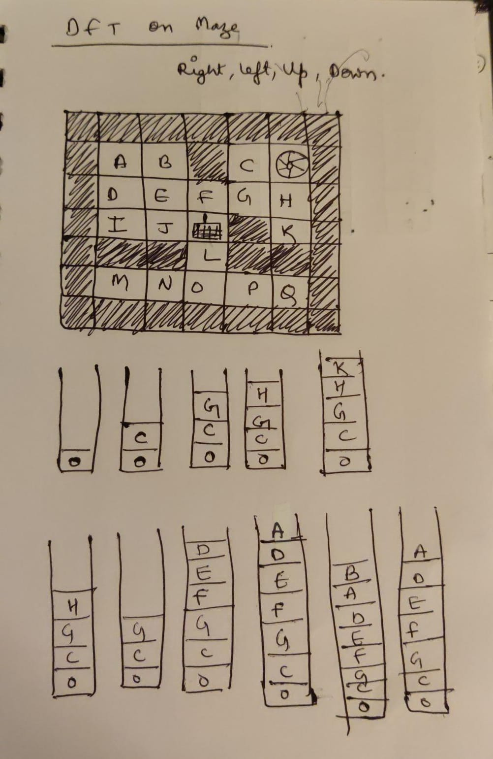
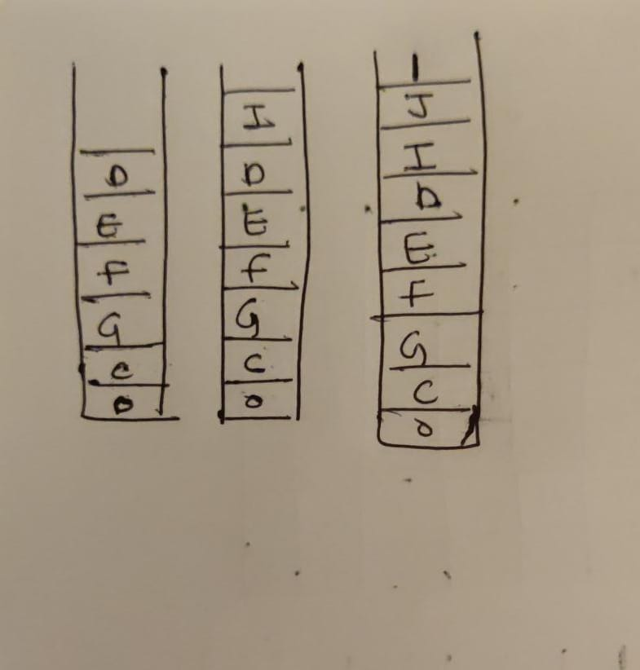
Design
Example 1- The Maze (DFT)
Rolling robot

Slide 14
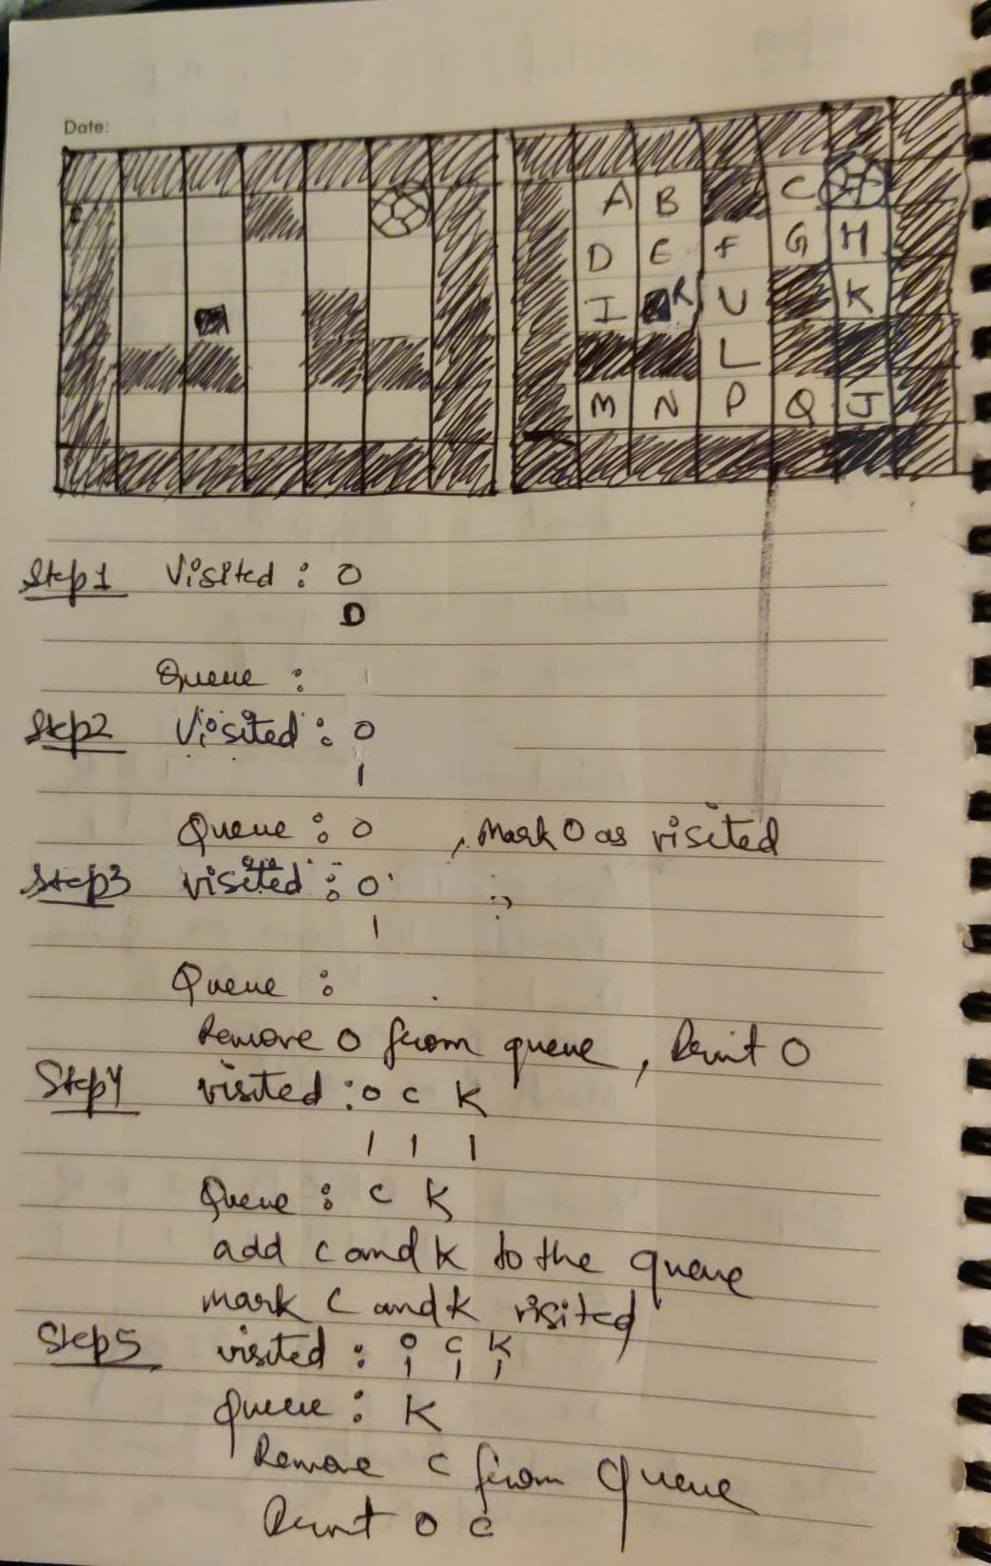
Design
Example 1- The Maze (BFT)
Rolling robot

Slide 15
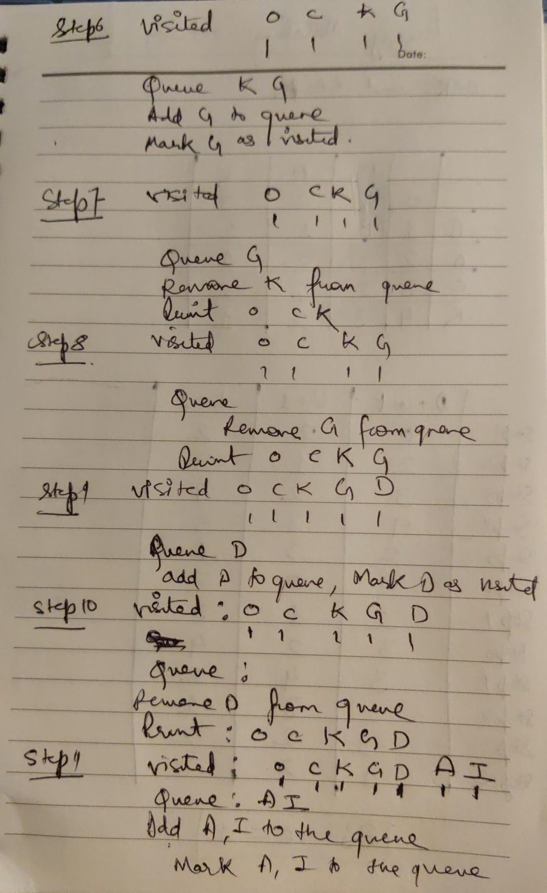
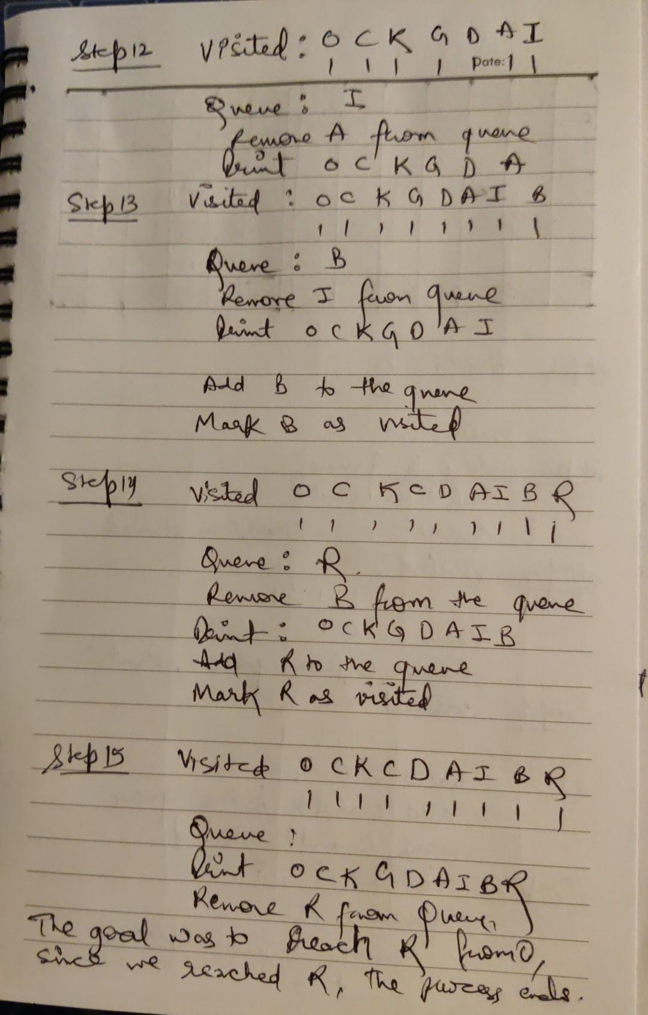

Slide 16
Implementation and Source code
def hasPath(maze, start, destination):
def dfs(x, y):
if [x, y] == destination:
return True
visited.add((x, y))
for dx, dy in [(0, 1), (0, -1), (1, 0), (-1, 0)]:
newX, newY = x, y
while 0 <= newX + dx < len(maze) and 0 <= newY + dy < len(maze[0]) and maze[newX + dx][newY + dy] == 0:
newX += dx
newY += dy
if (newX, newY) not in visited:
if dfs(newX, newY):
return True
return False
visited = set()
return dfs(start[0], start[1])

Slide 17
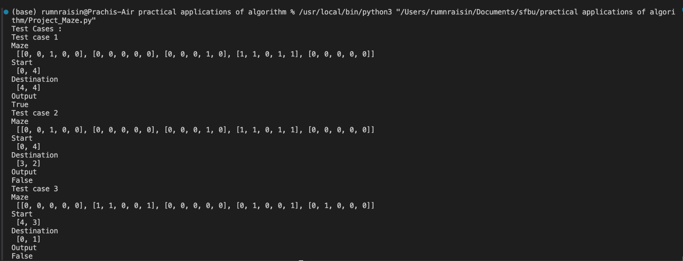
Test Cases

Slide 18
Enhancement Ideas
Dynamic Maze Generation: Implement algorithms to dynamically generate mazes with varying complexities. This provides a comprehensive evaluation of traversal algorithms under different maze structures, enhancing the project's versatility and realism.
Optimization Techniques: Explore optimization techniques like memoization or heuristic approaches to improve the efficiency of DFS and BFS algorithms. This ensures faster maze solving and enables the project to handle larger and more complex mazes effectively.
Interactive Visualization: Develop interactive visualization tools to demonstrate maze navigation in real-time. This enhances understanding and engagement, making it easier for users to grasp traversal algorithms' behavior and effectiveness.
Real-world Simulation: Integrate real-world simulation environments to simulate maze navigation scenarios realistically. By deploying traversal algorithms in practical settings, this enhancement provides insights into their performance and feasibility for real-world applications.

Slide 19
Conclusion
In conclusion, the project "Maze" has provided valuable insights into traversal algorithms and their applications in maze navigation. Through the comparison of Depth-First Traversal (DFS) and Breadth-First Traversal (BFS), we have explored their effectiveness in finding the shortest path in various scenarios, including navigation with a legged robot and a self-driving car.
The project has highlighted the strengths and limitations of DFS and BFS, emphasizing the importance of considering algorithmic efficiency and solution accuracy in maze solving. By implementing manual solutions and Python code, we have demonstrated the practical implications of traversal algorithms in real-world applications.
Moving forward, the enhancement ideas presented offer opportunities to further improve the project's scope and impact. By incorporating dynamic maze generation, optimization techniques, interactive visualization, and real-world simulation, we can enhance the project's versatility, efficiency, and realism.
Overall, the project "Maze" contributes to a deeper understanding of traversal algorithms and their relevance in robotics, autonomous systems, and computer science. By continuing to explore and innovate in this field, we can address complex navigation challenges and pave the way for future advancements in autonomous navigation technologies.

Slide 20
Bibliography
https://hc.labnet.sfbu.edu/~henry/npu/classes/algorithm/graph_alg/slide/exercise_graph_alg.html#490_bft
https://hc.labnet.sfbu.edu/~henry/npu/classes/algorithm/graph_alg/slide/exercise_graph_alg.html#level_1_dft
https://hc.labnet.sfbu.edu/~henry/npu/classes//algorithm/graph_alg/slide/maze.html#a1
https://hc.labnet.sfbu.edu/~henry/npu/classes/algorithm/tutorialpoints_dsa/slide/depth_first_traversal.html
https://hc.labnet.sfbu.edu/~henry/npu/classes/algorithm/graph_alg/slide/exercise_graph_alg.html#mbft

