Slide 1
Task 3: VLA-Based control in simulation
CAPSTONE PROGRESS UPDATE 3
WalkTheTalk · Vision-Language-Action navigation on a Unitree Go2
Notes:
Hi everyone. My capstone project is called WalkTheTalk. The goal is to teach a four-legged robot, the Unitree Go2, to follow plain spoken instructions, like ‘exit the bedroom, turn left, and stop near the rug’, and walk there on its own, without a map.
To do that I use a Vision-Language-Action model called NaVILA which basically serves as a brain , it looks at the robot’s camera, reads the instruction, and decides the next move in words, like ‘move forward 75 centimetres’ or ‘turn left 30 degrees’. The robot’s walking controller is the ‘legs’: it turns that command into actual steps and keeps the robot balanced.

Slide 2
Tasks 1 and 2 are done; NaVILA now runs in simulation
1
2
3
4
DONE
DONE
IN PROGRESS
LATER
Task 1
Task 2
Task 3
Task 4
Orin–Go2 integration & high-level control
Go2 simulation environment (Isaac Sim)
VLA-based control in simulation
VLA deployment on the real Go2
Covered last time
Covered last time
Today · Phase 2, Oct 1 – Nov 15
Phase 3 · Nov 16 – Dec 7
Today: 1) Task 3 progress 2) Why NaVILA 3) Our planned contribution
Notes:
The project has four tasks. In my last presentation I covered the first two: connecting the onboard computer to the real Go2, and getting the Go2 walking in the Isaac Sim simulator. Today I’ll cover Task 3, where NaVILA now drives the simulated robot end to end, and the contribution I plan to make, a fix for NaVILA’s habit of finding the goal but not stopping there

Slide 3
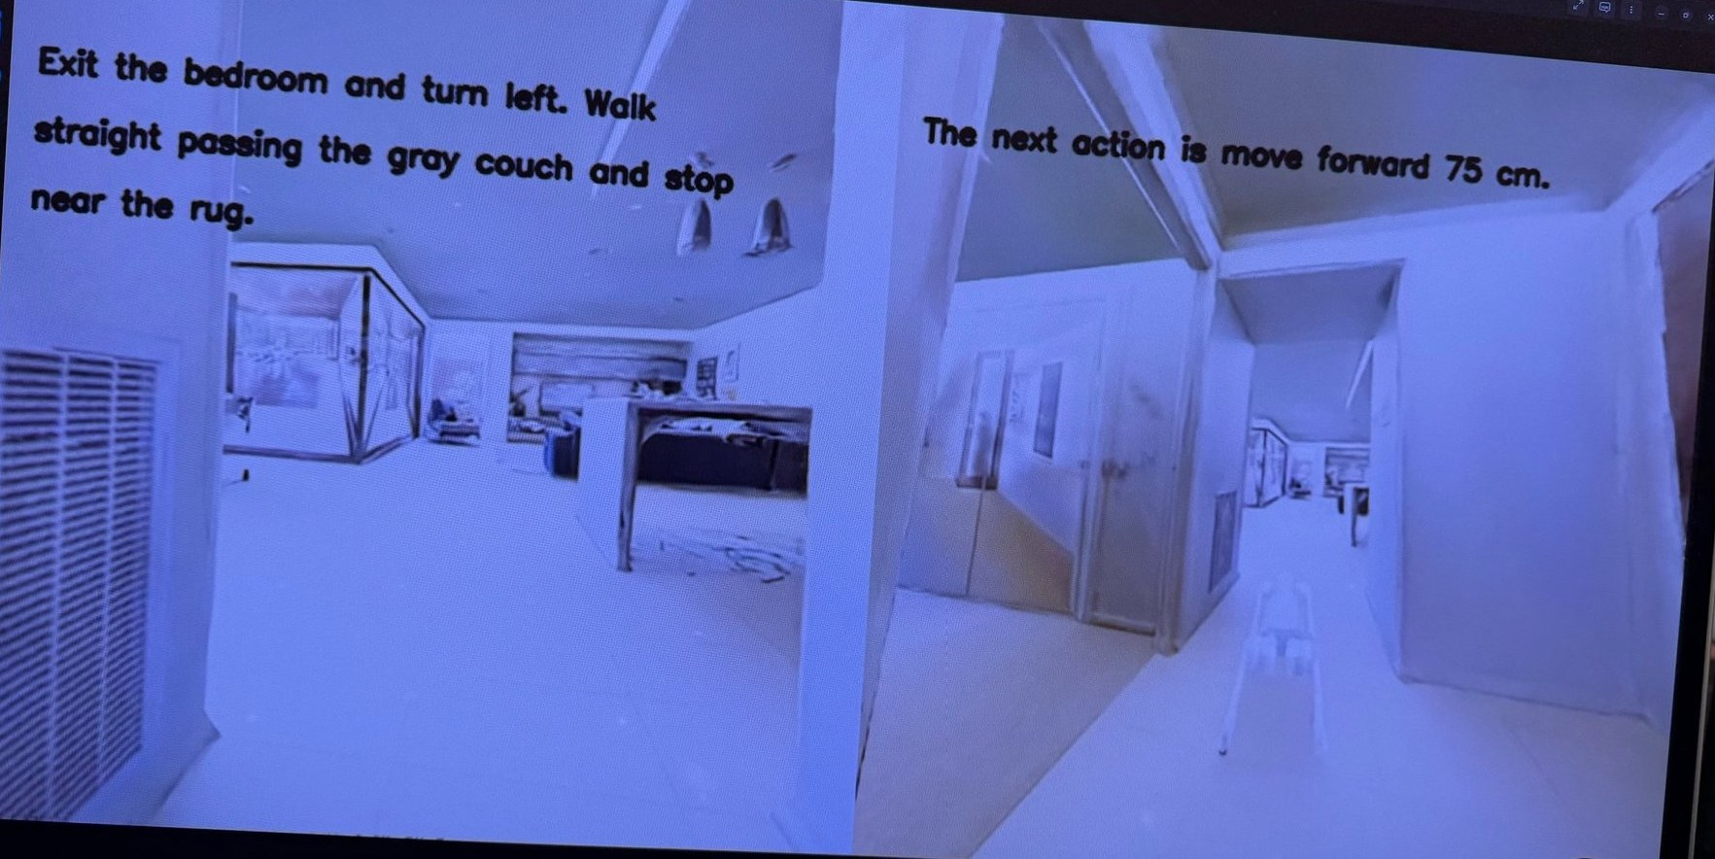




NaVILA now drives the simulated Go2 end to end
TASK 3
Camera frame + instruction
"Exit the bedroom and turn left. Walk straight passing the gray couch and stop near the rug."
NaVILA (8-bit) decides
Replies in words: "move forward 75 cm", "turn left 45 degree" or "stop"
Command mapping
Python turns the words into a velocity command
Walking policy moves the Go2
Episode video from our run: the instruction (left) and NaVILA's decision with the Go2 (right)
Low-level legs controller handles balance; repeat with the next frame
Notes:
This is the Task 3 loop working end to end, and this is the ss from one of our episode videos. We connected Isaac Sim to NaVILA so that, for each instruction in the benchmark, NaVILA reads the instruction, watches the simulated Go2's camera, and picks the next move in words, while the walking policy carries each move out, until NaVILA decides it has arrived.
On the left is the instruction: exit the bedroom, turn left, walk past the gray couch and stop near the rug. On the right is the Go2 in the hallway, with NaVILA's current decision, move forward 75 cm. The camera fr
Ame and instruction go into NaVILA, NaVILA answers in words, code maps those words to a velocity command, and the moves the legs. Then it repeats.
Instructions comes from benchmark dataset
It's built from R2R (Room-to-Room), a well-known research dataset where people wrote directions for routes through real houses. The houses were 3D-scanned; that collection is called Matterport3D.
The NaVILA authors took 1,077 of those routes and placed them in Isaac Sim, so a simulated Go2 can walk them. Those are the 1,077 "episodes."
Each episode has three things:
A house (a 3D-scanned home loaded into Isaac Sim)
A start position for the robot
A written instruction, in this style: "Walk past the kitchen counter, turn left into the hallway, and stop at the bathroom door." (That's an example of the style, not a specific episode.)
The dataset also stores the goal location, but only the scoring code sees it. NaVILA never gets the goal's coordinates and must find it from the words and the camera alone.
It's an AI model with 8 billion parameters, similar in kind to the models behind chatbots, but trained on navigation data.
"…serves as a brain: it looks at the robot's camera, reads the instruction, and decides the next move in words…"
Each time a decision is needed, NaVILA receives:
8 camera images from the robot's simulated front camera: the current view plus 7 earlier ones, so it remembers where it has been
The instruction text
It replies with one sentence, like "The next action is move forward 75 cm." That's the "decides the next move in words" part. It only ever chooses from a small set of moves:
move forward 25, 50 or 75 cm
turn left or right 15, 30 or 45 degrees
• • stop

Slide 4
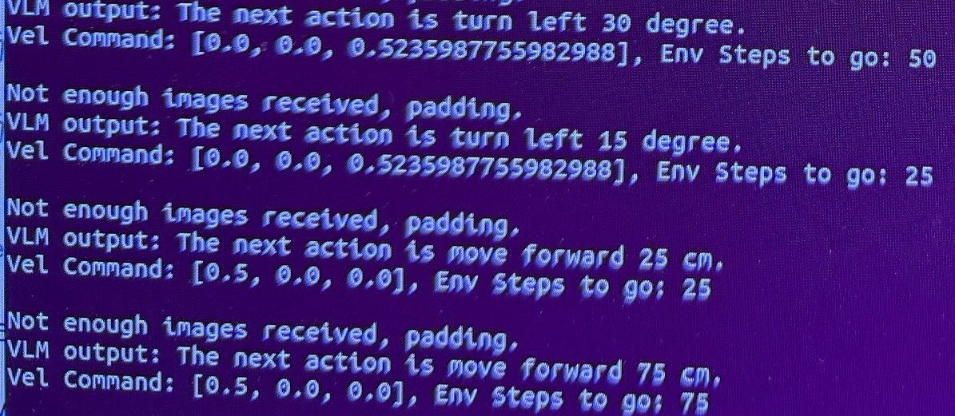
How NaVILA's words become motion
TASK 3 · HOW IT WORKS
NaVILA says | Command | For
"move forward 25 / 50 / 75 cm" | 0.5 m/s forward | 25 / 50 / 75 steps
"turn left / right 15 / 30 / 45 degree" | 0.52 rad/s turn (30°/s) | 25 / 50 / 75 steps
"I think I should stop…" | zero | episode ends
… more moves and turns …
Speed is fixed; the step count sets the distance. 75 steps at 0.5 m/s covers 75 cm, so the sim runs about 50 steps per second.
Log from one of our episodes: each NaVILA reply (VLM output) and the command it became (Vel Command)
This mapping is where our fix plugs in: near the goal, swap 75-step moves for 25-step moves.
Notes:
This is the log from one of our episodes. Each pair of lines is one NaVILA decision: the sentence it outputs, labelled VLM output, and the velocity command my code sends to the walking policy. The three numbers are forward speed, sideways speed and turning speed. Turn left 30 and turn left 15 both turn at 0.52 radians per second, about 30 degrees per second, but for 50 and 25 steps. Move forward 25 and 75 both go at 0.5 metres per second, for 25 and 75 steps. So speed is fixed and the step count sets the distance; 75 steps at 0.5 m/s gives 75 cm, which means the sim runs at about 50 steps per second. When NaVILA says it has finished the instruction, the command goes to zero and the episode ends. The "not enough images" line just means NaVILA had fewer than 8 past frames at the start, so it padded. This mapping, the get_vel_command function, is exactly where the stop-aware controller will sit.

Slide 5
8-bit weights let NaVILA fit beside Isaac Sim
TASK 3 · MAKING IT FIT
We store NaVILA's 8 billion parameters at 8-bit instead of 16-bit precision, halving its memory so it fits beside Isaac Sim on a 20 GB GPU.
GPU memory on the lab RTX A4500 (20 GB)
Why it halves the memory
16-bit NaVILA (original)
16-bit: 2 bytes × 8B params ≈ 16 GB of weights
8-bit: 1 byte × 8B params ≈ 8 GB of weights
No retraining: the weights are rounded when the model loads
≥ 24 GB needed
8-bit NaVILA (ours)
12.9 GB peak
Isaac Sim
20 GB limit
Notes:
NaVILA has 8 billion parameters. Stored at 16-bit, each one takes 2 bytes, so about 16 GB for the weights alone, and over 24 GB once the camera frames and working memory are added. That is why last time I said it would not fit. At 8-bit each weight takes 1 byte, so the weights shrink to about 8 GB, and the measured peak is 12.9 GB. That leaves about 7 GB for Isaac Sim on the 20 GB A4500. Nothing is retrained; the weights are rounded when the model is loaded. The trade-off is some possible accuracy loss, which I measure as part of the contribution.

Slide 6
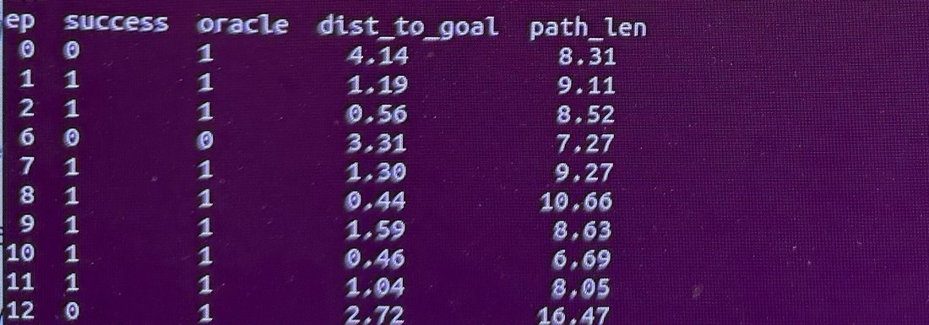

First 10 episodes: 8-bit NaVILA works
TASK 3 · FIRST RESULTS
70%
Success
Stopped within ~3 m of the goal
90%
Oracle success
Reached the goal area at some point
0.647
SPL
Per-episode results on the lab machine. Failures: episodes 0, 6 and 12.
Success weighted by path efficiency (1.0 = perfect)
NaVILA paper: 50.2% success · 58.7% oracle success
Re-running the 3 failed episodes
Why we can't compare yet: with only 10 episodes, 70% success could really be anywhere from about 40% to 100% (±28 points). A 210-episode baseline replaces these numbers.
80% success 0.736 SPL
One failure became a success on a second try, so results vary from run to run.
Notes:
These are the first 10 benchmark episodes of 8-bit NaVILA on the lab machine; the episode numbers are the benchmark's own IDs. 70% success, 90% oracle success, and an SPL of 0.647. Oracle success means the robot got to the goal area at some point; success means it also stopped there. Three episodes failed: 0, 6 and 12. When I re-ran just those three, one of them succeeded, which lifts the score to 80% and the SPL to 0.736. So the same episode can pass or fail on different runs, which matters for the question at the end. Both numbers are above the paper's 50.2%, but 10 episodes is far too few to claim that: the margin of error is about plus or minus 28 points. The 210-episode run is the fair baseline.

Slide 7





What our project needs from a model
WHY NAVILA
1
2
3
4
5
Follows language instructions
Built for a legged robot
Public code and weights
Works in Isaac Sim
Fits our GPU
Camera + instruction in, high-level navigation actions out (Task 3)
Designed for, and ideally tested on, a quadruped like our Go2
A pretrained model we can download and run, no training from scratch
Fits the Go2 simulation already built in Task 2
Runs beside Isaac Sim on one RTX A4500 (20 GB)
Notes:
These five criteria come straight from the project description and our hardware. Criteria 3 to 5 matter most in practice: without public weights we cannot run a model at all, without Isaac Sim support we would have to redo Task 2, and it has to fit on the GPU we actually have.

Slide 8
Only NaVILA meets every criterion we could check
WHY NAVILA · SIDE BY SIDE
Paper | Instruction navigation | Legged / Go2 | Code + weights | Isaac Sim | Role in our project
NaVILA | Yes | Yes, Go2 | Yes | Yes | Base model (Task 3)
StreamVLN | Yes | Yes, Go2 | Yes | No, Habitat | Closest alternative
MobileVLA-R1 | Yes | Yes, quadruped | Yes | No, Habitat | Related work: RL training
MoRE | Partly, multi-skill | Yes, quadruped | None found | No | Related work: RL scaling
TrackVLA | No, tracking | Yes, Go2 | Benchmark only | No | Object-goal extension
Token pruning | Add-on only | Yes, Go2 | None found | No | Possible speed add-on
Efficient-VLN | Yes | No, sim only | No | No | Related work: 73.2% R2R-CE
ABot-N0 / N1 | Yes | Yes, Go2 | Benchmark only | No | Related work: newest models
Fits our GPU: only NaVILA has been tested on it (8-bit: 12.9 GB peak, leaving room for Isaac Sim). Code status checked on GitHub and project pages, Oct 2026.
Notes:
Blue cells meet the criterion, white cells do not, grey is partly. The two models with the best benchmark scores, Efficient-VLN and ABot, have not released their models, so they cannot be our base. StreamVLN and MobileVLA-R1 are open but built for the Habitat simulator, so they would mean redoing Task 2. NaVILA is the only one that is open, legged, and works in Isaac Sim, and the only one we have run on our GPU.

Slide 9

NaVILA's published results back the choice
WHY NAVILA?
54%
50.2%
88%
Success on R2R-CE
Success, Go2 in Isaac Sim
Success on a real Go2
Best single-camera result when published (NaVid: 37%)
VLN-CE-Isaac, the same benchmark we run in Task 3
25 instructions × 3 tries in home, office and outdoor scenes
Same two-level design as our project: a vision-language "brain" gives mid-level commands, and a separate walking policy is the "legs". That split is what lets us add our own module in between.
Notes:
From the NaVILA paper, Cheng et al., RSS 2025: 54% success on R2R-CE, the standard language-navigation benchmark; 50.2% on the Go2 in Isaac Sim, which is exactly the benchmark I run; and 88% on a real Go2. The two-level design is also why it suits a contribution: NaVILA's decisions are plain text, so I can add a small module between its output and the walking policy without touching the model.

Slide 10
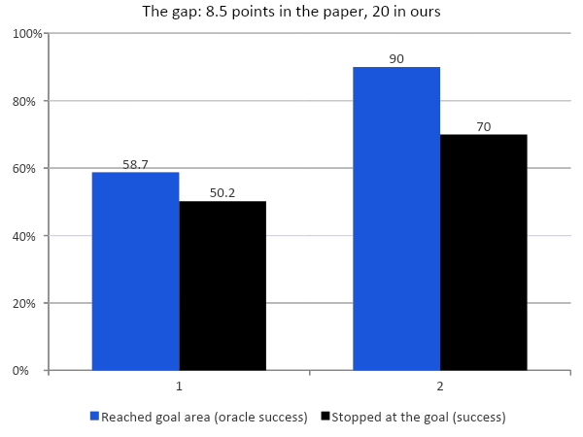


NaVILA usually finds the goal, but doesn't always stop
OUR CONTRIBUTION · THE PROBLEM
Never stopped
Episode 12: reached the goal area, then kept correcting until the time limit
Overshot
Episode 0: passed the goal and stopped 4.1 m away, outside the 3 m zone
Stopped in the wrong place
Episode 6: confident stop in the wrong room, 3.3 m away (not our target)
Notes:
Oracle success counts any episode where the robot got within about 3 m of the goal. Success also requires NaVILA to say stop there. The difference between the two bars is the stopping problem: 8.5 points in the paper and 20 in our first run. On the right are the three failure types from NaVILA's logged decisions. Never stopped and overshot are both stopping failures, which is what we target. Stopping in the wrong room is a different, harder problem about understanding the instruction, and we are not trying to fix it.

Slide 11
A training-free, stop-aware controller
OUR CONTRIBUTION · THE FIX
Camera +
instruction
NaVILA
8-bit
NEW: stop-aware
controller
Walking
policy
Go2
moves
1
Finer steps near the goal
2
Stop check
3
8-bit vs full precision
When NaVILA is close to stopping or unsure, replace 75 cm moves with 25 cm moves, so one extra step can't carry the robot past the goal.
Every few steps, ask NaVILA directly: "Have you reached the goal in the instruction? Yes or no." Stop on yes.
Measure how much accuracy and speed 8-bit costs. This is what lets NaVILA fit on a 20 GB GPU.
Targets: overshoot
Targets: never stopped
Secondary result
No retraining: these changes only touch the command mapping and evaluation loop we already control, so one RTX A4500 is enough.
Notes:
The fix is a small module between NaVILA's text output and the walking policy, in code we already run: the command mapping (get_vel_command) and the evaluation loop. Idea 1 targets overshooting by taking smaller steps near the goal. Idea 2 targets never stopping by asking NaVILA a direct yes/no question. The wrong-room failure is not addressed. Idea 3 is a secondary result that measures the cost of running on our hardware.

Slide 12
How we will measure the improvement
OUR CONTRIBUTION
1
Baseline
Plain NaVILA (8-bit) on 210 episodes
Running
The claim we aim for
A higher success rate than plain NaVILA on NaVILA's own Isaac Sim benchmark, with no retraining.
2
Fix
NaVILA + stopping fix on the same 210 episodes
Next
3
Variance
Re-run ~30 episodes twice to measure run-to-run noise
~2.5 h
Fair comparison
4
Full benchmark
All 1,077 episodes, if time and lab GPU allow
Optional, ~45 h
Before and after on exactly the same episodes, so the only difference is our fix.
5
Real Go2
Small real-robot test, like the paper's 25 instructions
Task 4
Notes:
The key design choice is comparing before and after on exactly the same episodes, so the only thing that changes is the fix. The paper's 50.2% is a reference point, but our own 8-bit baseline is the fair comparison. The success-rate improvement is a target, not a result yet. Which leads to my question.

Slide 13

How many simulation runs do we need for a fair comparison?
More episodes give a tighter answer, but each one costs about 2.5 minutes. Which option is enough for baseline vs fix?
A
210 episodes
B
210 + variance
C
All 1,077 episodes
baseline + fix
add ~30 episodes re-run twice
baseline + fix
±6 points
±6 points
±3 points
margin of error on success rate
margin of error on success rate
margin of error on success rate
~18 h (2 runs × 9 h)
~20 h total
~90 h (2 runs × 45 h)
What we have planned
Adds a run-to-run noise check
Full benchmark, like the paper
Margins are 95% ranges for a single success rate. Comparing on the same episodes is fairer than this suggests, but small gains (a few points) still need the larger runs.
Notes:
My question: how many simulation runs do I need for the baseline-vs-fix comparison to count? Option A is the 210 episodes I planned, about 9 hours per run, with a margin of about plus or minus 6 points. Option B adds the variance check, re-running about 30 episodes twice. Option C is the full 1,077-episode benchmark, about 45 hours per run but a margin of about plus or minus 3 points. Because both runs use the same episodes, the comparison is stronger than the single margin suggests. If the fix gives a small gain, only the larger runs will show it clearly. Related questions if there is time: is a workshop paper the goal, how much lab GPU time can I use, and is 8-bit NaVILA acceptable?

