Slide 1
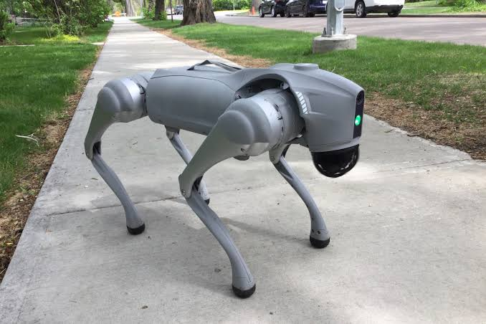
Capstone Project
Vision-Language-Action Navigation
for a Quadruped Robot
Prachi
Notes:
Hi everyone, this is my capstone progress update. The project is about teaching a four-legged robot, the Unitree Go2, to follow natural-language instructions and walk to the right place on its own using a Vision-Language-Action model. Today I'll quickly set up the project, then spend most of the time on the five papers I read and on future work.

Slide 2
Project description
Goal: a Unitree Go2 robot that follows instructions and navigates on its own.
How it works, simply:
➜
➜
See
Think
Move
camera + instruction
a VLA model decides
the robot walks
Robot: Unitree Go2 EDU ·
Onboard computer: NVIDIA Jetson Orin
2
Notes:
Here's the project in one picture. The goal is a Go2 quadruped that takes an instruction like 'go to the kitchen and stop at the red bowl' and navigates there on its own, without being given a map. The pipeline is just three steps: it sees through its camera, a Vision-Language-Action model thinks and decides the next move, and the robot walks. Our hardware is the Go2 EDU with an NVIDIA Jetson Orin onboard. The reason we use a legged robot instead of a wheeled one is that legs can handle stairs, rough ground, and clutter.

Slide 3
Project tasks
1
NVIDIA Orin–Go2 Integration and High-Level Control
Connect the computer to the robot: read sensors, send high-level commands (forward, turn, stop).
2
Go2 Simulation Environment
Set up the Go2 in NVIDIA Isaac Sim with the same controls as the real robot.
3
VLA-Based Control in Simulation
Run a pretrained VLA so the simulated Go2 follows language instructions.
4
VLA Deployment on the Real Go2
Deploy the pipeline on the physical robot via the Orin and test in the real world.
3
Notes:
There are four core tasks. Task 1 is connecting the Orin computer to the Go2 so I can read its sensors and send basic movement commands. Task 2 is setting up the same robot in the Isaac Sim simulator, so I can test safely. Task 3 is running a pretrained VLA model in that simulation so the robot follows instructions. Task 4 is putting it all on the real robot and testing in the real world. The three items on the right are stretch goals — separate mini-projects I'll only attempt if time allows, so I'm being upfront that they're bonuses, not promises.

Slide 4
Requirements
Hardware
Unitree Go2 EDU · NVIDIA Jetson Orin (onboard) · LiDAR + RGB camera
Compute
SLU Libra HPC cluster — a GPU with 24 GB+ memory to run the VLA and the simulation
Software
Ubuntu Linux · ROS 2 · Unitree SDK · NVIDIA Isaac Sim 4.1.0 / Isaac Lab 1.1.0 · Python
Model + data
A pretrained VLA checkpoint · navigation datasets (R2R / RxR)
4
Notes:
These are the requirements. On hardware, the Go2 EDU with the Jetson Orin onboard, plus its LiDAR and camera. For compute, this is important: the VLA model is too big to run on the robot's small computer, so I use SLU's Libra HPC cluster, which gives me a GPU with enough memory. On software, it's the standard robotics stack: Ubuntu, ROS 2, the Unitree SDK for the real robot, and Isaac Sim and Isaac Lab for simulation. And finally I need a pretrained model, navigation datasets, and the Go2 assets for the simulator. The one thing I'd flag as the main risk is compute and speed — running a heavy model fast enough — which Libra largely solves.

Slide 5
Code & resources
Unitree Go2 SDK
My project repo
github.com/unitreerobotics/
unitree_sdk2_python
https://github.com/Prachi817/go2-vla-navigation
https://navila-bot.github.io/
5
Notes:
Two links. On the left is the official Unitree SDK — that's the public code I use for Task 1 to talk to the real robot, read its sensors, and send movement commands. On the right is my own project repository, named WalkTheTalk, where all my code, notes, and results live. Quick reminder to myself to fill in my actual username in that link before presenting.

Slide 6
Related Papers
1.NaVILA
2.MobileVLA-R1
3.TrackVLA
A VLA that follows a moving target (runs on a Go2)
Legged robot follows language using a VLA + a walking policy
Adds step-by-step reasoning, trained with reinforcement learning
4.MoRE
5.Token Pruning
Scales up training for quadruped VLAs (runs on a Go2)
Makes navigation models faster (runs on a Go2)
6
Notes:
These are the five papers I read. They all sit in the same family: robots that take in vision and language and produce actions. NaVILA, marked MAIN, is the one closest to my project because it's built for a legged robot like our Go2, so I spend the most time on it. The other four each add something: reasoning, target-following, scalable training, and speed. And a nice detail — three of the five actually run on a Unitree Go2, the exact robot I'm using, which tells me my whole approach is well-supported by recent work.

Slide 7
NaVILA
Cheng et al., RSS 2025 · arXiv 2412.04453
What it does
Splits the job in two: a “brain” (vision-language model) and “legs” (walking policy).
The brain reads camera + instruction and outputs a simple command like “move forward 75 cm.”
The legs turn that into real walking and avoid obstacles in real time.
Works with just a camera; runs on Go2, H1, and T1 robots.
~17% more better than previous benchmark.
7
Notes:
NaVILA is the main paper. Its big idea is splitting navigation into two levels: a 'brain', which is a large vision-language model that reads the camera and instruction and outputs a plain command like 'move forward 75 centimeters', and 'legs', a fast walking controller that turns that into real movement and dodges obstacles. It works with just a camera, runs on several robots including the Go2, and hit about 88% success in the real world. For me it's the strongest starting point because it's the same robot and task, with released code and a pretrained model.

Slide 8
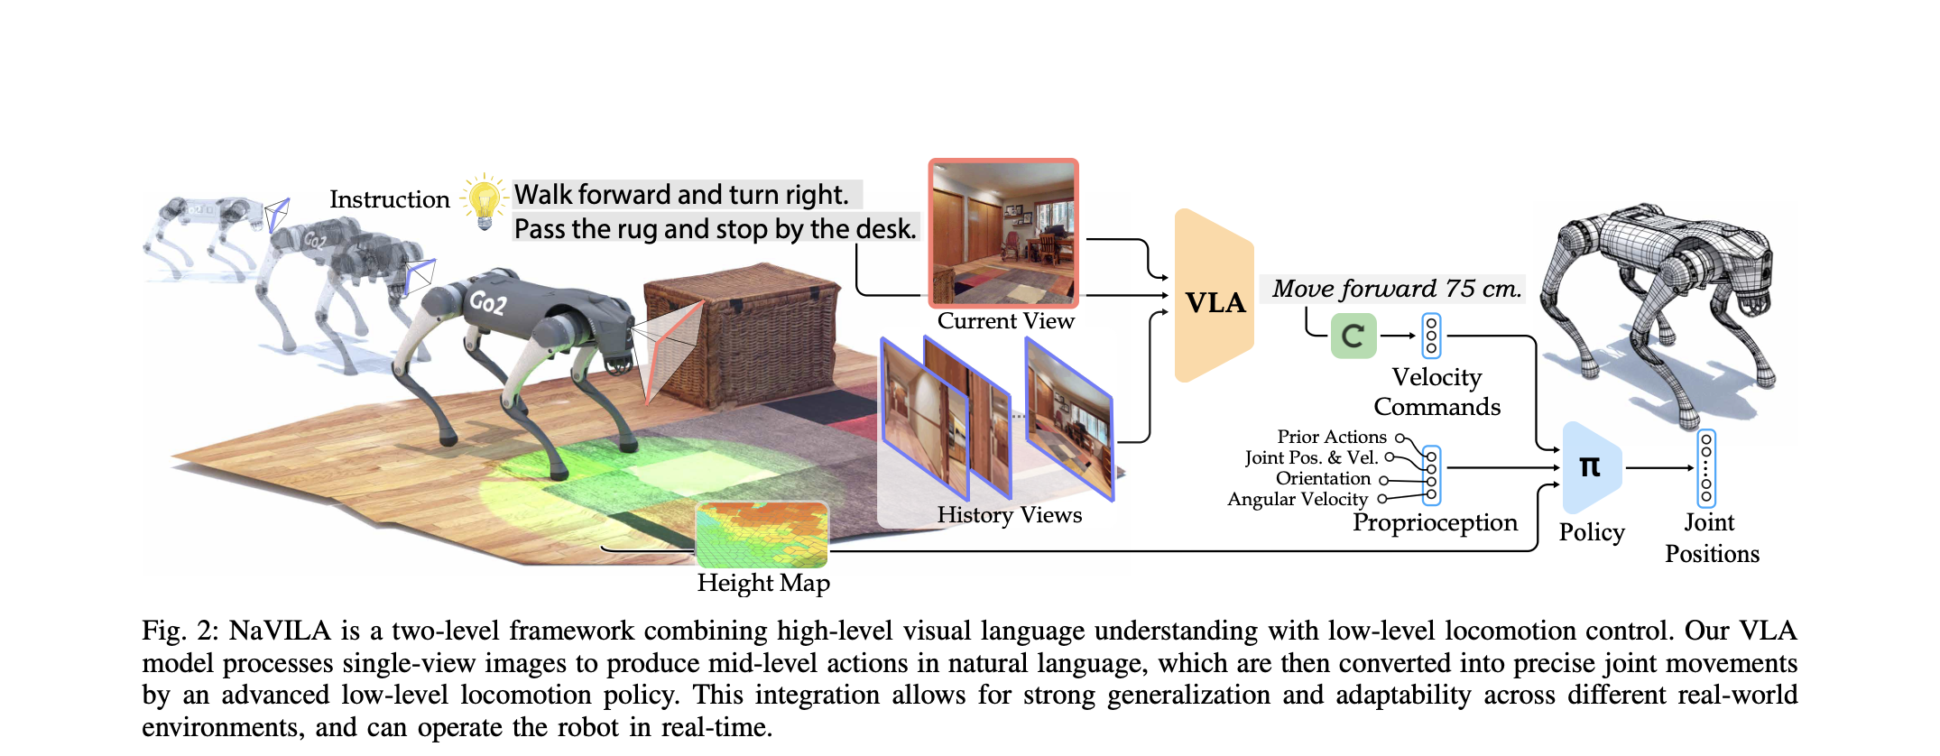
the architecture diagram showing how the whole system works end to end

Slide 9
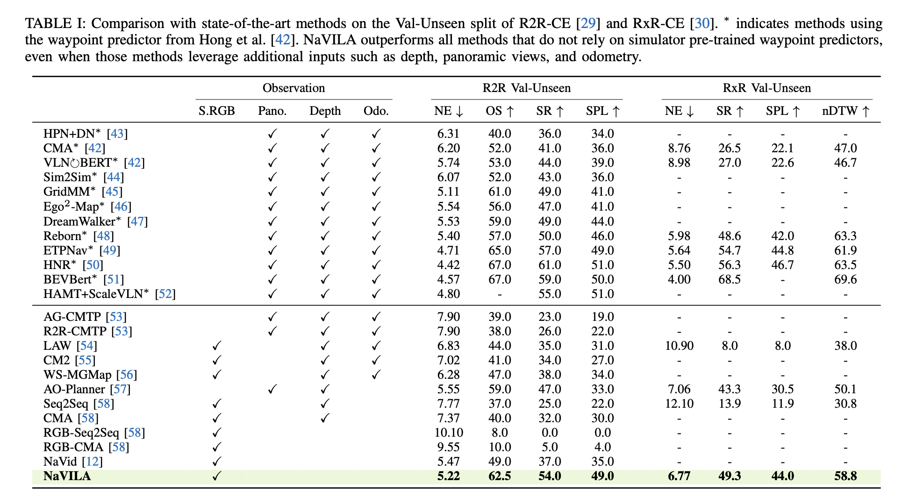

Slide 10
MobileVLA-R1
Huang et al., 2025 · arXiv 2511.17889
Adds reasoning, trained with reinforcement learning
What it does
Targets the same problem: language → smooth control for quadrupeds.
Teaches the model to “think step by step” before acting (chain-of-thought).
Two-stage training: learn to reason, then sharpen with reinforcement learning.
Uses camera + depth + point cloud as input.
About a 5% improvement over strong baselines on VLN and VLA tasks.
8
Notes:
MobileVLA-R1 tackles the same problem but adds a reasoning layer. Instead of jumping straight from instruction to action, it's taught to think step by step first, and then that reasoning is sharpened using reinforcement learning, where the model is rewarded for good decisions. It uses more sensors than NaVILA — camera, depth, and point cloud — and it's about 5% better than strong baselines. For me, the lesson is a concrete upgrade path: if my robot's decisions come out shaky, this reasoning-plus-RL recipe is a documented way to fix it.

Slide 11
TrackVLA
Wang et al., 2025 · arXiv 2505.23189
Following a moving target — runs on a Go2
What it does
Different task: follow a described moving target (e.g. a person), not navigate to a place.
One model does both recognition and path planning together.
Fast — runs at 10 frames per second.
Deployed on a real Unitree Go2 with a camera streaming to a GPU server.
9
Notes:
TrackVLA is a slightly different task — instead of navigating to a place, it follows a moving target, like following a person. What's clever is that one model does both recognizing the target and planning the path, together, which avoids the errors you get when those are separate. It runs fast, at 10 frames per second, and it's deployed on a real Go2. The reason it matters to me is its real-world setup is almost exactly my Task 4 plan: the model runs on a GPU server, and the robot streams camera images to it over Wi-Fi and gets back where to go. So it validates my deployment approach.

Slide 12
MoRE
Zhao et al., 2025 · arXiv 2503.08007
Scaling up training for quadruped VLAs — runs on a Go2
What it does
Makes a quadruped VLA bigger without a big jump in compute.
Uses a “mixture of experts”: only the relevant parts of the model switch on per task.
Learns from messy, mixed-quality data — not just perfect demos.
Beat baselines by up to ~20% across six skills, on a real Go2.
10
Notes:
MoRE is about training. Its focus is making a quadruped VLA bigger and more capable without a huge jump in compute cost. It does that with a 'mixture of experts' design, where only the relevant parts of the model turn on for a given task, and it can learn from messy, imperfect data instead of needing perfect demonstrations. It beat baselines by up to 20% across six skills on a real Go2. For me this is the reference for scalable fine-tuning — I'd reach for it only if I go beyond using a pretrained model and actually train my own, which is more of a stretch goal.

Slide 13
Token Pruning for VLN
Wang et al., 2026 · arXiv 2603.06480
Making navigation models faster — runs on a Go2
What it does
Navigation models are slow because they process many image pieces (“tokens”).
This method drops the tokens that don’t add useful information.
Treats the current view and past frames differently (keeps recent detail, compresses old).
No retraining needed — plug it into an existing model.
Faster with little loss in accuracy; tested on a real Go2.
11
Notes:
The last paper is about speed, and it's the most practically useful for me. Navigation models are slow because each camera frame becomes hundreds of little data pieces called tokens, and processing them all is expensive. This method throws away the tokens that don't carry useful information, and cleverly treats the current view and old frames differently — keeping detail on what the robot sees now, compressing the older memory. Best of all, it needs no retraining; you just plug it into an existing model. It was tested on a real Go2. This directly attacks my biggest worry, which is making a heavy model run fast enough on limited hardware.

Slide 14
Future work
Core path
Connect Orin ↔ Go2
➜
Build Go2 in Isaac Sim
➜
Run the VLA in sim
➜
Deploy on real Go2
Next steps (near term)
Get Task 1 working
Set up simulation
Pick a VLA model
Read sensors + send commands on the real Go2
Install Isaac Sim / Isaac Lab, load the Go2
Start from NaVILA; keep StreamVLN as backup
13
Notes:
The second part of future work is my own plan. The core path across the top is four steps: connect the Orin to the Go2, build the Go2 in the Isaac Sim simulator, run the VLA in simulation, then deploy on the real robot. My near-term next steps are the three cards: get Task 1 working, set up the simulator, and pick a model — I'll start from NaVILA and keep StreamVLN as a backup. I'm treating success as a strong simulation result plus a simple real-robot demo, like 'go to the chair and stop', because running the heavy model in real time is the risky part. Stretch goals only if there's time.

Slide 15
