Slide 1
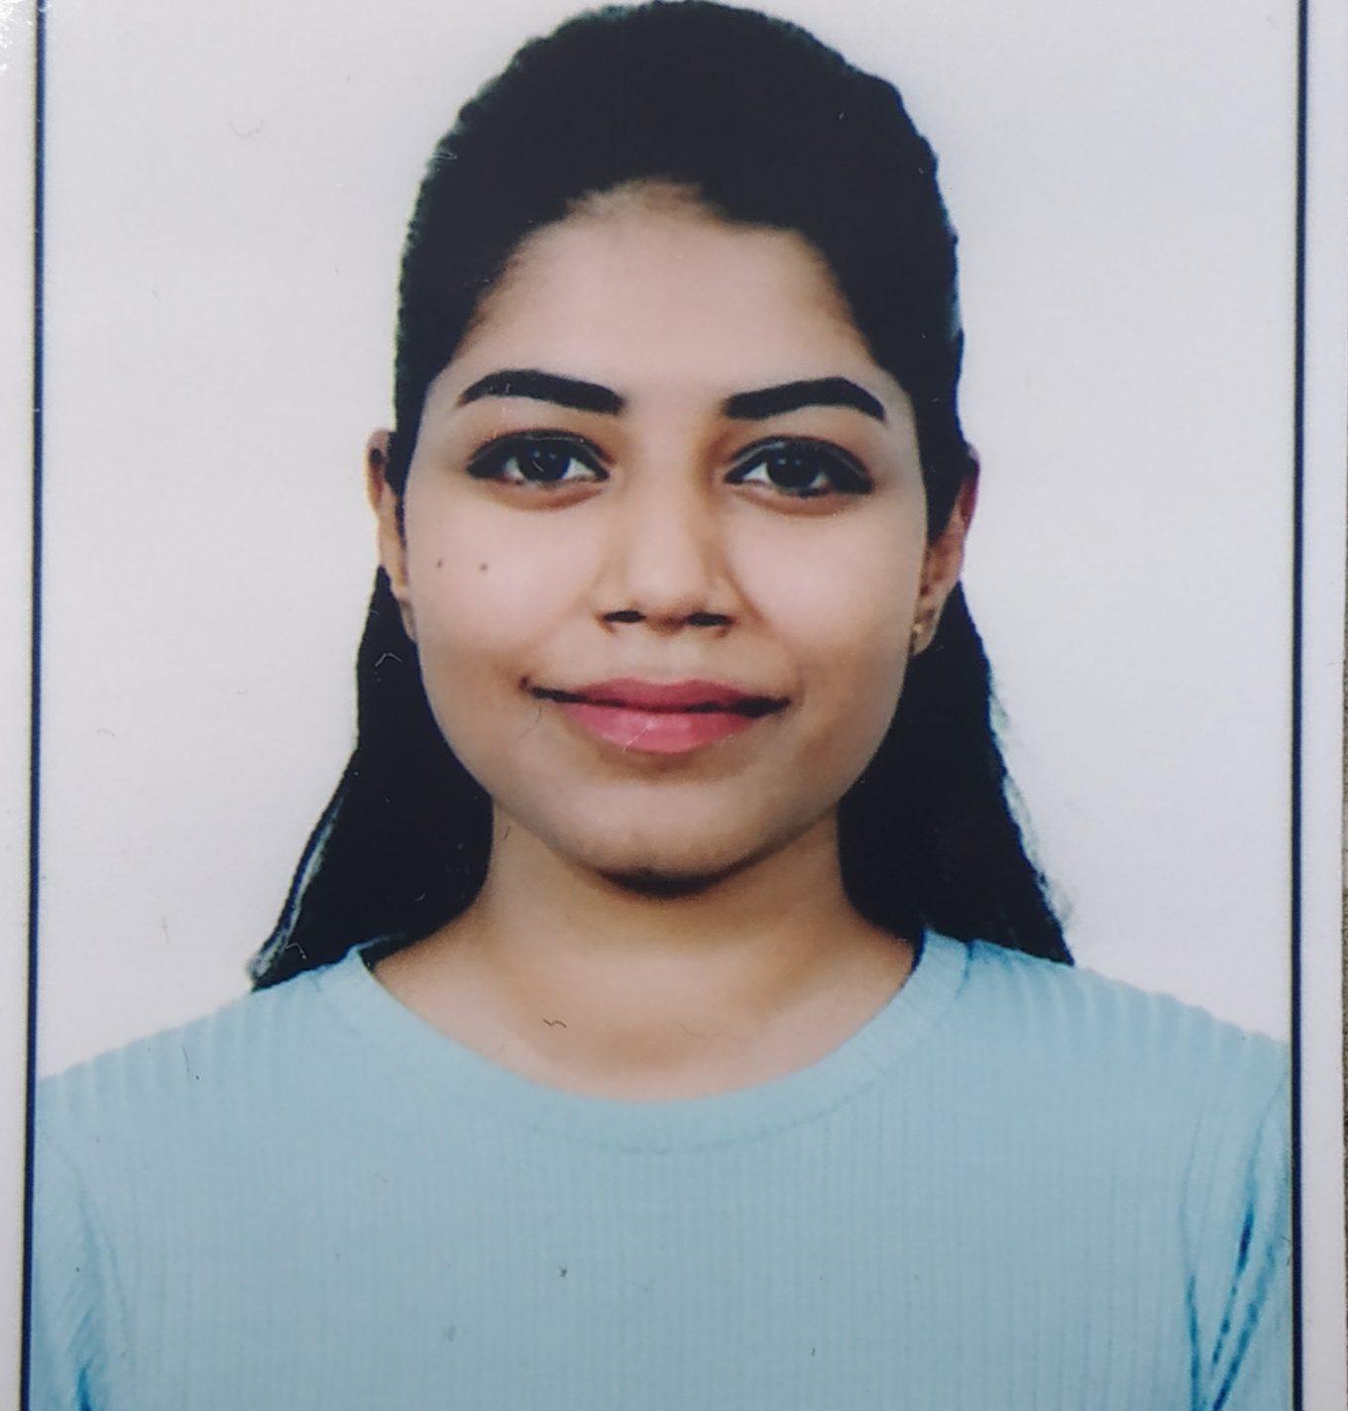


Prachi Amar Achkarpohre
Bachelor of Engineering
Civil 2018-2022
Analyst
Skills
Java 11 /J2EE | Java Basics, OOPS, Generics, Collections, Arrays, Loops, Lambda Exp, Stream API Junit, Servlets
Spring core | IOC & Dependency Injection, Autowire
Spring REST | REST controllers, Implementation of GET, POST, PUT & DELETE, Bean Validation, Controller & Repository layer
Spring Data JPA | Implement DAO layer using spring Data repositories
Spring Boot Microservices | Spring Boot Starters, annotations.
Angular | Components, Services, Modules, Routing, Forms & Validation
Database | MongoDB, No SQL Basics
UI Tech | HTML 5 & CSS 3,JavaScript, ES6 & TypeScript
Tools | Git, Postman, Maven, IDE
Add On skills | Communications, Team management. Optimistic, Punctual
Mumbai
prachi.achkarpohre@capgemini.com
+91 7038539919
A4
Java Full Stack Developer with Angular
Created microservices with Spring boot, Spring Security, Spring Cloud Rest API Gateway, Eureka server, swagger, load balancing.
Proficient in creating Single page Web Application in Angular with Authentication with forms, angular routing.
Hands on experience with NodeJS & spring boot in case study and upskilling my knowledge continuously.
Created documentation with swagger and in unit testing.
Understanding of deploying spring boot applications.
Online Railway Reservation Application
Completed end to end case study of online railway reservation along with JWT authentication, Swagger and CSS, Angular used for user interface.
backend (MongoDB), Midware (Spring Boot) and Frontend (Angular) at Capgemini Degreed Platform
Learned and recompiled all concepts of the backend, midware and frontend technologies to polish my skills to work on real time projects.
Check out my work on GitHub & Video Profile https://github.com/PrachiAch/Assignments

