Slide 1
Multifunctional NLP and Image Generation Tool using Hugging Face Models “MultiMind AI App"
BY PRACHI CHOUDHARY

Slide 2
Project Overview
MultiMind is an interactive AI-powered application integrating 7 essential NLP and generative tasks:
- Summarization
- Next Word Prediction
- Story Continuation
- Chatbot
- Sentiment Analysis
- Question Answering
- Image Generation
It is optimized for performance, ease-of-use, and user experience — especially suited for beginners and non-coders.

Slide 3
Features & Interactivity
✅ Animated splash screen
✅ Theme toggle (light/dark)
✅ Task-based modular UI
✅ Chat history & clear options
✅ File download and text-to-speech
✅ Image generation with preview & download
✅ Voice playback and prompt suggestions

Slide 4
Models Used & Why
1. Summarization: Facebook BART-large-CNN (state-of-the-art for summarizing long texts)
2. Next Word Prediction: GPT-2 (lightweight, fast open-ended generation)
3. Story Continuation: GPT-Neo 1.3B (creative continuation with large language capacity)
4. Chatbot: DialoGPT-medium (optimized for dialogue-based responses)
5. Sentiment Analysis: DistilBERT-based sentiment classifier (fast and accurate)
6. Question Answering: RoBERTa-base-SQuAD2 (high accuracy on span-based QA)
7. Image Generation: Stable Diffusion v2.1 (text-to-image SOTA generator)

Slide 5
System Architecture
Each task runs through the `transformers` or `diffusers` pipelines:
- Tasks selected via sidebar (Streamlit UI)
- Pipeline loaded with pre-trained models (Torch/Accelerate supported)
- Result is streamed back with download options

Slide 6
How to Use
1. Open the app on your browser or run in VS Code
2. Choose a task (e.g. summarization)
3. Enter or upload your input text
4. Click on 'Run Task' / 'Send'
5. Download results or listen via speaker icon
6. Try predefined prompts or switch tasks with one click

Slide 7
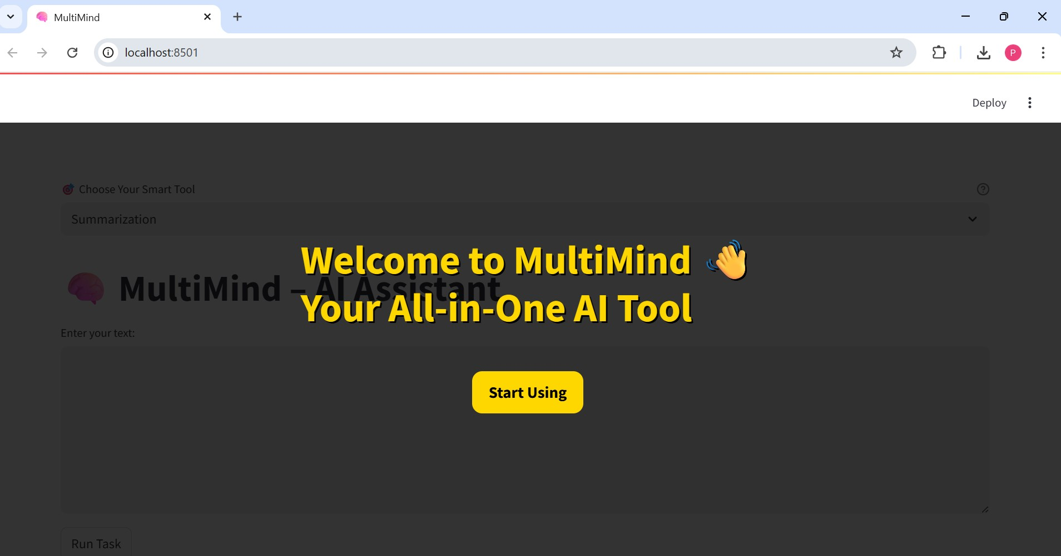
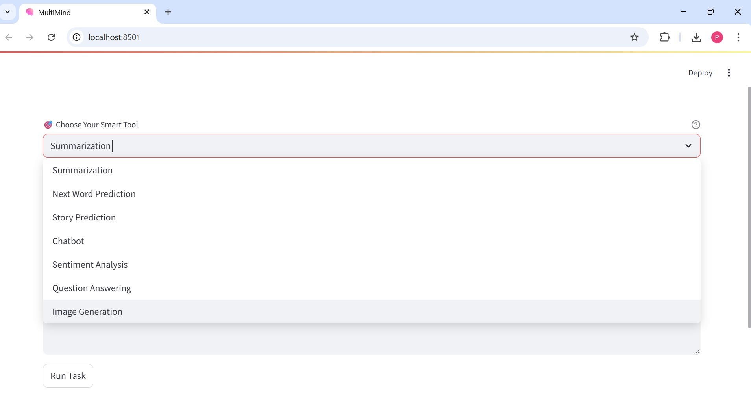

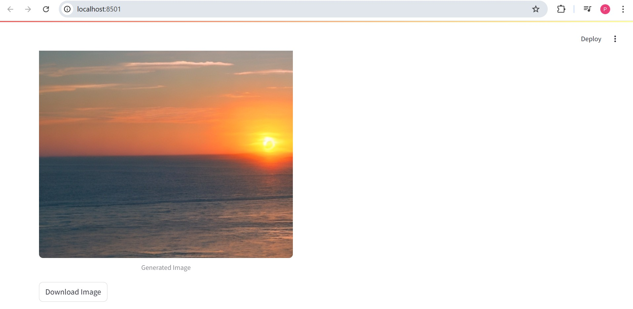
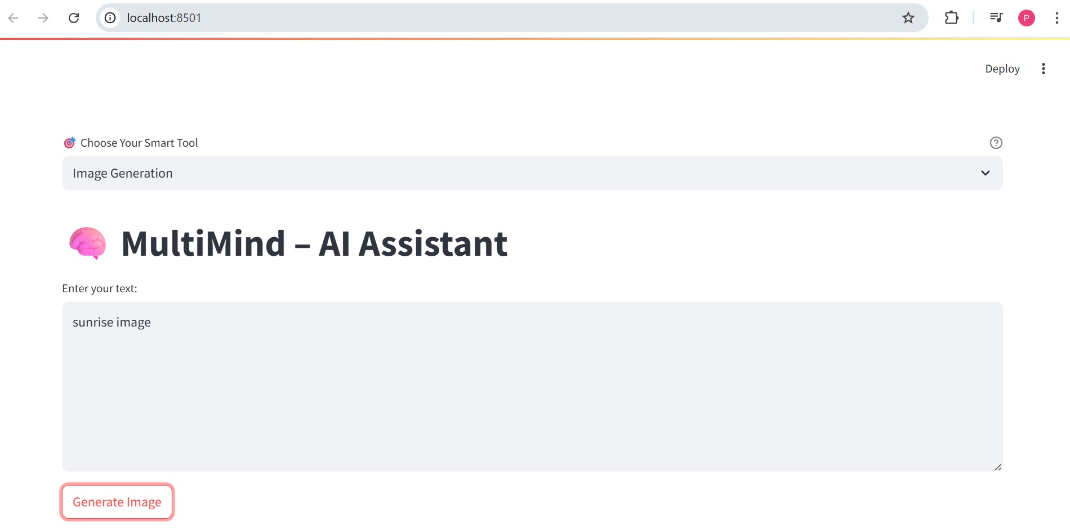
Steps To Follow

Slide 8
Link to Video Demo
https://drive.google.com/file/d/1wPE3r2aQ3Wk-HSn5MCXiDkgZjkU6StNc/view?usp=sharing

Slide 9
Conclusion
MultiMind is a streamlined AI companion that enables users to explore practical natural language processing and image generation tasks in one unified interface.
Designed for clarity, speed, and usability, it serves as an ideal tool for education, demonstrations, and early AI adoption. Simply select a task, interact, and experience the capabilities of modern AI—no coding required.

