Slide 1
Sequence-to-Sequence Modeling with Attention Mechanism
BY PRACHI CHOUDHARY

Slide 2
Objective
Build a sequence-to-sequence model with attention that learns to reverse a sequence of numbers using GRU-based encoder-decoder architecture.

Slide 3
Model Architecture
- Encoder: Embedding + GRU
- Attention: Aligns encoder output with decoder input
- Decoder: GRU + Attention context vector
- Loss: Cross Entropy Loss
- Optimizer: Adam

Slide 4
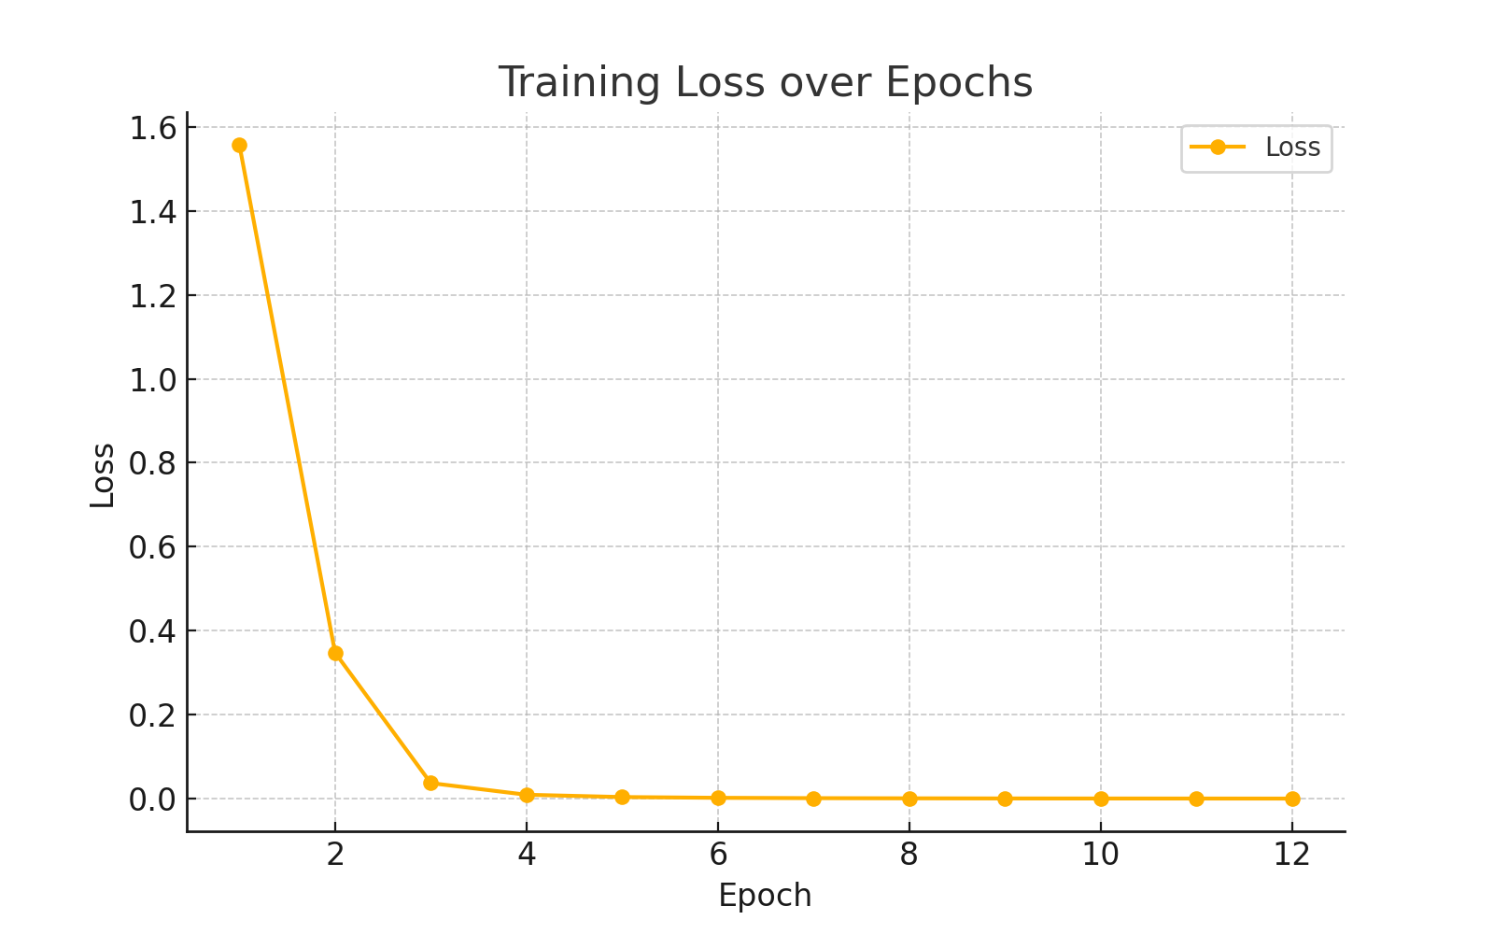
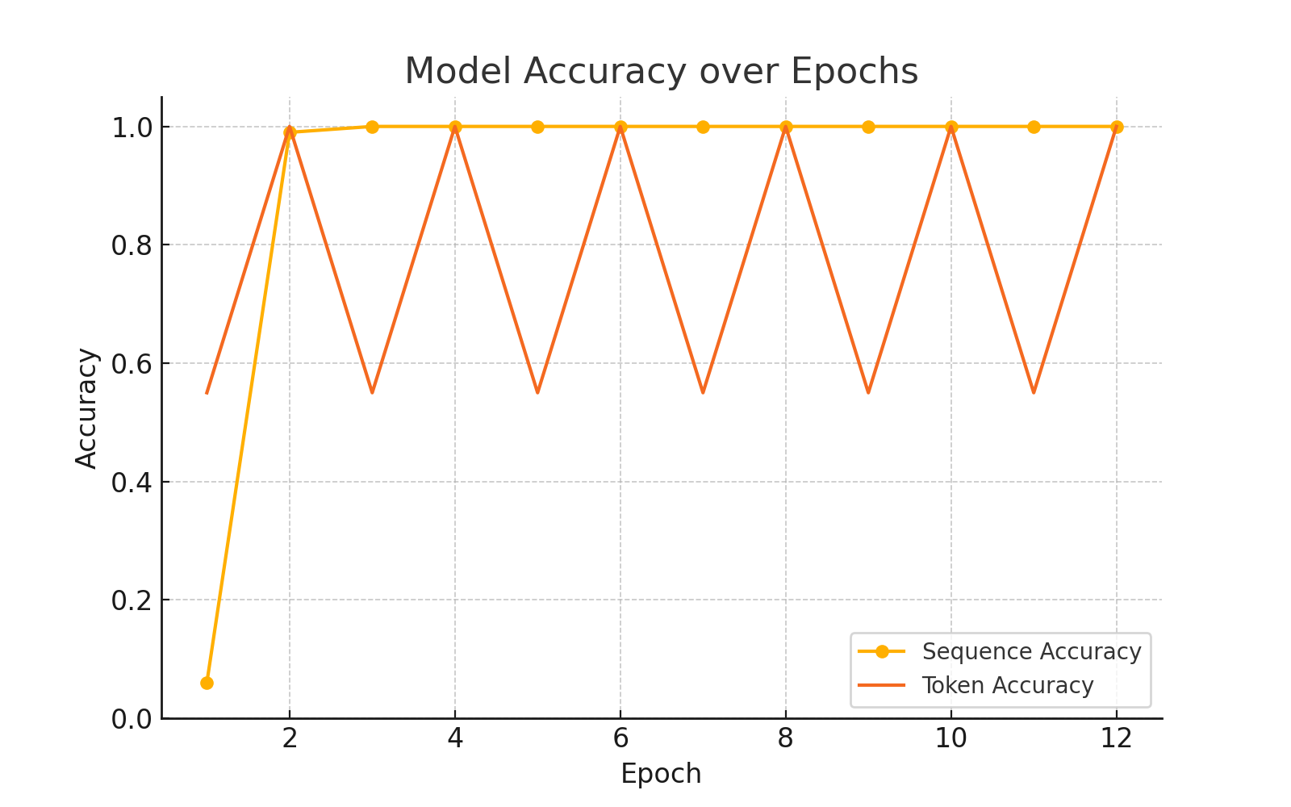
Loss Curve & Accuracy

Slide 5
Model Performance
- Sequence Accuracy: 0.06 → 1.00 (Epoch 2)
- Token Accuracy: 0.55 → 1.00
- Fast convergence within 2 epochs
- Sustained perfect accuracy for 10+ epochs

Slide 6
Key Concepts
*<sos> Token Alignment- Start-of-sequence token allows decoder to begin generation properly.
*Teacher Forcing- During training, the decoder receives actual previous token to stabilize learning.

Slide 7
Sample Predictions
Input : [4, 5, 8, 6, 3, 6]
Target : [6, 3, 6, 8, 5, 4]
Predicted : [6, 3, 6, 8, 5, 4] ✔️
Input : [5, 9, 7, 8, 8, 3]
Target : [3, 8, 8, 7, 9, 5]
Predicted : [3, 8, 8, 7, 9, 5] ✔️

Slide 8
Real-World Applications
- Language Translation (e.g., Hindi ↔ English)
- Text Summarization
- Chatbot Response Generation
- Speech Recognition
- Reversing command steps in procedural AI tasks

Slide 9
Limitations
- Model may overfit simple numeric patterns
- Not robust to long or variable-length inputs
- Real datasets need <eos> handling and padding
- Doesn’t yet use bidirectional encoder (optional improvement)

Slide 10
Conclusion
The attention-based Seq2Seq model successfully learned to reverse sequences with 100% accuracy.
Its lightweight structure and explainability make it ideal for showcasing sequence modeling in interviews.

