Slide 1

Capstone Project - 2
Supervised machine learning(Regression)-Bike Sharing Demand Prediction
Submitted by
Dr. Raj Kumar & Prachi Jadhav
Data science Trainee, Almabetter

Slide 2
List of content
Introduction
Business context and Problem statements
Methodology
Load data and Data exploration
Data pre-processing
Performing exploratory data analysis(EDA).
ML model implementation with SciKit-Learn
Model Explainability using Shap
Conclusions
Challenges faced

Slide 3
Business context
Currently Rental bikes are introduced in many urban cities for the enhancement of mobility comfort. It is important to make the rental bike available and accessible to the public at the right time as it lessens the waiting time. Eventually, providing the city with a stable supply of rental bikes becomes a major concern. The crucial part is the prediction of bike count required at each hour for the stable supply of rental bikes.
Problem statements
We have a Dataset contains the hourly and daily count of rental bikes between years 2017 and 2018 in Capital bike share system with the corresponding weather and seasonal information. It is important to make the rental bike available and accessible to the public at the right time as it lessens the waiting time, eventually, providing the city with a stable supply of rental bikes. The goal of this project is to build a best ML model that is able to predict the demand of rental bikes in the city of Seoul.

Slide 4
Methodology:
Pre-processing & Data Cleaning
Removing duplicate rows
EDA
Data distribution of features
Model Approach
Model approach
Handling missing values
Convert column to appropriate datatype
Adding new features and renaming the features
Deal with multicollinearity
Separate dependent and independent features
Fitting
Prediction
Evaluation matrices

Slide 5
Load dataset and Data Exploration :
We have a Dataset of bike sharing demand prediction from years 2017 to 2018 and having 14 columns. Our aims to find the relevant insights from this dataset.
Data Description:
Date - year-month-day
Rented Bike count - Count of bikes rented at each hour
Hour - Hour of he day
Temperature-Temperature in Celsius
Humidity - %
Wind Speed - m/s
Visibility - 10m
Dew point temperature - Celsius
Solar radiation - MJ/m2
Rainfall - mm
Snowfall - cm
Seasons - Winter, Spring, Summer, Autumn
Holiday - Holiday/No holiday
Functional Day - No(Non Functional Hours), Yes(Functional hours)

Slide 6
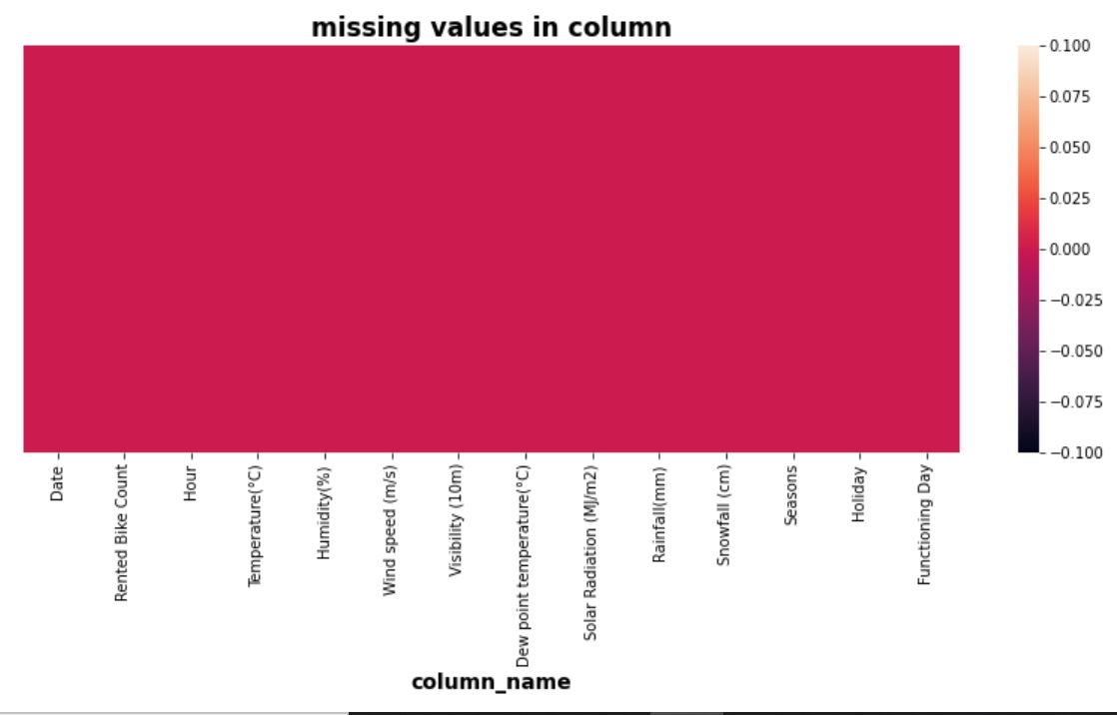
Data Pre-processing:
1) Data cleaning
2) Data Transformation
3) Data Reduction
Observation:
There is no missing and duplicate values in dataset.

Slide 7
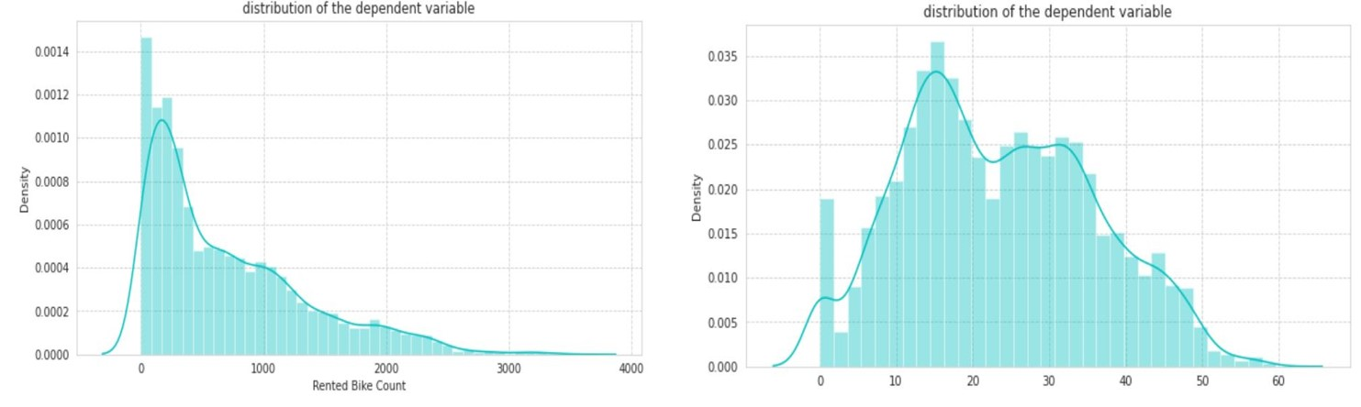
Performing EDA:
Analyzing the distribution of the dependent variable
Observations:
Dependent variable is positively skewed, As skewness is reduce after square root of dependent variable. Therefore, We will use sqrt of dependent variable in ML modeling.

Slide 8
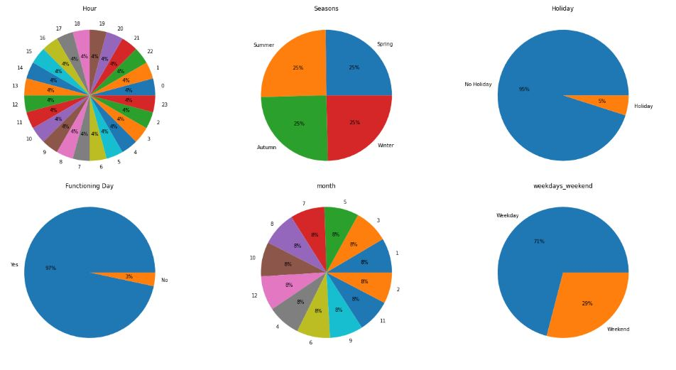
EDA on Categorical Features:

Slide 9
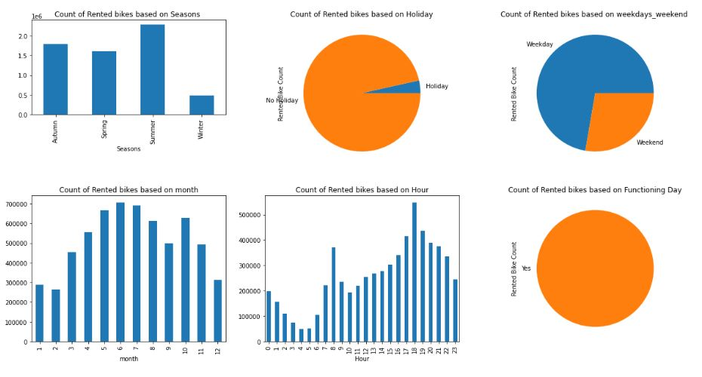
EDA on Categorical Features:
Explore relation between categorical feature and dependent variable
Observation:
Most of bikes have been rented in summer followed by Autumn, Spring and Winter.
Use of rented bike is more on 'No holiday' means on working days as compared to 'Holiday'.
Most of the bikes have been rented on working days.
People generally use rented bikes during their working hours.
People use rented bike only in functioning day.

Slide 10
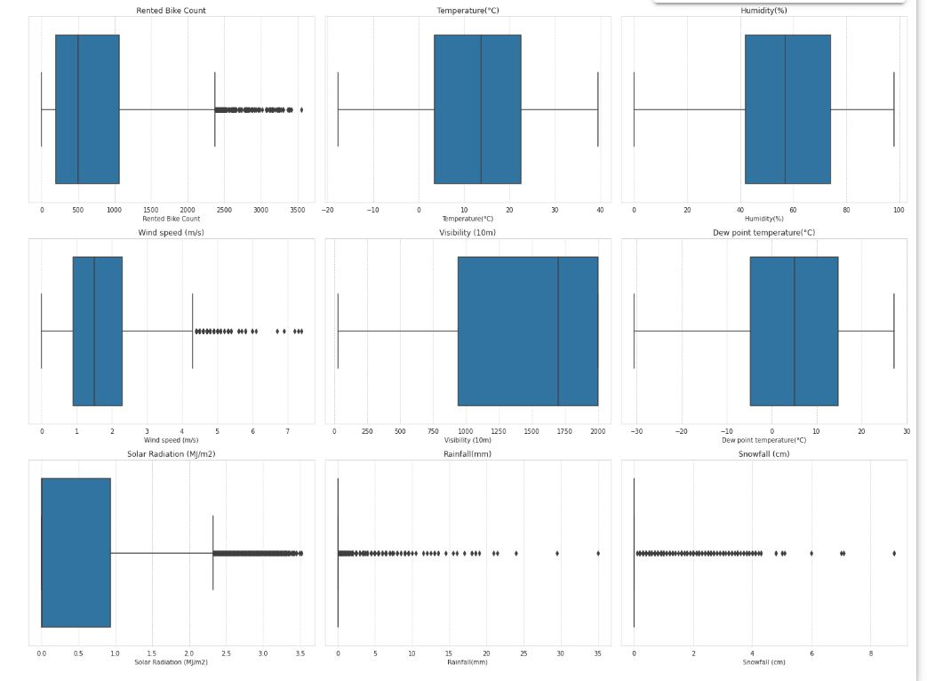
EDA on Numeric Features:
Observation:
In our dataset there is outlier presented, but we don't have to worry about outliers, because When we are treating the outliers from Rainfall and snowfall columns using IQR its removed all the information of the data and all values became zero.

Slide 11
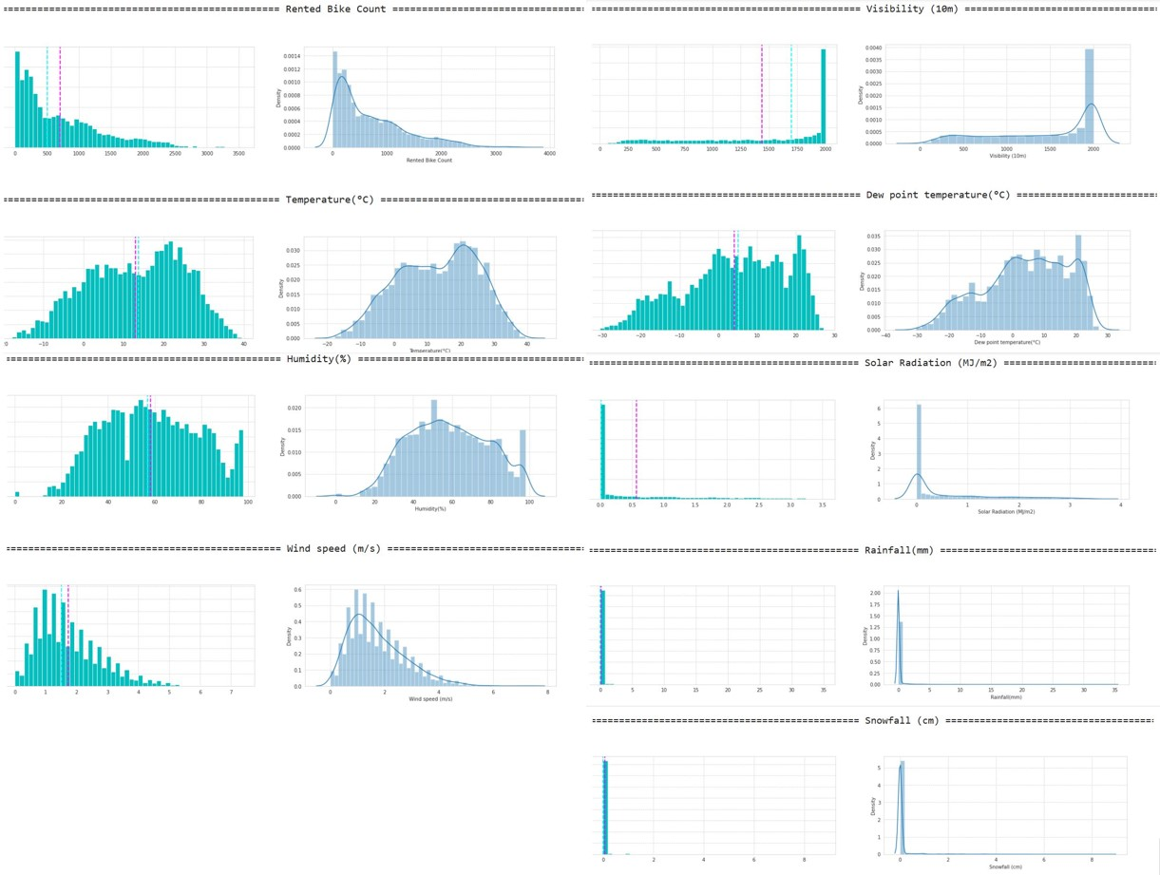
EDA on Numeric Features:
Plotting histogram with mean and median, and distplot of all the numeric features of the dataset
Observations:
Normally distributed attributes: temperature, humidity, Dew point temperature(°C).
Positively skewed attributes: wind, solar radiation, snowfall, rainfall.
Negatively skewed attributes: visibility.

Slide 12
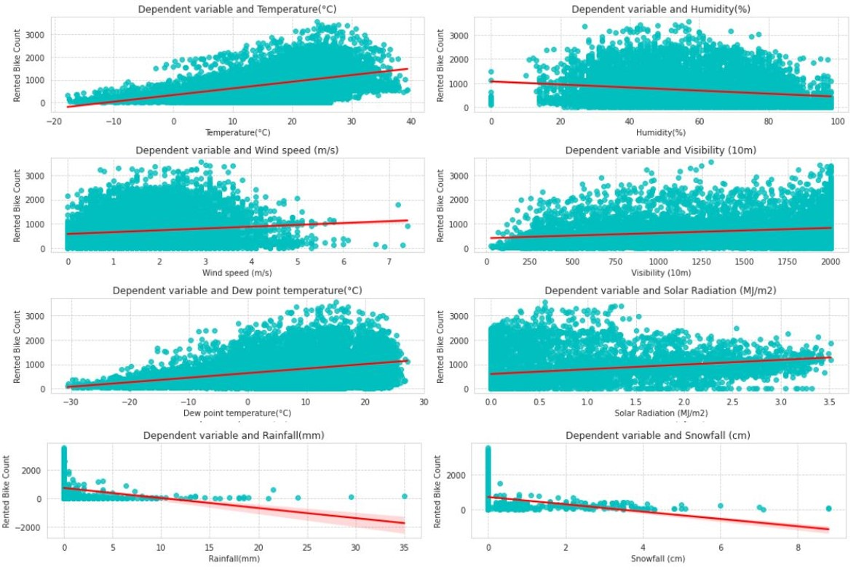
Regression plot to know relation between dependent variable and numerical feature
Observations:
Linear regression graph clearly shows that Hour, Temperature, Wind speed, Visibility' and Solar-Radiation are positively related to the dependent variable, i.e., Rented bike count increases with increase of these features.
On the other hand, Rainfall, Snowfall, Humidity are negatively related with the dependent variable, i.e., the rented bike count decreases when these features increases.

Slide 13
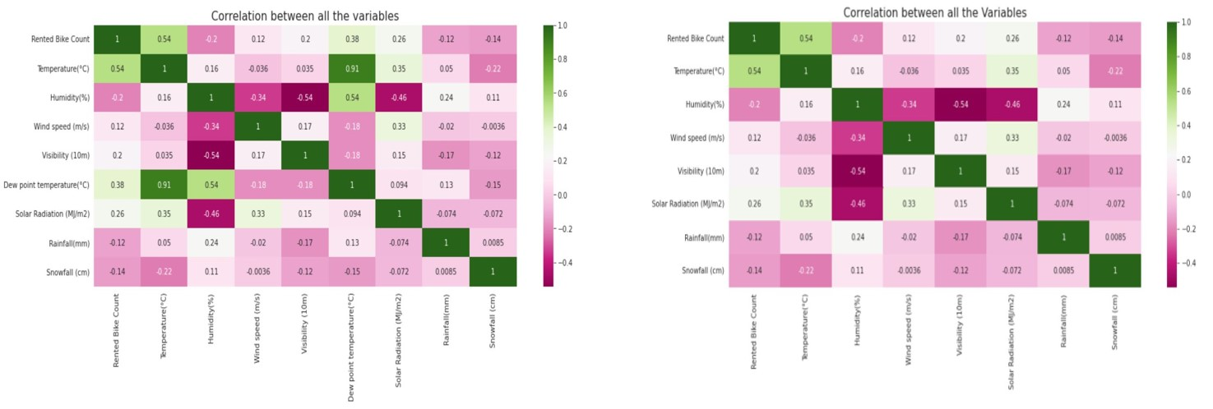
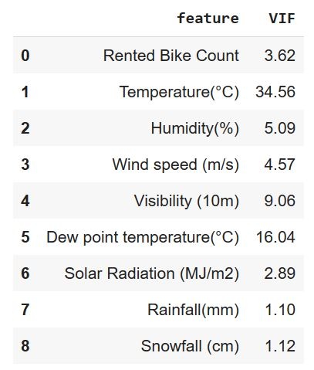
Check Correlation and Multi-collinearity between features:
Observation:
From heat-map and VIF, we can clearly visible Temperature and Dew point temperature(°C) has the high correlation and high multi-collinearity respectively. As a result, to reduce correlation and multi-collinearity. We can drop dew point temperature column.

Slide 14
ML model implementation with SciKit-Learn
Linear regression model
Polynomial Linear Regression
Regularized Linear Regression
Ridge regression model (L2)
Lasso regression model (L1)
Elastic net regression model (L1+L2)
Decision tree regression model
Random-forest regression model
XG Boost regression model
XG Boost Regressor with GridSearchCV

Slide 15
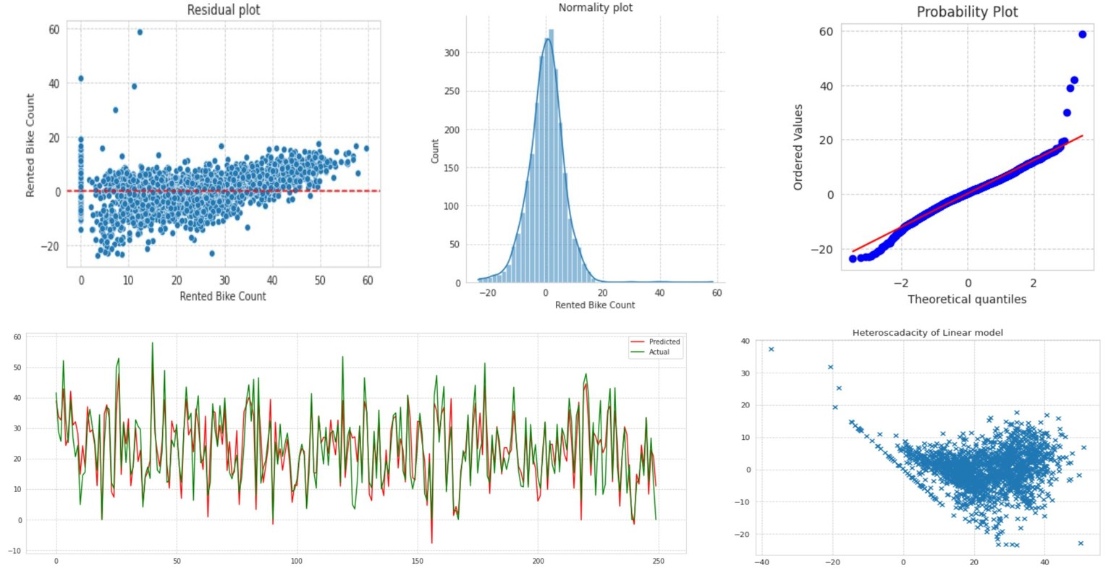
Linear Regression

Slide 16
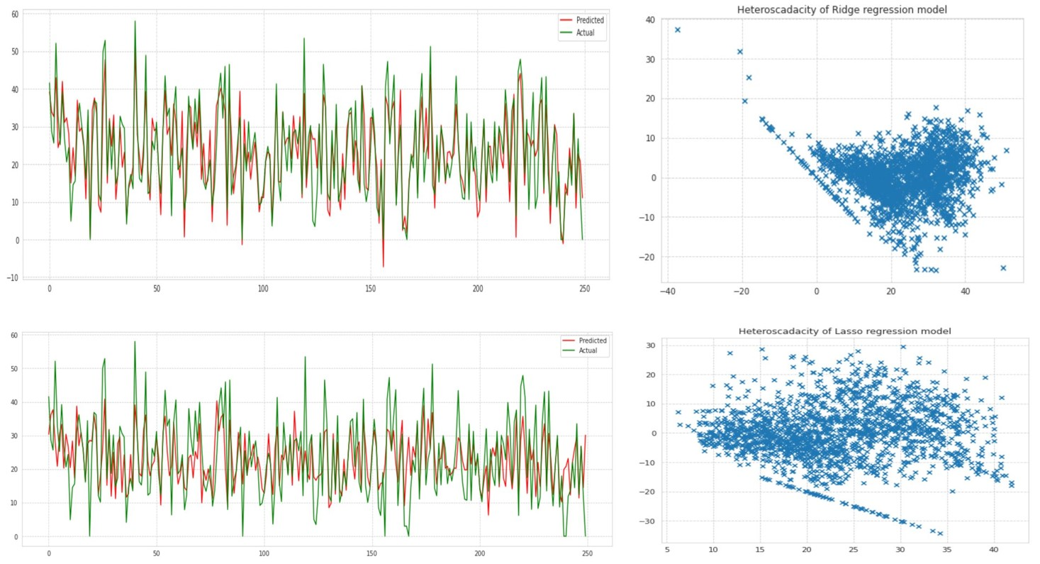
ML models fitting and Heteroscadacity

Slide 17
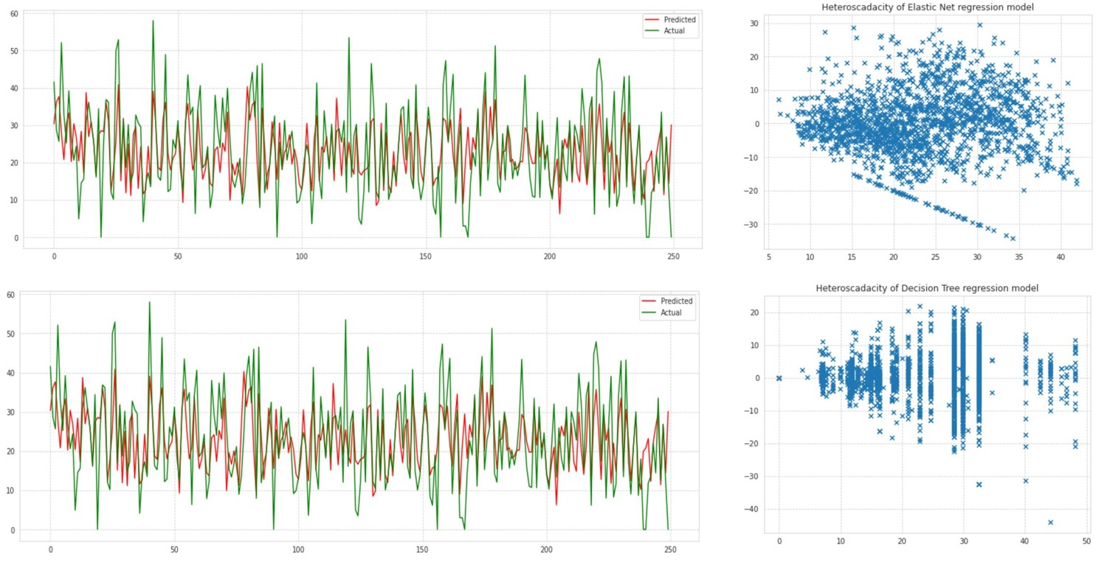
Cont….

Slide 18
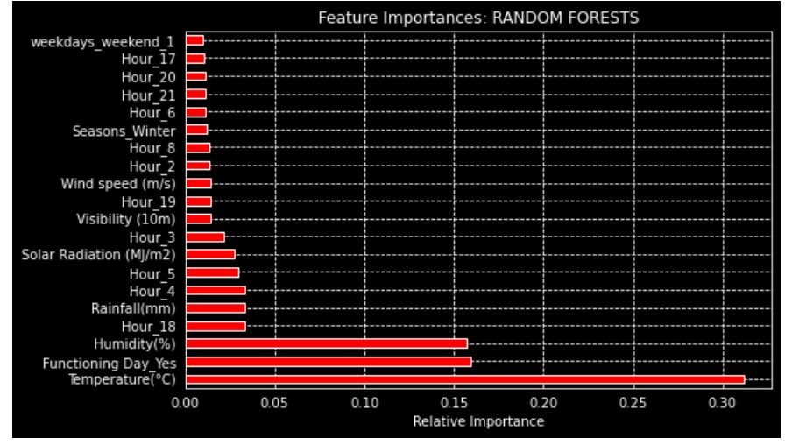
Random Forest Regression: Feature Importance

Slide 19
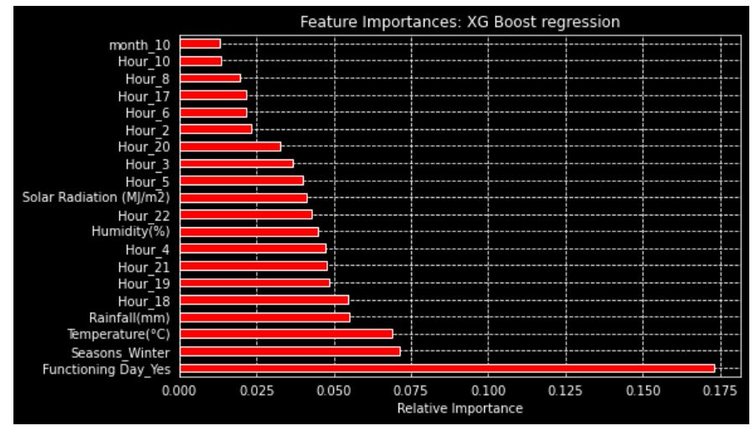
XG Boost Regression: Feature Importance

Slide 20
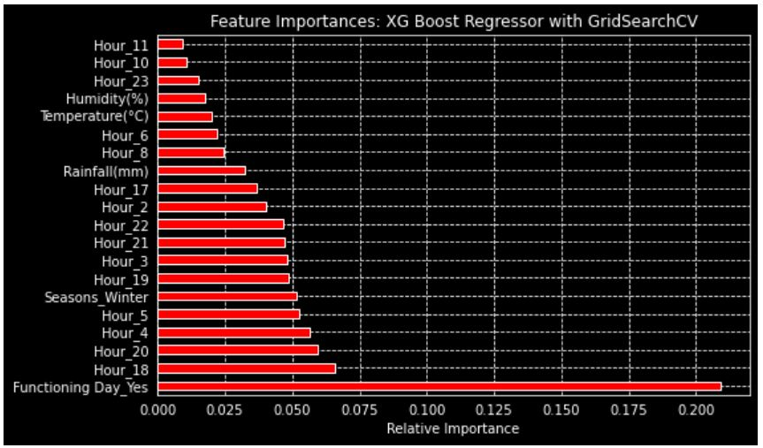
XG Boost Regressor with GridSearchCV: Feature Importance

Slide 21
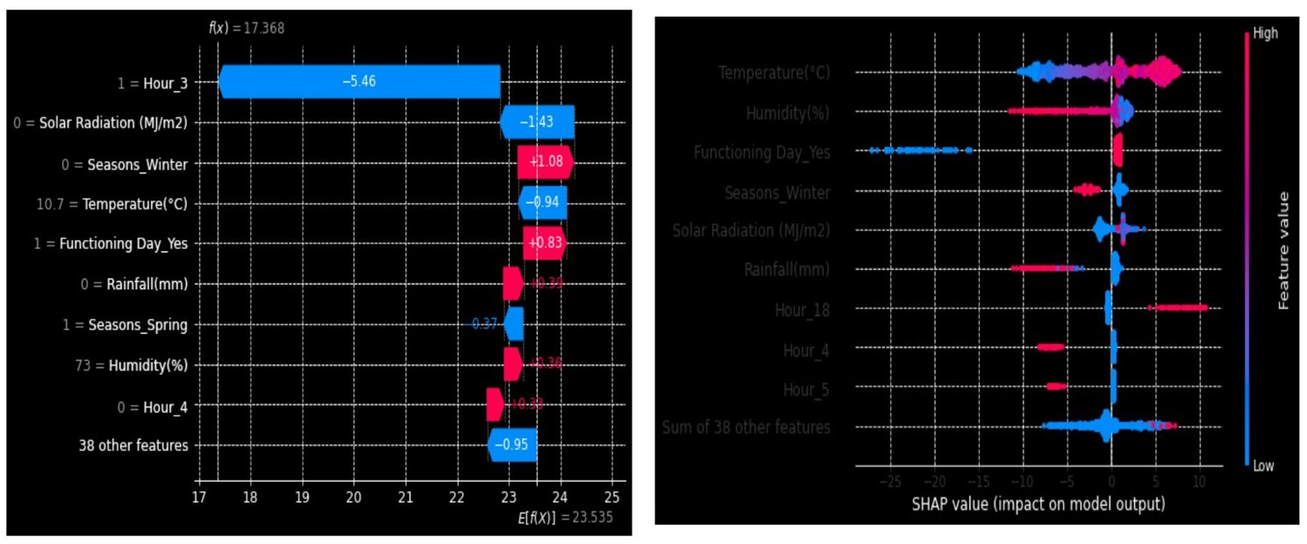
Model Explainability using shap:

Slide 22
Conclusions: EDA summary
Dependent feature is positively skewed, therefore, square root of dependent feature is used in ML modeling.
Most of bikes have been rented in summer followed by Autumn, Spring and Winter.
Use of rented bike is more on 'No holiday' means on working days as compared to 'Holiday'.
Normally distributed features: temperature, humidity, Dew point temperature(°C).
Positively skewed features: wind, solar radiation, snowfall, rainfall.
Negatively skewed features: visibility.
Positive linear related features: Hour, Temperature, Wind speed, Visibility' and Solar-Radiation.
Negative linear related features: Rainfall, Snowfall, Humidity.
Temperature and Dew point temperature(°C) was high correlated and multi-collinearity. We released dew point temperature column.

Slide 23
Conclusions: ML modelling
As our primary goal was to make a ML model to predict the demand for rental bikes based on different weather and others conditions. We trained seven unique Machine Learning models and improved their performance through hyper-parameter tuning.
The XG Boost prediction model had the lowest RMSE.
The final choice of model for deployment depends on the business need; if high accuracy in results is necessary, we can deploy XG Boost model.
If the model interpretability is important to the stakeholders, we can choose deploy the decision tree model.

Slide 24
Challenges Faced
Pre-processing of data includes removing highly correlated variables from the data.
Feature engineering –which features to be dropped, kept and transformed.
Deciding on how to handle outliers and choose best ML model makes for predictions.
Choosing the best hyper-parameters, which prevents overfitting.

Slide 25
References
W3 schools
Pandas libraries
Numpy libraries
Scikit-Learn libraries
Alma Better Class material

Slide 26
Github Id’s details
Dr. Raj Kumar Github Link: - https://github.com/rajkumarpec/Supervised-ML
Prachi Jadhav Github Link: - https://github.com/https://github.com/PrachiJadhav12/Seoul_Bike_Sharing_Prediction

Slide 27

Regards

