Slide 1
Final Project on Stock Data Analysis
Name: Prachi Khatri
Student No: 100889770

Slide 2
Which Stock Index is the best one to invest your money in, and why, according to the dataset?

Slide 3
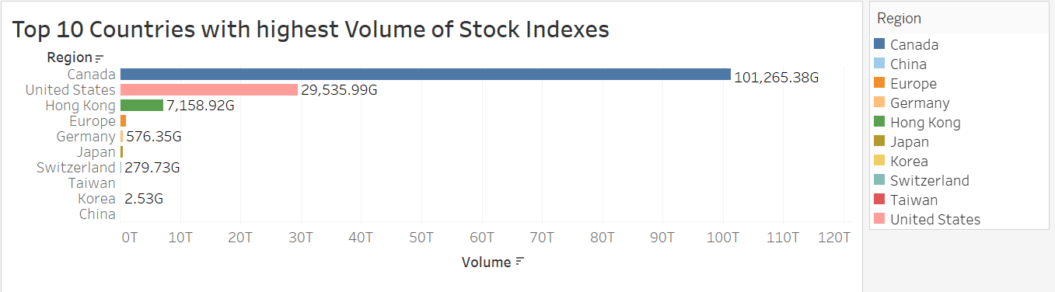
1.Top 10 Countries with the highest volume of Stock Indexes
We observe from the bar chart that the highest volume of Stock Indexes in top 10 countries across the globe.
We can see that Canada has the highest volume i.e. 101,265.38G
Whereas, China has the lowest volume of 2.06G

Slide 4
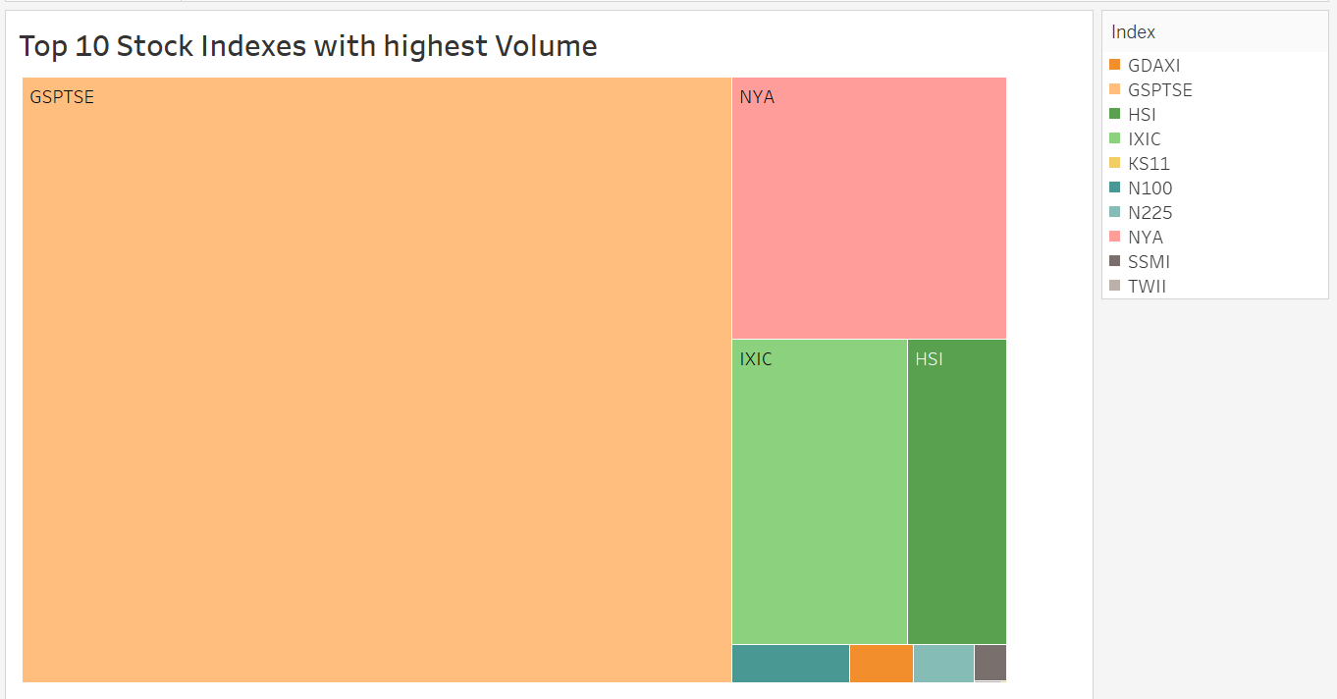
2.Top 10 Stock Indexes with the highest Volume
The above treemap, depicts the Highest Volume of Stock Indexes.
We can see that GSPTSE has the highest volume showing the greatest area of proportion.
While SSMI has the lowest volume among all the stock indexes.

Slide 5
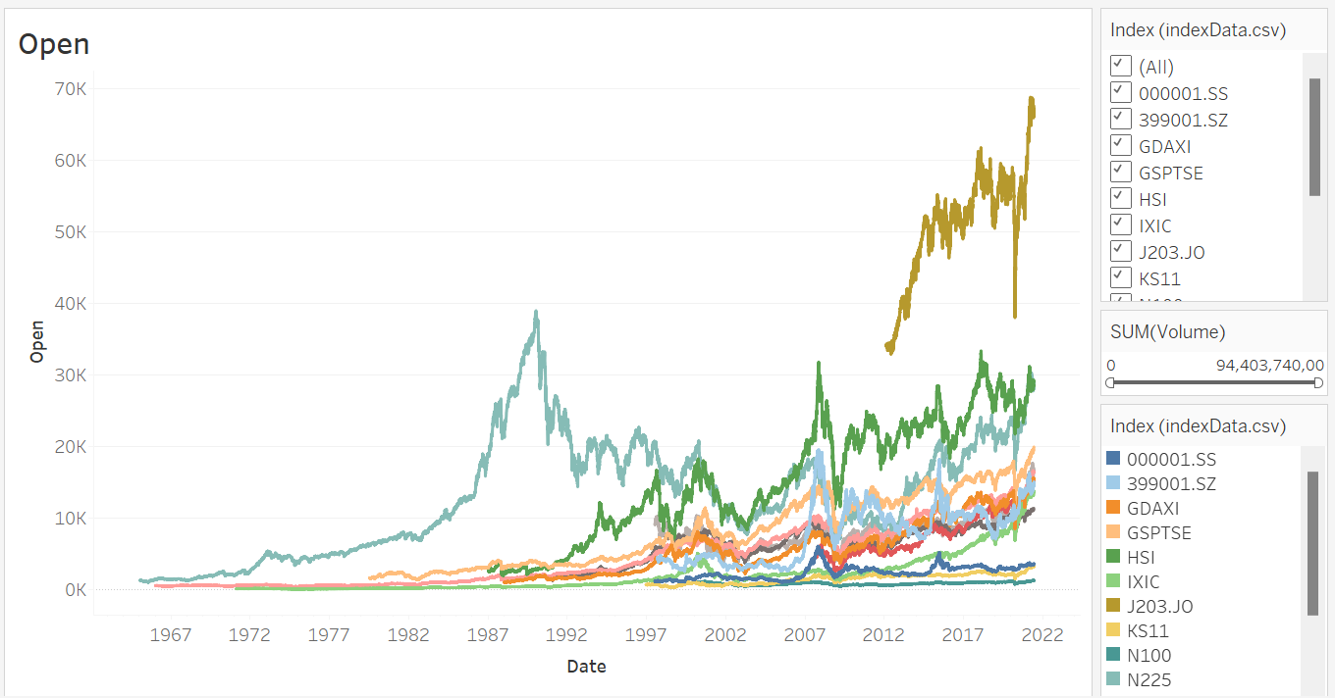
3.Open of different Stock Indexes
In the line graph, we see the open of all the stock indexes.
We can also filter the stock indexes by volume according to the range.
We can all filter to see the open according to the stock indexes.

Slide 6
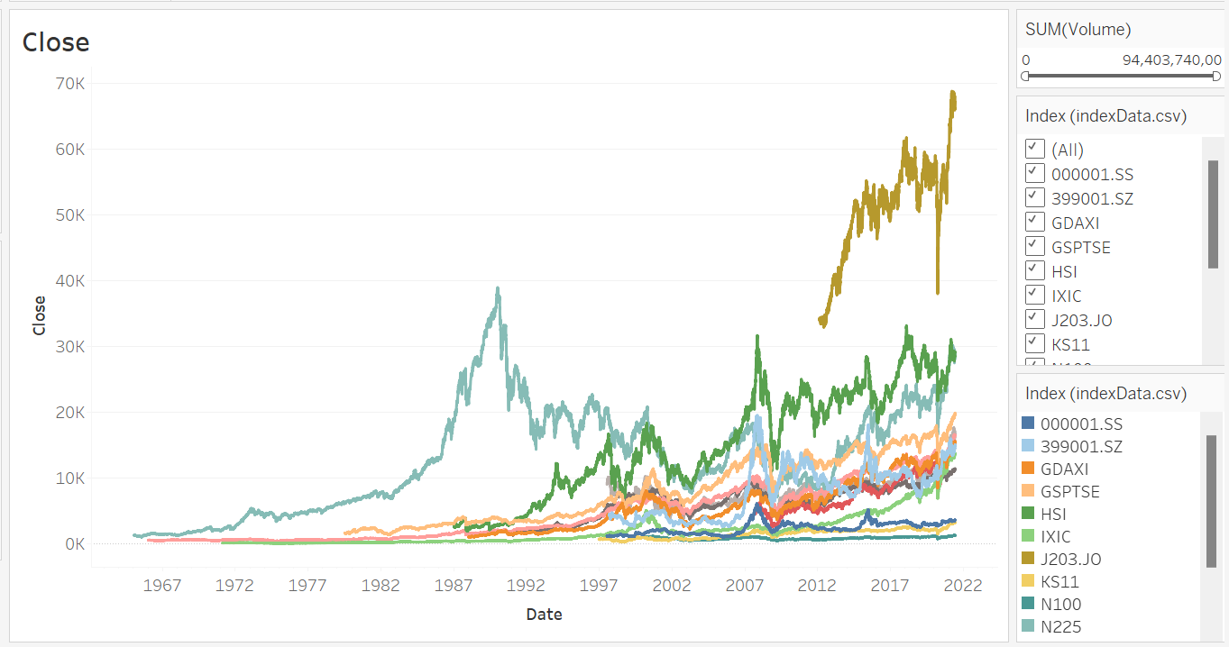
4. Close of different Stock Indexes
In the line graph, we see the close of all the stock indexes.
We can also filter the stock indexes by volume according to the range.
We can all filter to see the open according to the stock indexes.

Slide 7
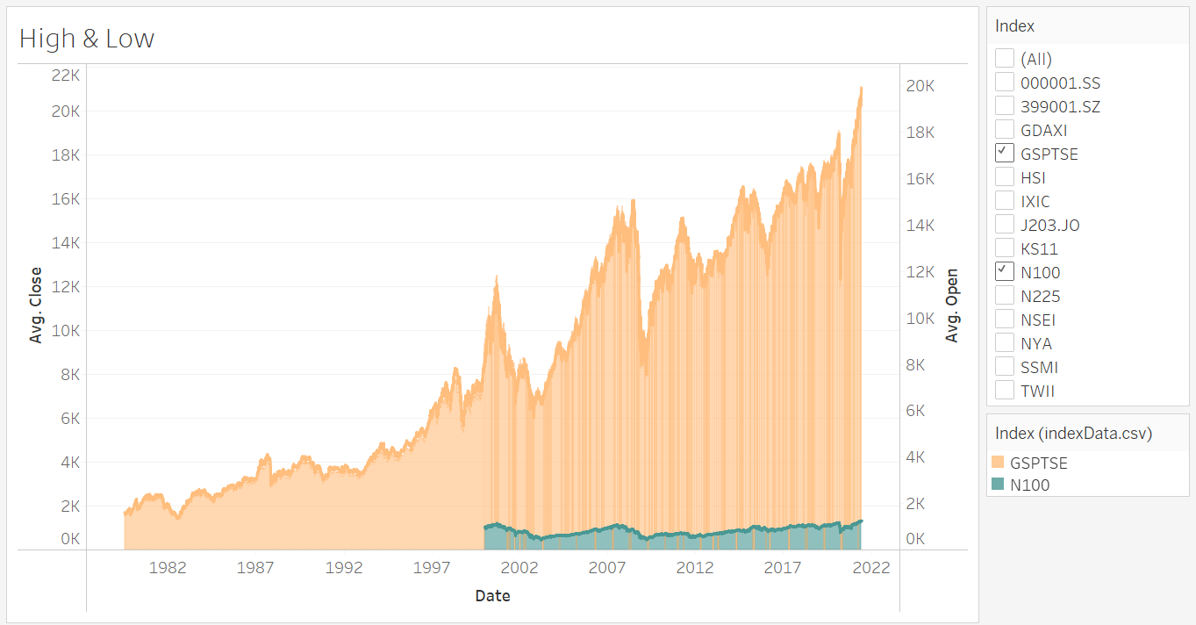
5.High & Low of different Stock Indexes
In the area chart, we see the high is marked in bold and the shaded region below denotes the low with the year.
We can also filter the stock indexes and compare with one another.

Slide 8
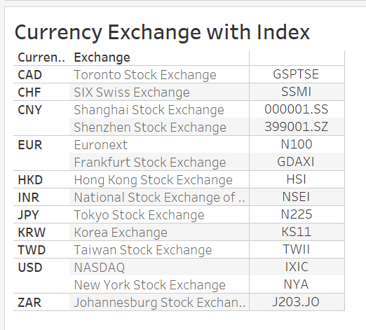
6.Currency Exchange with the Currency and Stock Indexes
The table gives information of the Currency Exchange with the Stock Indexes along with the Currency.
We can depict from observation that there are 2 stock indexes in China, Europe and United States where as other countries have only one Stock Exchange.
From the exchange column we get to know that where the headquarter of each stock index is located.

Slide 9
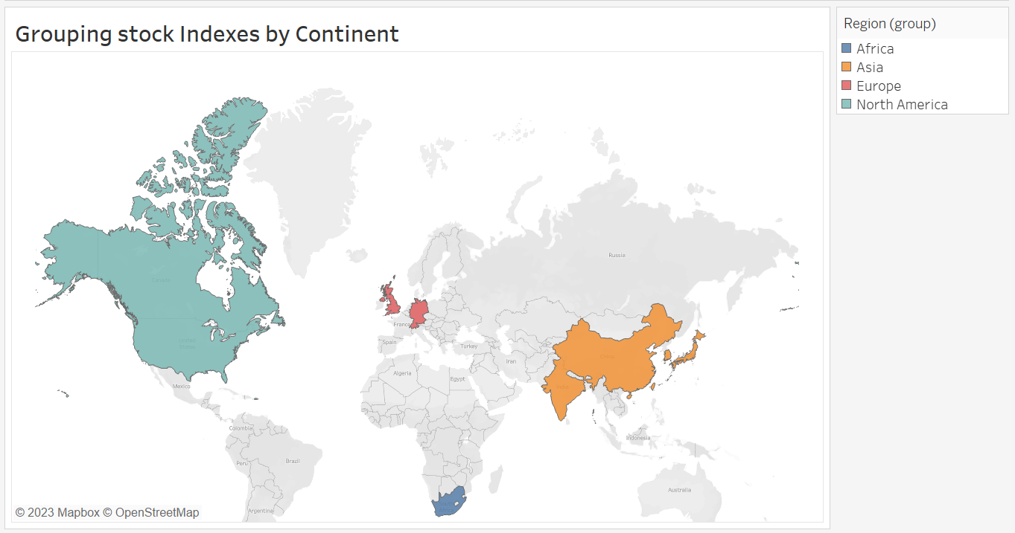
7.Group of countries showing average OCHL & Volume
In the map, we have grouped the countries into the continents.
We have calculated the average Open, Close, High, Low, (OCHL) and Volume for each continent.

Slide 10
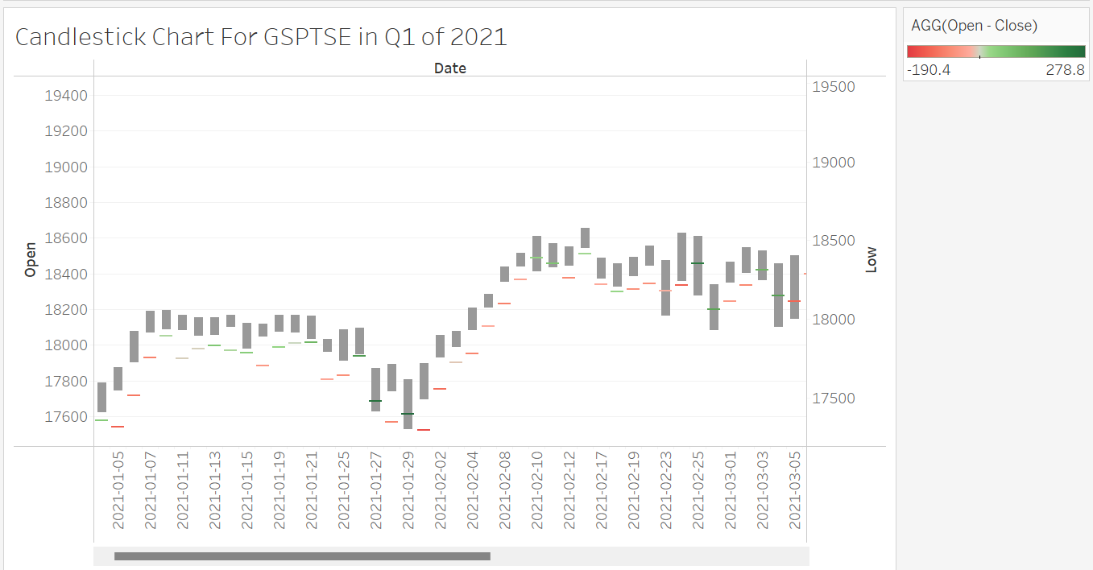
8.Candlestick Chart for GSPTSE
In this Candlestick Chart, we can see the daily variation based on open and close of the stock indexes.
The top of the candle stick indicates the daily high, whereas the bottom indicates the daily low.
The Green line means that the price of the stock index has rose from the previous day closing.
The Red line means that the price of the stock index has dipped from the previous day closing.
We can analyse the daily trend and predict the future price of the stock index using this chart.

Slide 11
8.Candlestick Chart for GSPTSE
We calculate the High- Low in the calculated field and name it as High-Low, which we can see as the candle length of this chart.
We also calculate the Open - Close in the calculated field and name it as Open – Close, which we see as the red and green sticks in the chart.

Slide 12
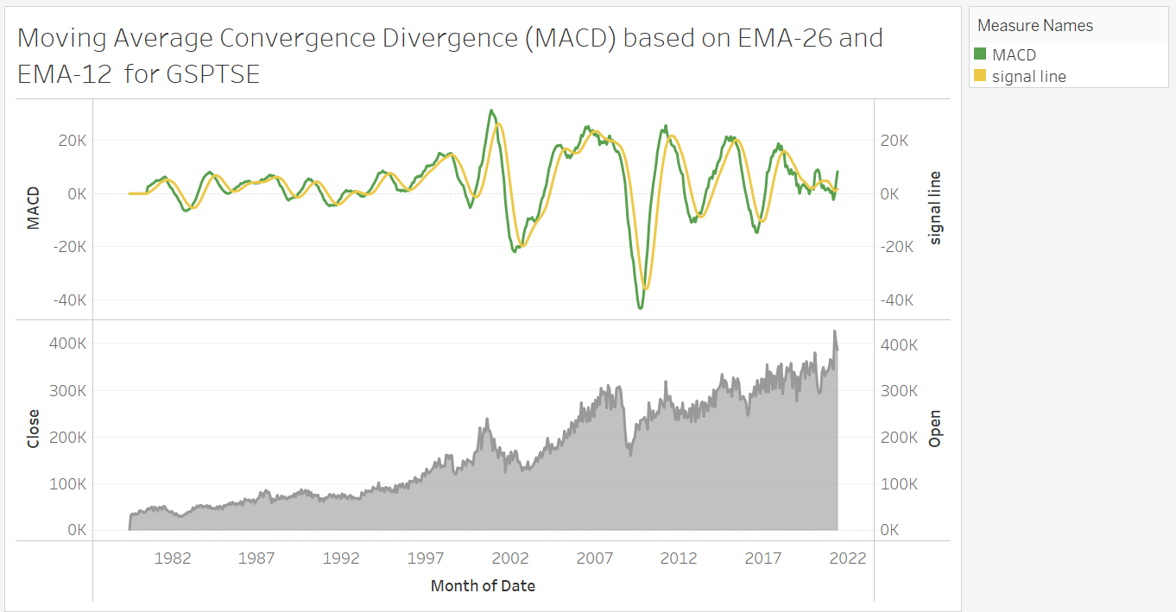
9.MACD based on EMAs for GSPTSE
We are using the MACD indicator, along with the signal line to predict the market trend for the stock index.
If the signal line and the MACD line intersect each other than we can see the change in trend i.e. if the stock index was rising then in future it falls and vice versa.
To support this theory we can see the open and close chart show the changes in trend as predicted by the MACD.

Slide 13
9.MACD based on EMAs for GSPTSE
We have used Exponential Moving Average (EMA) for 14 days and also EMA26.
To calculate the signal line, we used MACD used as the calculated field.

Slide 14
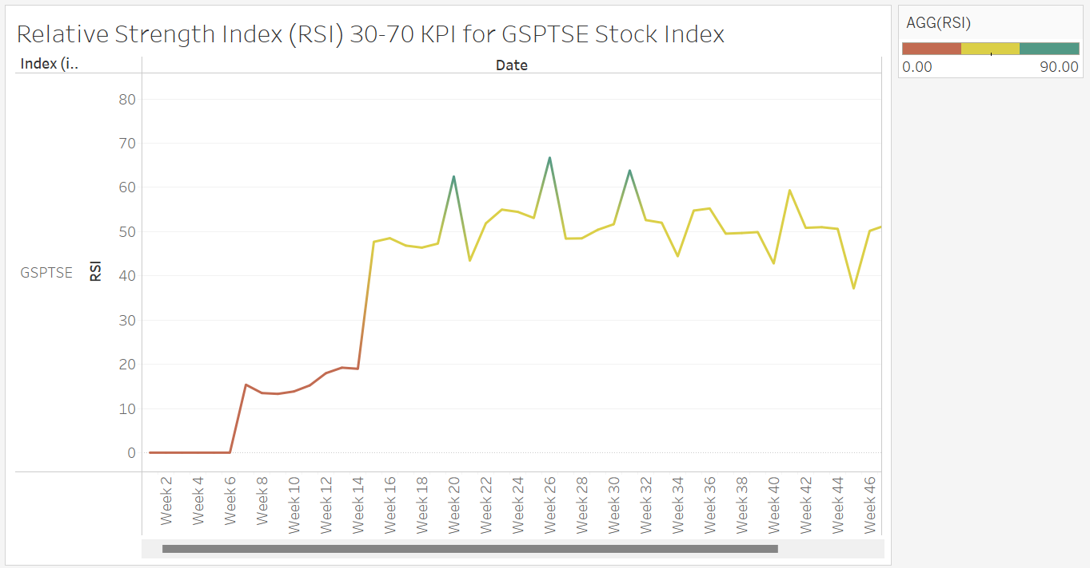
10.RSI based on EMAs for GSPTSE
RSI is used to find out when a particular stock is over bought or over sold.
If the value of RSI is below 30, then the stock index is over sold.
If the value of RSI is above 70, then the stock index is over bought.

Slide 15
10.RSI based on EMAs for GSPTSE
The red colour shows over sold condition.
The green colour shows over bought condition.
The yellow colour shows normal condition.
If the RSI is in red, the price of the stock index will increase in future.
If the RSI is in green, the price of the stock index will decrease in future.

Slide 16
10.RSI based on EMAs for GSPTSE
Relative strength index (RSI) is calculated using Relative strength (RS).
RS is calculated with the help of Average Gain And Loss.
Average gain is calculated from gain and loss is calculated from price change.
Gain comes from Price change and Price change comes from close value of stock index.

Slide 17
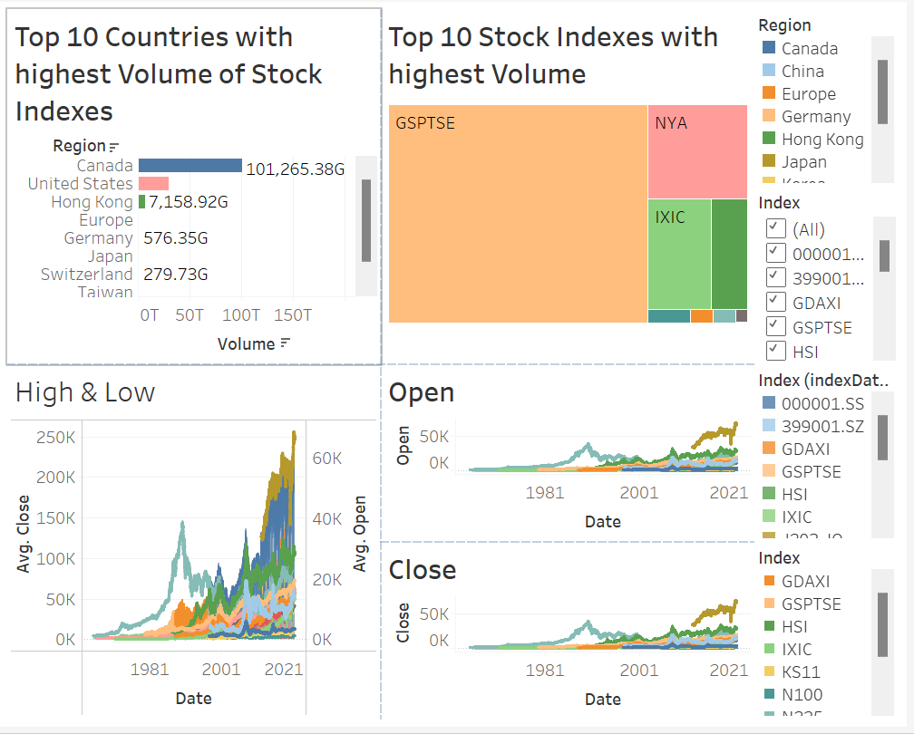
Dashboard 1- All Stock Index

Slide 18
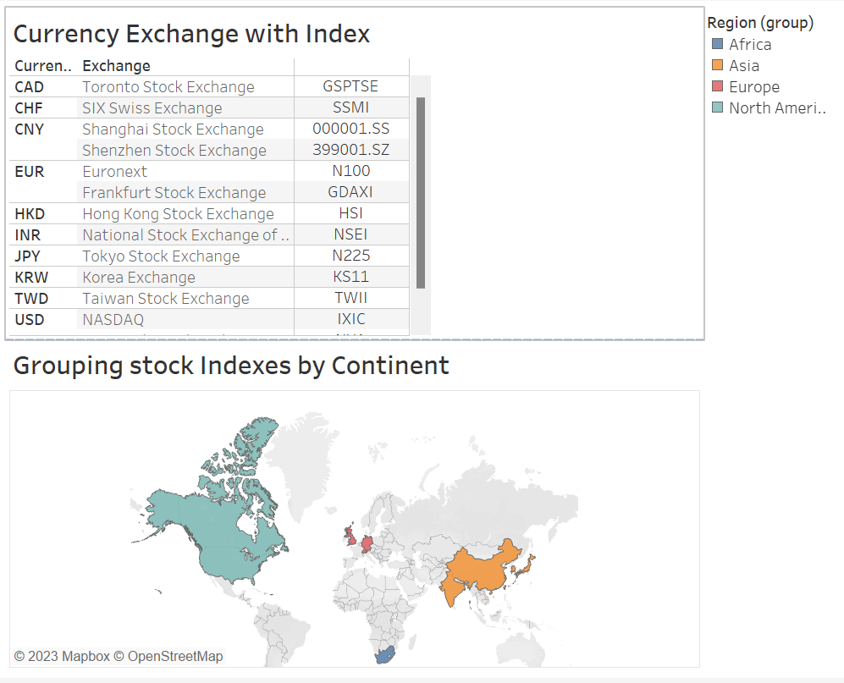
Dashboard 2- Stock Index across the globe

Slide 19
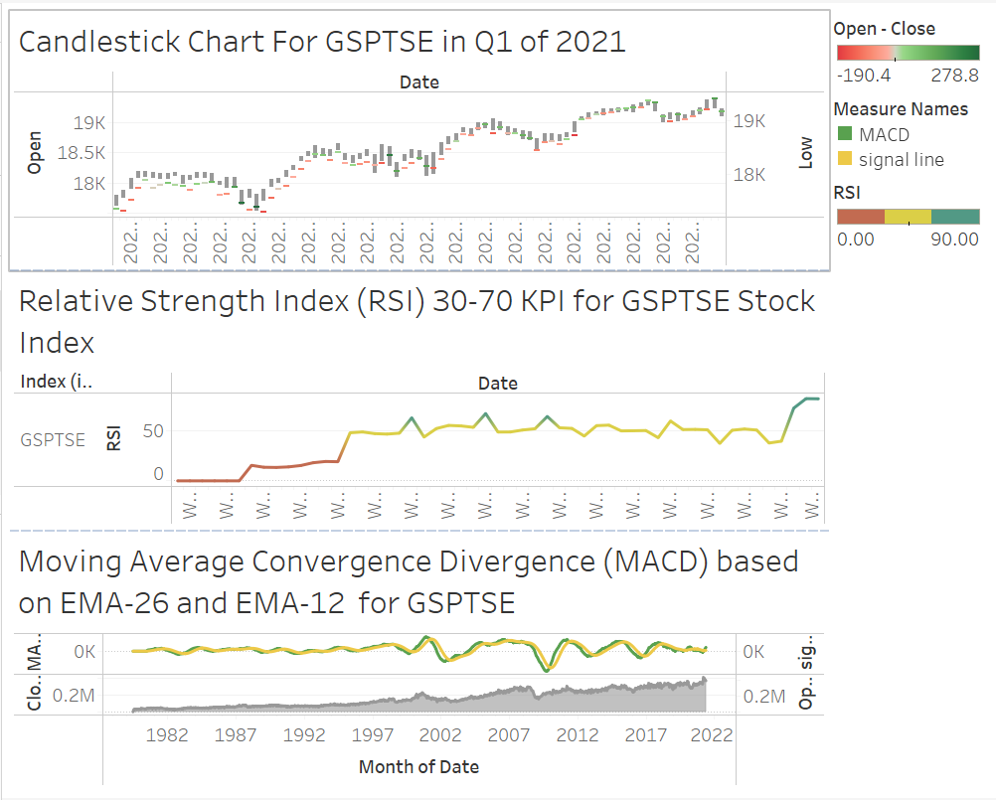
Dashboard 3- Stock Index GSPTSE Analysis

Slide 20
Conclusion
Firstly, we find out the best country who has the highest volume of stock indexes.
Later, we find the best stock index according to the volume.
Then, we see the trend in open of the different stock indexes.
Later, we see the trend in close of the different stock indexes.
We also compare the high and low of the different stock indexes with each other.
Then, we get some information of the Currency and Stock Exchange of different regions.
We group the countries in different continents and find the OCHL and volume of the stock indexes.
We make the candle stick chart as one of the KPI measures and do the analysis.
Later we make MACD chart based on EMAs for only GSPTSE as we recognize as the best stock index and MACD is second of the KPI measure in our story.
RSI is the third KPI measure which show the trend and helps us to predict the future price of the stock.
Dashboard-1 helps in analysis of all stocks across the globe.
Dashboard-2 depicts the stock exchange along with the grouping of continents.
Dashboard-3 gives us detailed analysis of future predictions of stock price and the trend of the stock index

Slide 21
Thank You

