Slide 1
HAPPIEST HEALTH SUMMIT 2026 / DIGITAL TWIN FOR TYPE 2 DIABETES
GlucoTwin
A two-hour warning, and a what-if sandbox, for type 2 diabetes.
six seven · [COLLEGE] · [INCUBATOR]
1

Slide 2
India does not have a diabetes problem.
It has a daily one.
•
101 million people with diabetes in India. 136 million with prediabetes. [CITE]
•
Most of them see a doctor two or three times a year.
•
The disease acts every day, between those visits.
ICMR-INDIAB, 2023. Citation to be completed before submission.
2

Slide 3
The dangerous hours are the ones nobody sees.
•
Glucose above 180 mg/dL for 30 minutes does damage quietly.
•
The worst window is usually after the evening meal.
•
A 09:00 fasting reading cannot show it.
•
The next HbA1c test arrives three months later.
3

Slide 4
So we rebuilt the patient as a twin.
•
Static record: labs, medications, genotype, history.
•
Dynamic stream: 14 days of CGM, heart rate, HRV, steps, sleep.
•
Output: two-hour event risk, with a calibrated probability.
•
Output: a what-if sandbox that runs on this patient's physiology.
4

Slide 5
1,500 synthetic patients. 14 days each.
6.05 M
5 min
55
1 CPU
glucose readings
sampling interval
model features
to train and run
Seed 42. The whole cohort is regenerated by one command.
5

Slide 6
Synthetic is a design choice, not a shortcut.
•
No real patient data, so no consent or re-identification risk.
•
The record drives the physiology, so the two streams are genuinely linked.
•
Fasting glucose sets the baseline. BMI, duration and genotype set sensitivity.
•
The cost: results do not transfer to real patients without validation.
6

Slide 7
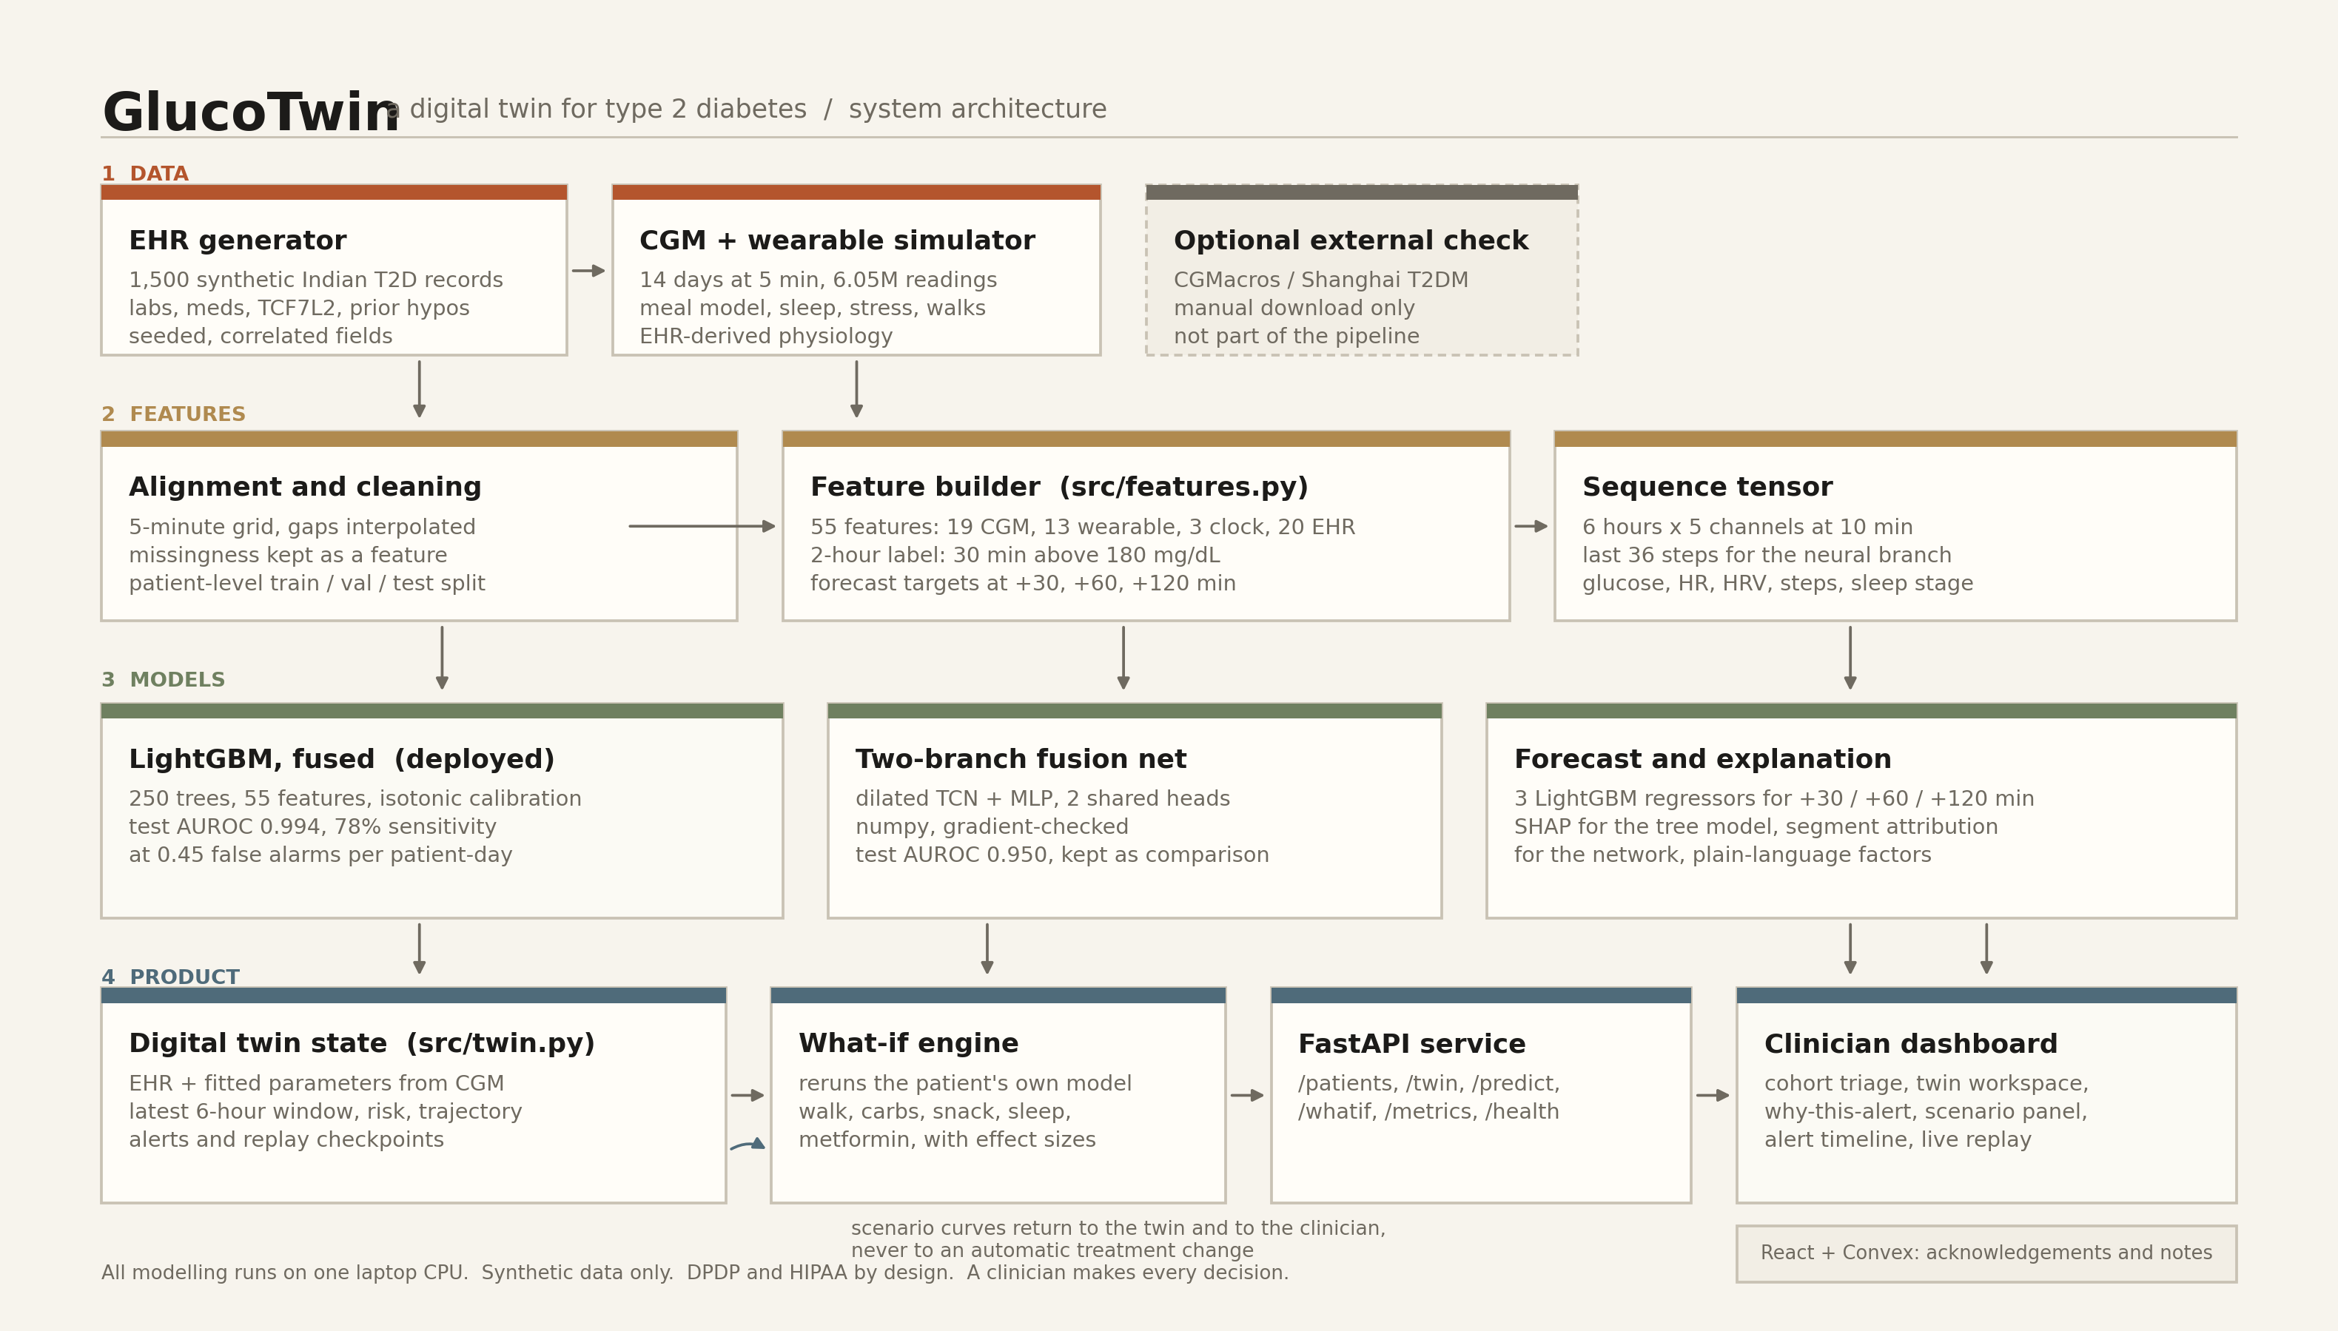
One pipeline, from a synthetic record to a clinical screen.
Data generation, features, models, twin, what-if, API, dashboard. External validation is optional and off to the side.
7

Slide 8
The label is a real clinical event.
1 if glucose stays above 180 mg/dL for 30 minutes
inside the next 2 hours
•
41.1% of test windows are positive.
•
The cohort is deliberately uncontrolled, so events are not rare.
•
Split by patient: 900 train, 300 validation, 300 test.
8

Slide 9
55 features. Four blocks. One fused vector.
•
19 CGM: level, means, variability, slopes, time above range, gaps.
•
13 wearable: heart rate, HRV, steps, sleep and deep sleep.
•
3 clock: time of day and night flag.
•
20 record: age, BMI, waist, HbA1c, eGFR, lipids, medications, TCF7L2.
Plus a 6-hour, 5-channel tensor for the neural branch.
9

Slide 10
Five models. The tree won.
Model
Input
AUROC
Sensitivity at 0.5 FA/day
Persistence
current glucose
0.797
6%
LightGBM, CGM only
15 CGM features
0.984
70%
LightGBM, EHR only
20 record fields
0.791
5%
LightGBM, fused
all 55 features
0.994
78%
Fusion net
6 h x 5 channels + record
0.950
24%
Test patients only. Calibrated probabilities. Threshold fixed on validation.
10

Slide 11
The network was supposed to win.
It did not.
•
Two-branch TCN + MLP, written in numpy, gradient-checked.
•
AUROC 0.9496, against 0.9941 for the tree model.
•
Two epochs on one CPU core is not enough to beat 250 boosted trees.
•
So the tree is deployed, and the network stays in the ablation.
This is the comparison the brief asked for, reported as it is.
11

Slide 12
Results on 300 patients the model never saw.
0.994
0.992
78%
53 min
AUROC
AUPRC
sensitivity
mean warning
Brier 0.028. 0.45 false alarms per patient-day. Dense 15-minute run: 81% sensitivity, 60 min mean lead.
12

Slide 13
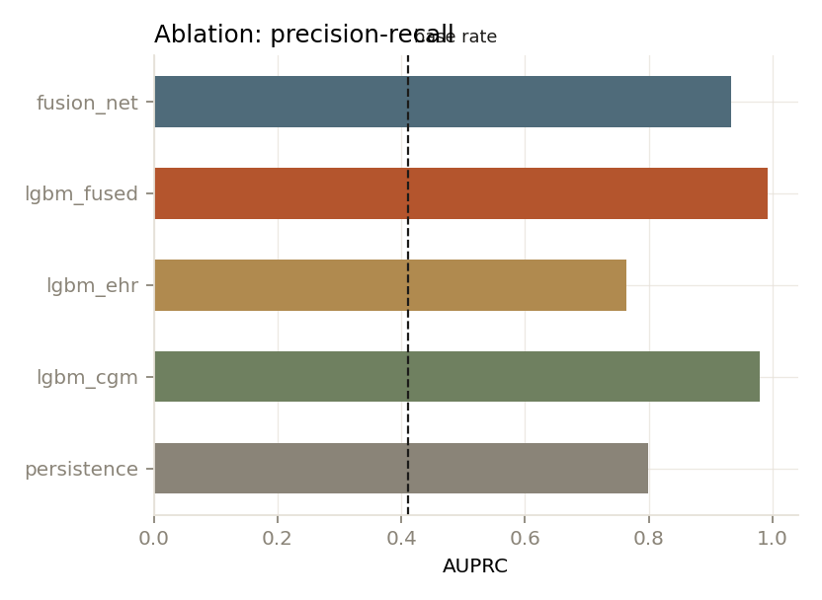
Every input helps. The sensor helps most.
Same checkpoints for every model. EHR-only cannot rank moments inside one patient's day, so its within-patient AUROC is 0.5.
13

Slide 14
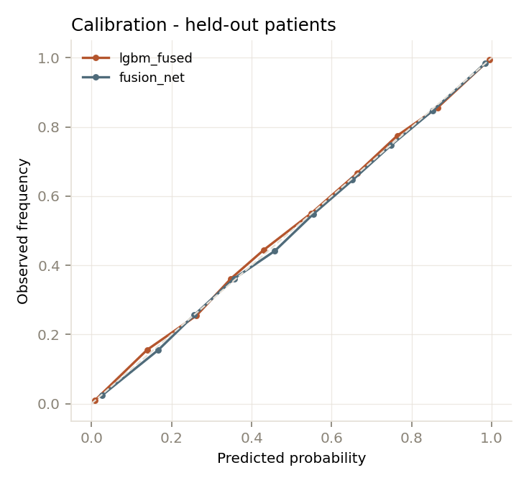
A probability you can act on, not just a ranking.
Brier 0.028 after isotonic calibration. Forecast RMSE 11 / 14 / 23 mg/dL at 30 / 60 / 120 minutes.
14

Slide 15
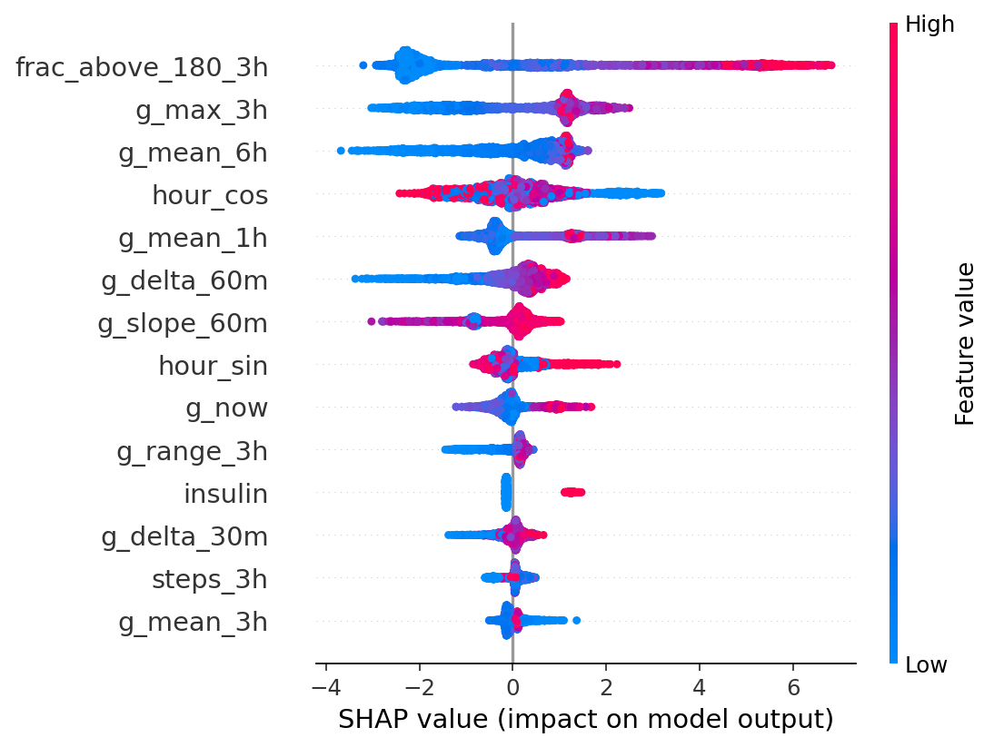
Why this alert, in words a clinician can use.
Recent time above range and the size of the current excursion dominate. The record explains who is at risk, not when.
15

Slide 16
The twin fits the patient, not the population.
•
Insulin sensitivity and basal glucose are fitted from the CGM signal.
•
Held-out check: R2 0.82, median error 8.4%, Spearman 0.91.
•
Those numbers validate the fitting procedure, not the physiology.
•
The twin updates as new readings arrive, and keeps its own risk trace.
16

Slide 17
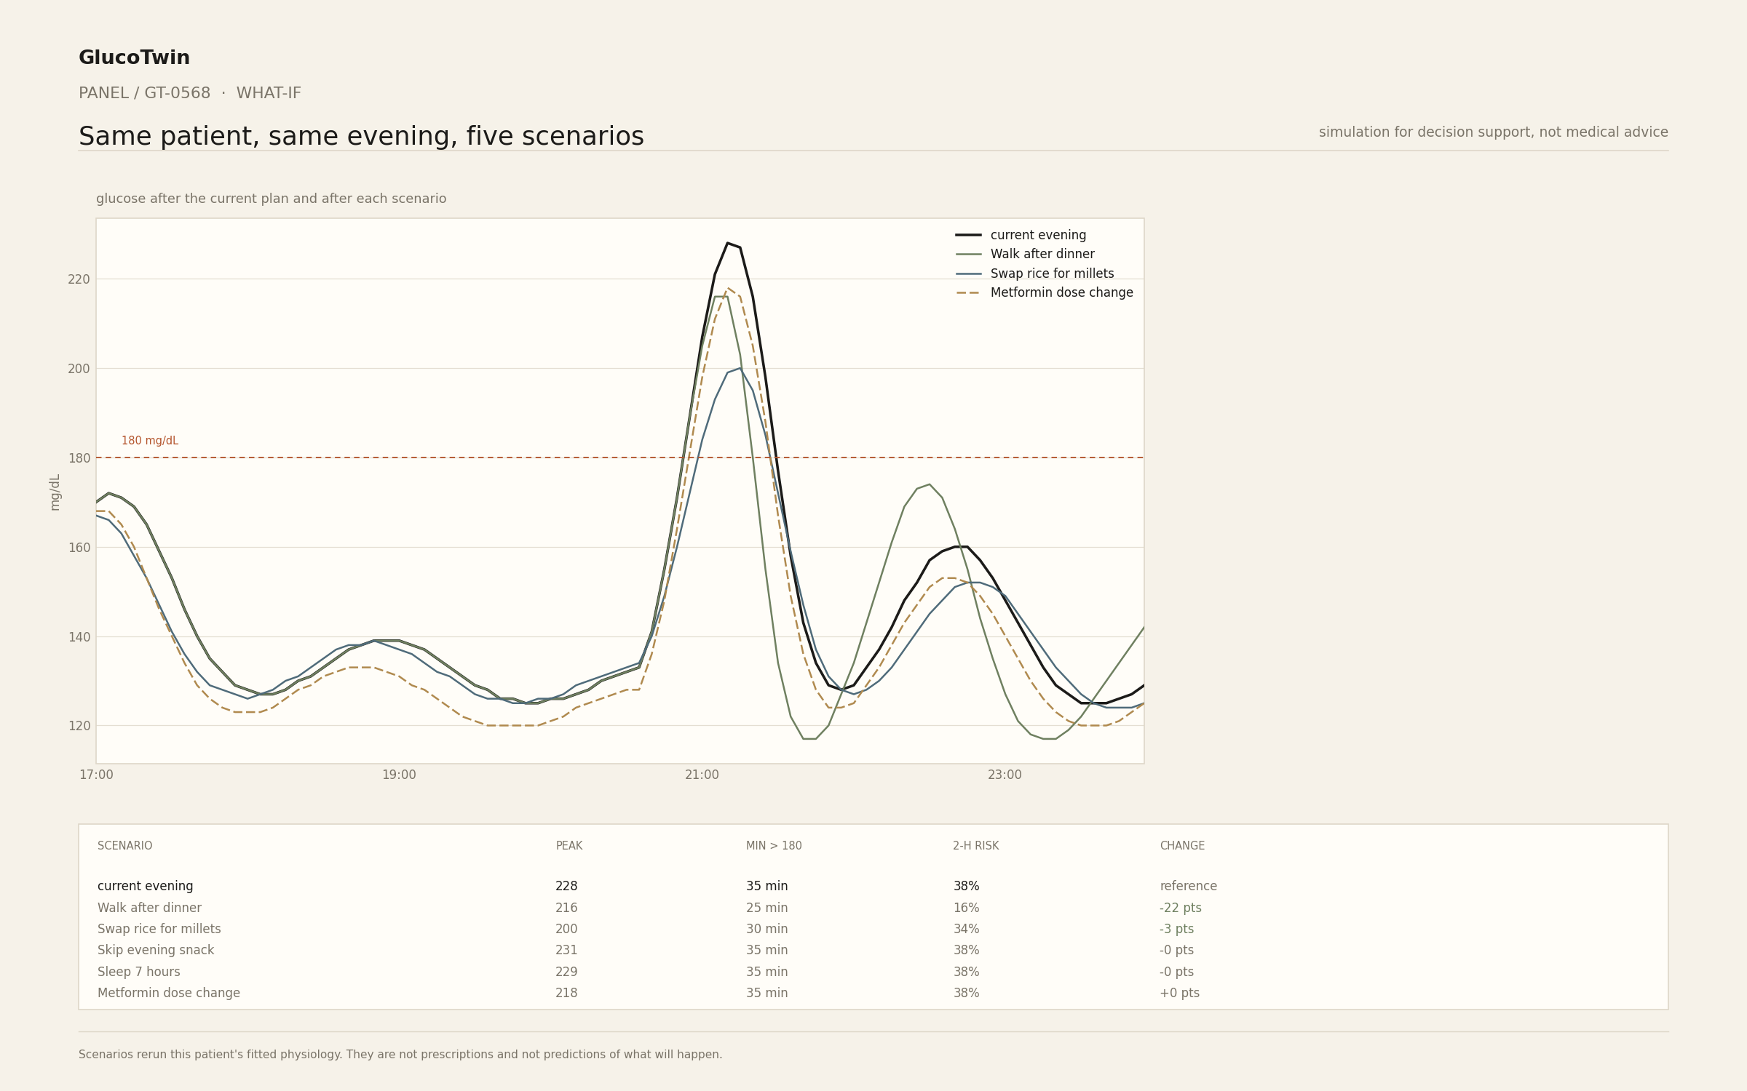
A walk after dinner cuts the peak by 12 mg/dL.
Same patient, same evening. Risk falls from 38% to 16%. Swapping rice for millets cuts the peak by 28 mg/dL. Skipping the snack does almost nothing.
17

Slide 18
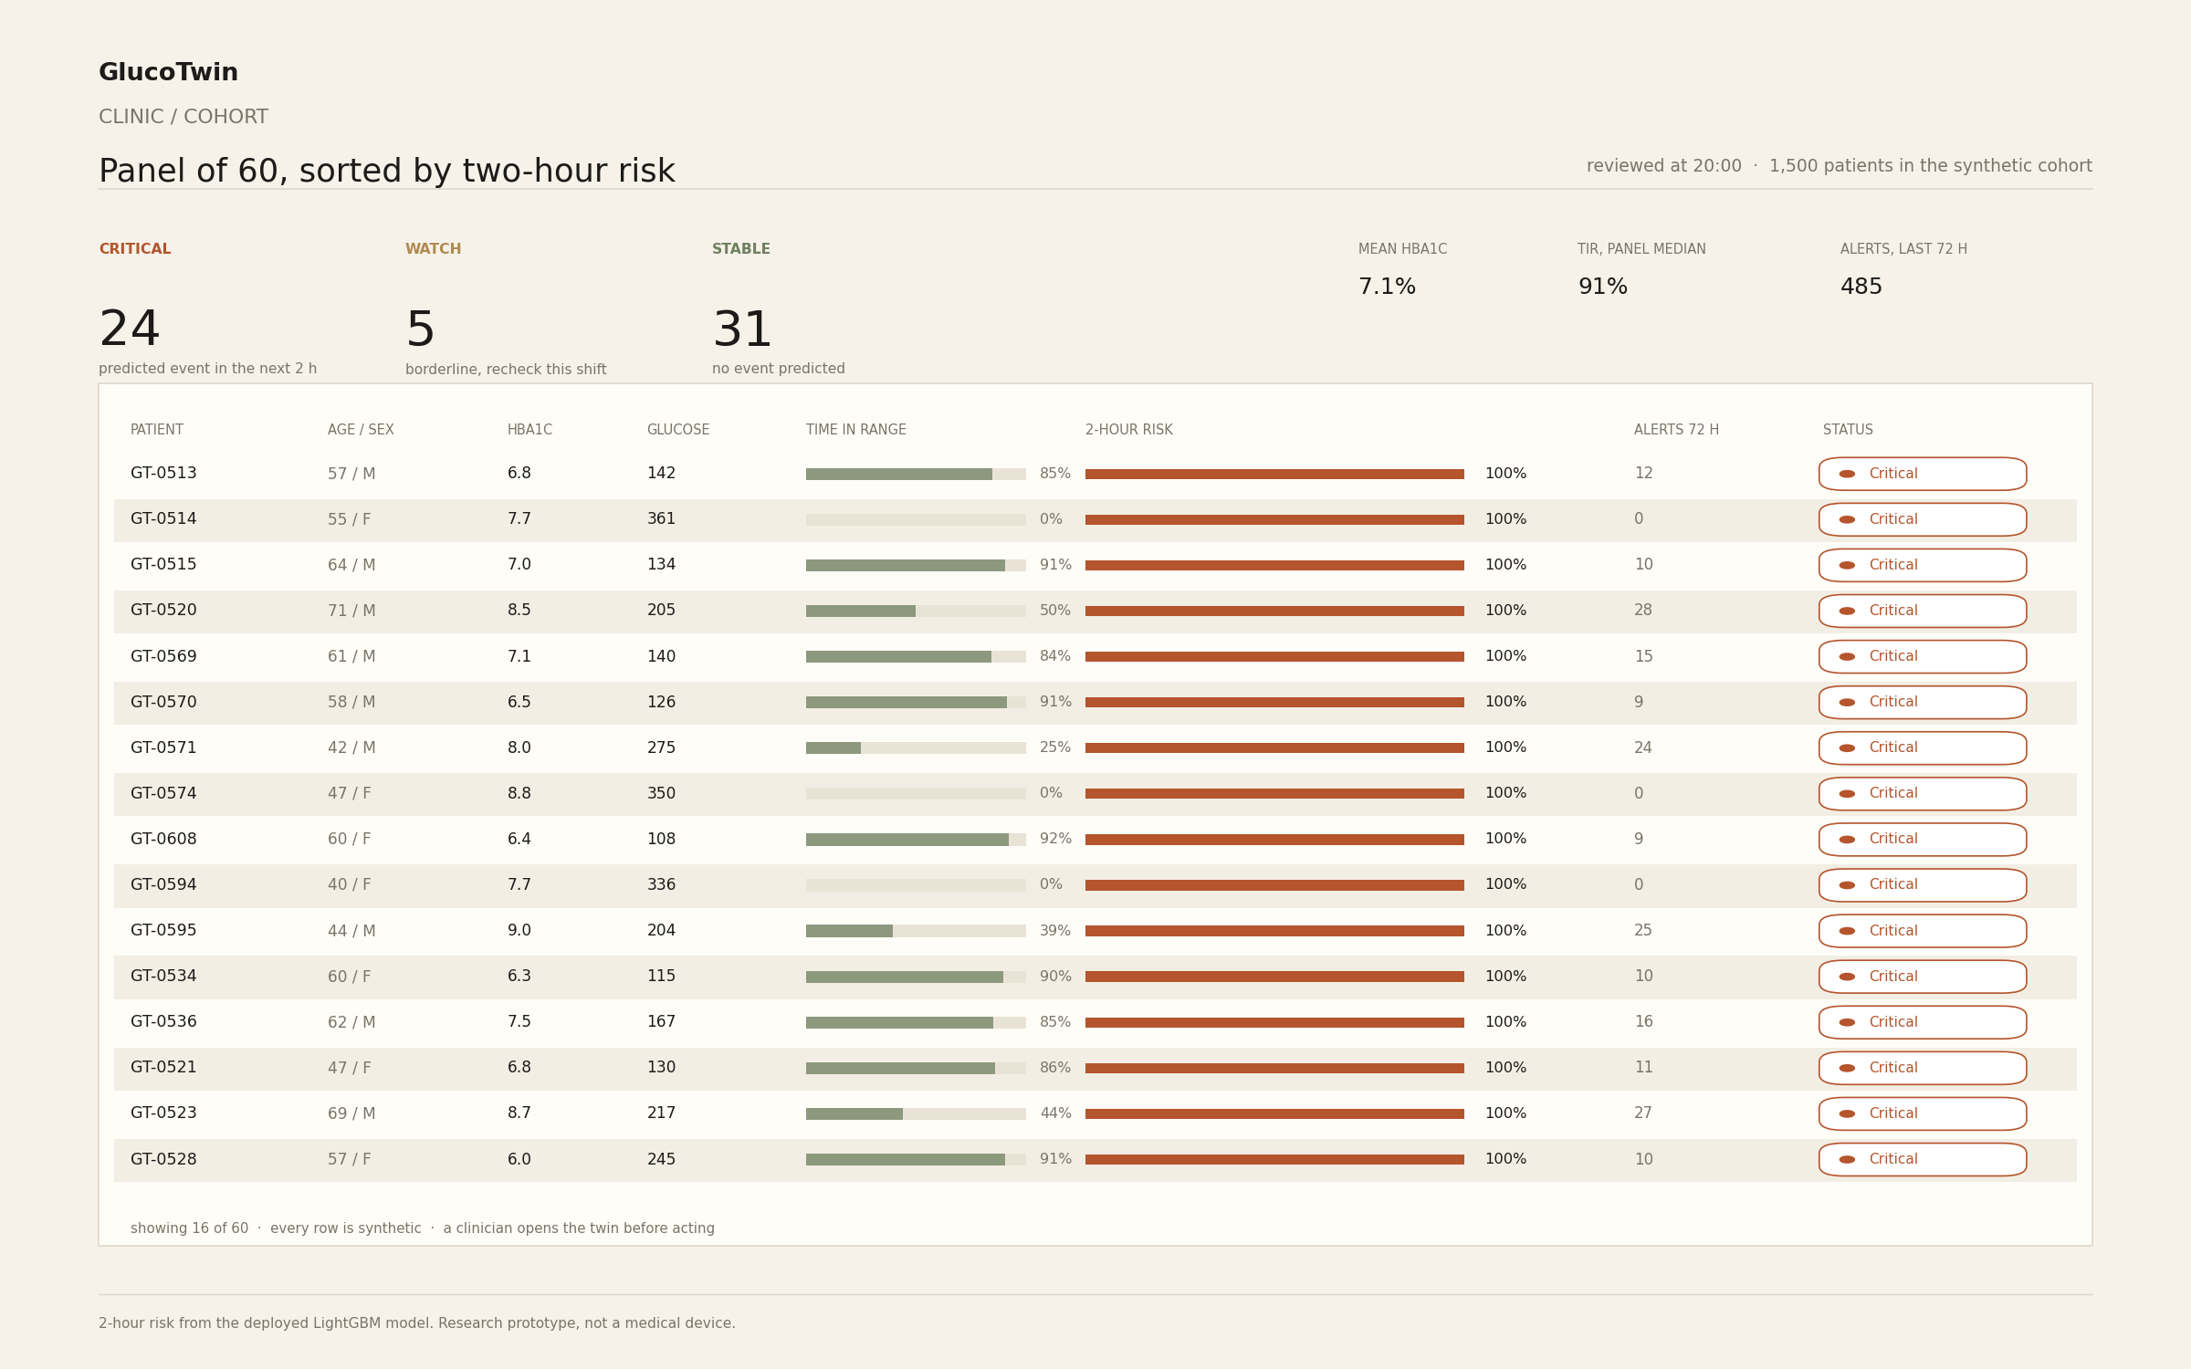
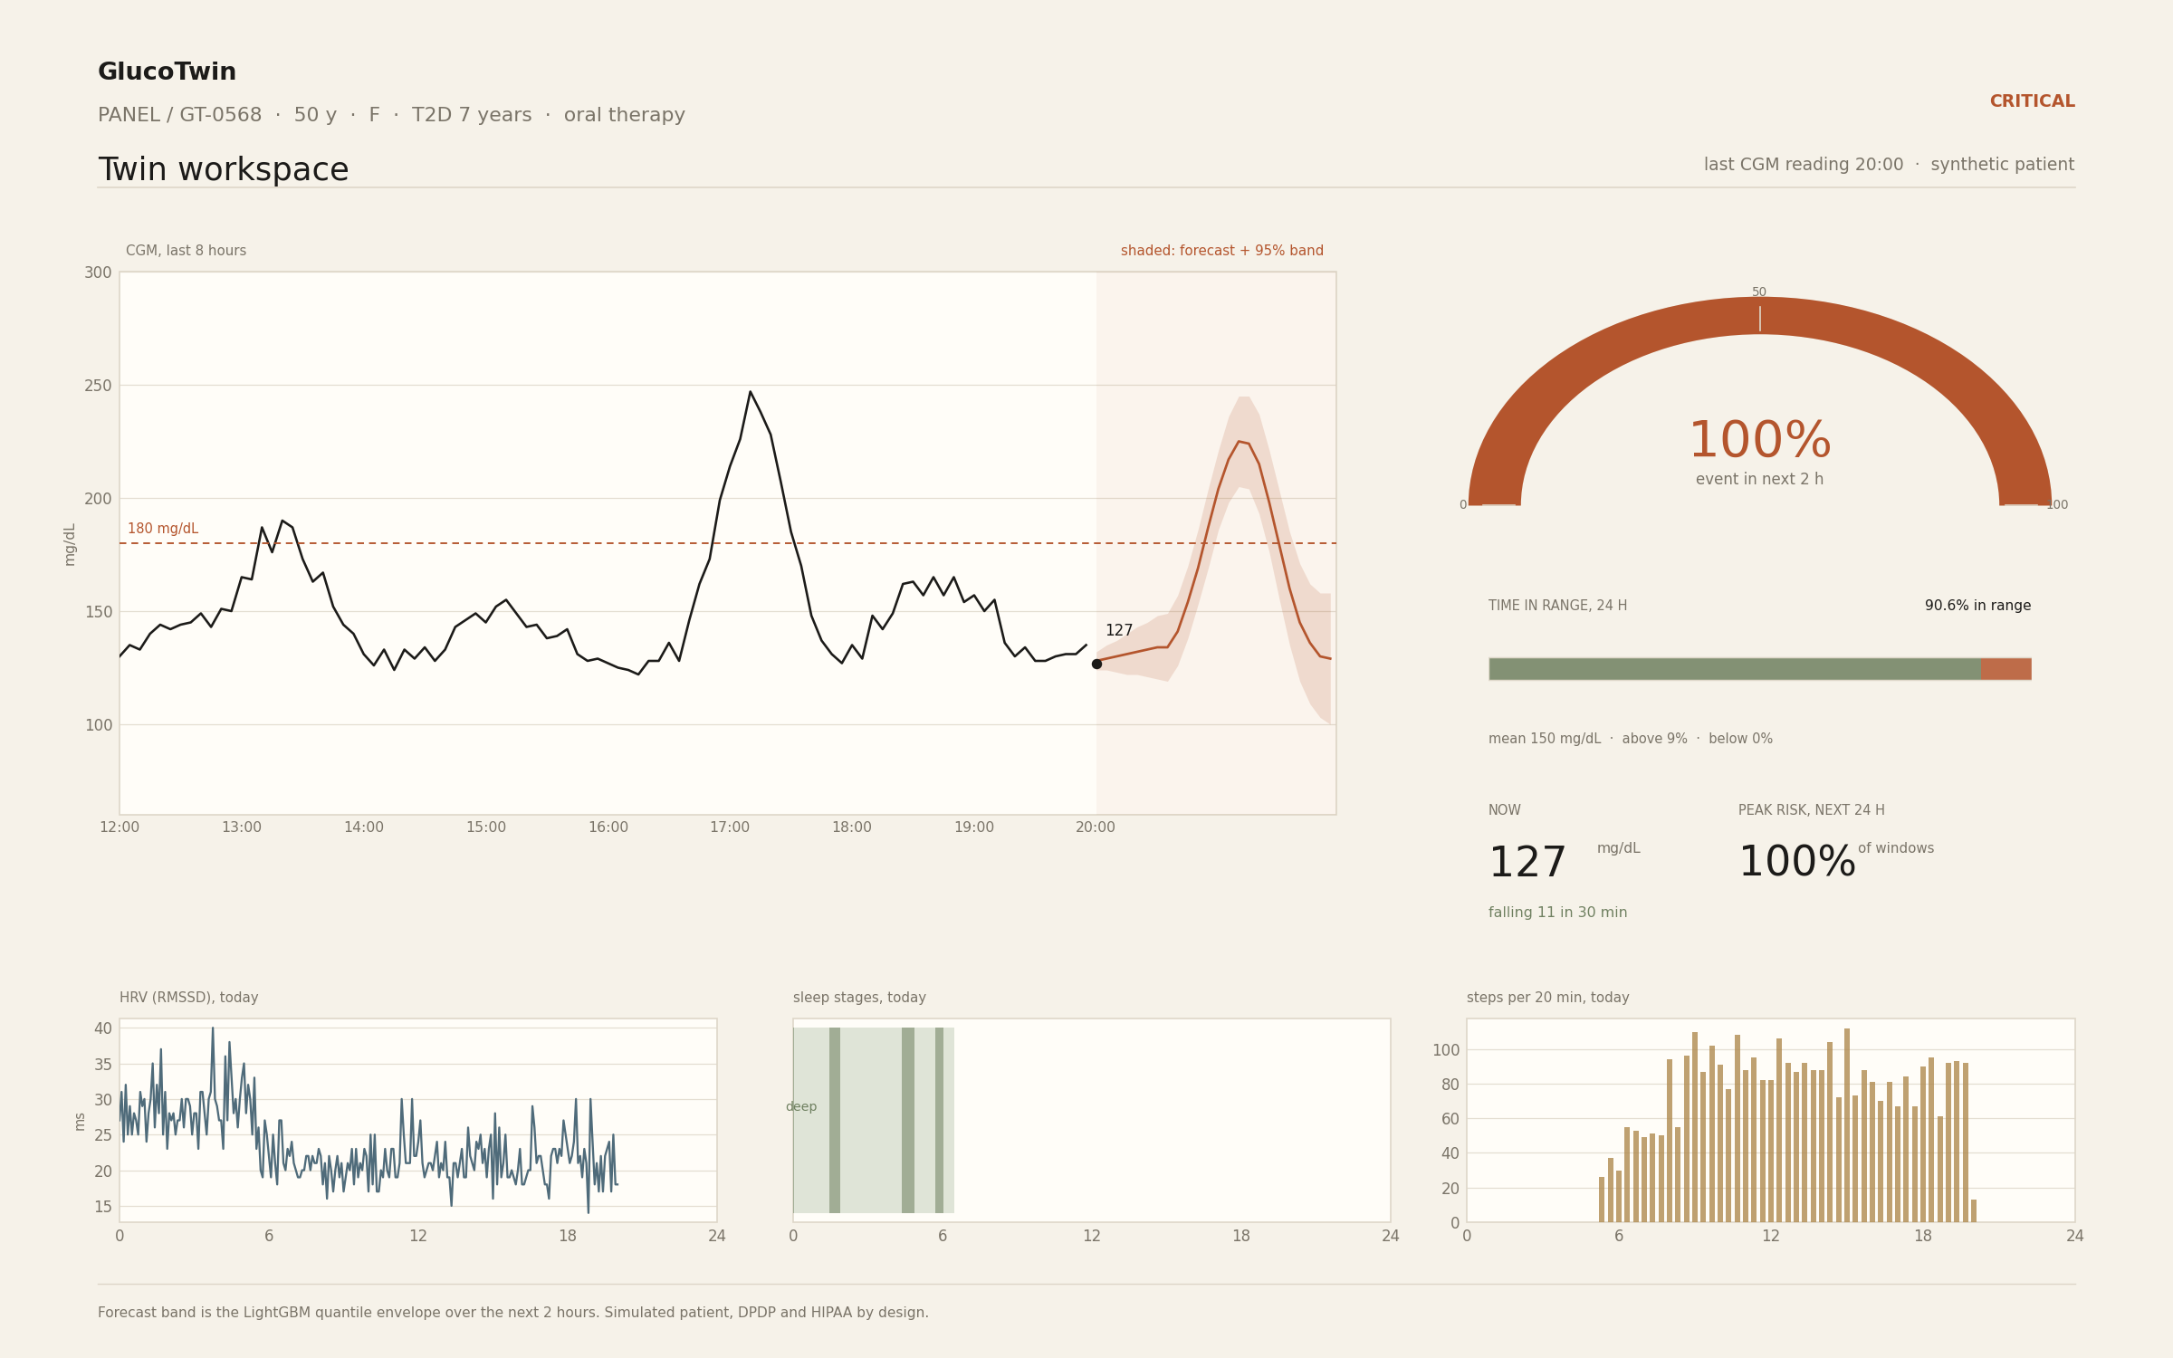
Built for a clinic, not for a demo.
Cohort sorted by two-hour risk. Twin workspace with forecast band, gauge, time in range, wearables and the alert timeline.
18

Slide 19
What we did not prove.
•
This is synthetic data. No clinical accuracy is claimed.
•
External validation is written but not run.
•
About 2.7 alerts per patient-day at the deployed threshold.
•
Subgroup fairness is not measured.
•
It is not a medical device, and it is not approved.
DPDP Act and HIPAA by design. Human in the loop. No automatic treatment change.
19

Slide 20
What comes next.
•
A prospective 8 to 12 week study in one clinic, threshold frozen in advance.
•
ABDM and ABHA records, Apple Health and Google Fit, CGM vendor APIs.
•
Federated learning across clinics, so records never move.
•
A fairer cohort: CKD, SGLT2 and GLP-1, and well-controlled patients.
20

Slide 21
Thank you.
GlucoTwin is a decision aid, not a doctor. The clinician decides.
six seven · [EMAIL] · Demo video: [LINK] · Code: [REPOSITORY]
21

