Slide 1

MACHINE LEARNING HACKATHON
Data Munchers
17 April 2022

Slide 2
Agenda
Business Context
Problem Statement
Use cases
Our Process
Objective & KPIs
EDA – Analysis
Feature Engineering
Prediction Model
Conclusion

Slide 3

Data Munchers
The Team
Keyur Patel
Gurucharan Saluja
Prakul Garg
Manikandan
Prachi Ranjan
Deepak Mattada

Slide 4
Our Mantra
“Information is the oil of the 21st century, and analytics is the combustion engine.”
Peter Sondergaard
(Gartner Research)

Slide 5
Business Context
A leading shopping mall wants to increase the footfall
Discount coupons are selected as one of the catalysts to improve footfall
The mall tied up with coffee shops, takeaways, bars and restaurants to distribute their coupons
It has historical data of past customers who availed the coupons
Historic data has demographic details to assess user behavior

Slide 6
Problem Statement
1
The shopping mall wants to increase the footfall by providing the discounts coupons to potential customers who have high probability of availing the coupon.

Slide 7
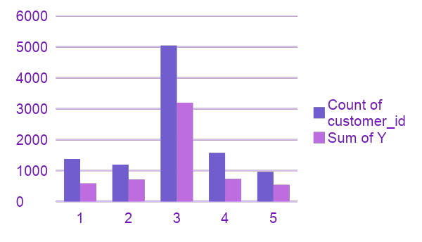
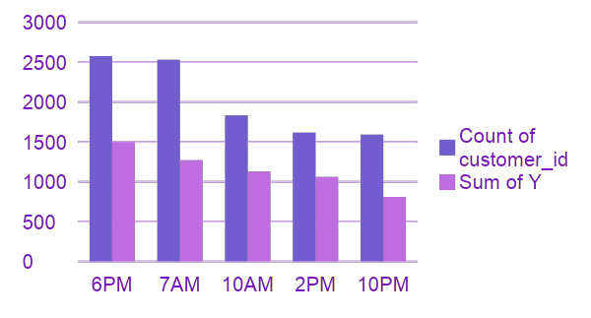
Use Case – A
Destination and Directions
When Destination is ‘No Urgent Place’, Irrespective of Direction feature the Acceptance rate is higher.
Direction Same and Direction Opposite features are inverse of each other.
No Urgent Place should be one of root node for decisioning
Footprint pattern by Time
Footprint is high during the morning time (7 AM and 10 AM) and Evening time (6 PM and 10 PM)
It is less at 2 PM
Time is changed to three Bins as Pre-Noon, Noon and Post-Noon.

Slide 8
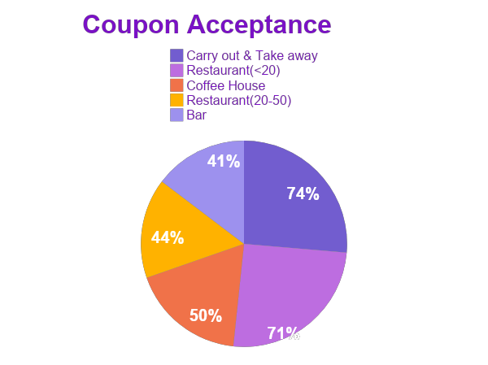
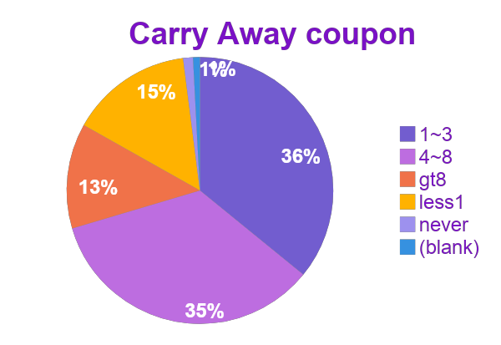
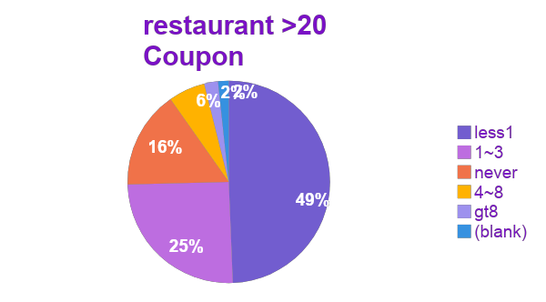
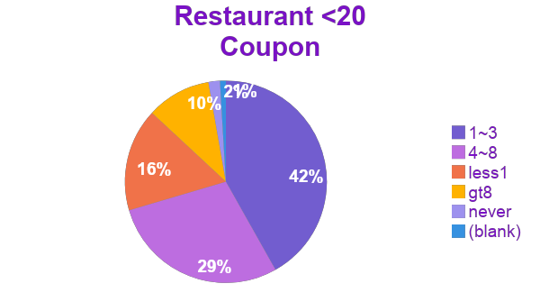
Use Case – B
Coupon Type, Monthly Frequency and Acceptance Rate
Carry Away and Restaurant <20 have more than 70% Coupon acceptance rate
Frequent customers are the reasons to see high coupon acceptance rate.
Monthly Frequency can be made as Boolean as Frequent user of mall or not in a given month.

Slide 9
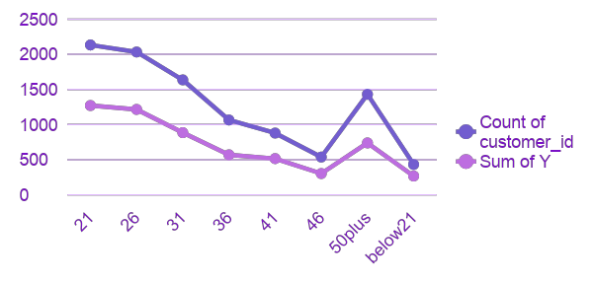
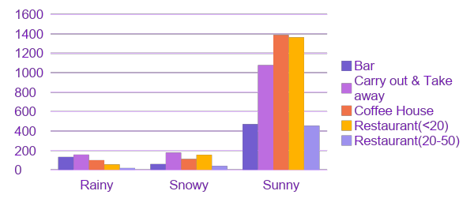
Use Case – C
Age Impacts on Footprint
Age is having a linear impact on the Footprint and Acceptance of coupon
Coupon acceptance is better in the age band 20 -29
Age is binned in terms of 10 years to reduce the distinct values.
Weather role on Footprint
Mall receives 80% footprint during the summer with better coupon acceptance rate.
Mall does not get more than 10% in rainy and snowy weather. These 10% could be regular visitors of mall.
Sunny weather is one of the driving decision to accept a coupon.

Slide 10
Our Process
Predictive Modeling
KNN Model
Random Forest Model
XG Boost
03
Exploratory Data Analysis
Data Exploration
Data Cleaning
Data Standardization
01
02
Feature Engineering
Statistically understand the strength of contribution of each feature in affecting the result
Remove the features that has low impact on the predicted value
Validate the hypothesis against different statistical tests

Slide 11
OBJECTIVE & KPIs
Build a model with high accuracy that can classify the customers whether they will avail the coupon or not
Key Performance Indicator
High Score for Feature Selection
Statistical Model
Tree Based Model
High Accuracy Score of the Classification Model

Slide 12
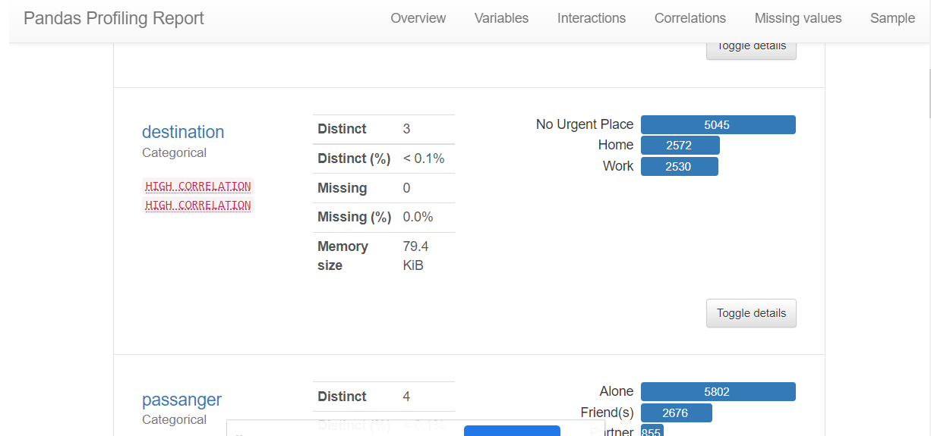
Data Exploration Analysis
Generate initial report using pandas-profiling library
Do thorough analysis of each column, its missing values, type of data, it’s correlation with other column, sub-categories

Slide 13
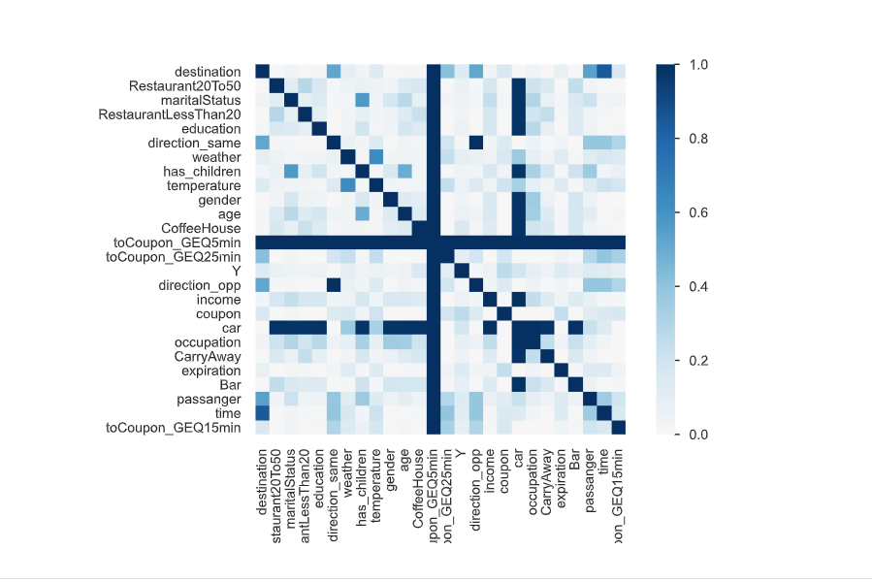
Cramer’s correlation
Cramér's V (φc)
Cramér's V is an association measure for nominal random variables. The coefficient ranges from 0 to 1, with 0 indicating independence and 1 indicating perfect association. The empirical estimators used for Cramér's V have been proved to be biased, even for large samples. We use a bias-corrected measure that has been proposed by Bergsma in 2013 that can be found here.

Slide 14
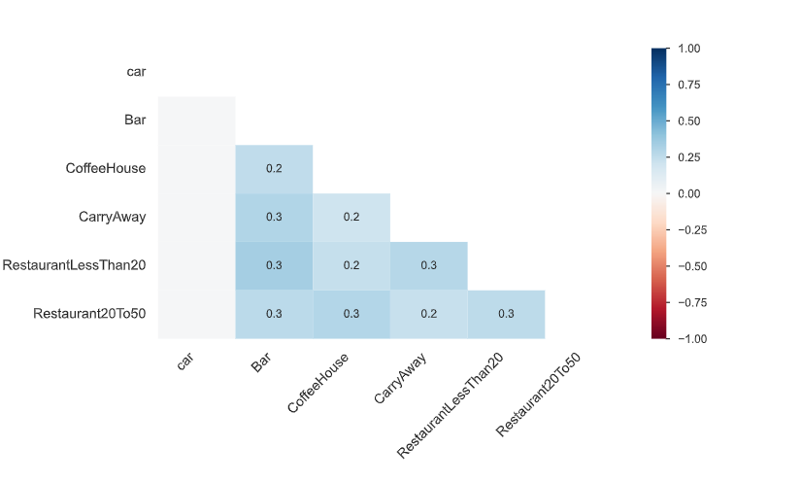
Missing Values
Delete row/column with missing values
Car column has most null values so we removed it.
Filling missing values
Used mode to fill 1 % of missing values

Slide 15
Data Cleaning
Identified columns that has many sub-categorical data
Plot Pie chart to check the distribution of each category
Plot Pie Chart to check the distribution of each category for people who availed coupons
Merge the sub-categories as per the distribution, and logical understanding
Merged sub-categories for following features:
Age
Education
Income
Time
Passanager
Carry Away
Bar
Restaurant Less Than 20
Restaurant 20-50

Slide 16
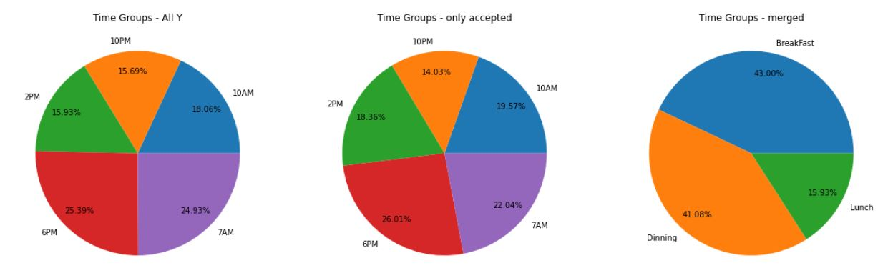
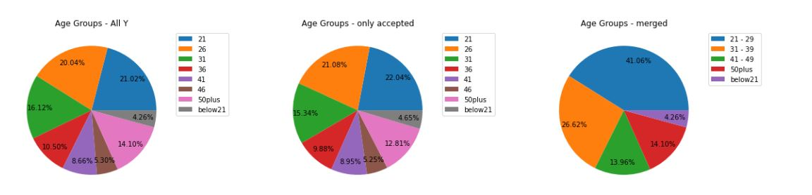
Data Cleaning - examples

Slide 17
FEATURE Engineering
What
Feature selection using univariate analysis
Why
Inference
Compared XG-Boost feature selection with Static based and Tree-based feature selection models.
We found Tree-based algorithm was able to understand the feature very well and we went with XG-Boost classifier only.
Compare each feature to the target variable, to see whether there is any statistically significant relationship between them.
How
Ordinal encoder (For encoding category value)
Sklearn → Select K Best (Chi Square test)
Random Forest Classifier (Tree based)
XG-Boost Classifier (Base Model for prediction)
O

Slide 18
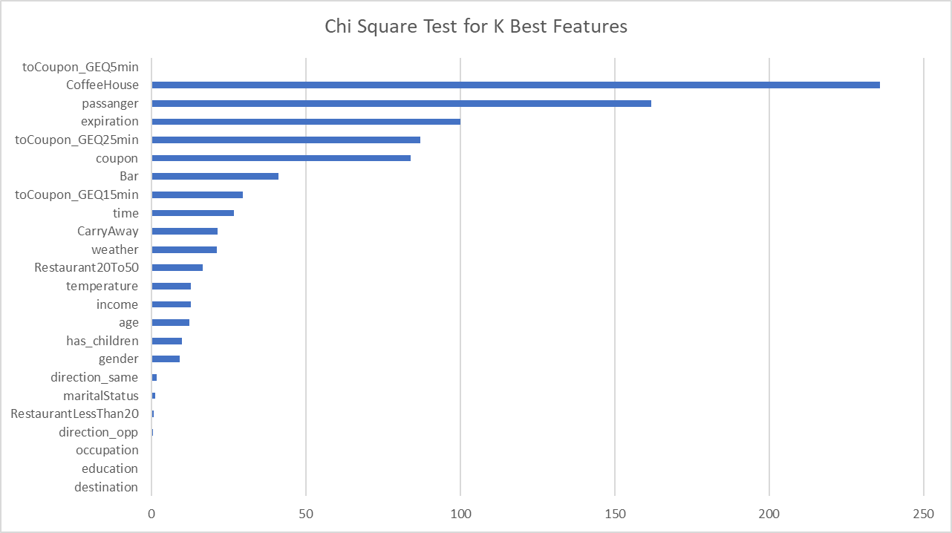

Slide 19
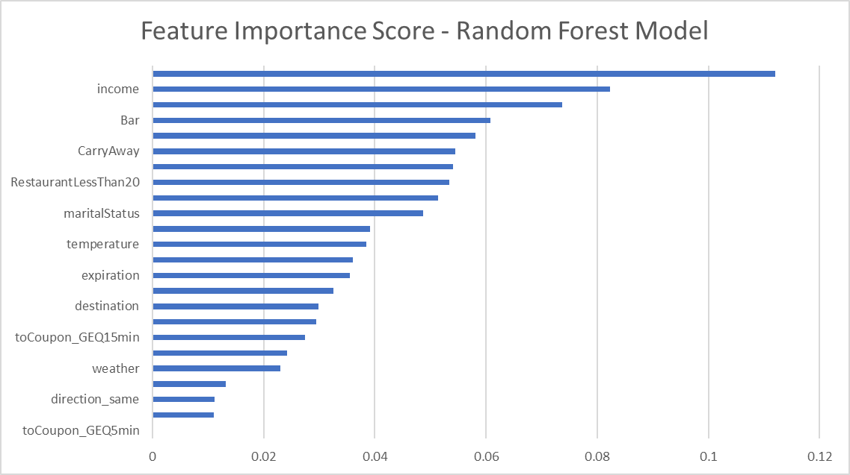

Slide 20
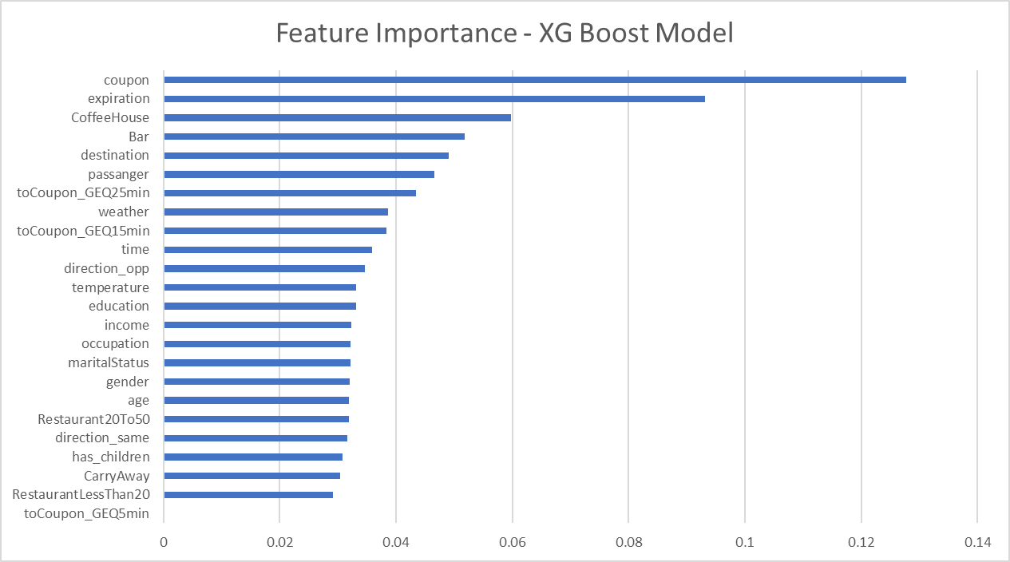

Slide 21
Classification Model
KNN Model -
The default parameter gave accuracy of 64%
Hyper Parameter tuning gave accuracy of 65%
We leveraged greed based cross validation to identify best hyper parameter from below hyper-parameters
Grid Based Algorithm
KNN_hyper = {
'n_neighbors': [1, 2, 3, 4, 5, 6, 7, 8, 9, 10, 11, 12, 13, 14, 15, 16, 17, 18, 19, 20, 21, 22, 23, 24, 25, 26, 27, 28, 29, 30],
'algorithm': ['auto', 'ball_tree', 'kd_tree', 'brute']
}
Result:
N_neighbour: 29
Algorithm: Ball Tree

Slide 22
Classification Model
Random Forest Model -
The default parameter gave accuracy of 72%
Hyper Parameter tuning gave accuracy of 74%
We leveraged greed based cross validation to identify best hyper parameter from below hyper-parameters
Grid Based Algorithm
rf_hyper = {'bootstrap': [True, False],
'max_depth': [6, 10, None],
'max_features': ['auto', 'sqrt',None],
'n_estimators': [200, 400, 600, 800, 1000, 1200, 1400, 1600, 1800, 2000] }
Result:
Bootstrap: True
Max Depth: 6
Max Feature: Auto
N Estimator: 200

Slide 23
Classification Model
XG-Boost Model -
Default parameter gave accuracy of 74.42%
Hyper Parameter tuning gave accuracy of 76.47%
We leveraged greed based cross validation to identify best hyper parameter from below hyper-parameters
XGBoost_hyper = {
'booster': ['gbtree', 'gblinear', 'dart'],
'learning_rate': [0.01, 0.03, 0.1, 0.3],
'max_depth': [6, 10, None],
'colsample_bytree':[0.03, 0.5, 1],
'objective': ['reg:logistic', 'binary:logistic'],
'eval_metric': ['auc', None],
'n_estimators': [100, 200, 400, 600, 800, 1000, 1200, 1400, 1600, 1800, 2000] }
Result:
Bootster: GBTree | Learnign rate: 0.01 | Max Depth: 6 | Col Sample by Tree: 0.5
Objective: Regression Logistic | Eval Metric: AUC | N Estimator: 1800

Slide 24
Conclusion
XG-Boost is giving the best performance of 76.47%
Top 10 features give 90-95% of our overall performance
XGBoost is an optimized distributed gradient boosting library designed to be highly efficient, flexible and portable. It implements machine learning algorithms under the Gradient Boosting framework. XGBoost provides a parallel tree boosting (also known as GBDT, GBM) that solve many data science problems in a fast and accurate way.
On further hyper tuning, the accuracy was decreasing

Slide 25
Thank you!
Any questions?
You can find us at:
data-muncher_16_17april@googlegroups.com

