Slide 1
Business Intelligence System
Prachi Sablani

Slide 2
TABLE OF CONTENTS
01
04
05
02
03
06
Extract, Transform, Load
Introduction
Approach
Data Analysis and Visualization
Conclusion
Data Modeling

Slide 3
INTRODUCTION

Slide 4
INTRODUCTION
Objective:
To build an end-to-end Business Intelligence System for a manufacturing company that helps in analyzing data and presenting actionable information which helps executives, managers and other corporate end users make informed business decisions
Background Information:
The company manufactures and sells products to make money
The products are sold either directly to customers or to resellers
Each product has a retail price, a wholesale price and a cost price
The products are grouped into product categories and types
These product sales happen through different channels - physical stores, online

Slide 5
SYSTEM ARCHITECTURE

Slide 6
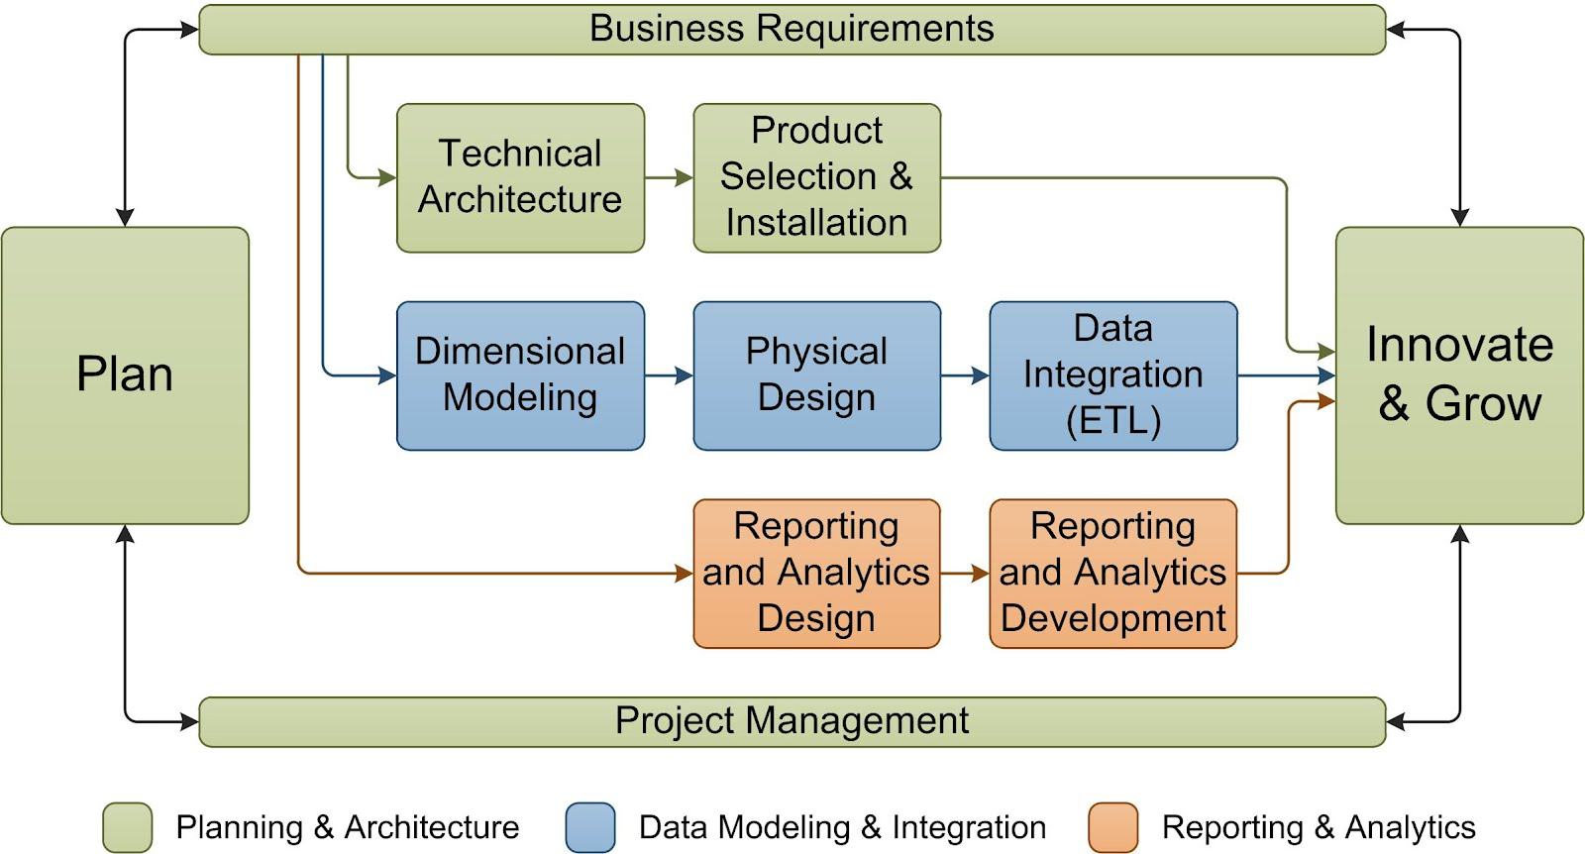
SYSTEM ARCHITECTURE
AZ
AZ
AZ

Slide 7





TOOLS & TECHNOLOGIES USED
Microsoft Excel
Microsoft Visio Professional
SQL Server Management Studio
Tableau
SQL Server Integration Services

Slide 8
APPROACH

Slide 9
APPROACH
Data Analysis & Visualization
Physical Design
Dimensional Modeling
Data Integration (ETL)

Slide 10
DATA MODLEING

Slide 11
DIMENSIONAL DATA MODEL
Dimensions:
Store
Customer
Reseller
Product
Channel
Location
Date

Slide 12
EXTRACT TRANSFORM LOAD

Slide 13
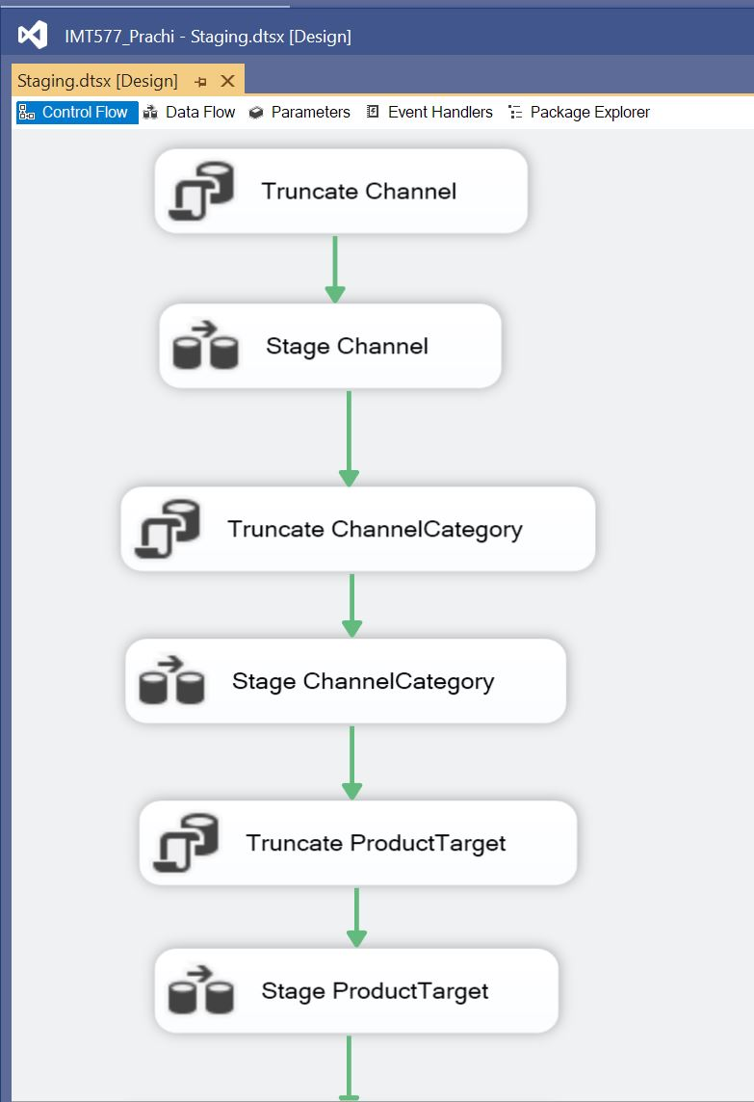
STAGING
A temporary storage area between the data sources and a data warehouse
Used to extract data from multiple data sources
Data transformations, validations, cleansing
Data is transformed into a star schema prior to loading a data warehouse

Slide 14
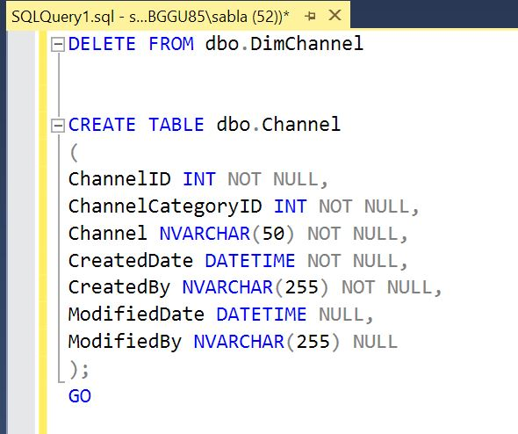
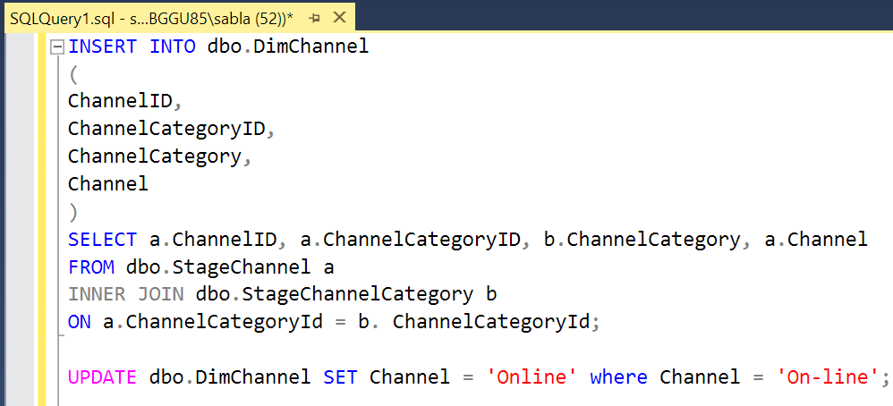
CODE SNIPPETS

Slide 15
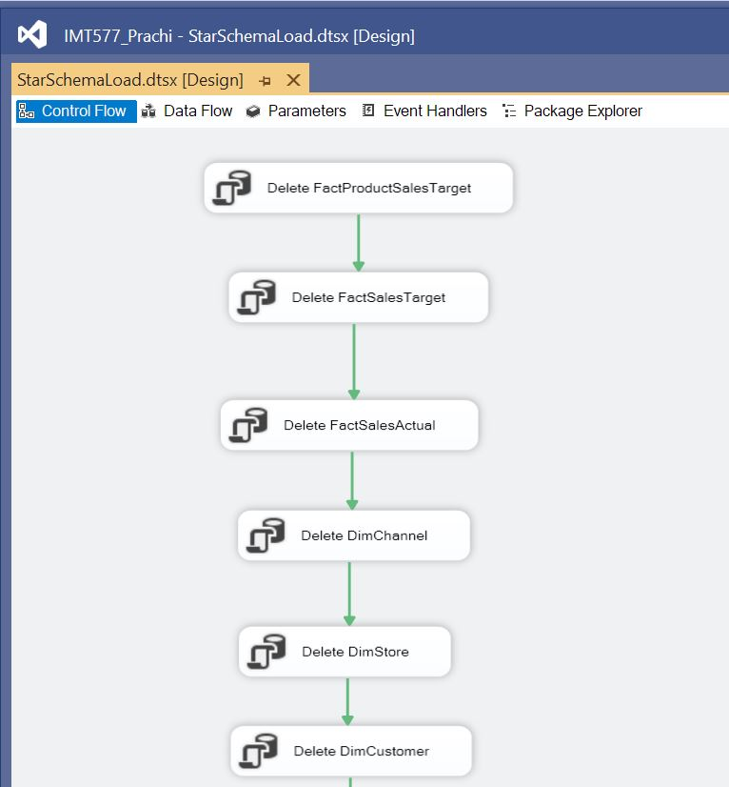
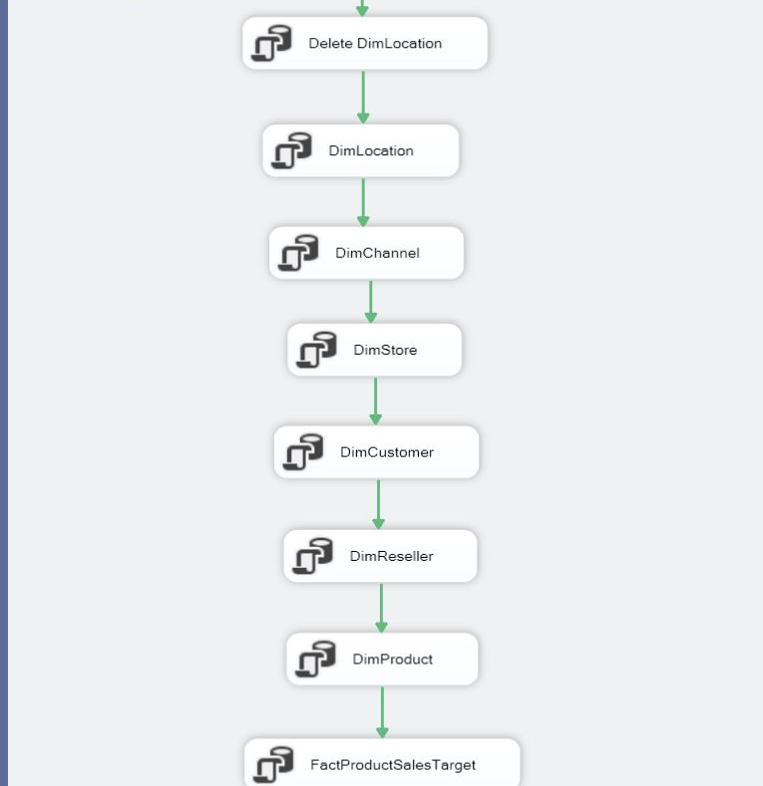
STAR SCHEMA LOAD

Slide 16
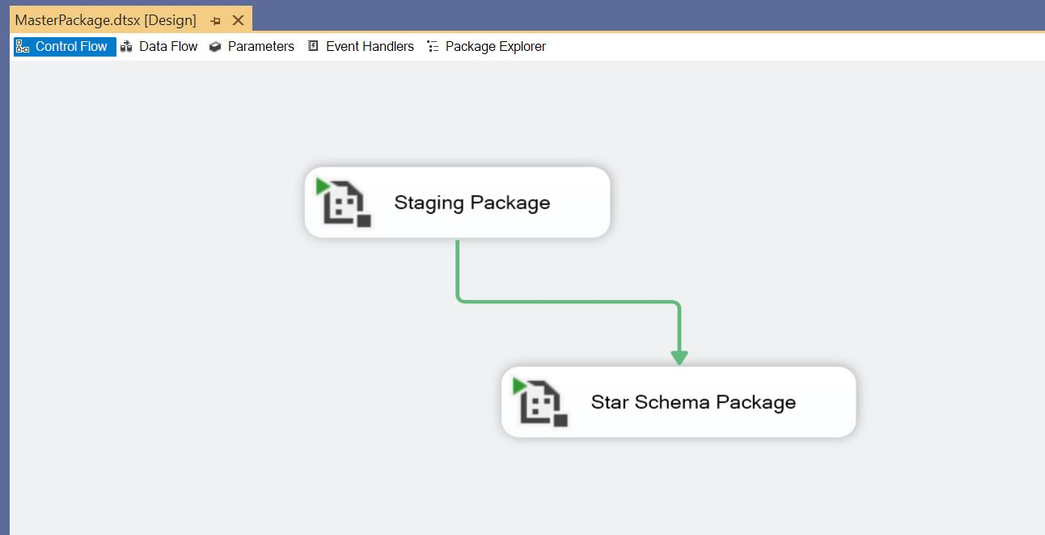
EXTRACT, TRANSFORM, LOAD (ETL)

Slide 17
DATA ANALYSIS AND VISUALIZATION

Slide 18
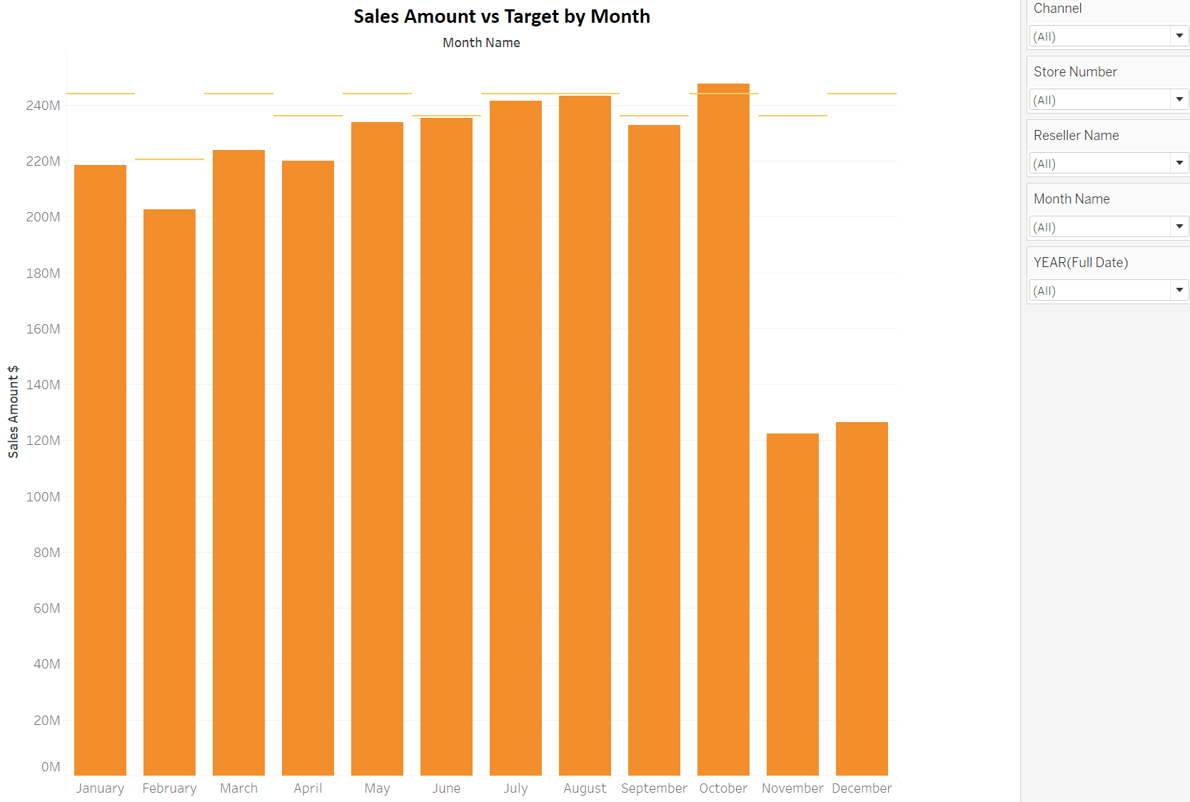

Slide 19
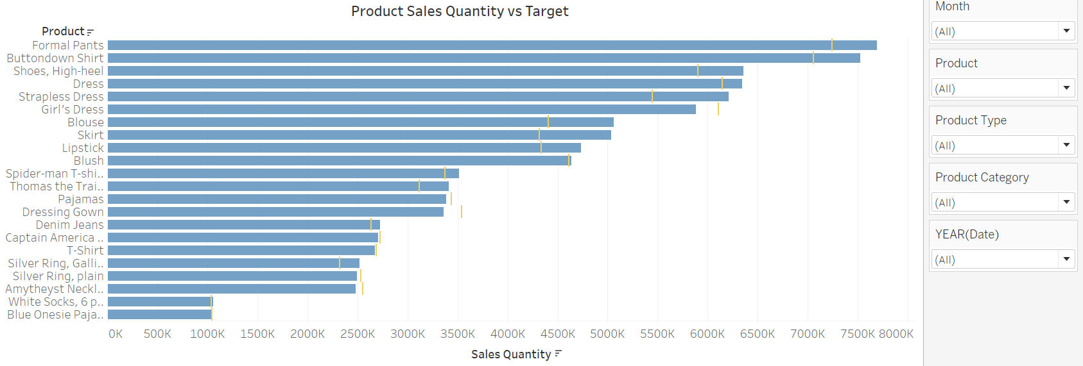

Slide 20
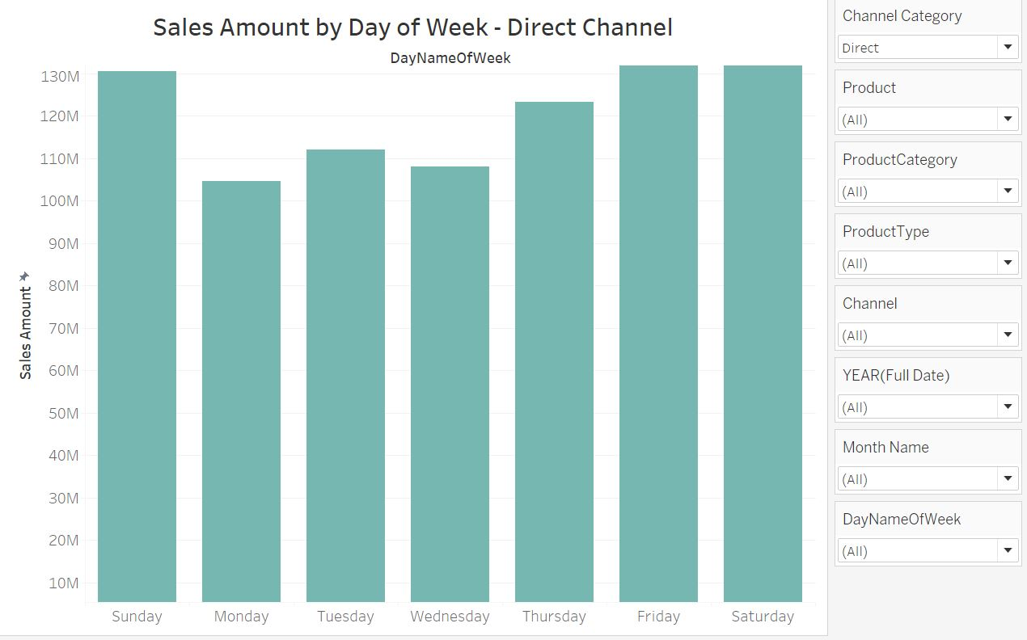
Product sales by day of the week for the Direct Channel
Observation:
Weekends has the highest sales
Recommendation:
To increase the sales on weekdays, the stores can have a sale specifically for weekdays.

Slide 21
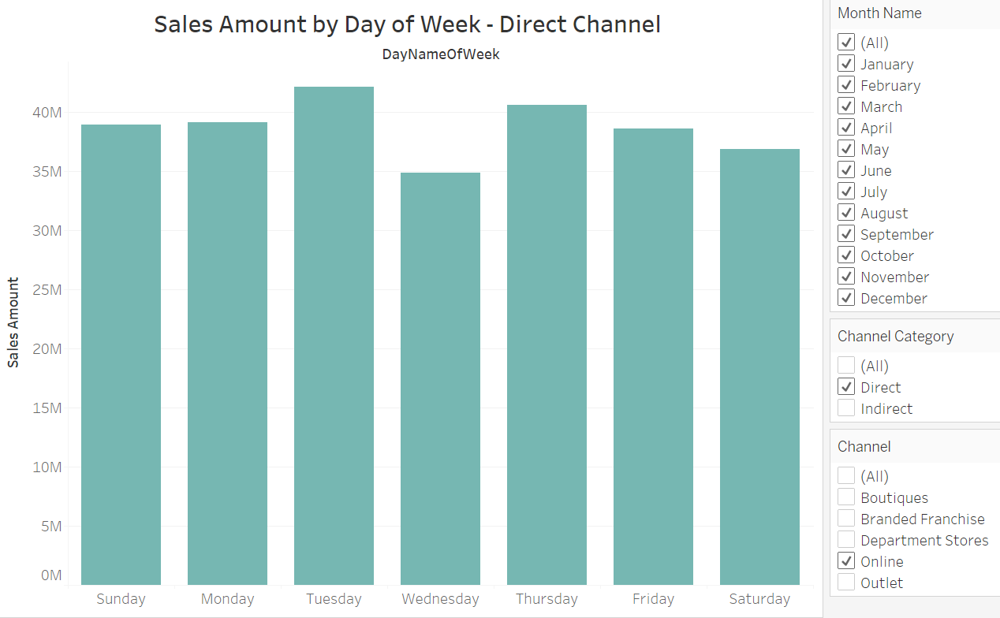
Product sales by day of the week for the Direct Channel
Observation:
For online sales, we can see maximum sale on weekdays

Slide 22
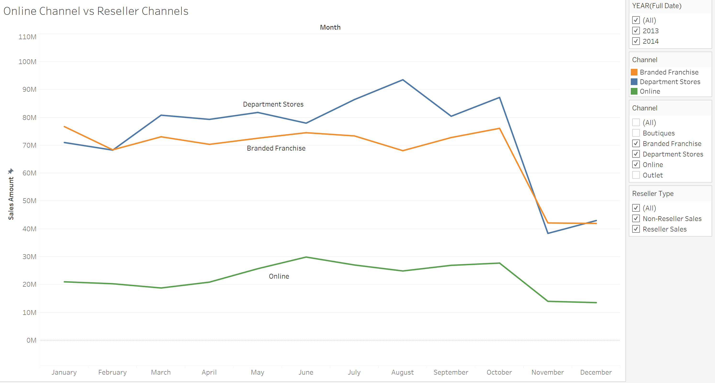
Are the Online channel sales a threat to the reseller market share?
Recommendations:
Exclusive, in-demand products available online at a discount.
A 30-day return policy/same day shipping
Provide accurate description of products (Measurements and pictures help)

Slide 23
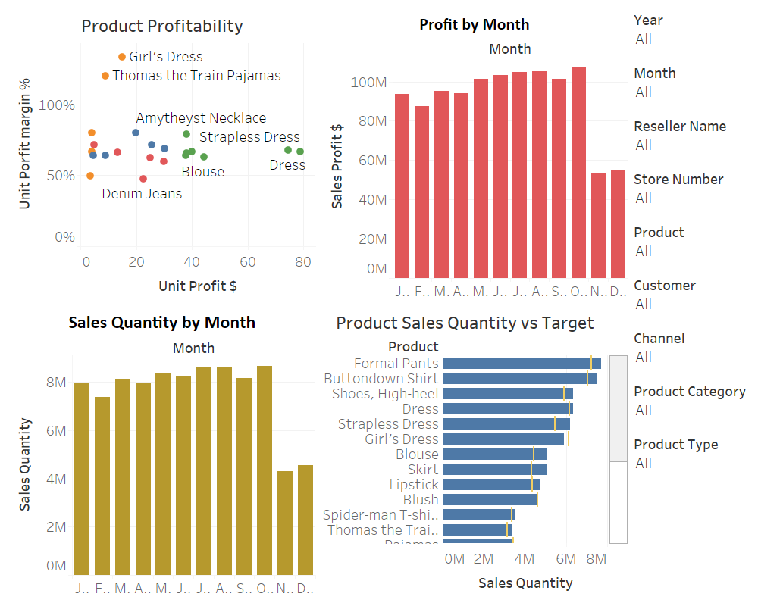

Slide 24
CONCLUSION

Slide 25

THANK YOU ☺
QUESTIONS?

