Slide 1
IBM University Engagement Project Submission
“Exploring the Power of Agentic AI with IBM Granite and LangFlow”

Slide 2

Project Tile – [Fitness Buddy]
Domain of Project – [ Fitness and Wellness]
Student Name | Recent Passport Photo | Email ID | Mobile number [WhatsApp]
Prachi Shirsath |  | 23030331245042@dbatu.ac.in | 7276512812

Slide 3
Problem Statement -
Problem Statement : Fitness Buddy
The Challenge
In today's fast-paced world, many individuals struggle to maintain a healthy lifestyle due to a lack of personalized guidance, time constraints, and inconsistent motivation. Traditional fitness solutions often require expensive subscriptions, in-person consultations, or rigid schedules that do not adapt to personal preferences or daily routines.
There is a growing need for an accessible, friendly, and intelligent virtual assistant that provides personalized fitness advice, healthy lifestyle suggestions, and basic nutrition guidance anytime.
The Objective
To develop an AI-powered Fitness Buddy that acts as a personalized virtual fitness coach. The system will:
Personalized Workout Plans: Recommend home workouts based on age, fitness level, goals, available time, and equipment.
Smart Nutrition Guidance: Suggest simple, nutritious meals according to dietary preferences and fitness goals.
Daily Motivation: Provide motivational messages, fitness tips, and encouragement.
Progress Dashboard: Display weekly workout completion, activity trends, and fitness goals.

Slide 4
Proposed Solution: AI-Powered Personal Fitness Assistant
Fitness Buddy is an AI-powered personal fitness assistant that uses IBM Granite through IBM watsonx.ai to provide personalized fitness, workout, and nutrition guidance. It combines multiple health and fitness features into one easy-to-use platform, helping users maintain a healthy and active lifestyle.
The application offers a single platform where users can:
AI Fitness Coach: Interact with an AI-powered conversational assistant to ask fitness and wellness questions, receive personalized guidance, and get motivational tips.
Personalized Workout Planner: Generate customized home workout plans based on fitness level, fitness goals, available equipment, and preferred workout duration.
Smart Nutrition Planner: Get healthy meal suggestions according to dietary preferences, meal types, and calorie requirements, including ingredients and preparation steps.
Daily Habit Tracker: Create and manage healthy habits, track daily completion, view weekly progress, maintain streaks, and receive AI-generated motivational messages.
Personalized Experience: Use individual fitness goals, preferences, and selected options to receive more relevant workout and nutrition recommendations.

Slide 5
Technology Used
Technology | Role in Fitness Buddy
React 18 | Develops the interactive frontend and application pages.
HTML5 and CSS3 | Design and style the user interface.
JavaScript | Implements frontend and backend functionality.
Node.js | Provides the backend runtime environment.
Express.js | Handles API requests and server-side operations.
IBM Granite 4 | Generates conversational fitness and nutrition responses.
IBM watsonx.ai | Provides access to the IBM Granite foundation model.
IBM watsonx.ai SDK | Connects the Node.js backend to the AI model.
Axios | Sends HTTP requests from frontend to backend.
React Markdown | Displays AI-generated responses in formatted text.
Browser Local Storage | Stores habit-tracking information locally.
IBM Technology Integration
IBM Granite model: ibm/granite-4-h-small
IBM watsonx.ai service URL: https://us-south.ml.cloud.ibm.com
Authentication: IBM IAM API key.
Model access: watsonx.ai Project ID.
Backend SDK: @ibm-cloud/watsonx-ai.

Slide 6
Actual component Used -
Component | Implementation | Purpose
User Interface | React 18 | Provides the application interface.
Chat Component | ChatPage.js | Accepts user messages and displays AI responses.
Workout Component | WorkoutPage.js | Collects workout preferences and displays generated plans.
Nutrition Component | NutritionPage.js | Collects meal preferences and displays meal suggestions.
Habit Component | HabitsPage.js | Tracks daily habits and displays progress.
Navigation Component | Sidebar.js | Provides navigation and user profile settings.
API Layer | Express.js | Processes requests from the frontend.
AI Model Integration | watsonx.ai SDK | Sends prompts to IBM Granite.
Local Storage | Browser Local Storage | Saves habit data.

Slide 7
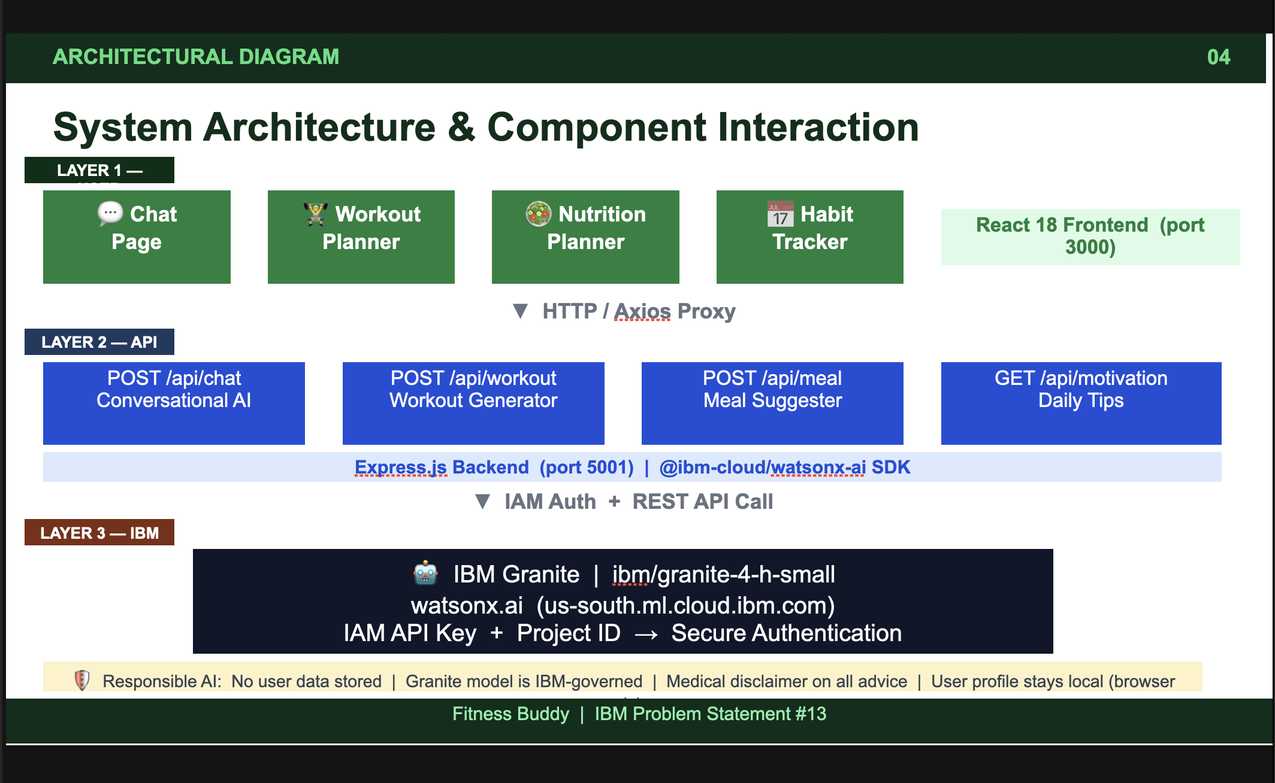
Architecture blueprint

Slide 8
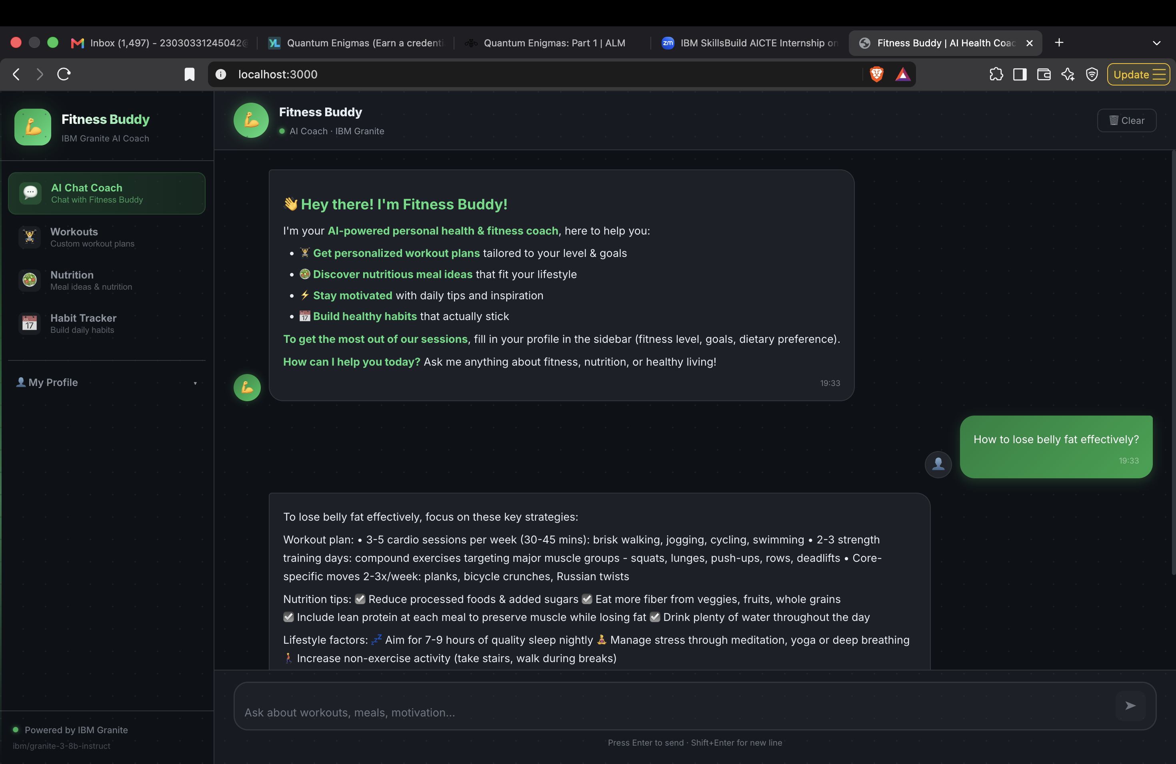

Slide 9
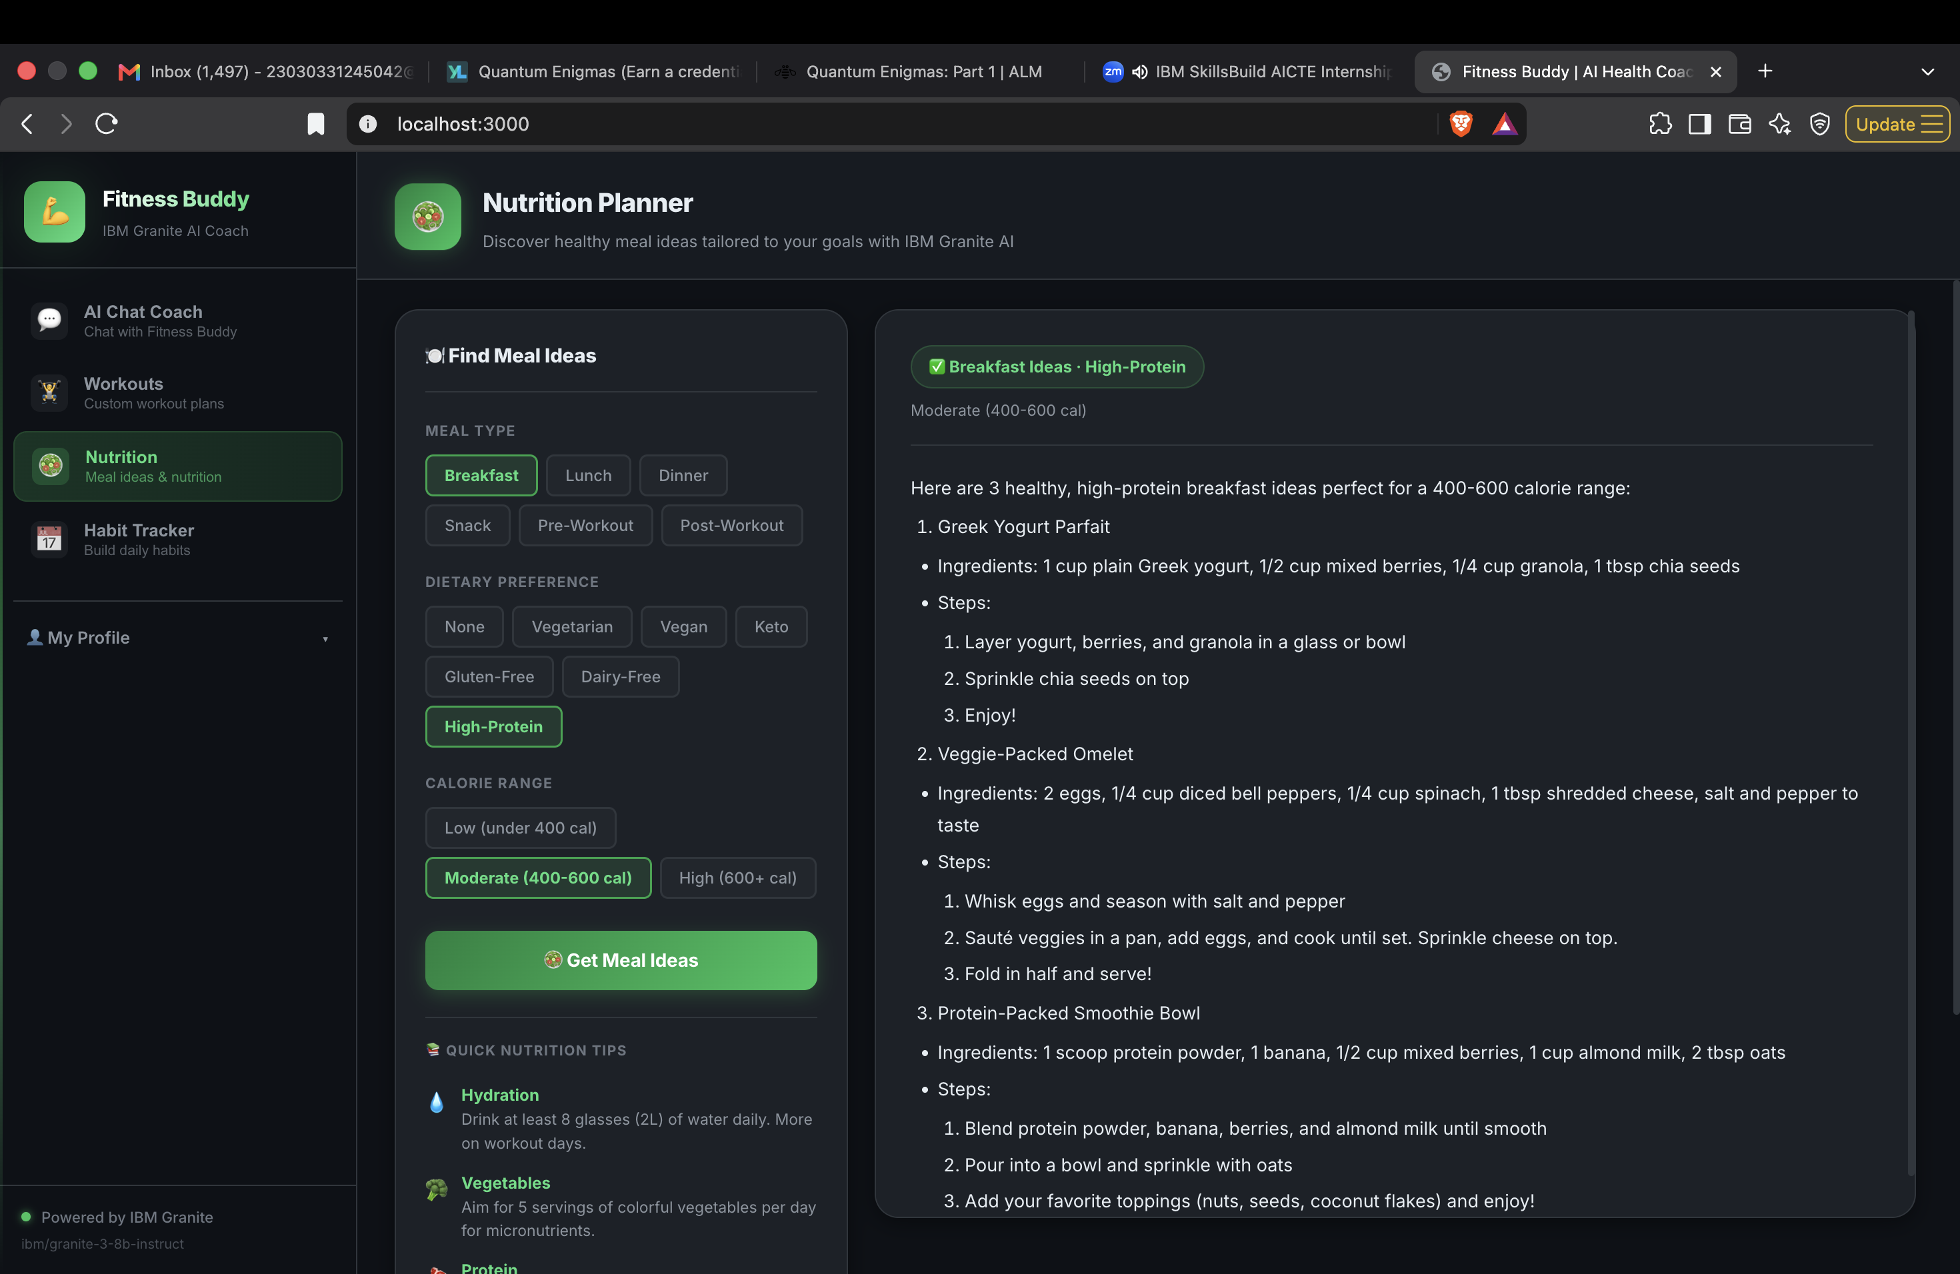

Slide 10
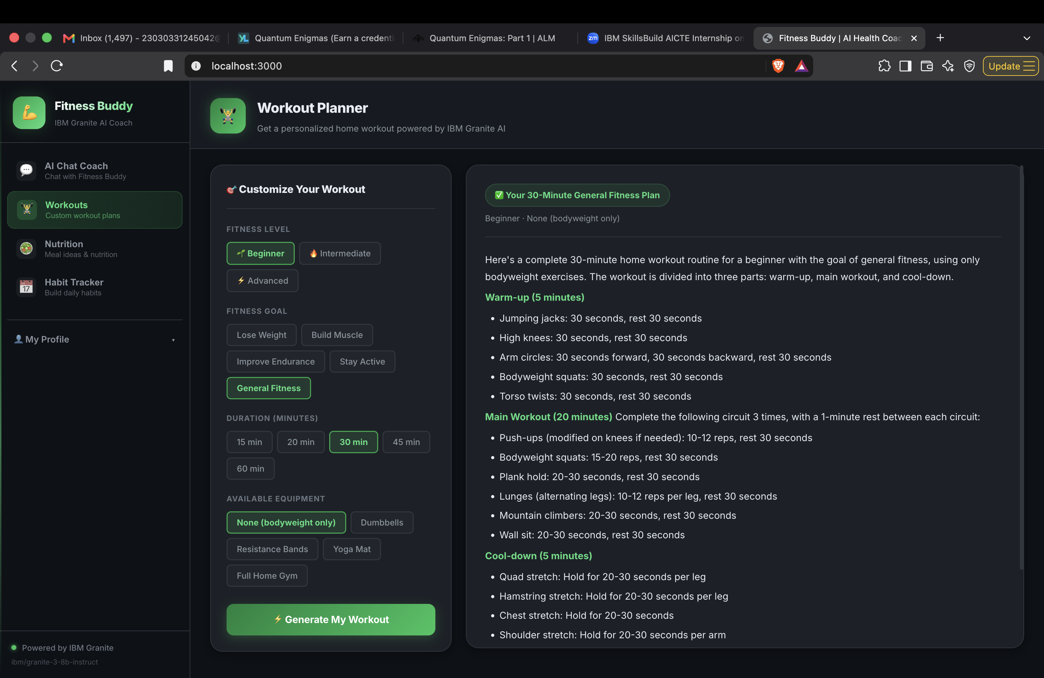

Slide 11
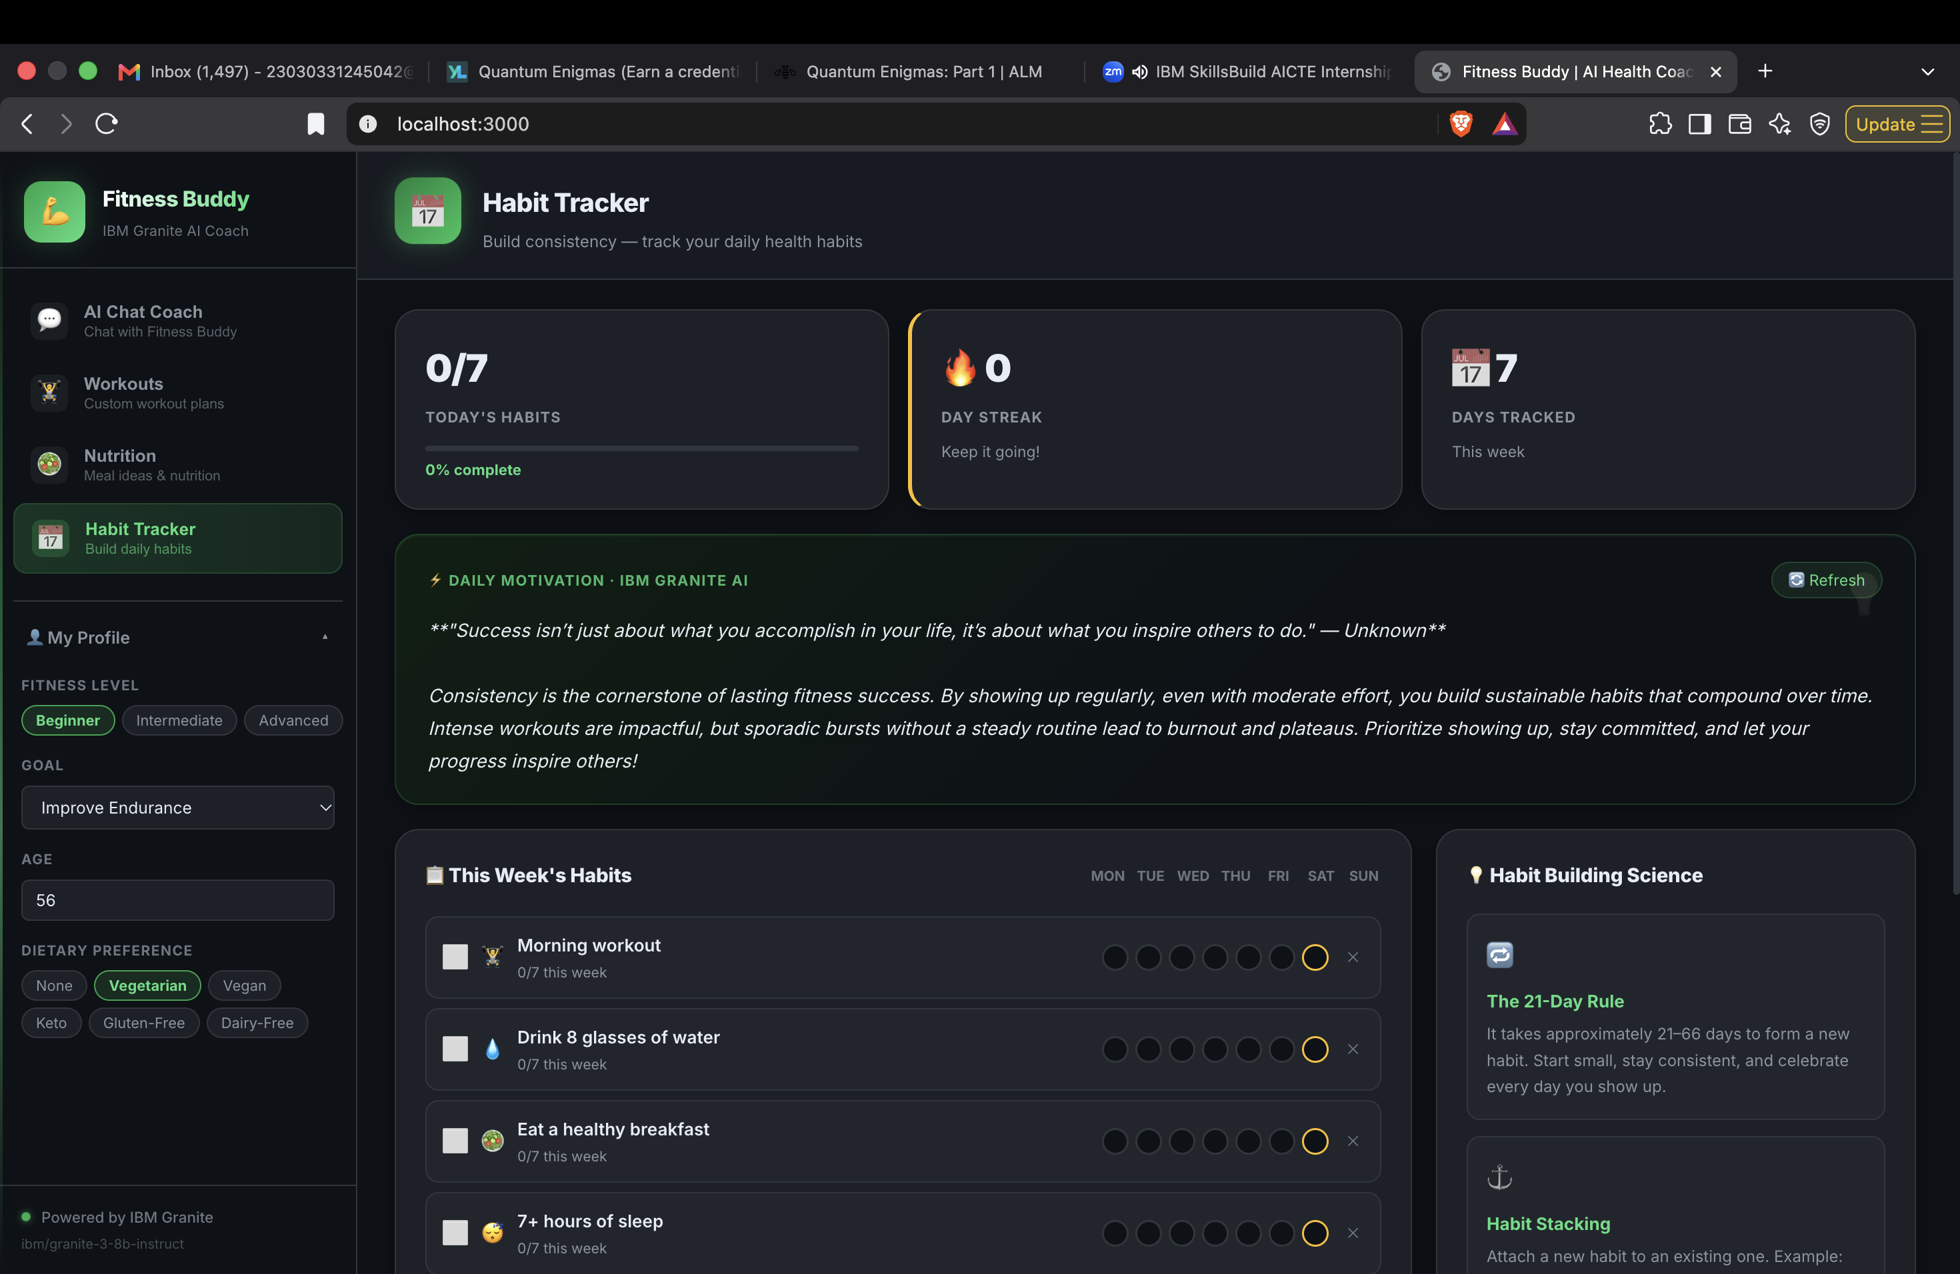

Slide 12

Role of Agentic AI in the solution
Role of AI in Fitness Buddy
Fitness Buddy uses IBM Granite as a conversational AI model to understand fitness-related questions and generate relevant responses.
AI Functionalities
Context Understanding: The backend includes user profile information such as fitness level, goal, age, and dietary preference in chat prompts.
Conversational Interaction: The application maintains recent conversation history to support multi-turn interactions.
Workout Generation: IBM Granite generates routines based on duration, fitness level, goal, and equipment.
Nutrition Recommendations: The model suggests meal ideas according to meal type, dietary preference, and calorie range.
Motivational Assistance: The application requests AI-generated motivational messages and habit-building tips.
How Agentic AI Can Enhance the System in the Future
A Fitness Agent could coordinate workout-related tasks.
A Nutrition Agent could manage dietary recommendations.
A Habit Coach Agent could analyze progress and suggest improvements.
A Personalization Agent could coordinate user preferences across modules.

Slide 13
Novelty and Uniqueness
What Makes Fitness Buddy Different?
Four-in-One Platform: Combines AI chat, workout planning, nutrition guidance, and habit tracking.
Conversational Fitness Assistance: Users can ask questions naturally instead of following fixed instructions.
Flexible Workout Generation: Supports three fitness levels, five workout durations, multiple goals, and different equipment options.
Dietary Personalization: Generates meal suggestions according to meal type, dietary preference, and calorie range.
Habit Customization: Users can add and remove their own daily health habits.
Weekly Progress Visualization: Displays completion percentages, weekly tracking, and streak information.
AI-Generated Motivation: Uses IBM Granite to provide personalized motivational and habit-building messages.
Accessible Home Fitness: Provides workout suggestions that can be performed with or without equipment.

Slide 14
Git Hub Link
https://github.com/PrachiShirsath/fitness-Buddyy.git

Slide 15
Future Scope
1. Voice-Based Fitness Assistant
Allow users to interact with Fitness Buddy using voice commands.
2. Multilingual Support
Provide fitness guidance in Marathi, Hindi, and other regional languages.
3. Wearable Device Integration
Connect smartwatches and fitness bands to collect activity and sleep information.
4. Progress Analytics
Add charts and reports to visualize weekly and monthly fitness progress.
5. Advanced AI Personalization
Use user feedback and activity history to improve workout and nutrition suggestions.
6. Food Image Recognition
Allow users to upload meal images and receive AI-generated food information.
7. Smart Reminders
Provide reminders for workouts, hydration, meals, and sleep routines.
·
·
·

Slide 16
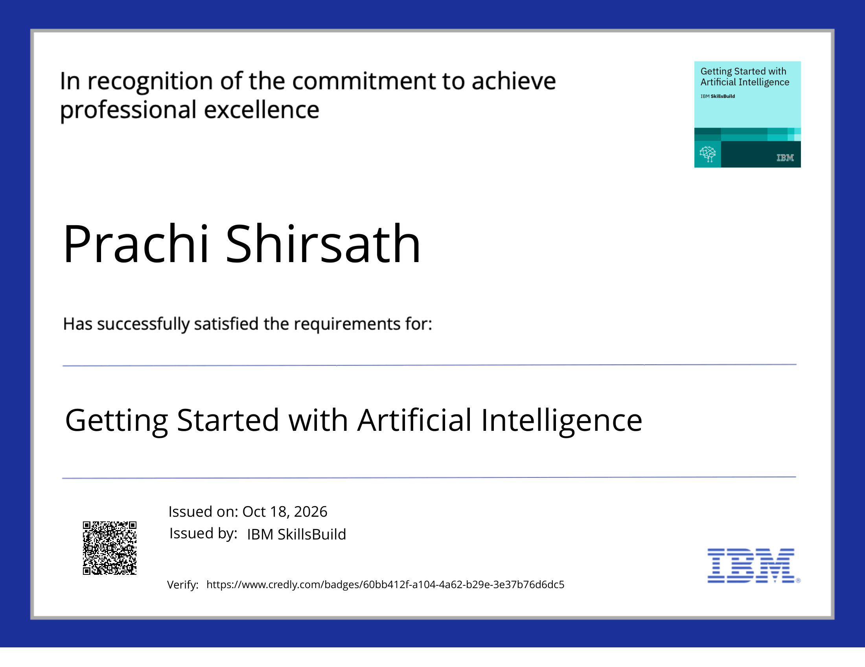
Certificates Earned:
Please add your credly certificate

Slide 17
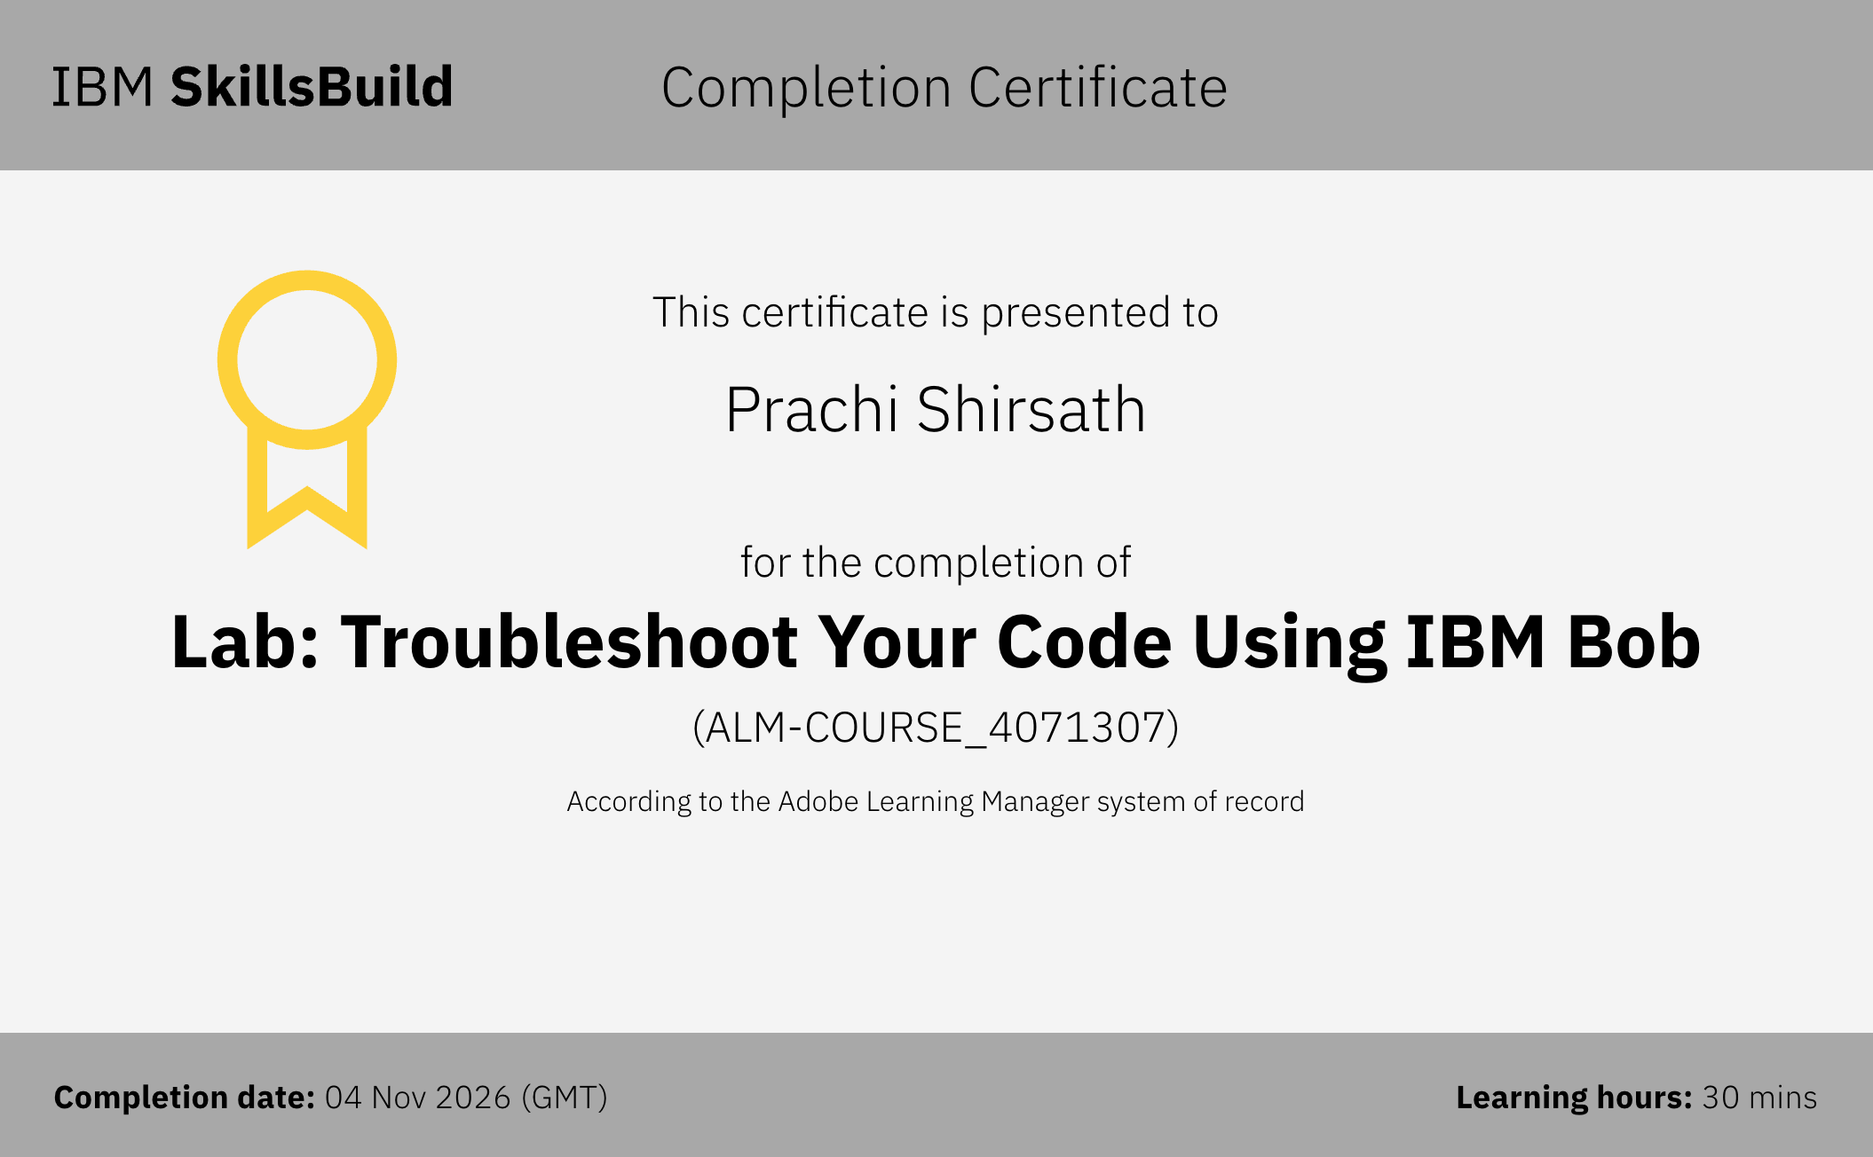
Certificates Earned:​
Add your IBM BOB Certificate

Slide 18


