Slide 1

Project Title - Seasonal Agriculture Performance Analysis
[Prachi Choudhary] [Meerut Institute of Engineering and Technology]
AICTE STU ID : [STU6a644531ce22b1784956209]

Slide 2

PROBLEM STATEMENT
Agricultural activities are influenced by seasonal variations in environmental conditions, farming practices, resource availability and market conditions. As a result, agricultural performance may differ from one season to another. However, raw agricultural data does not clearly explain how agricultural performance changes across seasons or what patterns can be observed in different seasonal conditions. The problem is to analyze the given agricultural dataset and investigate seasonal differences in agricultural performance by identifying meaningful patterns, trends, relationships and variations within the available data.
(

Slide 3
Project Description
The dataset represents agricultural activities carried out across different seasons, geographical areas and farming conditions. It contains information related to farming practices, environmental conditions, crop production, resource usage and economic performance.
• Understand how agricultural performance changes across seasons.
• Clean and prepare the data before analysis.
• Compare yield, production, resource usage and economic performance.
• Identify meaningful patterns and relationships from the available data.
• Give evidence-based insights and recommendations.

Slide 4

WHO ARE THE END USERS?
• Farmers – understand seasonal and crop-level performance.
• Agriculture officers – support agricultural planning.
• Researchers and students – study agricultural patterns.
• Agribusinesses – compare production and profitability.
• Policy planners – use evidence for further planning.

Slide 5

Technology Used
• Python
• Google Colab
• Pandas
• NumPy
• Matplotlib
• Seaborn
• CSV dataset

Slide 6
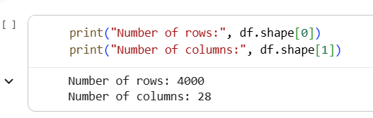
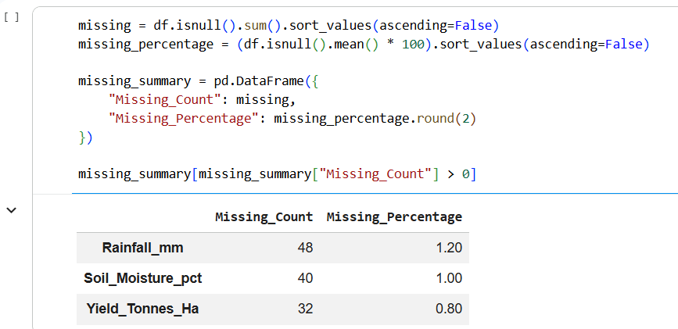
RESULTS – DATA UNDERSTANDING & CLEANING
• Dataset contains 4,000 rows and 28 columns.
• Missing values were found in Rainfall, Soil Moisture and Yield.
• 48 rainfall, 40 soil-moisture and 32 yield values were missing.

Slide 7
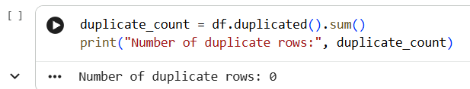
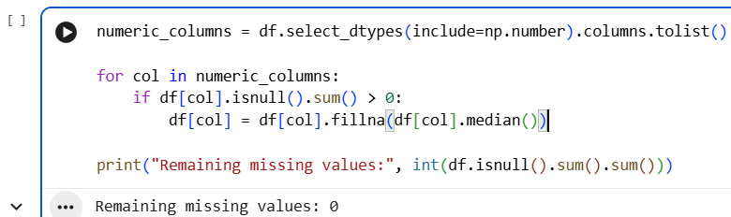
RESULTS – DATA UNDERSTANDING & CLEANING
No duplicate records were found.
Missing numerical values were handled using median imputation.

Slide 8
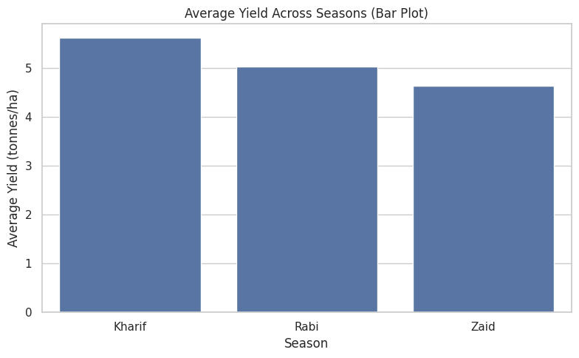
RESULTS – SEASONAL PERFORMANCE
[Add screen shots of your code ]
• Kharif had the highest average yield: 5.63 tonnes/ha.
• Rabi had an average yield of 5.04 tonnes/ha.
• Zaid had the lowest average yield: 4.64 tonnes/ha.
• Kharif had the highest average profit: about ₹178,915 per record.
• Zaid had a negative average profit of about ₹24,805 per record.

Slide 9
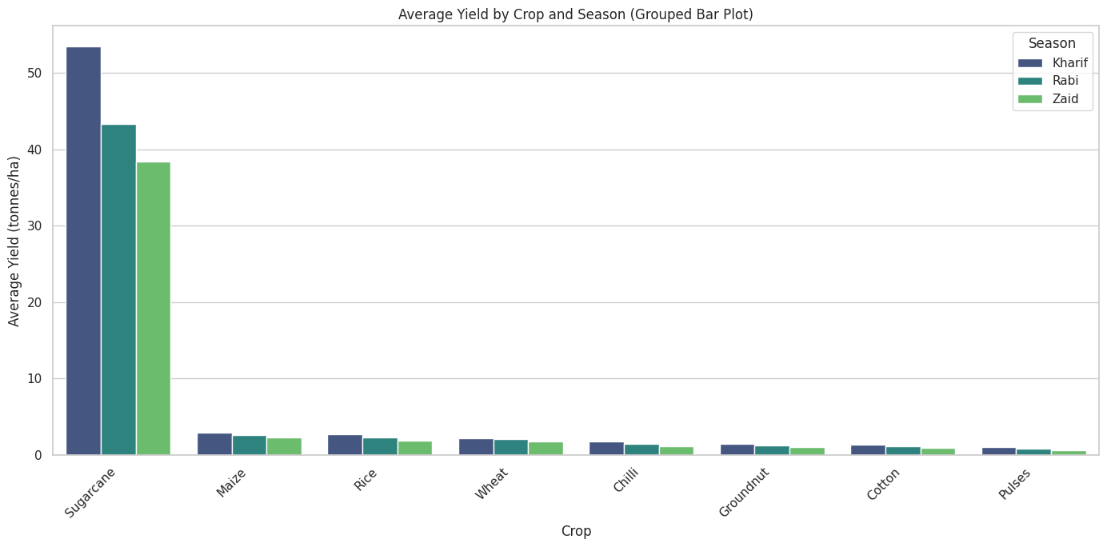
RESULTS – CROP & SEASON COMPARISON
[Add screen shots of your code ]
• Crop performance changes across seasons.
• Sugarcane showed substantially higher yield than the other crops in the available results.
• Kharif sugarcane had an average yield of about 53.46 tonnes/ha.
• Profitability also differed between crop-season combinations.
• Season and crop together provide a clearer view than looking at crop averages alone.

Slide 10
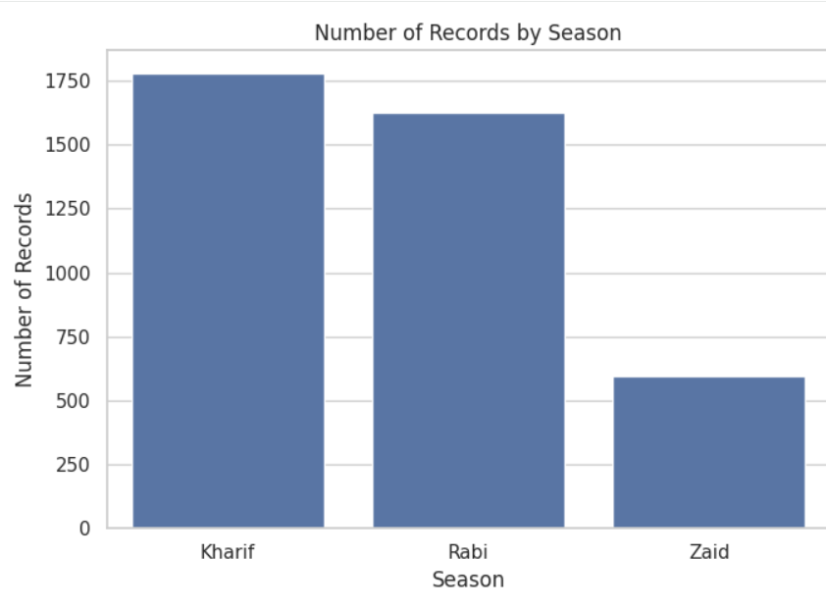
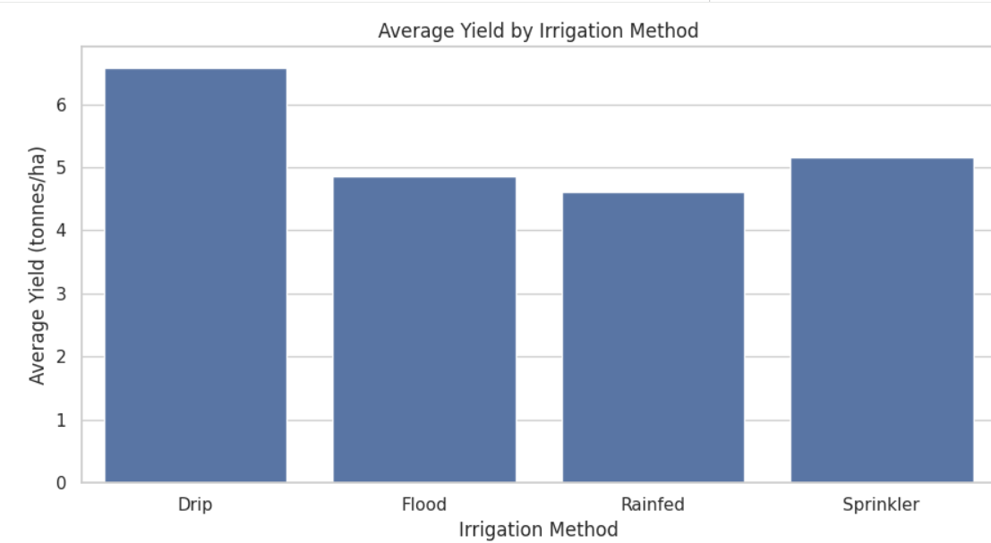
RESULTS – ADDITIONAL ANALYSIS & INSIGHTS
[Add screen shots of your code ]
• Univariate analysis was used to understand individual variables.
• Bivariate analysis compared rainfall vs yield and farm area vs production.
• Multivariate analysis considered several factors together.
• Correlation analysis identified relationships among numerical variables.
• Irrigation methods were compared using yield, water usage and water efficiency.
• Disease/pest risk groups were compared with yield and profit.
• These analyses supported evidence-based insights and recommendations.

Slide 11
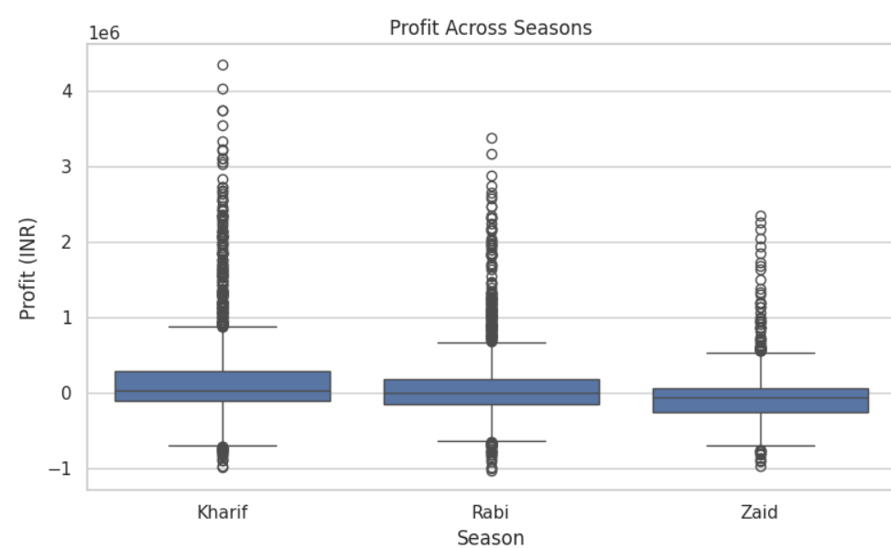
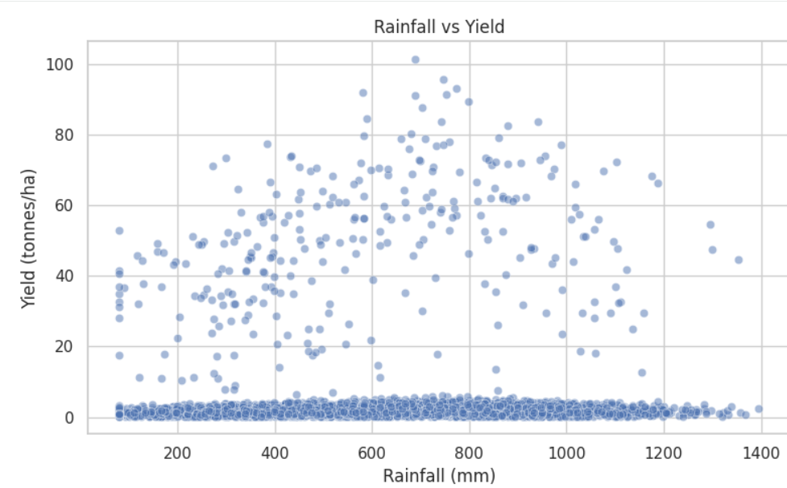
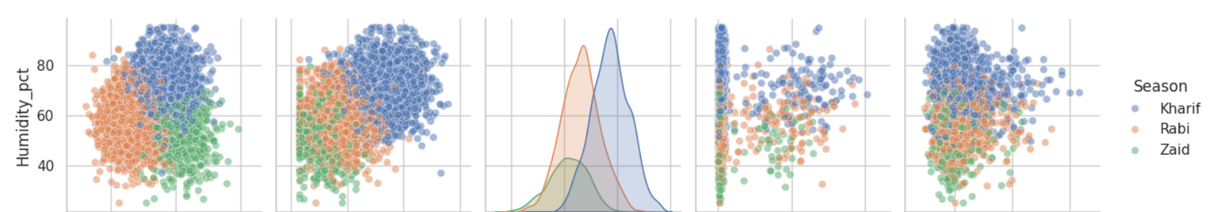
RESULTS
[Add screen shots of your code ]

Slide 12
Future Scope
• Build an interactive Power BI dashboard using the cleaned dataset.
• Add more years of data for long-term seasonal trends.
• Use machine learning for future crop-yield or profit prediction.
• Combine weather and market-price information.
• Develop region-specific recommendations for crop and irrigation planning.

Slide 13
GitHub Link
Project repository:
https://github.com/Prachichoudhary28/Seasonal-Agriculture-Performance-Analysis

Slide 14
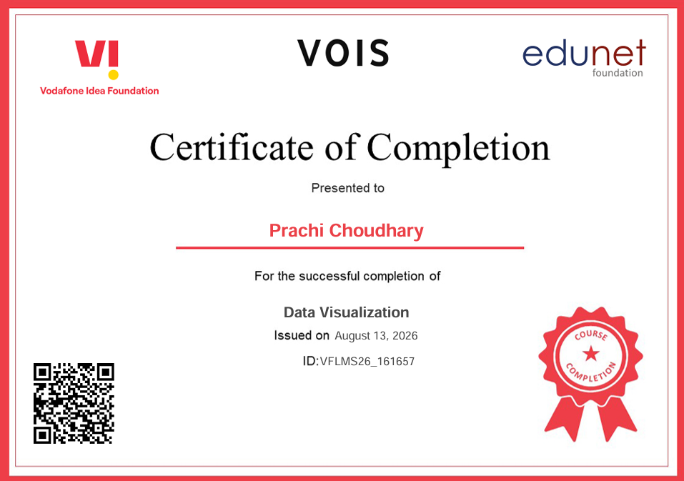
VOIS Course Completion Certificate Course name - Data Visualization

Slide 15
Thank you
Seasonal Agriculture Performance Analysis

