Slide 1
Session | 2024-25(ODD)
Course Name | Web Technology Lab
Semester | 4
Course Code | 23CT1301
Roll No. | 16(Reg no.-24071042)
Student Name | Prachi Chandrashekhar Dhobale

Slide 2
Practical Number | 4
Course Outcome | 1.Understand the various internet technologies . 2.Design a webpage using HTML and CSS. 3.Implemented XML technology to story data. 4.Develop the interactive web pages using Javascript.
Aim | Write a program in JSON to store information related to programming books along with edition and author name.
Problem Defination | Design a JSON structure to maintain a list of programming books. Each book entry should contain the title of the book, the author's name, and the edition. The format should allow storage of multiple book records in an organized and readable manner. This JSON data can be used in applications like online libraries or book inventory systems.
Theory | JSON (JavaScript Object Notation) is a lightweight data format used to store and exchange data. It is easy to read and write for humans and simple to parse for machines. In this practical, JSON is used to store information about programming books. Each book includes details like the title, author's name, and edition. Using JSON makes it easier to manage and organize book data, especially when working with web-based or software applications that need structured input.

Slide 3
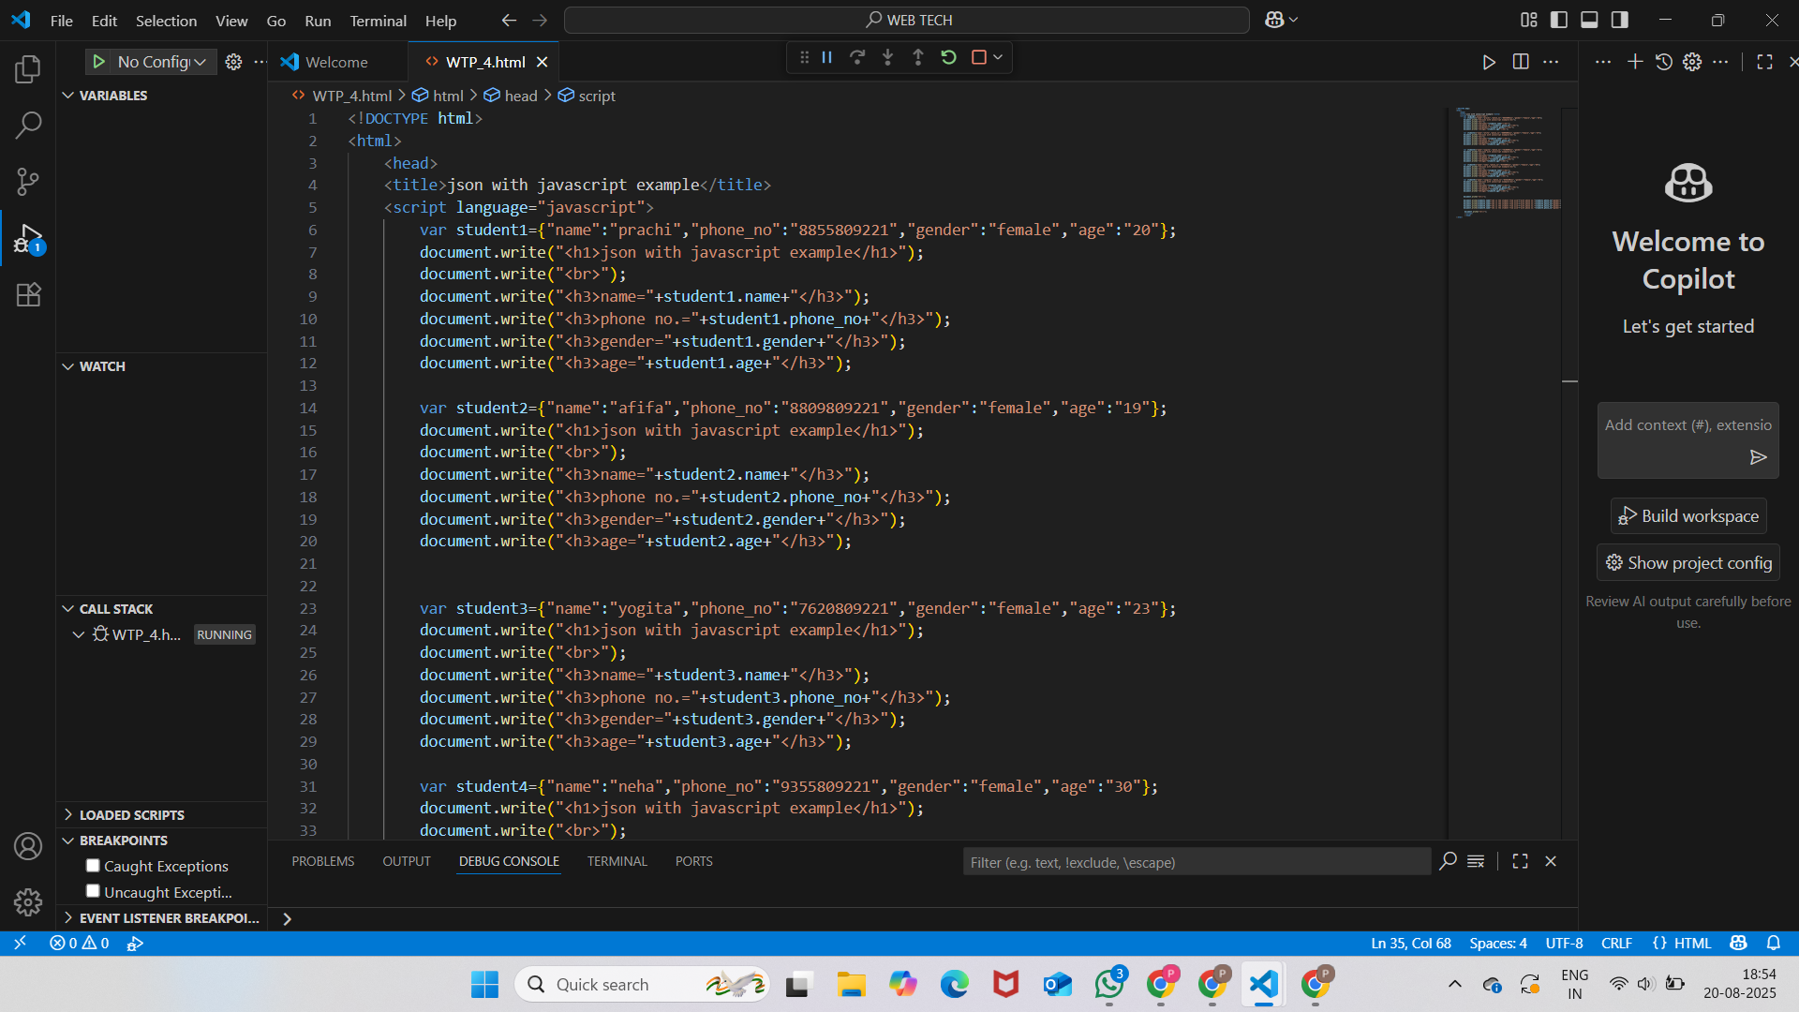
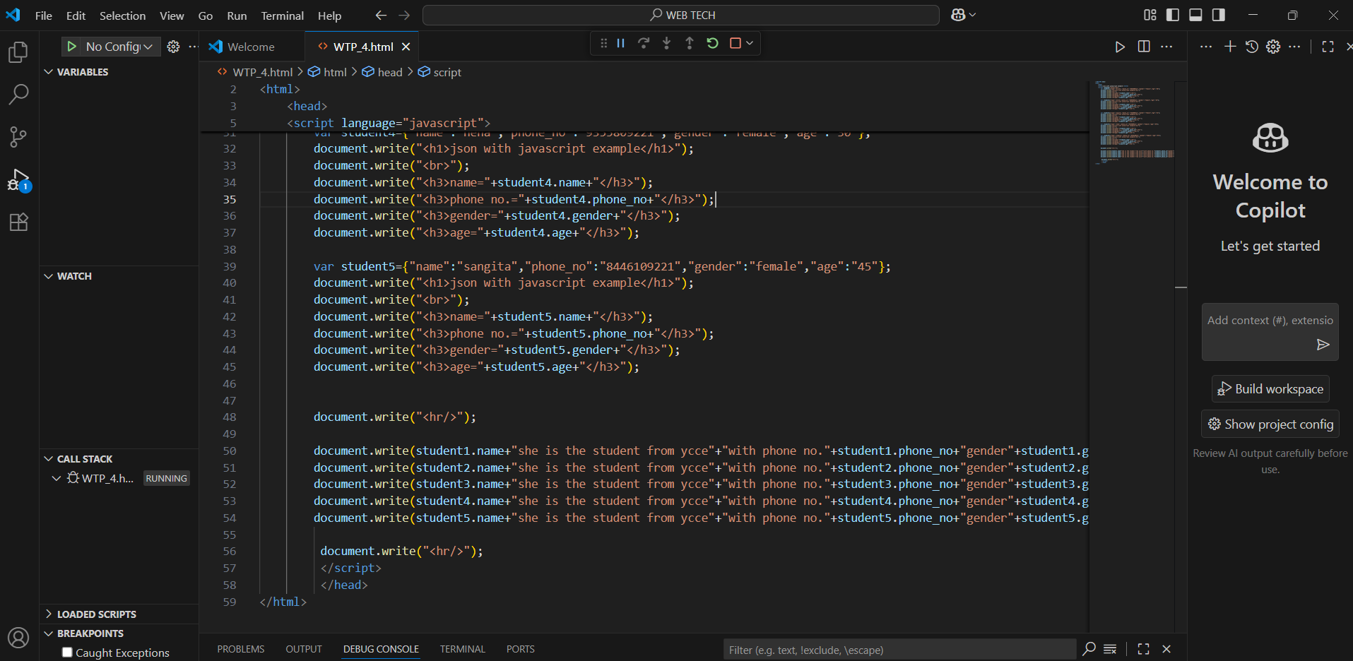
Procedure and Execution | Start by creating the JSON file or the JSON object in your code. Make a list (array) to hold multiple books. For each book, create an object with keys: title, author, and edition. Add each book object to the list. Save or display the final JSON structure. Use this JSON data to access or manage book details when needed.
 | Program-

Slide 4
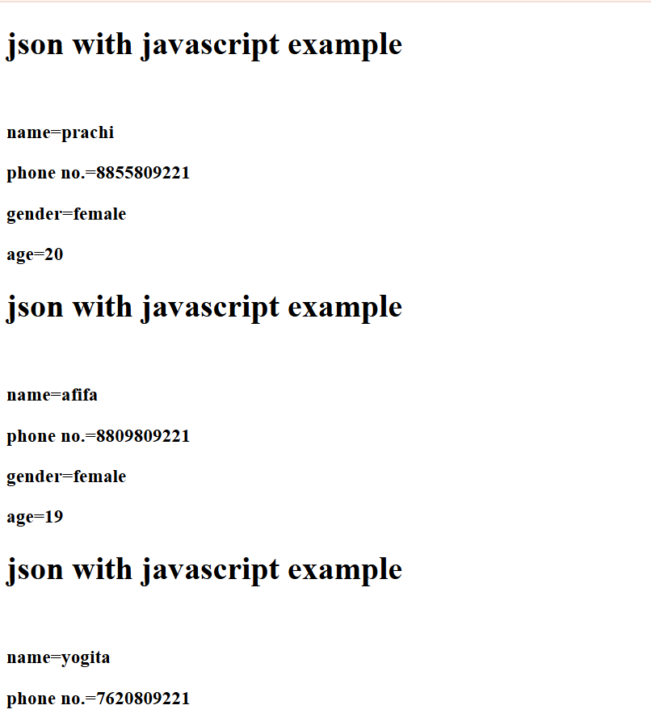
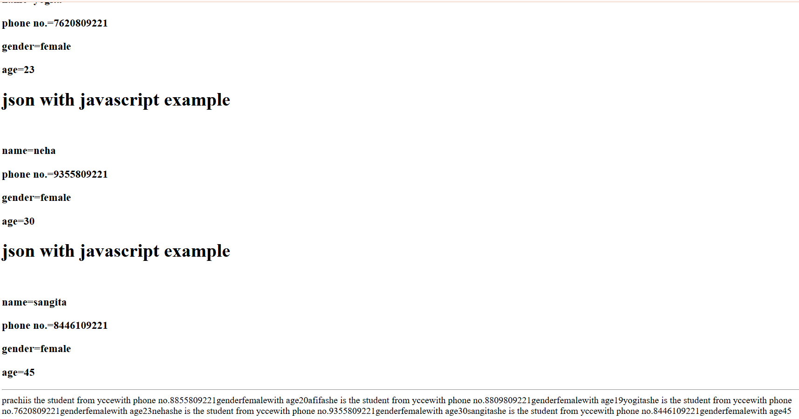
Code- | Output-

Slide 5
Output Analysis | The output of the program is a well-structured JSON format that displays details of programming books. Each book entry shows the title, author name, and edition clearly. The books are stored in an array, making it easy to view multiple records at once. The format is clean and readable, which helps in easily finding or updating book information. This output can be used in applications like digital libraries, book management systems, or APIs. Overall, the JSON output successfully represents the book data in an organized and user-friendly way.
Link of student github profile
Conclusion | JSON helps organize book details in a simple and clear way. It makes storing and accessing information easy. This method is useful for managing programming books efficiently.
Plagarism Report
Date | 22/08/2025

