Slide 1
CODEBASICS VIRTUAL INTERNSHIP
SHIELD
INSURANCE
Data Analytics Dashboard – Business Insights Report
Presented by: Prachi Jha
Tools: Power BI | DAX | Power Query | SQL
April 2026

Slide 2
PROJECT OVERVIEW
01
About Shield Insurance
➢ Shield Insurance delivers tailored and comprehensive insurance solutions that cater to the diverse needs of individuals and families across all age groups.
➢ With an unwavering focus on customer satisfaction, the company has built a strong reputation as a reliable partner in protecting the future.
➢ Recognized for its dependable coverage and customer-first approach, Shield Insurance provides peace of mind and security against life’s uncertainties.
02
Objective
➢ The aim is to enable Shield Insurance to harness the power of a user-friendly, insight-driven dashboard that supports smarter, data-driven decision-making.
➢ As a Data Analyst Intern, my role involves engaging with clients, performing in depth data analysis, and designing intelligent dashboards customized to their business needs.
➢ The final deliverables include an interactive dashboard, a detailed presentation, and a demonstration of how data can be fully leveraged to drive organizational growth.

Slide 3
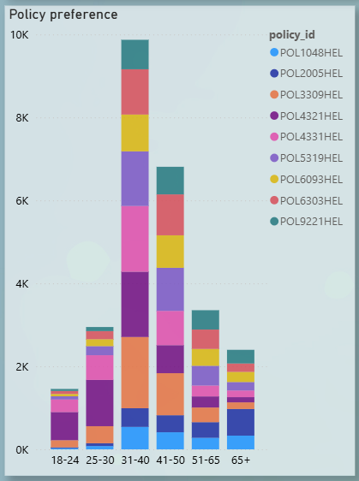
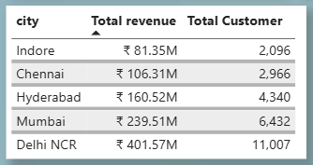
PROJECT DETAILS
Shield Insurance: Shield Insurance is a leading provider of insurance services, operating across five major cities in India: • Delhi NCR • Mumbai • Hyderabad • Chennai • Indore
The company offers a diverse portfolio of 9 insurance policy types, catering to the varying needs of its customers.
📊 Dataset: 26,841 customers | 5 cities | 6 age groups | 4 sales channels | Multiple policy types | Jan–Dec data

Slide 4
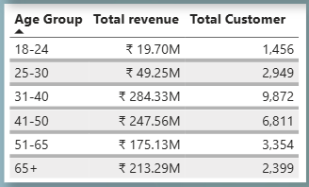
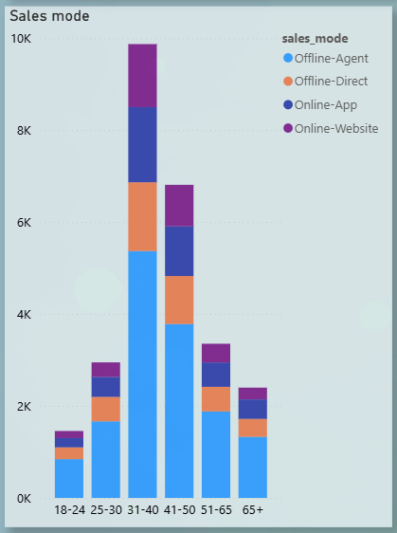
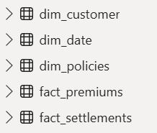
The company operates through two primary sales modes, each with two distinct categories:
Customers must be at least 18 years of age. Age Categories:
Offline Mode:
Online Mode:
Age
18–24 years
Sales Agent
Mobile Application
Website
25–30 years
Direct Sales
31–40 years
41–50 years
51–65 years
65 years and above
Data was available from November 2022 to April 2023
Input Dataset:
With the help of the given data, I developed an interactive dashboard that enables stakeholders to effectively track revenue, monitor customer growth, and gain actionable insights into business performance across multiple dimensions.

Slide 5
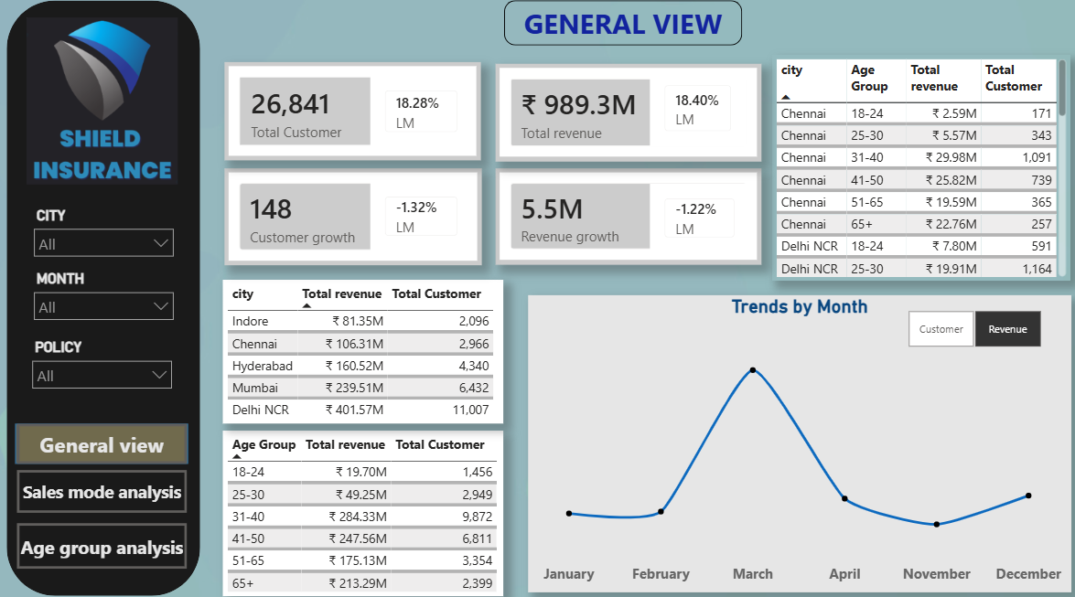
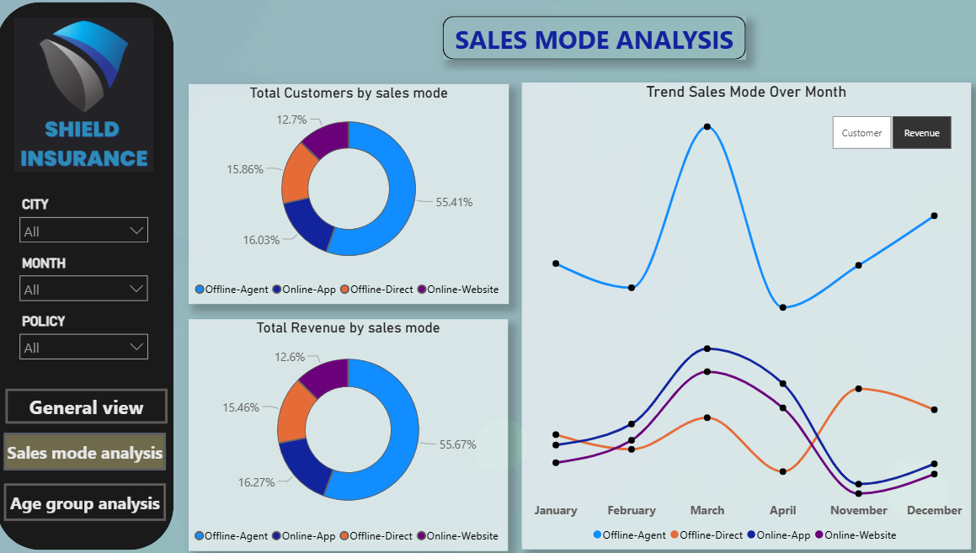
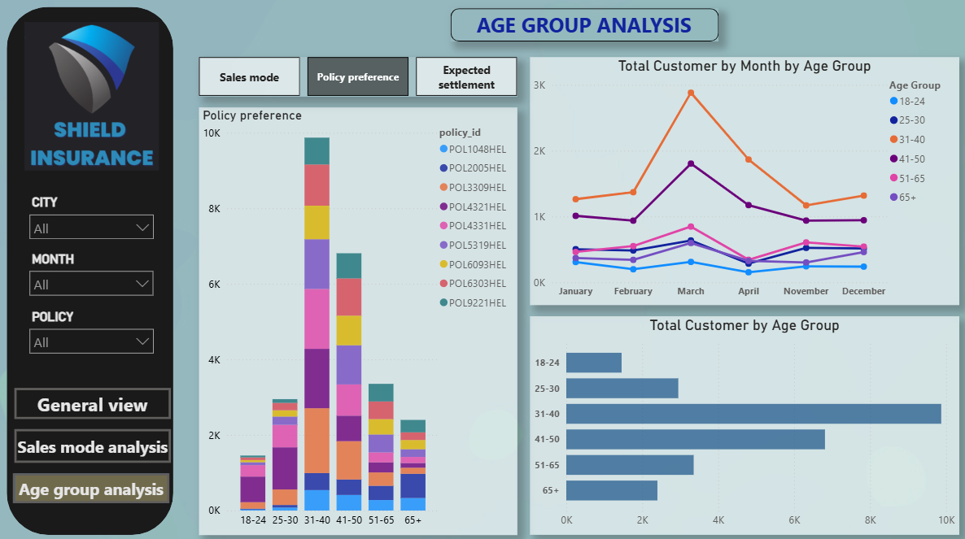
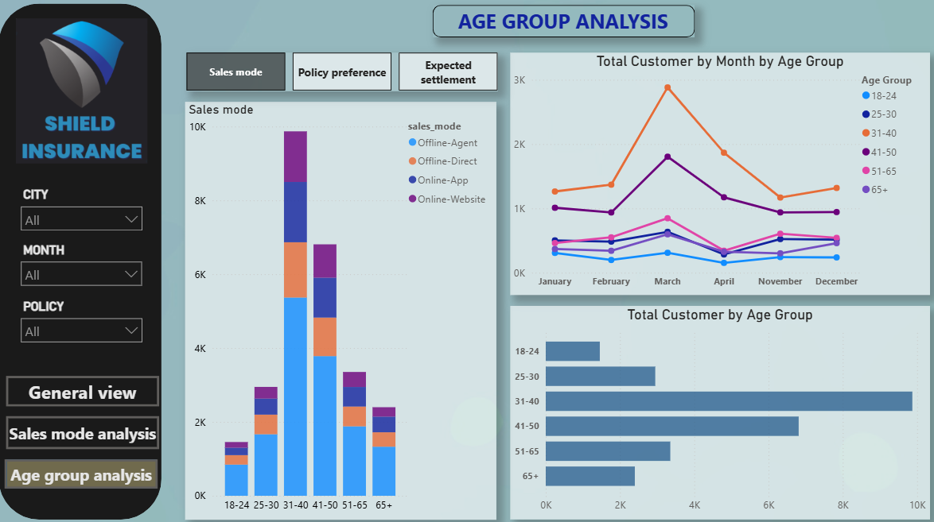
DASHBOARD OVERVIEW

Slide 6
KEY INSIGHTS
➢ Strong Age Segment (31–40 years): The majority of customers and revenue came from this age group, making it the most valuable segment. ➢ Top Performing Month – March 2023: Highest number of new customers acquired and peak revenue achieved. ➢ Delhi NCR Leads: Among all five cities, Delhi NCR recorded the largest customer base and generated the highest revenue. ➢ Policy Preference by Age: Customers aged 31–40 consistently preferred all types of policies more than other groups. ➢ Most Popular Policy: Policy ID POL4321HEL (₹5,000 base premium) was purchased by over 4,000 customers. ➢ Dominant Sales Channel – Agents (Offline): The majority of policies were sold through sales agents, driving the highest revenue. ➢ Emerging Online Channels: From February 2023 onwards, sales via mobile app and website showed steady growth, while direct offline sales declined.

Slide 7
RECOMMENDATION
➢ Leverage March Success: Analyze the factors behind March 2023’s peak performance and replicate them in future campaigns.
➢ Expand City Strategies: Apply the successful approaches from Delhi NCR to boost growth in other cities.
➢ Target Age Group 31–40: Design focused marketing initiatives and tailored policy options for the most active customer segment.
➢ Strengthen Direct Sales: Adapt strategies from the growing mobile app and website channels to enhance offline direct sales.
➢ Enhance Popular Policy (POL4321HEL): Introduce upgrades or variations of the top performing policy to attract wider age groups.

Slide 8
THANK YOU
Shield Insurance – Data Analytics Dashboard
Presented by Prachi Jha
Codebasics Virtual Internship | April 2026
Power BI
DAX
Data Analytics
Power Query
Insurance Domain
Questions & Discussion Welcome 🙌

