Slide 1

C Division
C1 batch:- 3rd group
Teacher:-
Subject:- smart sensors
Topic:- Sensors used in our day to day life
BRACT’S, Vishwakarma Institute of Information Technology, Pune-48
(An Autonomous Institute affiliated to Savitribai Phule Pune University)
(NBA and NAAC accredited, ISO 9001:2015 certified)
BRACT’S, Vishwakarma Institute of Information Technology, Pune-48
(An Autonomous Institute affiliated to Savitribai Phule Pune University)
(NBA and NAAC accredited, ISO 9001:2015 certified)

Slide 2

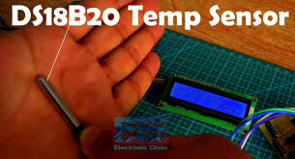
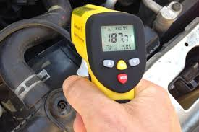
Temperature Sensor
Temperature Sensor is a device used to measure temperature. It is used to measure hotness or coldness of a material which provides temperature feedback used to monitor or control the process.
Working :
These sensors are composed of two metals that generate an electrical voltage or resistance when a temperature change occurs by measuring the voltage across the diode terminals. When the voltage increases, the temperature also increases.
The two main types of temperature sensors are :
(1)Contact Type Temperature Sensors :
These types of temperature sensor are required to be in physical contact with the object being sensed and use conduction to monitor changes in temperature. They can be used to detect solids, liquids or gases over a wide range of temperatures.
(2)Non-Contact Type Temperature Sensors :
These types of temperature meters are not in direct contact of the object rather,
they measure the degree of hotness or coolness through the radiation emitted by the heat source.

Slide 3

Temperature Sensor
Applications :
-Industrial Applications :
[Monitor various machinery, environment, power plant]
-Scientific and laboratory Applications :
[Science and biotech monitoring]
-Medical Applications :
[Monitoring Patient, medical devices, gas analysis]
-Motorsport :
[Monitor inlet air temperature, oil temperature, engine temperature, exhaust gas]
-Domestic appliances :
[Monitor Kitchen appliances (ovens, kettles)]
We have to consider various parameters while selecting a Temperature sensor :
-Temperature range
-Accuracy and stability
-Size and Package
Some basic Temperature sensors used are :
-Thermocouple:-
[Range: 95°C – 1260°C]
-Thermister:-
[Range: -40°C to 125°C but can go to 325°C]
-RTD:-
[Range: -196°C +850°C]
Some basic units to measure temperature :
-Degree Celcius (°C)
-Degree Fahrenheit (°F)
-Kelvin (K)

Slide 4
Temperature Sensor
Thermocouple :
Thermister :
RTD :
Adv.
Wide temperature range
Highly rugged
Best for high temperatures
Highly sensitive
Perfect for small temperature ranges
Easy to use
Fast response
Standard two wire connection
Highly accurate
Good stability
Good linearity
Consistent
High temperature ranges
Industrial Applications
Science
Biotech
Environmental monitoring
Aerospace applications
Medical devices
Communications and computing equipment
Automotive applications
Engineer temperature
Power electronics
Computers
Aerospace applications
Appli.
Temp.
range
95°C to 1260°C
-40°C to 125°C but can go to 325°C
-196°C to +850°C

Slide 5
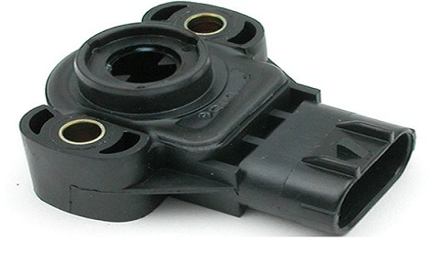
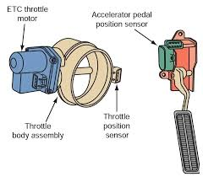
Throttle Body Positioning Sensor (TPS)
A throttle position sensor (TPS) is a sensor used to monitor the air intake of an engine. The sensor is usually located on the butterfly spindle/shaft, so that it can directly monitor the position of the throttle.
This sensor is usually mounted on the throttle body. It senses the position of the throttle valve or butterfly valve and transmits the
information to the Engine control unit.
This sensor monitors how far down the accelerometer pedal is pushed and gives the output current determining the position of the pedal.
The position of the pedal controls the airflow of the engine. If the valve is wide opened, a large amount of air is supplied to the engine and vice-versa.
The output given by this sensor, along with other sensors is transmitted to the engine control unit, which decides the amount of fuel to be injected into the engine accordingly.

Slide 6
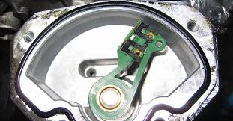
Throttle Body Positioning Sensor (TPS)
Working Principle of throttle body positioning sensor :
The working principle of this sensor is similar to potentiometer.
This sensor is a three wired potentiometer. Through the first wire, a power is supplied to the sensors resistive layer. The second wire is used as ground whereas the third wire is connected to the potentiometer wiper and provides input to the Engine control system.
The output given by this sensor, along with other sensors is transmitted to the engine control unit, which decides the amount of fuel to be injected into the engine accordingly.
Application :
It is used in throttle body of an vehicle and also used a crank shaft positioning sensor.

Slide 7
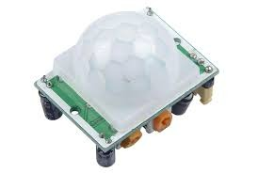
PIR Sensor
What is a PIR Sensor :
A passive infrared sensor (PIR sensor) is an electronic sensor that measures infrared light radiating from objects in its field of view.
What does it detect :
PIR sensors are also known as PID or Passive Infrared Detectors. Thus it can detect infrared radiation that is emitted by particles.
PIR can detect presence of animal, human or any moving object in a required range. The detector itself does not emit any energy but detects infrared radiation from the environment.
Applications of PIR Sensor :
(1) All outdoor Lights
(2) Lift Lobby
(3) Multi Apartment
(4) Complexes Common staircases
(5) For Basement or Covered Parking Area
(6) Shopping Malls
(7) Security Alarms
Range of PIR Sensor :
Indoor type : The detection distance ranges from 25cm to 20m.
Outdoor type : The detection distance ranges from 10m to 150m

Slide 8
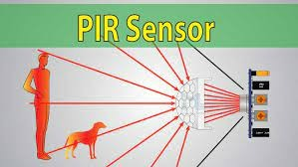
PIR Sensor
How does a PIR Sensor work :
The PIR Sensor is pretty complicated when compared to the other sensors.
Since they have 2 slots, and the slots are made of sensitive material.
The Fresnel lens is used to see that the two slots of the PIR can see out past some distance.
When the sensor is inactive, then the two slots senses the same amount of ambient light which radiates from the outdoors, walls or room.
When a human body or any animal passes by, it intercepts the first slot of the PIR sensor.
This causes a positive differential change between the two bisects. But when the body leaves the sensing area, the sensor generates a negative differential change between the two bisects.

Slide 9
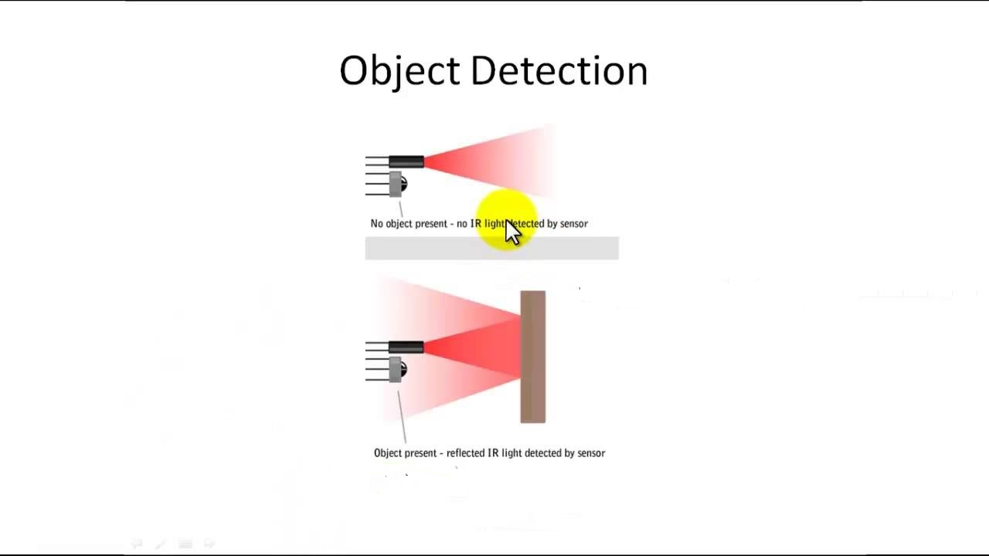
PIR Sensor
Advantages of PIR Motion Sensors :
(1) PIR motion sensors can detect moving objects even in dark with great accuracy.
(2) PIR sensors can detect the motion of objects without coming in contact with them.
(3) They are very easy to install and do not require much wiring.
(4) They reduce a lot of human efforts by making things to work automatically.
(5) They consume very less energy and thus reduce usage of electricity.
Disadvantages of PIR Motion Sensors :
(1) PIR motion sensors are a bit costly and can not be afforded by a majority of people.
(2) Passive Infrared Sensors sometimes behave abnormally during bad weather conditions.
(3) PIR sensors sometimes become incapable of detecting a very slow-moving object.
(4) Home security systems with PIR motion detectors sometimes trigger false alarms due to no reason.
(5) PIR motion sensors have a very short detection range and thus sometimes it leads to a loophole in Burglar alarm systems because of incomplete coverage issue.

