Slide 1




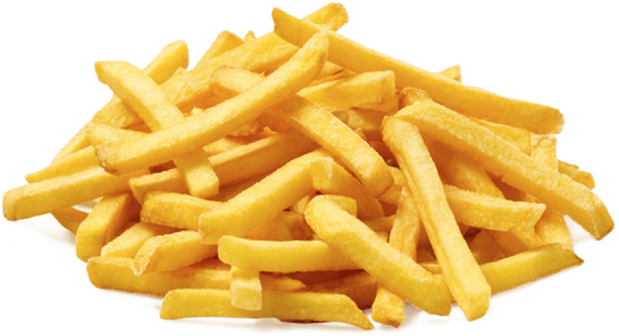
PYTHON PROJECT
PARK BOOK CAFÉ APP
PRACHI
ANU
ROMAN
KAVYA
This Photo by Unknown Author is licensed under CC BY-SA

Slide 2

FAVOURITES:
TEAM WORK
MULTIPLE PERSPECTIVES
MOTIVATION

Slide 3
CHALLENGES
THOUGHT PROCESS
TESTING
TIME

Slide 4

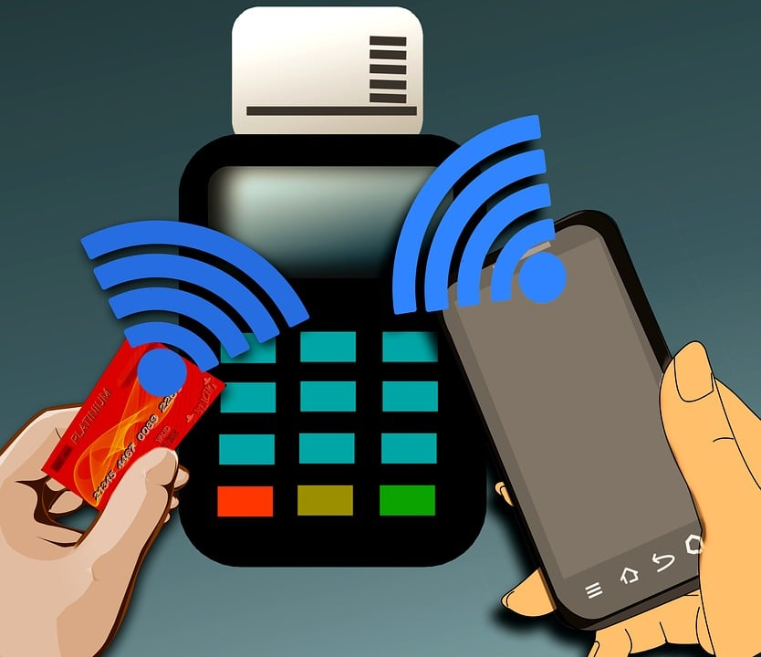
MORE TIME?
USER FRIENDLY
MORE OPTIONS
SECURITY

