Slide 1
CS G623 · ADVANCED OPERATING SYSTEMS
Distributed Ticket Booking System
Clients
Milestone 1 · Project Foundation, gRPC & LLM Integration
App Server
Vaccine-slot booking on Architecture A
Team AOS · BITS Pilani · Semester I 2026–27
LLM Server
Notes:
Milestone 1: foundation. We chose Architecture A (Distributed Ticket Booking) and instantiated it as a vaccine-slot booking system.

Slide 2
What Milestone 1 delivers
Team & topic
Architecture A: Distributed Ticket Booking, instantiated as vaccine-slot booking
1
gRPC service definitions
One .proto file: 3 services, 7 RPCs, generated Python stubs
2
Client–server communication & auth
Login → token → post / get → logout, all over gRPC
3
Fundamental business logic
Slot inventory, mock payment, cancellation, per-slot locking
4
Domain LLM on its own node
Qwen2.5-0.5B FAQ assistant, CPU-only, offline-first
5
Notes:
Maps one-to-one to the Milestone 1 objectives and deliverables in the assignment PDF.

Slide 3
System architecture
NODE 5
NODE 2 · :50051
NODE 1 · :50052
Clients
Application Server
LLM Server
Multiple concurrent gRPC clients simulating citizens booking slots
Session store (tokens)
Qwen2.5-0.5B-Instruct
Batched worker
CPU · offline
Booking service
login · logout
post · get
Per-slot locks
getLLMAnswer
Dispatcher + LockManager
Mock payment
All inter-node calls are gRPC. State is in memory in Milestone 1; replication arrives with Raft in Milestone 2.
Notes:
The LLM runs on a separate server as the assignment requires. The app server never loads the model; it calls LLMService over gRPC.

Slide 4
gRPC contract & sessions
Service | RPC | Assignment signature
Client | Login | login(username, password)
Client | Logout | logout(token)
Client | Post | post(token, type, data)
Client | Get | get(token, type, params)
App | ProcessBusinessRequest | processBusinessRequest(id, payload, ctx)
App / LLM | GetLLMAnswer | getLLMAnswer(id, query, ctx)
SESSION FLOW
Login returns a UUID token
1
Token stored in the session map
2
Post / Get verify the token, else "unauthorized"
3
Typed protobuf messages carry JSON payloads, so new request types need no schema change.
Logout deletes the token
4
Notes:
Function signatures follow the assignment; minor changes are allowed. Note: authentication is a stub in M1 (any non-empty password is accepted); real credential checks are future work.

Slide 5
Booking logic & concurrency control
BOOKING TRANSACTION
10 CLIENTS RACING FOR 3 SLOTS (LIVE gRPC RUN)
1
Enqueue in Dispatcher
3
7
0
2
Acquire the slot’s own lock
3
Validate slot, quantity, availability
accepted
rejected
overbooked
4
Mock payment
One lock per slot: users booking different slots run in parallel; only same-slot contenders are serialized. Cancellation restores inventory under the same lock.
5
Decrement + record appointment
6
Release lock
Notes:
Run of scripts/demo_concurrency.py: 10 threads, slot with 3 available. Result: 3 accepted, 7 rejected, remaining 0, finished in about 12 ms on our machine.

Slide 6
Domain LLM integration
Separate node
SAMPLE QUERIES
LLMService on :50052, reached from the app server via getLLMAnswer
How to cancel a booking?
Domain-specific
To cancel your vaccination appointment, please follow these steps: 1. Check Availability … 2. Contact Support … (excerpt)
System prompt encodes 8 booking rules: dose gaps, ID, cancellation, fees
Context-aware
Live slot availability injected when a query is about availability
What documents do I need?
CPU & offline
1. Government-issued Photo ID: this could be an Aadhaar card, Voter ID, Passport, or Driver’s License … (excerpt)
Cached Qwen2.5-0.5B, 60 ms request batching, keyword fallback
Notes:
Sample queries come from scripts/client_demo.py. Answers are excerpts of real Qwen2.5-0.5B output from our live run (about 12 s per answer on a MacBook CPU). A 0.5B model sometimes drifts from the system-prompt rules, e.g. it invented a medical-certificate requirement; larger or fine-tuned models are future work.

Slide 7
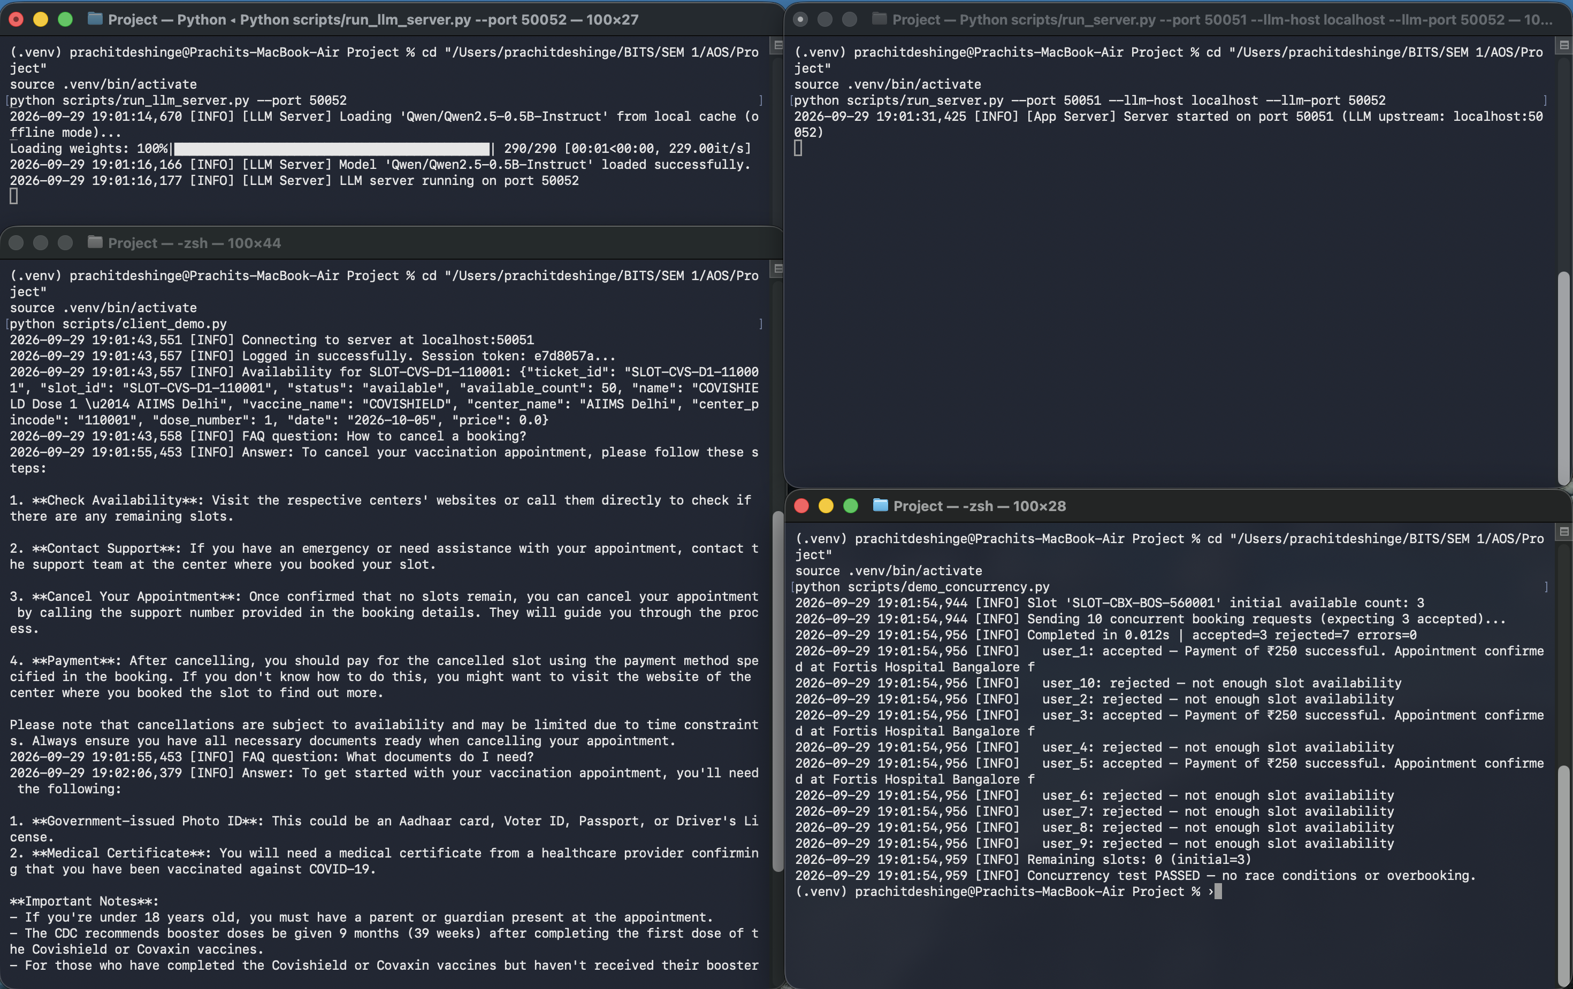
Live run: 3 nodes, 4 terminals
Node 1
Qwen2.5-0.5B loaded from local cache, serving on :50052
Node 2
App server on :50051, upstream LLM at localhost:50052
Client demo
Login, availability, then 2 FAQs answered by the LLM
Race test
10 clients, 3 slots: 3 accepted, 7 rejected, 0 overbooked
Notes:
Screenshot from our own machine on 29 Sep 2026. LLM answers took roughly 12 seconds each on CPU; the booking race finished in 12 ms.

Slide 8
Verified today, Raft next
13/13
unit tests passing
2
gRPC integration tests passing
0
overbooked in the 10-client race
RUN IT
MILESTONE 2 · DUE 18 NOV
pip install -e .
python scripts/run_all_demo.py
# or manually
run_llm_server.py --port 50052
run_server.py --port 50051
demo_concurrency.py
Raft leader election and log replication
Booking state replicated to 3 app nodes
Kill-leader recovery demo
Replace mock auth, in-memory-only state
Notes:
Tests: 13 unit tests pass without a server; 2 integration tests pass against live servers. Known M1 gaps: mock authentication, in-memory state, single app server.

