Slide 1






PRESENTATION 2026
Next Generation Sales Intelligence System
Student Name
Student Email
PRACHI THAGELA
30093@arsd.du.ac.in
Mentor Name
Uma maheshwari

Slide 2

Outline
Abstract of the Project
Problem Statement
Proposed Solution
System Architecture
Live Demo of the Project
Embedded Video of Project
Conclusion
Future Scope

Slide 3
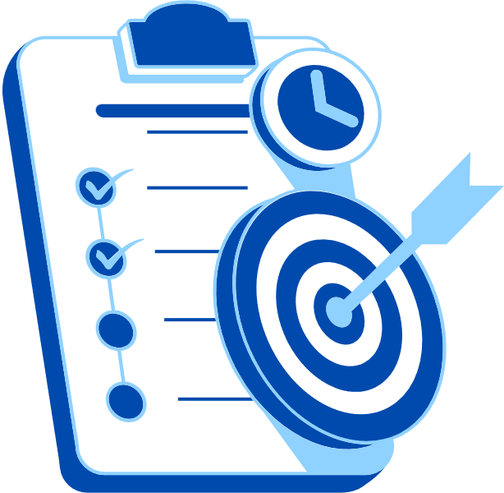
Abstract
Multi channel data integrated into unified dashboard
Azure deployment enabled scalable cloud based access
Power BI provided interactive real time insights
AI chatbot ranked products based profitability
Predictive analytics improved demand forecasting accuracy
Automated reports simplified leadership decision making process

Slide 4

Problem Statement
No idea which products were actually profitable
Always running out of stock at the wrong time
Customers were leaving and nobody noticed
Sales data was scattered everywhere
The website,physical stores, mobile app, and partner platofrms all tracked data separately.
Nobody had a single clear picture of what was working and what wasn’t.

Slide 5

Proposed Solution
AI Chatbot tool with API key to rank products by real profit
Predict demand before it happens using Microsoft PowerBI dashboard
Flag customers before they leave
One dashboard for everything connected all channels into one single system using Azure Deployment
Weekly reports are now auto-generated in plain English so leadership can review performance in under a minute.

Slide 6
System Architecture
Data Input / Source
Processing / Analysis
Data is collected from multiple sources like website, stores, & mobile phones.
It includes sales transactions, customer data and inventory records.
Raw data is cleaned, structured, and transformed for analysis.
Data from different platforms is integrated into one system. It ensures accuracy & consistency of information
AI / Tool Integration
Output / Dashboard
Power BI dashboard displays real time insights and KPIs.
Interactive visuals helps users explore trends & performance.
Automated reports simplify understanding for business users
Used Microsoft azure for cloud hosting and APIs.
Applied Microsoft power BI for predictive insights
Deployed solution using github integration

Slide 7
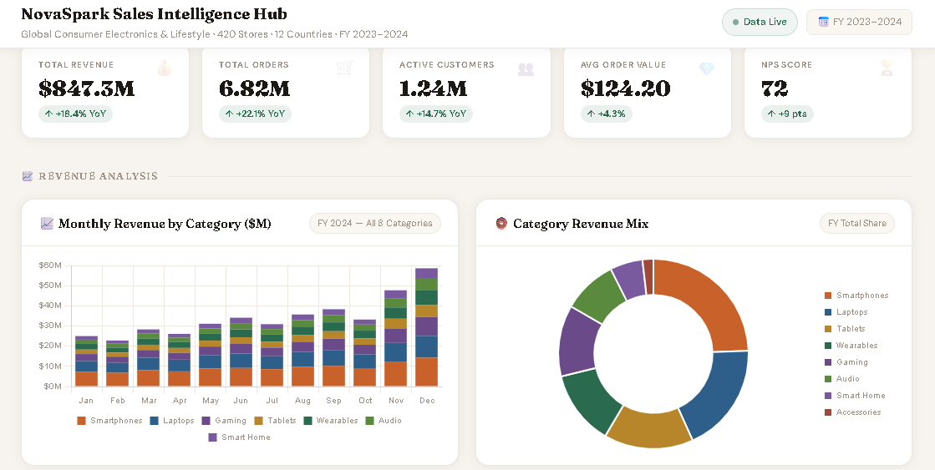
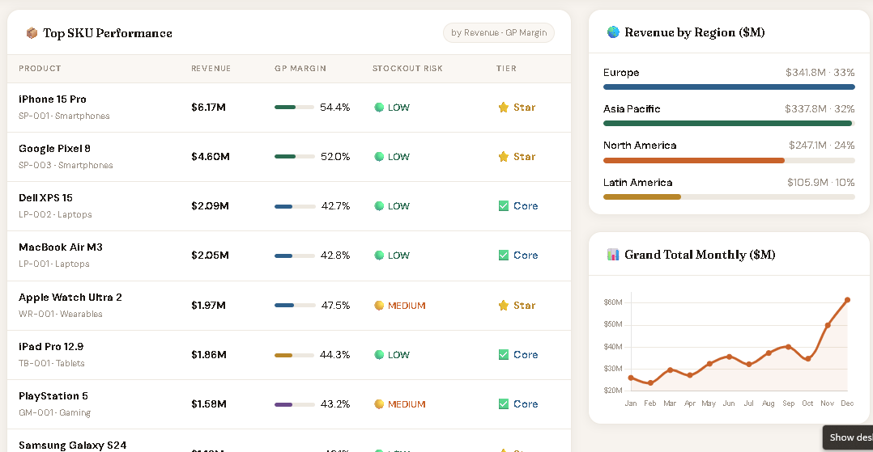
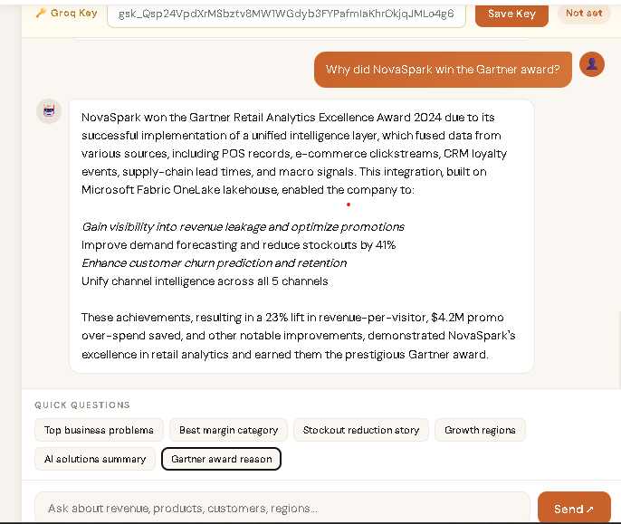
Live Demo of Project
Here's the list of some demo screenshots / features of the project:
Demo 1- Dashboard
Demo 2- Dashboard
Demo 3- chatbot

Slide 8
Video of Project Demo
▶

Slide 9

Conclusion
Centralised dashboard improved business visibility significantly
Profit based product ranking enhanced revenue strategies
Predictive insights reduced inventory mismanagement issues
Customer churn tracking improved retention outcomes.
Automation reduced manual analysis and reporting time
Cloud deployement ensured scalability and relaibility
CONCLUSION

Slide 10

Future Scope
Integrate real time streaming data for updates
Apply advanced AI models for deeper insights
Expand chatbot with voice based interaction system
Implement personalised customer recommendation engine
Strengthen data security using Azure services
Enable cross region scaling for global operations

Slide 11
Thank You
AICW Fellowship | Student Project Presentation 2026
LinkedIn | Edunet Foundation

