Slide 1
DATA ANALYSIS USING TABLEAU

Slide 2
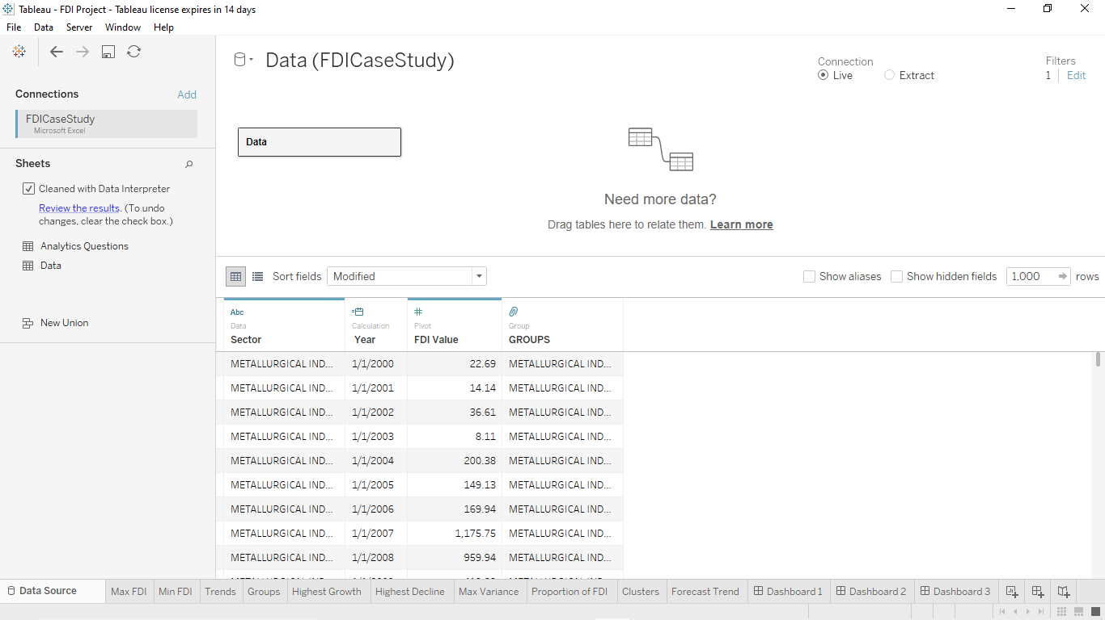
DATA SOURCE

Slide 3
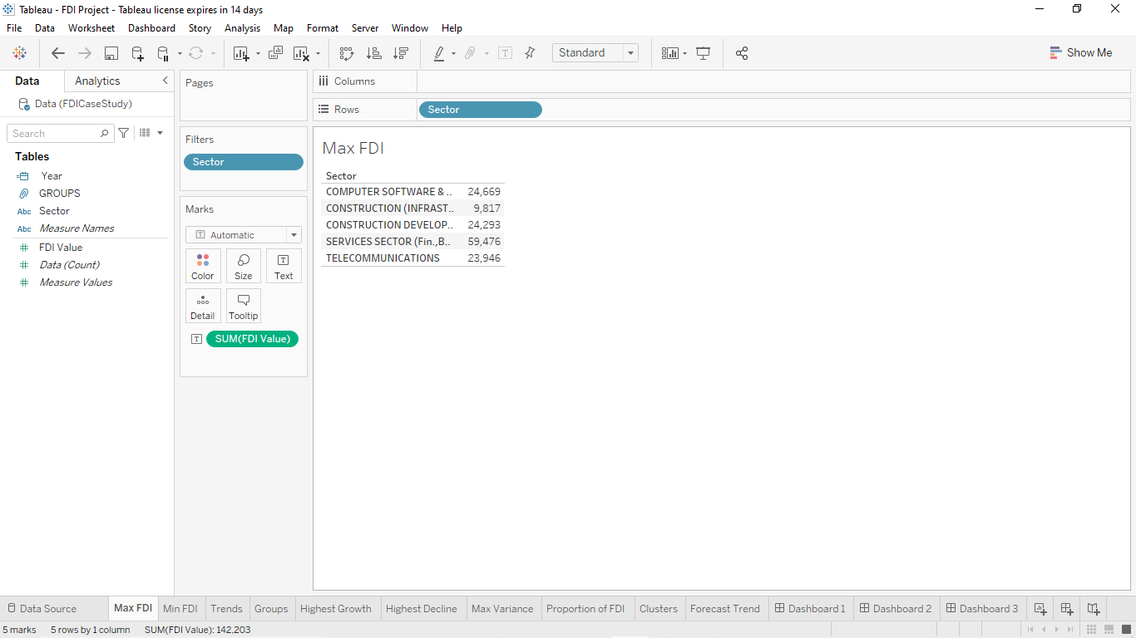
MAX

Slide 4
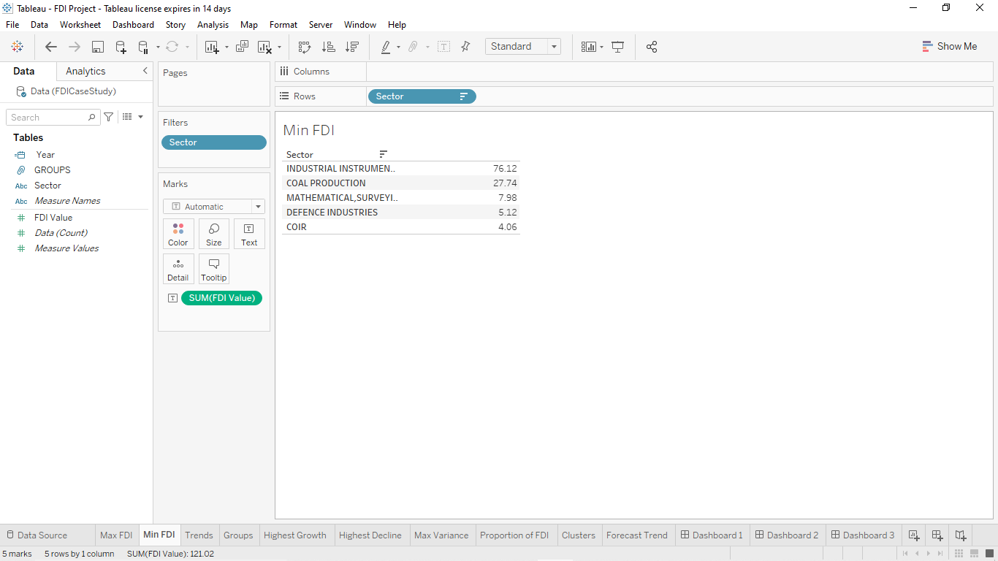
MIN

Slide 5
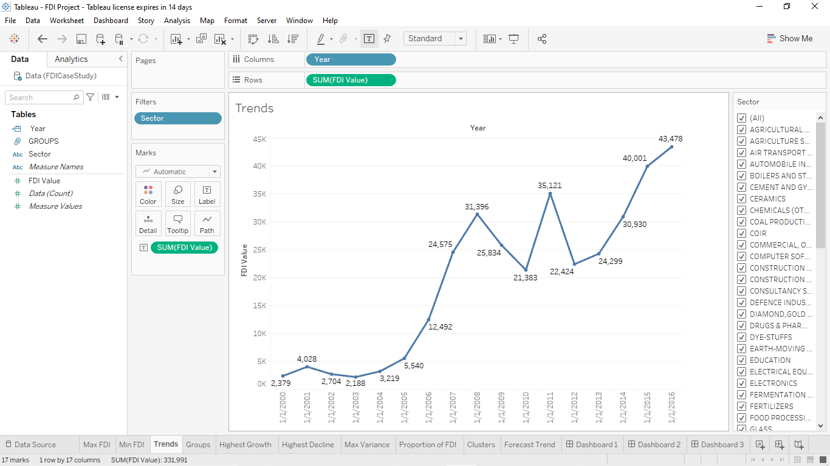
TREND LINE

Slide 6
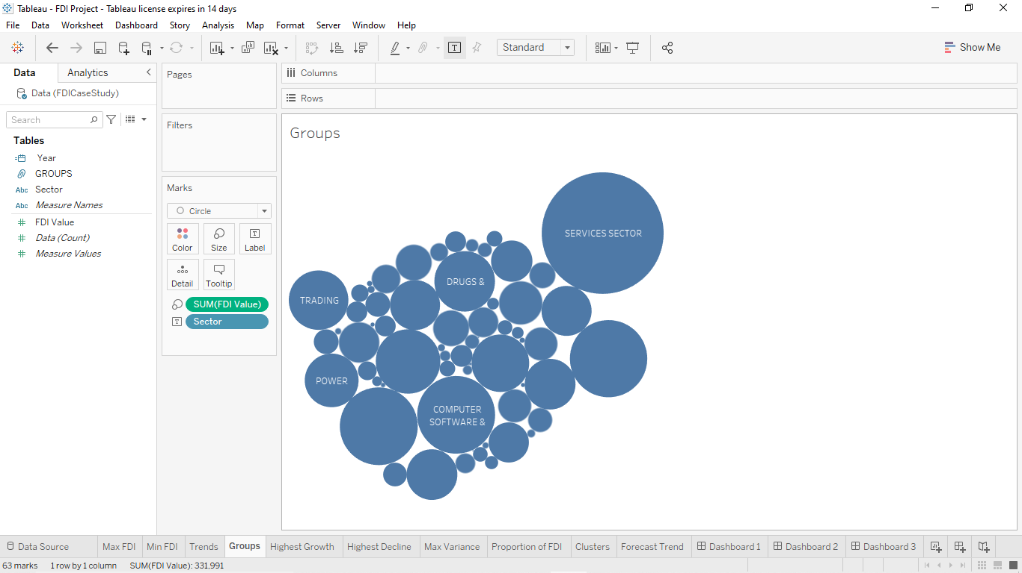
GROUPS

Slide 7
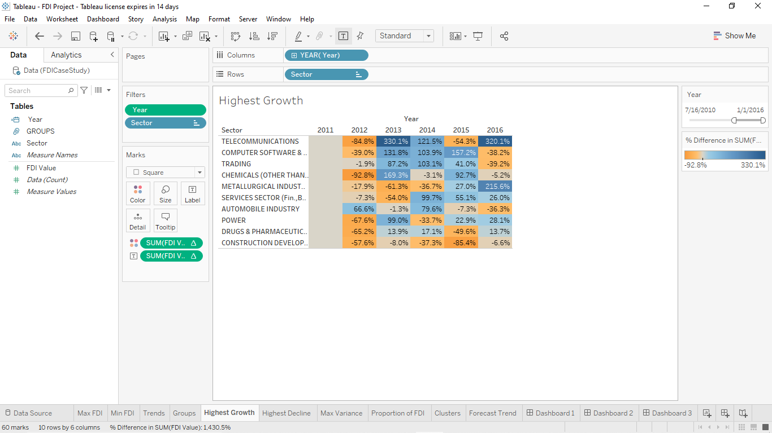
HIGHEST GROWTH

Slide 8
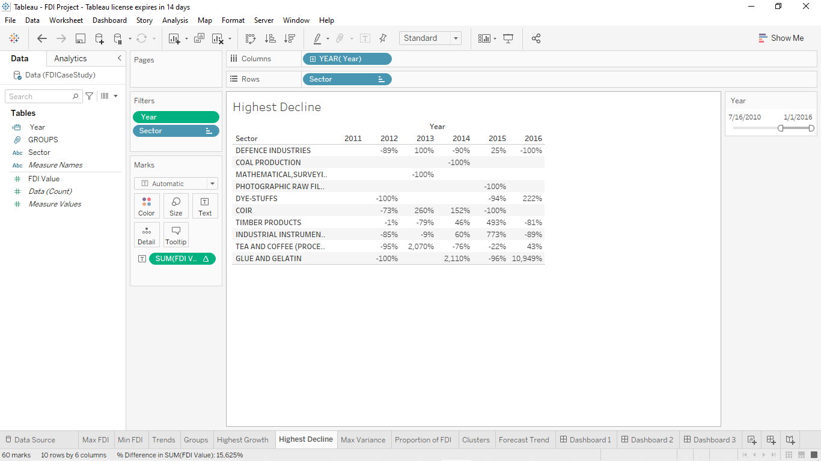
HIGHEST DECLINE

Slide 9
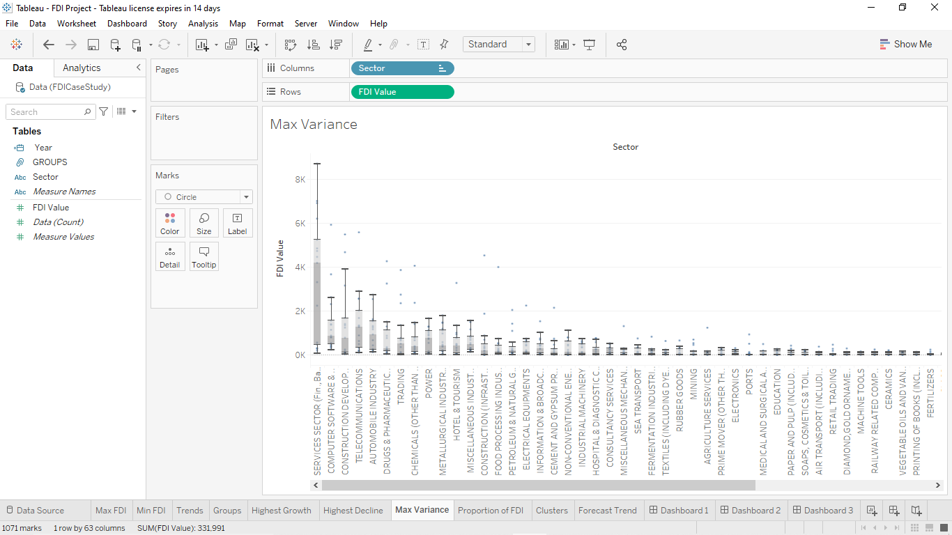
MAX VARIANCE

Slide 10
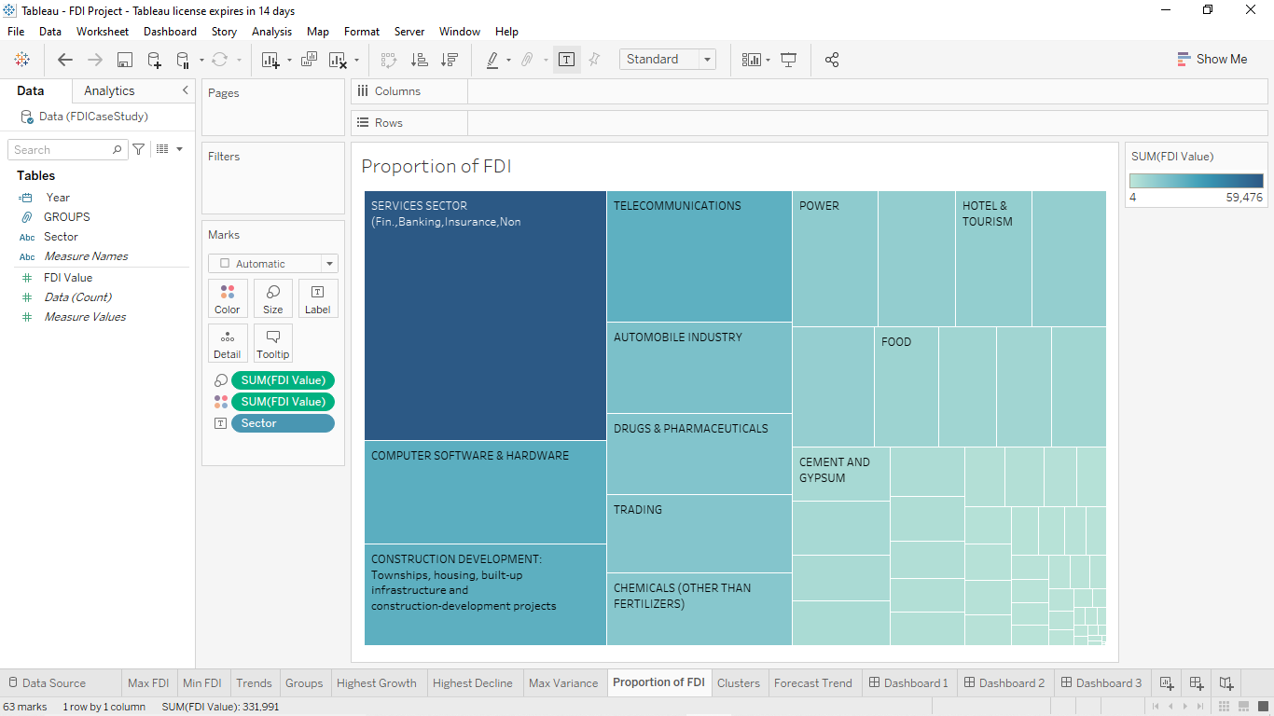
PROPORTION OF FDI

Slide 11
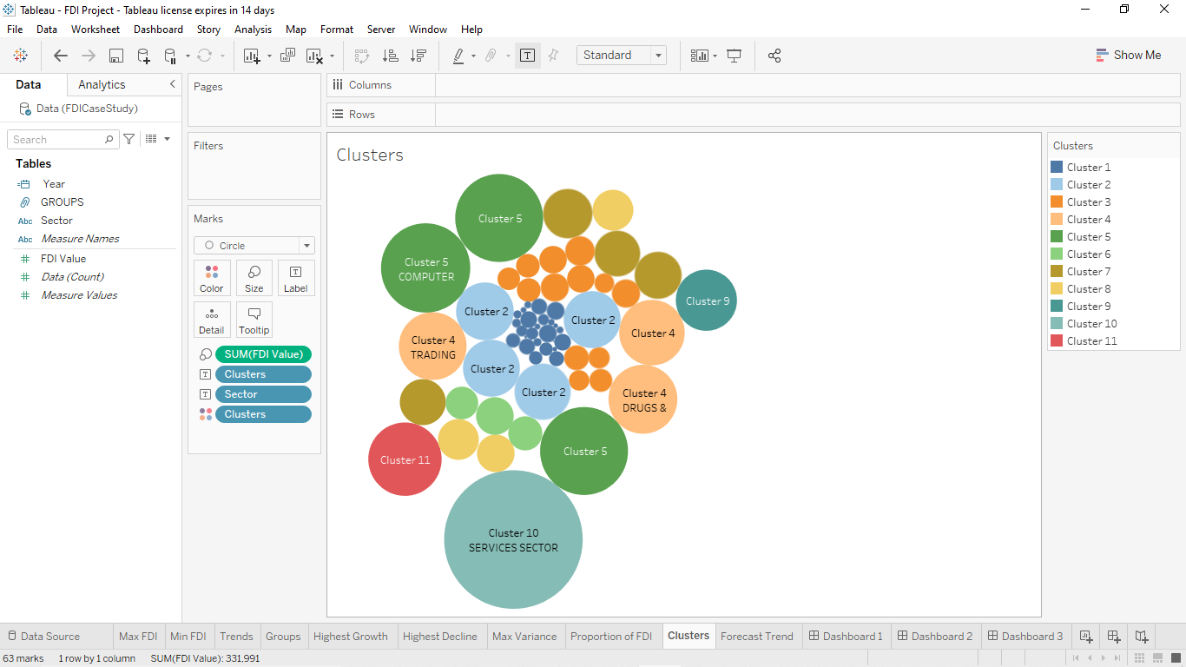
CLUSTERS

Slide 12
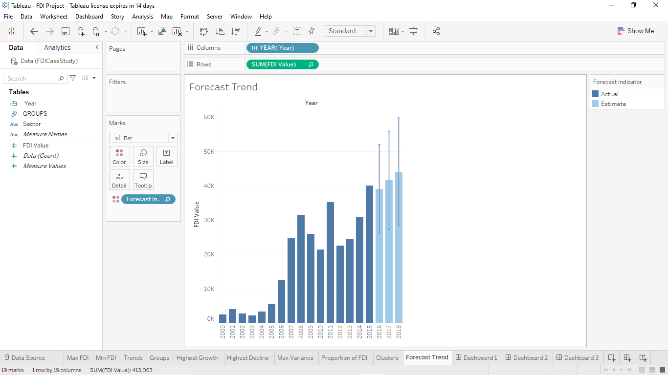
FORECAST TREND

Slide 13
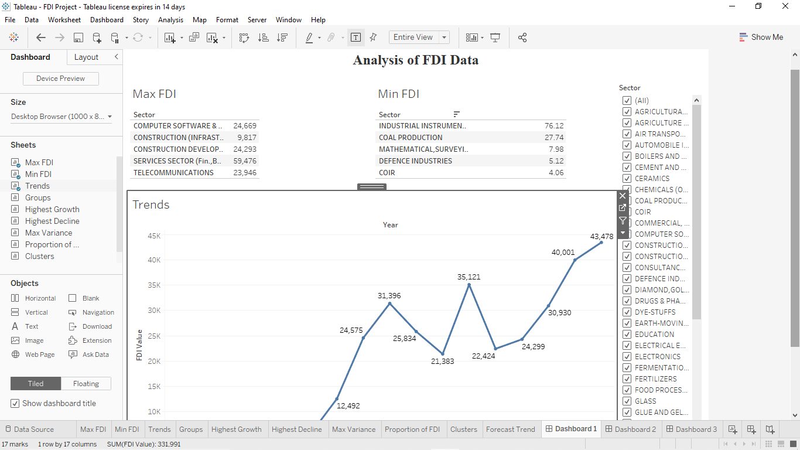
DASHBOARD 1

Slide 14
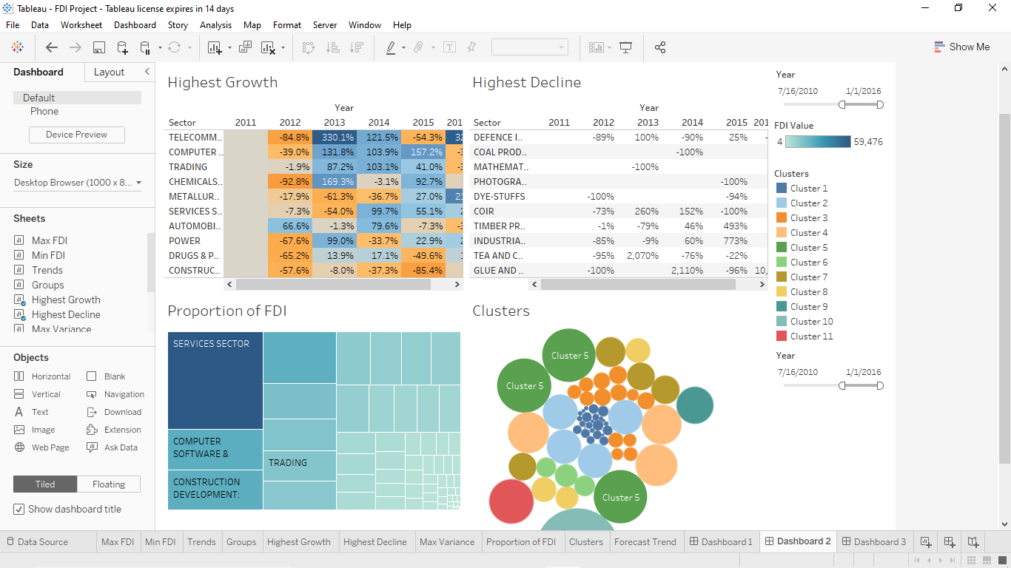
DASHBOARD 2

Slide 15
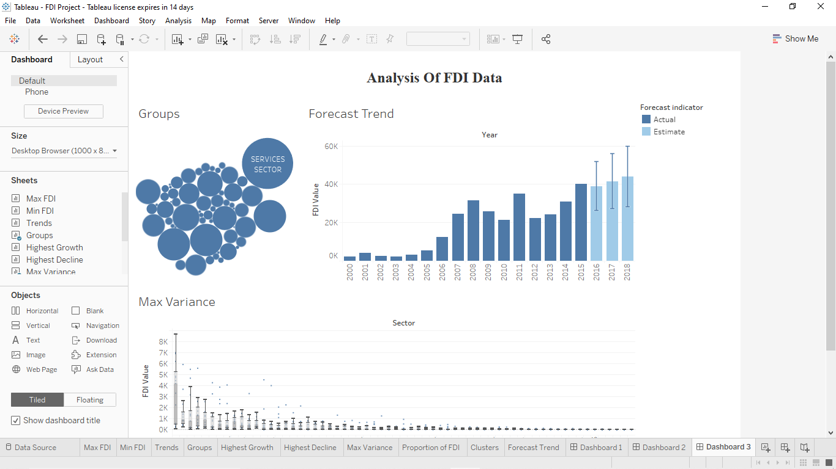
DASHBOARD 3

