Slide 1
Project Manager
Course: Practical Software Technology (SS2018)
Lydia Grillenberger, 0145
Julia Hofer, 0145
Lukas Schiefermüller, 01455483

Slide 2
Overview
For what purpose should this program be?
What should the Project Manager do?
Set Up of the program.
Screenshots.
GUI (JavaFX and SceneBuilder)
Programming details.

Slide 3
Purpose
Client is a Photographer and Filmmaker.
An Overview of the actual jobs.
Details of the jobs.
Status of the job
Contact Persons
Tasks
Notes and Remark
Description

Slide 4
The Project Manager should
Contain all actual jobs.
List all jobs in the main view.
Show details at a selected jobs
Create new jobs.
Edit existing jobs.
Delete closed jobs.

Slide 5
Set Up
The projects are saved in created folders.
In the folders there are three files
“Project.txt”
“Customer.txt”
“Tasks.txt”
saved as csv-files.

Slide 6
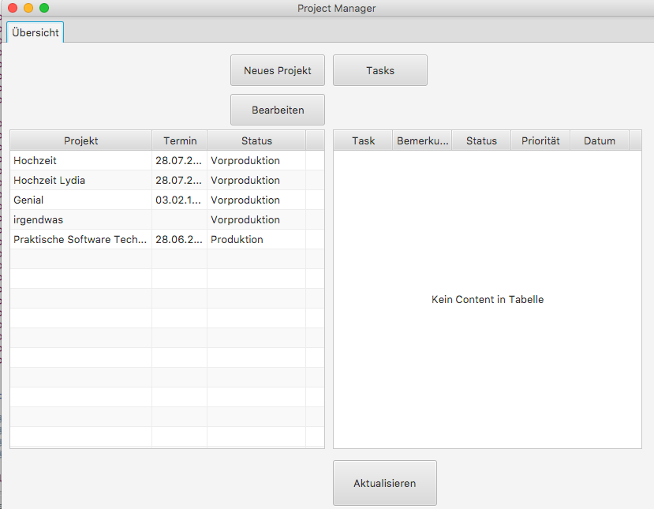
Screenshots, Main Page

Slide 7
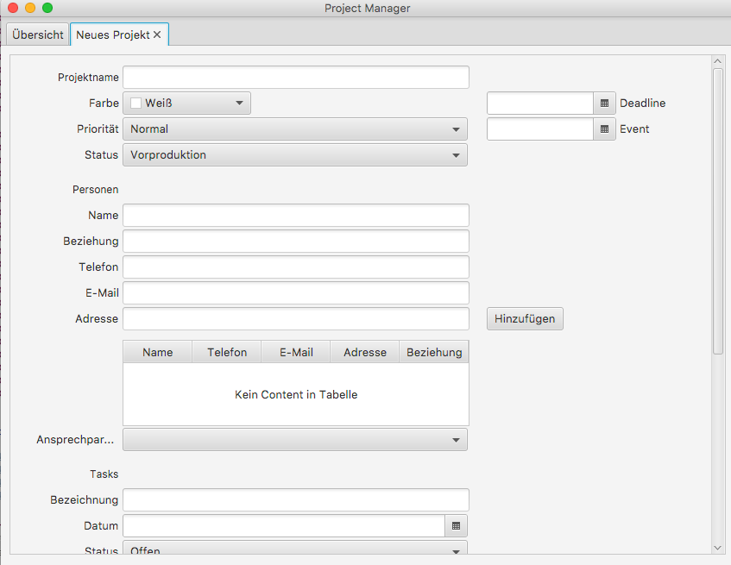
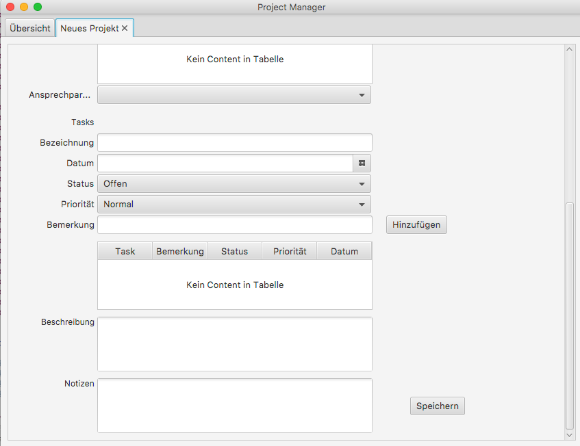
Screenshots, new Project

Slide 8
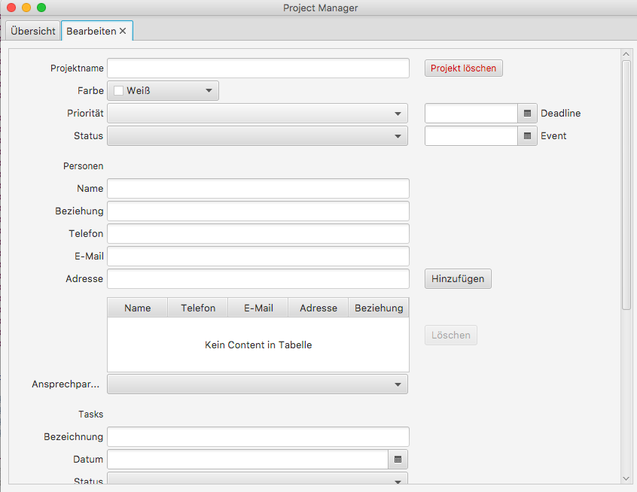
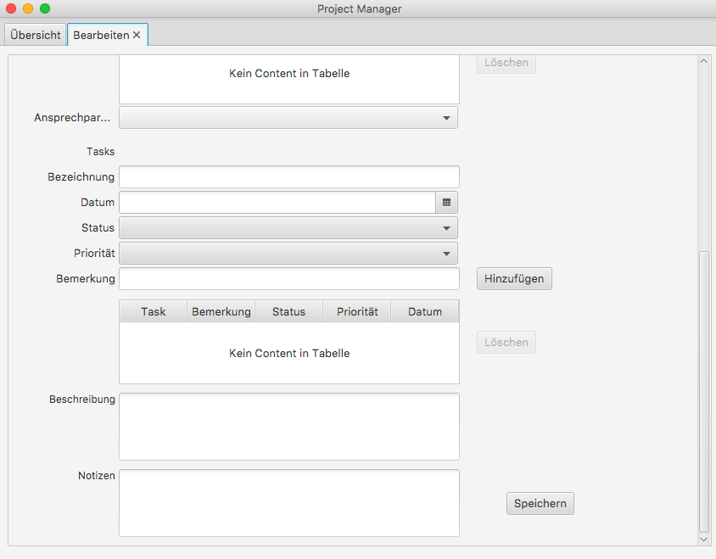
Screenshots, edit Project

Slide 9
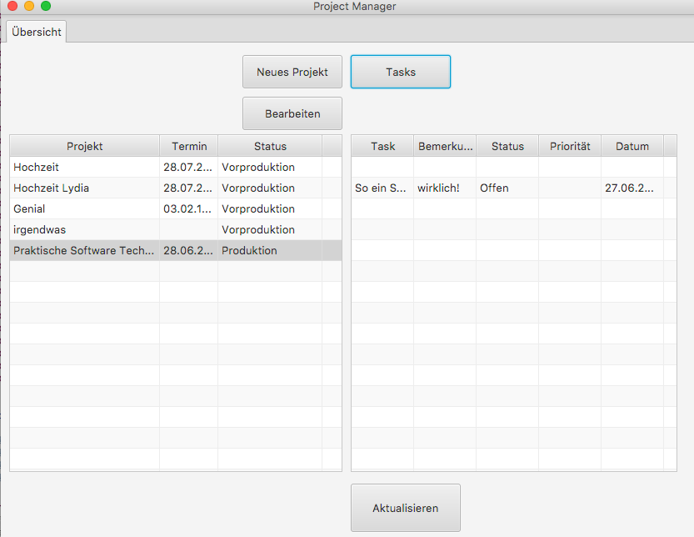
Screenshots, Tasks

Slide 10
GUI
The GUI was designed and created by JavaFX via SceneBuilder.
JavaFX: https://docs.oracle.com/javase/8/javafx/get-started-tutorial/jfx-overview.htm
SceneBuilder: http://www.oracle.com/technetwork/java/javase/downloads/javafxscenebuilder-info-2157684.html

Slide 11
GUI
JavaFX works with *.fxml files, like *.html.
In java you have so called controller for each *.fxml file to implement the functionality.
Button actions
Add content to tableviews

Slide 12
Details
project, package
Project, public class
Priority, public enum
Status, public enum
Task, public class

Slide 13
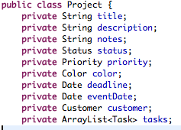
Project
What does a Project consist of?
Title
Description
Notes
Status
Priority
Color
Deadline
Event
Customer
Tasks

Slide 14
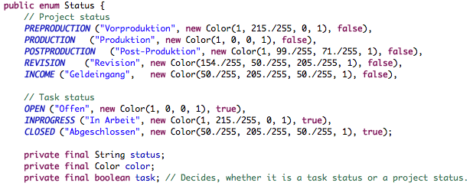
Status, predefined
What is a Status?
Status
Color
Task

Slide 15
Priority, predefined
Three cases
LOW
NORMAL
HIGH

Slide 16

Task
Name
Remark
Status
Priority
Date

Slide 17
Details
files, package
FileHandlerInterface, public interface
FileHandler, public class
Singleton

Slide 18
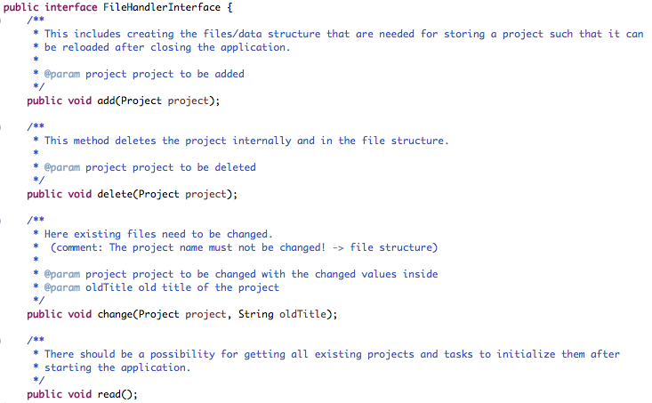
FileHandlerInterface

Slide 19
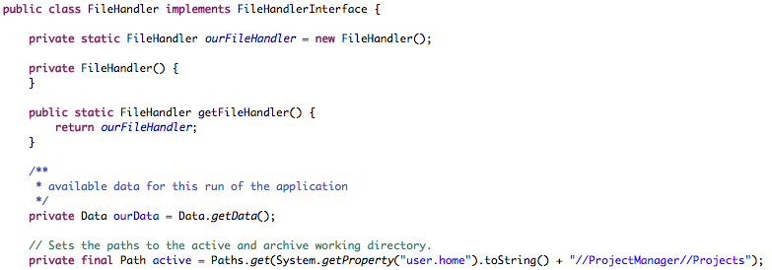
FileHandler

Slide 20
Details
customer, package
Customer, public class
Person, public class

Slide 21
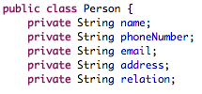
Person

Slide 22

Customer

Slide 23
Details
application, package
App, public class
Data, public class
Singleton
Main, public class
application, package
CreateProjectController, public class
CreateProject.fxml
EditProjectController, public class
EditProject.fxml
StatusSettingsController, public class
StatusSettings.fxml
TasksController, public class
Tasks.fxml

Slide 24
App

