Slide 1
Lecture 2
Case Studies
Most material from Andrew NG’s Course at Coursera and Fei Fei Li’s Course at Standford University

Slide 2

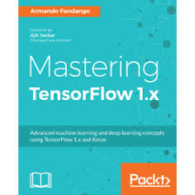


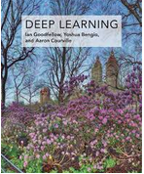

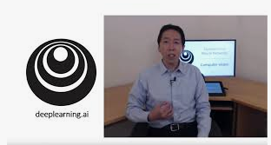
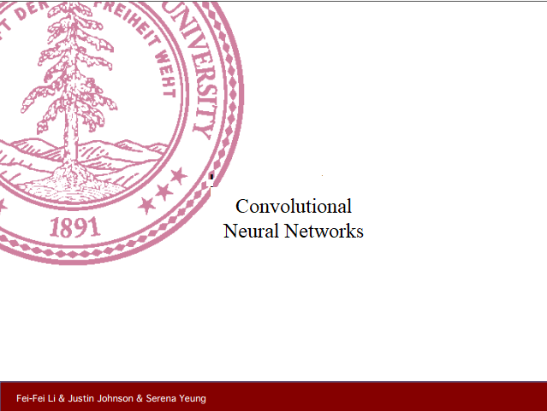
Last time: Course resources

Slide 3


Last time: Vertical edge detection
3 | 0 | 1 | 2 | 7 | 4
1 | 5 | 8 | 9 | 3 | 1
2 | 7 | 2 | 5 | 1 | 3
0 | 1 | 3 | 1 | 7 | 8
4 | 2 | 1 | 6 | 2 | 8
2 | 4 | 5 | 2 | 3 | 9
1
0
-1
1
0
-1
1
0
-1
1
0
-1
-5 | -4 | 0 | 8
-10 | -2 | 2 | 3
0 | -2 | 4 | -7
-3 | -2 | -3 | -16
1 | 0 | -1
1 | 0 | -1
1 | 0 | -1
1
0
-1
1
0
-1
$$∗$$
$$=$$

Slide 4

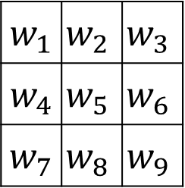

Learning to detect edges
1 | 0 | -1
1 | 0 | -1
1 | 0 | -1
1 | 0 | -1
2 | 0 | -2
1 | 0 | -1
3 | 0 | -3
10 | 0 | -10
3 | 0 | -3
Sobel
Scharr
3 | 0 | 1 | 2 | 7 | 4
1 | 5 | 8 | 9 | 3 | 1
2 | 7 | 2 | 5 | 1 | 3
0 | 1 | 3 | 1 | 7 | 8
4 | 2 | 1 | 6 | 2 | 8
2 | 4 | 5 | 2 | 3 | 9
$w_{1}$ | $$w_{2}$$ | $$w_{3}$$
$w_{4}$ | $$w_{5}$$ | $$w_{6}$$
$w_{7}$ | $$w_{8}$$ | $$w_{9}$$
$$∗$$
$$=$$

Slide 5
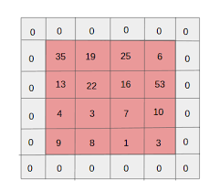
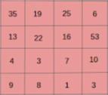
Last time: Padding
Shrink output
Throw away information

Slide 6
Last time: Valid and Same convolutions
“Valid”: No padding
“Same”: Pad so that output size is the same as the input size

Slide 7


Last time: Strided convolution
2 | 3 | 7 | 4 | 6 | 2 | 9
6 | 6 | 9 | 8 | 7 | 4 | 3
3 | 4 | 8 | 3 | 8 | 9 | 7
7 | 8 | 3 | 6 | 6 | 3 | 4
4 | 2 | 1 | 8 | 3 | 4 | 6
3 | 2 | 4 | 1 | 9 | 8 | 3
0 | 1 | 3 | 9 | 2 | 1 | 4
3
4
4
3
4
4
1
0
2
1
0
2
-1
0
3
3 | 4 | 4
1 | 0 | 2
-1 | 0 | 3
91 | 100 | 83
69 | 91 | 127
44 | 72 | 74
-1
0
3
$$∗$$
$$=$$

Slide 8
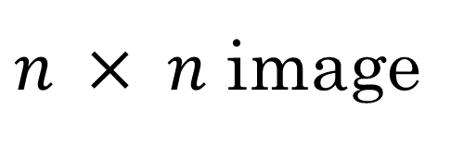
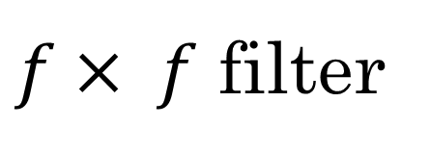
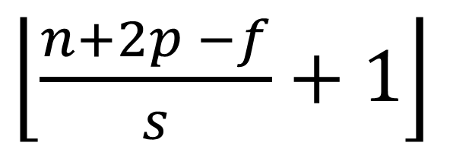

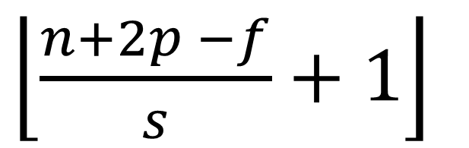
Last time: Summary of convolutions
$n × n$ image
$f× f$ filter
padding p
stride s
$\left\lfloor \frac{n+2p −f}{s}+1\right\rfloor$
$\left\lfloor \frac{n+2p −f}{s}+1\right\rfloor$
$$×$$

Slide 9




Last time: Multiple filters
$$∗$$
$$=$$
3 x 3 x 3
4 x 4
$$∗$$
$$=$$
4 x 4 x 2
6 x 6 x 3
3 x 3 x 3
4 x 4

Slide 10


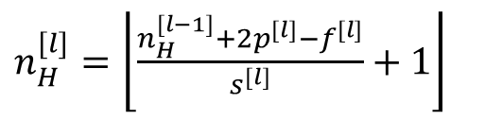











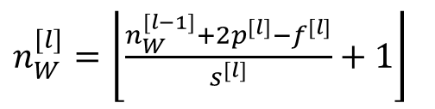



Last time: Summary of notation
If layer 1 is a convolution layer:
$$f^{[l]}=filter size$$
$$p^{[l]}=padding$$
$$Input:$$
$n_{H}^{[l−1]}$ x $n_{W}^{[l−1]}$ x $n_{c}^{[l−1]}$
$$s^{[l]}=stride$$
Output$:$
$n_{H}^{[l]}$ x $n_{W}^{[l]}$ x $n_{c}^{[l]}$
$$n_{c}^{[l]}=number of filters$$
$$Each filter is:$$
$f^{[l]}$ x $f^{[l]}$ x $n_{c}^{[l−1]}$
$n_{H}^{[l]}=\left\lfloor \frac{n_{H}^{[l−1]}+2p^{[l]}−f^{[l]}}{s^{[l]}}+1\right\rfloor$
$$Activations:$$
${a^{[l]}≫n}_{H}^{[l]}$ x $n_{W}^{[l]}$ x $n_{c}^{[l]}$
$n_{W}^{[l]}=\left\lfloor \frac{n_{W}^{[l−1]}+2p^{[l]}−f^{[l]}}{s^{[l]}}+1\right\rfloor$
$$Weights:$$
$f^{[l]}$ x $f^{[l]}$ x $n_{c}^{[l−1]} \text{x} n_{c}^{[l]}$
$$bias:$$
$$n_{c}^{[l]}$$

Slide 11
Last time: Max pooling
1 | 3 | 2 | 1
2 | 9 | 1 | 1
1 | 3 | 2 | 3
5 | 6 | 1 | 2
9
2
6
3

Slide 12


Last time: Why convolutions
10 | 10 | 10 | 0 | 0 | 0
10 | 10 | 10 | 0 | 0 | 0
10 | 10 | 10 | 0 | 0 | 0
10 | 10 | 10 | 0 | 0 | 0
10 | 10 | 10 | 0 | 0 | 0
10 | 10 | 10 | 0 | 0 | 0
0 | 30 | 30 | 0
0 | 30 | 30 | 0
0 | 30 | 30 | 0
0 | 30 | 30 | 0
1 | 0 | -1
1 | 0 | -1
1 | 0 | -1
$$∗$$
$$=$$
Parameter sharing: A feature detector (such as a vertical edge detector) that’s useful in one part of the image is probably useful in another part of the image.
Sparsity of connections: In each layer, each output value depends only on a small number of inputs.

Slide 13
Today
Classic networks:
LeNet-5
AlexNet
VGG
Preprocessing
Weight Initialization
Batch Normalization
ResNet
DenseNet
SENet

Slide 14



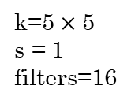

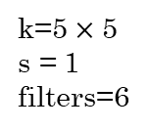




LeNet - 5
avg pool
avg pool
$$\hat{y}$$
k=5$×$ 5
s = 1
filters=6
f = 2
s = 2
k=5$×$ 5
s = 1
filters=16
f = 2
s = 2
$$⋮$$
$$⋮$$
32$×$32 $×$1
28$×$28$×$6
14$×$14$×$6
10$×$10$×$16
5$×$5$×$16
120
84
[LeCun et al., 1998. Gradient-based learning applied to document recognition]

Slide 15


LeNet-5 Notes:
No padding
No ReLU
Avg pool
Small Network >>> 60k
$n_{h} ,n_{w} decrease and n_{c} increases$
$conv pool conv pool fc fc ouput$
[LeCun et al., 1998. Gradient-based learning applied to document recognition]

Slide 16

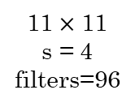
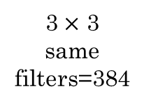



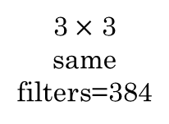

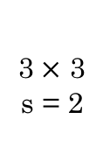



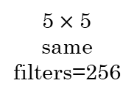

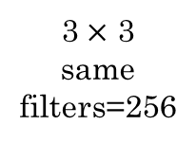


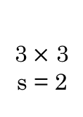
AlexNet
MAX-POOL
MAX-POOL
11$×$ 11
s = 4
filters=96
3$×$ 3
s = 2
5$×$ 5
same
filters=256
3$×$ 3
s = 2
55$×$55 $×9$6
27$×$27 $×$96
27$×$27 $×$256
13$×$13 $×$256
227$×$227 $×$3
MAX-POOL
=
3$×$ 3
same
filters=384
3$×$ 3
same
filters=384
3$×$ 3
same
filters=256
3$×$ 3
s = 2
$$⋮$$
$$⋮$$
$$⋮$$
Softmax
1000
13$×$13 $×$384
13$×$13 $×$384
13$×$13 $×$256
6$×$6 $×$256
9216
4096
4096
[Krizhevsky et al., 2012. ImageNet classification with deep convolutional neural networks]

Slide 17
AlexNet Notes:
Similar to LeNet-5 but much bigger >>> 60M
SGD Momentum 0.9
First use of ReLU
Learning rate 1e-2 , reduced by 10 manually when val accuracy plateaus
Used Norm layers(not common anymore)
Heavy data augmentation
L2 weight decay 5e-4
Droput 0.5
7 CNN ensemble: 18.2% -> 15.4%
[Krizhevsky et al., 2012. ImageNet classification with deep convolutional neural networks]

Slide 18
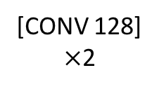


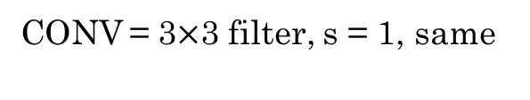


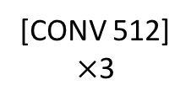



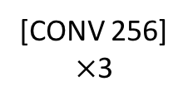
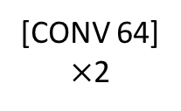



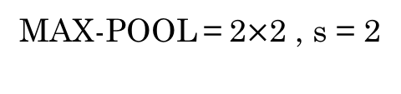

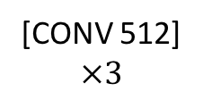
VGG - 16
CONV = 3$×$3 filter, s = 1, same
MAX-POOL = 2$×$2 , s = 2
224$×$224$×$64
112$×$112 $×$64
112$×$112 $×$128
56$×$56 $×$128
[CONV 64]
$×$2
POOL
[CONV 128]
$×$2
POOL
224$×$224 $×$3
56$×$56 $×$256
28$×$28 $×$256
28$×$28 $×$512
14$×$14$×$512
[CONV 256]
$×$3
POOL
[CONV 512]
$$×3$$
POOL
14$×$14 $×$512
7$×$7$×$512
FC
FC
Softmax
[CONV 512]
$×$3
POOL
4096
4096
1000
[Simonyan & Zisserman 2015. Very deep convolutional networks for large-scale image recognition]

Slide 19
VGGNet Notes:
$Simple architecuture$
No Local Response Normalization(LRN)
$n_{h} ,n_{w} decrease by factor of two$
Use VGG16 or VGG19(VGG19 only slightly better, more memory)
$n_{c} increases by factor of two$
$138M parameters$ :(
Use ensembles for best results
$ILSVRC^{′}14 2nd in classification, 1st in localization$
FC7 features generalize well to other tasks
[Simonyan & Zisserman 2015. Very deep convolutional networks for large-scale image recognition]

Slide 20
VGGNet Question:
Why use smaller filters? (3x3 conv)
Stack of three 3x3 conv (stride 1) layers has same effective receptive field as one 7x7 conv layer
But deeper, more non-linearities
And fewer parameters: 3 *(3*3*C*C) vs. 7*7*C*C for C channels per layer

Slide 21
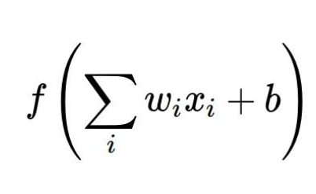
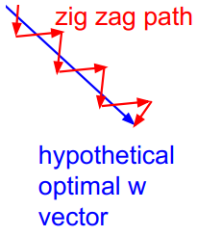
Preprocessing:
Consider what happens when the input to a neuron is always positive...
What can we say about the gradients on w?
Always all positive or all negative :(

Slide 22
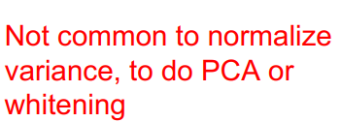
Preprocessing:
In practice for Images: center only
e.g. consider CIFAR-10 example with [32,32,3] images
- Subtract the mean image (e.g. AlexNet) (mean image = [32,32,3] array)
- Subtract per-channel mean (e.g. VGGNet) (mean along each channel = 3 numbers)

Slide 23


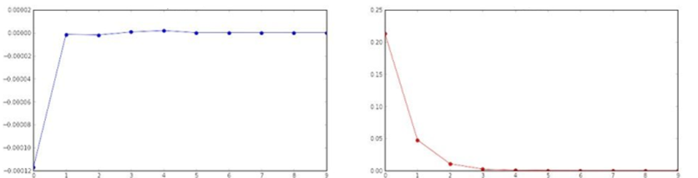
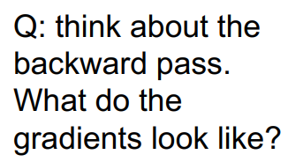
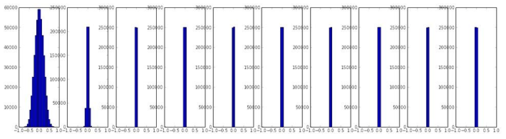
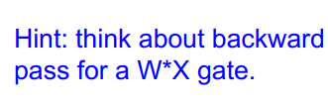
Weight Initialization:
Activation is tanh
Layer mean
Layer std

Slide 24
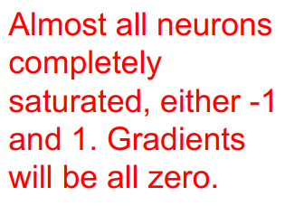
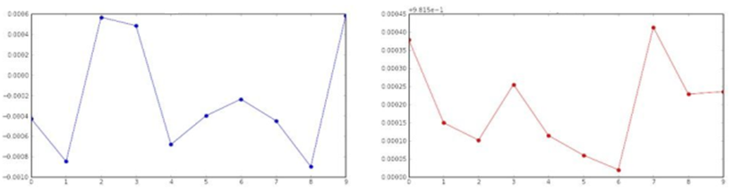
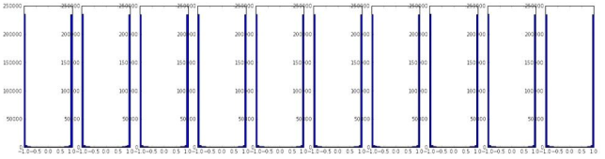
Weight Initialization:
Layer mean
Layer std

Slide 25

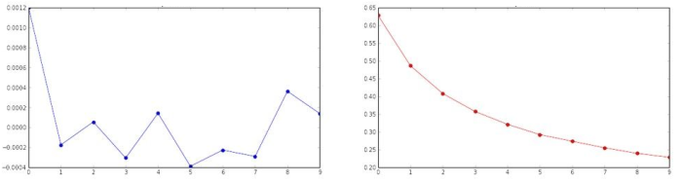
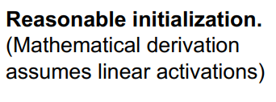
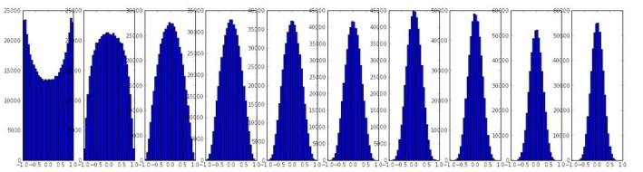
Weight Initialization:
Layer mean
Layer std

Slide 26

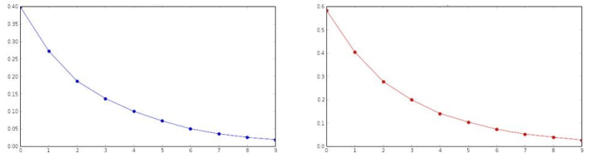
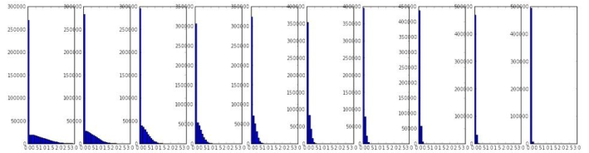
Weight Initialization:
Layer mean
Layer std

Slide 27

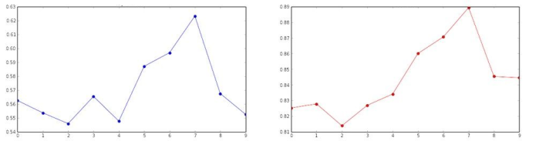
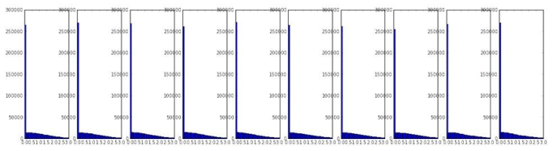
Weight Initialization:
Layer mean
Layer std

Slide 28

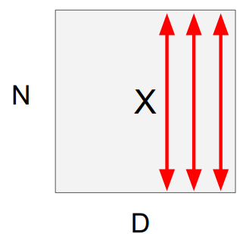
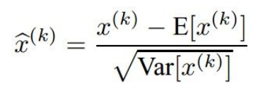
Batch Normalization:
“you want zero-mean unit-variance activations? just make them so.”
1. compute the empirical mean and variance independently for each dimension.
2. Normalize

Slide 29
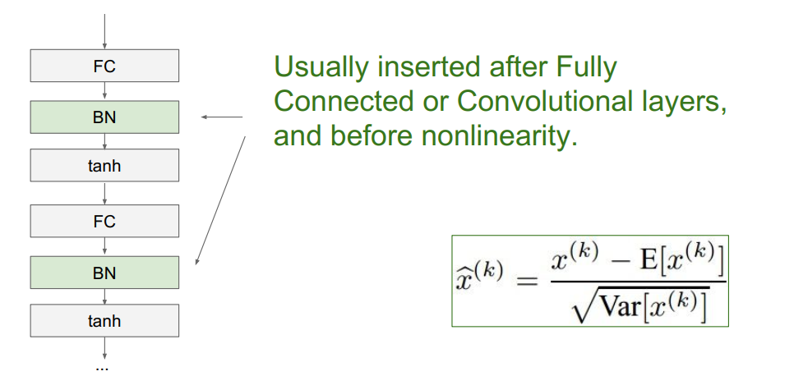
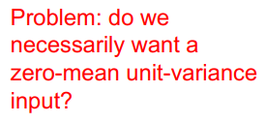
Batch Normalization:

Slide 30



Batch Normalization:
And then allow the network to squash the range if it wants to:

Slide 31

Batch Normalization:
- Improves gradient flow through the network
- Allows higher learning rates
- Reduces the strong dependence on initialization
- Acts as a form of regularization in a funny way, and slightly reduces the need for dropout, maybe

Slide 32
Batch Normalization:
Note: at test time BatchNorm layer functions differently:
The mean/std are not computed based on the batch. Instead, a single fixed empirical mean of activations during training is used.
(e.g. can be estimated during training with running averages)

Slide 33


ResNet-Question:
What happens when we continue stacking deeper layers on a “plain” convolutional neural network?
56-layer model performs worse on both training and test error The deeper model performs worse, but it’s not caused by over-fitting!

Slide 34
ResNet:
Hypothesis: the problem is an optimization problem, deeper models are harder to optimize
The deeper model should be able to perform at least as well
as the shallower model
A solution by construction is copying the learned layers from the shallower
model and setting additional layers to identity mapping.
[He et al., 2015. Deep residual networks for image recognition]

Slide 35


ResNet: Residual block
Solution: Use network layers to fit a residual mapping instead of directly trying to fit a desired underlying mapping
[He et al., 2015. Deep residual networks for image recognition]

Slide 36
Residual block Notes:
Learning Identity function is easier for Residual Block
Identity shortcut(skip) connection add neither extra parameters
nor computational complexity
3. Deep residual networks gains more accuracy from greatly increased depth

Slide 37


ResNet
[He et al., 2015. Deep residual networks for image recognition]

Slide 38

ResNet Architecture:
- Stack residual blocks
- Every residual block has two 3x3 conv layers
- Periodically, double # of filters and
downsample spatially using stride 2
(/2 in each dimension)
- Additional conv layer at the beginning
- No FC layers at the end (only FC 1000 to output classes)

Slide 39
ResNet Training :
- Batch Normalization after every CONV layer
- Xavier/2 initialization from He et al.
- SGD + Momentum (0.9)
- Learning rate: 0.1, divided by 10 when validation error plateaus
- Mini-batch size 128
- Weight decay of 1e-5
- No dropout used

Slide 40


DenseNet
Dense blocks where each layer is connected to every other layer in feedforward fashion
2. Alleviates vanishing gradient, strengthens feature propagation, encourages feature reuse
[Huang et al., 2017. Densely Connected Convolutional Networks ]

Slide 41



SENet
Add a “feature recalibration” module that learns to adaptively reweight feature maps
2. Global information (global avg. pooling layer) + 2 FC layers used to determine feature map weights
3. ILSVRC’17 classification winner (using ResNeXt-152 as a base architecture)
[Hu et al., 2017. Squeeze-and-Excitation Networks ]

