Slide 1
Lecture 8
Policy Gradients
Most material from Fei Fei Li’s Course at Standford University

Slide 2
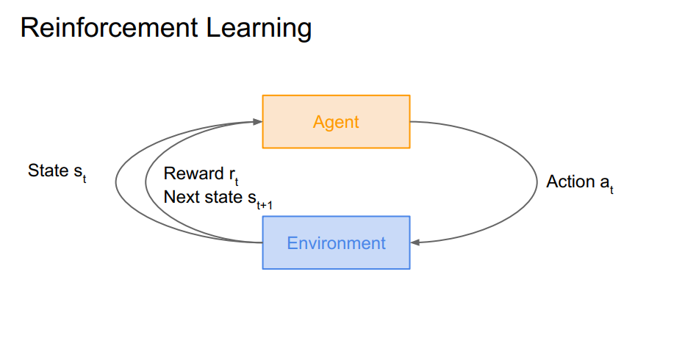
Last Time: Reinforcement Learning

Slide 3
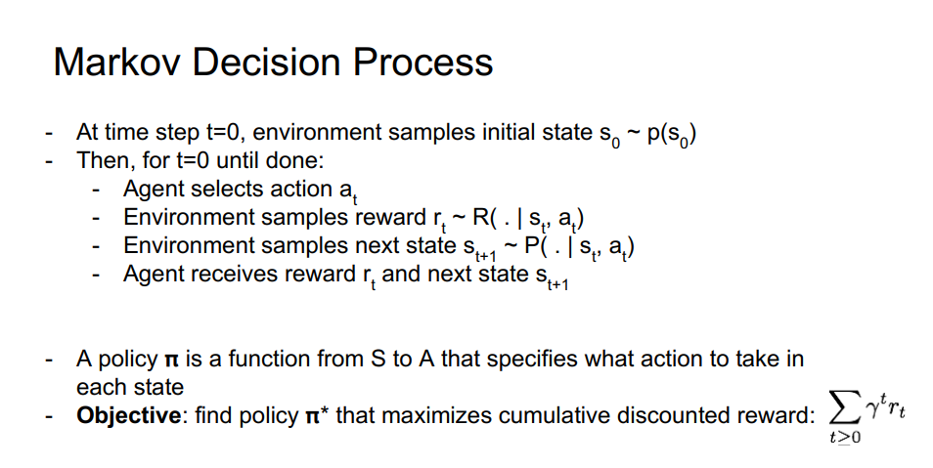
Last Time: MDP

Slide 4
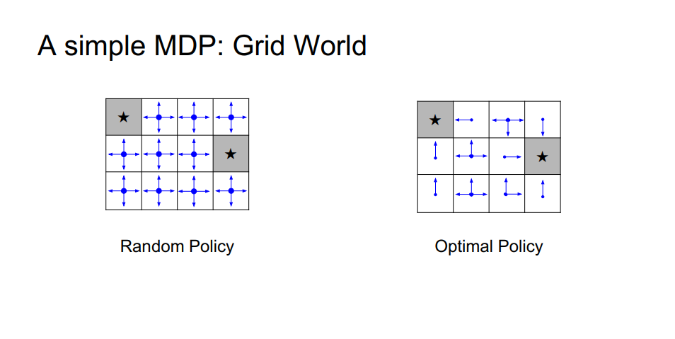
Last Time: Simple MDP

Slide 5
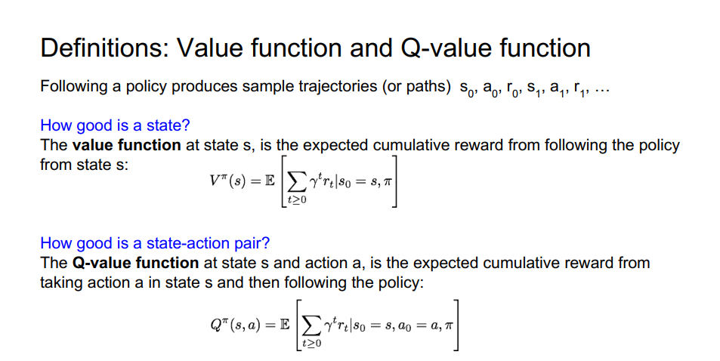
Last Time: Value and Q function

Slide 6
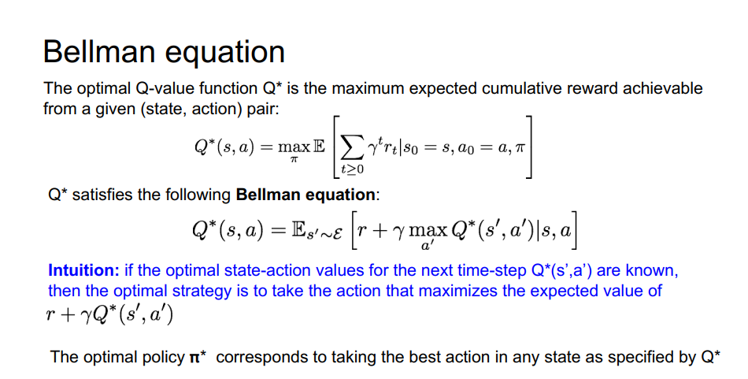
Last Time: Bellman equation

Slide 7
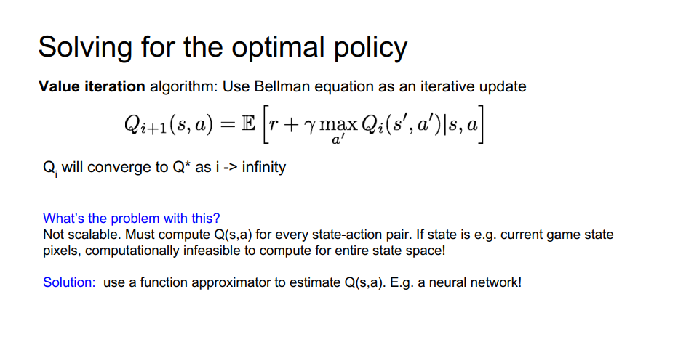
Last Time: Solving optimal policy

Slide 8
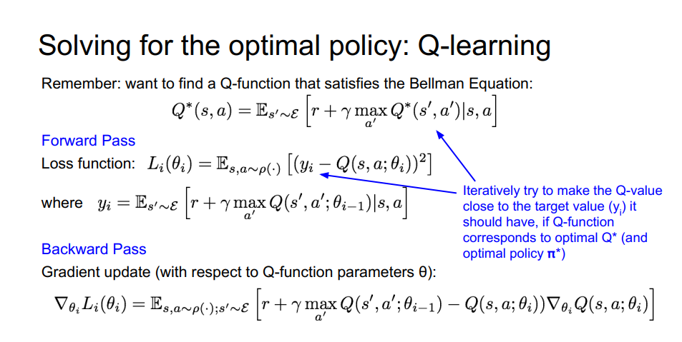
Last Time: Q-Learning

Slide 9
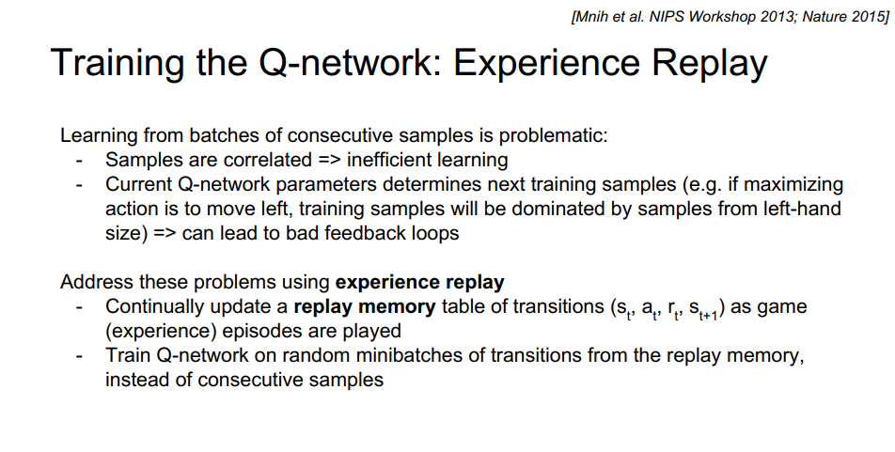

Last Time: Experience reply

Slide 10
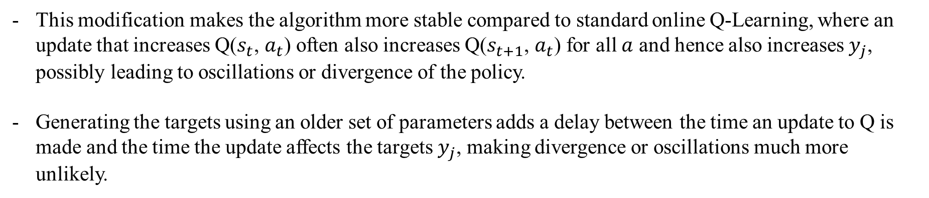
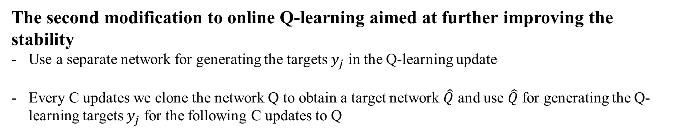
Last Time: Target Network
The second modification to online Q-learning aimed at further improving the stability
Use a separate network for generating the targets $y_{j}$ in the Q-learning update
Every C updates we clone the network Q to obtain a target network $\hat{Q}$ and use $\hat{Q}$ for generating the Q-learning targets $y_{j}$ for the following C updates to Q
This modification makes the algorithm more stable compared to standard online Q-Learning, where an update that increases Q($s_{t}$, $a_{t}$) often also increases Q($s_{t+1}$, $a_{t}$) for all $a$ and hence also increases $y_{j}$, possibly leading to oscillations or divergence of the policy.
Generating the targets using an older set of parameters adds a delay between the time an update to Q is made and the time the update affects the targets $y_{j}$, making divergence or oscillations much more unlikely.

Slide 11
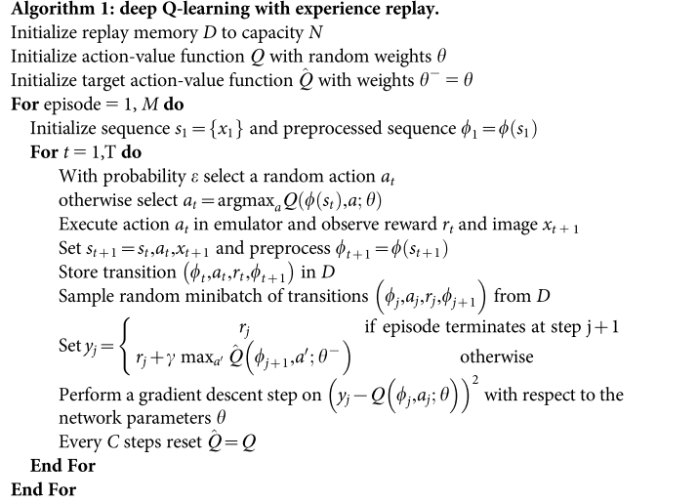
Last Time: Deep Q-learning with Experience Replay & Target Network

Slide 12
Policy Gradients

Slide 13
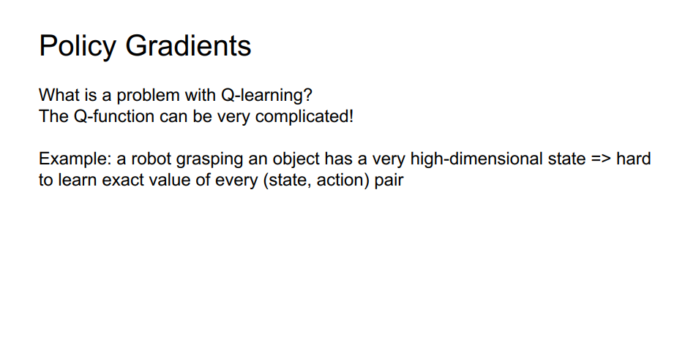
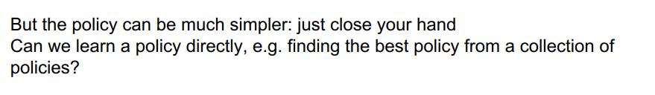

Slide 14
Pros
Policy Gradients usually converges faster than Q-Learning
Policy Gradients is generally believed to be able to apply to a wider range of problems
Policy Gradients model probabilities of actions, it is capable of learning stochastic policies
Policy Gradients can be easily applied to model continuous action space
Cons
DQN shows a better sample efficiency and more stable performance(when it works!)
One of the biggest drawbacks of Policy Gradients is the high variance in estimating the gradient of E[R_t]

Slide 15
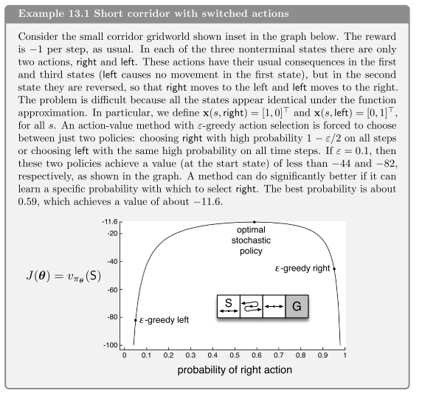
[Sutton et al. Reinforcement Learning second edition]

Slide 16
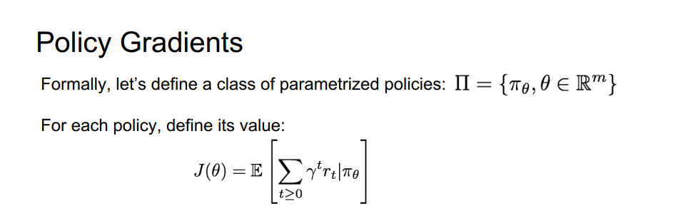
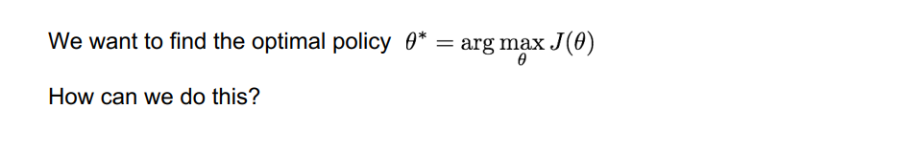

Slide 17
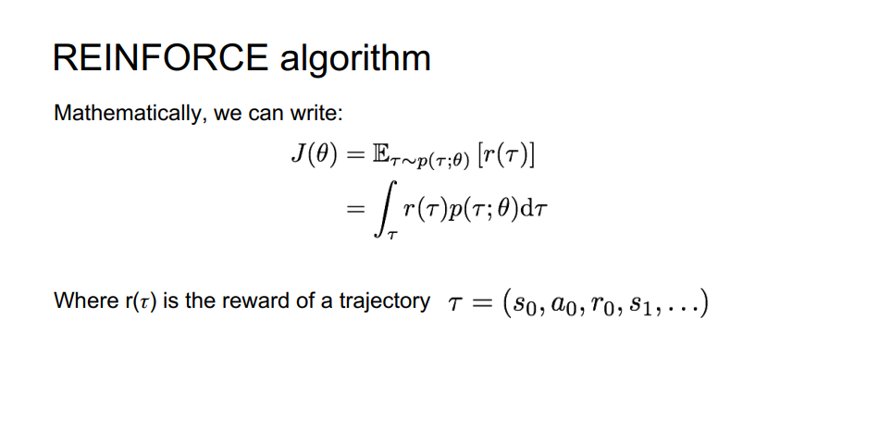

Slide 18
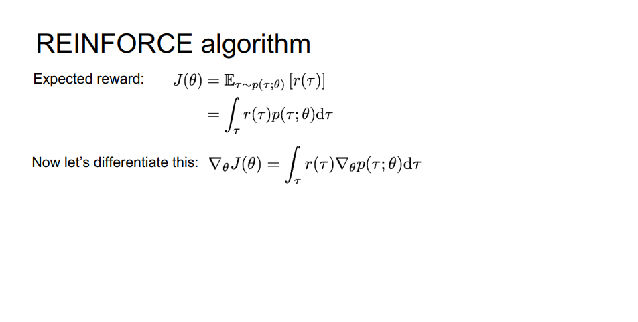

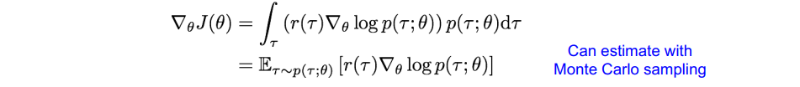

Slide 19
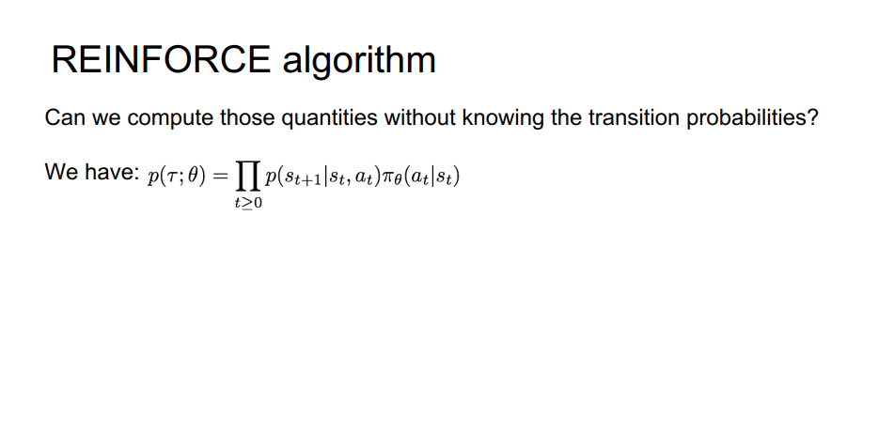

Slide 20
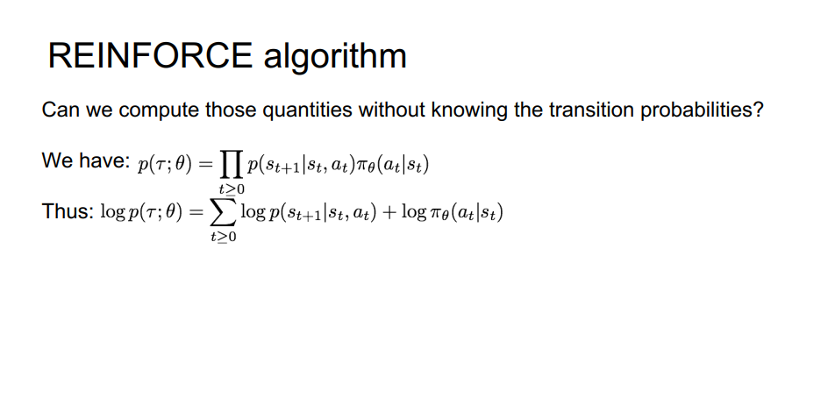

Slide 21
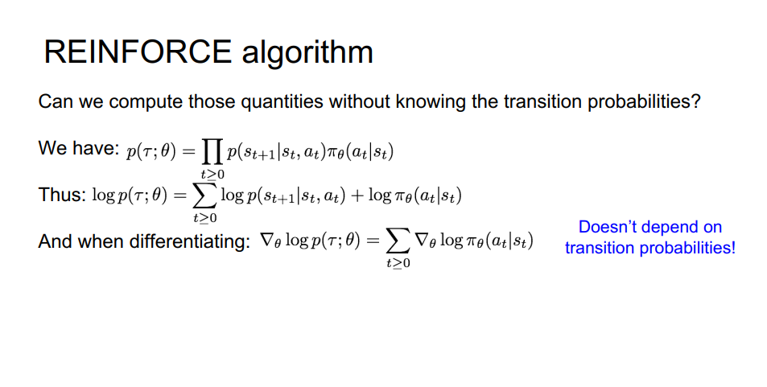

Slide 22
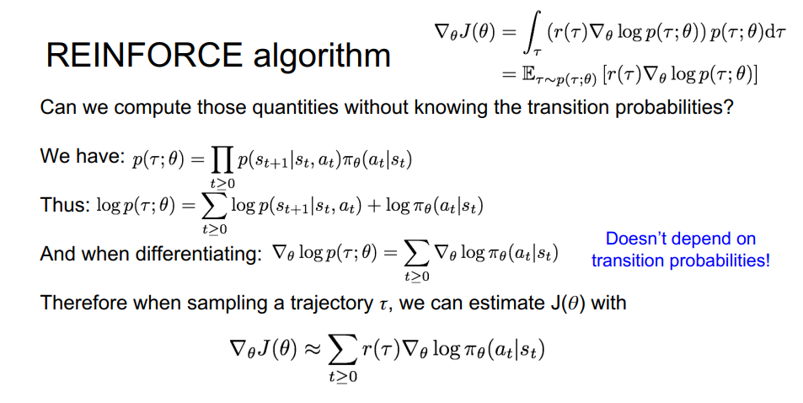

Slide 23
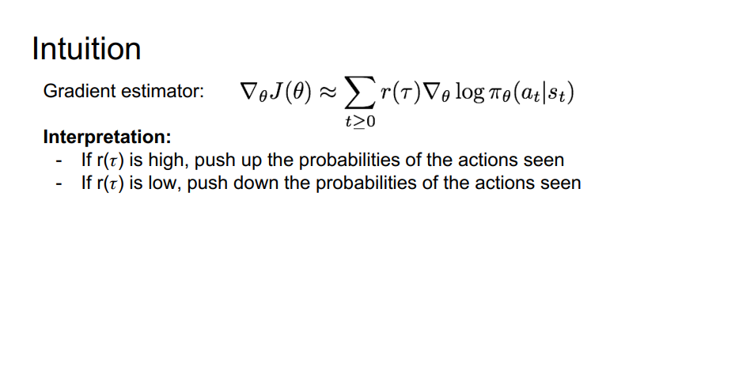

Slide 24
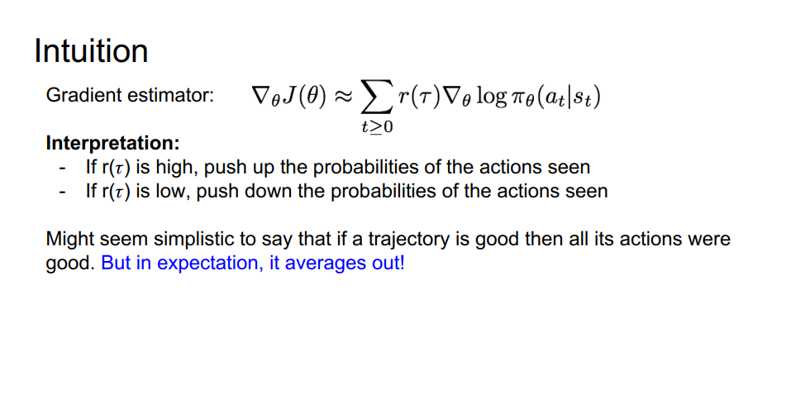

Slide 25
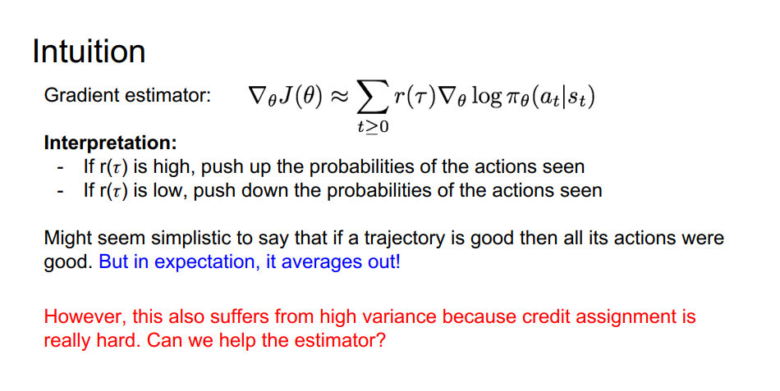

Slide 26
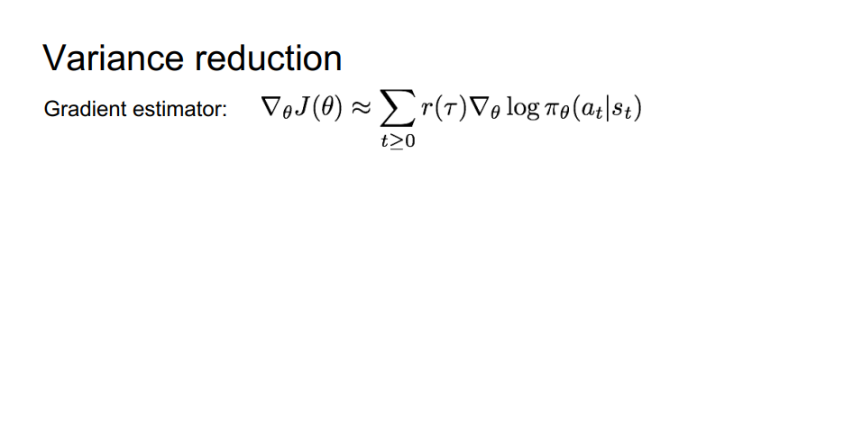

Slide 27
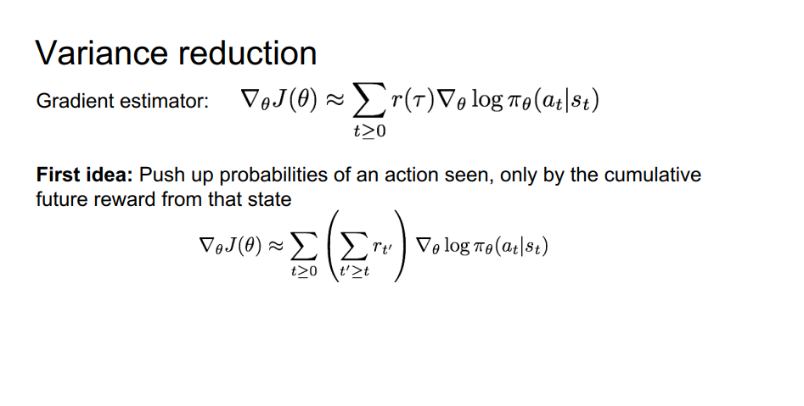

Slide 28
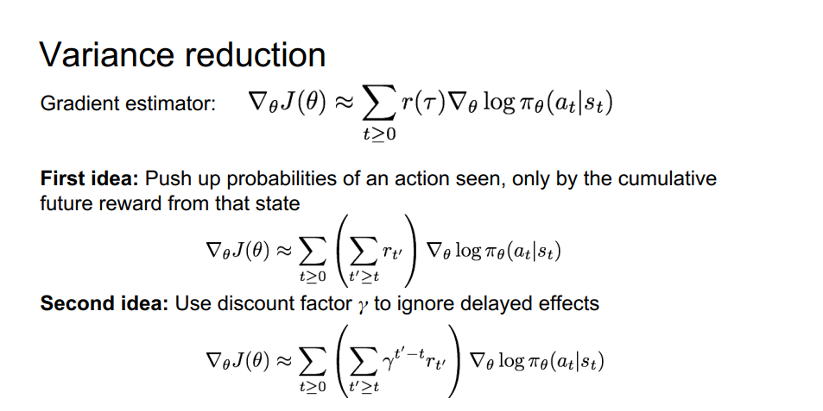

Slide 29
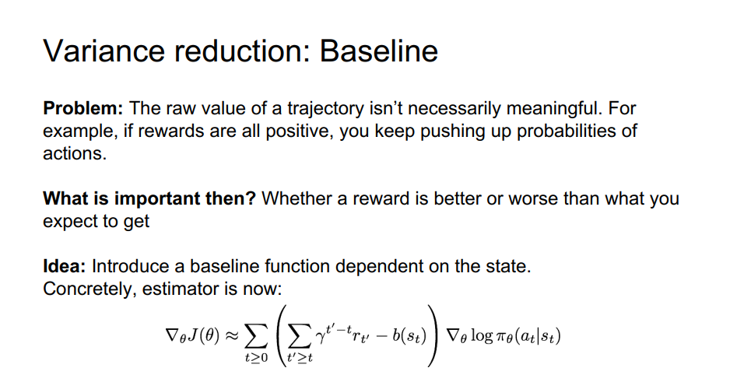

Slide 30
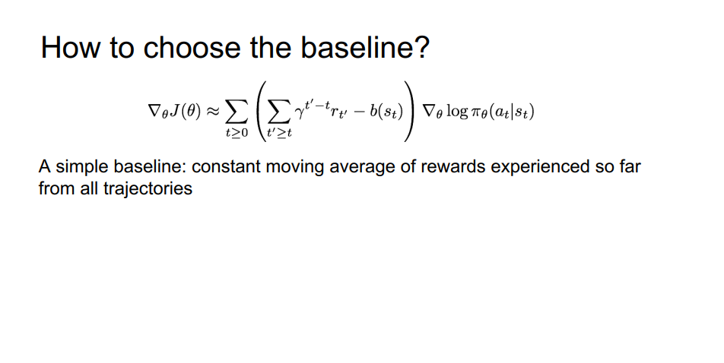

Slide 31
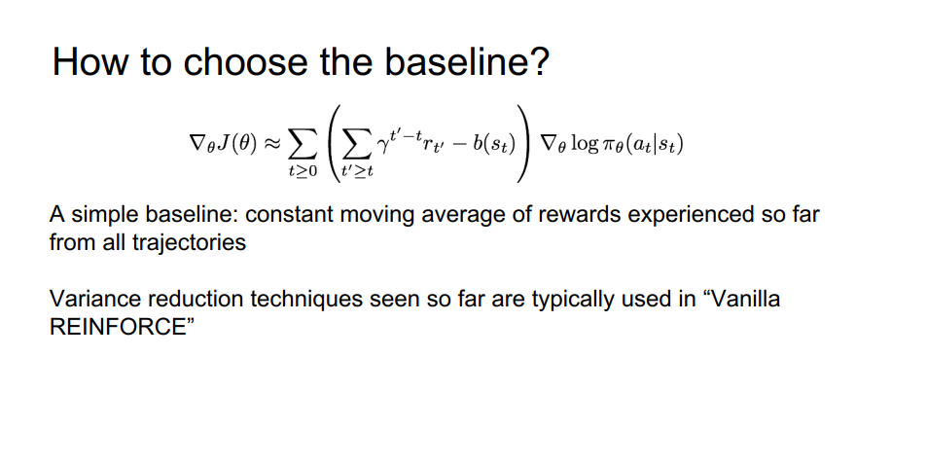

Slide 32
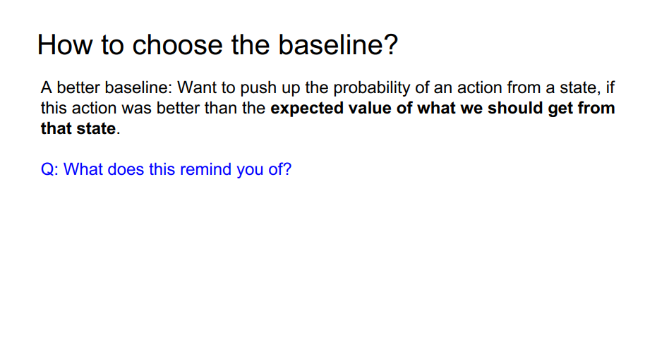

Slide 33
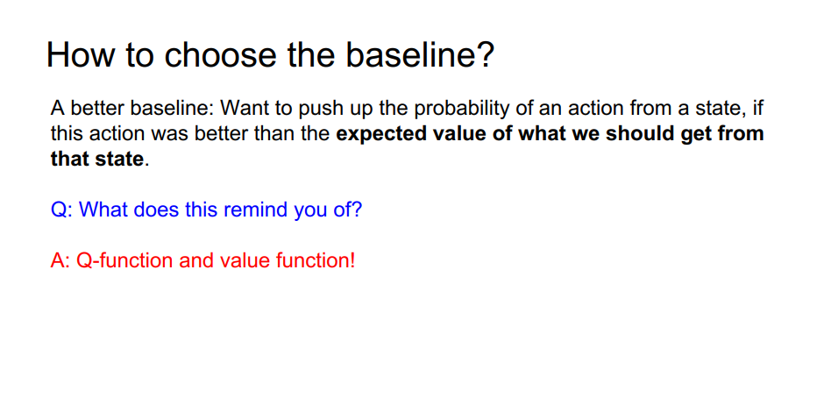

Slide 34
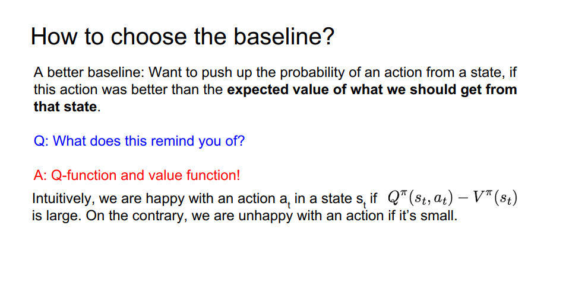

Slide 35
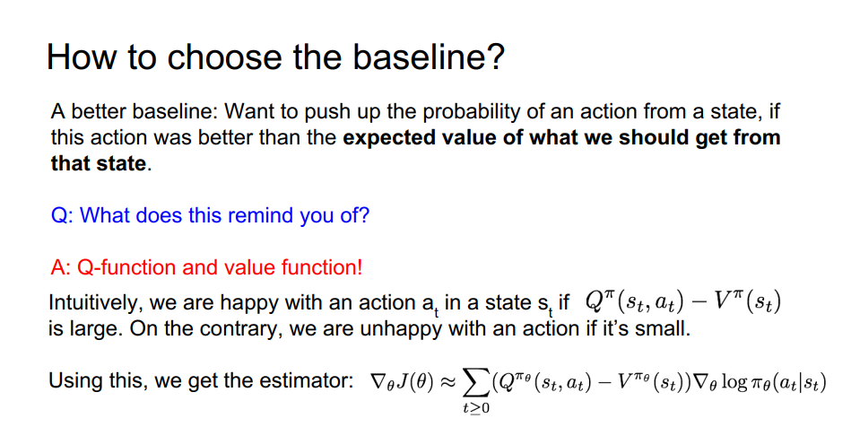

Slide 36
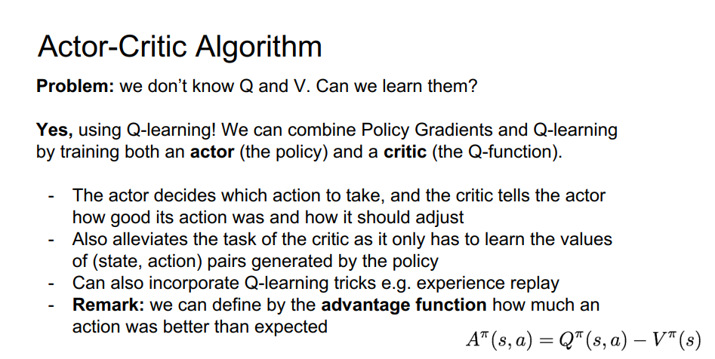

Slide 37
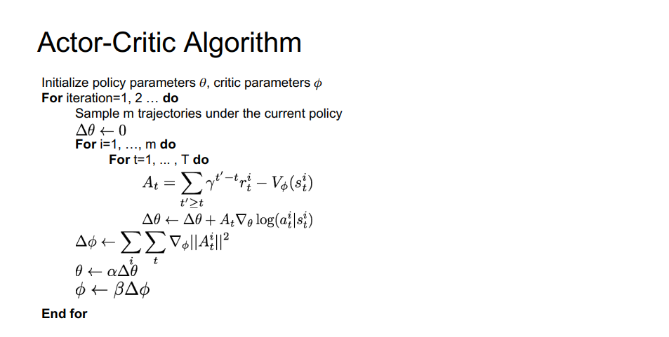

Slide 38
Asynchronous Advantage Actor-Critic(A3C)
Maintains a policy π(a_{t}| s_{t}; θ) and an estimate of the value function V(s_{t}; θ_{v})
n-step Actor-Critic method
Uses parallel actor-learners and accumulate updates to improve training stability
Use a neural network that has one softmax output for the policy π(a_{t}| s_{t}; θ) and one linear output for the value function V(s_{t}; θ_{v}) with all non-output parameters shared

Slide 39
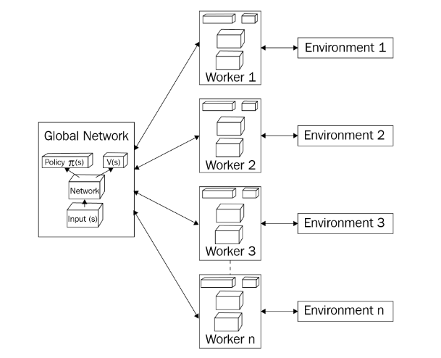
Asynchronous Advantage Actor-Critic(A3C)

Slide 40
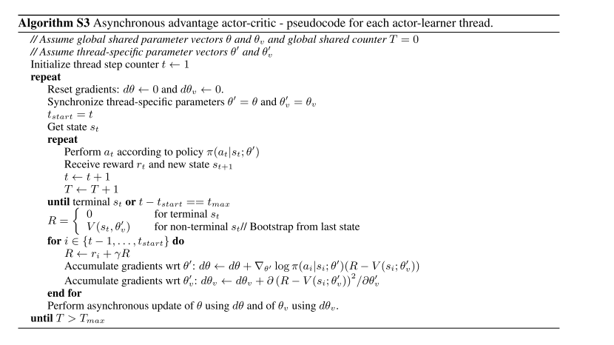

A3C Algorithm
Initial global and thread specific parameters
Play until max episode
Copy global parameters to thread-specific paramters
Play until terminal state or max steps
Take action a and observe reward r and next state
Get state value of last state
Get value target and gradients
Update global parameters
[Mnih et al. Asynchronous methods for deep reinforcement learning 2016]

Slide 41
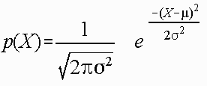
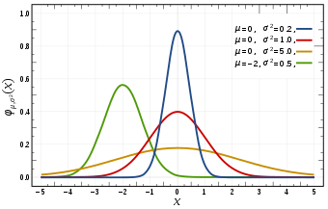
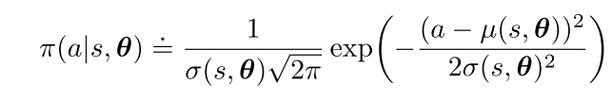
Policy Gradient for continuous Actions
Instead of computing learned probabilities for each of the many actions, we instead learn statistics of the probability distribution
Use a neural network that has two outputs for the policy π(a_{t}| s_{t}; θ) , one for mean and another for sigma and another linear output for the value function V(s_{t}; θ_{v}) with all non-output parameters shared.
[Sutton et al. Reinforcement Learning second edition]

Slide 42
What about Exploration??
We will add entropy of policy distribution to actor loss to encourage Exploration

