Slide 1
Lecture 3:
Neural Network
Pooya Mohammadi Lecture 3 - 1 Winter-2020

Slide 2

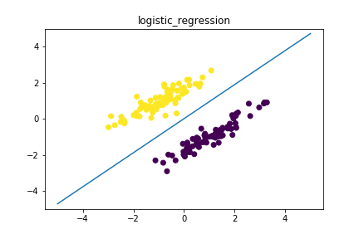
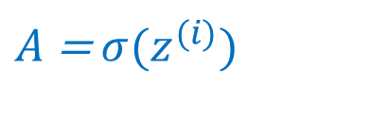
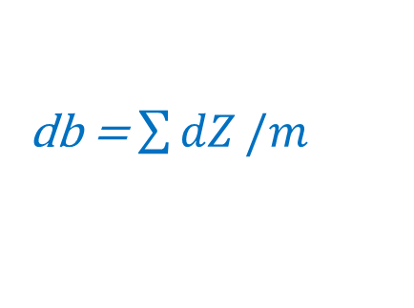
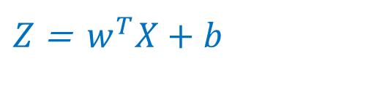
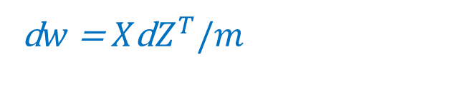

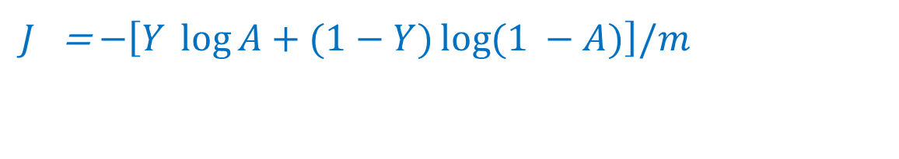
Last time: Binary Classification - Vectorization
Code:
for epoch in range(n_epochs):
$Z$ =$w^{T}X+b$
$A$ = $σ{(z}^{(i)})$
$J$= $−\left[Y \log{A+(1−Y)\log{(1 −A)}}\right]/m$
d$Z$ = $A−Y$
d$w$= $X\text{d}Z^{T}/m$
db = $\sum{dZ}/m$
Pooya Mohammadi Lecture 3 - 2 Winter-2020

Slide 3
Today
Gradient Descent
Neural Network
Multi-Classification
Pooya Mohammadi Lecture 3 - 3 Winter-2020

Slide 4
Gradient Descents Variants
An overview of gradient descent optimization algorithms(Sebastian Ruder)
Deep Learning - MIT press
Pooya Mohammadi Lecture 3 - 4 Winter-2020

Slide 5
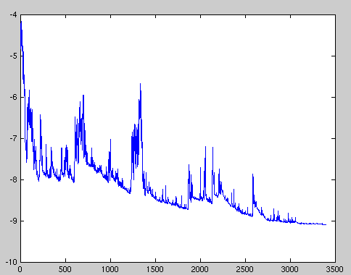



Gradient Descents Variants
Batch or Deterministic
Stochastic or Online
Mini-batch Stochastic(stochastic)
a) reduces the variance of the parameter updates
b) can make use of highly optimized matrix optimizations
Pooya Mohammadi Lecture 3 - 5 Winter-2020

Slide 6
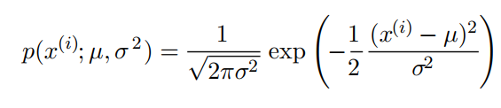
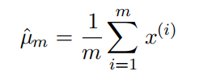
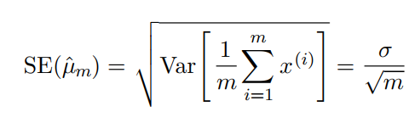
Gradient Descents Variants
Normal Distribution
Mean parameter
The standard error of mean is given by:
Pooya Mohammadi Lecture 3 - 6 Winter-2020

Slide 7
Gradient Descents Variants
Mini-batch sizes are generally driven by the following factors:
Larger batches provide a more accurate estimate of the gradient, but with less than linear returns.
Use some absolute minimum batch size, below which there is no reduction in the time to process a mini-batch.
If all examples in the batch are to be processed in parallel (as is typically the case), then the amount of memory scales with the batch size. For many hardware setups this is the limiting factor in batch size.
Some kinds of hardware achieve better runtime with specific sizes of arrays. Especially when using GPUs, it is common for power of 2 batch sizes to offer better runtime. Typical power of 2 batch sizes range from 32 to 256, with 16 sometimes being attempted for large models.
Small batches can offer a regularizing effect (Wilson and Martinez, 2003), perhaps due to the noise they add to the learning process.
Pooya Mohammadi Lecture 3 - 7 Winter-2020

Slide 8
Gradient Descents Variants
Challenges: Vanilla mini-batch does not guarantee good convergence
Choosing a proper learning rate can be difficult.
Learning rate schedules try to adjust the learning rate during training. These schedules have to be defined in advance.
The same learning rate applies to all parameter updates. It’s preferred to perform large update for rarely occurring features.
Saddle points and surrounding plateau of the same error.
Pooya Mohammadi Lecture 3 - 8 Winter-2020

Slide 9
Gradient Descent Optimization Algorithms
Pooya Mohammadi Lecture 3 - 9 Winter-2020

Slide 10
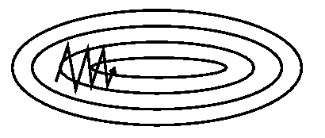
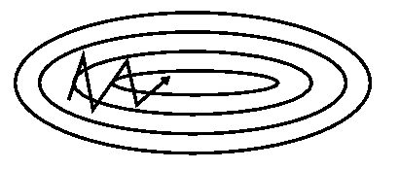

GD Algorithms: Momentum
Without momentum
With momentum
Formula:
γ is set to 0.9
Pooya Mohammadi Lecture 3 - 10 Winter-2020

Slide 11
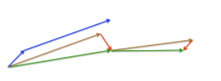

GD Algorithms: Nesterov
Formula:
γ is set to 0.9
Pooya Mohammadi Lecture 3 - 11 Winter-2020

Slide 12
GD Algorithms
Now that we are able to adapt our updates to the slope of our error function and speed up SGD in turn, we would also like to adapt our updates to each individual parameter to perform larger or smaller updates depending on their importance.
Pooya Mohammadi Lecture 3 - 12 Winter-2020

Slide 13



GD Algorithms: Adagrad
Frequently occurring features
Low learning rate
Infrequently occurring features
High learning rate
Formula:
$G_{t}$ contains the sum of the squares of the past gradients
η = 0.01
Pooya Mohammadi Lecture 3 - 13 Winter-2020

Slide 14
GD Algorithms: Adagrad
What is the problem??
While using Adagrad, every added term is positive, the accumulated sum keeps growing during training. This in turn causes the learning rate to shrink and eventually become infinitesimally small, at which point the algorithm is no longer able to acquire additional knowledge.
Pooya Mohammadi Lecture 3 - 14 Winter-2020

Slide 15


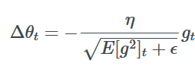
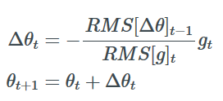

GD Algorithms: Adadelta
Frequently occurring features
Low learning rate
Infrequently occurring features
High learning rate
We don’t need default learning rate
Formula:
γ is set to 0.9
Pooya Mohammadi Lecture 3 - 15 Winter-2020

Slide 16
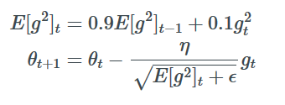
GD Algorithms: RMSProp
Frequently occurring features
Low learning rate
Infrequently occurring features
High learning rate
RMSprop is an unpublished, adaptive learning rate method proposed by Geoff Hinton
RMSProp and Adadelta both try to resolve the Adagrad's radically diminishing learning rates
Formula:
γ is set to 0.9
η = 0.001
Pooya Mohammadi Lecture 3 - 16 Winter-2020

Slide 17

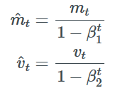
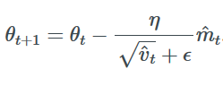
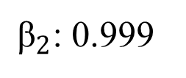
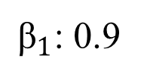
GD Algorithms: Adam (Adaptive Momentum Estimation)
Adam adds Momentum to RMSProp
Formula:
Bias correction:
${\text{β}}_{2}$: 0.999
${\text{β}}_{1}$: 0.9
η = 0.001
ϵ: 1e-8
Pooya Mohammadi Lecture 3 - 17 Winter-2020

Slide 18
Optimizer Behavior
Pooya Mohammadi Lecture 3 - 18 Winter-2020

Slide 19
Optimizer Behavior: Saddle Point
Pooya Mohammadi Lecture 3 - 19 Winter-2020

Slide 20
What optimizer to use?
If your input data is sparse
Adaptive learning-rate methods
Adam, RMSProp, and Adelta are
very similar
bias-correction helps Adam slightly outperform them
Adam might be the best overall choice!!
Pooya Mohammadi Lecture 3 - 20 Winter-2020

