Slide 1
Introduction to Deep Learning

Slide 2
Outline
Machine Learning basics
Introduction to Deep Learning
what is Deep Learning
why is it useful
DNN basic architectures:
Dense
Convolutional
Recurrent
Advanced:
Auto encoder
GAN
RL

Slide 3
Machine Learning Basics
Machine learning is a field of computer science that gives computers the ability to learn without being explicitly programmed
Labeled Data
Machine Learning algorithm
Training
Prediction
Labeled Data
Learned model
Prediction
Methods that can learn from and make predictions on data

Slide 4

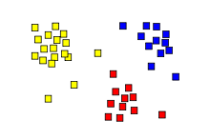
Types of Learning
Supervised: Learning with a labeled training set
Example: email classification with already labeled emails
Unsupervised: Discover patterns in unlabeled data
Example: cluster similar documents based on text
Reinforcement learning: learn to act based on feedback/reward
Example: learn to play Go, reward: win or lose
class B
class A
Classification
Regression
Clustering
Anomaly Detection
Sequence labeling
…

Slide 5
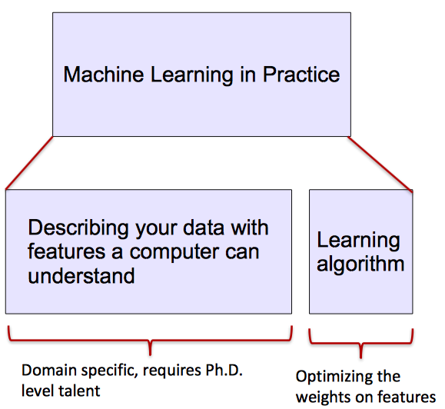
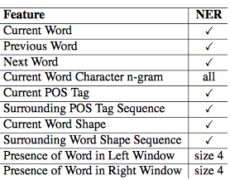
ML vs. Deep Learning
Most machine learning methods work well because of human-designed representations and input features
ML becomes just optimizing weights to best make a final prediction

Slide 6
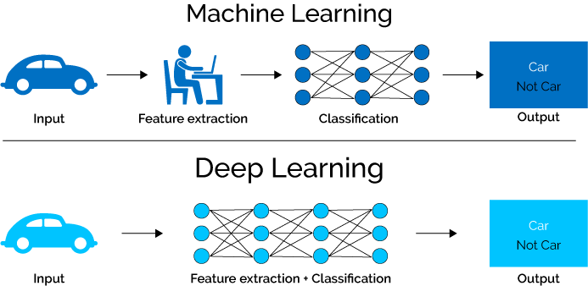
What is Deep Learning (DL) ?
Deep learning algorithms attempt to learn (multiple levels of) representation by using a hierarchy of multiple layers
If you provide the system tons of information, it begins to understand it and respond in useful ways.

Slide 7
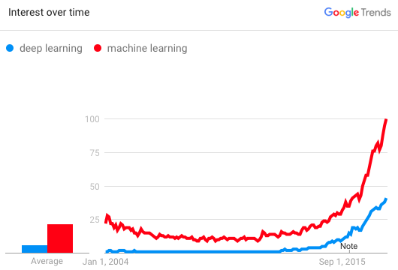
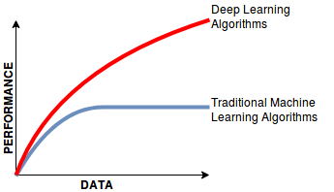
Why is DL useful?
Manually designed features are often over-specified, incomplete and take a long time to design and validate
Learned Features are easy to adapt, fast to learn
Deep learning provides a very flexible, (almost?) universal, learnable framework for representing world, visual and linguistic information.
Can learn both unsupervised and supervised
Effective end-to-end joint system learning
Utilize large amounts of training data

Slide 8
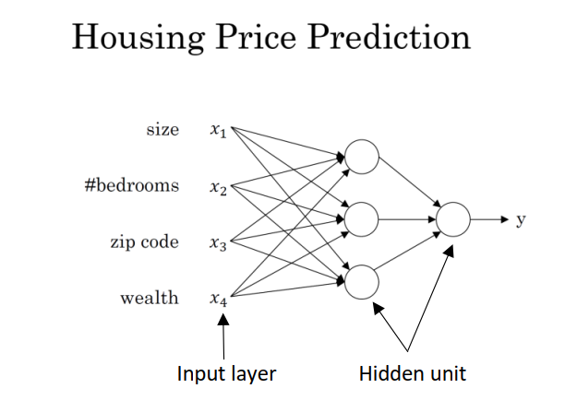
What is neural network?
It is a powerful learning algorithm inspired by how the brain works.
House Pricing Example:
Notes:
Hyper-parameters

Slide 9
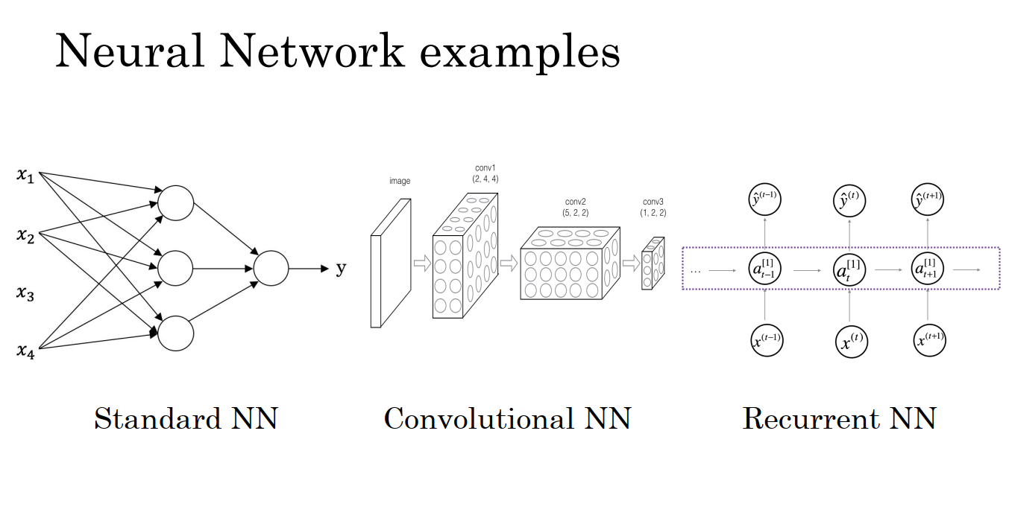
DNN Architectures

Slide 10
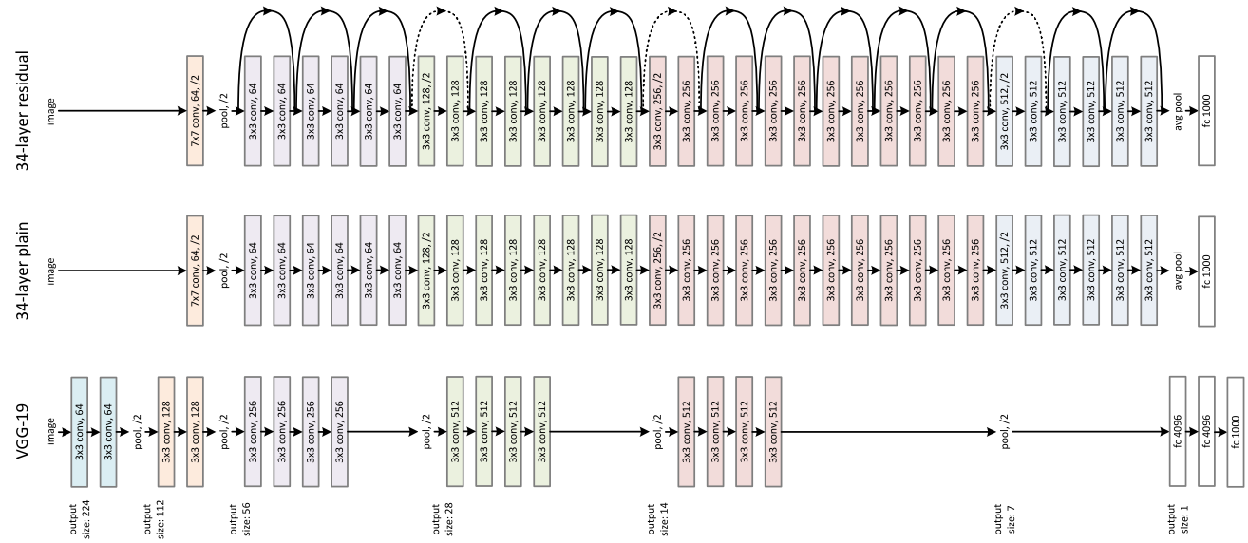
Advanced Architectures

Slide 11
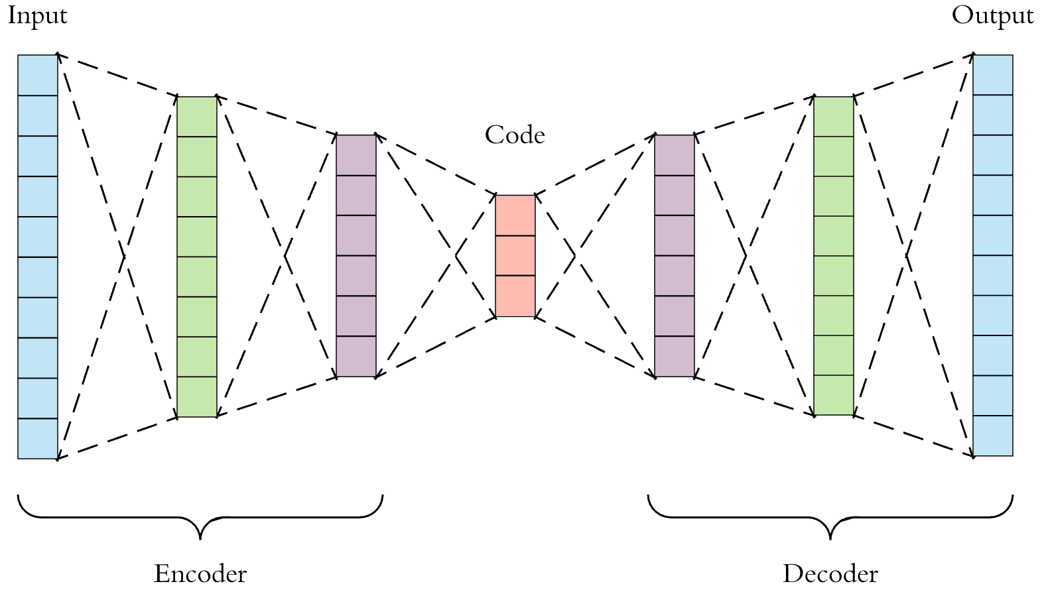
Advanced Architectures

Slide 12
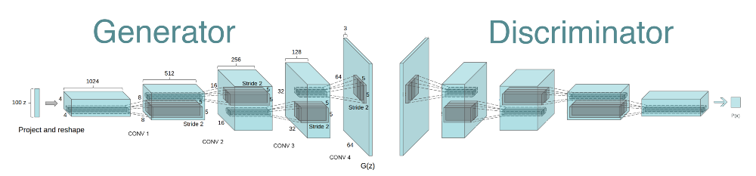
Advanced Architectures

Slide 13
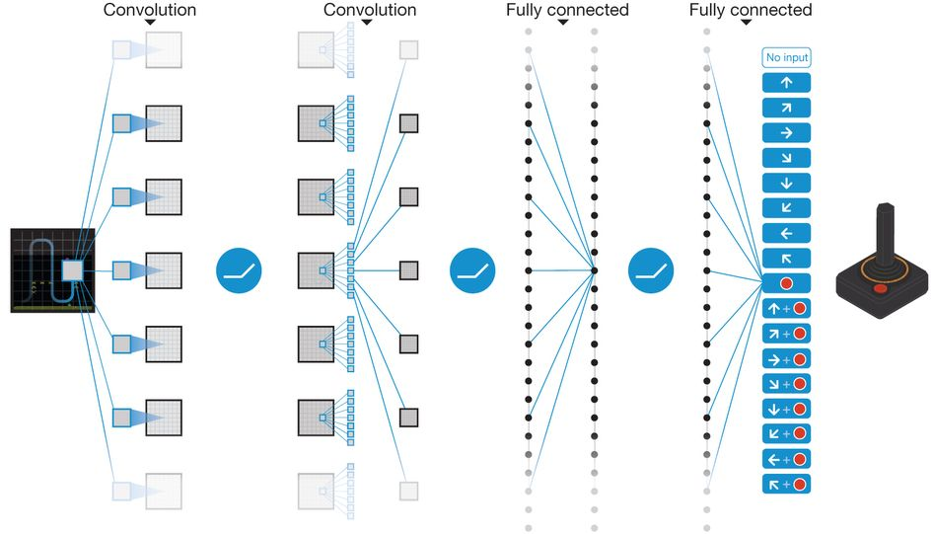
Advanced Architectures

Slide 14
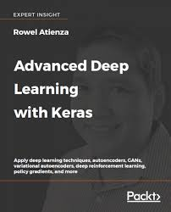
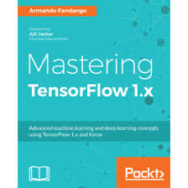
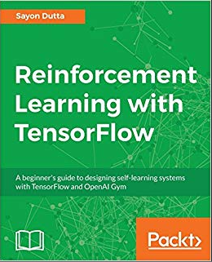
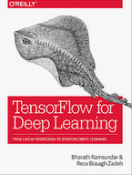



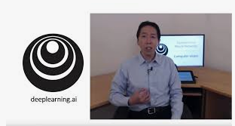
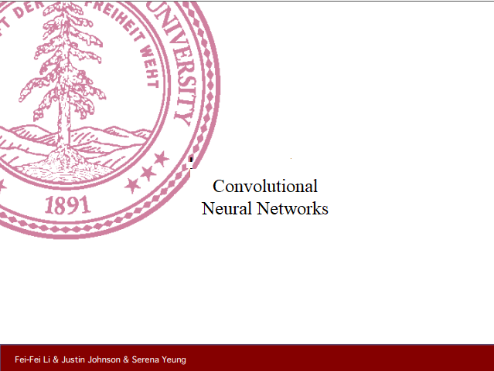

Course resources

